Slide 1
Understand URL and User Web Activity

Slide 2
Overview
Understand URL
Understand user web activity
Bowser history

Slide 3
Understand URL

Slide 4
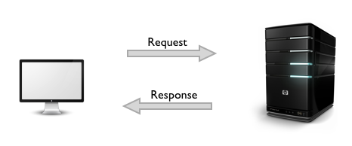
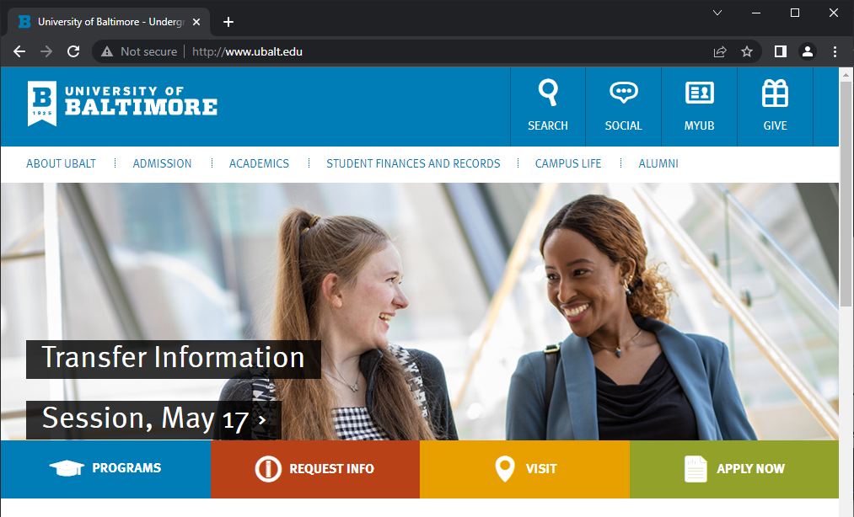
What is URL?
Uniform Resource Locators (URLs) identify web content (Resource) at web servers
A user agent uses URLs to request content from server
Request content
ubalt.edu
content
Response with content
http://ubalt.edu
Server
Notes:
https://datatracker.ietf.org/doc/html/rfc1738#section-5

Slide 5
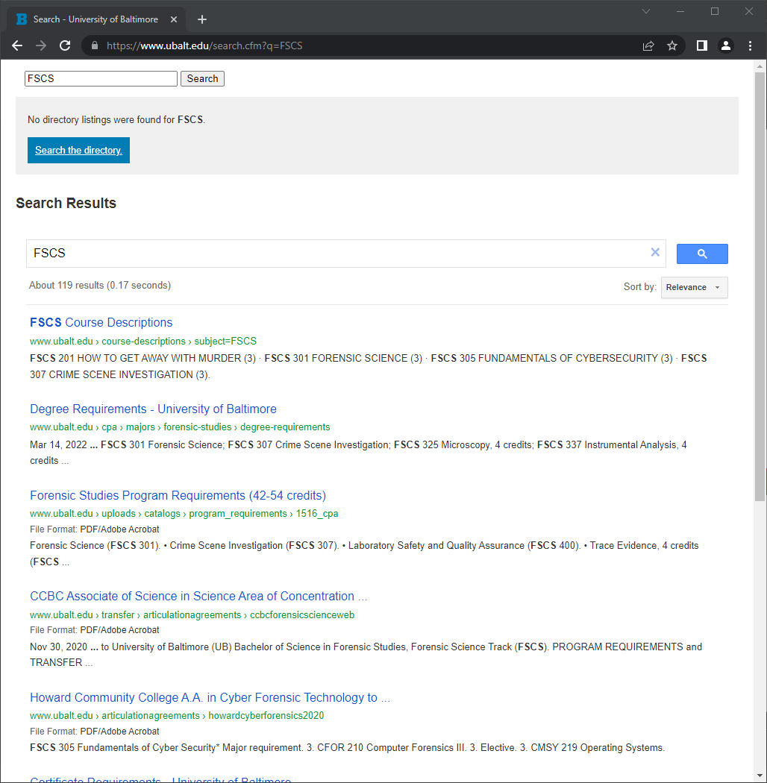
URL structure
Title
Protocol/Scheme
Hostname
Path
Filename
Query
Query String
/var/www/html/search.cfm

Slide 6
How is a URL created?
Define recourse on a web server
  HTML files and images
Save resource to a specific location on web server
  /var/www/html/
Find the domain name/IP
URL in a browser

Slide 7
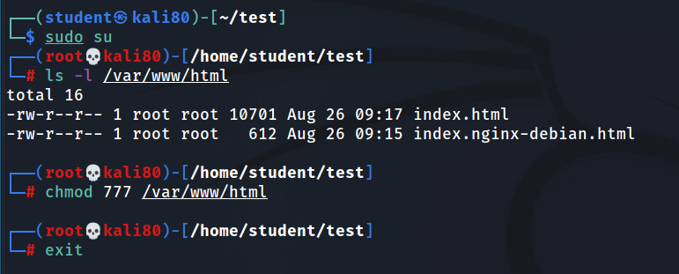
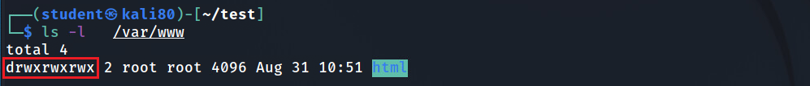
(optional) if you are logged in as a non-admin account, such as student, you must change the html folder permission

Slide 8
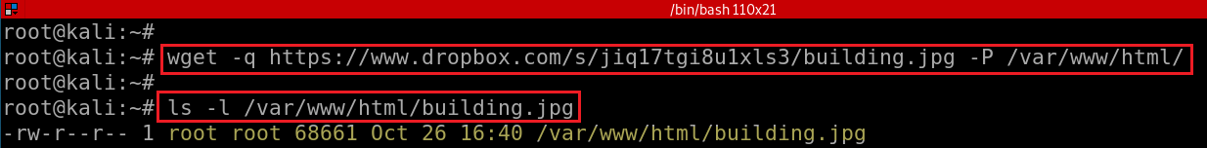
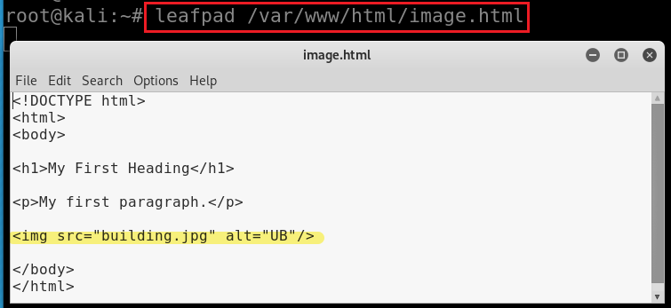
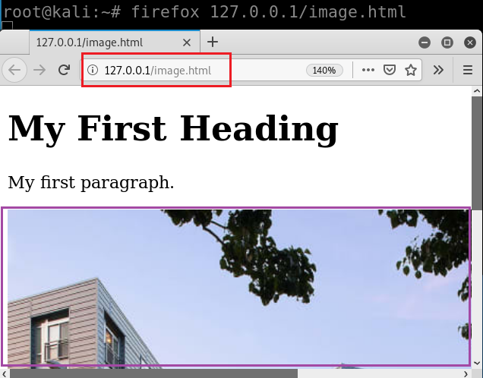

Download an image building.jpg
Save it to /var/www/html
-P: directory prefix
Add building.jpg in a webpage image.html
Show the webpage with the image
service apache2 stop
service apache2 restart
https://raw.githubusercontent.com/frankwxu/digital-forensics-lab/main/Illegal_Possession_Images/lab_files/traffic/image.html
Notes:
wget -q https://www.dropbox.com/s/jiq17tgi8u1xls3/building.jpg -P /var/www/html/
<!DOCTYPE html>
<html>
<body>
<h1>My First Heading</h1>
<p>My first paragraph.</p>
<img src=“building.jpg” alt=“UB”/>
</body>
</html>

Slide 9
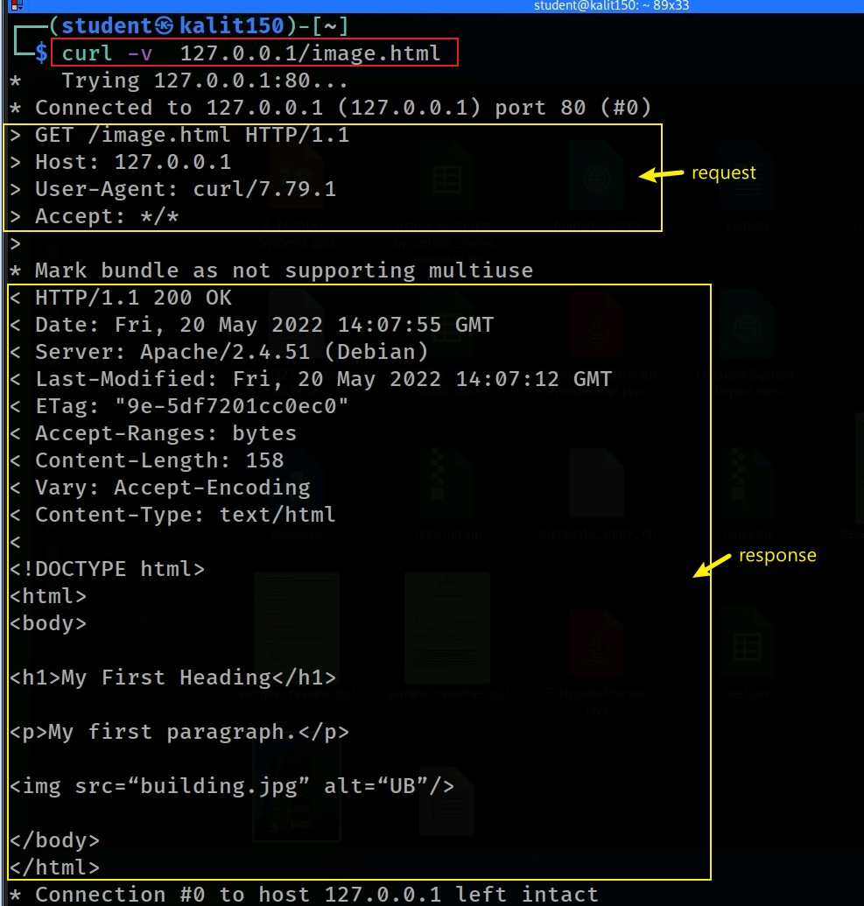
How an agent requests resource using a URL?

Slide 10
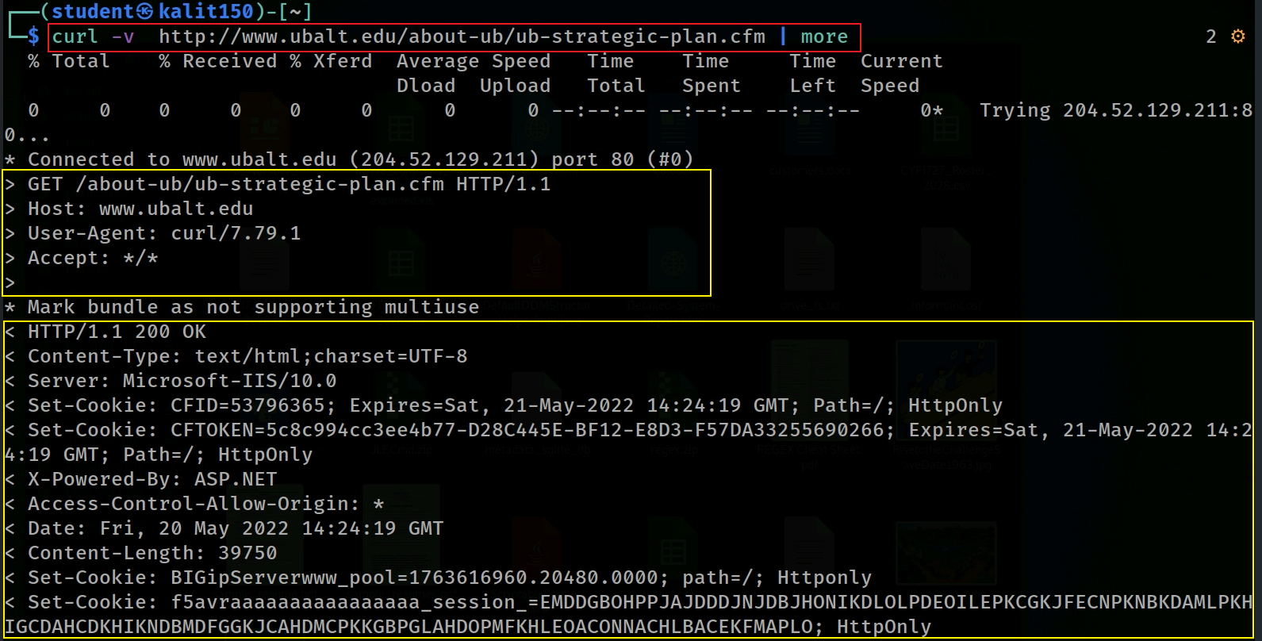
curl a live page of University of Baltimore at /var/www/html/about/ub-strategic-plan.cfm
Notes:
curl -v http://www.ubalt.edu/about-ub/ub-strategic-plan.cfm | more
curl -vi http://www.ubalt.edu/about-ub/ub-strategic-plan.cfm -o ub-strategic-plan.cfm

Slide 11
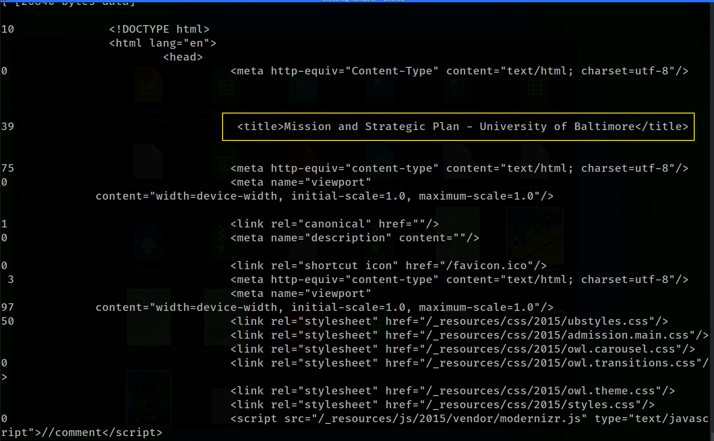
Title: useful information about the page

Slide 12

Optional
Save the source code

Slide 13
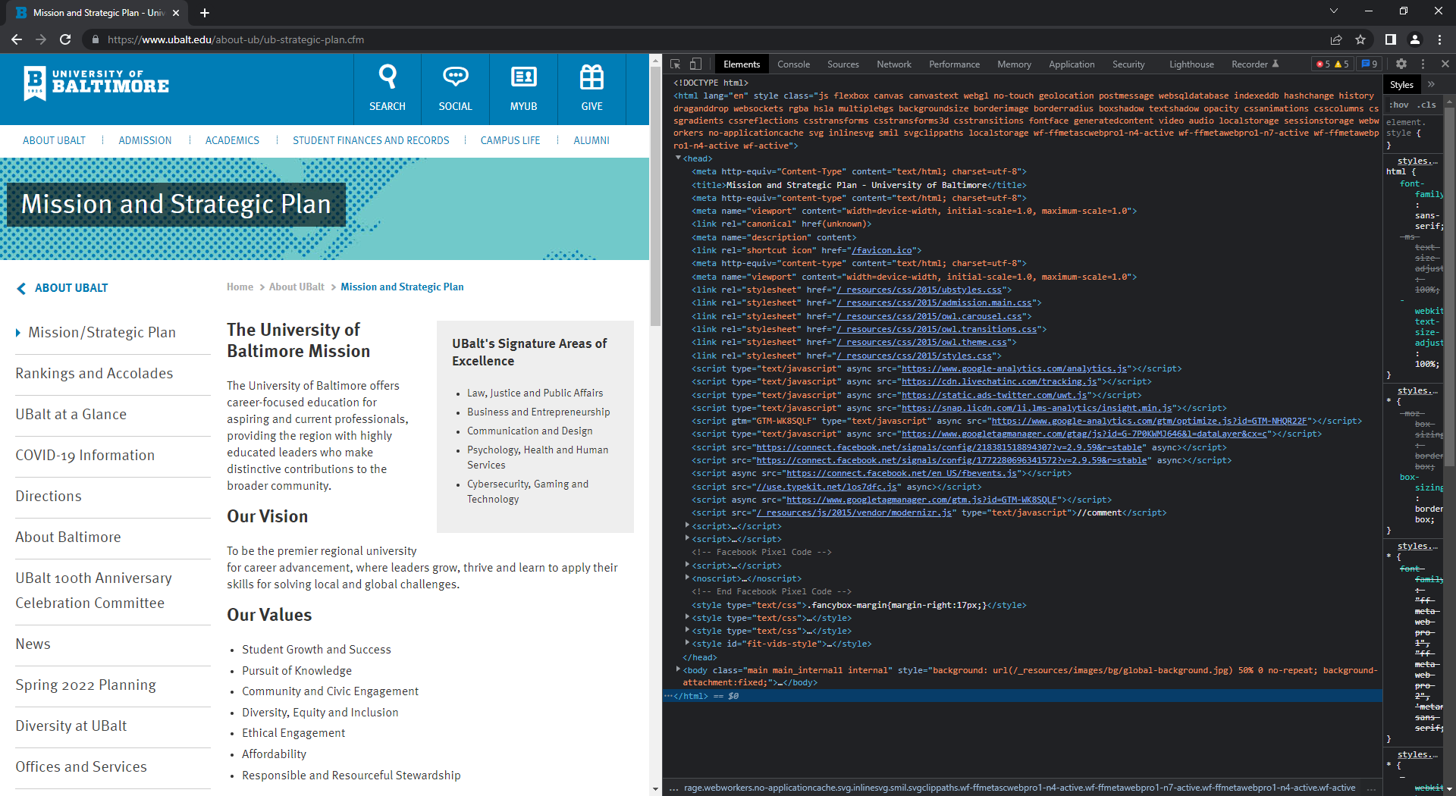
Use a browser(a different type agent) to view the same page and html source code

Slide 14

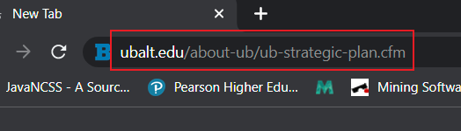
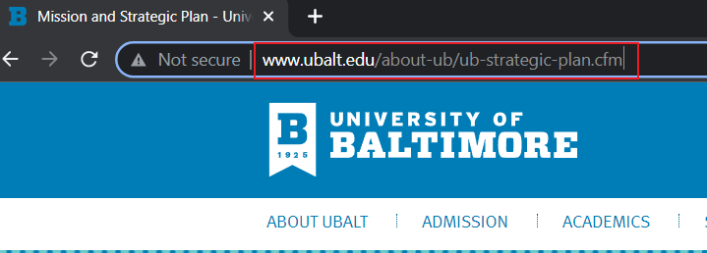


Your typed URL (HTTP request) in an address bar
You see (HTTP response) in an address bar!
What you typed (URL without www.)
What you actually see (URL with www.)
URL redirecting

Slide 15
What is URL redirecting?
“This thing is no longer here. Go over here."
Browser may redirect URLs for various reasons:
  Site moved to new domain
  Several different URLs for one site
  Merging sites together
  Page removed
Redirect reasons are not recorded by browsers
  Must guess what reason for redirect might be

Slide 16
Types of redirect URL
302 – Found (was: temporary redirect)
303 – See Other
307 - Temporary
301 - Permanent
  The most common type of redirect.
  Server asks agents to redirect.
  Search Engine Optimization
301 Sample redirects implementation
301 /old.html /new.html
RewriteCond %{HTTP_USER_AGENT} firefox
RewriteRule ^abc.html$ http://example.com/firefoxabc.html [R=301]
Notes:
https://ahrefs.com/blog/301-redirects/#:~:text=A%20301%20redirect%20indicates%20the,code%20of%20the%20redirected%20page.&text=In%20simple%20terms%2C%20a%20301,This%20page%20has%20moved%20permanently.

Slide 17
URL Redirect flow
Browser send a URL request to a web server
Server responds with a redirect status code (e.g., 301)
Browser makes the second request to the new URL
Server responds to the new URL

Slide 18
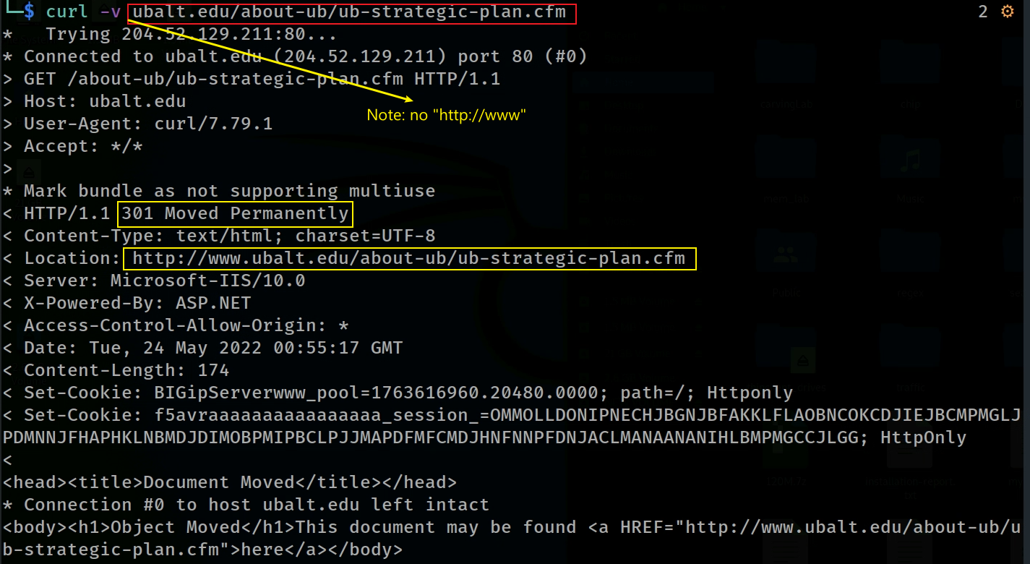
(301 redirect example 1) add http://www to the beginning of a URL
cURL does not follow HTTP redirects by default
add –L, --location to redirect
Notes:
curl -v ubalt.edu/about-ub/ub-strategic-plan.cfm

Slide 19
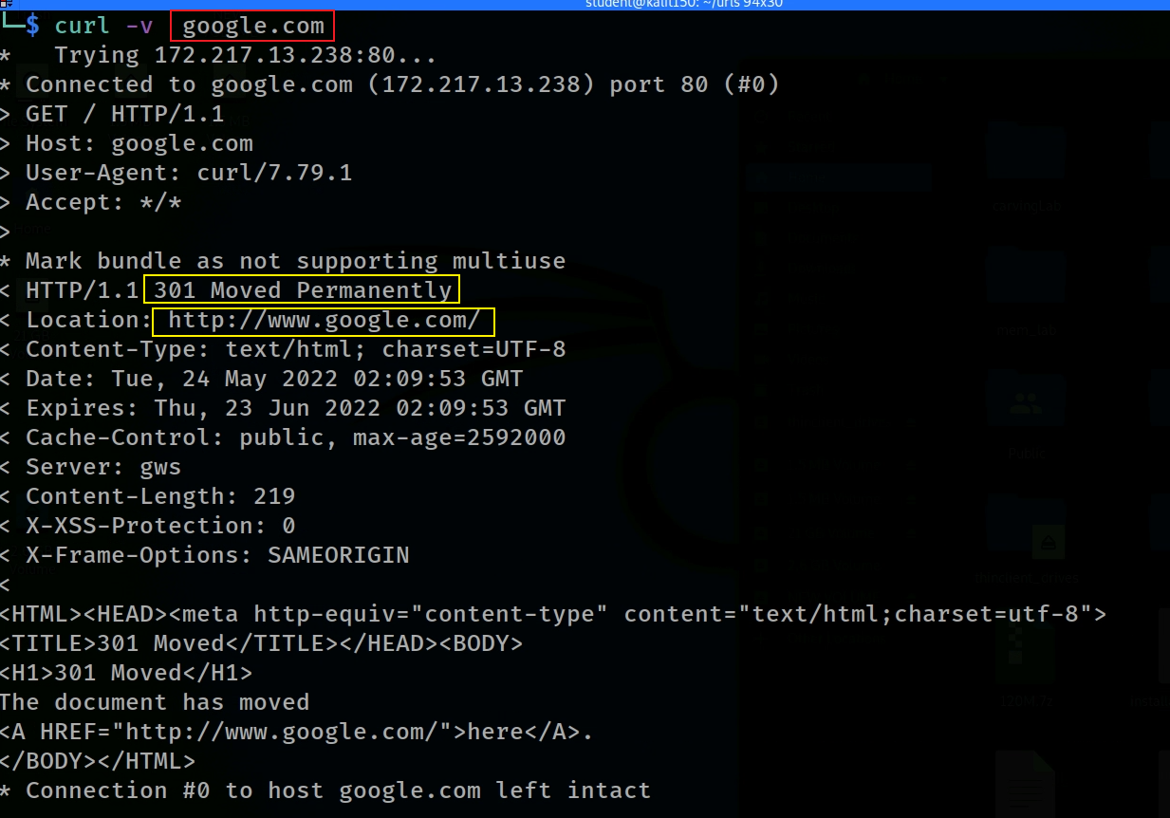
(301 redirect example 2) add http://www to the beginning of a URL
Notes:
curl -v google.com

Slide 20
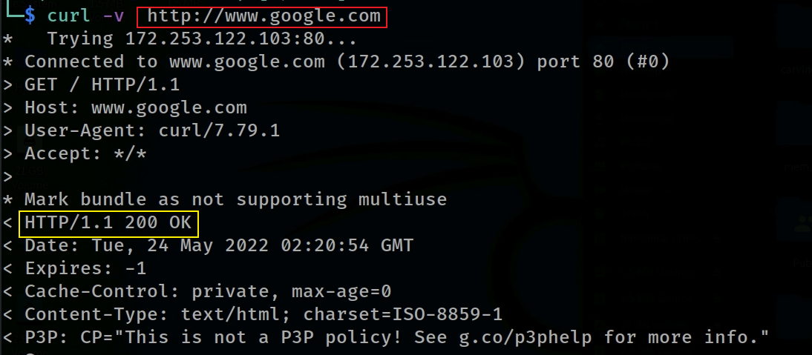
(301 redirect example 3) No redirect. Why?

Slide 21
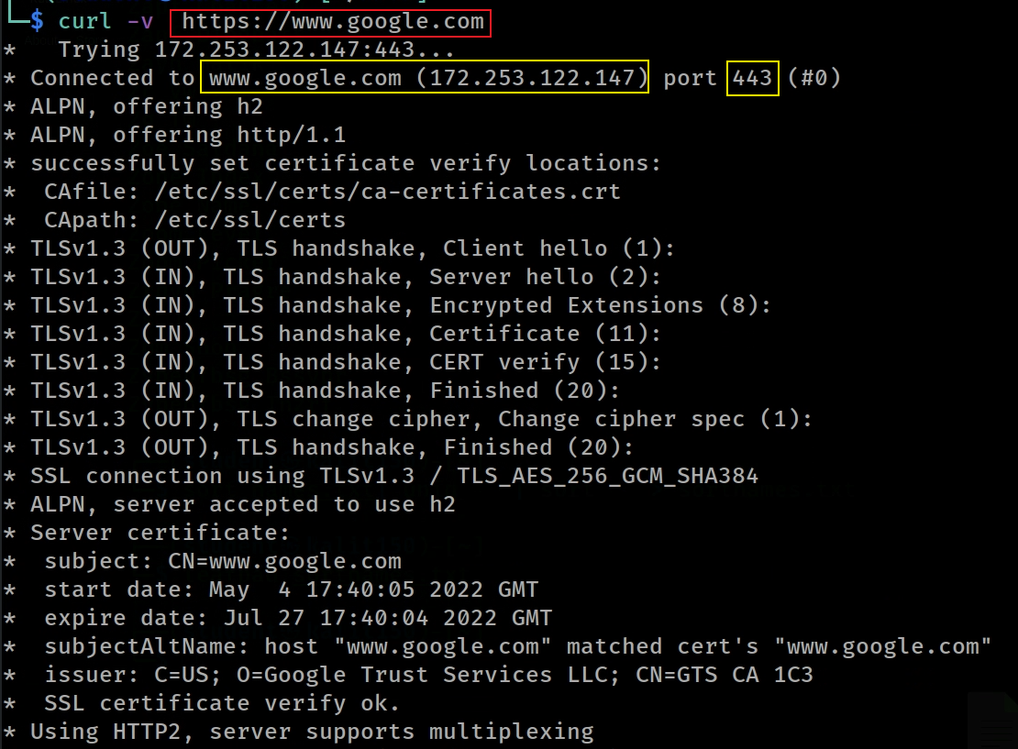
(301 redirect example 4) https no redirect.

Slide 22
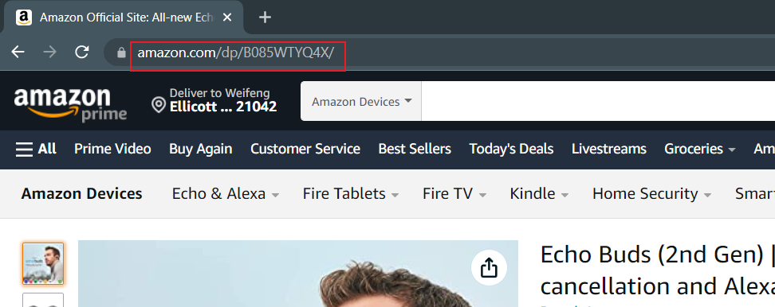
URL rewriting
URL you type
rewriting back to original link
http://amazon.com/dp.aspx?id=B085WTYQ4X

Slide 23
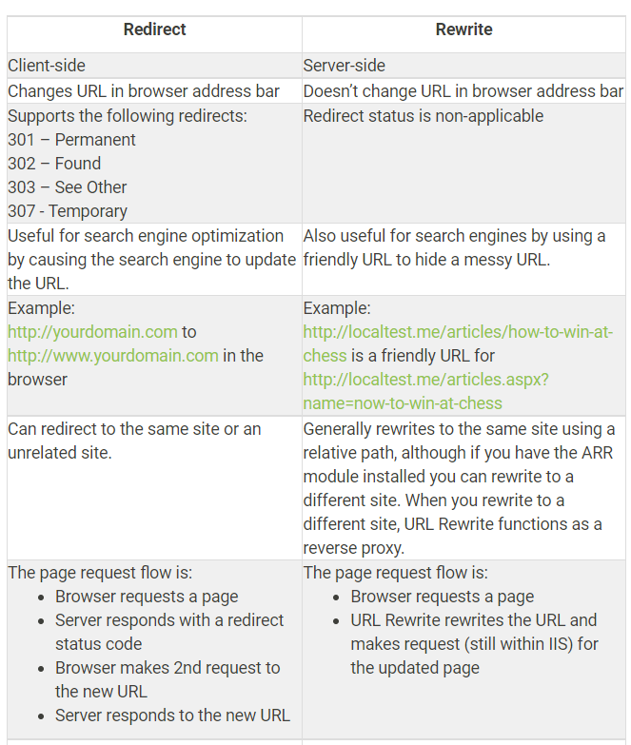
URL Rewrite vs. Redirect
Notes:
https://weblogs.asp.net/owscott/rewrite-vs-redirect-what-s-the-difference

Slide 24
Understand user web activity

Slide 25

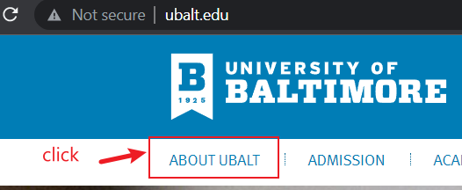
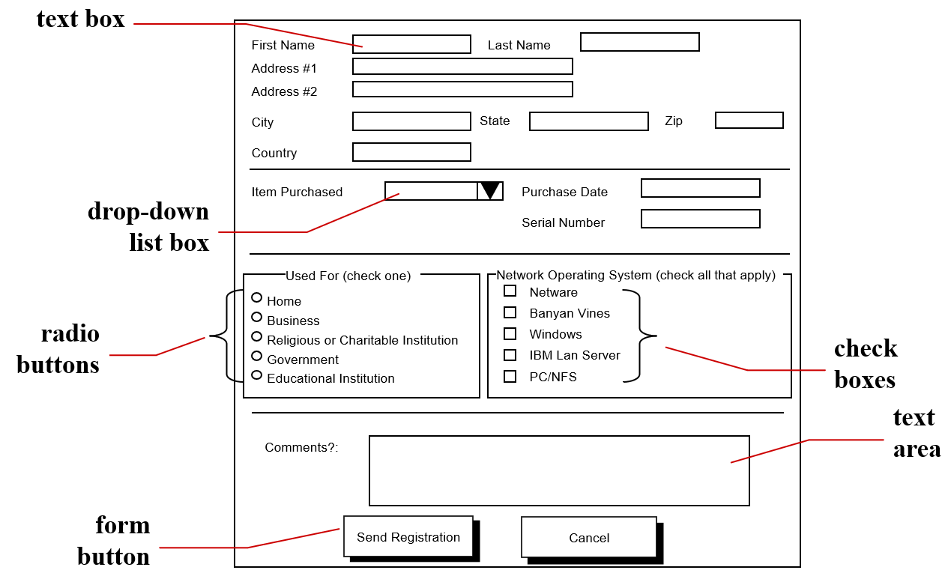
User web activity
A user’s inputs into a browser
  Type search strings in address bar/enhanced address bar (omnibox)
  Click links
  Submit Forms
    Fill text fields
    Click Bottoms
    Check checkboxes
    Check radio buttons
    Choose from dropdown menus
http://jjcweb.jjay.cuny.edu/ssengupta/

Slide 26
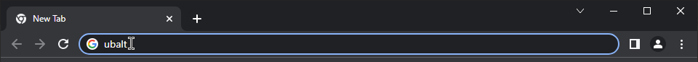
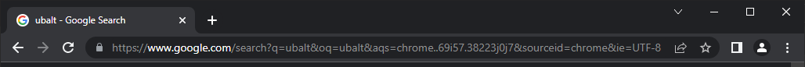
How does user activity affect URL?
Type in address bar as a search string
After entering
search: action
ubalt: query value
q: query parameter

Slide 27
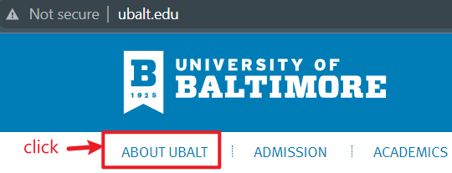

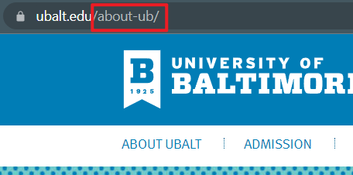
Click a link
link
footage show the URL of the link
After clicking

Slide 28
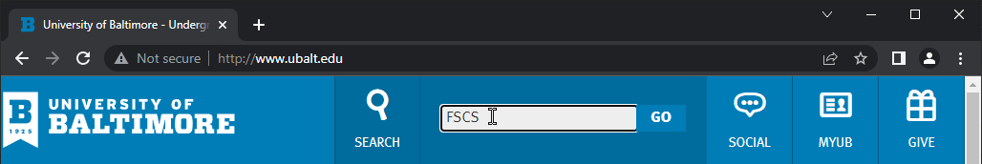
Fill text field and Click submit/Go
value
action
parameter variable

Slide 29
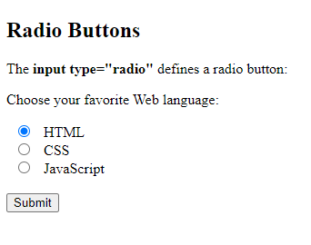
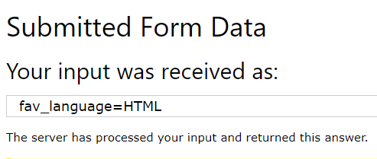
Select radio button option and submit
1
2

Slide 30
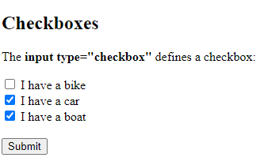
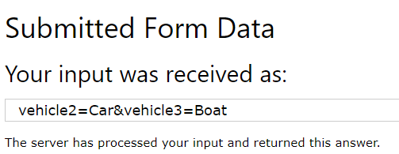
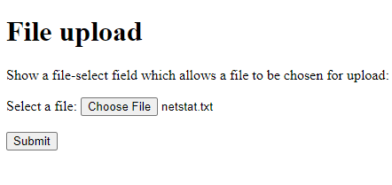
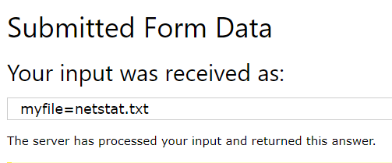
Check checkboxes and submit
1
2
Upload a file

Slide 31
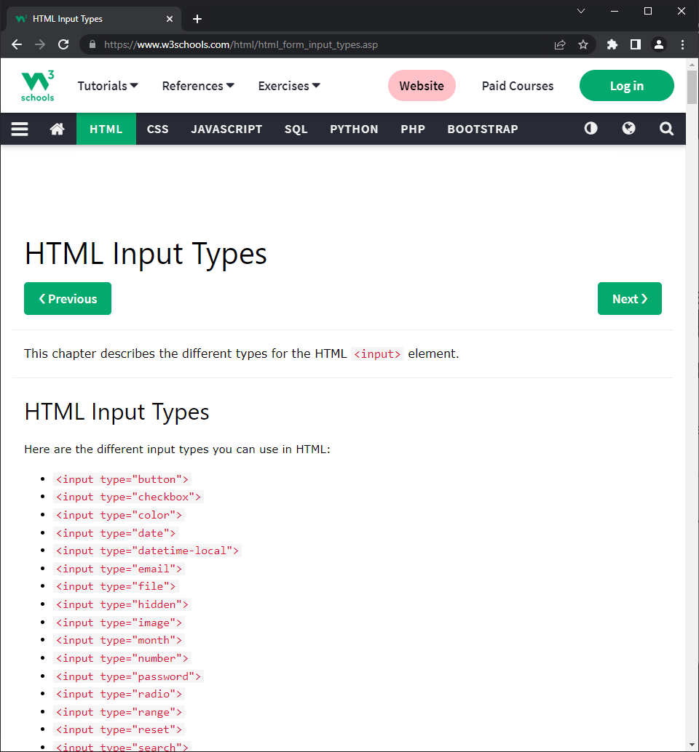
Other user web form activity affects URL
w3schools.com

Slide 32
Bowser history

Slide 33
All requests (URLs) are saved by Browsers
All requests include
  Direct requests
  Redirect requests
Repository formats: text, database, xml

Slide 34
Location of Google Chrome history
Windows XP
  C:\Documents and Settings\<username>\Local Settings\Application Data\Google\Chrome\User Data\Default
  C:\Documents and Settings\<username>\Local Settings\Application Data\Google\Chrome\User Data\Default\Cache
Windows Vista, 7, 8, 10
  C:\Users\<username>\AppData\Local\Google\Chrome\User Data\Default
  C:\Users\<username>\AppData\Local\Google\Chrome\User Data\Default\Cache
Mac OS X
  /Users/<username>/Library/Application Support/Google/Chrome/Default
  /Users/<username>/Library/Caches/Google/Chrome/Default/Cache
Linux/Unix
  /home/<username>/.config/google-chrome/Default
  /home/<username>/.cache/google-chrome/Default/Cache
Notes:
https://www.foxtonforensics.com/browser-history-examiner/chrome-history-location#:~:text=Chrome%20Searches%20are%20stored%20in,within%20the%20'urls'%20table.&text=Chrome%20Session%20Data%20is%20stored,'%20and%20'Tabs'%20files.

Slide 35
Items of Google Chrome history
Bookmarks: Chrome Bookmarks are stored in the 'Bookmarks' JSON file.
Cache: Chrome Cache is stored using an Index file ('index'), a number of Data Block files ('data_#'), and a number of separate data files ('f_######’).
Cookies: Chrome Cookies are stored in the 'Cookies' SQLite database (located in the Network folder), within the 'cookies' table.
Downloads: Chrome Downloads are stored in the 'History' SQLite database, within the 'downloads' and 'downloads_url_chains' tables.
Favicons: Chrome Favicons are stored in the 'Favicons' SQLite database, within the 'favicons', 'favicon_bitmaps' and 'icon_mapping' tables. Older versions of Chrome stored Favicons in a 'Thumbnails' SQLite database, within the 'favicons' table.
Form History: Chrome Form History is stored in the 'Web Data' SQLite database, within the 'autofill' table. Older versions of Chrome stored associated dates within an 'autofill_dates' table.
Logins: Chrome Logins are stored in the 'Login Data' SQLite database, within the 'logins' table. Older versions of Chrome stored Logins in the 'Web Data' SQLite database.
Searches: Chrome Searches are stored in the 'History' SQLite database, within the 'keyword_search_terms' table. Associated URL information is stored within the 'urls' table.
Session Data: Chrome Session Data is stored in the 'Sessions' folder within the 'Session' and 'Tabs' files.
Thumbnails: Chrome Thumbnails are stored in the 'Top Sites' SQLite database, within the 'thumbnails' table. Older versions of Chrome stored Thumbnails in a 'Thumbnails' SQLite database, within the 'thumbnails' table.
Website Visits: Chrome Website Visits are stored in the 'History' SQLite database, within the 'visits' table. Associated URL information is stored within the 'urls' table. Older versions of Chrome stored archived Website Visits in a separate 'Archived History' SQLite database, within the 'visits' table.
Notes:
https://www.foxtonforensics.com/browser-history-examiner/chrome-history-location#:~:text=Chrome%20Searches%20are%20stored%20in,within%20the%20'urls'%20table.&text=Chrome%20Session%20Data%20is%20stored,'%20and%20'Tabs'%20files.

Slide 36
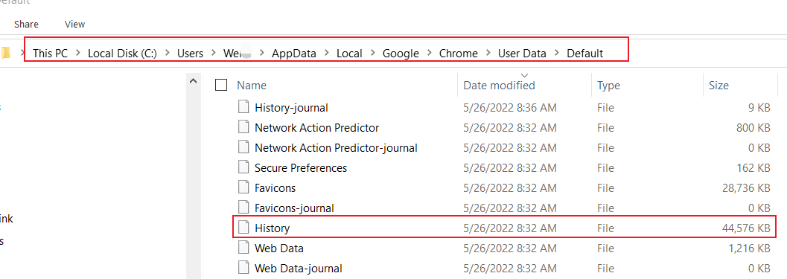
Chrome Website Visits history repository (Win10)

Slide 37
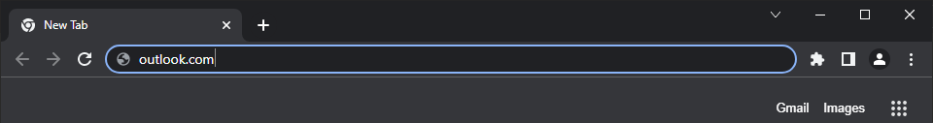
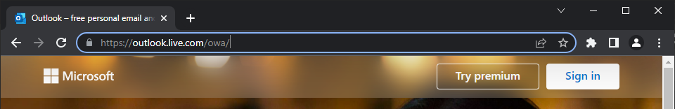
outlook.com redirects saved in ‘urls’ table
URL URL redirecting example

Slide 38
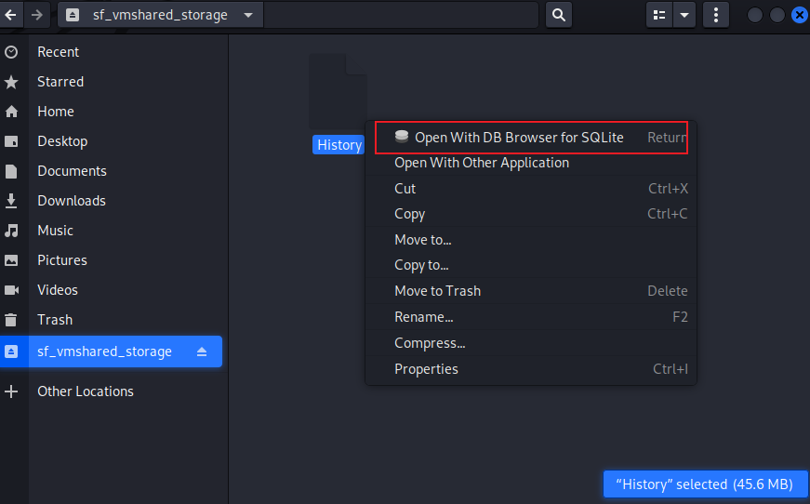
Open History database

Slide 39
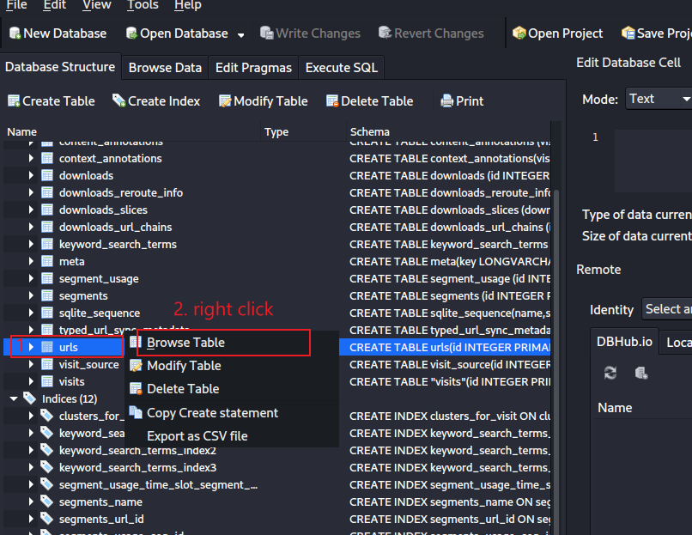
Browse urls table

Slide 40
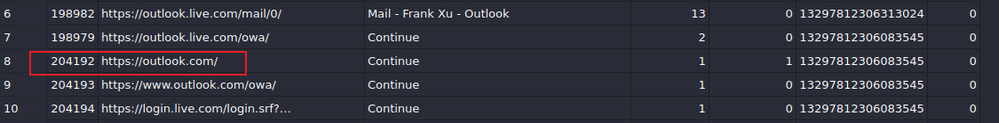



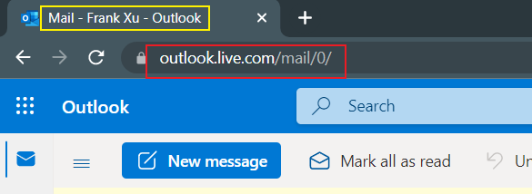
typed count
url
title
visit count
timestamp
I typed:
A few redirects: … see different URLs in database
What I see after being auto logged in
Notes:
echo $((13297812306-11644473600))
date -d@1653338706
January, 1601
January, 1700

Slide 41
Summary
URL used by browser to request content from server
Server responds and browser displays content
User activities are the user’s input into the browser
Redirects ask agents to visit different URLs
Given only URL, we can guess user activity
Title leaks the content sent back from a web server

