Slide 1
Extending Titanium Mobile through Native Modules
Olivier Morandi

Slide 2
# whoami
Olivier Morandi
Freelance mobile developer & software engineer
olivier.morandi@gmail.com
@olivier_morandi
https://github.com/omorandi

Slide 3
Titanium Mobile
A set of tools for developing cross-platform mobile applications in JavaScript
  iOS (iPhone/iPod/iPad)
  Android
  Blackberry (through a commercial subscription)
http://www.appcelerator.com
https://github.com/appcelerator/titanium_mobile

Slide 4
Anatomy of a project
Project directory
  build/
    android/
    iphone/
  Resources/
    app.js
  manifest
  tiapp.xml
Build folders, per platform
Resource files: JS code, images, sounds, Sqlite DBs, etc.
Project files

Slide 5
manifest
#appname: whymca
#publisher: olivier
#url: http://www.whymca.org
#image: appicon.png
#appid: com.whymca.test
#desc: undefined
#type: mobile
#guid: 746e9cb4-49f6-4afe-af0b-5de9f0116f65

Slide 6
tiapp.xml
<?xml version="1.0" encoding="UTF-8" standalone="no"?>
<ti:app xmlns:ti="http://ti.appcelerator.org">
<deployment-targets>
<target device="iphone">true</target>
<target device="ipad">false</target>
<target device="android">true</target>
</deployment-targets>
<id>com.whymca.test</id>
<name>whymca</name>
<version>1.0</version>
<publisher>olivier</publisher>
<url>http://www.whymca.org</url>
<description>not specified</description>
<copyright>2011 by olivier</copyright>
<icon>appicon.png</icon>
<persistent-wifi>false</persistent-wifi>
<prerendered-icon>false</prerendered-icon>
<statusbar-style>default</statusbar-style>
<statusbar-hidden>false</statusbar-hidden>
<fullscreen>false</fullscreen>
<navbar-hidden>false</navbar-hidden>
<analytics>false</analytics>
<guid>746e9cb4-49f6-4afe-af0b-5de9f0116f65</guid>
<iphone>
<orientations device="iphone">
<orientation>Ti.UI.PORTRAIT</orientation>
</orientations>
<orientations device="ipad">
<orientation>Ti.UI.PORTRAIT</orientation>
<orientation>Ti.UI.UPSIDE_PORTRAIT</orientation>
<orientation>Ti.UI.LANDSCAPE_LEFT</orientation>
<orientation>Ti.UI.LANDSCAPE_RIGHT</orientation>
</orientations>
</iphone>
<android xmlns:android="http://schemas.android.com/apk/res/android">
</android>
<modules>
</modules>
</ti:app>

Slide 7
app.js (1)
var win = Titanium.UI.createWindow({
  title:'Hello',
  backgroundColor:'#fff'
});
var label1 = Titanium.UI.createLabel({
  color:'#333',
  text:’Hello World!',
  textAlign: 'center',
  font: {fontSize: 30, fontWeight: 'bold'}
});
win.add(label1);

Slide 8
app.js (2)
var bt = Titanium.UI.createButton({
  title: 'Click me',
  width: 100,
  height: 40,
  bottom: 40
})
bt.addEventListener('click', function(e) {
  label1.text = 'WHYMCA ROCKS!';
});
win.add(bt);
win.open();

Slide 9
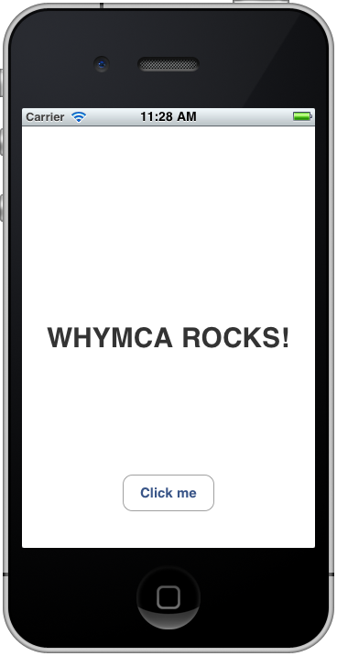
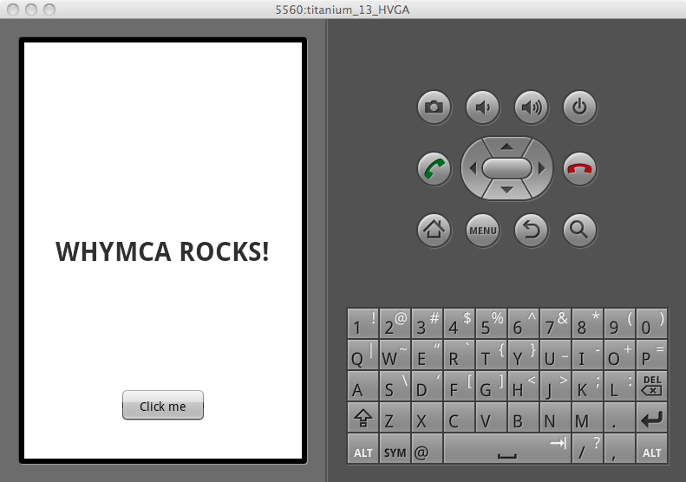
UI widgets created in JS are mapped on the native components of the target platform

Slide 10
App distribution
The product ready for distribution is actually a native app
JS Code
  Partially compiled and optimized
  Packed in binary format into the bundle
Resources
  Copied into the bundle

Slide 11
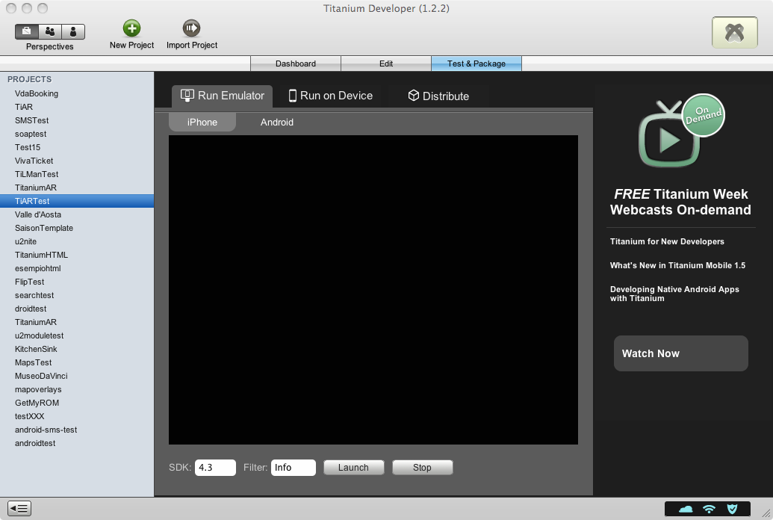
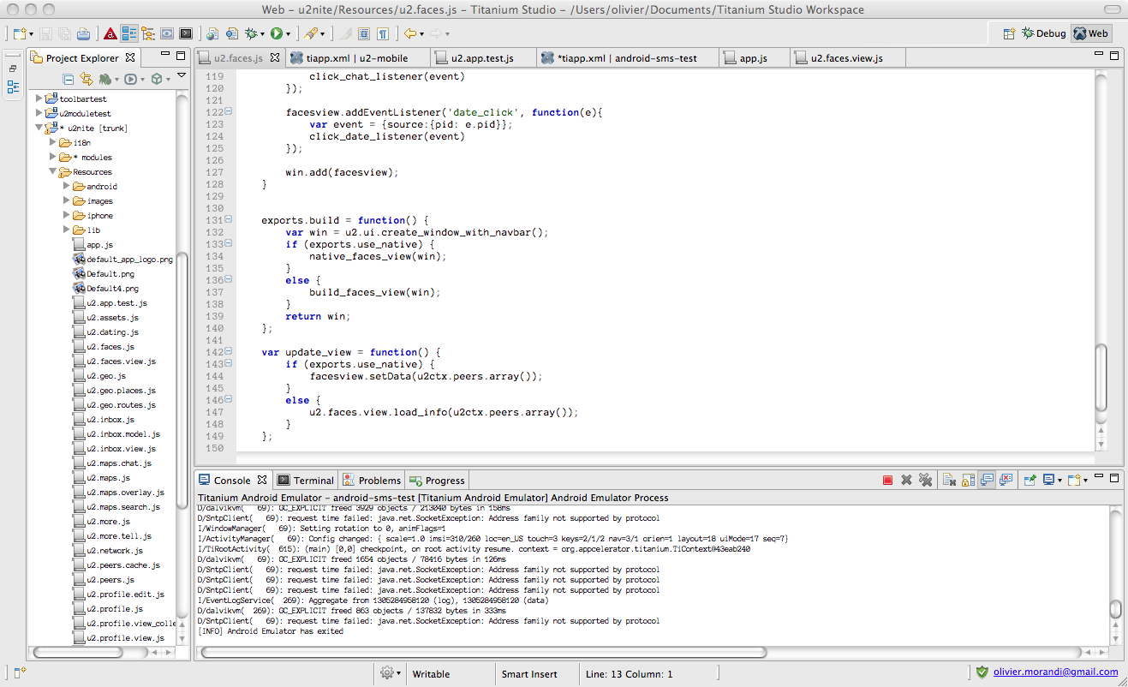
Development toolchain
Ti Developer (toolchain GUI)
Ti Studio (IDE)
Ti SDK toolchain
(Python scripts)
Xcode/iOS SDK
Android SDK
Mac OSX
Windows
Linux
Mac OSX

Slide 12

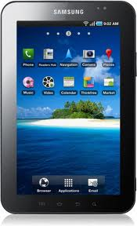
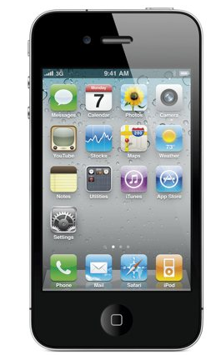
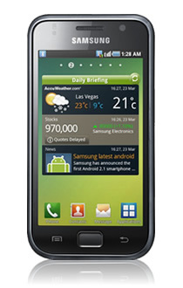
Application Stack
JavaScript Application Code
Titanium JavaScript API
JS Interpreter
iOS
Modules
JS Interpreter
Android
Modules
Titanium Framework
Runtime
Runtime
iOS SDK
Android SDK

Slide 13
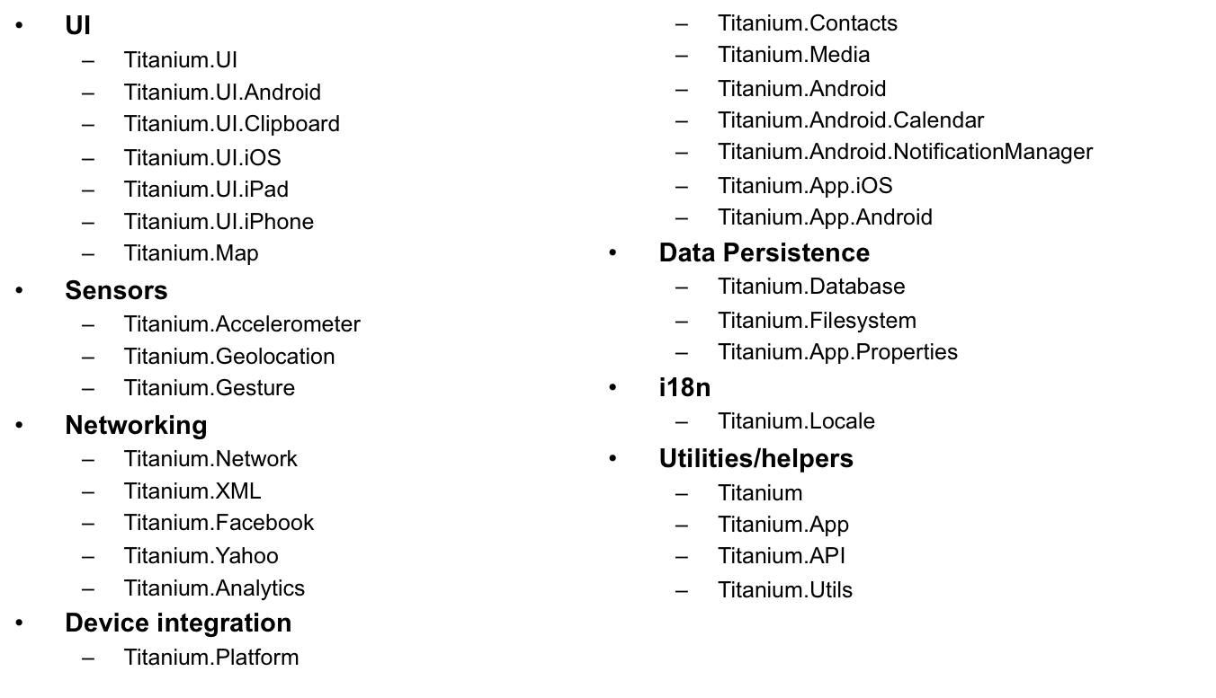
Ti JavaScript API
http://developer.appcelerator.com/apidoc/mobile

Slide 14
Extending the API: why?
Accessing specific OS features
Leveraging existing native libraries
Optimizing critical portions of the app
Extending/ameliorating portions of the Titanium Mobile framework

Slide 15
Extending the API: how?
Creating a fork of Titanium Mobile’s source code on github
  Unflexible approach
    You put your hands in the heart of the framework
    Maintaining a separate branch can be tedious and costly
  There are situations where this is the cheaper approach
    E.g. when needing to extend the functionality of core modules of the framework (networking, maps, ecc.)

Slide 16
Extending the API: how?
Creating one or more native modules throught the Titanium Module SDK
  Great flexibility
  Easy to distribute as
    Open Source
    Binary packages
    Appcelerator Ti+Plus Marketplace (?)

Slide 17
Moduli nativi – some examples
Android barcode scanner (Zxing wrapper)
  https://github.com/mwaylabs/titanium-barcode
iOS ZipFile (create/decompress zip files)
  https://github.com/TermiT/ZipFile
iOS TiStoreKit (in app purchase)
  https://github.com/masuidrive/TiStoreKit
iOS TiSMSDialog (in app sms sending)
  https://github.com/omorandi/TiSMSDialog
Appcelerator Titanium modules (sample modules)
  https://github.com/appcelerator/titanium_modules

Slide 18
Titanium JS Interface
var bt = Titanium.UI.createButton({
  title: 'Click me',
  width: 100,
  height: 40,
  bottom: 40
});
bt.addEventListener('click', function(e) {
  label1.text = 'WHYMCA ROCKS!';
});

Slide 19
Titanium JS Interface
Module
    Titanium.UI
Object
    Titanium.UI.Button
Object Factory
    Titanium.UI.createButton()
Property getters/setters - methods
    Button.title
    Button.width
    Button.animate()
    Ecc.
Event handling
    Button.addEventListener()

Slide 20
Module Architecture
Namespace
Object
Object property/method
Titanium.UI
Titanium.UI.Button
Titanium.UI.Button.width
JavaScript
Module
Proxy
Titanium
abstraction
Internal State
setters/getters
Methods
Events
Internal State
setters/getters
Methods
Events
Implementation
Factory
Module Class
Proxy Class

Slide 21
The path to module development
Define the functionality you need to be exposed and how they’ll be invoked from JavaScript code → define the API of the module
Create a project with the tools of the Module SDK
Implement the API
Build-Test-Debug

Slide 22
Case Study – iOS SMS module
The Titanium API provides email sending functionality through the Ti.UI.EmailDialog component, but nothing for sending SMS messages
On iOS this feature is available since version 4.0 of the OS through the MFMessageComposeViewController class

Slide 23
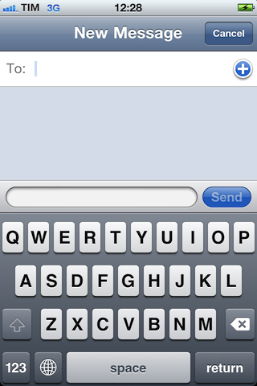
MFMessageComposeViewController

Slide 24
Case Study – iOS SMS module
Implement a native module capable of exposing the features of the MFMessageComposeViewController class through a JavaScript API:
  Check the availability of the component (not present in iOS versions < 4.0)
  Programmatically set recipients and message body
  Set UI properties (e.g. navbar color)
  Notify the caller about the result of the send operation

Slide 25
Resources
Module SDK Docs
  Android
    http://wiki.appcelerator.org/display/guides/Module+Developer+Guide+for+Android
  iOS
    http://wiki.appcelerator.org/display/guides/Module+Developer+Guide+for+iOS
Titanium Mobile source code
  https://github.com/appcelerator/titanium_mobile
Code of other modules released as open source

Slide 26
1. Defining the API
Object
  SMSDialog
Properties
  recipients
  messageBody
  barColor
Methods
  isSupported()
  open()

Slide 27
Example code
var smsDialog = module.createSMSDialog();
if (smsDialog.isSupported())
{
smsDialog.recipients = [’+14151234567'];
smsDialog.messageBody = 'Test message from me';
smsDialog.barColor = ’red';
smsDialog.addEventListener('complete', function(e){
Ti.API.info('Result: ' + e.resultMessage);
});
smsDialog.open({animated: true});
}

Slide 28
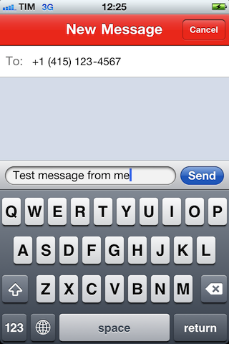
Result

Slide 29
2. Creating the project
# titanium create
--platform=iphone
--type=module
--dir=~/
--name=SMSDialog
--id=com.whymca.smsdialog

Slide 30
titanium (alias)
Mac OS X
  alias titanium="/Library/Application Support/Titanium/mobilesdk/osx/1.7.0/titanium.py"
Linux
  alias titanium="$HOME/Library/Application Support/Titanium/mobilesdk/osx/1.7.0/titanium.py"
Windows XP
  PATH=C:\Documents and Settings\All Users\Application Data\Titanium\mobilesdk\win32\1.7.0
Windows Vista/7
  PATH=C:\ProgramData\Titanium\mobilesdk\win32\1.7.0

Slide 31
Xcode project generated
assets/
Classes/
  ComWhymcaSmsdialogModule.h
  ComWhymcaSmsdialogModule.m
  ComWhymcaSmsdialogModuleAssets.h
  ComWhymcaSmsdialogModuleAssets.m
example/
  app.js
build.py
ComWhymcaSmsdialog_Prefix.pch
manifest
module.xcconfig
smsdialog.xcodeproj
titanium.xcconfig
Asset files to be distributed with the module
Implementation files
To be filled with our code
Sample program for testing module invocations
Script for building and packaging the module
Metadata for managing the module in Titanium
Include/linking directives used at integration-time
Include/linking directives used at build-time

Slide 32
3. Implementation
The generated project already contains the class that implements the module:
  ComWhymcaSmsdialogModule
The class name is a CamelCase transposition of the module id chosen when creating the project
In JS it will be instantiated as
  var module = require(‘com.whymca.smsdialog’);

Slide 33
Implementing the proxy
The SMSDialog object we defined, must be implemented as a proxy
The name of the class must follow a convention similar to that used for the module name, in the form:
  <moduleID><proxyName>Proxy
  i.e.
  ComWhymcaSmsdialogSMSDialogProxy

Slide 34
SMSDialogProxy class
Must be a subclass of the TiProxy class
It should expose properties and methods that we want to make available to JavaScript code

Slide 35
Object creation and initialization
var smsDialog = module.createSMSDialog();
smsDialog.recipients = [’+391234567'];
smsDialog.messageBody = 'Test message';
//or
var smsDialog = module.createSMSDialog({
recipients: [’+391234567’],
messageBody: 'Test message’
});

Slide 36
Creation
Object creation is completely managed by the framework
The JS construct
  module.create<ProxyName>()
is mapped on code that instantiate an object of the correct class thanks to the naming convention used

Slide 37
Initialization
The object can be initialized either passing a dictionary of property values to the factory method, either setting single property values in a second moment through dot notation
In either case, if the proxy doesn’t explicitly provide getter/setter methods for those properties, they are automatically inserted in the dynprops dictionary of the proxy object

Slide 38
Initialization
It’s always possible to retrieve property values present in the dynprops dictionary with the message
[self valueForUndefinedKey:@"messageBody"]

Slide 39
Conversion utilities
The framework provides the TiUtils class, which contains methods for simplifying the conversion of values coming form JS code:
NSString * messageBody = [TiUtils stringValue:[self valueForUndefinedKey:@"messageBody"]];
UIColor * barColor = [[TiUtils colorValue:[self valueForUndefinedKey:@"barColor"]] _color];
BOOL animated = [TiUtils boolValue:@"animated" properties:args def:YES];

Slide 40
Methods
They are exposed to JavaScript by simply declaring them in the @interface section of the proxy class
They must be declared in one of the following forms:
  -(id)methodName:(id)args
  -(void)methodName:(id)args

Slide 41
Example
@interface ComWhymcaSmsdialogSMSDialogProxy: TiProxy <MFMessageComposeViewControllerDelegate>
- (id)isSupported:(id)args;
- (void)open:(id)args;
@end

Slide 42
Method arguments
The list of arguments passed in JavaScript to a method is passed as a NSArray object in the args parameter
The framework provides some C macros for the cases where a single argument is expected:
  ENSURE_SINGLE_ITEM(args,type)
  ENSURE_SINGLE_ARG_OR_NIL(args, type)

Slide 43
Passing JavaScript dictionary Objects
JS:
  smsDialog.open({animated: true});
OBJ-C:
- (void)open:(id)args {
  ENSURE_SINGLE_ARG_OR_NIL(args, NSDictionary);
  //args ora è un NSDictionary
  BOOL animated = [TiUtils boolValue:@"animated" properties:args def:YES];
  //[…]

Slide 44
Return values
The types
  NSString
  NSDictionary
  NSArray
  NSNumber
  NSDate
  NSNull
don’t need to be converted
Numeric types must be wrapped in a NSNumber object
It’s possible to return proxy objects (though they must be autoreleased if allocated by our method)
  return [[[TiColor alloc] initWithColor:color name:@"#fff"] autorelease];

Slide 45
Executing a method in the UI thread
There are cases where a method should be executed in the UI thread (e.g. when interacting with user interface objects)
In such cases we can use the macro
  ENSURE_UI_THREAD(method,args)
  for forcing the execution of the method on the UI thread

Slide 46
Events
The simplest way a proxy has to interact with JS code is through events
In JS we register an event-listener function on a specific event managed by the proxy
Example
JS:
  smsDialog.addEventListener('complete', function(e){
Ti.API.info('Result: ' + e.resultMessage);
});

Slide 47
Events
OBJ-C:
-(void)_listenerAdded:(NSString*)type count:(int)count
{
//type = @"complete"
}
-(void)_listenerRemoved:(NSString*)type count:(int)count {
//type = @"complete"
}

Slide 48
Events
OBJ-C:
NSDictionary *event = [NSDictionary dictionaryWithObjectsAndKeys:resultMessage, @"resultMessage", nil];
[self fireEvent:@"complete" withObject:event];

Slide 49
4. Build
We can build the project directly from Xcode
  Useful for checking out warning & syntax error messages

Slide 50
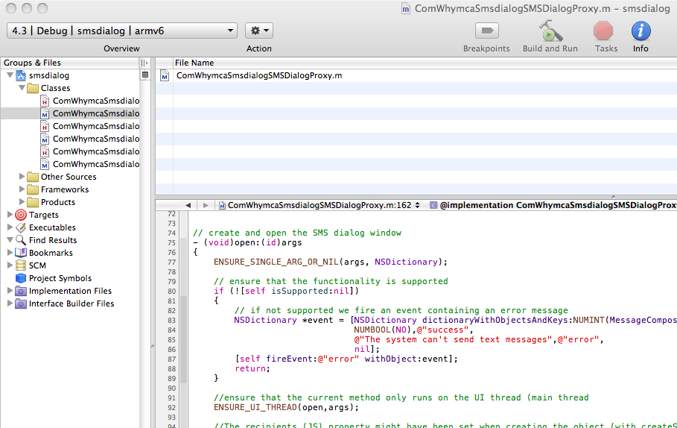
⌘B

Slide 51
4. Build
Using the script
# build.py
from the module project root directory
  It performs a complete build and it packages the module library + assets + metadata in a zip file

Slide 52
Package
Name in the form
  com.whymca.smsdialog-iphone-0.1.zip
For being used it must be decompressed in the directory
/Library/Application\ Support/Titanium/

Slide 53
Simple testing
By executing the script
# titanium run
in the project directory
This will create a temporary project based on the app.js file from the example directory
Not the best way for testing the module

Slide 54
Using the module in a Ti Mobile Project
<?xml version="1.0" encoding="UTF-8" standalone="no"?>
<ti:app xmlns:ti="http://ti.appcelerator.org">
<!–- SNIP… -->
<modules>
<module version=“0.1” platform=“iphone”>
com.whymca.smsdialog
</module>
</modules>
</ti:app>
tiapp.xml

Slide 55
Testing/Debugging
Create a new Ti Mobile project with test code and a reference to the module
Launch the app at least one time from Ti Studio/Developer
Open the Xcode project from the build/iphone directory found in the app project directory
Issue Build&Debug from there
Set breakpoints in the module code, test, etc.

Slide 56
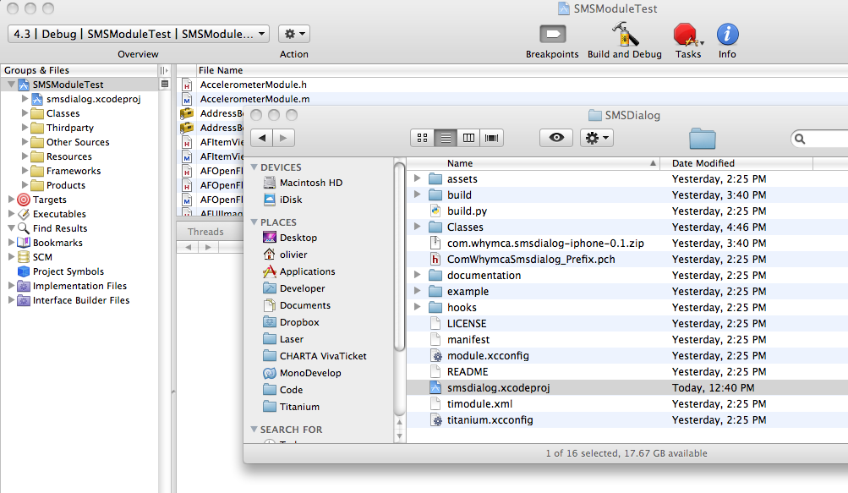

Slide 57
Thank you!
Any questions?
You can find all the code used for this presentation on
https://github.com/omorandi/whymca-conf-2011

