Slide 1
Multi-Store Fashion Retail
Sales Analysis
January 2024 Performance Analysis
Complete 10-Store Dataset
October 20, 2025

Slide 2
Executive Summary
Total revenue of ¥44.0M from 1,155 transactions across 10 stores
Kanto region dominates with 39.2% share (4 stores including new Ikebukuro)
Fukuoka debuts strong at #3 nationally, validating Kyushu expansion
Footwear leads categories at 29.1% share (¥12.8M)
Top 5 stores each contribute 10-12% revenue with balanced performance

Slide 3
Business Performance Overview
¥44.0M
1,155
Total Revenue
Transactions
¥38,095
10 of 10
Avg Transaction
Active Stores

Slide 4
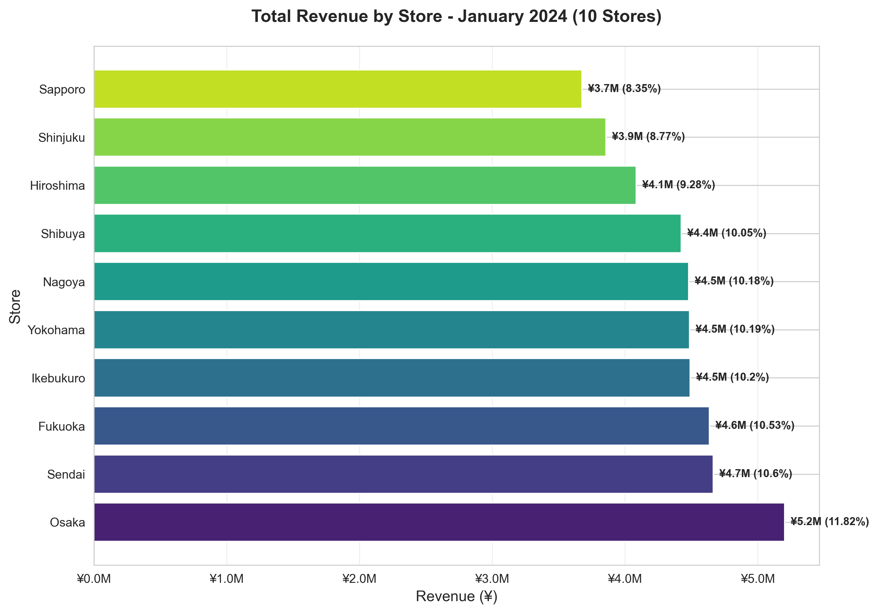
Store Performance Comparison
Osaka leads with ¥5.2M, followed by Sendai and Fukuoka

Slide 5
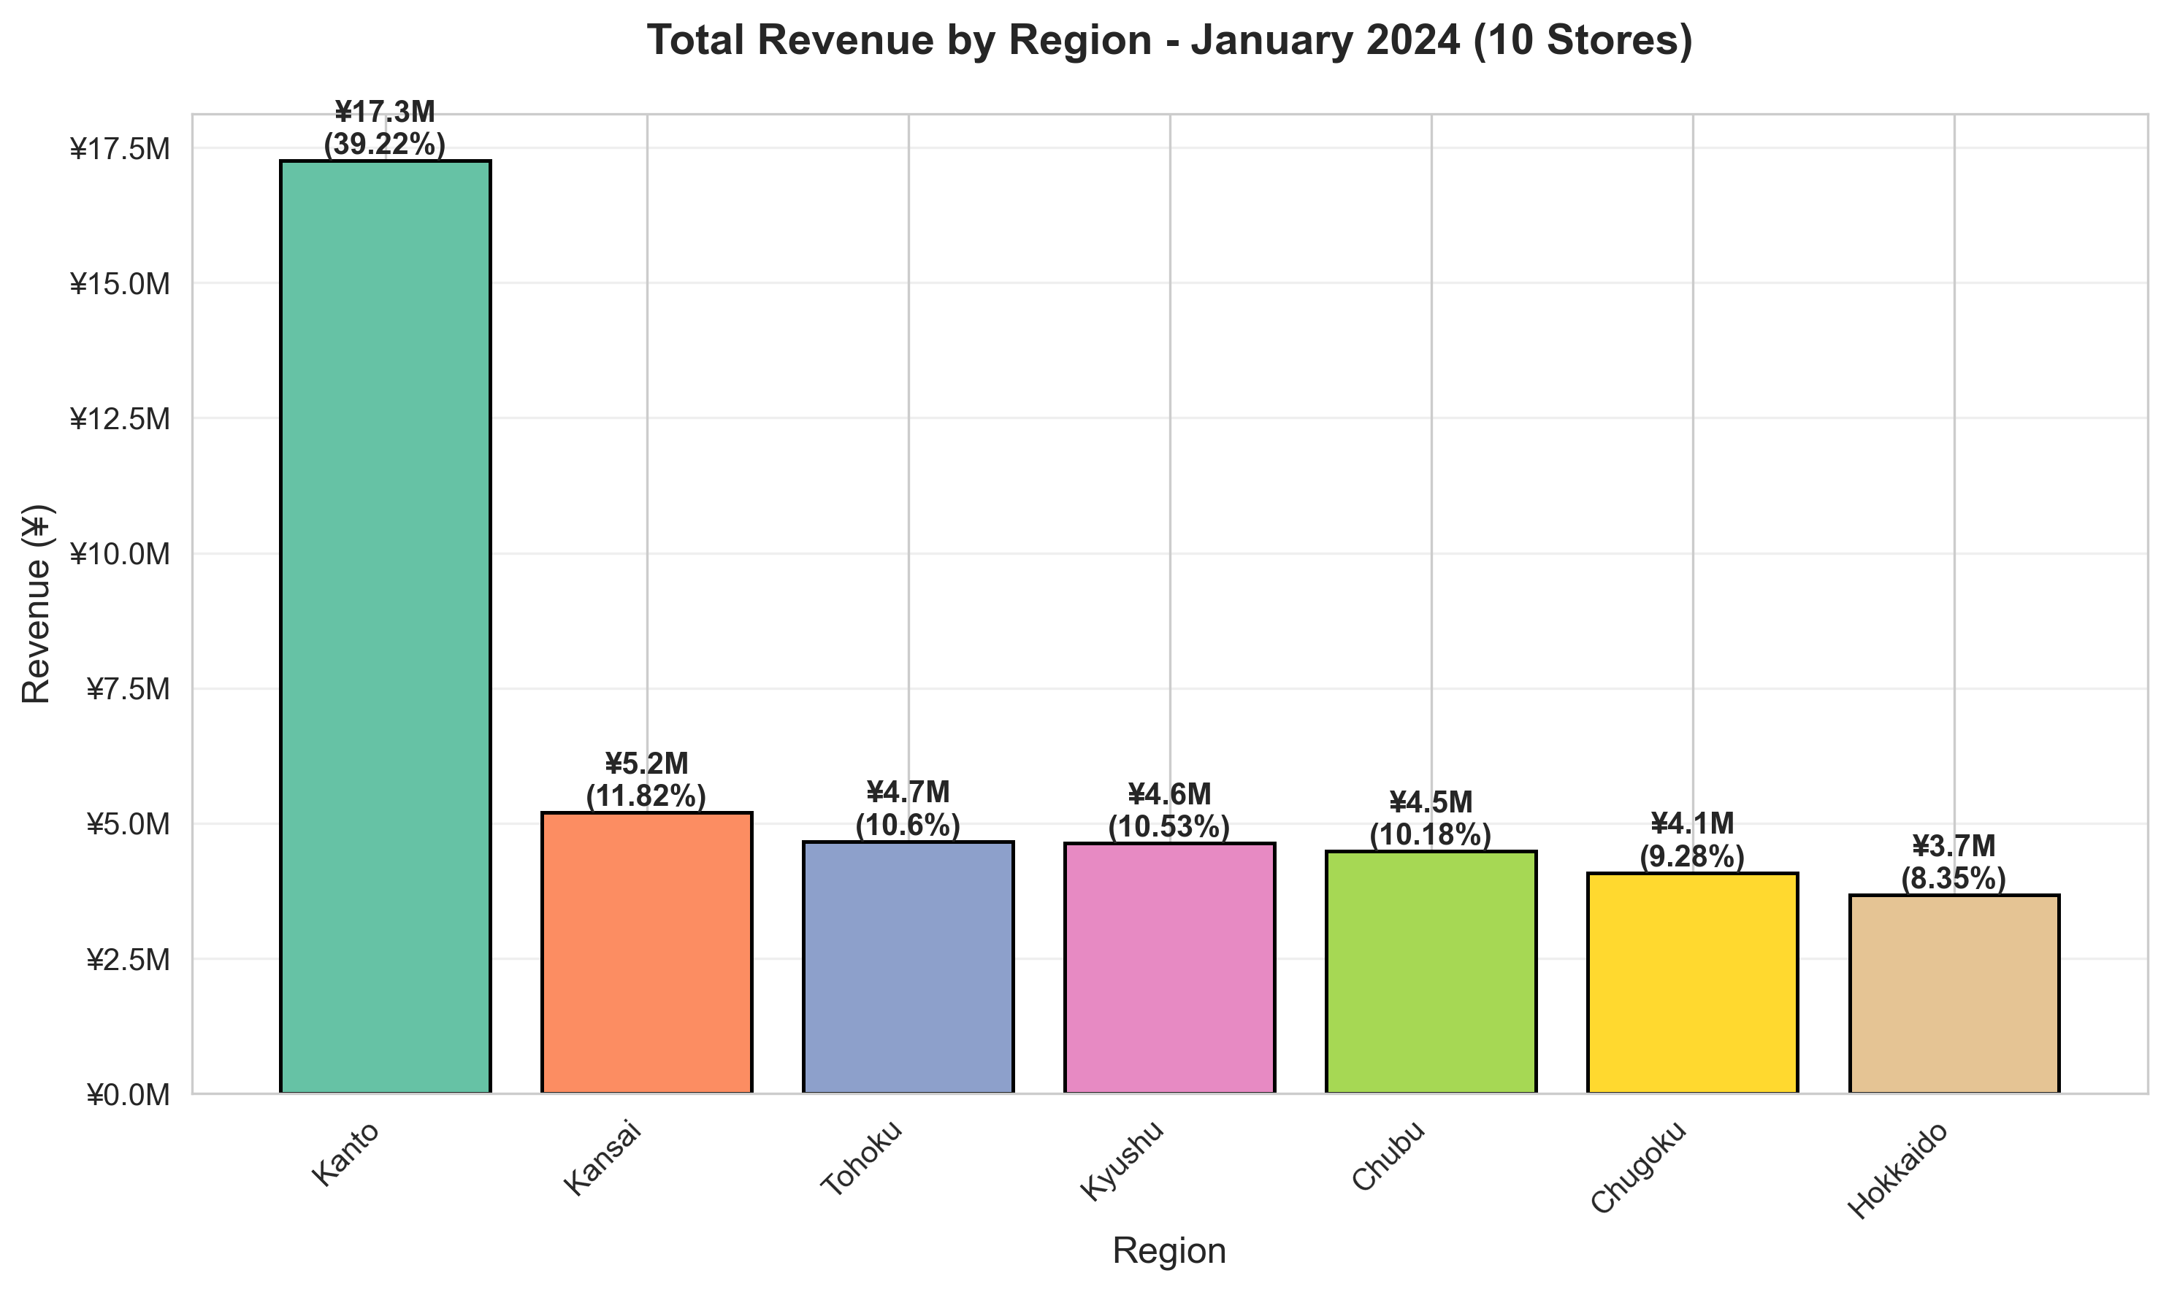
Regional Revenue Distribution
Kanto region generates ¥17.3M (39.2% share)

Slide 6
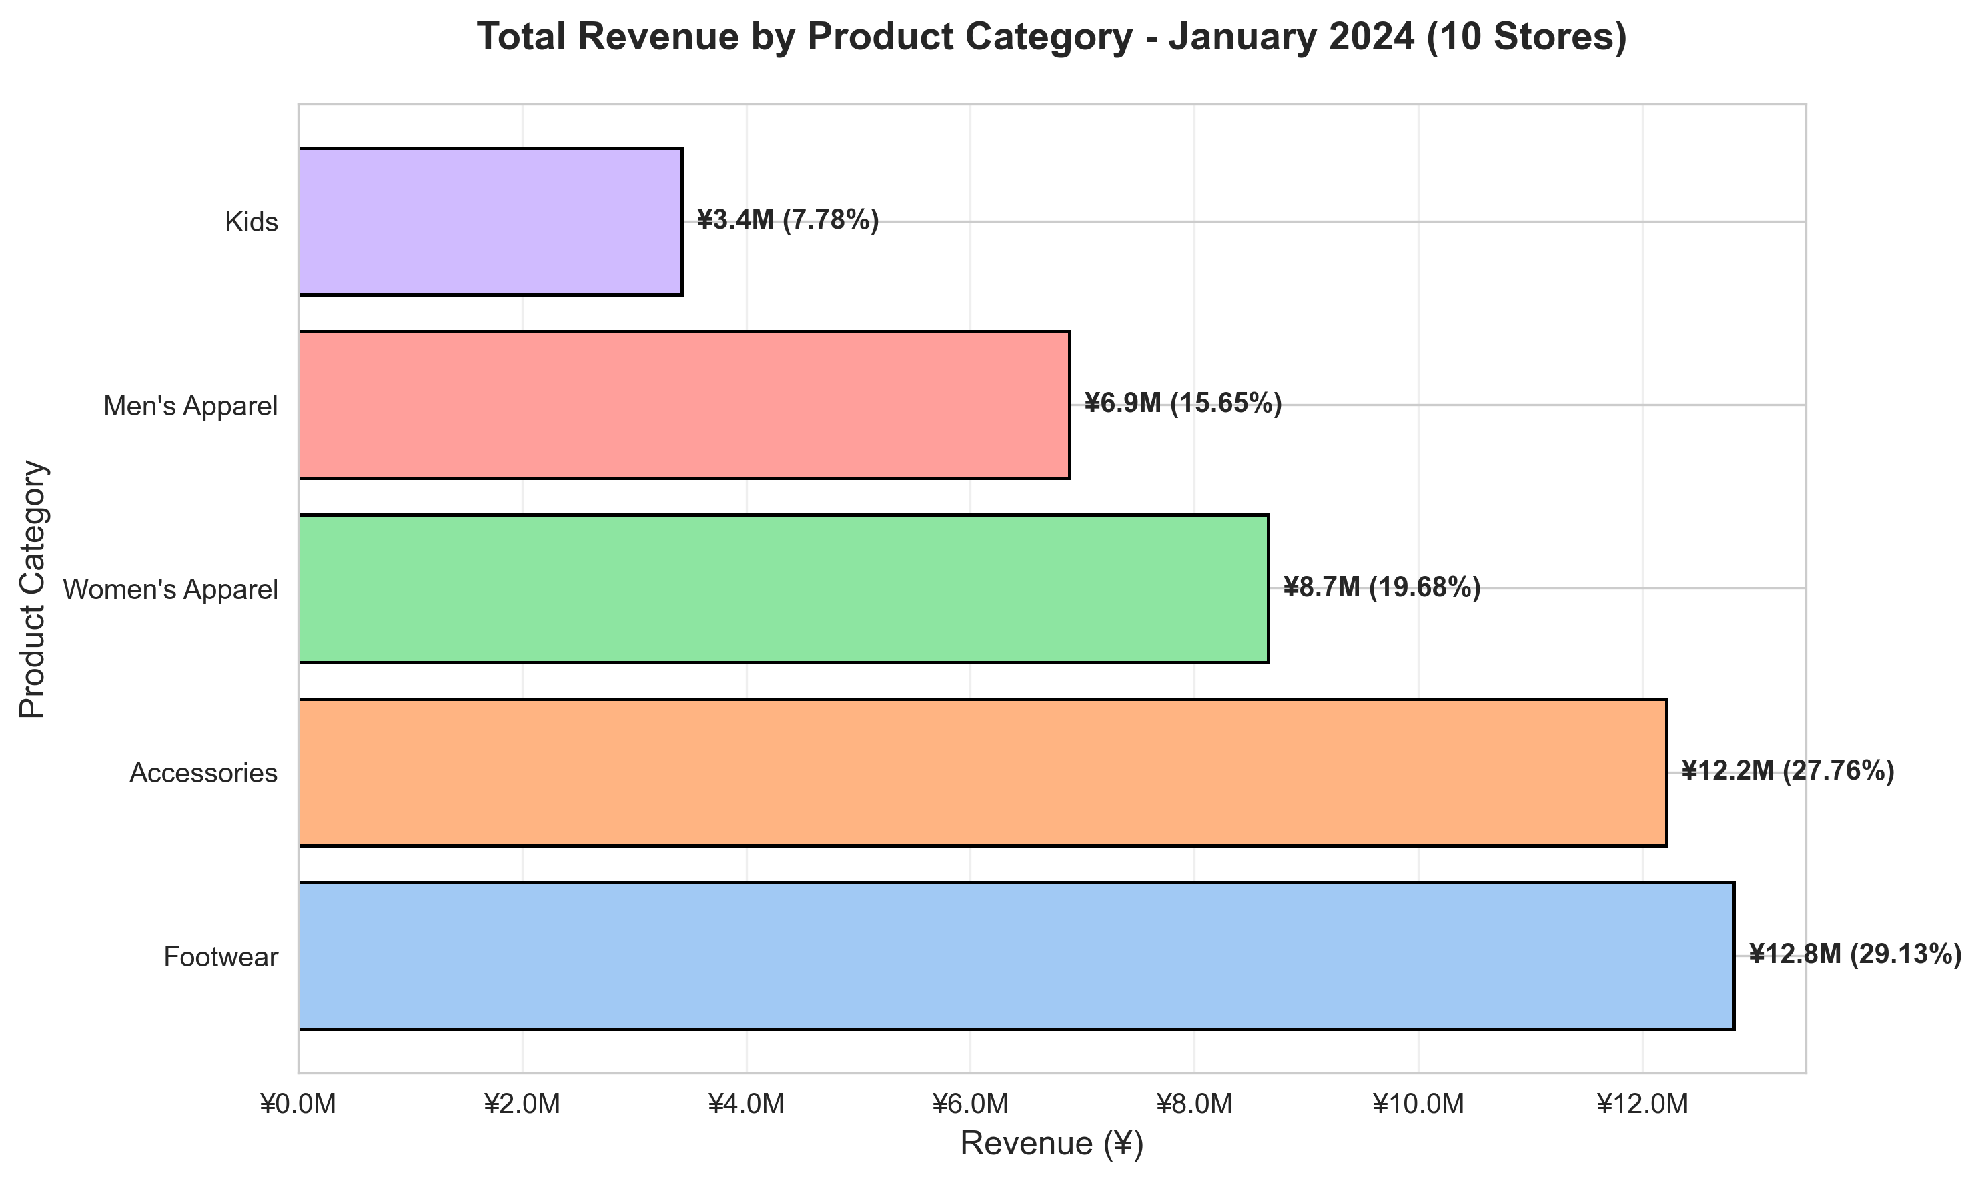
Product Category Performance
Footwear and Accessories together account for 56.9% of revenue

Slide 7
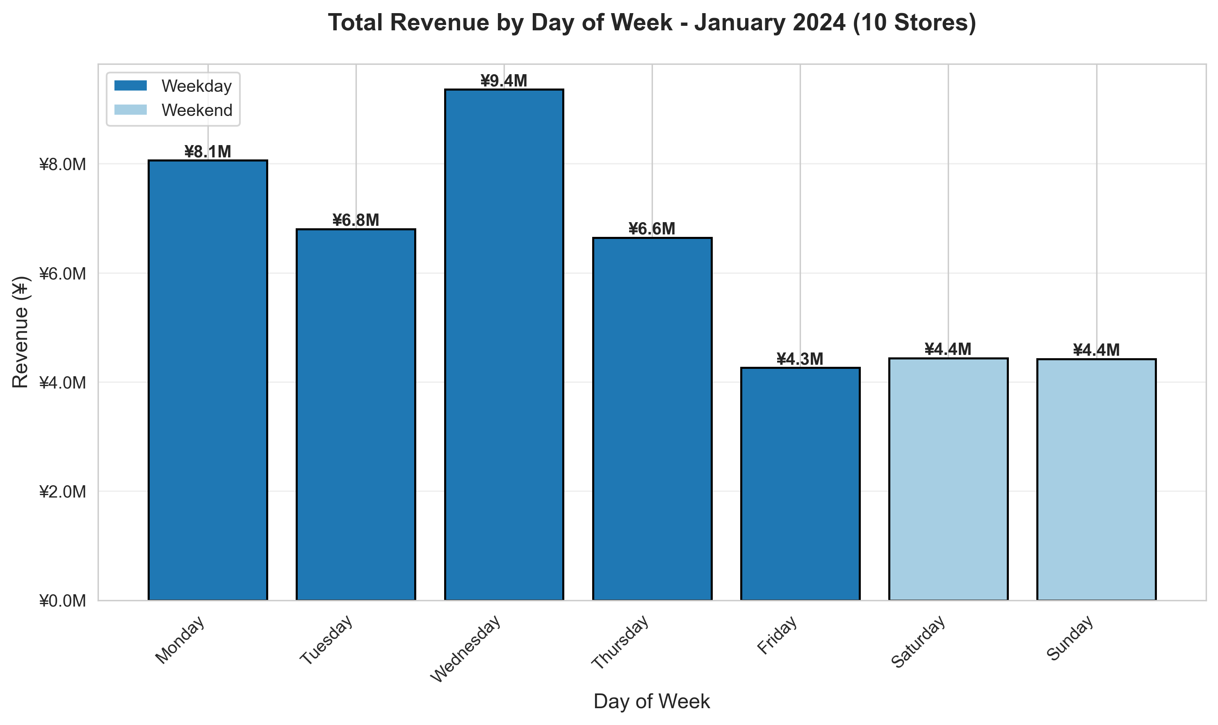
Sales Patterns by Day of Week
Weekdays outperform weekends - opportunity for weekend activation

Slide 8
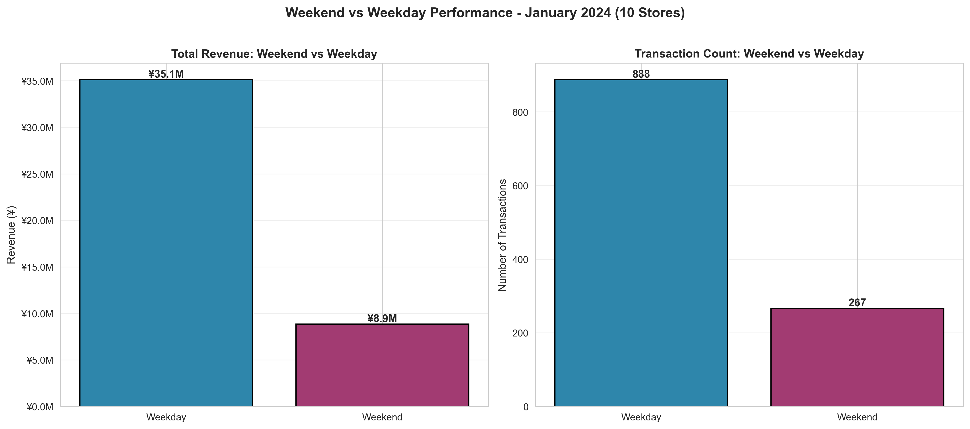
Weekend vs Weekday Performance
Weekdays generate 29% higher daily revenue

Slide 9
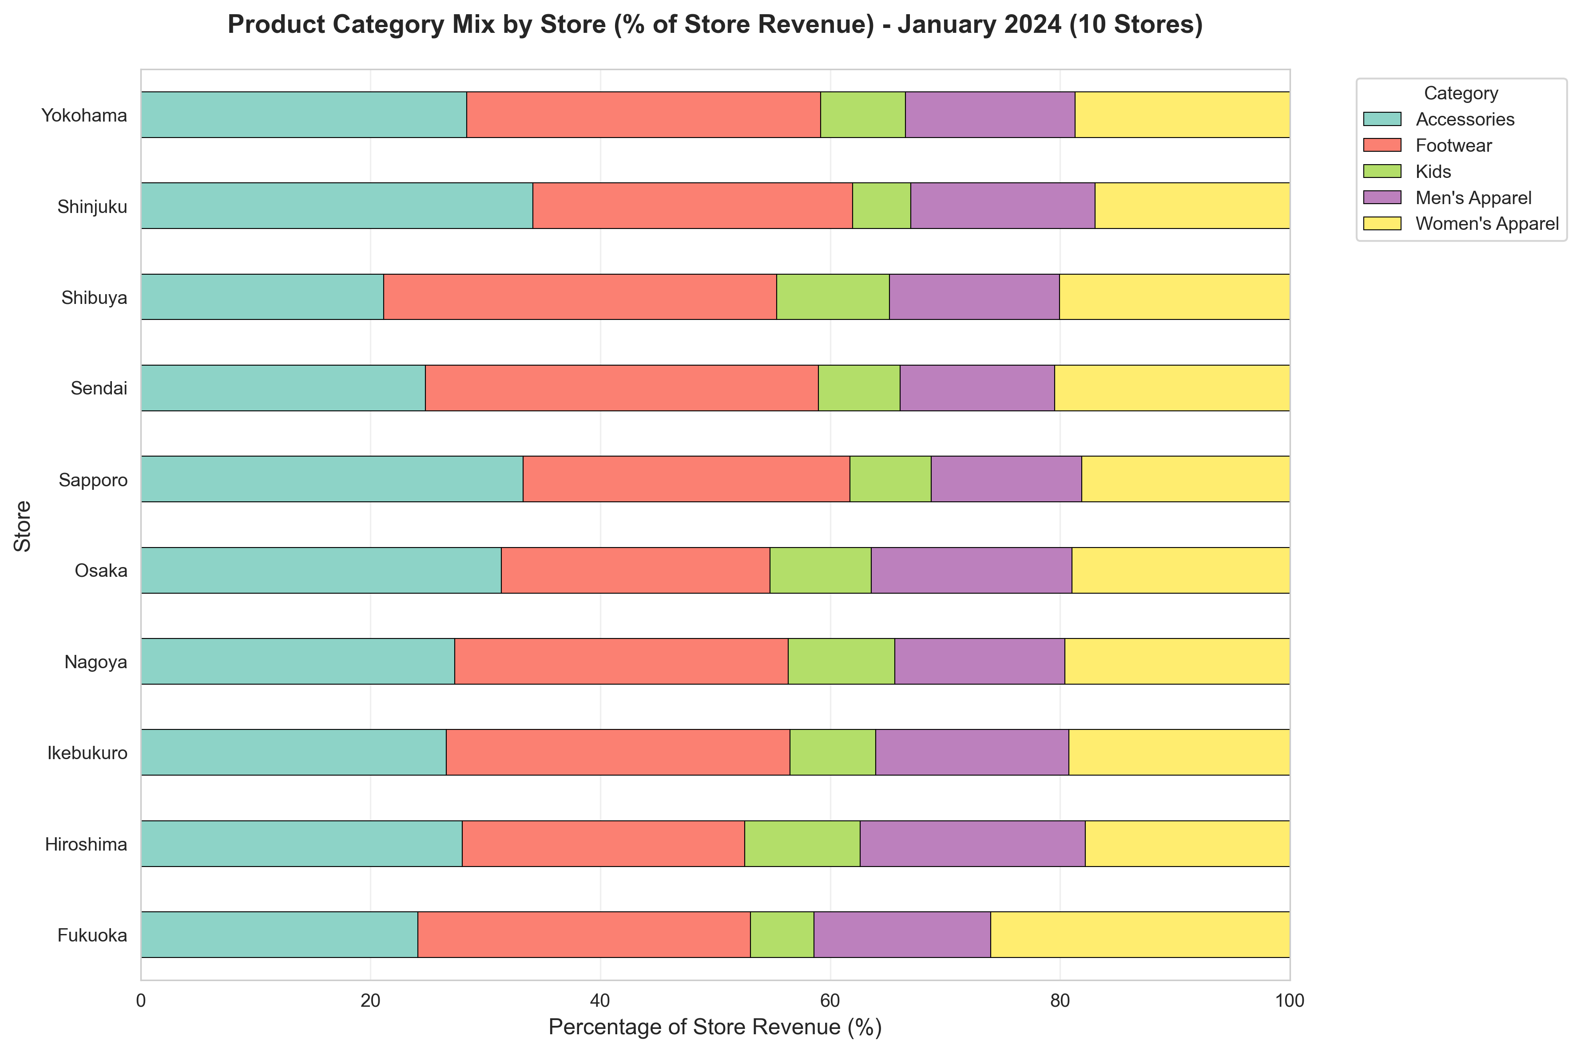
Category Mix by Store
All stores show balanced category distribution

Slide 10
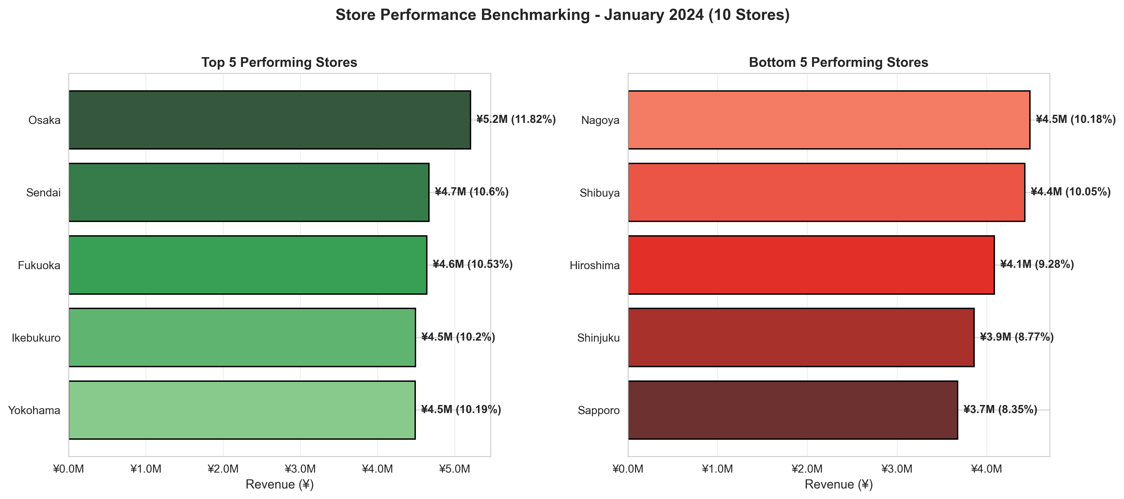
Performance Gap Analysis
42% gap between top and bottom performers presents opportunity

Slide 11
Key Findings
7-region national coverage achieved with 10-store network
¥528M annual revenue run-rate (¥44M monthly)
Consistent footwear strength across all stores indicates solid positioning
Kyushu market entry successful - Fukuoka ranks #3 nationally
Weekend activation opportunity identified

Slide 12
Strategic Recommendations for Q2 2024
Replicate Fukuoka's strong 3rd-place performance in other regions
Expand footwear inventory by 25-30% in Q2 (highest revenue category)
Launch weekend activation initiatives to boost Saturday/Sunday sales
Implement best practice exchange program between top and growth stores
Balance Kanto concentration risk (39% share) with regional diversification

Slide 13
Thank You
Questions?
Ready for Q2 2024 Implementation

