Slide 1

The AMGA metadata catalog – An Overview
Asterios Katsifodimos
Sunday, November 8, 2026
High Performance Computing systems Lab
University of Cyprus
Slides based on:
“AMGA metadata catalog with use cases”
by Tony Calanducci

Slide 2
Outline
Background and Motivation for AMGA
Interface, Architecture and Implementation
Metadata Replication/Federation on AMGA
Use cases

Slide 3
Arda Metadata Grid Application (history)
ARDA proposed an interface for Metadata access on the GRID
  Based on requirements of LHC experiments
  Designed jointly with the gLite/EGEE team
Adopted as the official EGEE Metadata Interface
  Endorsed by PTF (Project Technical Forum of EGEE)
Released on December 07 in gLite 3.1(update 10)
  All the release process was made by HPCL - University of Cyprus
    testing, test scripts, automatic configuration scripts, preparation for gLite environment
  Initial release: glite-AMGA_postgres
  Upcoming release(April 08): glite-AMGA_oracle
    now in preproduction services
  Releases are officially supported by EGEE
    Since the first release

Slide 4
Metadata on the GRID
Metadata is data about data
e.g. On a Data Grid: information about files
  Describe files
  Locate files based on their contents
AMGA makes DB access a simple task on the Grid
  Many Grid applications need structured data
  Many applications require only simple schemas
    Can be modelled as metadata
  Main advantage: better integration with the Grid environment
    Metadata Service is a Grid component
    Grid security
    Hide DB heterogeneity

Slide 5
Metadata user requirements
I want to
  store some information about files
    In a structured way
  query a system about those information
  keep information about jobs
    I want my jobs to have read/write access to those information
  have easy access to structured data using my proxy certificate
  NOT use a database

Slide 6
AMGA Features
Dynamic Schemas
  Schemas can be modified at runtime by client
    Create, delete schemas
    Add, remove attributes
Metadata organised as an hierarchy
  Collections can contain sub-collections
  Analogy to file system:
    Collection ⬄ Directory;
    Entry ⬄ File;
    attribute ⬄ inode information
Flexible Queries
  SQL-like query language
  Joins between schemas
  Example
QUERY EXAMPLE:
selectattr /gLibrary:FileName /gLibrary:Author ‘/gLibrary:FILE=/gLAudio:FILE \
and like(/gLibrary:FileName,“%.mp3")‘

Slide 7
Metadata Concepts
Some Concepts in AMGA:
  Metadata - List of attributes associated with entries
  Attribute – key/value pair with type information
    Type – The type (int, float, string,…)
    Name/Key – The name of the attribute
    Value - Value of an entry's attribute
  Schema – A set of attributes
  Entry – Lives in a schema – assigns values to attributes
  Collection – A set of entries associated with a schema
  Think of schemas as tables, attributes as columns, entries as rows

Slide 8
AMGA data organization
Relational schema
AMGA(hierarchy)
Schema/Directory
TABLE: HOSPITAL
/HOSPITAL/
#name
PATIENTS
DOCTORS
#type
people_group
people_group
Schema/Directory
PATIENTS/
DOCTORS/
TABLE: PATIENTS
Entries
#name | sickness | age
john | malaria | 68
george | otitis | 84
john
george
Collection
Attributes
sickness | otitis
age | 84

Slide 9
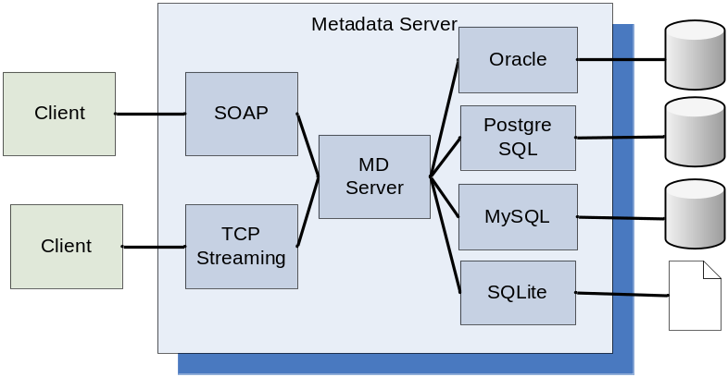
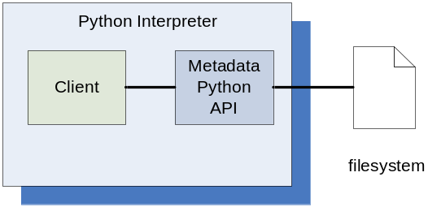
AMGA Implementation
C++ multiprocess server
  Runs on any Linux flavour
Backends
  Oracle, MySQL, PostgreSQL, SQLite
Two frontends
  TCP Streaming
    High performance
    Client API for: C++, Java, Python, Perl, Ruby
  SOAP
    Interoperability
Also implemented as standalone Python library
  Data stored on filesystem

Slide 10
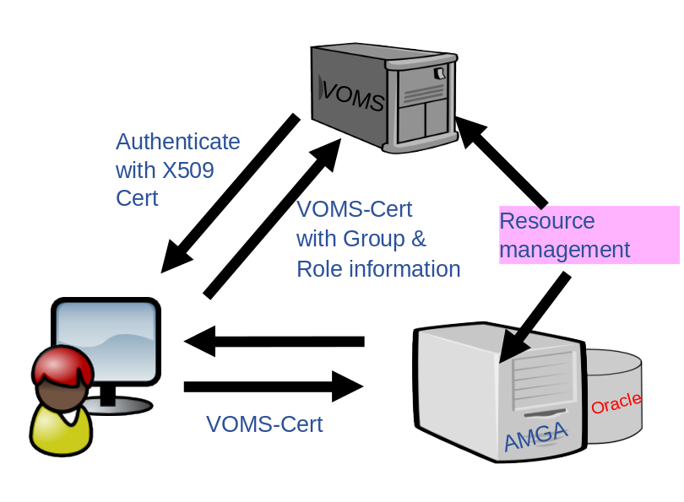
AMGA Security
Unix style permissions
  user-group-others (e.g. rwxr--r--)
ACLs – per-collection or per-entry.
Secure connections – SSL
Client Authentication based on
  Username/password
  General X509 certificates
  Grid-proxy certificates
Access control via a Virtual Organization Management System (VOMS)

Slide 11
Accessing AMGA
TCP Streaming Front-end
  mdcli & mdclient and C++ API (md_cli.h, MD_Client.h)
  Java Client API* and command line* (mdjavaclient.sh & mdjavacli.sh)
  Python* & PHP* Client API
SOAP Frontend (WSDL)
  C++ gSOAP
  AXIS (Java)*
  ZSI (Python)*
*(also under Windows)

Slide 12
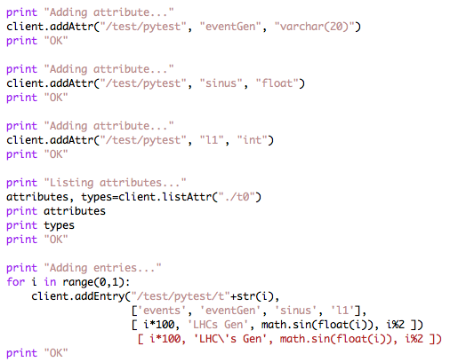
Python API example

Slide 13
AMGA Internals – Backend translation
To better understand how AMGA works
Example:
  $mkdir /hpcl
    INSERT INTO schema(id,name) VALUES(“/hpcl”,”dir2”);
    CREATE TABLE dir2;
  $addattr /hpcl id int
    ALTER TABLE dir2 ADD COLUMN "user:id" integer;
AMGA | DB Backend
Collections | Tables
Entries | Rows
Attributes | Columns

Slide 14
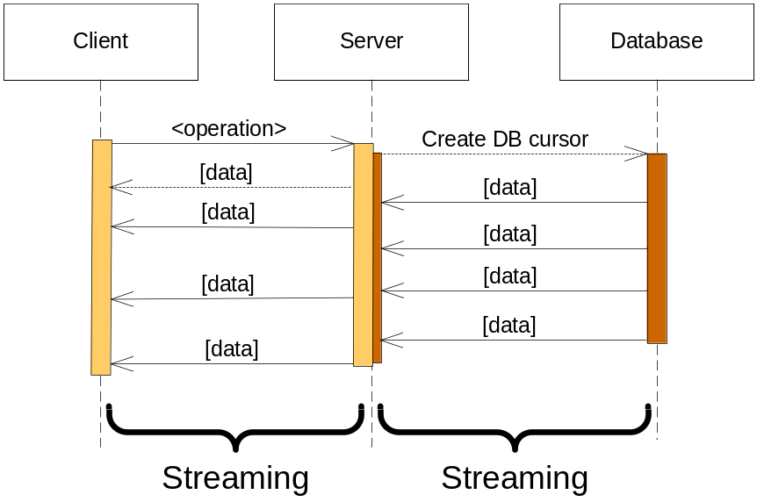
AMGA Internals – TCP-Streaming
Designed for scalability
  Asynchronous operation
    Reading from DB and sending data to client
  Response sent to client in chunks
    No limit on the maximum response size
Example: TCP Streaming
  Text based protocol (like SMTP, POP3,…)
  Response streamed to client
Client: listattr entry
Server: 0
entry
value1
value2
…
<EOT>

Slide 15
Metadata Replication 1/2
Motivation
  Scalability – Support hundreds/thousands of concurrent users
  Geographical distribution – Hide network latency
  Reliability – No single point of failure
  DB Independent replication – Heterogeneous DB systems
  Disconnected computing – Off-line access (laptops)
Architecture
  Asynchronous replication
  Master-slave – Writes only allowed on the master
  Replication at the application level
    Replicate Metadata commands, not SQL → DB independence
  Partial replication – supports replication of only sub-trees of the metadata hierarchy

Slide 16
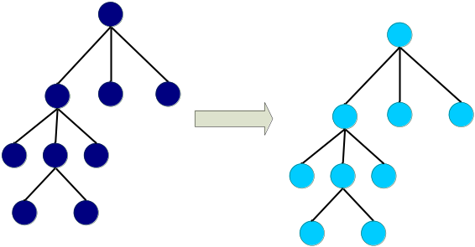
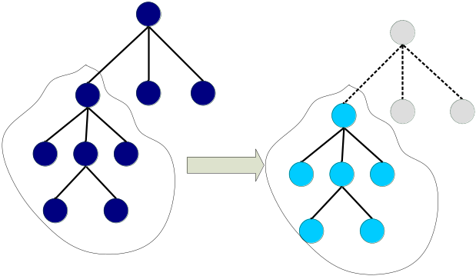
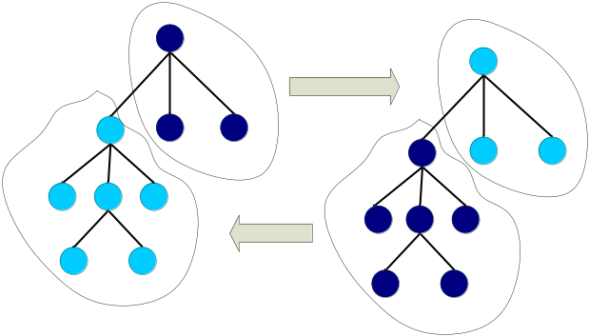
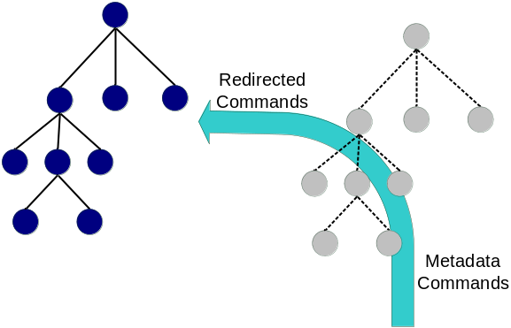
Metadata Replication 2/2
Full replication
Partial replication
Federation
Proxy

Slide 17
Importing existing data
Suppose that you have the data
  A reasonable question would be:
    Can I use my existing database data??
    The answer is YES
Importing data to AMGA
  Pretty simple
  Connect a database to AMGA
    Execute the import command
      import table directory
    Ready to go!

Slide 18
Using AMGA along with an LFC
LFC uses a database backend(commonly MySQL)
AMGA integration on an LFC
  Work on LFC’s database
  Logical File names in LFC → collections,entries in AMGA
  Very nice for managing files & directories
    Every new file entry is also put into AMGA
  BUT
Currently broken feature ☹
  The AMGA developers are working on it

Slide 19
Conclusion (uses cases follow)
AMGA – Metadata Service of gLite
  Part of gLite 3.1
    Officially Supported from EGEE
  Useful for simplified DB access
  Integrated on the Grid environment
    Security (voms proxies, globus proxies)
Replication/Federation features
Tests show good performance/scalability
AMGA Web Site
  http://amga.web.cern.ch/amga/

Slide 20
A generic use case
Use Storage Elements for storing files
Use LFN’s(Logical File Names) for having a file name (storing them on an LFC)
Use AMGA to store metadata about files
Query AMGA using complex queries about files
  I want all files that have:
    type=image AND size > 6kb AND description LIKE “%breast%cancer%”
Use results to retrieve only specific files

Slide 21
AMGA usage examples
Biomed: Medical Data Manager
  Deployed on EGEE production grid
gMOD
  Deployed on GILDA
Notes:
I’ll start by giving a brief overview of what metadata means to the GRID. Then, I’ll present the Metadata Interface developed by ARDA and gLite, which addresses the most common use cases for GRID metadata. I’ll continue by describing the prototype implemented by ARDA to validate this interface. I’ll finish by presenting the results of a performance study made using this prototype, where SOAP is compared with a traditional RPC protocol based on streaming.

Slide 22
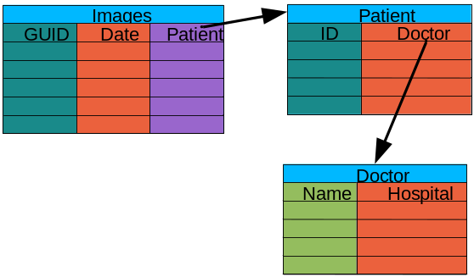
Biomed: Medical Data Manager
Store and access medical images exploiting metadata on the Grid
Strong security requirements
  Patient data is sensitive
  Data must be encrypted
  Metadata access must be restricted
  to authorized users
AMGA used as metadata server
  Demonstrates authentication and encrypted access
  Used as a simplified DB
  NO ENCRYPTION on DB Backend – Anyone interested?
More details at:
  http://www.i3s.unice.fr/~johan/mdm/mdm-051013.pdf

Slide 23
gMOD: grid Movie On Demand
gMOD provides a Video-On-Demand service
User chooses among a list of video and the chosen one is streamed in real time to the video client of the user’s workstation
For each movie a lot of details (Title, Runtime, Country, Release Date, Genre, Director, Case, Plot Outline) are stored and users can search a particular movie querying on one or more attributes
Two kind of users can interact with gMOD: TrailersManagers that can administer the db of movies (uploading new ones and attaching metadata to them); GILDA VO users (guest) can browse, search and choose a movie to be streamed.

Slide 24
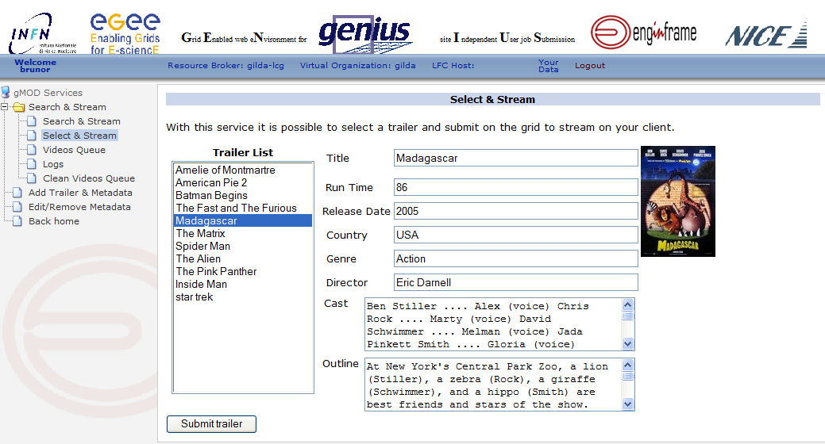
gMOD screenshot
gMOD is accesible through the Genius Portal (https://glite-tutor.ct.infn.it)
Selecting from left side menu: VO Services/gMOD

Slide 25
gMOD under the hood
Built on top of gLite services + GENIUS web portal:
Storage Elements, sited in different places, physically contain the movie files
LFC, the File Catalogue, keeps track in which Storage Element a particular movie is located
AMGA is the repository of the detailed information for each movie, and makes possible queries on them
The Virtual Organization Membership Service (VOMS) is used to assign the right role to the different users
The Workload Management System (WMS) is responsible to retrieve the chosen movie from the right Storage Element and stream it over the network down to the user’s desktop or laptop

Slide 26

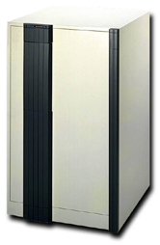
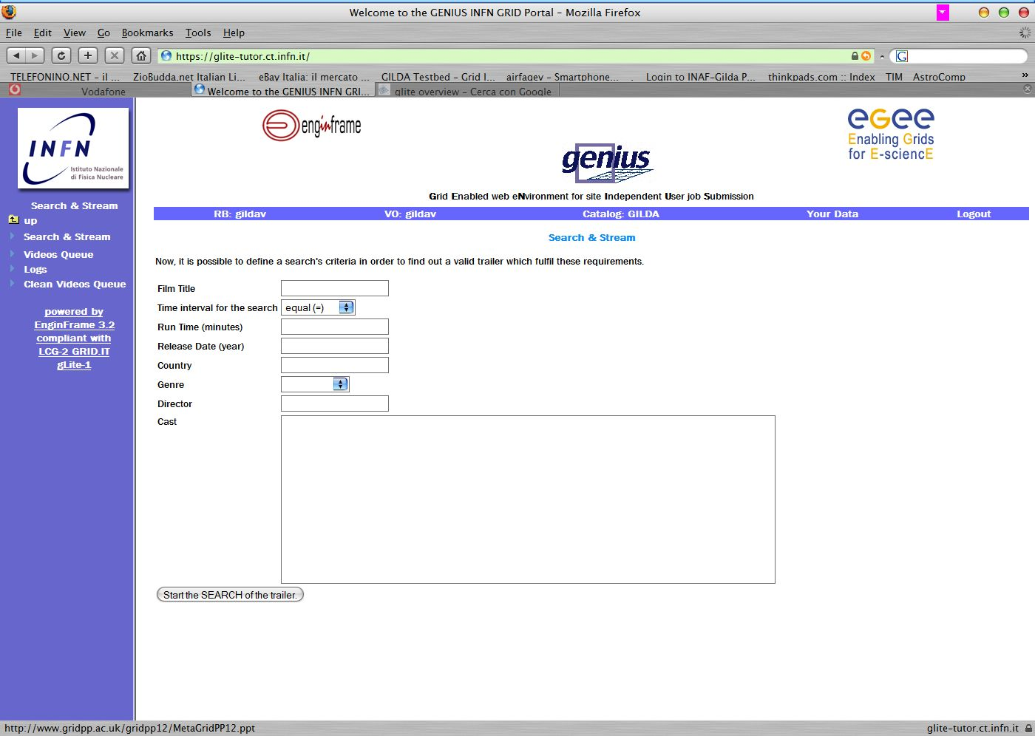




gMOD interactions
VOMS
Metadata
Catalogue
Storage Elements
Genius Portal
AMGA
get Role
LFC
Catalogue
User
Workload Management System
WN
CE
WN
WN

Slide 27
The End
Questions - Discussion

Slide 28
Backup Slides

Slide 29
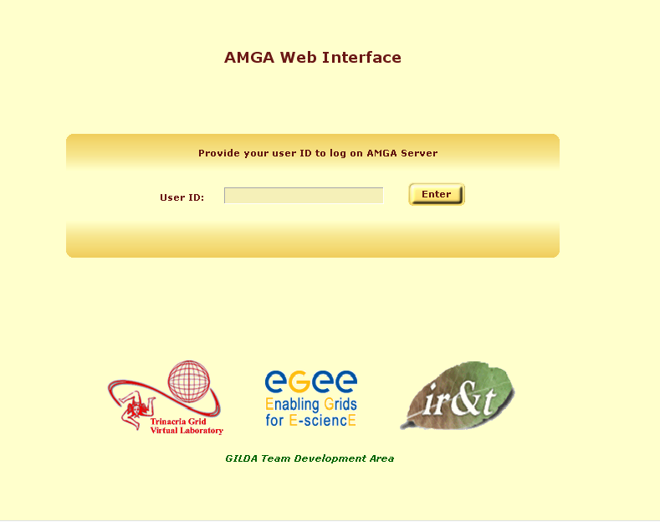
AMGA Web Interface

Slide 30
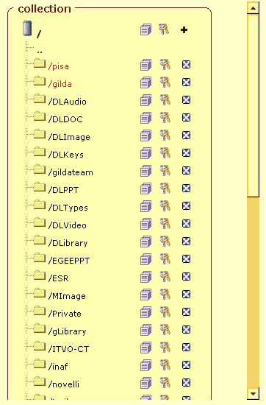
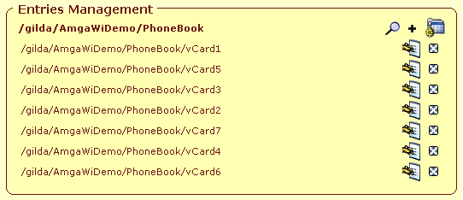
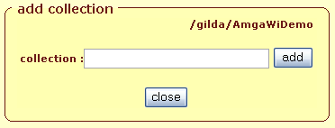
AMGA Web Interface

Slide 31
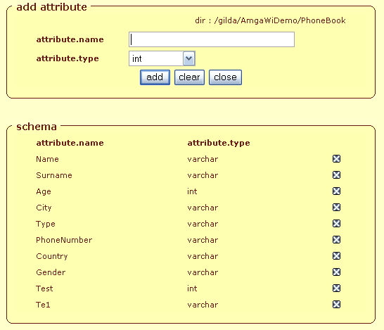
Metadata Schema Management

Slide 32
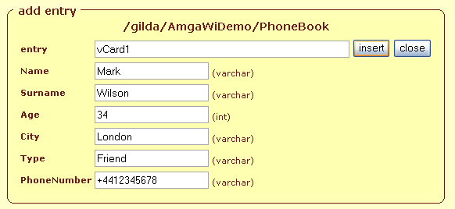
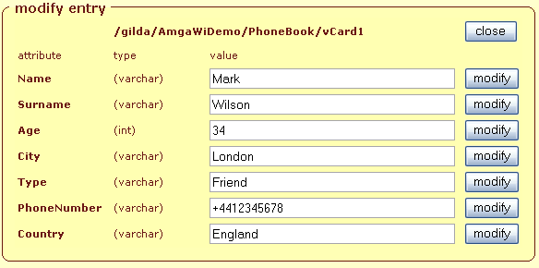
Entry Management

Slide 33
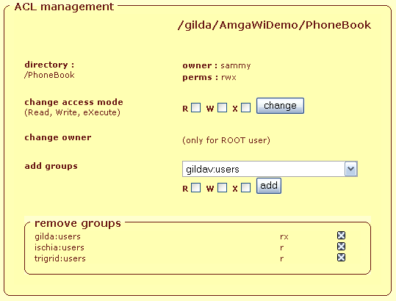
ACL Management

Slide 34
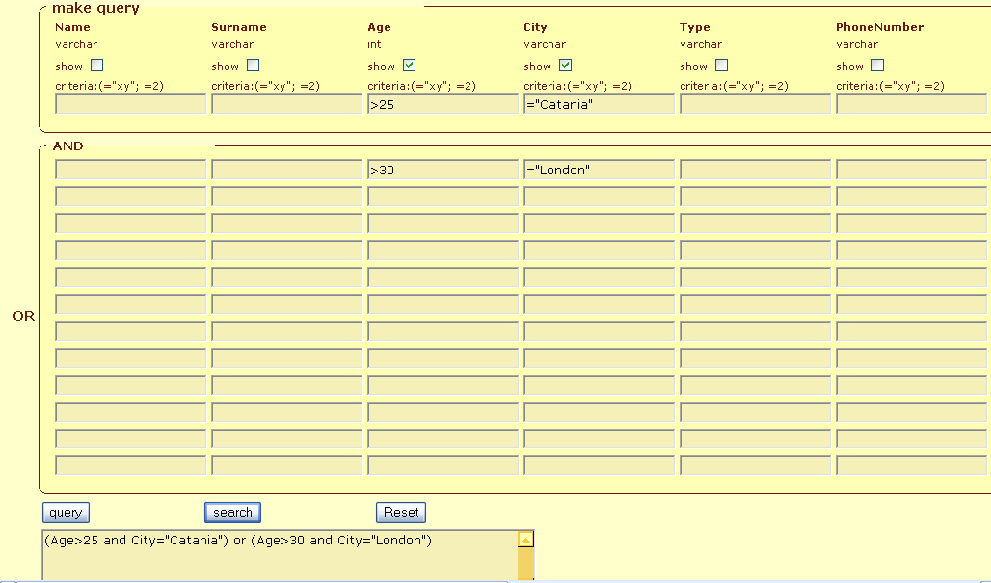
QBE like Query Engine

Slide 35

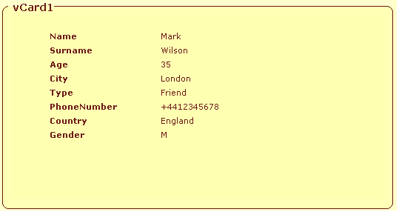
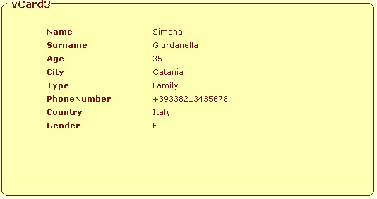
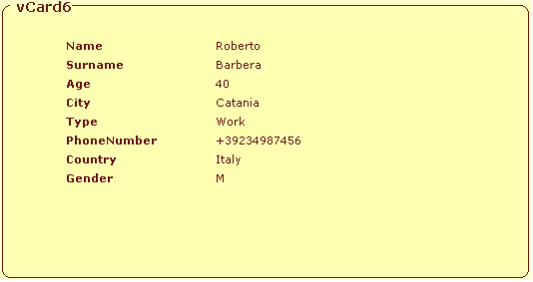
Query Result

