Slide 1
Ganga
A quick tutorial
Asterios Katsifodimos <asteriosk@cs.ucy.ac.cy>
Trainer, University of Cyprus
Nicosia, Feb 16, 2009

Slide 2
Outline
A motivation example
What is Ganga
Basic Ganga Features
Advanced Ganga features
Demo
Asterios Katsifodimos - Nicosia, 16 Feb 2009

Slide 3
Massive job submission
Suppose that you have to send 5000 Jobs
What would you use to send them?
  gEclipse
    Pros:
      Easy to use
      Nice interface
      Automatic job monitoring
    Cons:
      Many number of clicks per job submission
      Manual configuration only
      Cannot handle thousands of jobs!
  Scripts
    Pros:
      Automated tasks
      Can handle massive job submissions
    Cons:
      Have to build own data structures
      Fault tolerant
      Too much debugging
Asterios Katsifodimos - Nicosia, 16 Feb 2009

Slide 4
What do we need?
We need a job submission system that is:
  Easy to use
  Quick
  Extensible
  Command line
  And of course “scriptable”!
We have the solution
  Ganga is a system (and a framework at the same time)
  It allows really massive job manipulation
  It takes care of:
    Monitoring
    Submission
    Resubmission
    Input/output data retrieval
    Is scriptable
    And its a command line tool ☺
Nicosia, 16 Feb 2009

Slide 5
Object Orientated Interactive Job Submission System
The Job Object
  Jobs are created, configured, submitted and when complete, examined.
  They are persistent
    Saved automatically into a Registry
Creation
  On creation each gets unique ID
  This is a serial number that can be used to access the job
Configuration
  At any time can configure all aspects - executable, environment, input and output sandboxes, backend
Cloning
  Having configured one job it can be cloned to create others
Submission
  Job gets submitted to the configured backend(Local, PBS, gLite, EDG, LSF, Condor etc.)
Pulling
  A job puller runs in the background and monitors submitted jobs
  When job is complete it retrieves output and places in the job’s output directory
Resubmit
  If a job fails it can be resubmitted
Removal
Asterios Katsifodimos - Nicosia, 16 Feb 2009

Slide 6
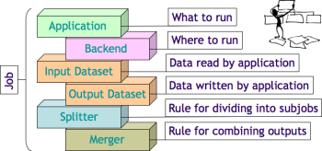
The Job Object
Nicosia, 16 Feb 2009

Slide 7
The Ganga solution
Object Orientated Interactive Job Submission System
  Written in python
  Based on the concept of a job object
Very easy automated install
  It just takes two commands and < 5 minutes!
Multiple job submission backends
  Local, psub, condor, LSF, PBS and of course… gLite(glite-wms-*)
  You can also create your own!
Both standalone and a framework
  Is a complete ready to run system for submitting jobs
  Also Python API on which additional features can be layered
Asterios Katsifodimos - Nicosia, 16 Feb 2009

Slide 8
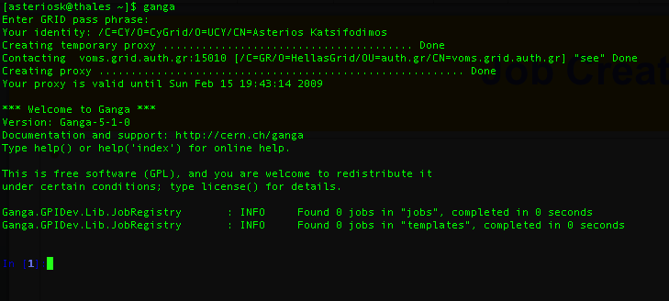
Ganga basics
Entering the iPython Interactive Shell
Asterios Katsifodimos - Nicosia, 16 Feb 2009

Slide 9
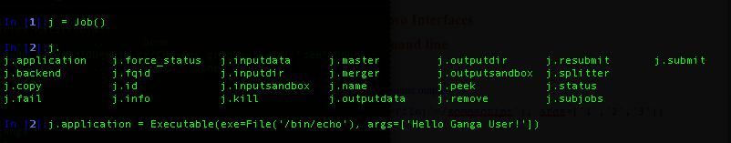
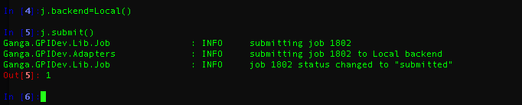
Ganga basics – Creating a job
Creating a Job
Submitting a Job to the local computer
Asterios Katsifodimos - Nicosia, 16 Feb 2009

Slide 10
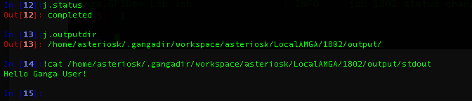
Ganga basics
Monitoring a Job and getting its standard output
Asterios Katsifodimos - Nicosia, 16 Feb 2009

Slide 11
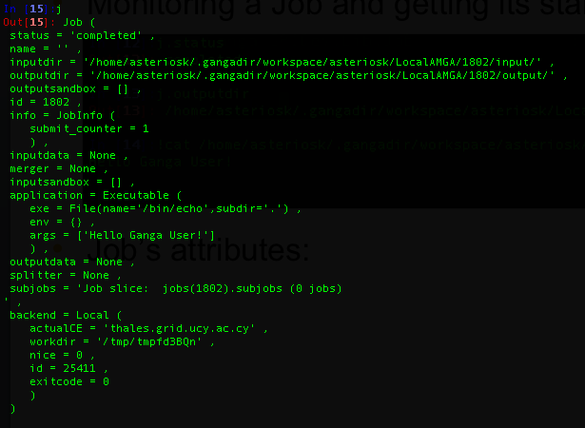
Ganga basics – Job attributes
A Local Job’s Attributes
Asterios Katsifodimos - Nicosia, 16 Feb 2009

Slide 12
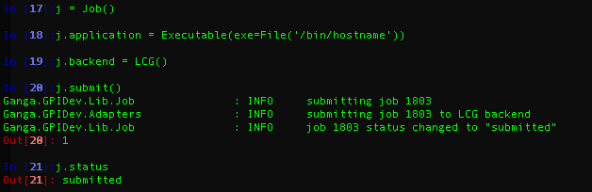
Ganga basics – Job Submission
Submitting a Grid Job
Asterios Katsifodimos - Nicosia, 16 Feb 2009

Slide 13
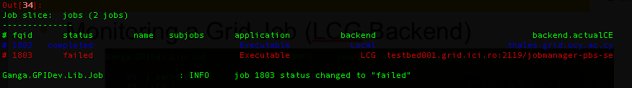
Ganga Basics - Job manipulation
Jobs manipulation
  There are many ways to manipulate jobs
  The best way is the jobs collection
    It can be iterated(with a for loop)
    Jobs can be queried by status, application, name, attributes etc
The “jobs” collection
    Oblect that contains all the jobs and their information
    Every job is automatically added to the collection after its creation
    E.g. In[33]: jobs
    Produces this output:
Asterios Katsifodimos - Nicosia, 16 Feb 2009

Slide 14
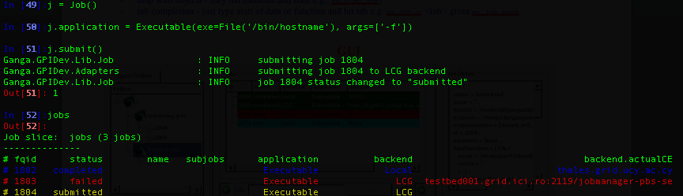
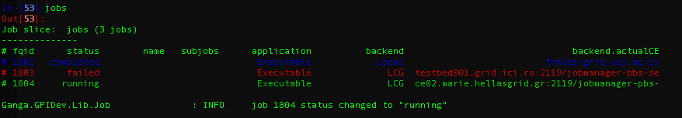
The Jobs Collection
Adding a new job adds it in the collection
The jobs collection is “alive”
  checks for job statuses in the background
Asterios Katsifodimos - Nicosia, 16 Feb 2009

Slide 15
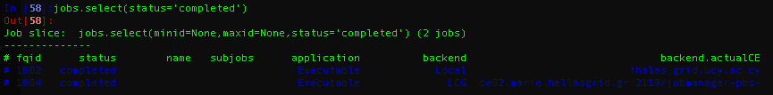
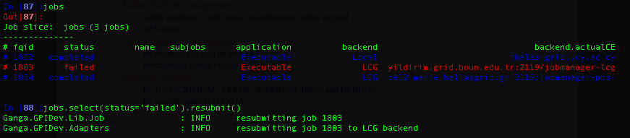
Querying the jobs collection
Jobs collection can be queried using jobs attributes
  Results are also objects that can be manipulated
  Example:
    Show me all the ‘completed’ jobs
    Resubmit all “failed” jobs
Asterios Katsifodimos - Nicosia, 16 Feb 2009

Slide 16
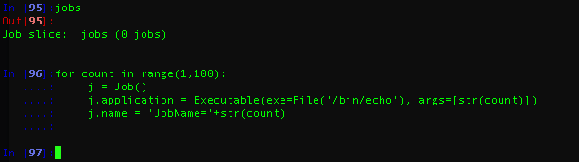
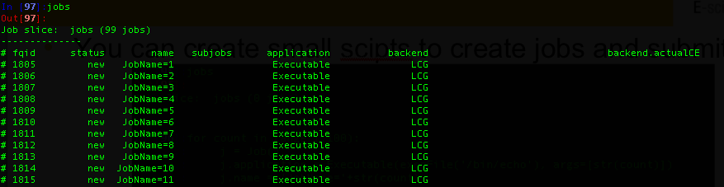
Ganga scripting
You can create small scripts to create jobs and submit them
The result:
Asterios Katsifodimos - Nicosia, 16 Feb 2009

Slide 17
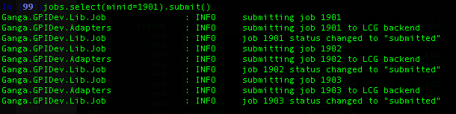
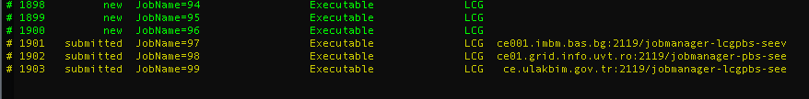
Submitting part of the created jobs
Submit all jobs that their jobid is greater than 1901
Result:
Asterios Katsifodimos - Nicosia, 16 Feb 2009

Slide 18
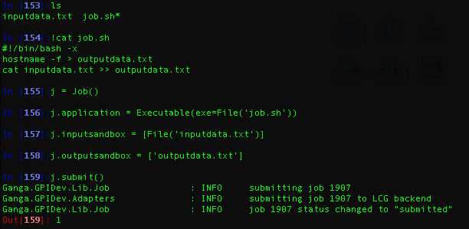
Jobs Input and Output files
Adding input/output files is really simple
Nicosia, 16 Feb 2009

Slide 19
Advanced Ganga Features
Splitters & Mergers
  Jobs can be split into subjobs
  Splitter functions have to be created for you application
  Each subjob takes a part of the dataset and processes it
  When all subjobs of a job are completed the Merger is called
  The merger combines all “splits” and creates the final output
Job trees
  You can organize your jobs in a tree(like directories in your PC!)
  The jobtree object helps you for this
Templates
  Preconfigured jobs
  Create a job template and create jobs with that
    E.g. In[32]: j = Job(jobTemplate)
  E.g. create a job template with all the details (executable, name etc)
    Change only the arguments of the executable
Asterios Katsifodimos - Nicosia, 16 Feb 2009

Slide 20
Ganga GUI
I am so tired by the command line
  Is there any GUI that I can use?
Yes, there is.
  It combines both command line tools
  And a GUI.
Nicosia, 16 Feb 2009

Slide 21

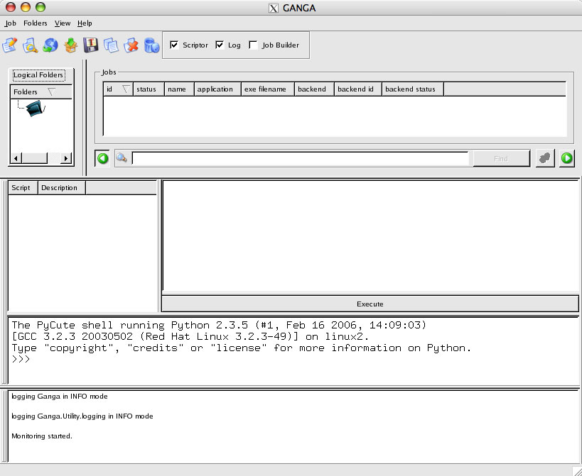
Ganga’s main window
Nicosia, 16 Feb 2009

Slide 22
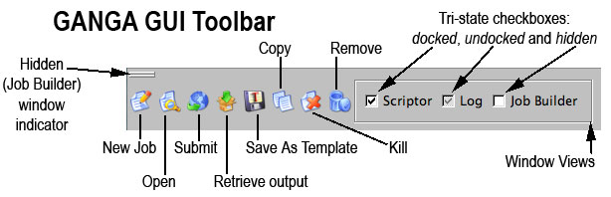
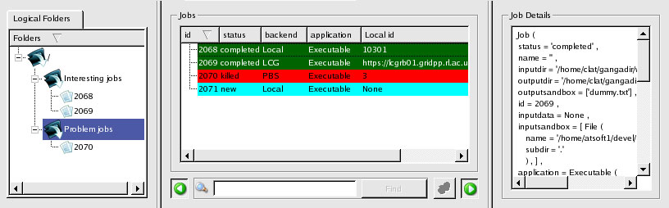
Jobs manipulation and toolbar
Nicosia, 16 Feb 2009

Slide 23
Demo - Discussion
Many thanks for your attention!
Nicosia, 16 Feb 2009

