Slide 1
Minersoft: Searching Software Resources in large-scale Grid and Cloud Infrastructures
Asterios Katsifodimos
High Performance Computing systems Lab

Slide 2

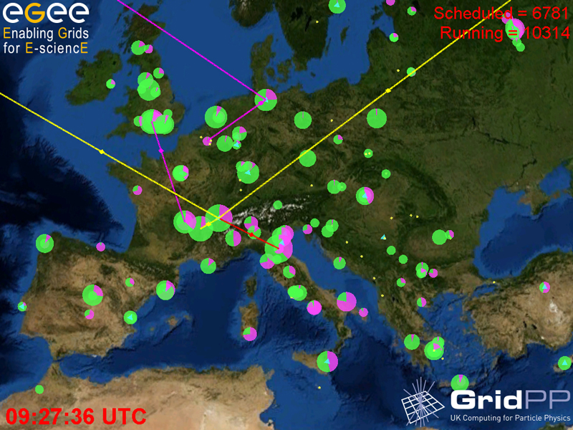
A look at the EGEE Grid
267 sites in 54 countries
~ 114 000 CPUs
> 20 PB storage
~ 20000 users
>152 VOs
Master thesis defence - Sep. 09

Slide 3
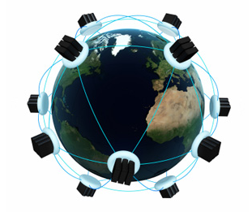

A look at the Cloud
Many Cloud Providers
Centralized datacenters
(Virtually)
Unlimited CPUs & Storage
Instantiation on demand
Pay as you Go
*picture: http://www.onestop.net
Master thesis defence - Sep. 09

Slide 4
How can we search for software that is installed on the sites of a large-scale Grid/Cloud infrastructure?

Slide 5
Software resources and services need to be
easily discoverable by and accessible to end-users
to enhance
inquiries about infrastructure functionality
software reuse
resource selection
Master thesis defence - Sep. 09

Slide 6
What are the options?

Slide 7
Searching for software
The manual way
  In EGEE, a user would have to gain access and search inside the file systems of 267 sites, several of which host well over 1 millionsoftware-related files
  Direct access is impossible, for security reasons
  “grep” does not provide good answers, especially if one is looking for generic information (“find graph analysis software”)
  Traditional file systems provide limited metadata about file types and relationships
  Semantic file systems have been proposed but are not widely adopted
Master thesis defence - Sep. 09

Slide 8
Searching for software (2)
The “Google”way
  Software is not transcribed in HTML, XML, or anything close to natural language
  Files are not accessible via HTTP
  No embedded hyperlinks that could help with result ranking
Master thesis defence - Sep. 09

Slide 9
Searching for software (3)
Through information systems
  Grid Information Services provide some query facilities (LDAP, SQL) but store little, if any, tags about installed software
  Tag setup is manual and often not done at all
  Modeling Grid-related information is not trivial
Master thesis defence - Sep. 09

Slide 10

A Motivation example
A biologist needs a software for protein docking
  He/she searches in a search engine for:
    Protein dock or
    Autodock
  A software search engine responds with the Software found and the Grid Sites where the software is installed
Master thesis defence - Sep. 09

Slide 11
Searching for protein docking software
Minersoft
Autodock protein docking
search
autodock3 [Grid Site1, Grid Site5, etc] dpf3gen [Grid Site1, Grid Site5, etc] …
Master thesis defence - Sep. 09

Slide 12
Challenges
File systems treat software resources as unstructured data and maintain no metadata about installed software.
  The provision of keyword-based search over large, distributed collections of unstructured datahas been identified among the main open research challenges in data management (SIGMOD Records, 2008)
No published information about installed software
Software files come with few or no free-text descriptors
Software resources do not lie in repositories
  They lie into the infrastructures
Master thesis defence - Sep. 09

Slide 13
Definitions
Software resource:
  A software resource is a file that is installed on a machine and belongs to one of the following categories:
    Executables (binaries or scripts)
    Software libraries
    Source codes
    Configuration files
    Unstructured or semi-structured software-description documents (manuals, readme files, etc)
Software Package:
  A software package consists of one or more content or/and structurally associated software resources that function as a single entity to accomplish a task, or group of related tasks.
Master thesis defence - Sep. 09
Notes:
Software components make an application

Slide 14




Related Work on Software Retrieval
Approaches | Corpus | Search paradigm | Software resources
 |  |  | Binaries | Source Codes | Description Docs | Binary Libraries
GURU IEEE Trans.Softw.Eng. 1991 | Software Repositories | Keyword-based
SEC ACM SAC, 2006 | Software Repositories | Keyword-based
Maracatu ACM SAC, 2007 | Software Repositories | Keyword-based
Extreme Harvesting IEEE IRI, 2004 | Web | Keyword-based
SPARS-J IEEE Trans.Softw.Eng. 2005 | Web | Keyword-based
Koders | Web | Keyword-based
Google Code Search | Web | Keyword-based
Sourcerer DMKD, 2009 | Web | Keyword-based
Minersoft | Grid/Cloud | Keyword-based
Master thesis defence - Sep. 09

Slide 15
Our approach
Build a keyword based, fast and precise Software Search Engine for Grid/Cloud Infrastructures
Find a way to:
  “Crawl” a Grid/Cloud Infrastructure
  Detect the Software files/resources
  Classify them into categories
  Find associations between them
  Be able to give answers to keyword based queries
Master thesis defence - Sep. 09

Slide 16
Publications
International Journals:
  “Minersoft: Searching Software Resources in Grid and Cloud Computing Infrastructures”, G. Pallis, A. Katsifodimos, M.D. Dikaiakos, submitted to the “ACM Transactions on Software Engineering and Methodology Journal”.
  “Minersoft: Searching Software Resources in EGEE infrastructure”, G. Pallis, A. Katsifodimos, M.D. Dikaiakos, submitted to the “Grid Computing Journal”, Springer
International Conferences:
  “Effective Keyword search for Software Resources installed in Large-scale Grid Environments”, G. Pallis, A. Katsifodimos, M.D. Dikaiakos: The 2009 IEEE/WIC/ACM International Conference on Web Intelligence (WI2009, acceptance rate 16%), 15-18 September 2009, Milan Italy.
  “Harvesting Large-Scale Grids for Software Resources”,A. Katsifodimos, G. Pallis, M.D. Dikaiakos, 9th IEEE International Symposium on Cluster Computing and the Grid, (CCGrid09, acceptance rate 21%), May 18-21, 2009. Shanghai, China.
National Conferences
  “Minersoft: A Keyword-based Search Engine for Software Resources in Large-scale Grid Infrastructures”,M.D. Dikaiakos, A. Katsifodimos, G. Pallis, : The 8th Hellenic Data Management Symposium (HDMS09), 31 August -1September 2009, Athens Greece.
Other Publication (referred)
  “Searching Software Resources in the Grid”, A. Katsifodimos, G. Pallis, M.D. Dikaiakos, Poster in the 4th EGEE User Forum/OGF 25, March 2-6, 2009, Catania, Italy.
Master thesis defence - Sep. 09

Slide 17
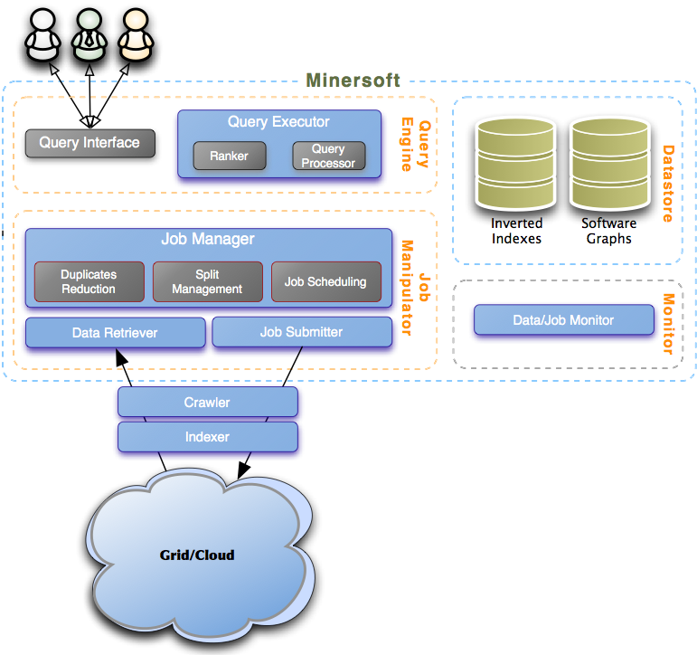
MinerSoft Architecture
Master thesis defence - Sep. 09

Slide 18
The Minersoft workflow
Visit Grid sites/Cloud servers
Construct the file-system tree
Prune unneeded files
Locate file associations
Enrich files with not many keyword descriptors
Construct full text indexes
Be ready to answer queries
Master thesis defence - Sep. 09

Slide 19
Software Graph
Software Graph is a weighted, metadata-rich, typed graph G(V,E)
/
File vertices
Directory vertices
tar
bin
Structural associations
lib
Content associations
tar
tar-2.4.3
tar-2.6
libtar.so
Readme
gzip
libgzip.so
Readme
Readme
tar.h
gzip.h
Master thesis defence - Sep. 09

Slide 20
Software Graph
Each vertexv of the Software Graph G(V,E) is annotated with associated metadata attributes, describing its content andcontext
type (e)
/
w (e) (0 < w ≤ 1)
bin
tar
lib
name
type
tar
tar-2.4.3
libtar.so
tar-2.6
site
Readme
path
gzip
libgzip.so
Readme
Readme
zones
tar.h
gzip.h
Master thesis defence - Sep. 09

Slide 21
Minersoft Algorithm
1. FST construction
/
bin
tar
logs
lib
tar
tar-2.4.3
tar-2.6
libtar.so
Readme
gzip
libgzip.so
Readme
…
Readme
tar.h
gzip.h
…
Master thesis defence - Sep. 09

Slide 22
Minersoft Algorithm
2. Classification & pruning
/
bin
tar
lib
tar
tar-2.4.3
tar-2.6
libtar.so
Readme
gzip
libgzip.so
Readme
Readme
tar.h
gzip.h
…
Master thesis defence - Sep. 09

Slide 23
Minersoft Algorithm
3. Structural dependency mining
/
bin
tar
lib
tar
tar-2.4.3
tar-2.6
libtar.so
Readme
gzip
libgzip.so
Readme
Readme
tar.h
gzip.h
Master thesis defence - Sep. 09

Slide 24
Minersoft Algorithm
4. Keyword scrapping
/
bin
tar
lib
tar
tar-2.4.3
tar-2.6
libtar.so
Readme
gzip
libgzip.so
Readme
Readme
tar.h
gzip.h
Master thesis defence - Sep. 09

Slide 25
Minersoft Algorithm
5. Keyword flow
/
bin
tar
lib
tar
tar-2.4.3
tar-2.6
libtar.so
Readme
gzip
libgzip.so
Readme
Readme
tar.h
gzip.h
Master thesis defence - Sep. 09

Slide 26
Minersoft Algorithm
6.Content association mining
/
bin
tar
lib
tar
tar-2.4.3
tar-2.6
libtar.so
Readme
gzip
libgzip.so
Readme
Readme
tar.h
gzip.h
Master thesis defence - Sep. 09

Slide 27
Minersoft Algorithm
7. Inverted index construction
/
bin
tar
terms | postings
winzip | 1,2,…
octave | 3,6,…
…. | …..
lib
tar
tar-2.4.3
tar-2.6
libtar.so
Readme
gzip
libgzip.so
Readme
Readme
tar.h
gzip.h
Master thesis defence - Sep. 09

Slide 28
Experimental results
The Crawling and Indexing process
We crawled/indexed
  10 Grid sites of the EGEE infrastructure,
  6 cloud servers the Amazon Elastic Cloud and
  4 cloud servers from the Rackspace Cloud
Examined the crawling/indexing rates
Studied the dataset in depth
Evaluated the Software Graph construction algorithm
Master thesis defence - Sep. 09

Slide 29
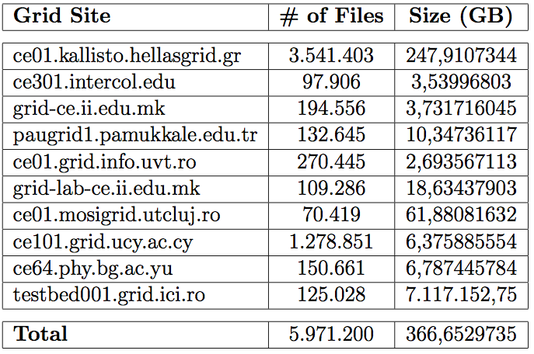
Experimental results
The testbed
Master thesis defence - Sep. 09

Slide 30
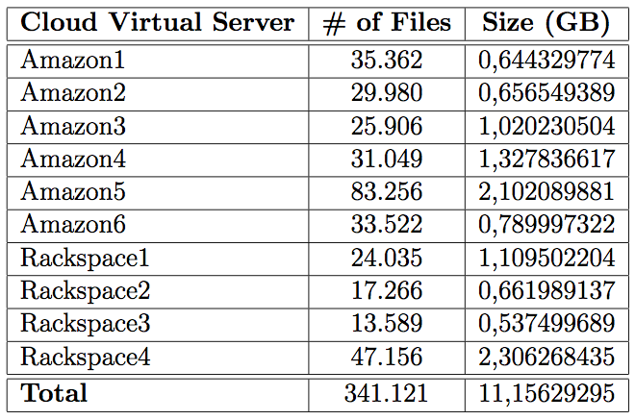
Experimental results
The testbed
Master thesis defence - Sep. 09

Slide 31
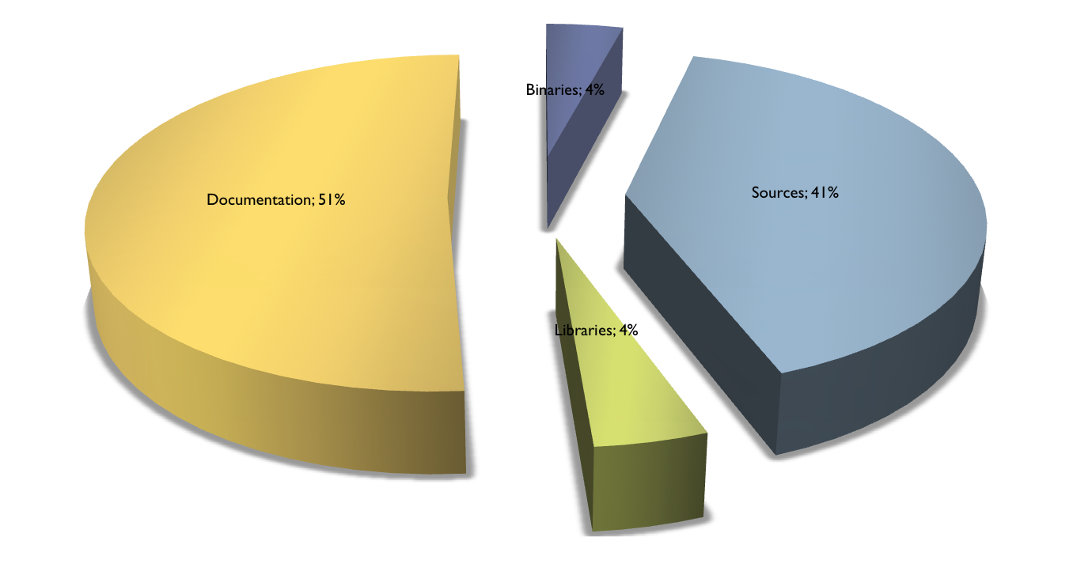
Experimental results
File Categories
Master thesis defence - Sep. 09

Slide 32
The crawling and indexing process

Slide 33
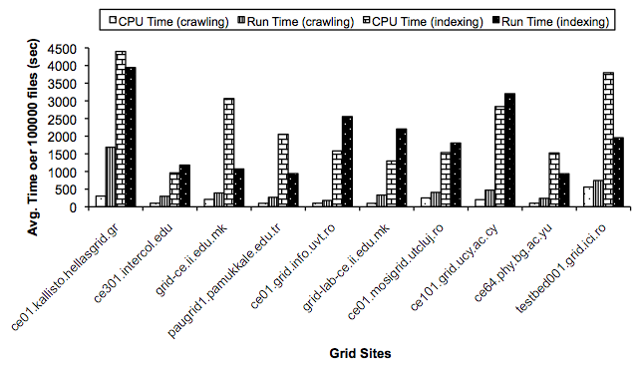
Experimental results
Crawling & indexing time per job
Master thesis defence - Sep. 09

Slide 34
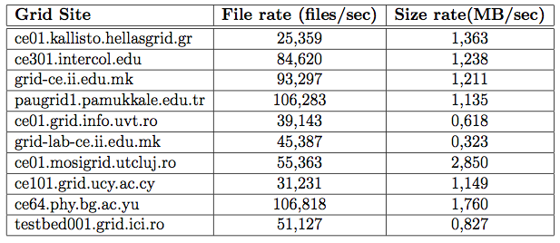
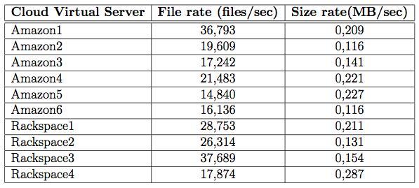
Experimental results
Indexing Rates
Master thesis defence - Sep. 09

Slide 35
Experimental results
Summary
Summary
  Minersoft successfully crawled 6.5 million files (~380 GB size) and sustained, in most sites, high crawling rates
    (In a previous study*, Minersoft crawled 12 Million files, ~600 GBs)
  33% of files belong to more than one Grid sites
  The crawling and indexing is significantly affected by the hardware, file types and the current workload of Grid sites and cloud servers.
  More than 75% of files that exist in the file systems of Grid sites & cloud servers are software files
*“Harvesting Large-Scale Grids for Software Resources”, A. Katsifodimos, G. Pallis, M.D. Dikaiakos, ccGrid2009
Master thesis defence - Sep. 09

Slide 36
Evaluating the Software Graph

Slide 37
Evaluation scenarios
File-search (baseline):
  Full-text content of discovered files, no SG
Context-enhanced search
  File classification, path & content zones included, irrelevant files removed
Software-description-enriched search
  Add documentation zone
Text-file-enriched search
  Add zones with same normalized file/names
name
type
site
path
Content zone
Doc.
zones
Norm. text zones
Master thesis defence - Sep. 09

Slide 38
Evaluation metrics
Relevance judgment
  Measure if search results satisfy user information needs
  User satisfaction:
    non-relevant, relevant
    “very satisfied”, “satisfied” “not satisfied”
Metrics:
  Precision@10: fraction of “relevant” resources
  Cumulative gain measures:
    Take into account ranking of relevant/irrelevant documents in top-K results
    Normalized Discounted Cumulative Gain (NDCG)
    Discounted Cumulative Gain (DCG)
Master thesis defence - Sep. 09

Slide 39
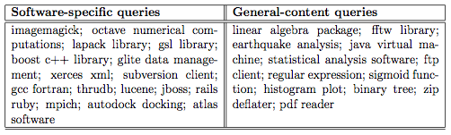
Queries
Master thesis defence - Sep. 09

Slide 40
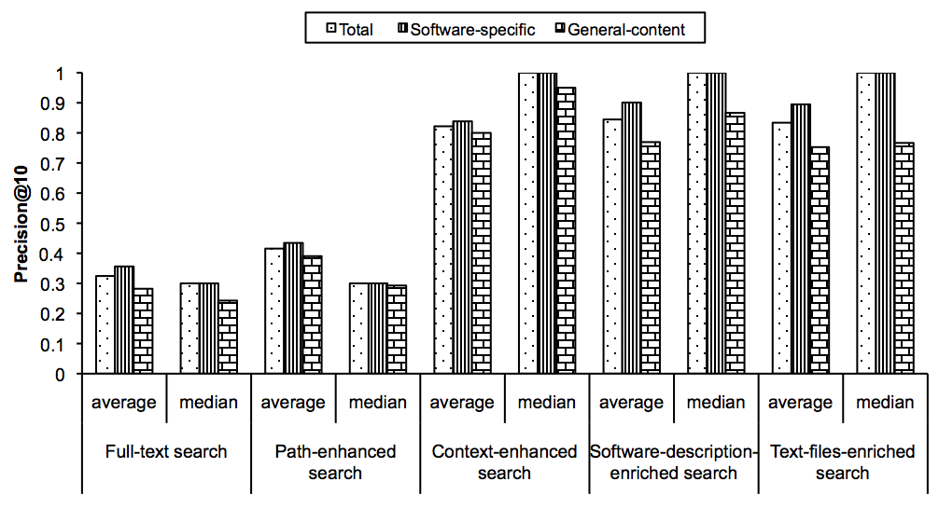
Software Graph evaluation
10-Precision
Master thesis defence - Sep. 09

Slide 41
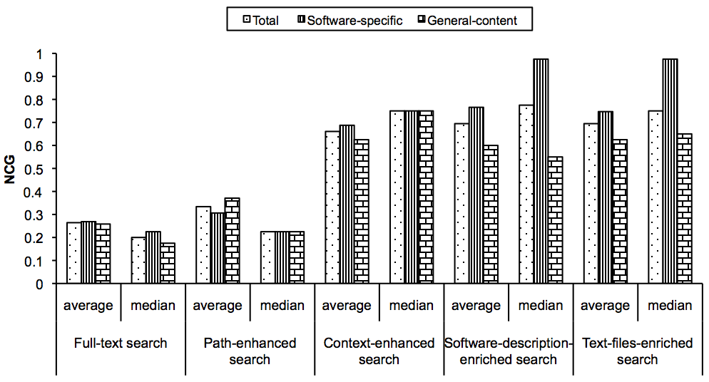
Software Graph evaluation
Normalized cumulative gain (NCG)
Master thesis defence - Sep. 09

Slide 42
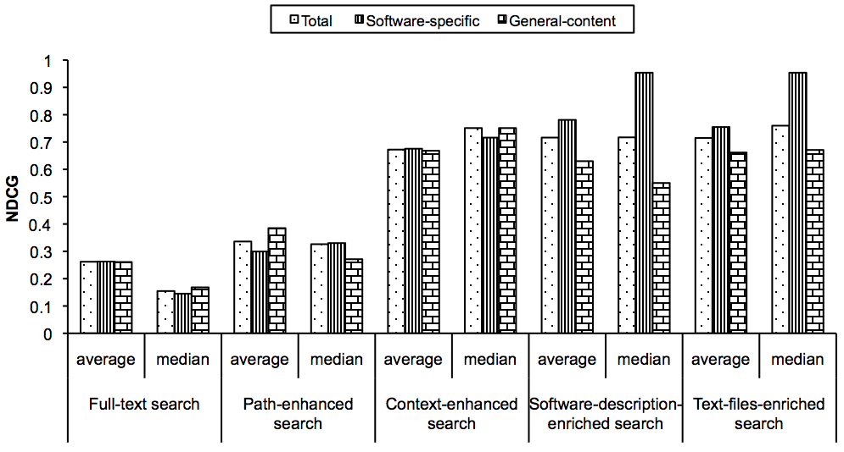
Software Graph evaluation
Normalized discounted cumulative gain (NDCG)
Master thesis defence - Sep. 09

Slide 43
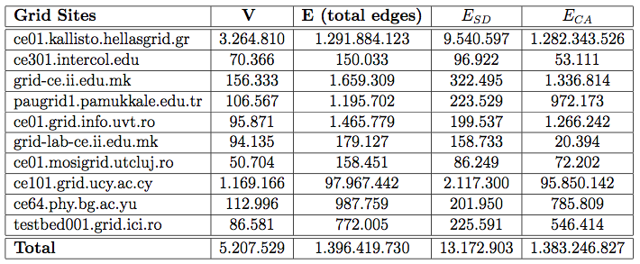
Software Graph Statistics (Grid Sites)
Master thesis defence - Sep. 09

Slide 44
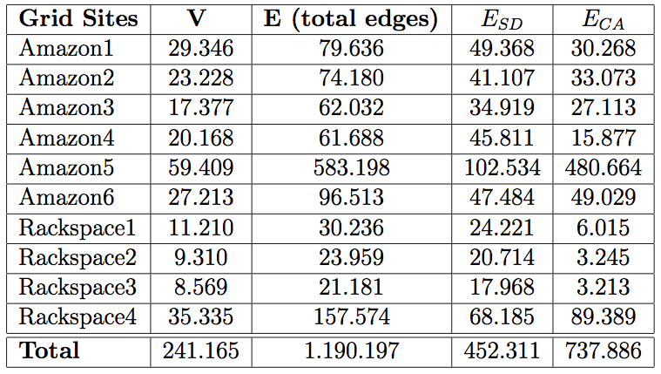
Software Graph Statistics (Cloud Servers)
Master thesis defence - Sep. 09

Slide 45
Summary
Software Graph Evaluation
Minersoft improves the
  Precision@10 about 160% and
  Cumulative gain measures (NDCG, NCG) over 173% with respect to the baseline approach.
Paths of software files in file-systems
  include descriptive keywords for software resources.
Using Stemming
  Deteriorates about about 4% the system’s performance. But
  Decreases the size of inverted indexes about 10%.
Software Graph Statistics
  According to E = V^{a (}a=2 means very dense graph⁾
    1.1 < a < 1.36 (Grid)
    1.1 < a < 1.36 (Cloud)
Master thesis defence - Sep. 09

Slide 46
Thank you!

