Slide 1
Review – 10/12/2020
Design A Robotic Arm
Mentors:
Anand A T
Sandeep Talya
Presented by:
Saurabh Chopade- 99002716
Bhavesh Chavda- 99002715

Slide 2
Index
Problem Statement
Robot Terminology
Concept Generation
Concept Selection Matrix
Terminology and Interface Study (Roboanalyzer)
Material Selection
Sample Calculation and Result
Robot Arm Assembly
Static Analysis
Summary

Slide 3
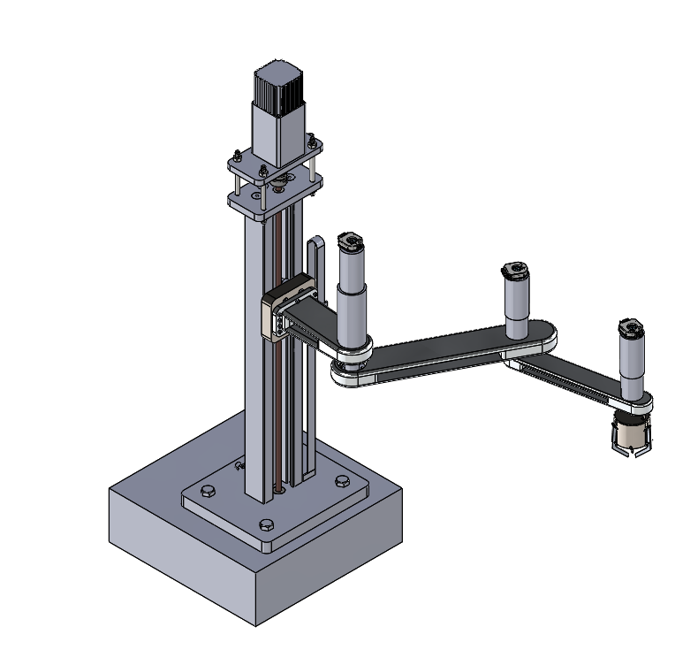
Problem Statement
Design A Robotic Arm
Input Constraints
Robot arm type | RRP (2-Revolute and 1-Prismatic)
Maximum speed of arm | Max. speed up to 1m/s
No. of Axis | 3axis
Weight of Payload | Can lift 1kg
Maximum reach | 600mm

Slide 4
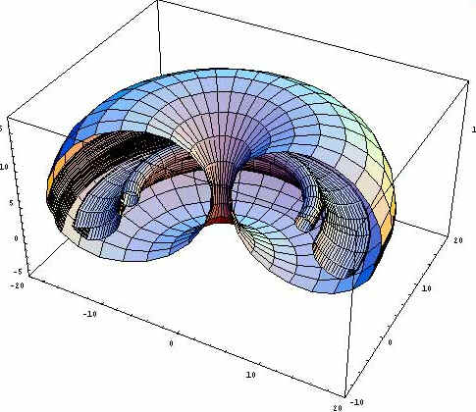
Robotics Terminology
Kinematics: The study of motion without regard to forces.
Two types of Kinematics,
Forward Kinematics : Input as angle between the link and we get output as co-ordinate of end effector.
Inverse Kinematics : Input as co-ordinate of end effector and we get output as angle between the link.
Dynamics: The study of motion with regard to forces.
Workspace: The volume in space that a robot’s end-effector can reach, both in position and orientation.

Slide 5
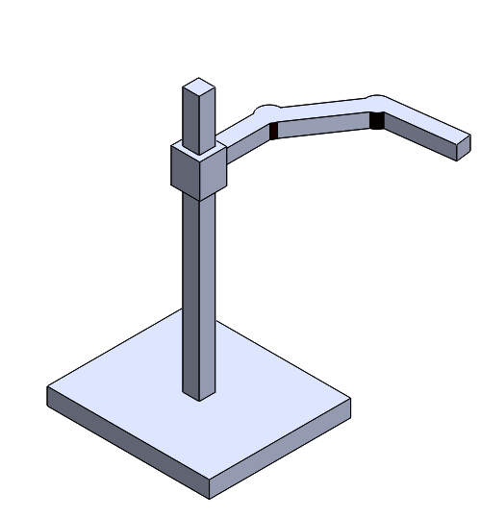
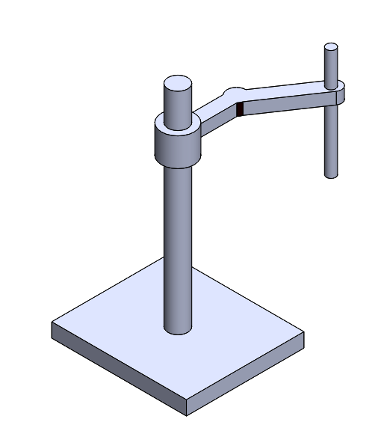
Concept Generation (1/2)
Revolute Joint 2
Revolute Joint 1
Prismatic Joint
Revolute Joint 2
Revolute Joint 1
Prismatic Joint
Concept 1
Concept 2

Slide 6
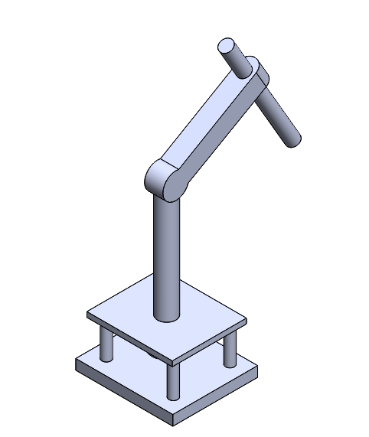
Concept Generation (2/2)
Prismatic Joint
Revolute Joint 2
Revolute Joint 1
Concept 3

Slide 7
Concept Selection
Parameter | Weightage | Concept 1 | Concept 2 | Concept 3
Speed | 5 | 3*5 | 3*5 | 2*5
Accuracy | 4 | 3*4 | 3*4 | 2*4
Lifting Capacity | 3 | 3*3 | 2*3 | 2*3
Up and Down Traverse | 2 | 3*2 | 1*2 | 3*2
Right and Left Traverse | 1 | 2*1 | 2*1 | 3*1
Total |  | 44 | 37 | 33
Property | Weightage
Best | 3
Better | 2
Good | 1

Slide 8
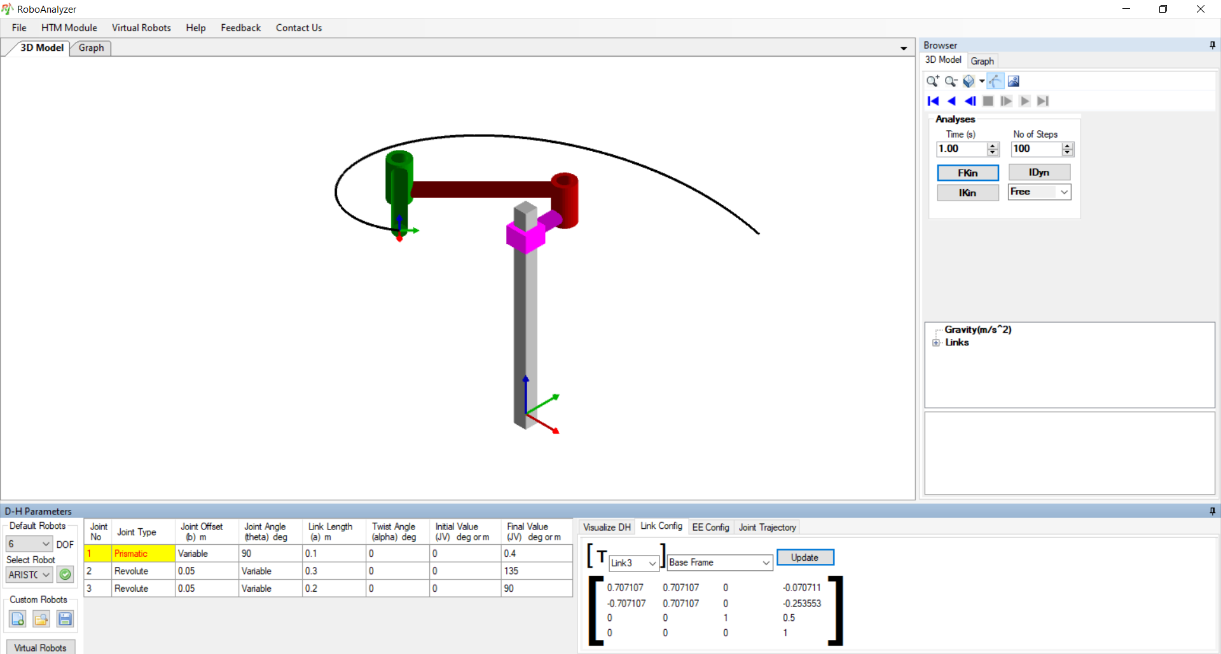
Terminology and Interface Study (Roboanalyzer)
Forward Kinematics
Work Interface
Inverse Kinematics
Forward Kinematics output Matrix

Slide 9
Material Selection (1/3)
Parameter | Weightage for parameter | Carbon Steel | Aluminum | ABS
Weight | 5 | 1*5 | 2*5 | 3*5
Strength | 4 | 3*4 | 2*4 | 1*4
Cost | 3 | 2*3 | 3*3 | 2*3
Manufacturability | 2 | 3*2 | 3*2 | 2*2
Corrosion Resistance | 1 | 3*1 | 3*1 | 3*1
Total |  | 32 | 36 | 32
Property | Weightage
Best | 3
Better | 2
Good | 1

Slide 10
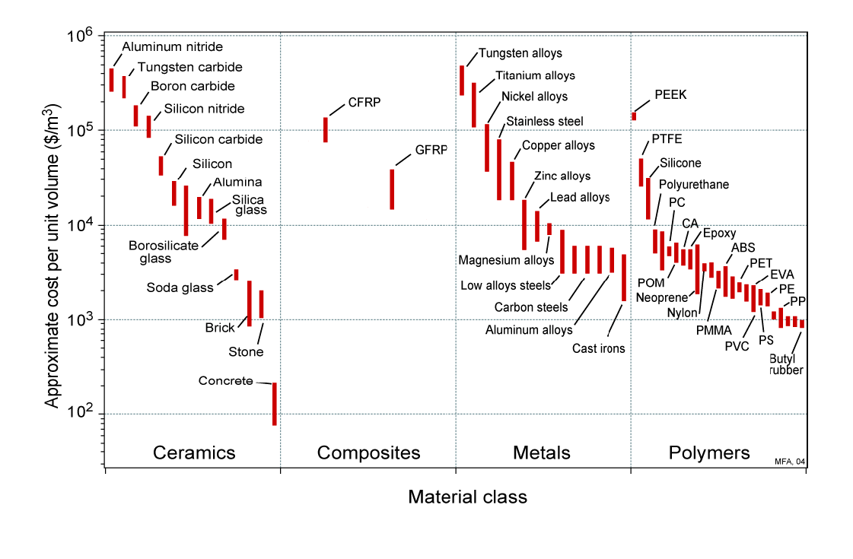
Material Selection (2/3)
Ashby Material Selection Chart

Slide 11
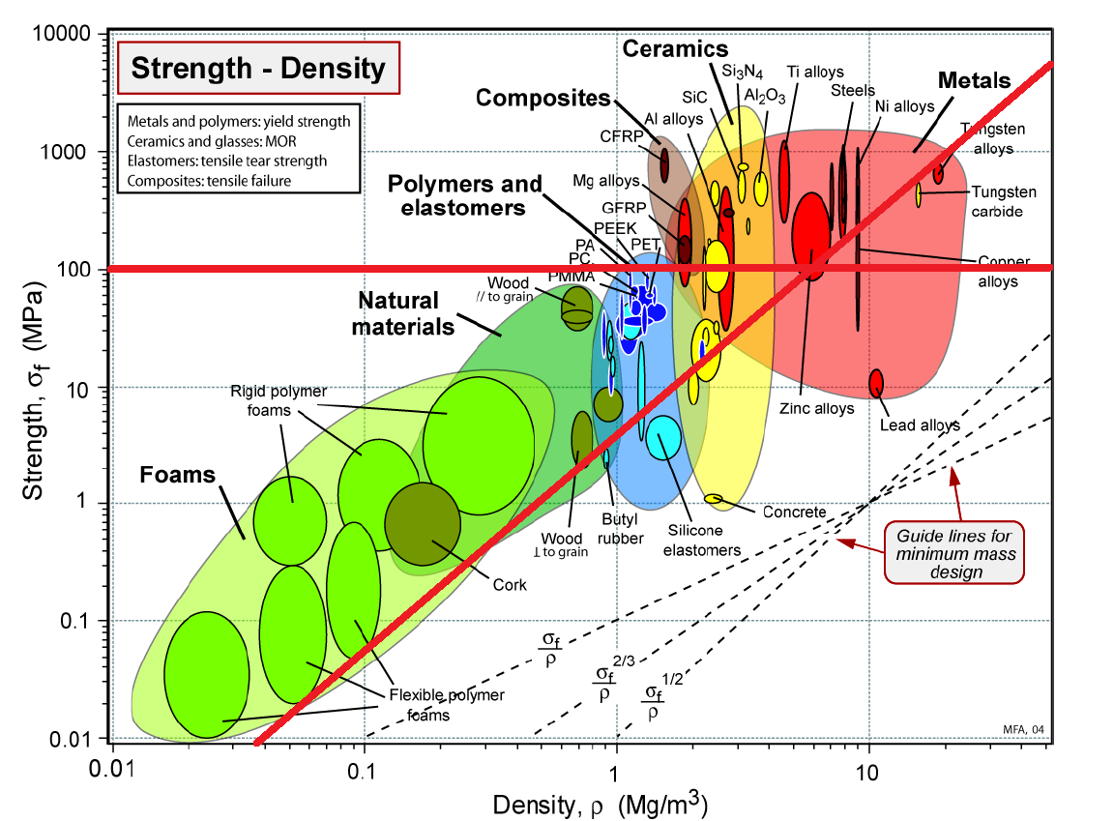
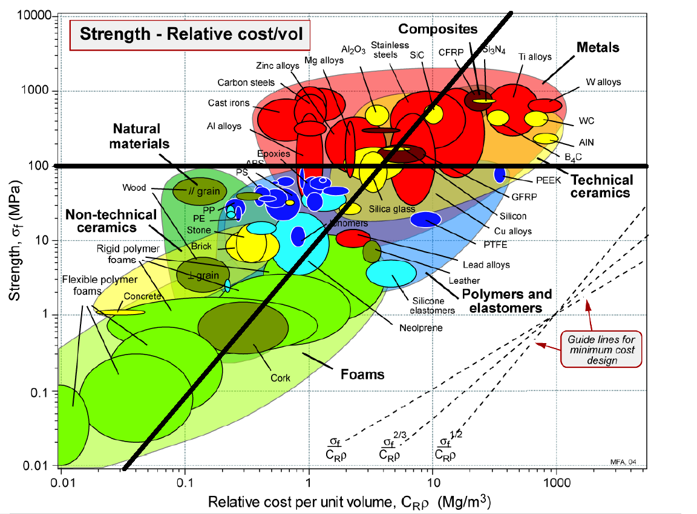
Material Selection (3/3)
Ashby Material Selection Chart

Slide 12
Sample Calculation and Result (1/6)
M1
Revolute Joint 1
Revolute Joint 2
M4
Prismatic Joint
M2
M3
L1
L2
L3

Slide 13
Sample Calculation and Result (2/6)
Sr.No. | Component | Mass (Kg) | Length(mm)
1 | Link 1 | 0.59 | 150
2 | Link 2 | 0.913 | 250
3 | Link 3 | 0.42 | 200
4 | Motor 1 | 1.62 | -
5 | Motor 2 | 1.17 | -
6 | Motor 3 | 0.49 | -
7 | Gripper + Motor 4 | 0.6 | -
8 | Payload | 3 | -

Slide 14
Sample Calculation and Result (3/6)
Torque for Motor 2
Mass of Motor =M
Mass of Link = m
Mass of Gripper = mg
Torque = {[(M4+mg) x (L2+L3 )] + [(m3) x (L3/2+L2)] + [(M3) x (L2)] + [(m2) x (L2/2)]} x g
= {(3.6 x 0.45) + (0.42 x 0.35) + (0.49 x 0.25) + (0.9 x 0.125)} x 9.81
Torque = 19.64 N.m
Torque for Motor 3
Torque = 7.5 N.m

Slide 15
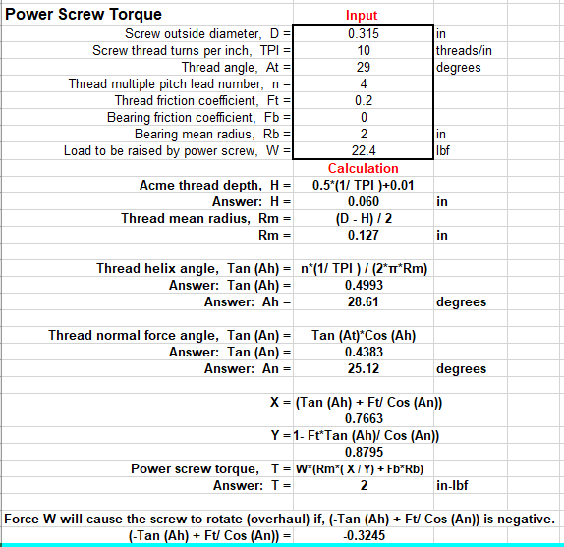
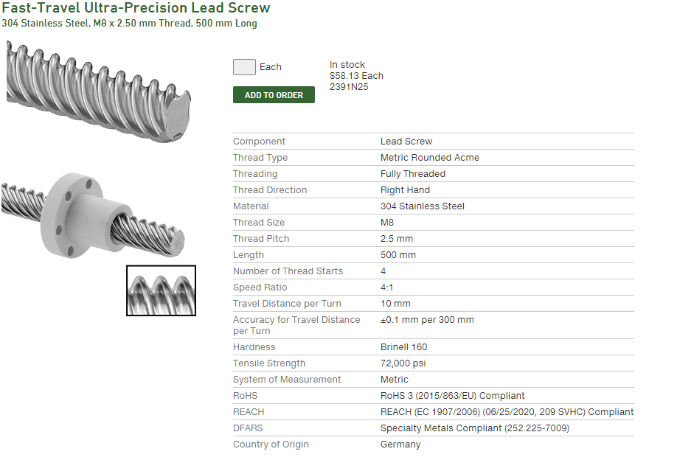
Sample Calculation and Result (4/6)
Torque = 0.22N.m
Torque Required = 0.22*FOS=0.66 N.m (Motor 1)

Slide 16




Sample Calculation and Result (5/6)
f
Gripper Calculation
Friction Force Calculation
F
N
$$θ$$
28.5 mm
30N
Friction Force =
$\frac{Weight of Payload}{3}$ = 10 N
29 mm
$$Friction Force= μ ×Normal Force$$
$$For aluminium μ=0.9$$
$$Normal Force= \frac{10}{0.9}=11.11 N ≈12 N$$
12N

Slide 17
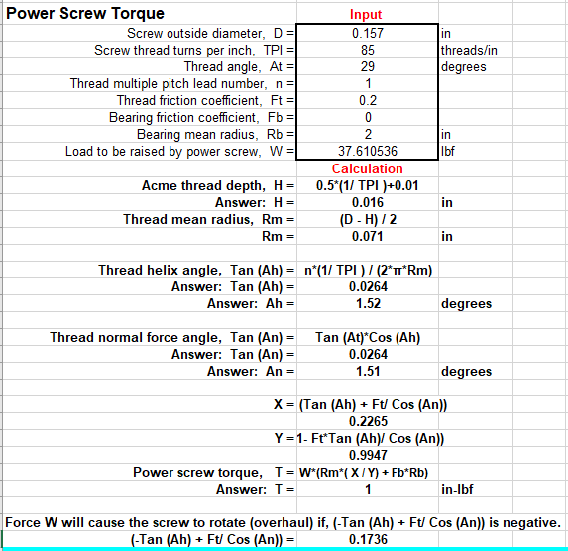
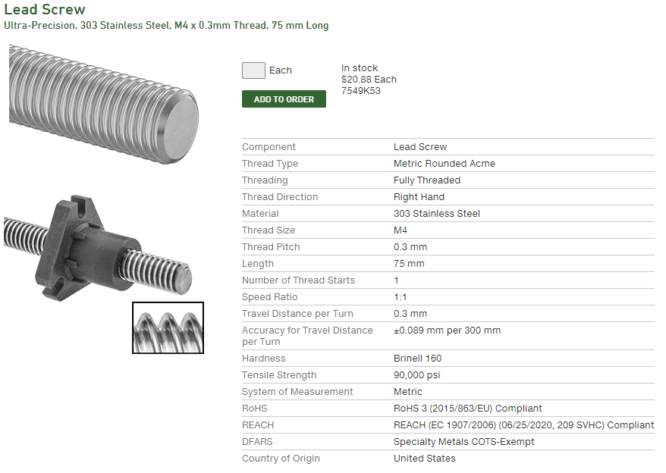





Sample Calculation and Result (6/6)
$$Fcosθ \left(28.5\right)−Fsinθ\left(1\right) − 12(29) =0$$
When gripper if fully open $θ$ = 83.83°
$3.063$F - 0.99F = 348
$$F=167.87N$$
Hence,
$$F_{v}=F\sin{θ=}166.89N$$

Slide 18
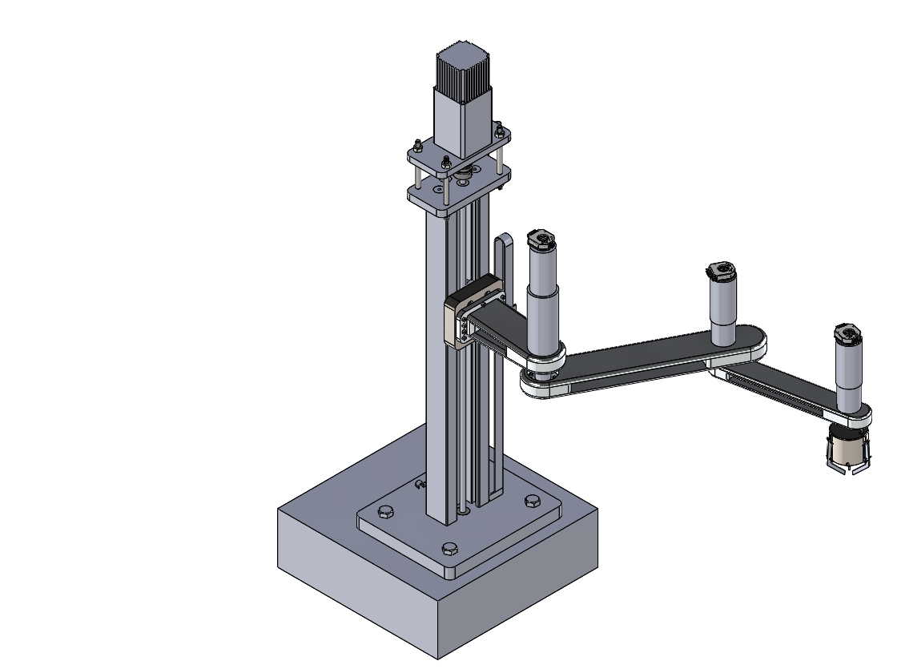
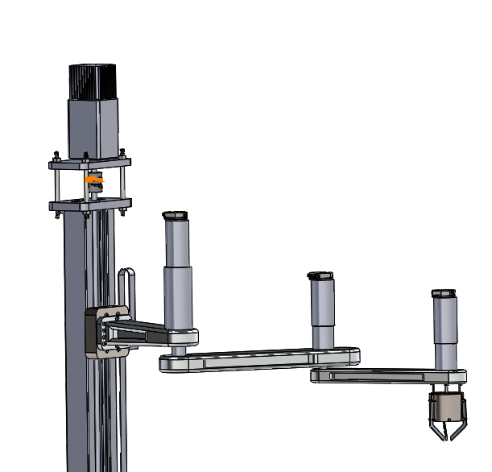
Robot Arm Assembly(1/3)
Motor 1
Middle Link
Motor 2
Motor 3
First Link
Motor 4
End Link
3 Finger Gripper

Slide 19
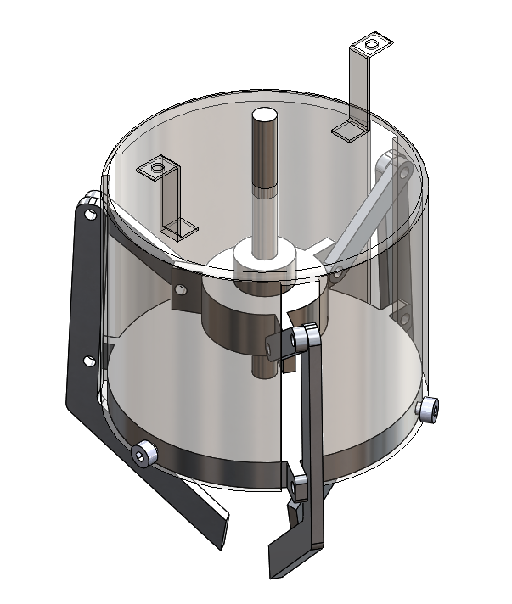
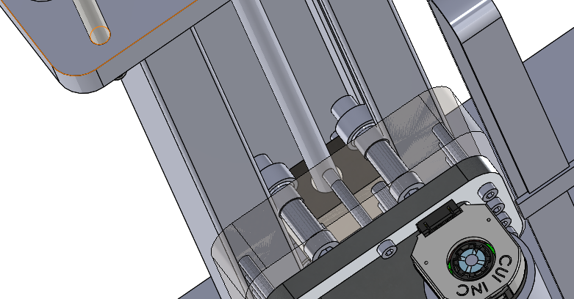
Robot Arm Assembly(2/3)
Roller Support
Lead Screw
Lead Screw
Slider

Slide 20
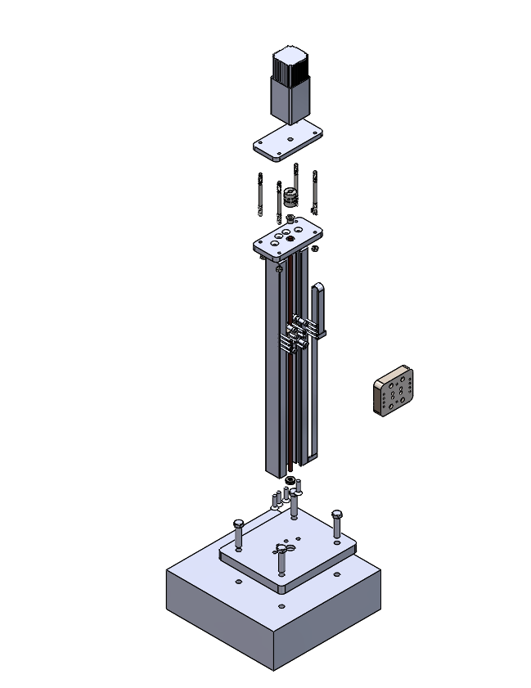
Robot Arm Assembly(3/3)
Coupling
Top Plate
Bush
Support Plate
Support Column
Thrust Bearing
Base Plate
Floor Block

Slide 21
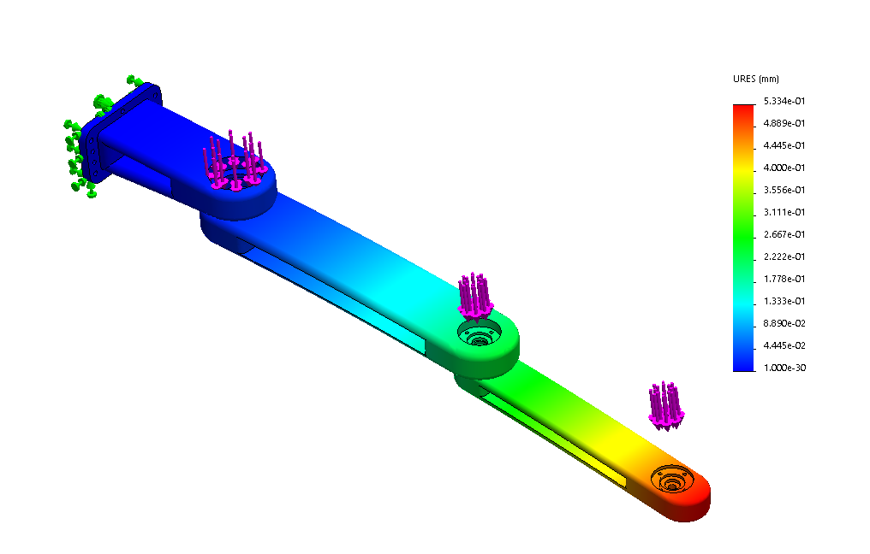
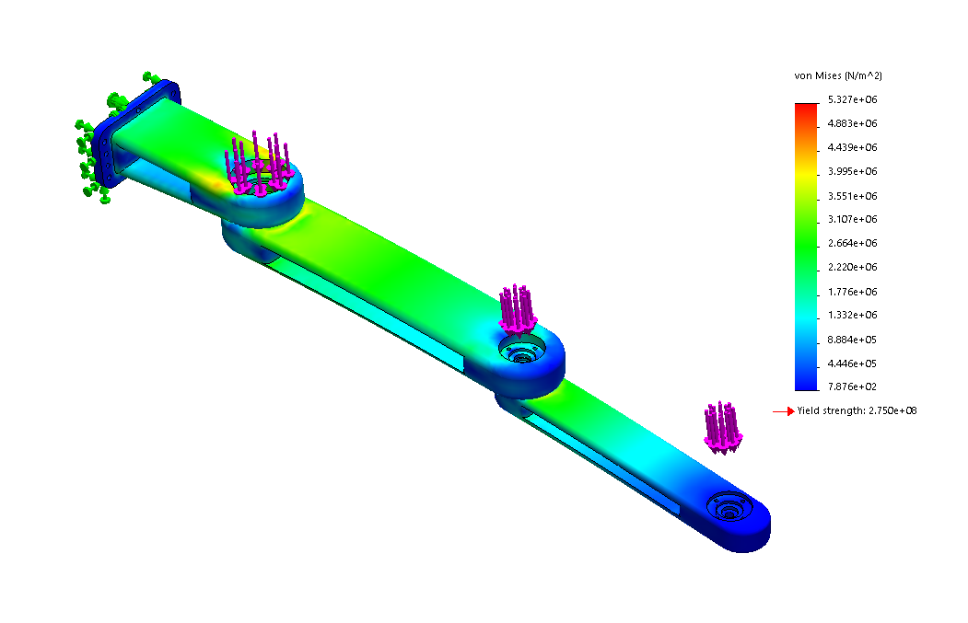
Static Analysis
Maximum deformation considering factor of safety
is 0.53mm
Maximum stress considering factor of safety
is 5.327e+06 N/m^2 < 2.75e+08 N/m^2 (Yield)

Slide 22
Index & Mechanical Inputs
Index:
Component Block Diagram
Robot Arm Sketch and Isometric View
Motor Selection List
Sample Torque Calculation
Motor Controller & Proximity Sensor Selection
Mechanical Inputs:
Torque values for each motors
Maximum operating speed

Slide 23
Robot Arm Sketch
M1
Revolute Joint 1
Revolute Joint 2
M4
Prismatic Joint
M2
M3
L1
L2
L3

Slide 24
Isometric View
Middle Link
First Link
End Link
3 Finger Gripper

Slide 25
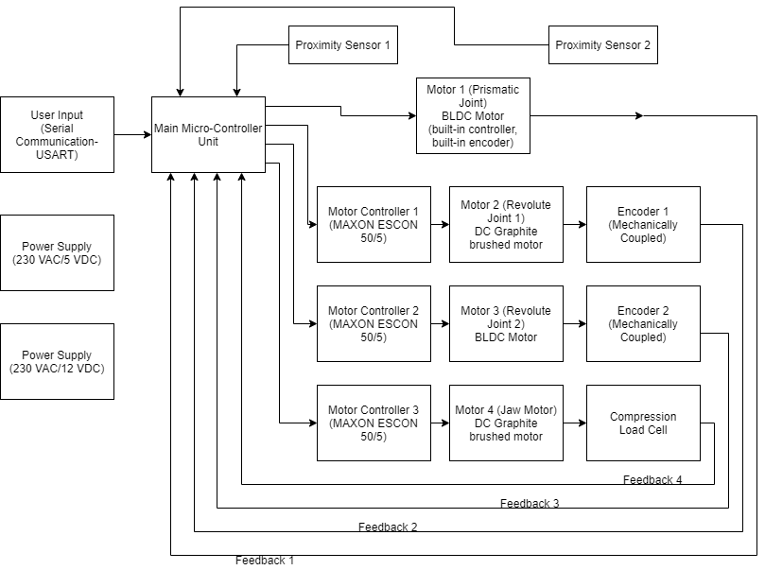
Component Block Diagram

Slide 26
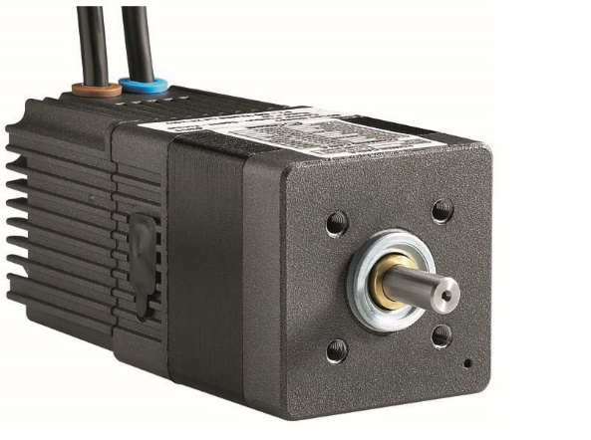
Motion Control-(Prismatic Joint)
Crouzet SQ57
BLDC Model | Crouzet SQ57
Part Number | 80280001
Operating Voltage | 12 – 36 VDC
Output Power | 82 W
Required Torque | 0.6 N-m
Torque achieved | 0.71 N-m
Base Speed | 1100 rpm (at 12 VDC)
Driver necessary | No
Encoder | Built-in (4096 resolution)
Weight | 1.62 kg

Slide 27
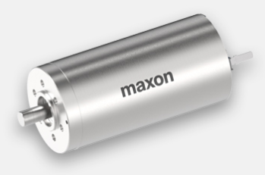
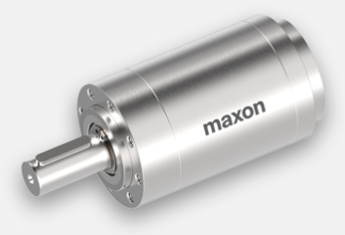
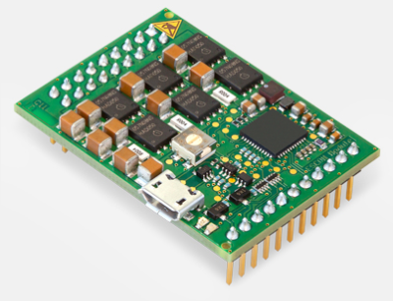
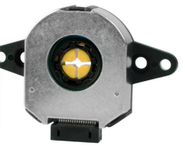
Motion Control-(Revolute Joint 1)
Maxon DCX 35 L (Motor) + Gearhead + Controller + Encoder
DC Model | Maxon DCX 35 L, DC Graphite brushed
DC Part Number | DCX35L01GBKL434
Operating Voltage | 12 VDC
Output Power | 80 W
Base Speed | 7610 rpm (at 12 VDC)
Weight | 380 g
Torque Required/achieved | 22 N-m/24 N-m
Gearbox Model | Planetary Gearhead GPX 42 UP, 4 stage
Part Number | GPX42UPKLSL0243CPLW
Gear Ratio | 243:1
Maximum Torque | 35 N-m
Weight | 790 g

Slide 28
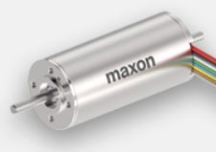
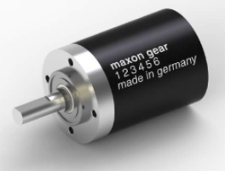
Motion Control-(Revolute Joint 2)
Maxon EC-Max 30(Motor) + Gearhead + Controller + Encoder
BLDC Model | Maxon EC-max 30
BLDC Part Number | 272762
Operating Voltage | 12 VDC
Output Power | 60 W
Base Speed | 6590 rpm (at 12 VDC)
Weight | 300 g
Torque Required/achieved | 7 N-m/7.5 N-m
Gearbox Model | Planetary Gearhead GP 32 C, Ceramic version
Part Number | 166942
Gear Ratio | 86:1
Maximum Torque | 6 N-m
Weight | 190 g

Slide 29
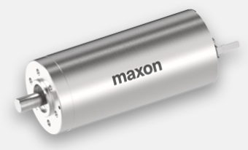
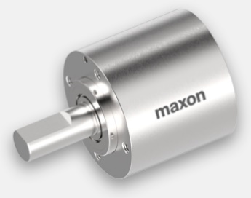
Motion Control-(Jaw)
Maxon DCX 32 L (Motor) + Gearhead + Controller + Encoder
DC Model | Maxon DCX 32 L, DC Graphite brushed
DC Part Number | DCX32L01GBKL448
Operating Voltage | 12 VDC
Output Power | 70 W
Base Speed | 6560 rpm (at 12 VDC)
Weight | 320 g
Torque Required/achieved | 0.5 N-m/0.54 N-m
Gearbox Model | Planetary Gearhead GPX 32, 1 stage
Part Number | GPX32AAKLSL05D3CPLW
Gear Ratio | 5.3:1
Maximum Torque | 1.25 N-m
Weight | 140 g

Slide 30
Sample Torque Calculation for Revolute Joint 1
Mechanical Torque required (T_{m}) = 22 N-m (considering Safety Factor of 3)
Motor Output Power (P_{o}) = 80 W
Motor Nominal Base Speed (N_{o})= 7610 rpm
Gearbox Teeth Ratio (k) = 243:1
Speed after gearbox (N) = (N_{o} /k) = 7610/243 = 31.31 rpm
Nominal Electrical Torque Output = (60 * P_{o})/(2 * π * N) = 24.4 N-m > 22 N-m

Slide 31
Motor Controller
ESCON Module 50/5
Controller Model | Maxon, ESCON Module 50/5
Part Number | 438725
Maximum Current | 15A
Operating Voltage | 10 – 50 VDC

Slide 32
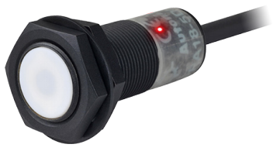
Proximity Sensor
Manufacturer | Autonics
Sensor Model | CR18-8DP
Sensor Type | Capacitive
Operating Voltage | 12-24 VDC
Sensing Distance | 8 mm
Response Frequency | 50 Hz
Response Frequency | 50 Hz

Slide 33
Summary
Tasks Achieved:
Selecting Motors based on Torque Requirements
Selecting Controller & Encoder (feedback/sensing devices) for Closed loop control
EMI/EMC Check
Task Remaining:
Finalize micro-controller based on motor controlling demands
PID Controller Calculation
To create Load profile for all motors
To select Power Supply adapter, connecting wires, connectors, etc.
To prepare Bill Of Materials

Slide 34


Thank You !

