Slide 1


G.H. RAISONI COLLEGE OF ENGINEERING
AND MANAGEMENT, WAGHOLI, PUNE
Department of CSE ( AI & AIML)
Image Generation using GAN
Guide:
Prof. Amruta Kulkarni
Name of Projectees
A53 - Nihal Rana
A54 - Nihir Borkar
A56 - Om Pajgade

Slide 2
Contents
Introduction
Justifications for Selecting the Title
Problem Statement
Literature Survey
Block Diagram
Expected Result
Work plan
References

Slide 3
Introduction
Generative Adversarial Network which is popularly known as GANs is a deep learning, unsupervised machine learning technique which is proposed in year 2014.
The main blocks of this architecture are :-
Generator - The generator creates images.
Discriminator - The discriminator evaluates the Images Generated by Generator.
These are trained simultaneously through adversarial processes, pushing the generator to create increasingly realistic images over time.
GANs have become a groundbreaking tool in image generation, enabling the creation of high-quality, realistic images that can be used in various applications, including art, design, gaming, and even healthcare.

Slide 4
Justification For Selecting The Title
The title "Image Generation using GAN" reflects the core objective of the project, which is to leverage the potential of GANs for producing high-quality images.
The choice of this title is justified by the relevance of GANs in modern AI-driven image processing tasks.
GANs have shown exceptional capability in generating images that are indistinguishable from real ones, making them an exciting area of research and application in computer vision and AI.

Slide 5
Problem Statement
Traditional image generation techniques often rely on manual design, extensive datasets, and are limited in the diversity of the images they can produce.
These methods struggle to create images that appear lifelike and can generalize well to new scenarios.
The problem addressed in this project is the development of a GAN model capable of generating realistic images with minimal human intervention, bridging the gap between machine-generated images and real-world visuals.

Slide 6
Literature Survey
Sr. No. | Paper Title and Year | Details of Publication | Findings
1 | Generative Adversarial Nets (2014) | Goodfellow et al. in NIPS Conference | Introduced the concept of GANs and demonstrated basic image generation capabilities.
2 | Unsupervised Representation Learning with Deep Convolutional GANs (2015) | Radford et al. in ICLR | Introduced DCGANs, improving stability and quality of image generation.
3 | Improved Training of Wasserstein GANs (2017) | Gulrajani et al. in NIPS | Proposed improvements for GAN training, reducing mode collapse.

Slide 7
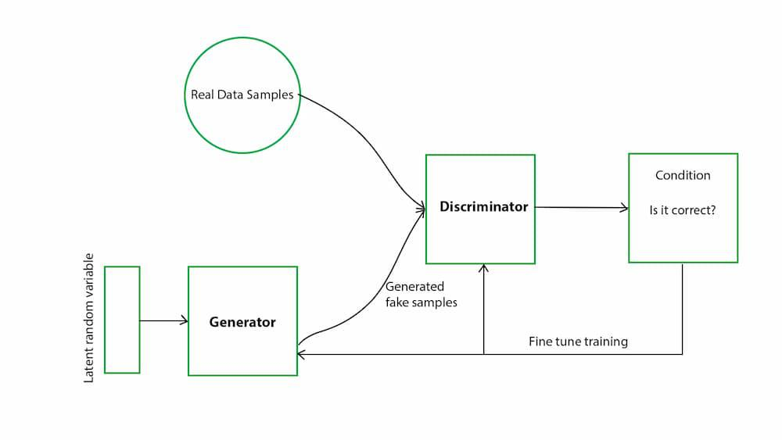
Block Diagram

Slide 8
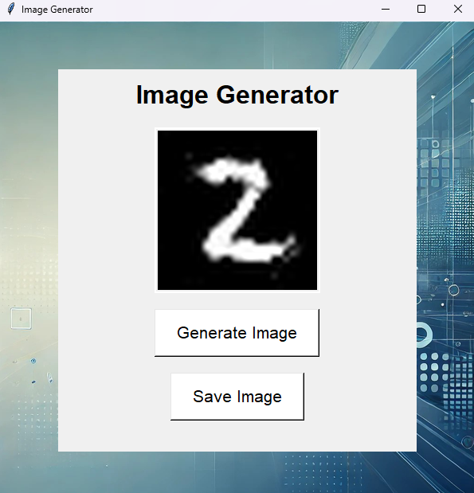
Expected Result
The image shows the UI designed for the project to show the image generated by the GAN model
The expected outcome of this project is a fully functional GAN model capable of generating high-resolution, realistic images.
The images should be indistinguishable from actual photographs and demonstrate the effectiveness of GANs in complex image synthesis tasks.

Slide 9
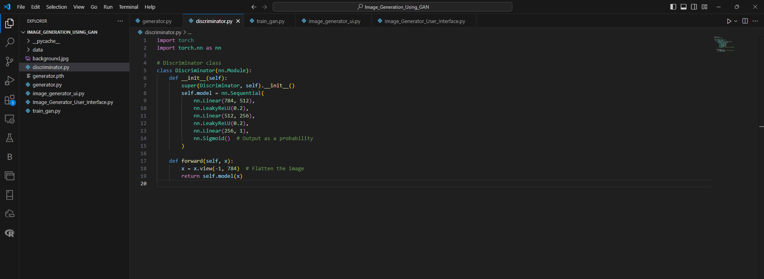
Expected Result
Both the generator and discriminator are trained simultaneously in a game-like scenario, where the generator strives to produce better images, and the discriminator becomes better at detecting fakes. This back-and-forth process continues until the generator becomes good enough to fool the discriminator, meaning it can generate images that look like real handwritten digits.

Slide 10
Work – Plan
Months Activities | June’24 | July’24 | Sept’24 | Oct’24
Literature Reviews | √
Requirement Analysis | √
Designing | √
Experimental Analysis | √ | √
Module wise Implementation |  | √
Testing and Debugging |  |  | √ | √
Preparation of Project Report |  |  |  | √

Slide 11
References
Goodfellow, I., et al. "Generative Adversarial Nets." NIPS, 2014.
Tim Salimans. "Improved Techniques for Training GANs.”
Gulrajani, I., et al. "Improved Training of Wasserstein GANs." NIPS, 2017.

Slide 12
Thank you !

