Slide 1

Business Intelligence-Machine Learning
By-OM BharatKumar Patel

Slide 2
Introduction
The dataset is Allegheny County Employee Salaries dataset of December 2019.
Data dictionary
Data source
https://catalog.data.gov/dataset/allegheny-county-employee-salaries/resource/8fc00877-324e-49d1-9bfc-ab39250d8a5f
FIRST_NAME | object
LAST_NAME | object
DEPARTMENT | object
JOB_TITLE | object
ELECTED_OFFICIAL | int64
DATE_STARTED | datetime64[ns]
SEX | object
ETHNICITY | object
ORIG_START | datetime64[ns]
DATE_TERM | datetime64[ns]
PAY_STATUS | object
ANNUAL_SALARY | float64
REGULAR_PAY | float64
OVERTIME_PAY | float64
INCENTIVE_PAY | float64
GROSS_PAY | float64

Slide 3
Data processing (cleaning)
Using Pandas with python:
Searched for null values
Replacing null with NAN
Removed any existing null values
Data formatting
Configuring data types
formatted target variable to use in regression techniques
Added columns : department code, sex code and year experience

Slide 4
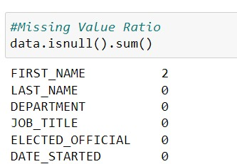
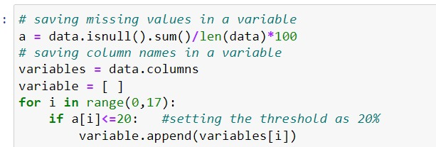
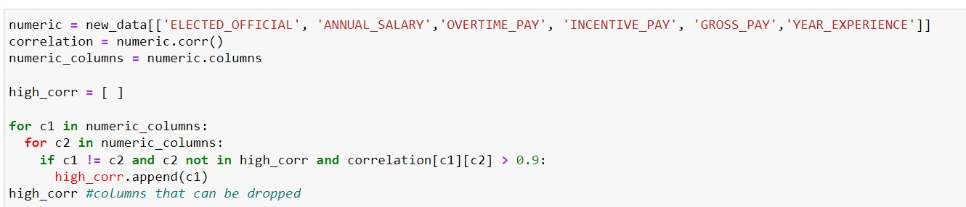
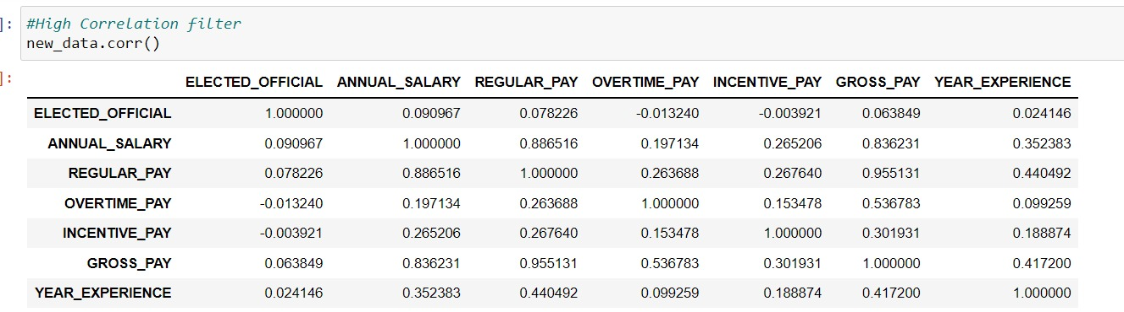
Dimension Reduction Technique
Missing value
High correlation

Slide 5
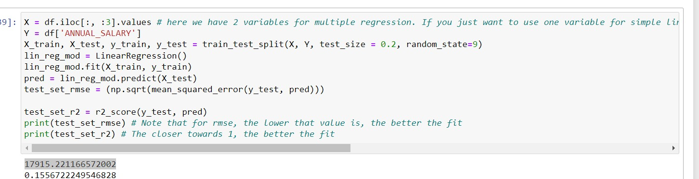
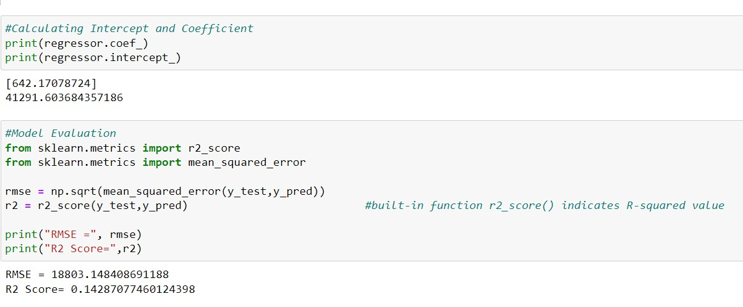
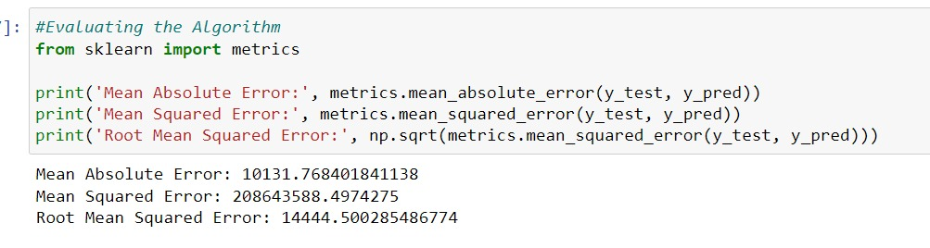
Algorithms
Linear
Multi linear
Random forest
Logistic

Slide 6
Dataset-Framed Questions
Which of the Job titles have most gross pay? (Top 10).
Does the ethnicity have a direct correlation to overtime?
Male Vs Female equality in the workspace regarding annual pay and Overtime?
Which of the departments pay there employees Most and least?(top 3)
Ratio of the Departments that have still active and Terminated pay status?

Slide 7
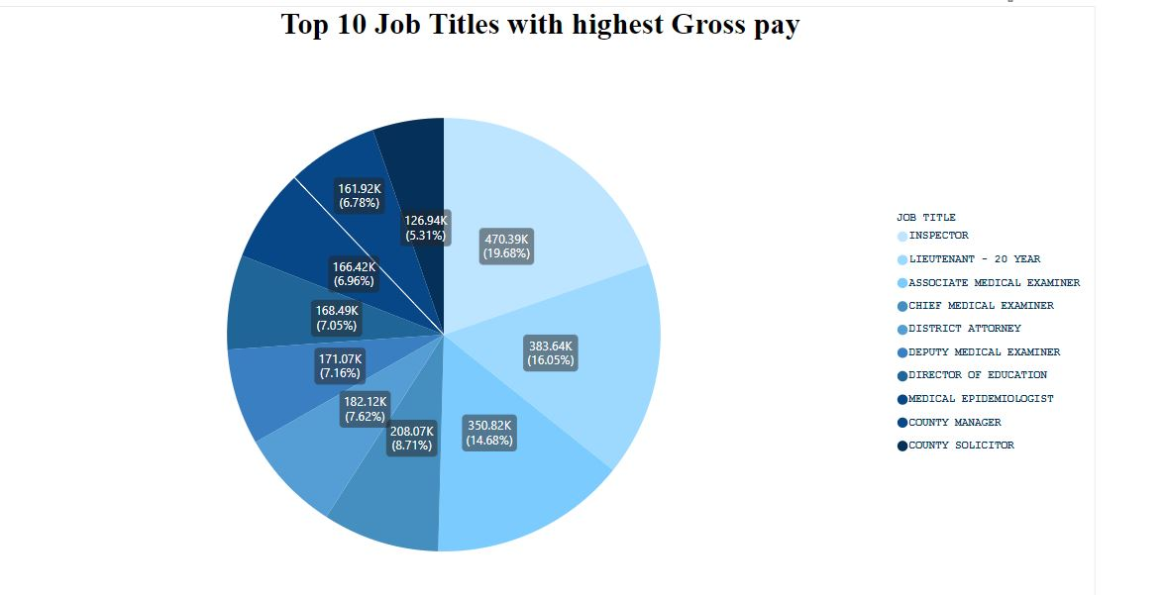
Which of the Job titles have most gross pay? (Top 10).

Slide 8
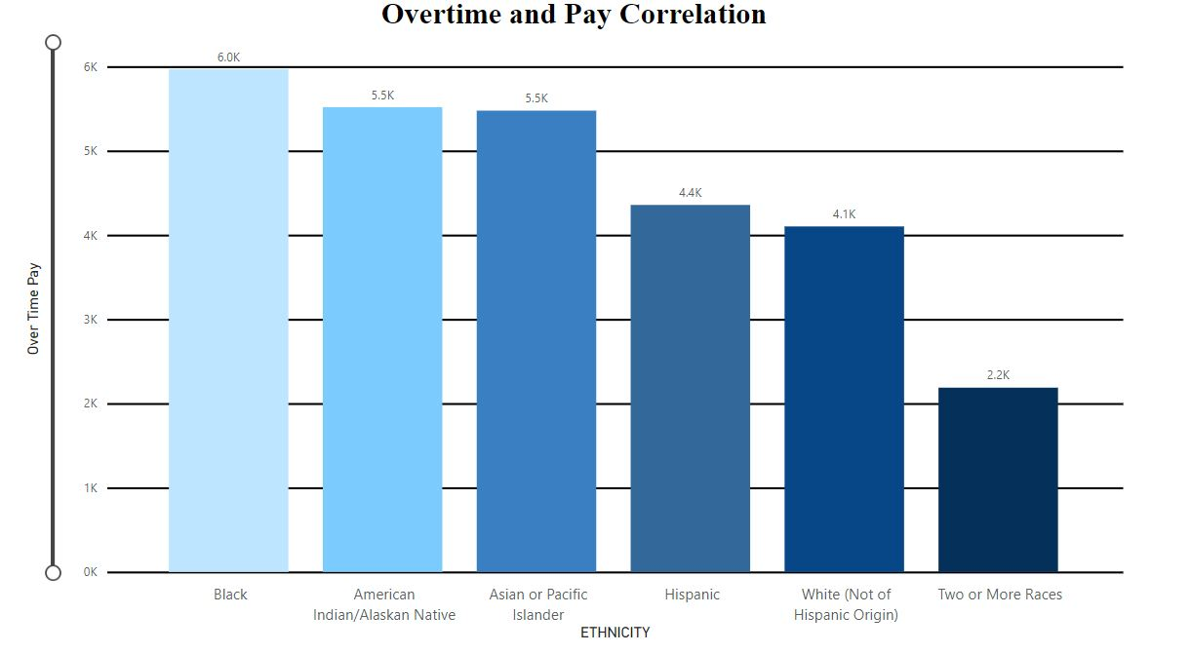
Does the ethnicity have a direct correlation to overtime?

Slide 9
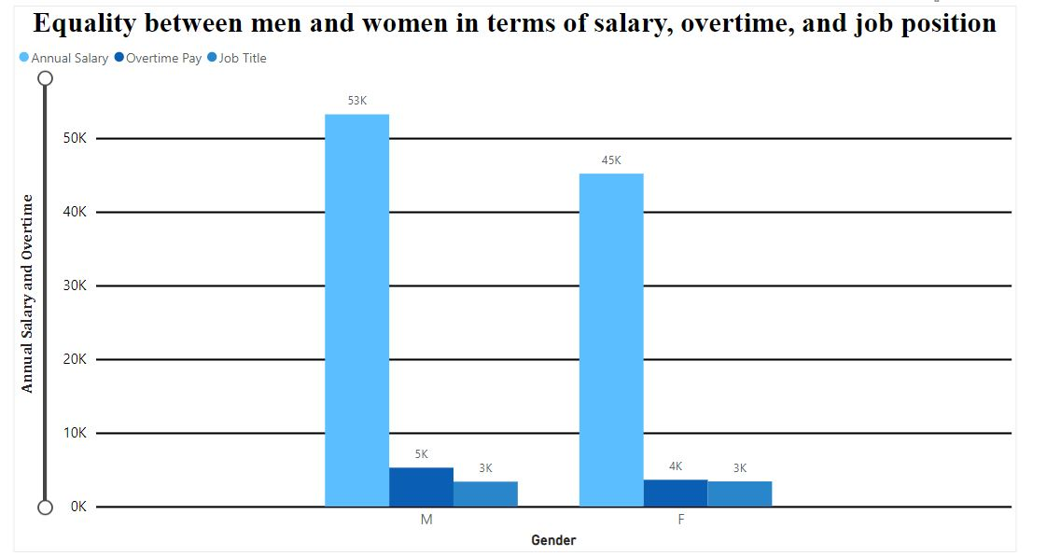
Male Vs Female equality in the workspace regarding annual pay and Overtime?

Slide 10
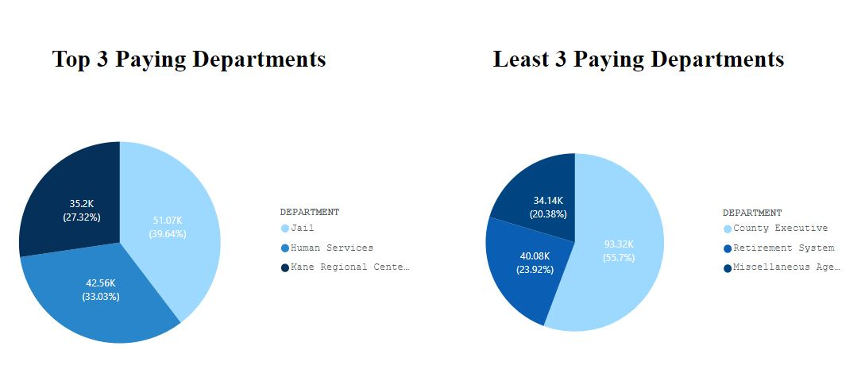
Which of the departments pay there employees Most and least?(top 3)

Slide 11
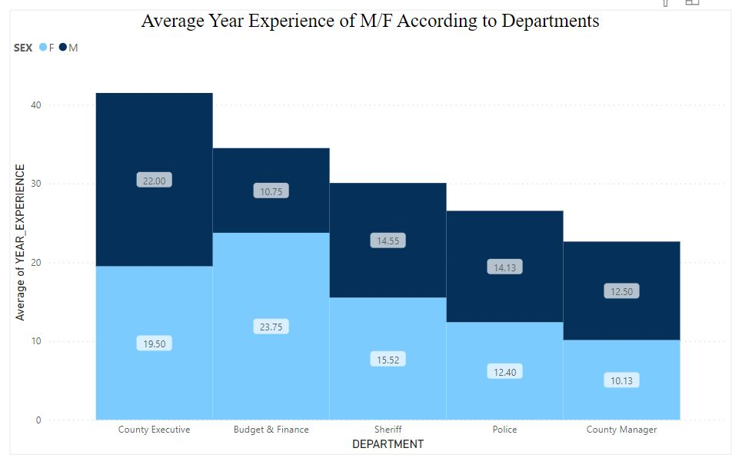
Average year experience of M/F According to Departments?

Slide 12
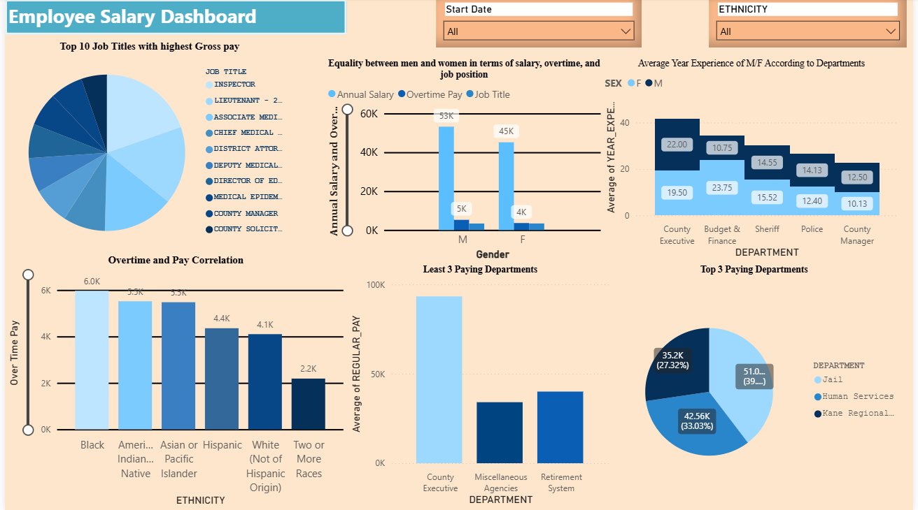
DASHBOARD

Slide 13
Conclusion
Random forest is best technique
High Accuracy Rate
Root mean squared error is least
Male employees earn more in terms of salary and overtime compensation than female employees.
We may conclude that the average experience and remuneration in the majority of departments are male rather than female.
The department roles are determined by gender, and some employment positions are assigned based on the results of the logistic regression study as well as the Power BI analysis.

Slide 14
Thank You

