Slide 1
Smart-Mate: An AI-Powered Cloud Interactive Assistant
Presented by: Om

Slide 2
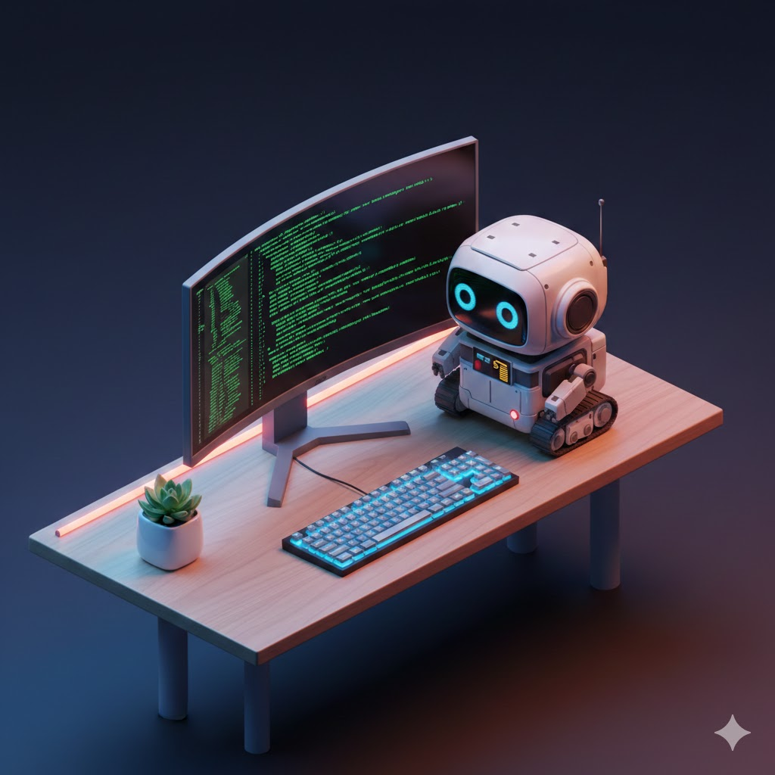
Work from home in this Tech era
Passive Tech: Smart speakers just sit there. They only help if you ask them to.
The Posture Crisis: We stare at our screens for 8 hours with no physical cues to take a break.
Blurred Boundaries: Working from home means we never truly "leave" the office.
Privacy Blindspots: Our personal spaces are now our workspaces, exposing us to new security risks.

Slide 3
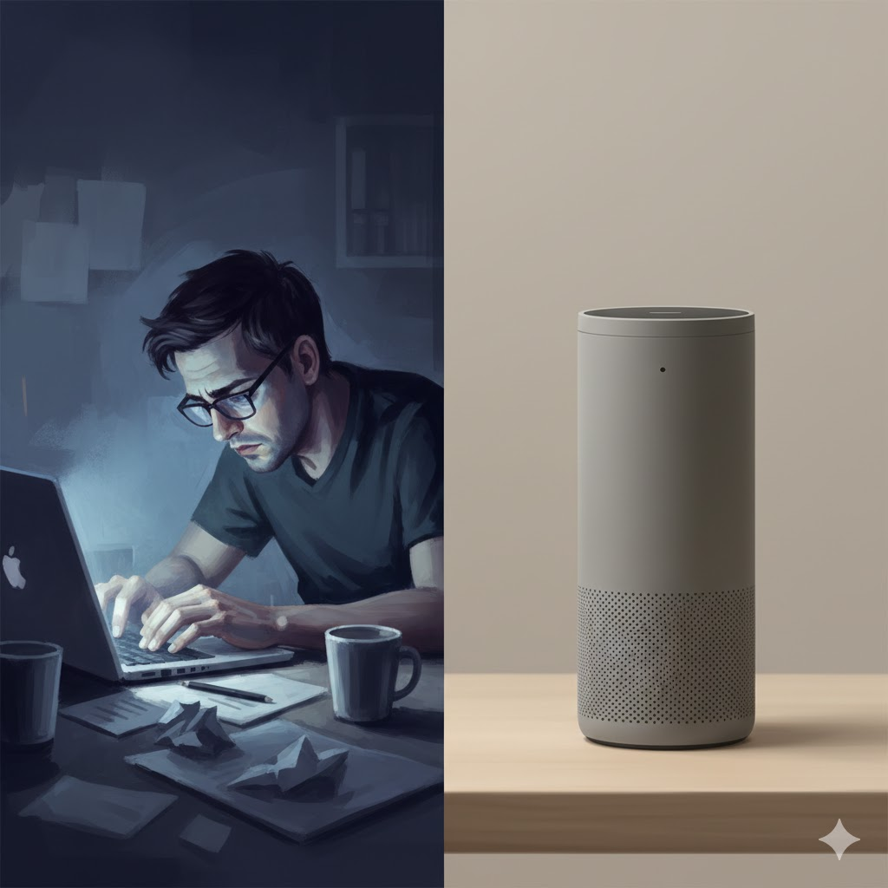
A bot that actually reacts to you.
Not just software: A physical, desk-sized companion that uses Cyber-Physical Systems (CPSI) to interact with you naturally.
It sees and learns: Uses Edge AI to understand your environment without relying on clunky buttons.
It remembers securely: Uses Cloud computing to log your habits, protected by Zero-Trust Cybersecurity protocols.

Slide 4
Proactive. Private. Protective.
The Posture Pet (AI + Actuation): If the camera sees you slouching, the robot physically droops its head and whimpers until you sit up.
The Focus Shield (AI + IoT): Picks up your phone during deep work? The robot shakes its head and logs the distraction to your Cloud dashboard.
The Context Switcher (HCD): At 6:00 PM, it physically turns its back to you and goes to sleep—giving your brain a hard boundary to stop working.
Zero-Trust Sentry (Cyber + Cloud): Steps away from your desk? It watches for intruders, encrypts the photos, and fires them to your secure AWS/Firebase vault.

Slide 5
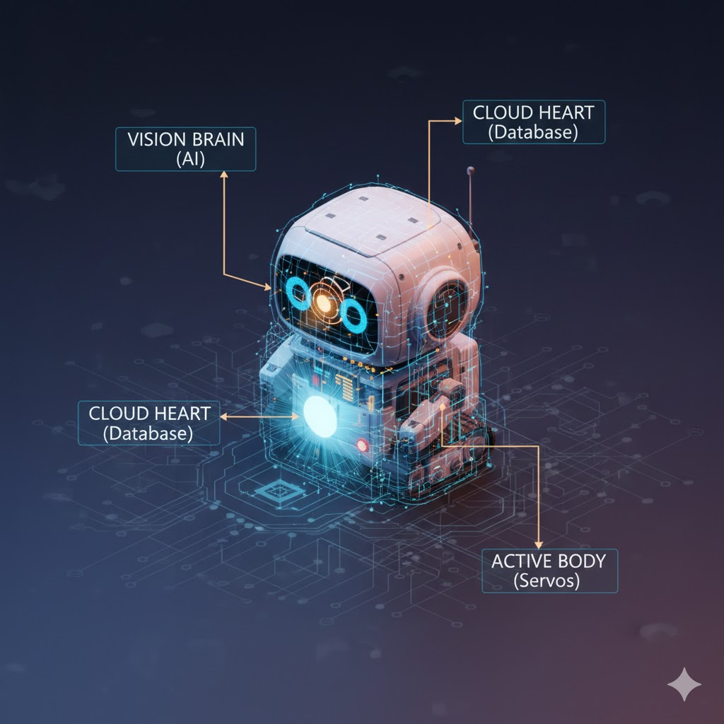
How we make it smart, small, and secure.
The Eyes (Local AI): OpenCV & Python process video locally for zero latency and high privacy.
The Body (IoT & Hardware): Micro-computing (Raspberry Pi/NodeMCU) drives physical servo reactions.
The Vault (Cloud Backend): Heavy lifting, historic logging, and dashboard hosting are offloaded to Firebase/AWS.
The Shield (Cybersecurity): Data in transit is secured via encrypted MQTT/HTTPS protocols.

Slide 6
How I build this in 12 weeks.
Phase 1: Teach it to see (Software Brain): Build the local AI vision models for posture and object detection.
Phase 2: Give it a memory (Cloud Backend): Set up secure databases and the web dashboard.
Phase 3: Give it a body (Hardware): Migrate code to the micro-computer and wire up the servos/sensors.
Phase 4: Bring it to life (Integration): Tie the physical reactions to the AI triggers and stress-test the network security.

