Slide 1


🚲 Bike Sales Analysis & Insights
Demographic, Income, Commute & Regional Behavior
Presented by: Om Patil
July 2025

Slide 2







Executive Summary
Goal: Uncover key buyer trends using data on demography, income, commute & region
Demographics
Income
Finding: Similar gender split, married customers purchase slightly more
Key buyer: Age 30-45, ₹60,000+ income, professionals, homeowners
Commute
Region
Regional: North America leads volume, Pacific converts best
Recommendations: Target high-potential customer segments for optimized marketing

Slide 3
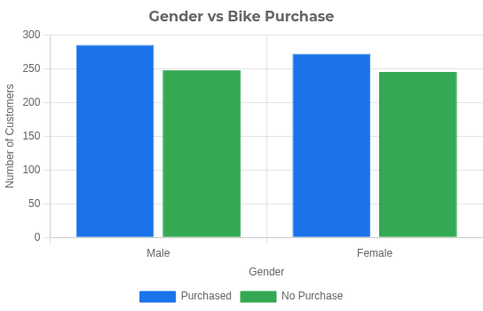
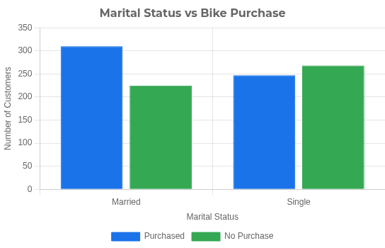

Customer Demographics
Key Insights:
Gender split is even among bike purchasers
Married customers are slightly more likely to buy

Slide 4
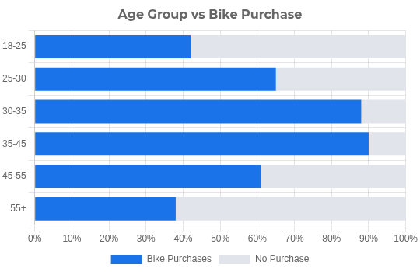
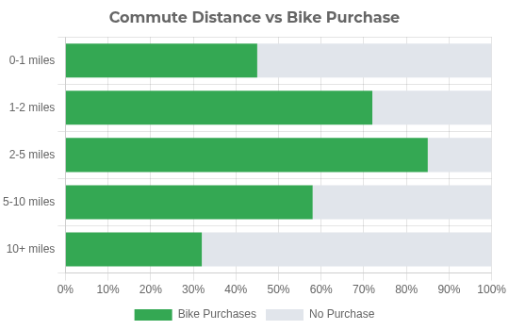


Age & Commute Behavior
Key Insights:
Age 30-45 is the top buyer segment, showing highest conversion rates Mid-range commutes (2-5 miles) show higher likelihood of bike purchase

Slide 5
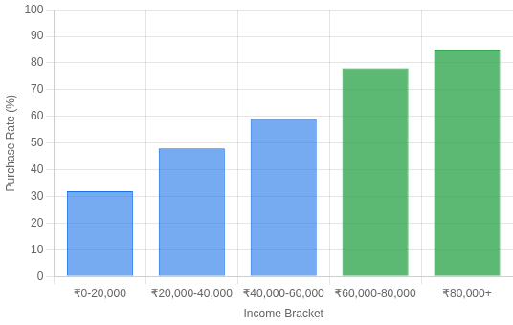
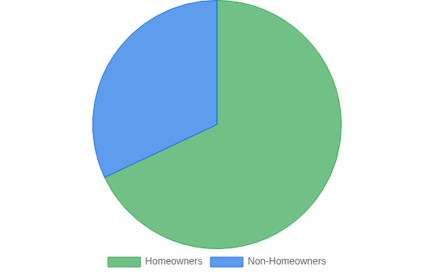


Income & Home Ownership
Income Bracket vs Bike Purchase
Home Ownership Distribution
Key Insights
Income Impact: Customers with income ₹60,000+ show significantly stronger interest in bike purchases
Ownership Influence: Homeowners are more likely to purchase bikes compared to non-homeowners
Made with Genspark

Slide 6
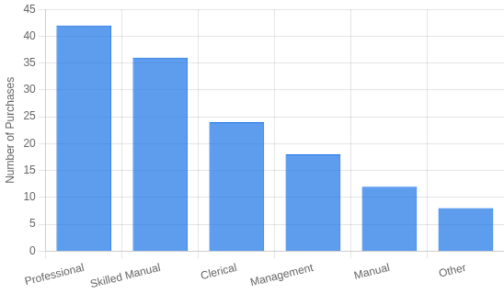
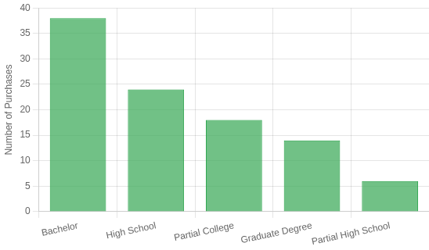


Occupation & Education
Occupation vs Bike Purchase
Education Level vs Bike Purchase
Key Insights
Occupation: Professionals and Skilled Manual workers dominate the bike purchases market
Education: Bachelor's degree is the most common education level among bike buyers
Made with Genspark

Slide 7
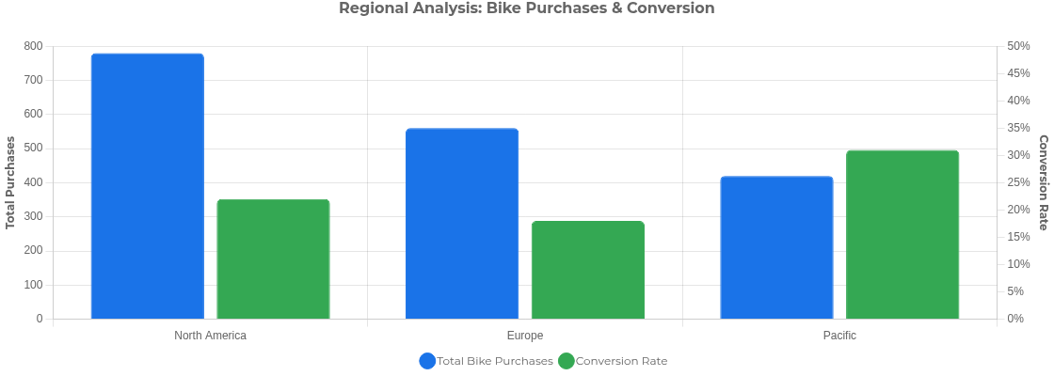


Regional Insights
North America leads in total purchase volume
Europe demonstrates consistent but moderate purchasing patterns
Pacific region shows the highest conversion rate
Opportunity: Target Pacific region for higher ROI potential
Made with Genspark

Slide 8
Buyer Persona Summary
Marital Status
Age Group
Income Level
Married
30-45 Years
₹60,000+
Home Status
Homeowner
Vehicle Ownership
1-2 Cars
Occupation
Professional

Slide 9




Recommendations
Target Pacific Region, Married Homeowners
Higher conversion rates in Pacific region combined with homeownership indicates stronger purchase intent
Focus on 30-45 Age Group, ₹60,000+ Income
This demographic shows highest purchase rates and better ROI for marketing efforts
Bundle Offers for 1-2 Car Households
Create complementary cycling solutions for households with existing vehicles
Focus Campaigns on Professionals
Professional occupations show highest purchase intent - target workplaces and professional networks
Based on a comprehensive analysis of demographic, income, commute & regional data

Slide 10
Thank You!
https://github.com/ompatilonmail/Bike-Purchase-Data-Analysis

