Slide 1
COICOP Classification Machine Learning Model

Slide 2
Introduction & Problem
The Business Problem
Automating COICOP classification for retail scanner data — assigning standardized 8-digit Classification of Individual Consumption According to Purpose (COICOP) codes to thousands of products from Shoprite.
Why It Matters
Manual classification is slow and expensive — statisticians manually assign COICOP codes for inflation/CPI calculations
Massive scale — 8,823 product records across 266 unique COICOP classes
Extreme imbalance — 20 classes had only 1 sample (had to be removed); some classes have 60+ samples while others have just 2
Key Challenge
How do we automatically classify 8,803 retail products into 246 COICOP categories, while handling extreme class imbalance (130× weight range), noisy text, and knowing when the model is uncertain enough to require human review?

Slide 3
Data & Methodology
Step 1: Text Cleaning
Lowercased text, removed punctuation/special chars, normalized whitespace
Result: 8,823 cleaned product descriptions ready for embedding
Step 2: Feature engineering
Feature Type | Count | Source
Categorical | 2 | Barcode, Category
FastText Embeddings | 300 | Unsupervised skipgram on Item
After PCA | 80 | Reduced from 300
Final feature set | 82 | 2 categorical + 80 PCA

Slide 4
Step 3: FastText Skipgram Training
fasttext.train_unsupervised(
'items_for_ft.txt', model='skipgram',
wordNgrams=3, dim=300, epoch=30,
lr=0.01, minCount=1, minn=3
)
Output: 8,823 embeddings × 300 dimensions
Why skipgram? Better for rare words (critical for niche product names)
Character n-grams handle abbreviations and OOV words
Step 4: Noise Filtering
Removed 20 single-member classes → 266 → 246 classes
Final dataset: 8,803 rows

Slide 5
Step 5: Principal Component Analysis(PCA) Dimensionality Reduction
Metric Value
Input dimensions 300
Output dimensions 80
Variance retained 94.59%
Train shape (7042, 82)
Test shape (1761, 82)
Step 6: Stratified Train-Test Split
Split Samples Percentage
Train 7,042 80.0%
Test 1,761 20.0%

Slide 6
Step 7: Class Imbalance Handling
Statistic Value
Min sample weight 0.1101 (most common class)
Max sample weight 14.3130 (rarest class)
Weight range 130.00×
Solved using compute_sample_weight('balanced’) + LightGBM class_weight='balanced'

Slide 7
Model Architecture
lgb_model = lgb.LGBMClassifier(
objective = 'multiclass', # Multiclass classification (246 classes)
num_class = len(np.unique(y)), # Number of output classes
num_leaves = 10, # Tree depth complexity (low = simpler trees, less overfit)
learning_rate = 0.01, # Learning rate (0.01 = conservative, stable)
n_estimators = 2000, # Max number of boosting rounds (trees to train)
min_data_in_leaf = 2, # Minimum samples per leaf (low = allows small groups)
importance_type = 'gain', # Feature importance = sum of gain in splits
class_weight = 'balanced', # Built-in class balancing (alternative to sample weights)
verbose = -1 # Suppress training output (-1 = no output)
)
Training Performance (Multi-LogLoss)
  Iteration Validation LogLoss Notes
  100 3.0107 Initial learning
  500 1.7219 Rapid improvement
  1000 1.5252 Plateau approaching
  1500 1.5177 Convergence
  1998 1.5145 Best iteration
  Training converged smoothly — no early stopping triggered, ran the full 2,000 rounds.

Slide 8
4. Results & Evaluation
Metric | Score
Test Accuracy (overall) | ~74.3%
F1 Weighted (test) | 0.7422
F1 Macro (test) | 0.5386
5-Fold CV F1 Weighted | 0.8176 ± 0.0118
5-Fold CV Accuracy | 0.8296 ± 0.0105
Auto-Classify Accuracy | 86.39%

Slide 9
Cross-Validation Stability
5-Fold Stratified CV scores were highly consistent:
Fold scores: [0.8293, 0.8111, 0.7984, 0.8200, 0.8293]
Mean F1: 0.8176 ± 0.0118 (very low std → stable model)
Filtered Evaluation (Classes with ≥2 test samples)
Metric | Value
Classes evaluated | 175(out of 246)
Test sample used | 1699 / 1761
F1 (macro) | 0.5656
F1 (weighted) | 0.7695

Slide 10
Confidence-Based Performance table
Subset | Count | % of Test | Performance
Confident (>0.8) | 1,352 | 76.8% | F1 = 0.8601
Uncertain (≤0.8 | 409 | 23.2% | manual review
Confidence Distribution table
Statistic | Value
Min confidence | 0.0187
Max confidence | 1.0000
Mean confidence | 0.8584
Median confidence | 0.9985
Median confidence of 0.9985 means most predictions are extremely confident

Slide 11
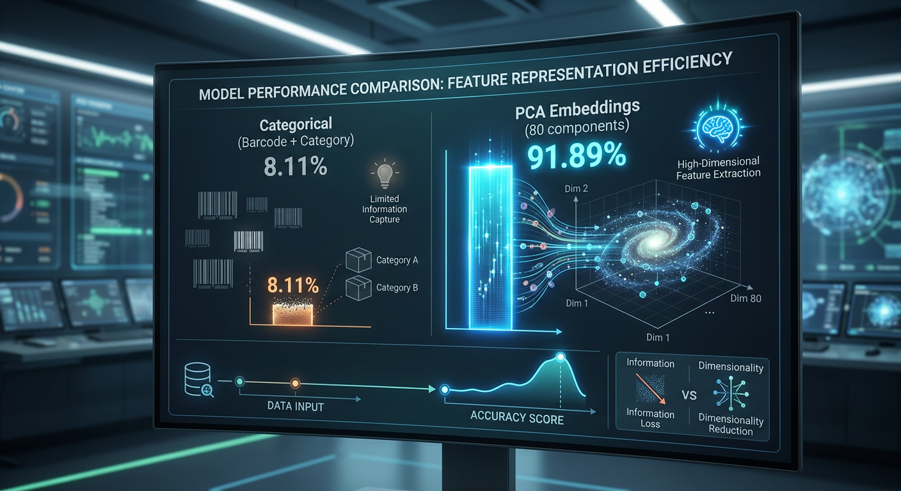
Key Insight: Although Category is the single most important feature, the 80 PCA embeddings collectively contribute 91.89% of model decisions — proving FastText embeddings capture critical semantic information.

Slide 12
Production Manual Review Examples
Top uncertain predictions flagged for human review:
Even with very low confidence, some predictions are still correct — but the system correctly flags them for human verification.
Rank | Confidence | Predicted | Actual | Match?
1 | 0.0187 | 1169100 | 1174500 | No match
2 | 0.0238 | 1162200 | 1182001 | No match
5 | 0.0247 | 1165900 | 1165900 | Match
7 | 0.0342 | 1176400 | 1176400 | Match

Slide 13
Conclusion & Future Work
Achievement | Evidence
End-to-end automated pipeline | Raw CSV → COICOP code
Strong classification performance | F1 = 0.74 test, 0.82 CV
High auto-classify accuracy | 86.39% on 76.8% of products
Stable, generalizable model | CV std = 0.0118 (very low)
Massive workload reduction | Only 23.2% require manual review
Production artifacts saved | 5 model files ready to deploy

Slide 14


Slide 15
Limitation | Impact
Single retailer/year (Shoprite 2023) | Limited generalization
Extreme imbalance | 20 classes too rare to train (removed)
F1 macro = 0.54 | Rare classes still struggle
No hyperparameter tuning | Performance ceiling not yet reached
Did not meet early stopping | Could potentially train longer
Enhancement | Expected Benefit
Multi-retailer training data | Better generalization
Hierarchical classification | Exploit COICOP tree structure (2→4→8 digits)
Transformer embeddings (BERT/RoBERTa) | Better text understanding
Hyperparameter tuning (Optuna) | Push F1 from 0.82 → 0.85+
Synthetic minority oversampling (SMOTE) | Improve macro F1 on rare classes
Lower confidence threshold | If manual capacity allows, increase auto-rate

Slide 16
Final Takeaway
The model successfully automates 76.8% of COICOP classification with 86.39% accuracy, while intelligently routing the most uncertain 23.2% to human reviewers — delivering a practical, deployable system that significantly reduces manual workload while maintaining classification quality.

Slide 17
THANK YOU

