Slide 1
NATURAL LANGUAGE PROCESSING · MACHINE LEARNING
Disaster Tweet
Classification
SIGNAL / NOISE
7,613
labeled tweets
Real-time disaster identification from social media using interpretable NLP and supervised learning.
81.3%
held-out accuracy
15-SLIDE PROJECT REVIEW
EDA → MODEL → DEPLOYMENT
TF-IDF + structure + sentiment
Human-in-the-loop decision support
Prepared by
OM PRAKASH
Project 7 / Disaster intelligence
Notes:
Introduce the project as a complete NLP workflow: exploration, feature engineering, model selection, validation, and a Streamlit deployment prototype.

Slide 2
EXECUTIVE DASHBOARD
A precise baseline with clear operating trade-offs
Selected model: tuned Logistic Regression. Results apply to the supplied 7,613-row dataset.
81.3%
82.5%
71.6%
76.7%
HELD-OUT ACCURACY
DISASTER PRECISION
DISASTER RECALL
DISASTER F1
1,523 test tweets
fewer false alarms
missed-event risk remains
CV mean: 75.3%
What the project delivered
Decision lens
01
Exploration
Class balance, data quality, keywords, words and phrases
The model is strongest as a triage aid—not an autonomous alerting system.
02
Preparation
Reproducible cleaning plus stratified 80/20 split
03
Modeling
Leakage-safe comparison of NB, Logistic Regression and Linear SVM
Key control
Choose the operating threshold on a separate validation set with emergency-response stakeholders.
04
Delivery
Persisted pipeline with Streamlit-ready inference workflow
DISASTER TWEET CLASSIFICATION / NLP PROJECT
Notes:
Emphasize the precision–recall trade-off. Accuracy alone is insufficient because disaster tweets are the minority class.

Slide 3
PROJECT MAP
Four tasks, one reproducible decision pipeline
Every transformation is trained on training data only; the held-out test set is reserved for final assessment.
01
02
03
04
05
06
Explore
Prepare
Engineer
Select
Validate
Deploy
Structure, missingness, class balance and language signals
Normalize text, preserve originals, stratify and export
Word/character TF-IDF plus 12 numeric signals
Five-fold CV, precision-led tuning, holdout evaluation
Generalization gaps and deterministic stress tests
Persisted pipeline and Streamlit user interface
DATA
DATA
DATA
DECISION
DECISION
DECISION
Governance principle
The notebook separates exploration from modeling, preserves raw text, fixes random seeds and avoids using the test set for model selection.
DISASTER TWEET CLASSIFICATION / NLP PROJECT
Notes:
Walk through the six-stage pipeline and underline the leakage-safe design.

Slide 4
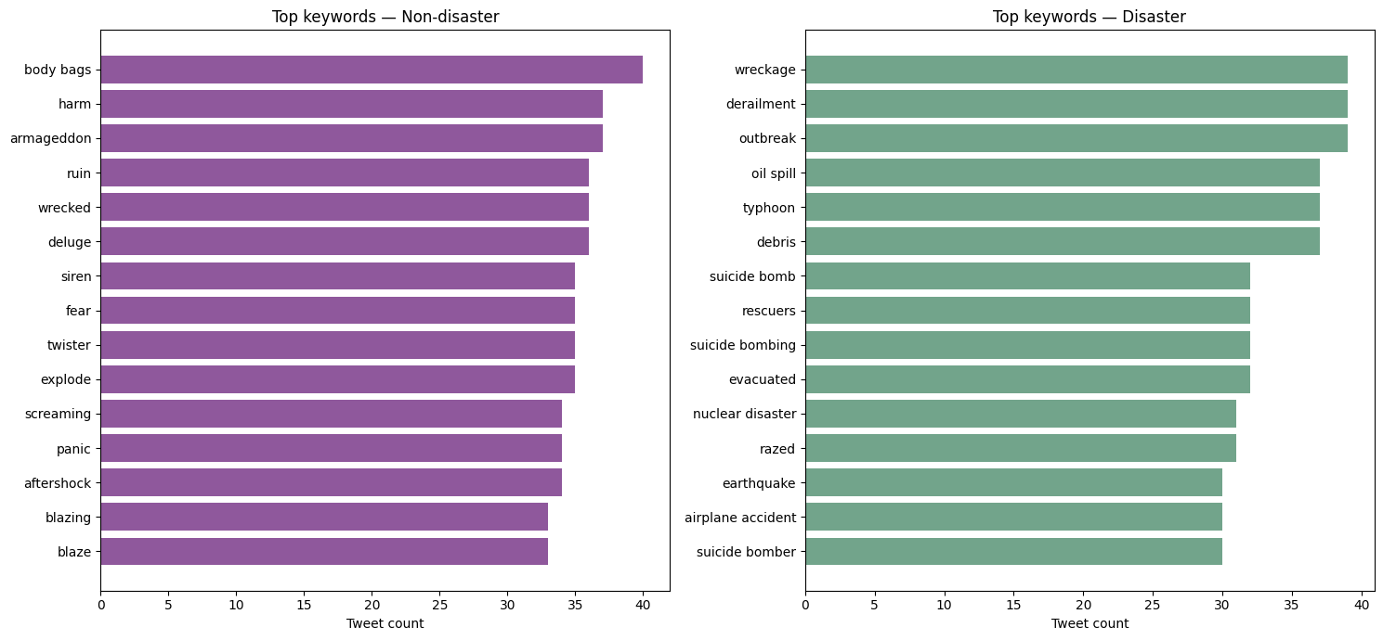
TASK 1 · DATA EXPLORATION
Keyword metadata separates literal events from figurative noise
The supplied keyword field is metadata; it is distinct from words extracted from tweet text.
Notebook graph · Top 15 keywords within each class
Disaster signals
Ambiguity to model
derailment, outbreak and wreckage each occur 39 times; oil spill, typhoon and debris follow closely.
body bags, armageddon, harm and wrecked also appear frequently in non-disaster tweets—often figuratively.
DISASTER TWEET CLASSIFICATION / NLP PROJECT
Notes:
Point out that keyword overlap makes context essential. A keyword-only classifier would struggle with figurative uses such as “wrecked” or “armageddon.”

Slide 5
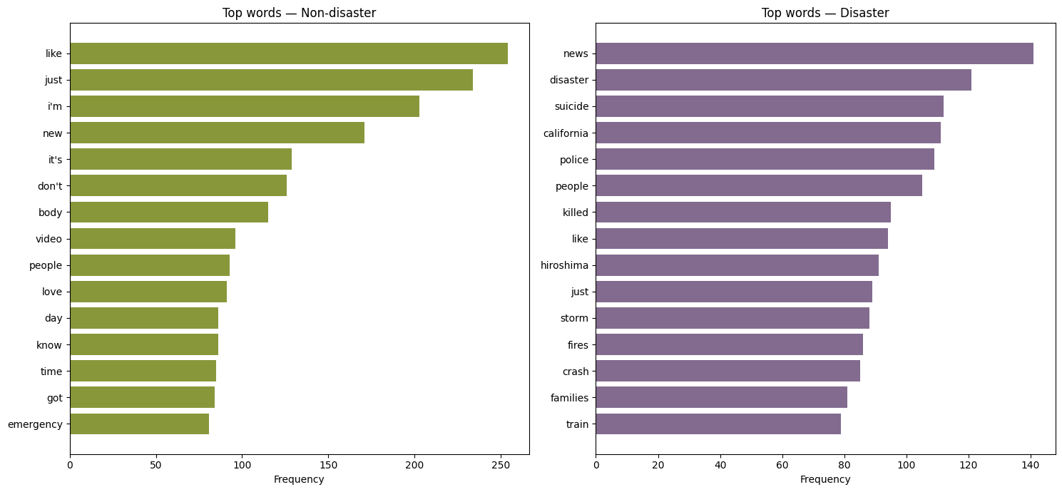
TASK 1 · DATA EXPLORATION
Word frequency reveals topic signal—and conversational overlap
URLs and common stop words are removed for this exploratory view; frequency alone is not a decision rule.
Notebook graph · Top words by class
SIGNAL
Disaster language
news · disaster · suicide · police · killed · storm · fires · crash
NOISE
Conversational overlap
“like,” “just,” “people” and “body” occur in both contexts; sequence and structure provide discrimination.
DISASTER TWEET CLASSIFICATION / NLP PROJECT
Notes:
The chart supports the use of n-grams rather than isolated counts: many high-frequency words are not class-exclusive.

Slide 6
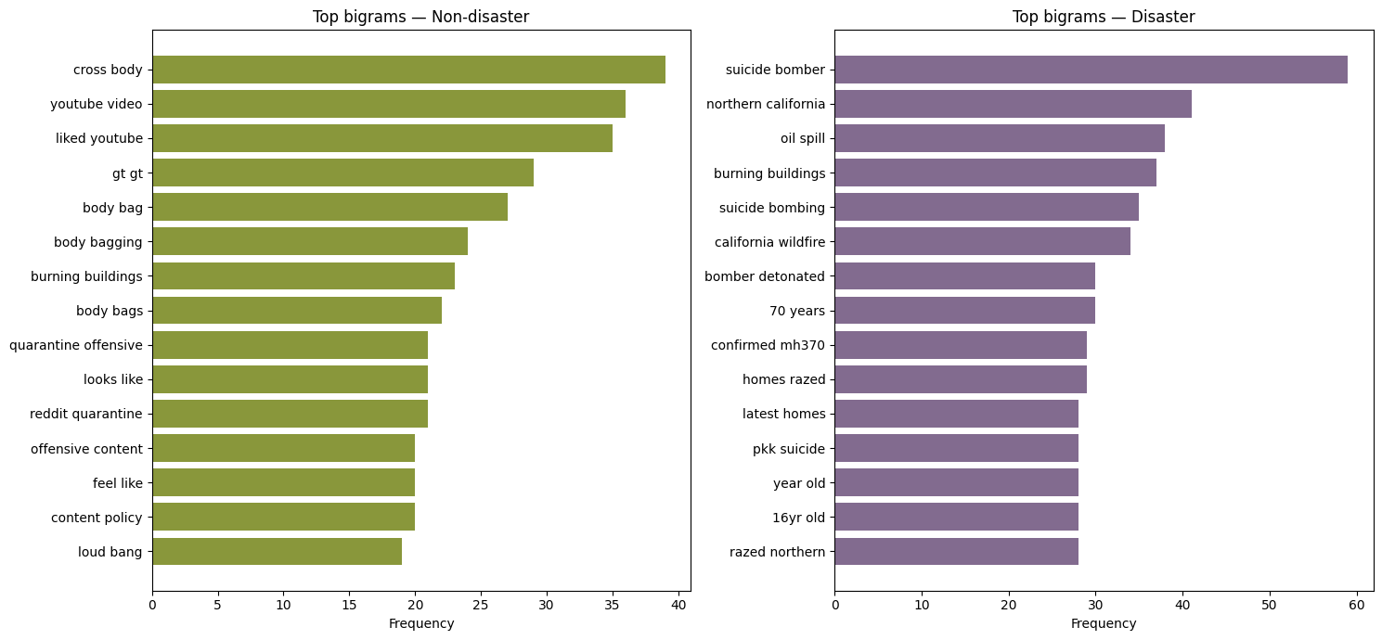
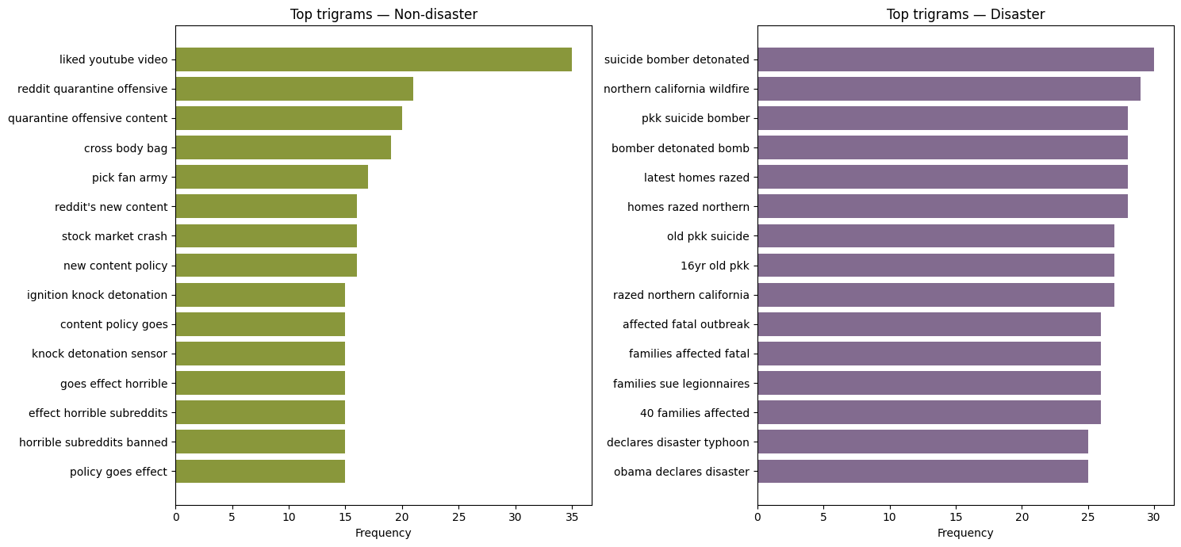
TASK 1 · INTERACTIVE DASHBOARD
Phrase mining adds context that single words cannot
The notebook dashboard organizes bigrams and trigrams by class; these graphs summarize its four views.
Bigrams · two-word patterns
Trigrams · three-word patterns
TOP DISASTER BIGRAM
suicide bomber · 59
TOP DISASTER TRIGRAM
suicide bomber detonated · 30
Repeated phrase clusters may reflect duplicated stories or event bursts—use grouped/event-aware validation in future work.
DISASTER TWEET CLASSIFICATION / NLP PROJECT
Notes:
Explain that n-grams restore local context. Several disaster phrases describe specific event narratives, while non-disaster phrases include platform and media chatter.

Slide 7
TASK 1 · DATA PREPARATION
Cleaning preserves evidence; stratification preserves prevalence
The original tweet remains available for audit while a normalized representation feeds the baseline models.
Text transformation
Stratified 80 / 20 split
01
Preserve
original_text is retained unchanged
6,090
train rows · 42.97% disaster
02
Remove
URLs, HTML fragments, punctuation and special characters
1,523
03
Normalize
lowercase and collapse repeated whitespace
test rows · 42.94% disaster
04
Tokenize
split clean text; zero empty token lists
Controls
random_state = 42
no overlapping IDs
prepared splits exported
DISASTER TWEET CLASSIFICATION / NLP PROJECT
Notes:
Cleaning removes expressive punctuation and URLs, which simplifies the baseline but may discard useful context. That limitation is tested later.

Slide 8
TASK 2 · FEATURE ENGINEERING
44,239 features combine language, spelling and tweet structure
All vectorizers and scalers are fit on training rows only, then applied unchanged to test data.
14,227
30,000
12
WORD TF-IDF
CHARACTER TF-IDF
NUMERIC + SENTIMENT
unigrams + bigrams
min_df = 2 · sublinear TF
character 3–5 grams
robust to spelling variation
length, hashtags, mentions, URLs, punctuation, casing and lexicon signals
Combined sparse matrix
Why this mix works
6,090 × 44,239
Words capture recognizable phrases. Characters capture typos and variants. Structural signals preserve social-media behavior that cleaned text removes.
1,313,231 non-zero training values
word 32.2%
character 67.8%
DISASTER TWEET CLASSIFICATION / NLP PROJECT
Notes:
Mention that pretrained embeddings were not used because none were supplied and the environment is designed for a transparent baseline.

Slide 9
TASK 1 · DATA EXPLORATION
Dataset profile and quality dashboard
Five fields describe each tweet; text and labels are complete, while location is optional and often absent.
7,613
5
93.18%
0
7,503
ROWS
VARIABLES
OVERALL COMPLETENESS
DUPLICATE ROWS
UNIQUE TEXTS
38,065 cells
id · keyword · location · text · target
all text + target present
7,613 unique IDs
110 repeated texts
Field-level completeness
Readout
id
100%
7,613
Text readiness
No blank tweets, no missing labels and only valid binary targets.
keyword
99.20%
7,552
location
66.71%
5,079
Caveat
text
100%
7,613
The brief references 10,000 rows; the supplied file contains 7,613. Metrics must be refreshed if the source changes.
target
100%
7,613
DISASTER TWEET CLASSIFICATION / NLP PROJECT
Notes:
Missing location values are expected metadata gaps, not failures in the modeling text or label fields.

Slide 10
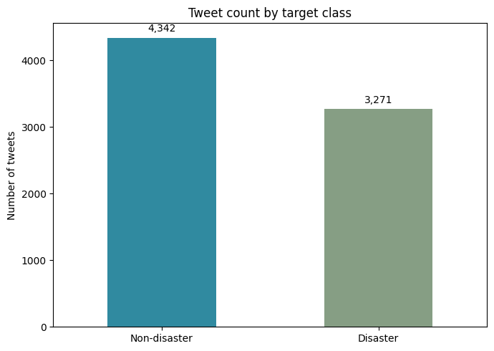
TASK 1 · DATA EXPLORATION
Class balance: manageable, but not symmetric
A 57/43 split supports standard stratified evaluation while making precision, recall and F1 essential.
Notebook graph · Tweet count by target class
CLASS BALANCE
4,342
non-disaster · 57.03%
3,271
disaster · 42.97%
Implication
Use stratification and evaluate the disaster class explicitly; accuracy alone can hide missed events.
DISASTER TWEET CLASSIFICATION / NLP PROJECT
Notes:
Explain that the imbalance is moderate, not extreme. The chosen 80/20 split preserves prevalence almost exactly.

Slide 11
TASK 2 · MODEL SELECTION
Cross-validation selects the most balanced baseline
Five stratified folds compare candidates by F1; a three-fold grid search then prioritizes precision.
Five-fold mean performance
SELECTED
Logistic Regression
75.3%
Logistic
Regression
Precision 82.2 · Recall 69.5
Linear SVM
74.2%
TUNED SETTINGS
Precision 77.8 · Recall 71.0
C = 0.5
class_weight = None
solver = liblinear
Multinomial Naive Bayes
73.7%
Precision 84.8 · Recall 65.2
Best tuning CV precision
F1 scale 0 → 85%
81.57%
DISASTER TWEET CLASSIFICATION / NLP PROJECT
Notes:
Logistic Regression leads CV F1, while Naive Bayes leads precision and Linear SVM leads recall. Selection is based on the predeclared cross-validation criterion.

Slide 12
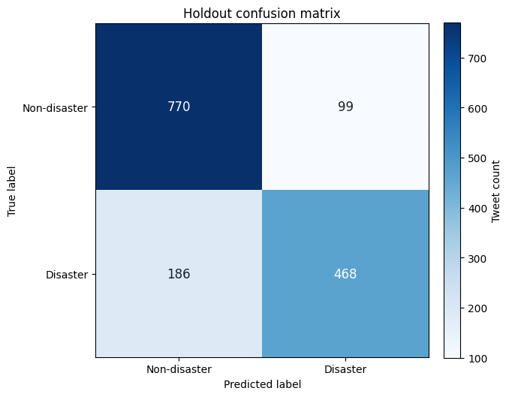
TASK 3 · FINAL EVALUATION
The selected model identifies 468 disaster tweets correctly
Held-out test metrics confirm usable precision with a meaningful recall gap.
81.3%
82.5%
71.6%
76.7%
ACCURACY
PRECISION
RECALL
F1
Notebook graph · Tuned Logistic Regression confusion matrix
Error anatomy
770
true non-disasters
468
true disasters
99
false alarms
186
missed disasters
Operational meaning
The model is comparatively conservative: false alarms are limited, but 28.4% of disaster tweets are missed at the default threshold.
DISASTER TWEET CLASSIFICATION / NLP PROJECT
Notes:
Use the confusion matrix to translate metrics into cases. Threshold selection should depend on whether missed events or false alarms are more costly.

Slide 13
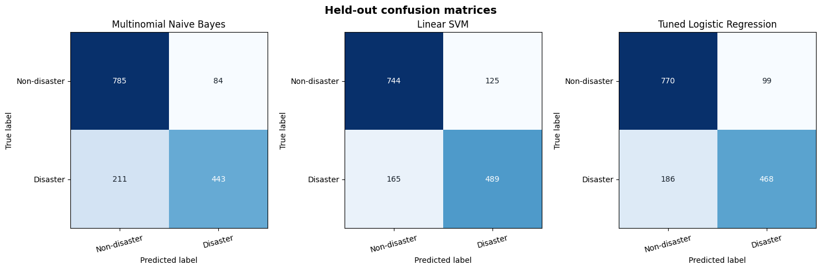
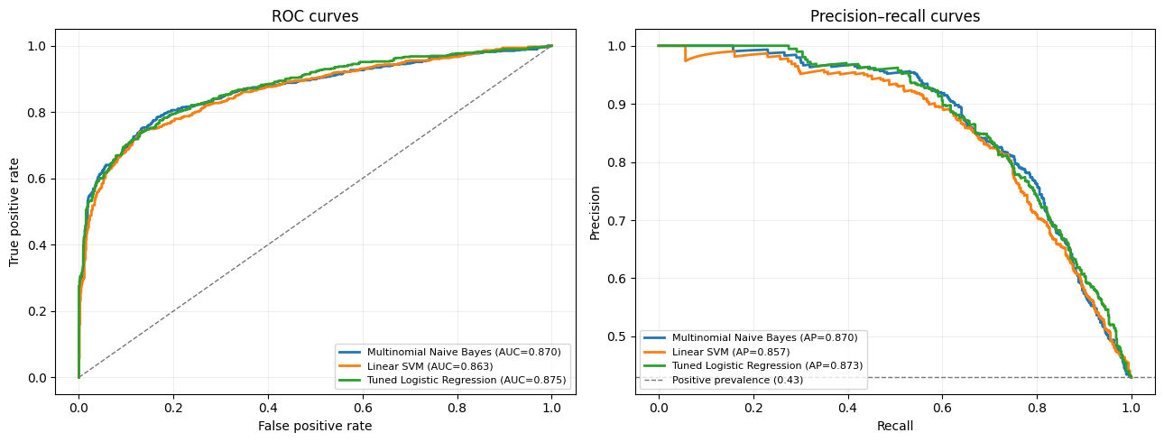
TASK 3 · COMPARATIVE EVALUATION
No candidate dominates every metric
The test-set comparison is diagnostic; the deployment choice remains the model selected by cross-validation.
All-model confusion matrices
ROC and precision–recall curves
Model
Accuracy
Precision
Recall
F1
ROC-AUC
Avg. precision
Linear SVM
80.96%
79.64%
74.77%
77.13%
0.8629
0.8572
Tuned Logistic Regression
81.29%
82.54%
71.56%
76.66%
0.8752
0.8732
Multinomial Naive Bayes
80.63%
84.06%
67.74%
75.02%
0.8696
0.8704
Best on test: SVM F1/recall · Logistic ROC-AUC/AP · Naive Bayes precision
DISASTER TWEET CLASSIFICATION / NLP PROJECT
Notes:
Linear SVM has the highest test F1 and recall, but selecting it after seeing the test results would leak evaluation information. Logistic Regression remains the defensible deployment candidate.

Slide 14
TASK 3 · VALIDATION
Generalization is stable; social-media artifacts shift the error profile
Synthetic stress tests are useful diagnostics, not substitutes for newer out-of-domain data.
F1 across evaluation layers
Robustness stress test
Training
84.5%
Original
F1 76.7%
agreement 100.0%
Uppercase + punctuation
F1 74.5%
5-fold CV
75.3%
agreement 94.6%
Common abbreviations
F1 76.4%
Held-out test
76.7%
agreement 99.0%
Added # @ URL
F1 76.0%
agreement 87.7%
Generalization readout
Train–CV F1 gap: +9.2 points. Test F1 is 1.35 points above the CV mean, so this split shows no material generalization drop.
Risk signal
Adding generic hashtag, mention and URL artifacts raises recall to 81.8% but lowers precision to 71.0%—a false-alarm shift.
DISASTER TWEET CLASSIFICATION / NLP PROJECT
Notes:
Common abbreviations are stable. Added social-media artifacts change predictions more substantially and reduce precision, motivating real-world robustness data.

Slide 15
TASK 4 · DEPLOYMENT AND NEXT STEPS
Ready for governed human-in-the-loop triage
The project includes a Streamlit entry point, shared predictor, themed configuration, pinned dependencies and hosting guidance.
Prototype user flow
Recommended next actions
1
Paste a tweet
01
Resolve source count
04
Calibrate + monitor
Confirm 7,613 vs. 10,000 rows and refresh metrics if needed.
Review scores, drift and precision/recall after deployment.
2
Run persisted pipeline
02
Validate prospectively
05
Keep human review
Return class + score
Use newer events, regions, slang, dialects and real artifacts.
Verify urgent reports with trusted sources before action.
3
03
Set threshold
4
Human verifies context
Quantify missed-event vs. false-alarm costs on validation data.
Status: deployment-ready prototype; not published to a public host.
CONCLUSION
A transparent TF-IDF baseline can prioritize likely disaster tweets with 82.5% precision—but must remain monitored, thresholded and verified by people.
15 / 15
Notes:
Close with the governance message: the system supports triage, not automatic emergency response. The next milestone is prospective validation and threshold setting.

