Slide 1
Stabilization of Rigid Body Dynamics by Internal and External Torques
Bloch, Krishnaprasad, Marsden, Sanchez de Alvarez
SC 618 Paper Review Presentation
Group 1
Om Prabhu
Arjun Sadananda

Slide 2
Contents
Introduction
Dual Spin Satellite
Rigid Body With An External Torque
Recovery of Externally Torqued System And The Heavy Rigid Body
Heavy Top
Hamiltonian Structure Of The Rigid Body With Three Rotors Under Feedback
Phase Shifts
Correcting Attitude Drift
Conclusion

Slide 3
Introduction
Stabilizing the angular momentum & attitude equations of the rigid body with n≥2 torques
Plays a pivotal role in areas such as incremental motion planning, space vehicles, etc
Previous works:
Arnold and Holm: stability of rigid body with flexible attachment
Bloch and Marsden: stabilization of rigid body angular momentum equations about middle axis of inertia by external torque (minor or major axis) by energy-Casimir method
Problem: analyze a rigid body with internal rotors with quadratic feedbacks such that the system is Hamiltonian wrt. a Lie-Poisson bracket

Slide 4
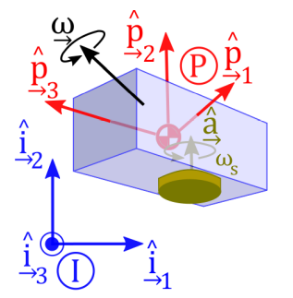
The Dual Spin Satellite
Analyzed by Krishnaprasad (1985) and Sanchez de Alvarez (1986)
Direction of a spinning body is fixed unless external torque is applied
Need to be stabilized so that perturbations (internal due to motor thrust, or external) do not significantly affect the nominal direction of incremental velocity
Drawbacks of single-spin stabilization wrt. communication efficiency
Attitude spin stabilization - stabilize the axis along the thruster
Gyrostat - asymmetric rotor & platform used to stabilize angular momentum about the longitudinal spin axis

Slide 5
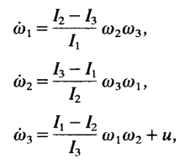

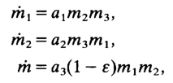

Rigid Body With An External Torque
Rigid body equations:
Equations of motion:
This system is Hamiltonian wrt. the Lie-Poisson structure

Slide 6

Rigid Body With An External Torque (contd.)
The obtained equations of motion are the generalized Euler equations for the Lie group:
The corresponding Eulerian form is: , where Λ_{Σ} is the Poisson tensor. Stability is proved by determining a suitable Lyapunov function using energy-Casimir method.
Energy-Casimir method: a technique gives a sufficient condition for stability of Hamiltonian systems through minimization of energy
Casimir functions: functions that commute with every other dynamic variable
Rigid body system with feedback can be proved to be stable about the relative equilibrium (0, M, 0)

Slide 7
Recovery of Externally Torqued System And The Heavy Rigid Body
The fact that the system with external torque feedback has conserved quantities and a Lie-Poisson structure, leads one to ask if there is a mechanical extension of the system to larger system where the closed loop dynamics is realized by an internal torque feedback.
This section shows that such a mechanical extension does indeed exist-
-a rigid body carrying three symmetric rotors with associated internal torques.

Slide 8

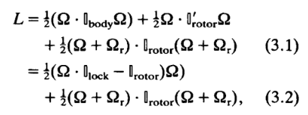


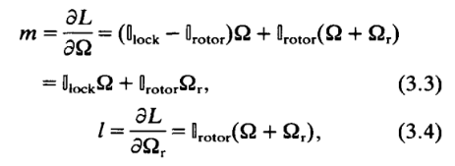
Configuration Space
Locked inertia tensor
the equations of motion with internal torques (controls) u in the rotors are
The Lagrangian (kinetic energy) of the free system is the total kinetic energy of the body plus the total kinetic energy of the rotor,
Change of Variables
By the Legendre transform, the conjugate momenta are:
Theorem 3.1. There is a choice of internal torque feedback u(pi, l) such that the body dynamics in the system (3.7)-(3.8) are precisely those of system (2.3) (with external torque feedback).

Slide 9

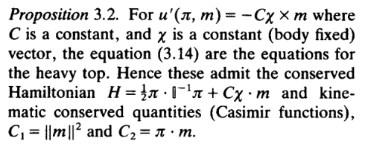
Consider now the following interesting case.
Let m = pi + l as before and take as controls u'(pi, m).

Slide 10
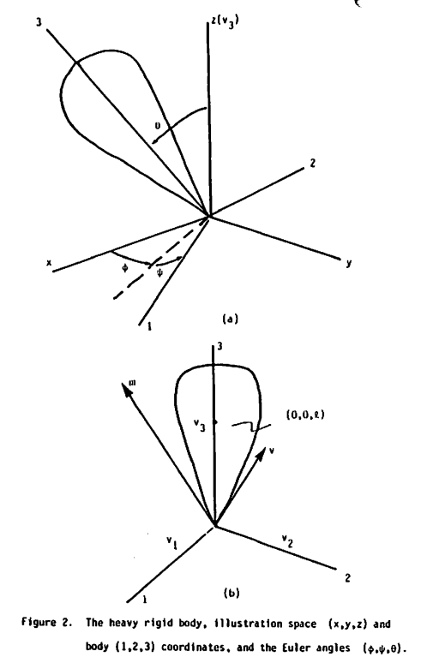
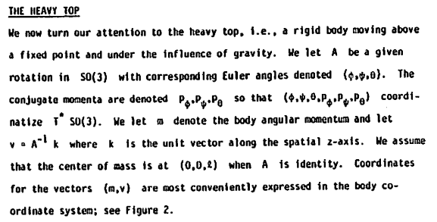
Heavy Top
J E Marsden (1984) Hamiltonian Structures for the Heavy Top and Plasmas
The system, which consists of a rigid body with a fixed point moving in a gravitational field, is of sufficiently low dimension that a reasonably thorough analysis is tractable, yet rich enough to possess many interesting features in common with other, more complicated systems.

Slide 11

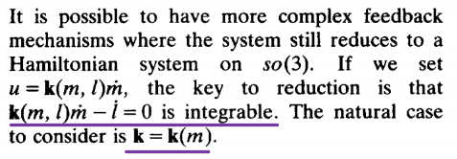
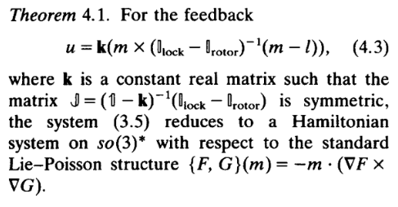
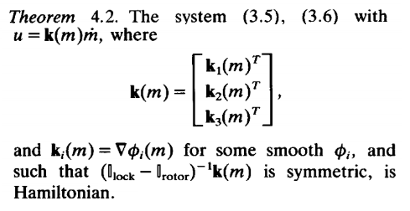
The Hamiltonian Structure Of The Rigid Body With Three Rotors Under Feedback

Slide 12
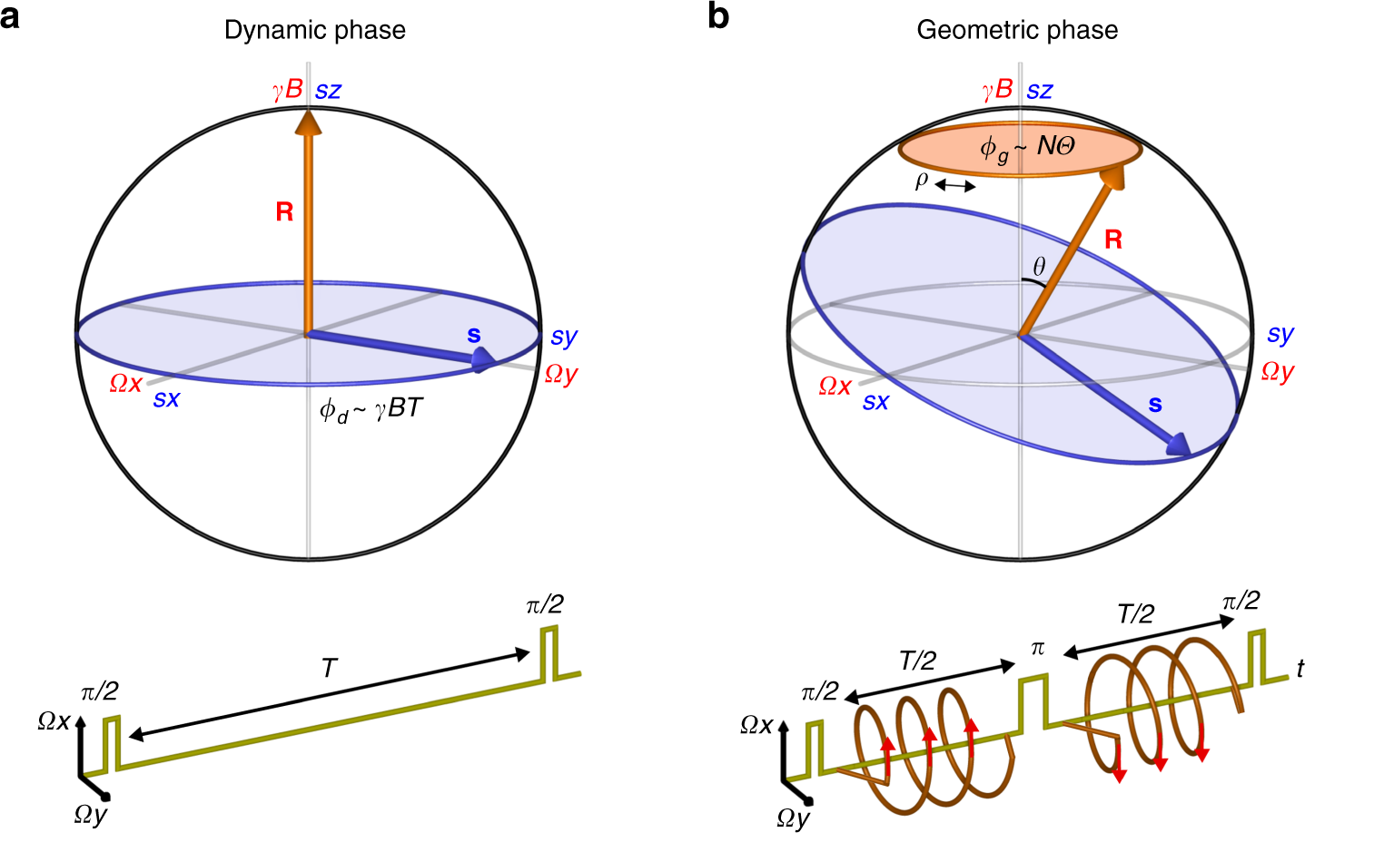

Phase Shifts
Definition: shift in angular motion of the rigid body system in response to external disturbances
Perturbation of the system from stable equilibrium results in periodic motion
Attitude equation: , ^ is the canonical map from real vectors to elements of so(3)
For periodic motion of rigid body, it can be shown that the body undergoes a certain amount of net rotation about the angular momentum vector - an example of attitude drift
This is an example of geometric phase shift, since the shift in phase is acquired over the course of cycles of periodic motion

Slide 13

Correcting Attitude Drift
In a zero total angular momentum case, the attitude drift can be compensated for by using two rotors
Total spatial angular momentum:
Attitude matrix as a reverse path-ordered exponential:
RHS depends only on traversed path in the space T² of rotor angles and not previous angular velocities

Slide 14
Conclusions & Key Takeaways
From this paper, we learnt the following:
Study of rigid bodies using external torques (via gas jets) and internal torques (via rotors/wheels)
Natural mechanical systems subjected to external forces can be modelled as Hamiltonian systems
Various methods of geometric mechanics such as energy-momentum algorithms and energy-Casimir method
Analysis of attitude drift due to perturbations from equilibrium, and how to correct it

Slide 15
Thank You!

