Slide 1
IE 643: COURSE PROJECT
ColBERT: Using BERT Sentence Embedding for
Humor Detection
Team YOLO
Gopalan Iyengar (19D170009)
Om Prabhu (19D170018)

Slide 2
OUTLINE
PROBLEM STATEMENT:
Overview
Technical Details
Literature Review
PROBLEM DETAILS:
Technical Viewpoint
Structure of Humor
Proposed Method
PAPER IMPLEMENTATION:
Data Processing
Technical Details
STATUS OF WORK:
Result Replication Status
Modifications Proposed

Slide 3
PROBLEM STATEMENT : Overview
Objective: Detection of humor in a given sample of text
Motivation: Authors describe a futuristic chat-bot similar to the bot TARS in the movie Interstellar (2014), alluding to the bot’s adjustable ‘humor used in conversation’ setting to the need for a model which can accurately determine the existence and/or level of humor in digital text
Background: For decades, machine learning researchers have been trying to develop language prediction/analysis tools using different models. One of the main objectives of these has been ‘sentiment analysis’, i.e. understanding the emotion behind a set of spoken/written text, in order to better model human-computer relations. One of the most researched ‘sentiments’ has been humor, and ColBERT is currently one of the few SOTA models for humor detection

Slide 4
PROBLEM STATEMENT : Technical Details
View and encode each sentence separately to capture the linguistic structure of humor in a proper way. [SENTENCES EMBEDDINGS]
Implementation of the BERT model to encode text into sentence embeddings to input into an 8-layered neural network. [EMBEDDINGS MODEL HUMOR DETECTION]
Going beyond existing datasets, which use a combination of informal jokes (positives) and formal texts (negatives), and develop a unified dataset:
Since they are of different types, their sentence structure is inherently different.
Filter data based on character and word length to ensure a similar distribution between the positives and negatives in the dataset.
Using dissimilar/incompatible data would make the model work, but unable to understand the underlying structure of humor.

Slide 5
LITERATURE REVIEW - 1
Humor Recognition Using Deep Learning (Chen and Soo, 2018)
Datasets Used:
16000 One-Liners - collection of humorous one-liners and formal writing resources
Pun Of The Day - Created by Yang et al. (2015)
Short Jokes - Open database on a Kaggle project - approx. 230,000 jokes
PTT Jokes - terminal-based bulletin board system for Chinese humor samples
Model: Convolutional Neural Network (CNN), with two factors F (increase of filter size) and HN (number of highway layers to train deep networks)
Observations & Results:
CNN + F + HN model gives highest accuracy as well as F1-Score
Model performs better in comparison to previous works - Word2Vec + HCF (by Yang et al.) and other CNN implementations
Recognition accuracy is above 90% for English as well as Chinese humor samples

Slide 6
LITERATURE REVIEW - 2
Humor Detection: A Transformer Gets the Last Laugh (Weller and Seppi, 2019)
Datasets Used:
Reddit Dataset - Collected by authors - 13884 unfunny jokes and 2025 funny jokes
Short Jokes - Available on Kaggle, modified by authors - approx. 230,000 jokes
Pun Of The Day - Created by Yang et al. (2015) - 16001 pun sentences and 16002 not-pun sentences
Model: BERT (Devlin et al., 2018), 2e-5 learning rate, max sequence length 128
Training: Training the model for 7 epochs on the Reddit dataset, applying selective sampling for train-validation-test split to make each of these 50-50 balanced
Results: Better performance than measured baselines: average human detection accuracy, and CNN implementation (Chen and Lee), on all the datasets, based on most performance metrics, such as accuracy, F1 score, precision and recall

Slide 7
OUTLINE
PROBLEM STATEMENT:
Overview
Technical Details
Literature Review
PROBLEM DETAILS:
Technical Viewpoint
Structure of Humor
Proposed Method
PAPER IMPLEMENTATION:
Data Processing
Technical Details
STATUS OF WORK:
Result Replication Status
Modifications Proposed

Slide 8
PROBLEM DETAILS
Technical Viewpoint: Supervised binary classifier that takes a string as an input and determines if it is humorous or not
End goal is not only to make the model function (as many previous works have done before), but to make it understand the underlying features that make a text humorous
This would not only reduce false positives & true negatives, but also make the model perform with much better accuracy with real-life data that may be vastly different from that in the dataset
Data: Training set must be inclusive of several types of humor (one-liners, puns, punchlines, etc)
Requires deep study of works in the field of linguistics
Create a fresh dataset with 200,000 labelled, equally distributed short texts

Slide 9
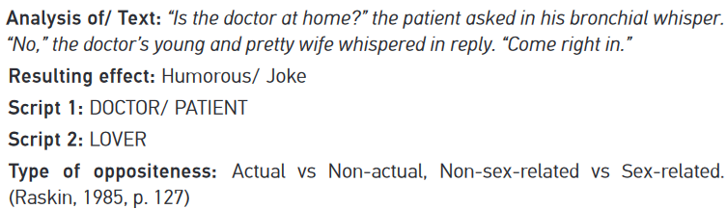
PROBLEM DETAILS
Based on semantic theory of humor, a necessary condition is that a text must have two distinct related scripts that are opposite in nature
Based on this, the classification model is modified as follows:
Proposed neural network structure includes parallel path to analyse the text as a whole
Also includes several other paths in the form of hidden layers to extract latent features from each sentence

Slide 10
PROPOSED METHOD
Text is separated into sentences and tokenized individually
BERT sentence embedding to embed the entire text as well as individual sentences
BERT sentence embedding for individual sentences is fed into parallel hidden layers
Extraction of mid-level features (e.g. context, sentence type, keywords, etc)
Output for each sentence is a vector of size 20
BERT sentence embedding for the whole text is fed into the hidden layers
Detect relationships between sentences and examine word-level connections within the text
Output is a vector of size 60
Three sequential layers combine the output of all previous paths of hidden layers to predict the final output

Slide 11
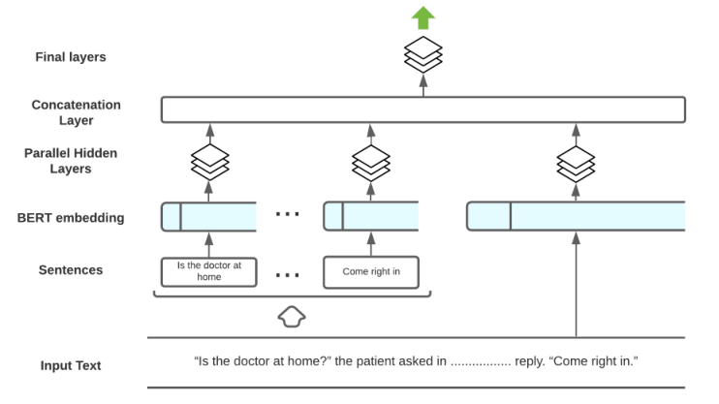
PROPOSED METHOD - ILLUSTRATION

Slide 12
OUTLINE
PROBLEM STATEMENT:
Overview
Technical Details
Literature Review
PROBLEM DETAILS:
Technical Viewpoint
Structure of Humor
Proposed Method
PAPER IMPLEMENTATION:
Data Processing
Technical Details
STATUS OF WORK:
Result Replication Status
Modifications Proposed

Slide 13
PAPER IMPLEMENTATION - Data Processing
Two different datasets collected:
News Dataset- 200,853 headlines scraped from the Huffington Post, across multiple categories. Acts as the source of formal text/non-humorous data
Jokes Dataset- 231,657 short jokes collected from r/jokes, r/cleanjokes subreddits
Pre-Processing Steps:
Duplicate removal from both datasets
Analysis of distribution of character length and number of words in both datasets
Selective filtering to bring both datasets to a similar distribution, the filter criterion being 30-100 characters and 10-18 words per data entry
Conversion of data entries from ‘Title Case’ format to ‘Sentence case’ in the News Dataset to match the Jokes Dataset
Contractions expanded (isn’t is not), and punctuations and special characters cleaned.
Random selection of 100,000 entries from each set and combination into the ‘ColBERT Dataset’

Slide 14
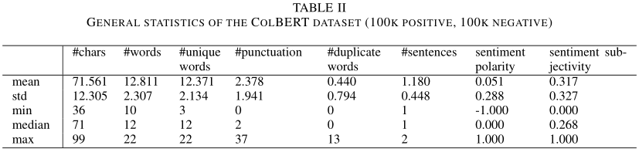
PAPER IMPLEMENTATION - Data Processing
A few statistics about the ColBERT Dataset: The dataset is well balanced, homogenous and much larger that previously used datasets
There is no significant correlation between the target (humor label) and:
Character Count: +0.09 measured correlation
Sentiment Polarity: -0.09 measured correlation
Sentiment Subjectivity: +0.02 measured correlation

Slide 15
PAPER IMPLEMENTATION - Technical Details
MODEL USED TO OBTAIN SENTENCE EMBEDDINGS: Pre-trained BERT_{BASE} model with 12 layers, 768-hidden, 12-heads, 110M parameters, which is pre-trained on lower-cased English text (uncased)
BERT TOKENIZER: The pre-processed data is fed into the tokenizer with maximum sequence length of 100 characters
EMBEDDINGS: The tokens are input into the BERT Model with vector size of 768, to obtain the sentence embeddings
TRAINING: Only the subsequent 8-layered neural network is trained on the sentence embeddings obtained from BERT on 80% of the ColBERT Dataset
PROGRAMMING: Language used is Python, utilized libraries include HuggingFace for BERT modules, and TensorFlow/Keras for the neural network modules

Slide 16
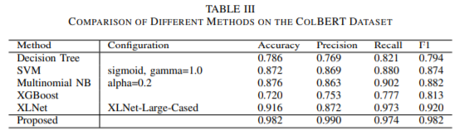
PAPER IMPLEMENTATION - Technical Details
COMPARISON AGAINST BASELINES: All baseline comparisons are made after 5 epochs of training on the designated training set (80% of the ColBERT Dataset)
Decision Trees, SVMs, XGBoost and Multinomial Naive Bayes models used traditional word tokenizers such as CountVectorizer, and TfidfVectorizer. XGBoost is one of the latest, and most optimized classification algorithms
Models which use sentence embeddings, i.e. XLNet and ColBERT consistently outperform traditional word representations by a huge margin
ColBERT (110M parameters, 8 layers) outperforms XLNet-Large (340M parameters, 24 layers), due to more effective utilization of the inherent linguistic structure of humour

Slide 17
OUTLINE
PROBLEM STATEMENT:
Overview
Technical Details
Literature Review
PROBLEM DETAILS:
Technical Viewpoint
Structure of Humor
Proposed Method
PAPER IMPLEMENTATION:
Data Processing
Technical Details
STATUS OF WORK:
Result Replication Status
Modifications Proposed

Slide 18

TEAM: RESULT REPLICATION STATUS
Browsed the links and papers on the following GitHub repositories to gain a better understanding of the ColBERT model:
https://github.com/Moradnejad/ColBERT-Using-BERT-Sentence-Embedding-for-Humor-Detection
Used a pre-trained model to load data from a standard dataset, predict the classification output and record a summary of the model
https://github.com/stanford-futuredata/ColBERT
Studied the documentation on how to train the ColBERT model on a custom dataset for future implementation within the course project

Slide 19
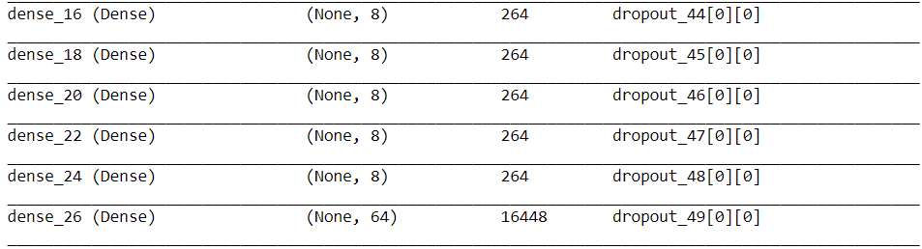
MODIFICATIONS PROPOSED
In place of the fully connected/dense layers in the neural network succeeding BERT, we can implement convolutional layers. This will probably improve the capability of recognizing features from the embeddings.

Slide 20
REFERENCES
Research Papers
ColBERT: Using BERT Sentence Embedding for Humor Detection (Issa Annamoradnejad, Gohar Zoghi)
Human Recognition Using Deep Learning (Chen and Soo, 2018)
Humor Detection: A Transformer Gets the Last Laugh (Weller and Seppi, 2019)
GitHub Repositories
https://github.com/stanford-futuredata/ColBERT
https://github.com/Moradnejad/ColBERT-Using-BERT-Sentence-Embedding-for-Humor-Detection
Disclaimer: The work presented in this document are in no way the work of Om Prabhu and/or Gopalan Iyengar, unless explicitly specified (Work Status Section).

