Slide 1
Understanding Health and Wellness through Microbiome research
30th July – 1st August 2025
Dr. Tarini Shankar Ghosh
Microbiome Informatics
IIIT-Delhi
Day 1
Lecture 1

Slide 2
Basics of metagenomics approach and obtaining microbiome data

Slide 3



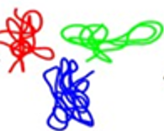


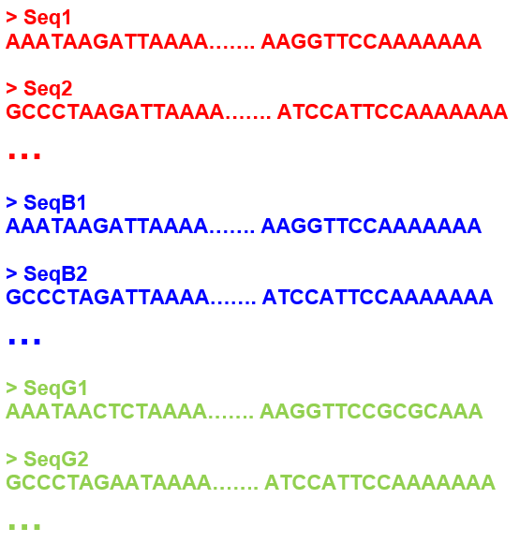

Microbiome Investigation utilizes the Metagenomics approach
Human Gut
Stool Samples
Microbial Cells
Extraction Microbial Community DNA
Sequenced Reads
Community DNA
Fragments
Sequencer

Slide 4
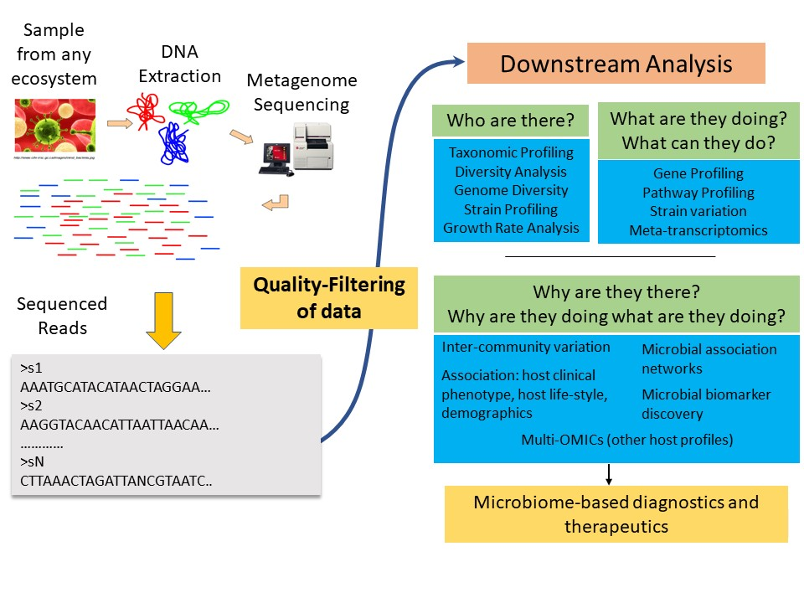
Metagenomic Investigation Workflow
Ghosh & Das, Springer book chapter, PMBTS-Part B

Slide 5
How do we extract community DNA?

Slide 6
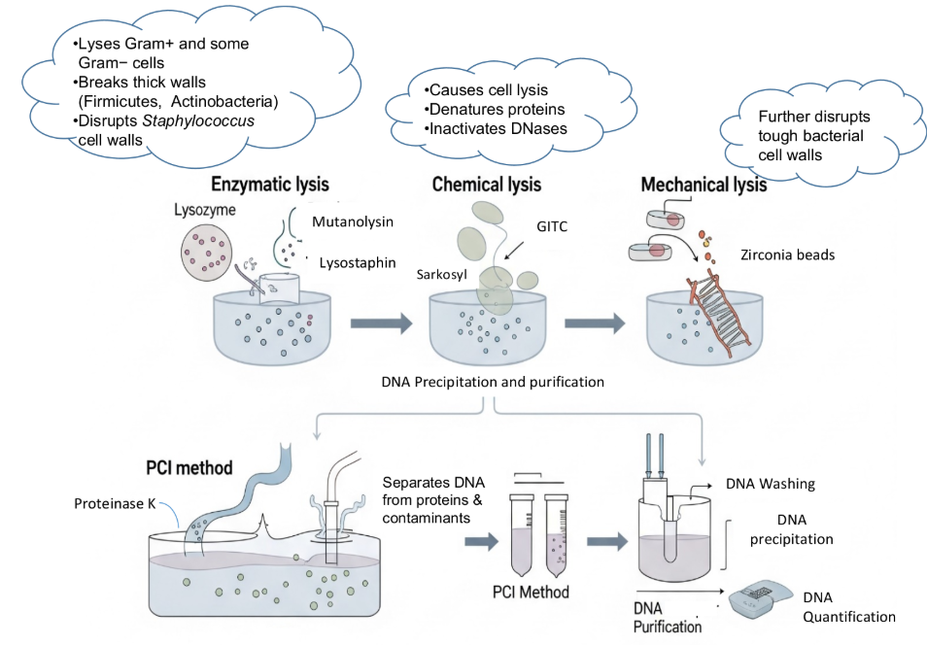
Steps in Community DNA extraction

Slide 7
How do we sequence the extracted community DNA?

Slide 8
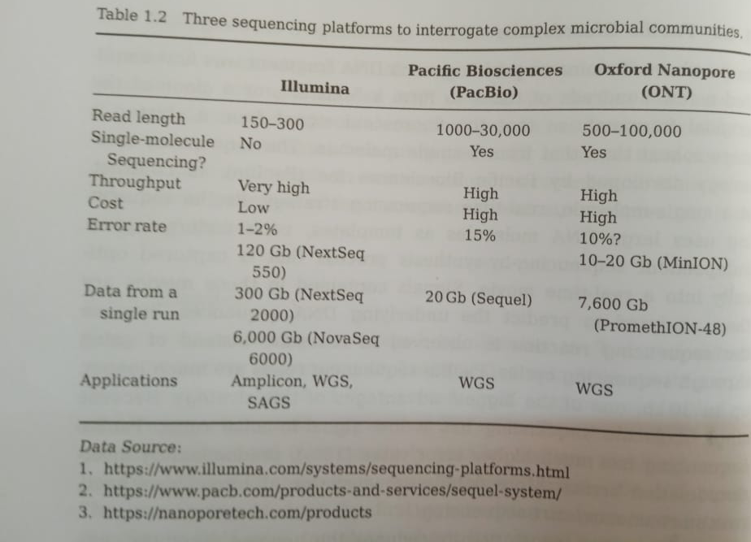
Three major sequencing technologies

Slide 9
Three major sequencing technologies
Illumina
Most popular
Low-cost
Very high-throughput
Highly accurate
But… Short reads (that is the sequences of genomic fragments that are being are short)

Slide 10
Three major sequencing technologies
Oxford Nanopore Technology (ONT)
Long reads
To achieve yields similar to Illumina, cost is high
Error rates higher
Pacific Biosciences
Long reads
Current versions are very accurate
Yields are low, but recent versions have adopted techniques that can generate equivalent yields like Illumina with similar costs.

Slide 11
Sequencing providers
If you are planning microbiome projects, don’t worry about sequencing…
There are many sequencing service provider companies in India where you can ship your extracted DNA.
They do the sequencing and send you the results
Examples: Eurofinn, MedGenome, Nueberg, Nucleome

Slide 12
Two variants of microbiome sequencing
Targeted Amplicon Sequencing (16S/18S/ITS)
Targeted Amplicon Reads
Community DNA
Fragment
Whole Genome Sequencing
Whole Genome Sequenced Reads

Slide 13

Targeted Amplicon Sequencing
Rapid and affordable way to generate the census of a given microbial community
Provides a Census: What species are present and what are their relative abundances
Amplifying and sequencing only one gene or specific regions of that gene (or species genic regions) across all species in an environment
These are called phylogenetic marker genes (or regions)
Species-specific barcode
Genome

Slide 14




Targeted Sequencing
Each Barcode Indicates A Species
Species abundance:
Number of copies of each barcode

Slide 15
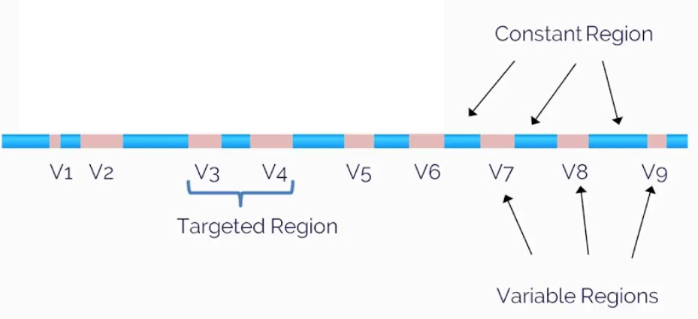
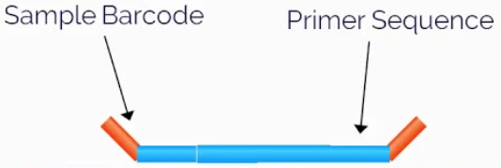
Why these specific genes?
https://i.ytimg.com/vi/_IpZOqFP9iY/maxresdefault.jpg
Example: 16S rRNA gene
Universally Conserved
Species-Specific
Census
Different Bacteria
Relative Abundances
Species-Specific
Amplified Species-specific hypervariable regions give an idea about what all bacterial/archaeal species are there along with their relative abundances

Slide 16
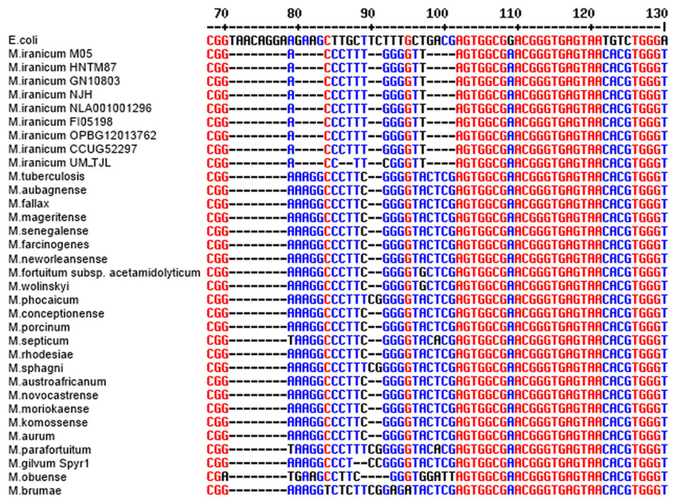
One snapshot.. how these genes look?
Hypervariable or Barcode Regions
Universally conserved Regions

Slide 17
These genes have two key beneficial attributes
Universally Conserved Regions bordering species-specific hypervariable regions enable designing a single set of primers (probes) that can fish all such genes from all species
Then sequencing and analysing the neighboring species-specific hypervariable regions give an idea about what all bacterial/archaeal species are there along with their relative abundances

Slide 18
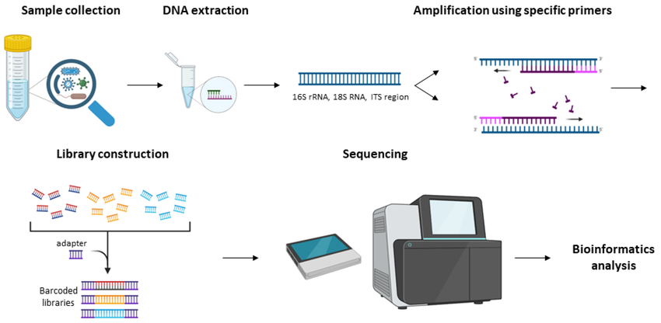
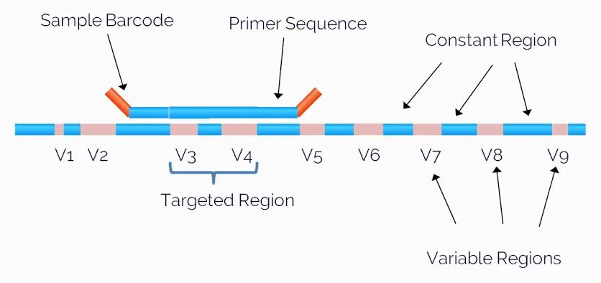
Workflow: Targeted amplicon sequencing

Slide 19
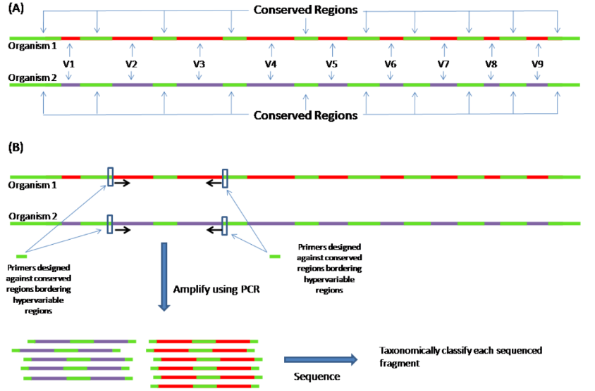
Overall Workflow

Slide 20
Targeted Amplicon Sequencing: Pros and Cons
Advantages
Affordable and Cost-effective
Sensitive, revealing even the rare members in the environment.
Especially applicable for low microbial biomass environments like biopsies, uro-genital tracts, stomach, hot springs.
Disadvantages
Cannot be used to cover viruses… as they do not have universal phylogenetic marker genes
Can only indicate who are there? We can not profile the functional potential of a microbiome
Errors introduced during amplification may lead to spurious patterns
Low Resolution (mostly genus level, in a minority at species)

Slide 21
To address this…

Slide 22
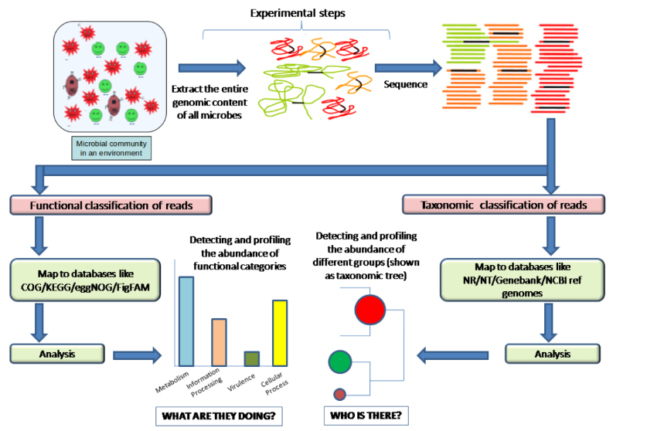
Whole genome sequencing (Shotgun Sequencing)
Here, we sequence the entire DNA content of a microbiome

Slide 23
Two major premises..
Discovery of novel species, including viruses, in a given environment
Discovery of novel genes and pathways with specific functionalities

Slide 24
We will cover both these approaches
Day 1 (Today): Targeted Amplicon Sequencing
Day 2 (Tomorrow): Whole Genome Sequencing

Slide 25
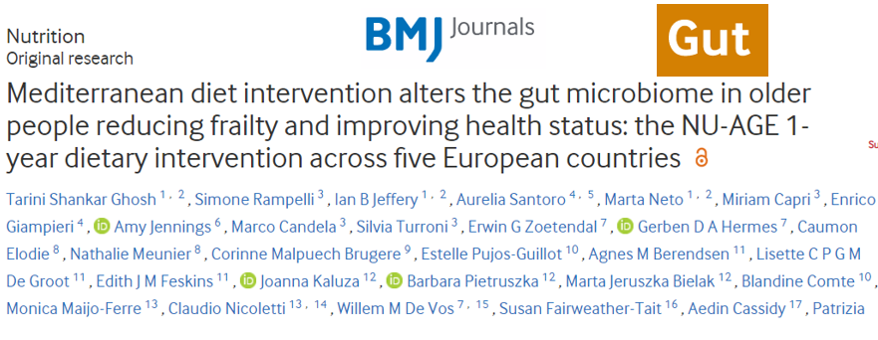


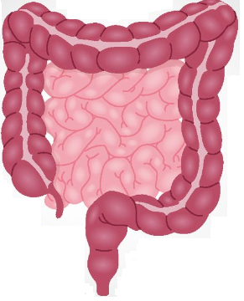
We will cover today with an example of a previously published study
Gut Microbiome
Diet
Transducer
Host Health
Link: https://gut.bmj.com/content/gutjnl/early/2020/01/31/gutjnl-2019-319654.full.pdf

Slide 26


Overall flow
Mediterranean Diet
Habitual Diet
..
..
..
..
Targeted 16S sequencing
Compare
Targeted 16S sequencing
Correlate with Diet, Clinical Phenotype

Slide 27
More on this .. Later today

