Slide 1
Understanding Health and Wellness through Microbiome research
30th July – 1st August 2025
Dr. Tarini Shankar Ghosh
Microbiome Informatics
IIIT-Delhi
Day 1
Lecture 2

Slide 2
Workflow
Quality Control Check
Identify Discrepancies
Sequence Classification
Data Normalization

Slide 3
Workflow for analyzing 16S data (Session 2)

Slide 4
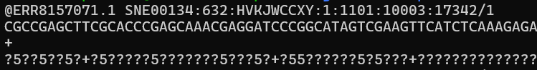
First look at the data… ☺ ☺
Majority of data output from sequencers are in the .fastq format which are compressed to the format .fastq.gz
Fastq
Identifier
Sequence
+ sign
Quality Scores
PHRED Quality Scores

Slide 5
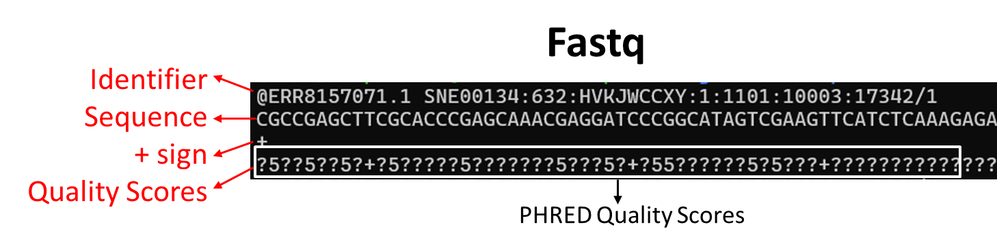
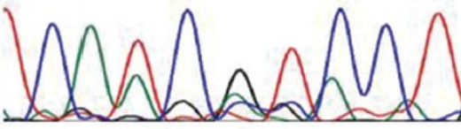
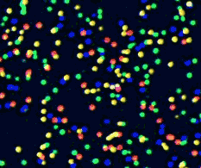
Judging Position-specific sequence quality
Chromatogram
A
G
C
A
Peak’s colour indicates the nucleotide base at the position
Peak’s intensity is then converted to the position’s quality
Position’s quality is encoded as a character
Indicates the probability of error at a given position
This is calculated using the Phred scoring scheme (Done in the software itself)
These character sequences in fastq sequences are thus utilized in the steps of our data analysis pipeline for sequence quality filtering
G
Height of each peak indicative of the strength of signal
T
A
G
G
A
Sequencing produces chromatogram

Slide 6
To know more about PHRED scores
Youtube Video Link:
https://www.youtube.com/watch?v=kgTf8-odrnY
Documentation:
https://www.drive5.com/usearch/manual/quality_score.html

Slide 7
Pre-processing of Sequences in each Fastq file

Slide 8
Quality Filtering and Sequence Trimming
The PHRED scores (described previously) thus indicate sequences that are ‘BAD’ or ‘UNRELIABLE’
Before analysing this data to draw biological conclusions, we need to remove these sequences or remove bad regions of other ‘GOOD’ sequences.

Slide 9
Quality Filtering and Sequence Trimming
We thus need to do quality checks to ensure:
Raw data is reliable enough to draw conclusions
Good Quality
No biases
Most sequencers output quality control (QC) report
But these deal mostly with errors in sequencer rather than the previous step or the starting biological material

Slide 10
Sequence Pre-processing
Quality check
1) FastQC - https://www.bioinformatics.babraham.ac.uk/projects/fastqc/
Low quality sequence trimming
1) Trimmomatic - http://www.usadellab.org/cms/uploads/supplementary/Trimmomatic/TrimmomaticManual_V0.32.pdf
2) Cutadapt - https://cutadapt.readthedocs.io/en/stable/guide.html

Slide 11
FastQC
FastQC is one of the widely used Sequence Quality Check tools for NGS sequence data
Available link: https://www.bioinformatics.babraham.ac.uk/projects/fastqc/
Features:
Both windows based and Linux server based
Supports a range of input formats
Informative summary graphs
Easily publication-worthy HTML reports

Slide 12
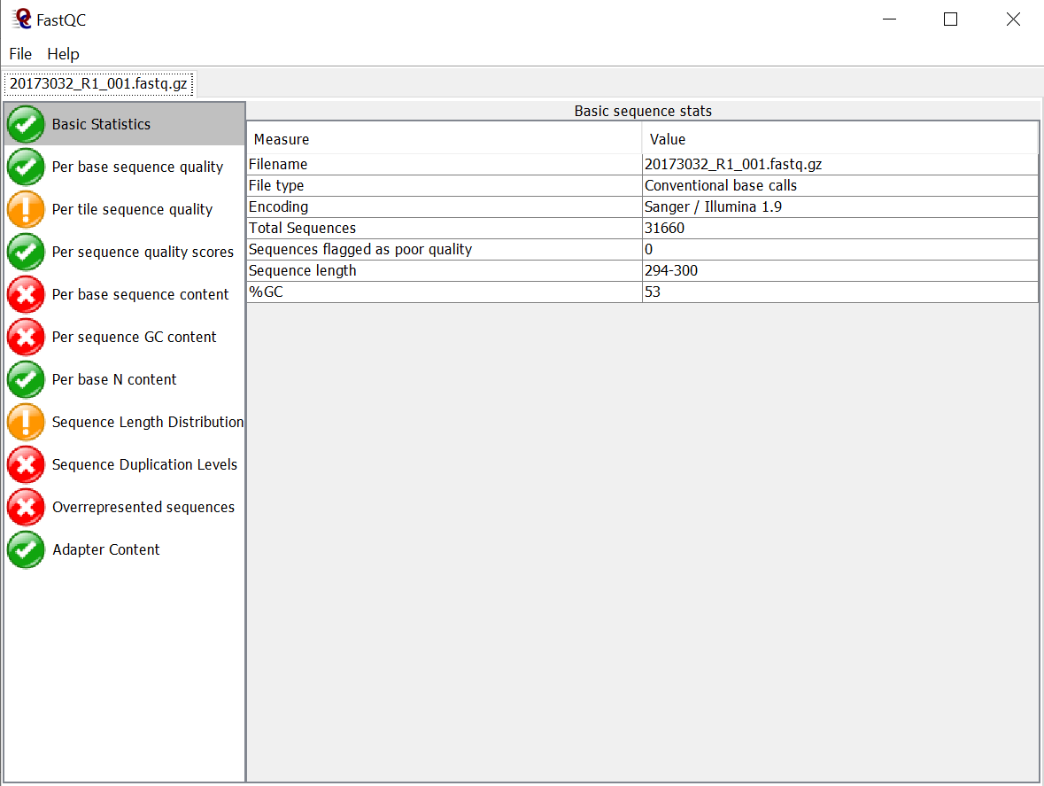
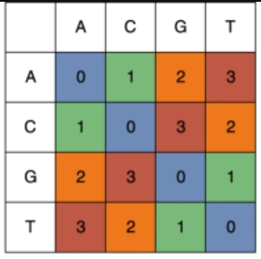
Sequence Data Report: Basic Statistics
Simple Summary
Filename: Name of the file
Filetype: Conventional Base Calls / Colorspace Data (ABi Solid)
Colorspace
Encoding: ASCII Encoding for Quality Scores (Illumina 1.9/Sanger indicates it is PHRED 33)
Total Sequences: Total number of sequences in the file
Sequences Flagged as poor quality: Sequences with mean quality scores below a certain threshold. Different criteria.e.g. if the median for any base is less than 20.
Sequence length range: Min-Max
%GC: GC content

Slide 13
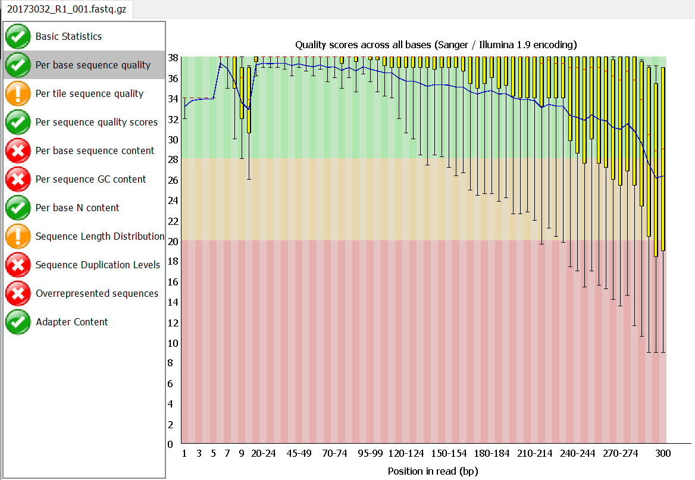
Sequence Data Report: Per Base Sequence Quality
Overview of the range of quality scores for each base position
Boxplots showing the range of scores for each position across all sequences in the dataset
Good
Ok
Good Quality in this length range
Bad
A warning will be issued if the lower quartile for any base is less than 10, or if the median for any base is less than 25.
This module will raise a failure if the lower quartile for any base is less than 5 or if the median for any base is less than 20.

Slide 14
What these pictures indicate?
For a majority of sequences, the sequences tend to become unreliable after position 270
Reliable/Good
Unreliable
1
270
300
The above visualization gives us an idea of where the sequences go bad or ‘WHERE TO TRIM’?

Slide 15
Similarly there are different ways to see the quality of the sequences
Good
Ok
Bad

Slide 16
FastQC gives us the picture of where or which sequences are bad
But it does not do any trimming or quality filtering
Next Question: How to actually trim

Slide 17
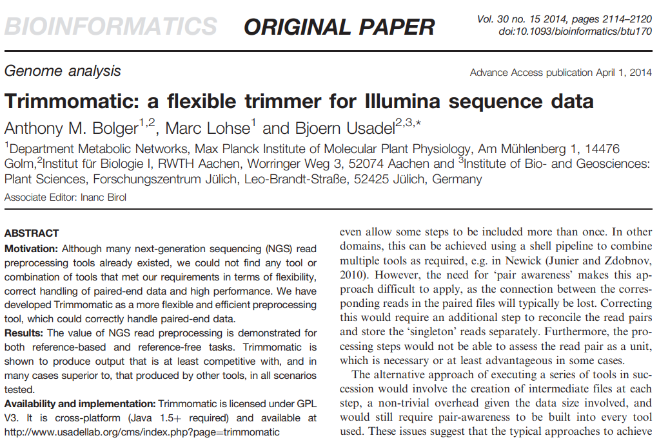
Trimmomatic
Perform actual quality filtering of Illumina sequence data
http://www.usadellab.org/cms/uploads/supplementary/Trimmomatic/TrimmomaticManual_V0.32.pdf

Slide 18
Trimmomatic
A fast multi-threaded command line tool that can be used to trim and crop Illumina (FASTQ) data as well as to trim adapters
Works with both single end and paired end
Functionalities
Quality Trimming
Removal of Technical Sequences

Slide 19
Three ways of Quality Reduction
Adapter
Read/Sequence
Quality Drop
A
5’
3’ Quality Drop
3’
Single End Trimming
5’
5’ Quality Drop
3’
Sliding Window based
5’
3’
After Trimming
B
5’
3’
Double End Trimming
5’
3’
Leading-Trailing based
After Trimming
C
5’
3’
Double End Trimming
5’
3’
CROP based
After Trimming
Irrespective of base quality, just crop from both side

Slide 20
Trimmomatic: Quality Trimming
Adapter
Read
LEADING
TRAILING
Adapter removal (ILLUMINACLIP)
SLIDINGWINDOW
MINLEN
AVGQUAL
CROP

Slide 21
Taxonomic Profiling in Amplicon Sequencing

Slide 22
Amplicon-based workflow (16S)
Taxonomic Profiling Strategy
Read-based
Assign each read to a node in the taxonomic tree
Cluster-based
First we identify clusters of read identical or extremely similar to each other
Taxonomically assign each cluster
Example - OTUs and ASVs
Methods
1) rdp classifier (https://sourceforge.net/projects/rdp-classifier/)
2) Sintax (https://www.biorxiv.org/content/10.1101/074161v1.full)
3) Vsearch (https://github.com/torognes/vsearch)
4) dada2 (https://benjjneb.github.io/dada2/tutorial.html)
5) Spingo (https://github.com/GuyAllard/SPINGO)
Databases (Will be covered later)

Slide 23

SPINGO
https://bmcbioinformatics.biomedcentral.com/articles/10.1186/s12859-015-0747-1
Works by computing the k-mer overlap between the query and a reference sequence
The score is computed as:
Q = Query (Sequence to map)
R = Reference sequence
Q_{K} ∩ R_{K} is the total k-mers common to Q and R
Q_{K} is the total number of k-mers in Q
Bootstrap based method of computing confidence scores for each node in the best lineage.

Slide 24
SPINGO Schematic
┌───────────────────────────────┐
│ Bootstrap Confidence Scoring │
└───────────────────────────────┘
A sequence from FASTA file
> SRR24682.12
AATCGGGCGCGCGAATCAGTACTGACTAAAAATGC
[ Replicate 1 ] [ Replicate 2 ] ... [ Replicate N ]
Subsampled k-mers Subsampled k-mers Subsampled k-mers
K-mer Generation (5-mer)
AATCG
ATCGG
TCGGG
CGGGG
GGGGC
GGGCG
GGCGC
GCGCG
CGCGC
GCGCG
CGCGA
GCGAA
CGAAT
GAATC
AATCA
ATCAG
TCAGT
CAGTA
[ Species 1 ] [ Species 1 ] [ Species 2 ]
(match) (match) (diff)
Reference Database
Species1
AATCGTCGGATCAACTTGGCTGA
Bootstrapping Multiple Sub-samples of k-mers
Count: Species1 = 95/100 ⇒ 95% Confidence
(How many times Species1 is still picked as the in the sub-samplings?)
Species2
ATCATGCTGGACAAGTCGAAG
Species .. n
How much overlap?
GACGATTTGCTGGAGTCTTACA
Confidence we considered >= 70%
Best Taxon (Highest K-mer Overlap)
Species assigned >>> Species1 (5 Bases)

Slide 25
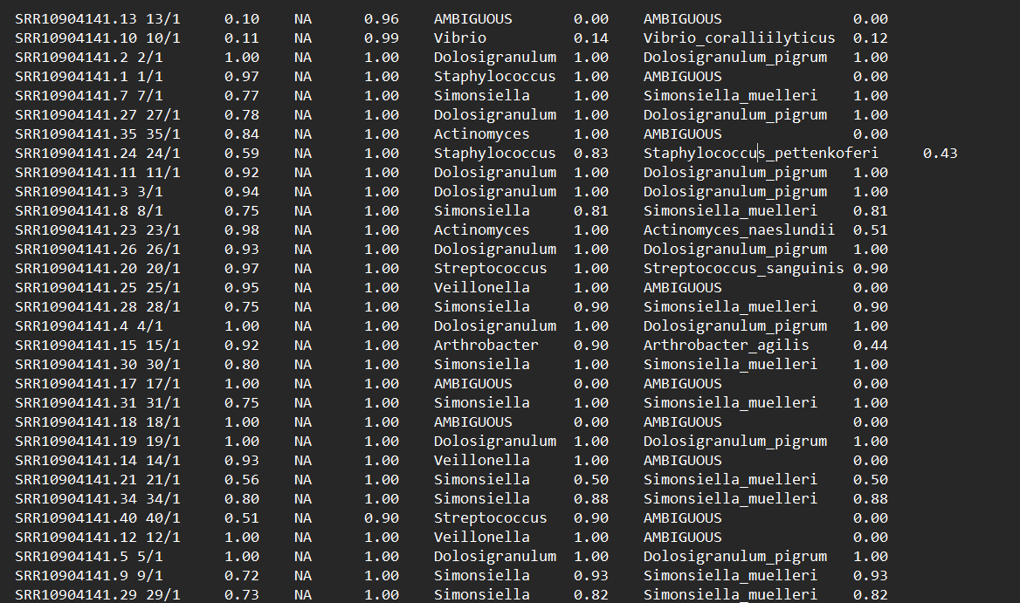
Output of SPINGO
Output of a Single Sample will look as below
Genus
Species
Confidence
Species with Confidence >= 70% is ideal to consider

Slide 26
Operational Taxonomic Units
“Operational definition used to define groups of closely related individuals.”
For 16S studies: Collection of 16S sequences having a certain maximum percentage of sequence divergence amongst each other
Typically this identity threshold is set at 97%

Slide 27
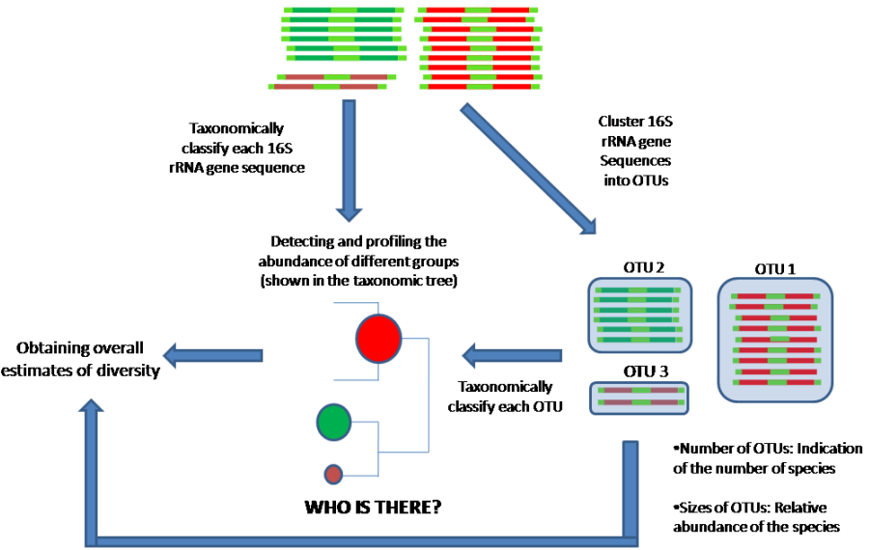
Operational Taxonomic Units
Tarini S Ghosh, PhD Thesis, 2014, UoH

Slide 28
Pipelines/Frameworks for amplicon data analysis
Integrated functionalities to process most stages of amplicon based data analysis in a single framework.
QIIME2
Manual Weblink: https://docs.qiime2.org/2022.8/
Publication: https://doi.org/10.1038/s41587-019-0209-9
Mothur
Manual Weblink: https://mothur.org/wiki/mothur_manual/
Publication: https://doi.org// 10.1128/AEM.01541-09
Vsearch
Manual Weblink: https://vcru.wisc.edu/simonlab/bioinformatics/programs/vsearch/vsearch_manual.pdf
Publication: https://doi.org// 10.7717/peerj.2584

Slide 29
Data Normalization Why Data Normalization? Types of Data Normalization

Slide 30
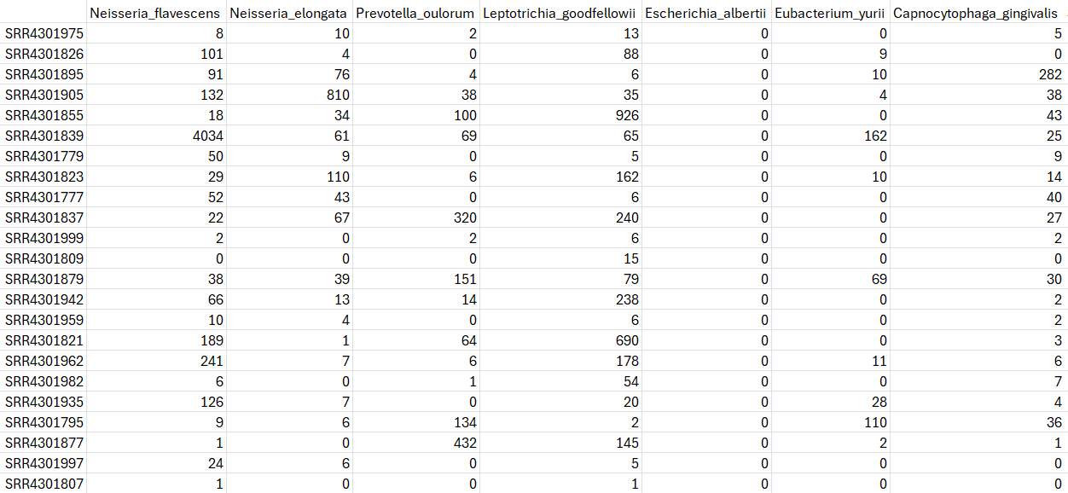
Here is how the data will now look..
Can be OTU, Genus, Family, Class etc
Taxa – Species
Samples
Number of occurrences of Taxa Neisseria elongata in SRR4301839 sample

Slide 31
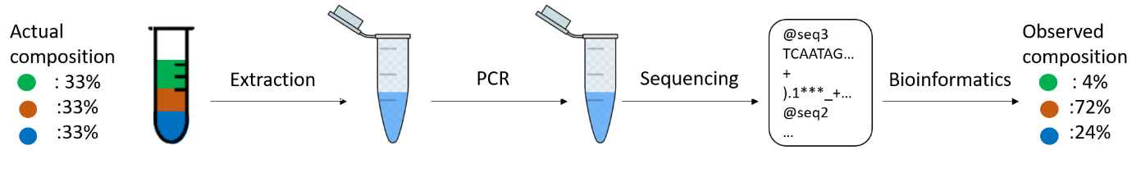
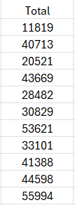
Normalizing the data: Why?
A
Species1
Species2
Species3
100%
100%
100%
B
https://carpentries-lab.github.io/metagenomics-analysis/figures/index.html
Species1
Species2
Species3
40%
60%
100%
DNA isolation errors
Errors in PCR cycles
Batch Effect
Full Composition
Not Observed
Variation in Total Count for Every Sample
……
……
……
……
……
……
……
……
……
……
……
……

Slide 32
Normalizing the data: Why?
Accounting for across the sample variability
Variability can originate because of issues during sequencing and due to genuine biological reasons.
Sequencing and Experimental Errors: By stochasticity and/or issues during sample preparation and DNA extraction, different samples may be sequenced to varying sequence depths resulting in different number of reads for different samples
Genuine Biological Reason: Different samples (or environments) may have different diversity in the microbial community

Slide 33
Normalizing the data
Sometimes these issues result in artefacts
To address this, there are some approaches:
Approach 1:
Total Sum Scaling (Obtaining Proportions or Relative Abundance)

Slide 34
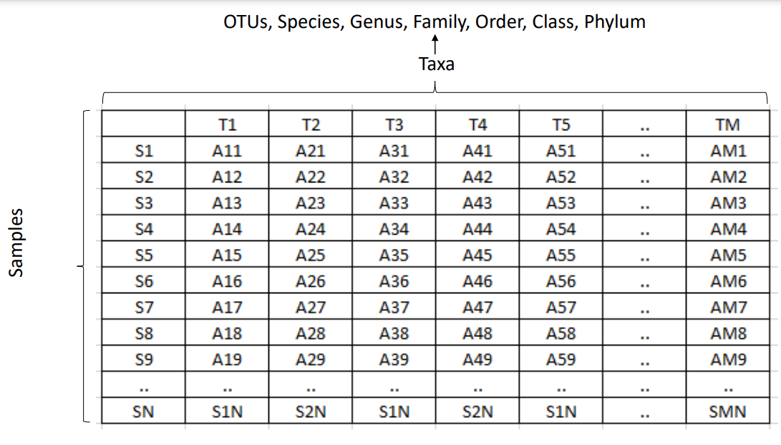
Relative Abundances (Total Sum Scaling)
Simplest Approach
Downside: Leads to Compositional Data
X_{ij}^{N}
Count of a given taxa in a sample
= X_{ij}^{N} / ∑ _{j=1toM} (X)
Sum all the values for a row
Count of a given taxa in a sample divided by the sum of all counts of taxa in that sample
Because Relative Abundances are essentially proportions, all values after normalization will sum to 1

Slide 35
Different Normalization Techniques in Microbiome Research
Youtube Video Link:
https://www.youtube.com/watch?v=lggqjmQzsGI
Documentation:
https://dataaspirant.com/data-normalization-techniques/

Slide 36
We will explore further in the next session

