Slide 1
Understanding Health and Wellness through Microbiome research
30th July – 1st August 2025
Dr. Tarini Shankar Ghosh
Microbiome Informatics
IIIT-Delhi
Day 3
Lecture 2

Slide 2
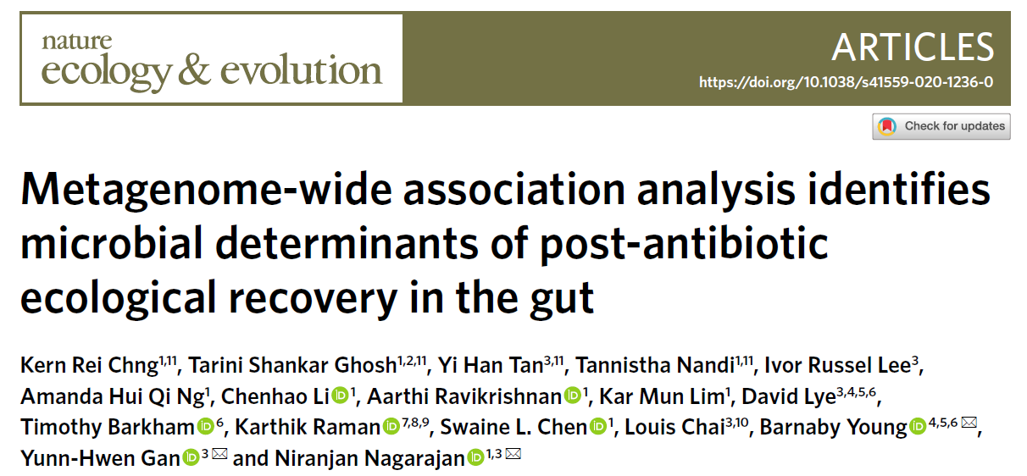
Case Study 1: Identification of recovery-associated bacteria
Data-driven identification of bacteria associated with recovery post-antibiotic treatment

Slide 3
Effect of antibiotic usage on the gut microbiome
Dysbiosis
INFLAMMATION
Antibiotic
Treatment
Loss
of
Activity
TRANSFER OF RESISTANCE
FUNCTIONS AFFECTED
IMMUNE MODULATION
NUTRIENT HARVEST
RESISTANT
PATHOGENS

Slide 4

Study Overview
Pre
During
Post
Treatment
Profiling of patients at outpatient departments of TangTok Seng Hospital, Singapore

Slide 5
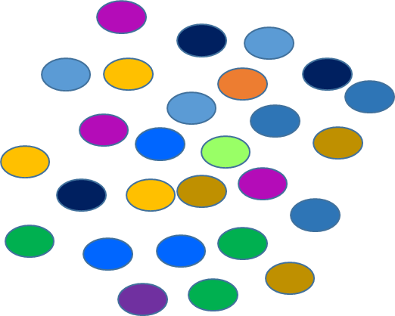
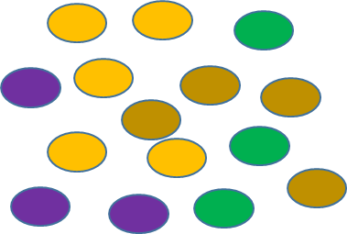
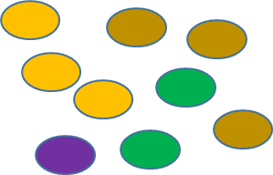
What do we expect when we give antibiotic treatment?
Pre
During
Post
Diversity

Slide 6
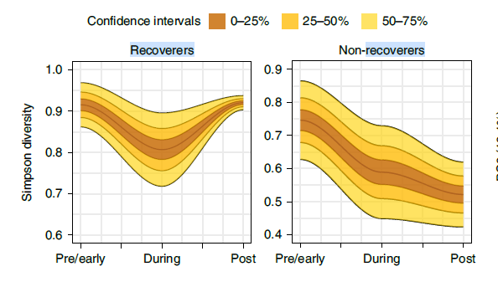
But what we observed was something different?
Some individuals recovered as expected. Some did not….

Slide 7
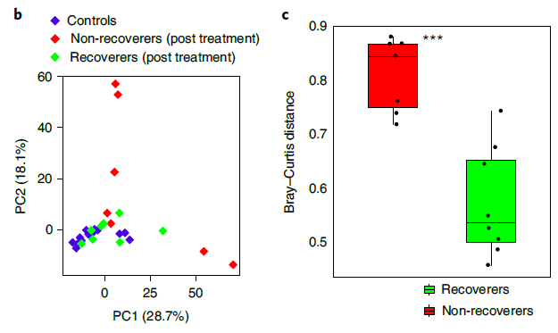
Non-recoverers have high beta-diversity with respect to controls… indicating dysbiosis

Slide 8
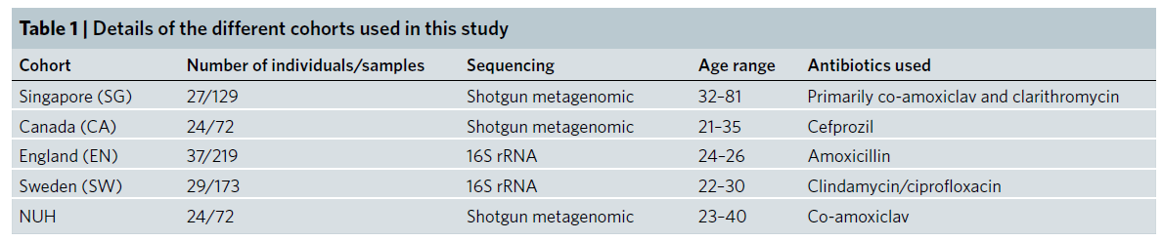
Can we distinguish them at an early stage using baseline microbiome composition?
Can we identify any markers that differentiate these two groups?
How reproducible are these signatures?

Slide 9
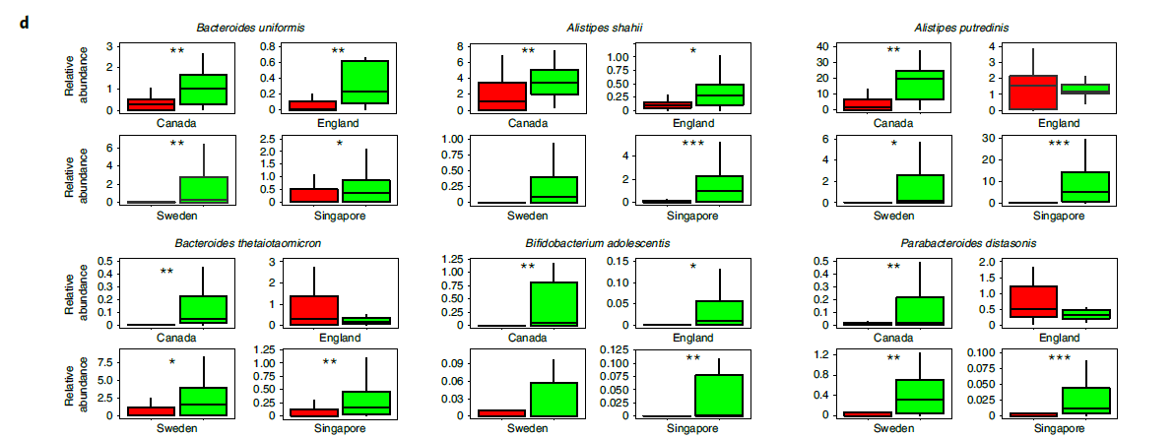
We identified some common microbes associated with recoverers?

Slide 10
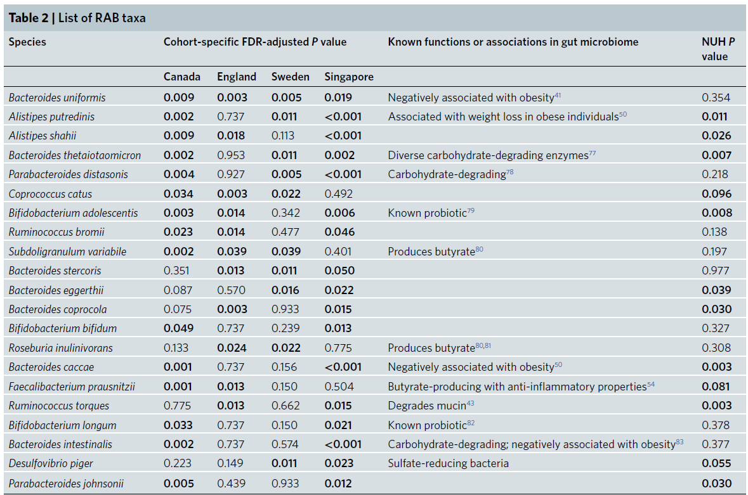
Complete list of Recovery-associated Bacteria

Slide 11
Summarize
There are some bacteria whose higher representation at baseline is associated with improved recovery of gut microbiome diversity post antibiotic treatment.
What functional features of these bacteria link to their association with Recovery?

Slide 12
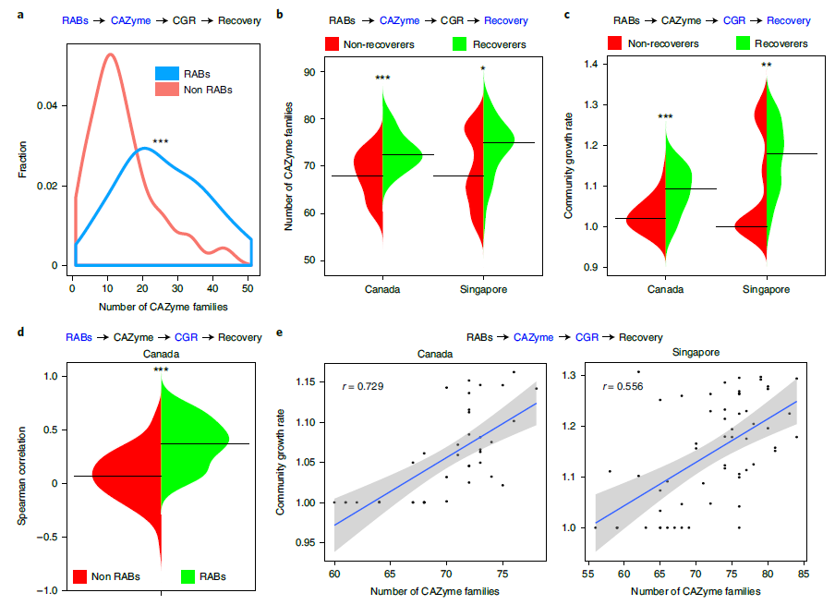
RABS > Higher Diversity of CAZymes > Community Growth Rate> Recovery

Slide 13
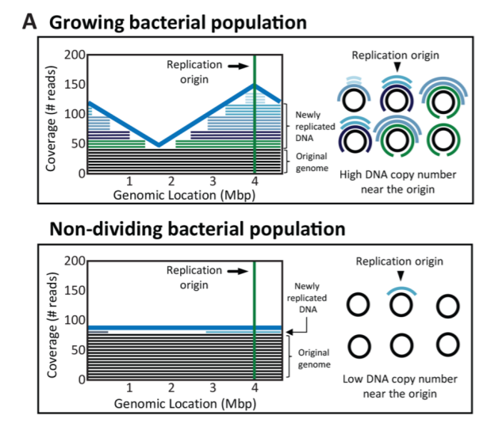
How do you calculate growth rate of microbes from microbiome data?
During cell division, the circular chromosome basically forms a replication fork starting from the origin
Reads mapping to the regions of the “opened” fork (near replication origin) will have higher coverage as they are coming from two strands as compared to the “unopened” region with one strand
Highly dividing cells will have more replication forks
Hence the coverage of reads to the replication origin region to those mapping to the terminus will be much more higher when compared to a relatively slow growing population of cells

Slide 14
How does these functions relate to microbiome community growth rate?

Slide 15
There is a technique called Association Rule Mining…

Slide 16
Association Rule Mining
Statistical technique to identify rules linking entities of a certain type
Example 1: People who like horror movies will also like thriller movies (may not be other way round)
Example 2: People who buy chicken will also buy onion and garlic (may not be other way round)
Example 3: Bacteria A is present only with Bacteria B (not the way round)
X
Bacteria A
Bacteria B

Slide 17
When you have multiple such relationships you can build a tree
BacteriaA > BacteriaB
BacteriaC > BacteriaB
BacteriaD > BacteriaA
D
A
C
B
This looks like a food web

Slide 18
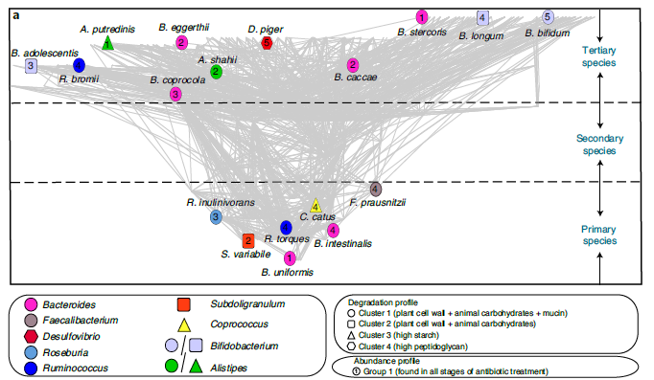
We created the first ever food-web in the gut microbiome

Slide 19
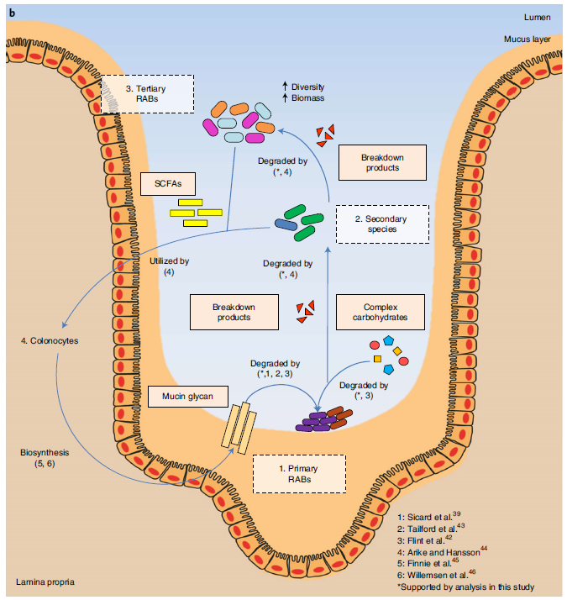
To summarize

Slide 20
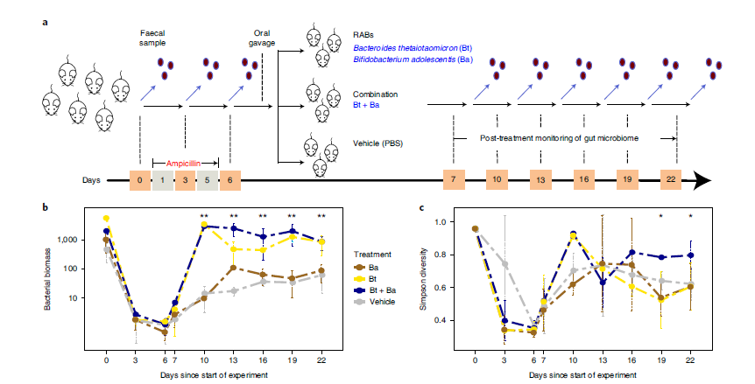
We also validated it in animal experiments

