Slide 1

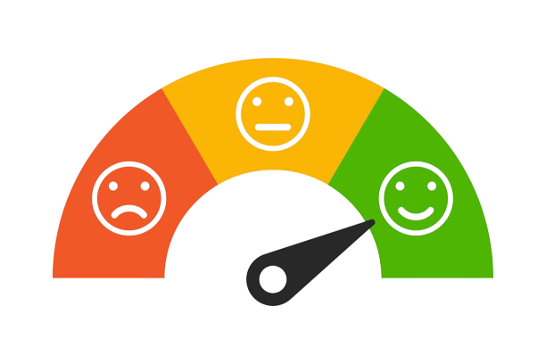
SENTIMENT ANALYSIS ON TWITTER
Presenters : Sudish Basnet, Omprakash Bista

Slide 2
TABLE OF CONTENTS
1. BACKGROUND INFORMATION
INTRODUCTION
APPLICATIONS
OBJECTIVES
CHALLENGES
ASSUMPTIONS
2. MODELLING
MODELLING PROCESS
DATASET
EDA
MODELLING & EVALUATION
3. INFERENCE
OPTIMAL FEATURES
RECOMMENDATIONS
CONCLUSION
4. REFERENCES

Slide 3
BACKGROUND INFORMATION

Slide 4


INTRODUCTION
Sentiment Analysis: Process of determining the emotional tone of text.
Twitter: Microblogging platform with short, dynamic messages called tweets.
Sentiment Analysis on Twitter: Extracting opinions and emotions from tweets.
Notes:
Sentiment refers to the emotional tone or attitude expressed in a piece of text, speech, or other forms of communication.
It reflects the underlying feelings, opinions, or attitudes of the speaker or writer towards a particular topic, subject, or situation.

Slide 5
Applications of Twitter Sentiment Analysis
Brand Perception
Understand public opinion about brands and products.
Monitor sentiment for brand management.
Political Analysis
Analyze public sentiment towards political candidates.
Gauge reactions to policies and events.
Real-time Event Monitoring
Track sentiment during live events and trending topics.
Instant feedback on social sentiment.

Slide 6

OBJECTIVES
Accurately categorize tweets into positive, neutral, and negative sentiment classes.
Preprocess and clean the tweet texts to mitigate noise and enhance the quality of input features for machine learning model.
Assess the model's effectiveness in sentiment classification by measuring its performance using evaluation metrics.
Provide insights into sentiment distribution, trends, and correlations within the analyzed tweet dataset.

Slide 7

Challenges in Twitter Sentiment Analysis
Short Text Length
Tweets are limited to 280 characters.
Limited context can lead to ambiguity.
Slang, Sarcasm and Abbreviations
Informal language, slang, and abbreviations are common.
Interpretation challenges for models.
Emojis and Emoticons
Emojis express emotions but require context.
A vital component of sentiment detection.
Memory Allocation
Training models with tweets features and user features in a large dataset uses more computational power and memory uses.

Slide 8
ASSUMPTIONS
The sentiment expressed in tweets can be accurately classified as positive, negative, or neutral.
Twitter users' expressed sentiments align with their true sentiments and reflect real-world consumer behavior or market trends.

Slide 9
MODELLING

Slide 10
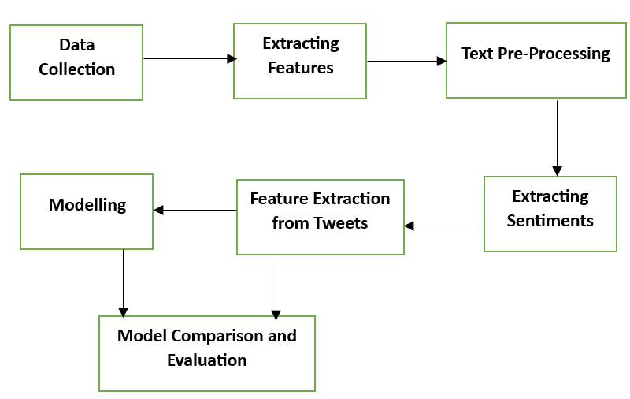
Modelling Process

Slide 11

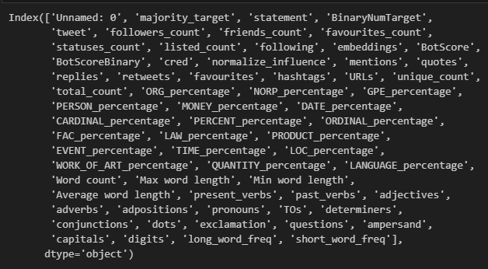

Dataset
Data Source: CIC Truth Seeker Dataset 2023
Initial Data Size: 134k+ records, 64 features
Exclusions: Attributes which are features of tweets (English Grammar)
Attributes Size after Exclusions: 10
Derived Variable: Sentiment
Original Attributes
Selected Attributes

Slide 12
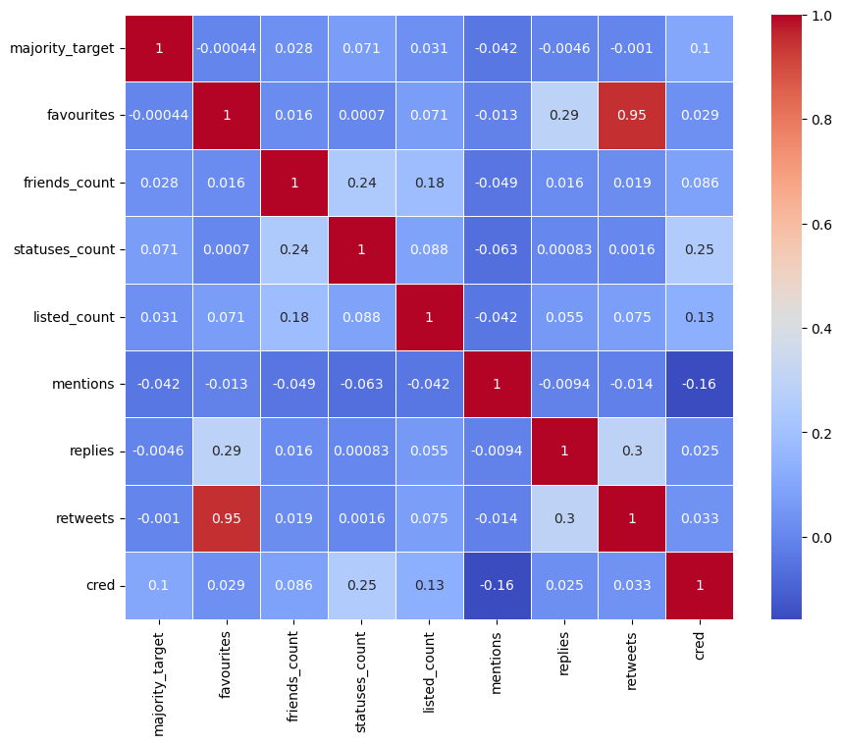
Correlation Matrix
Exploratory Data Analysis (EDA)

Slide 14
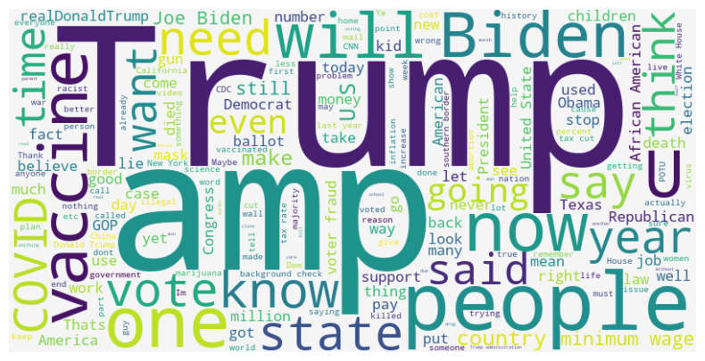
Word cloud of Tweets with Noises

Slide 15
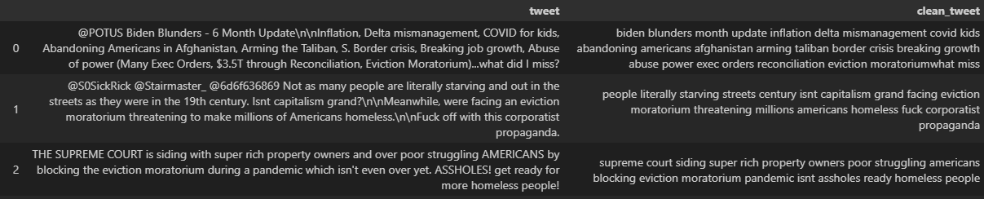
Raw Tweets vs Clean Tweets
Used NLTK package to remove noises

Slide 16
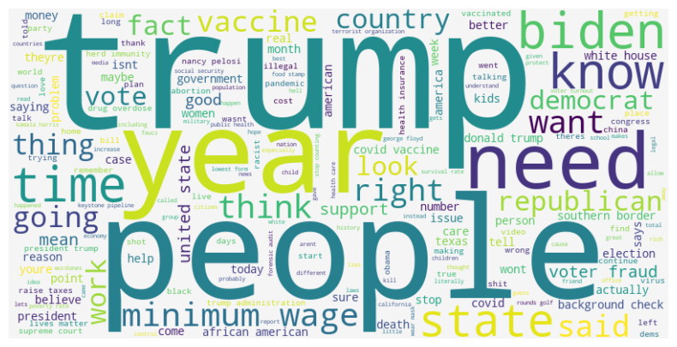
Word cloud of Clean Tweets

Slide 17
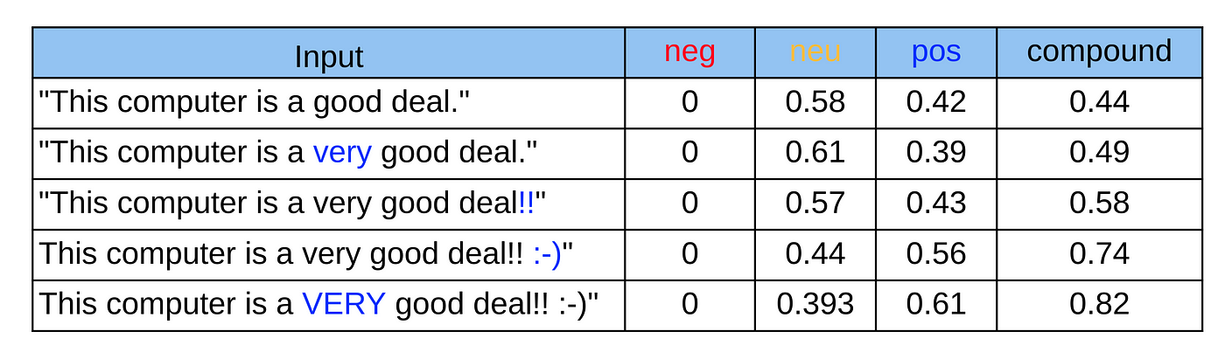
Extracting Sentiments
VADER( Valence Aware Dictionary for Sentiment Reasoning) is an NLTK module that provides sentiment scores based on the words used. It is a rule-based sentiment analyzer in which the terms are generally labeled as per their semantic orientation as either positive or negative.

Slide 18
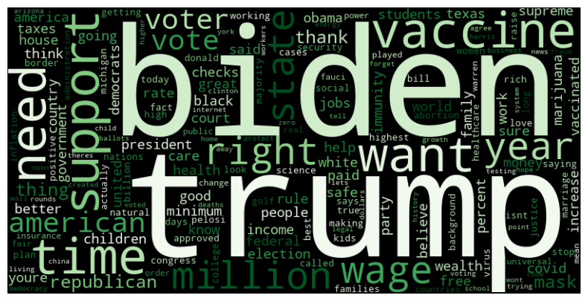
Word Cloud of Positive Tweets

Slide 19
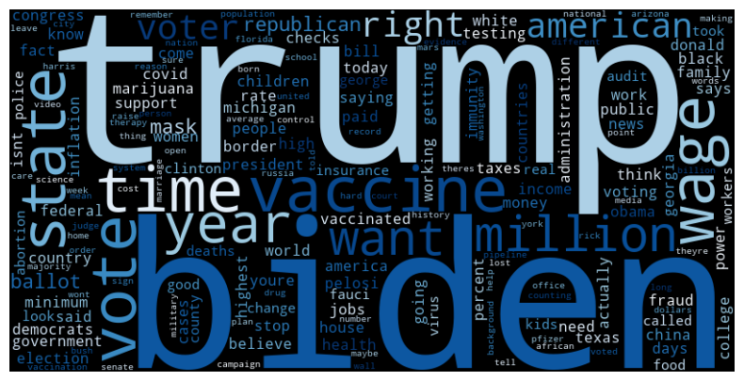
Word Cloud of Neutral Tweets

Slide 20
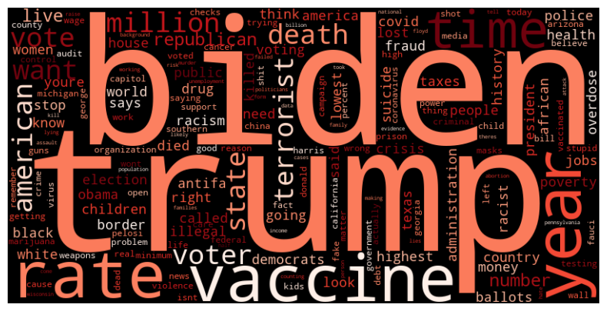
Word Cloud of Negative Tweets

Slide 21
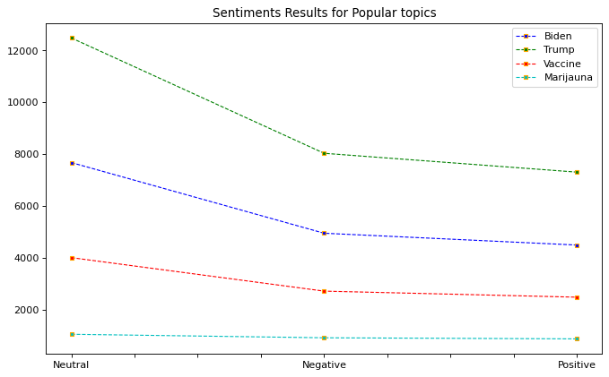
Trend of Sentiments
Negative Positive. Neutral

Slide 22
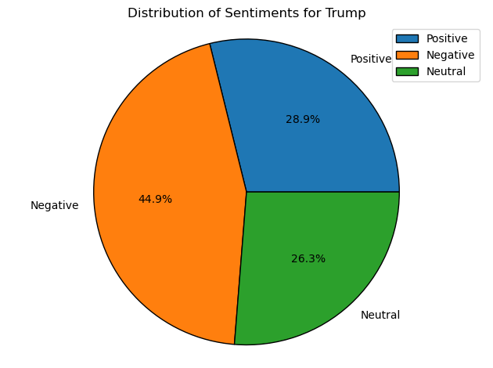
Sentiment distributions for Trump

Slide 23
True Negative Tweets about Trump
@AndreaR03428969 People vote with their pockets. Working class Americans (especially Obama-Trump-Biden voters) will remember that extra money from Trump, Bidens reconciliation failure &amp; $15 minimum wage failure, the ending of child tax benefits and eviction moratorium, and vote for Trump again.
@SpeakerPelosi You were so concerned about a partisan committee on January 6 that you forgot to do your job and help Americans by extending the eviction moratorium. You need to stop wasting your time with Trump, because youre not doing your job!
@jjz1600 @johncusack While so many Americans are struggling to keep roofs over their heads with Mortgage Eviction Moratorium expiring, and still struggling to find jobs, and deal with crazy Trump neighbors refusing to get immunized or wear masks.so disappointed in his tone deafness.
@PatriotMirror @RudyGiuliani You bots are pathetic. Ask Chicago where the million dollar refund is? Trump pays his but he is still living rent free in your head. Obviously the eviction moratorium includes those who suffer from TDS too. Of course Rudy read the bill. Most Americans who care did!

Slide 24
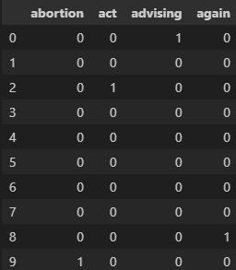
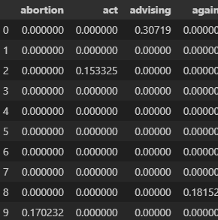
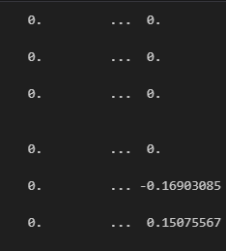
Feature Extraction Methods for Tweets
Bag of Words (Count Vectorizer)
Term Frequency – Inverse Document Frequency (TFIDF Vectorizer)
Hashing Trick (Hashing Vectorizer)

Slide 25
Feature Extraction Methods Comparison

Slide 26
Machine Learning Models
Logistic Regression
Multinomial Naïve Bayes
Linear SVC
Random Forest
K – Nearest Neighbors

Slide 27
Model Evaluation

Slide 28
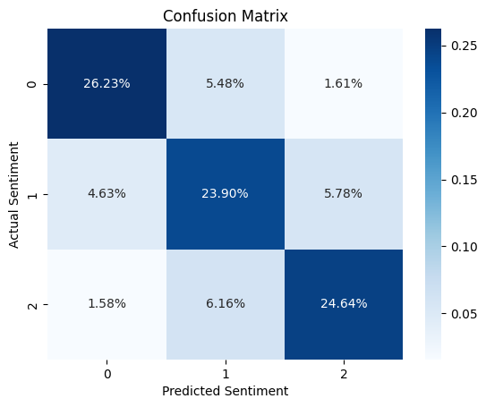
Confusion Matrix of Ideal Model

Slide 29
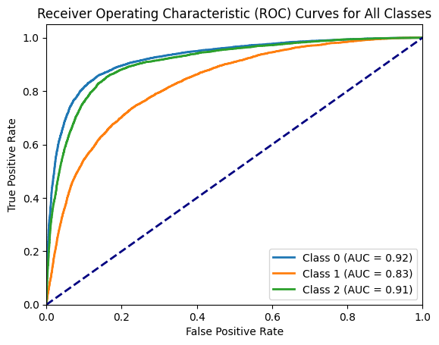
AUC – ROC Curve of Ideal Model

Slide 30
INFERENCE

Slide 31
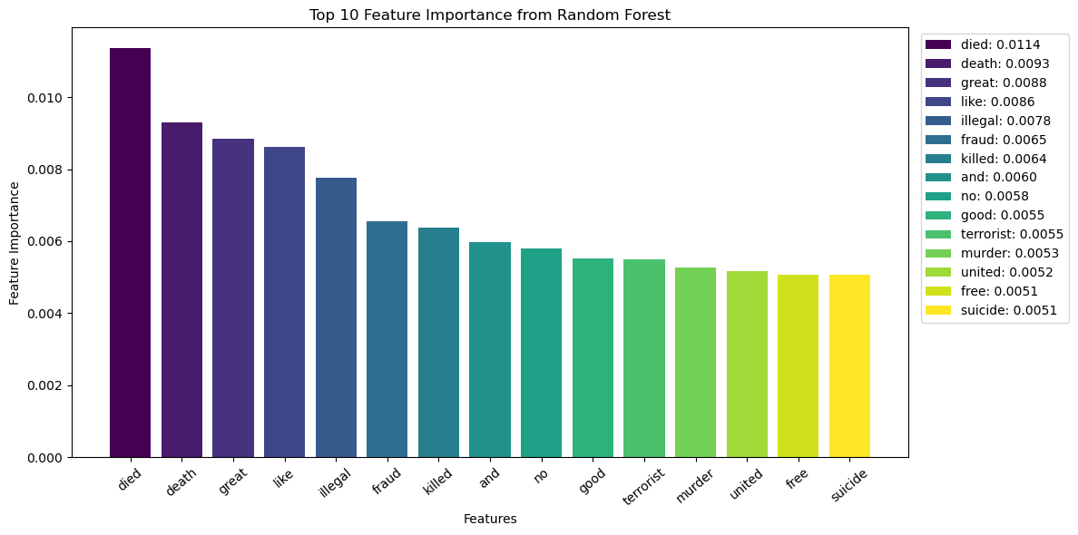
Optimal Features

Slide 32
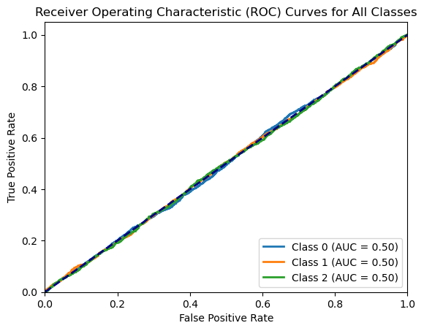
RECOMMENDATION
Refine features beside tweets, majority target, mentions, and cred and retrain model to gain more accuracy over time.
Increase the computational power and allocate memory to train our best model with the user data beside tweets.
Exclude data with nan’s if encountered during feature engineering or model trainings.
ROC Curve for model trained with all the excluded user attributes

Slide 33

Conclusion
Twitter sentiment analysis is a challenging yet valuable task. Advances in NLP and AI improve accuracy over time. Sentiment analysis with correctly classified sentiments can offers insights into public opinion, trends, and emotions. During modelling there can be issues with memory allocation; it can be temporarily solved by using sparse matrix for feature attributes.

Slide 34
References
https://towardsdatascience.com/sentiment-analysis-concept-analysis-and-applications-6c94d6f58c17
https://www.qualtrics.com/experience-management/research/sentiment-analysis/
https://blog.hootsuite.com/social-media-sentiment-analysis-tools/
https://www.unb.ca/cic/datasets/truthseeker-2023.html

Slide 35
QUESTIONS?
THANK YOU !

