Slide 1
DateTime in Python

Slide 2
Course Contents
Introduction
datetime.date
datetime.time
datetime.datetime
datetime.timedelta
Python format datetime
Handling timezone in Python

Slide 3
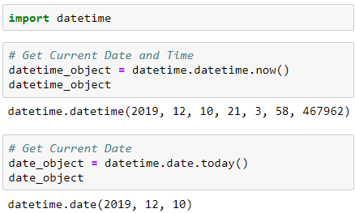
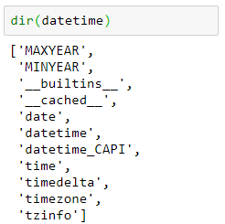
Introduction
Python has a module named datetime to work with dates and times. Following are simple programs to understand date and time.
To check what are the methods available in datetime module.

Slide 4
Classes in DateTime Module
date Class
time Class
datetime Class
timedelta Class

Slide 5
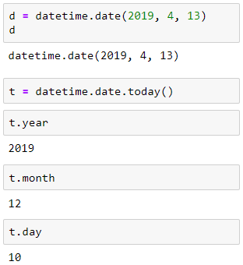

datetime.date Class
We can instantiate date objects from the date class.
A date object represents a date (year, month and day).
Get date from a timestamp
A Unix timestamp is the number of seconds between a particular date and January 1, 1970 at UTC.

Slide 6
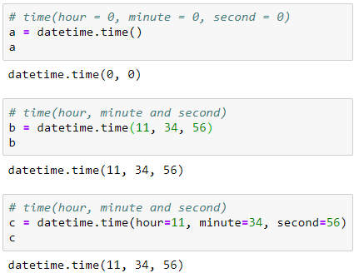
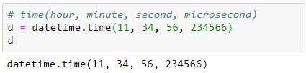
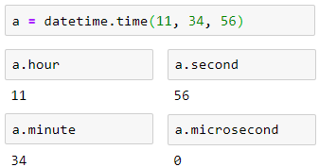
datetime.time class
A time object instantiated from the time class represents the local time.
Once we create a time object, we can easily print its attributes such as hour, minute etc.

Slide 7
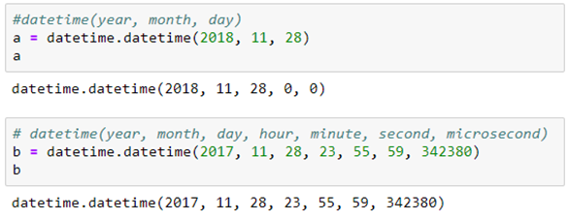
datetime.datetime class
The datetime module has a class named datetime that can contain information from both date and time objects.

Slide 8
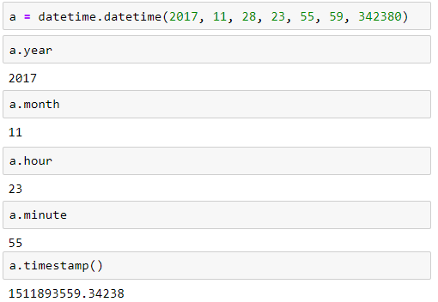
datetime.datetime class
Print year, month, hour, minute and timestamp

Slide 9
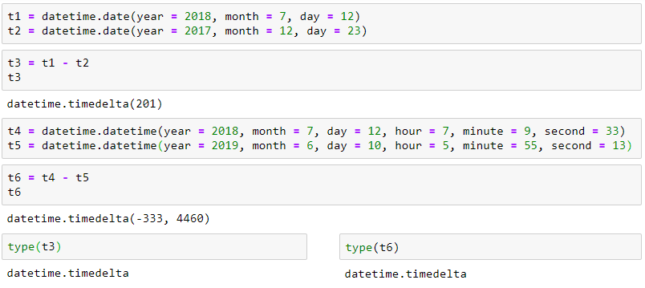
datetime.timedelta class
A timedelta object represents the difference between two dates or datetimes.

Slide 10
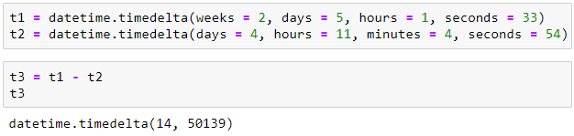
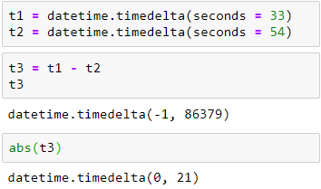
datetime.timedelta class
Difference between two timedelta objects
Printing negative timedelta object

Slide 11
Python format datetime
The way date and time is represented may be different in different places, organizations etc.
It's more common to use mm/dd/yyyy in the US, whereas dd/mm/yyyy is more common in the UK.
Python has strftime() and strptime() methods to handle this.

Slide 12
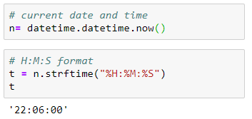
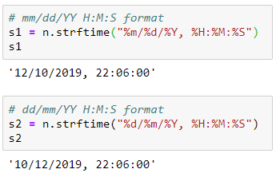
Python strftime() - datetime object to string
The strftime() method is defined under classes date, datetime and time.
The method creates a formatted string from a given date, datetime or time object.

Slide 13
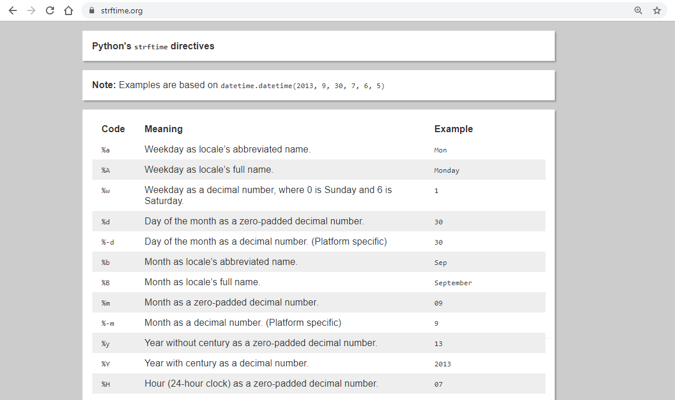
strftime.org

Slide 14
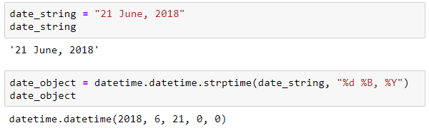
Python strptime() - string to datetime
The strptime() method creates a datetime object from a given string (representing date and time).

Slide 15
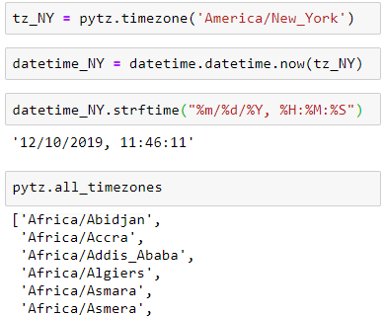
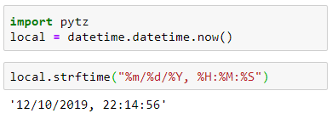
Handling timezone in Python
Suppose, we are working on a project and need to display date and time based on their timezone. Rather than trying to handle timezone ourself, we use a third-party pytz module.

