Slide 1
DeskSense
An on-device AI desk wellness companion
Your desk should watch out for you — not watch you for someone else.
Arduino UNO Q · Computer vision · On-device AI · Real-time embedded control
Team DeskSense
Government College of Engineering, Bargur
Notes:
DeskSense is a desk-side wellness device that runs entirely on an Arduino UNO Q. Nothing leaves the board.

Slide 2
Long desk hours create problems the desk cannot see
Poor posture builds gradually and attention breaks silently — both go unnoticed until discomfort shows up.
66%
66%
6–9 h
of Indian IT professionals report work-related musculoskeletal pain
pooled global prevalence of computer vision syndrome
of continuous sitting in a typical study or work session
pooled across 20 studies, 15,709 people
45 studies, 17,526 participants
students and desk workers alike
Why existing tools do not solve it
Activity trackers
Cloud webcam tools
Employer dashboards
Screen and keyboard logs infer focus. They can never see posture.
Frames leave the room for remote processing — a privacy cost users refuse.
Built to report on the worker, not to improve the desk they sit at.
Existing tools observe the user. DeskSense changes the desk.
Sources: Discover Public Health (2025), systematic review and meta-analysis of Indian IT professionals · Scientific Reports (2023), computer vision syndrome meta-analysis.
Notes:
Two independent meta-analyses land on the same number: two thirds of desk workers are already affected.

Slide 3
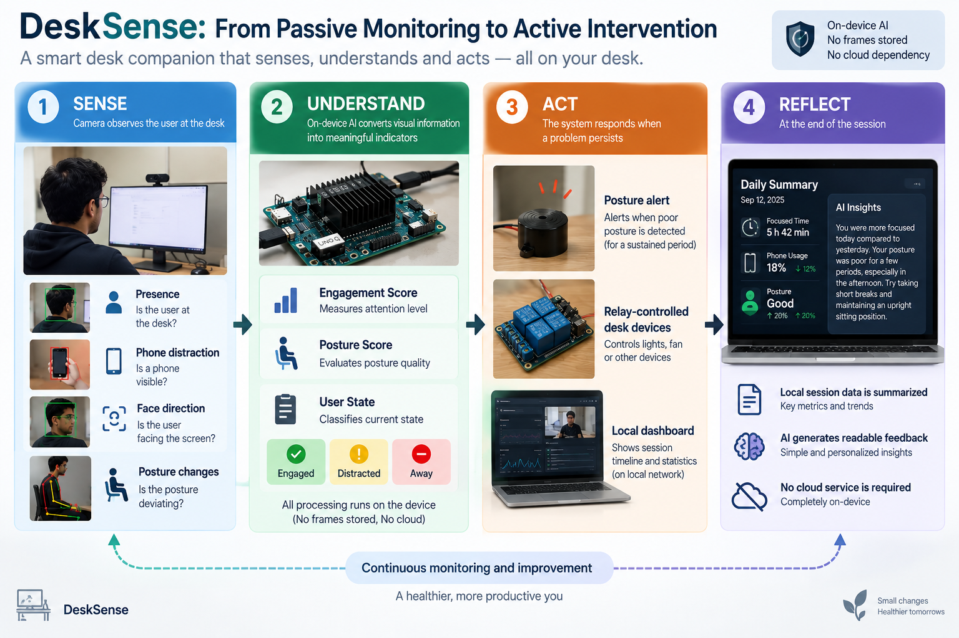
From passive monitoring to active intervention
The device senses, understands, acts and reflects — the whole loop runs on the desk.
Notes:
Four stages: sense, understand, act, reflect — all on-device.

Slide 4
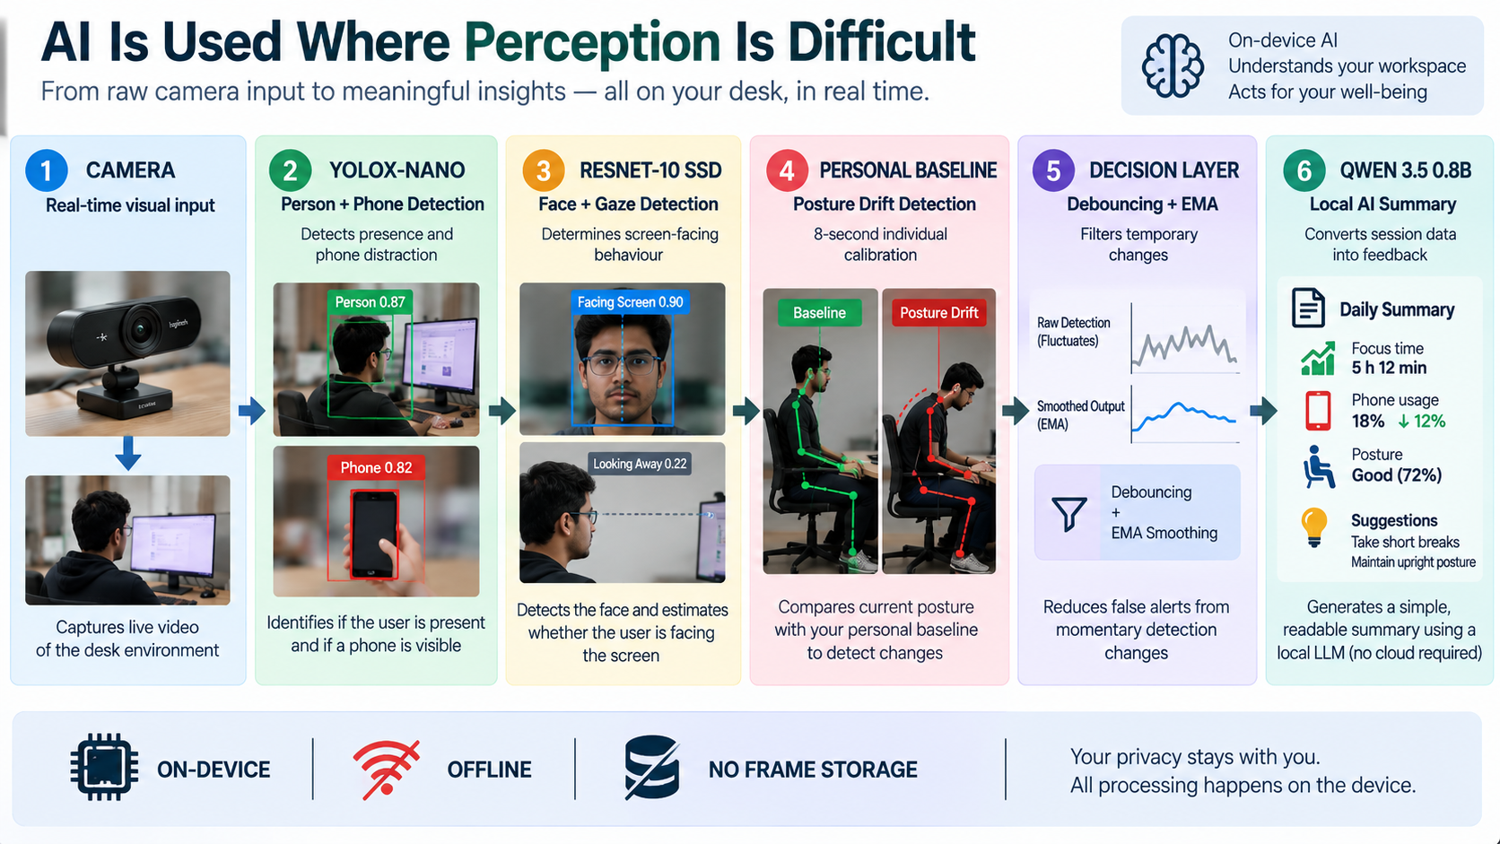
AI is used only where perception is difficult
Five models and a decision layer turn raw camera input into one honest posture and attention score.
Notes:
YOLOX-Nano, ResNet-10 SSD, a personal baseline, EMA debouncing and a local Qwen summary.

Slide 5
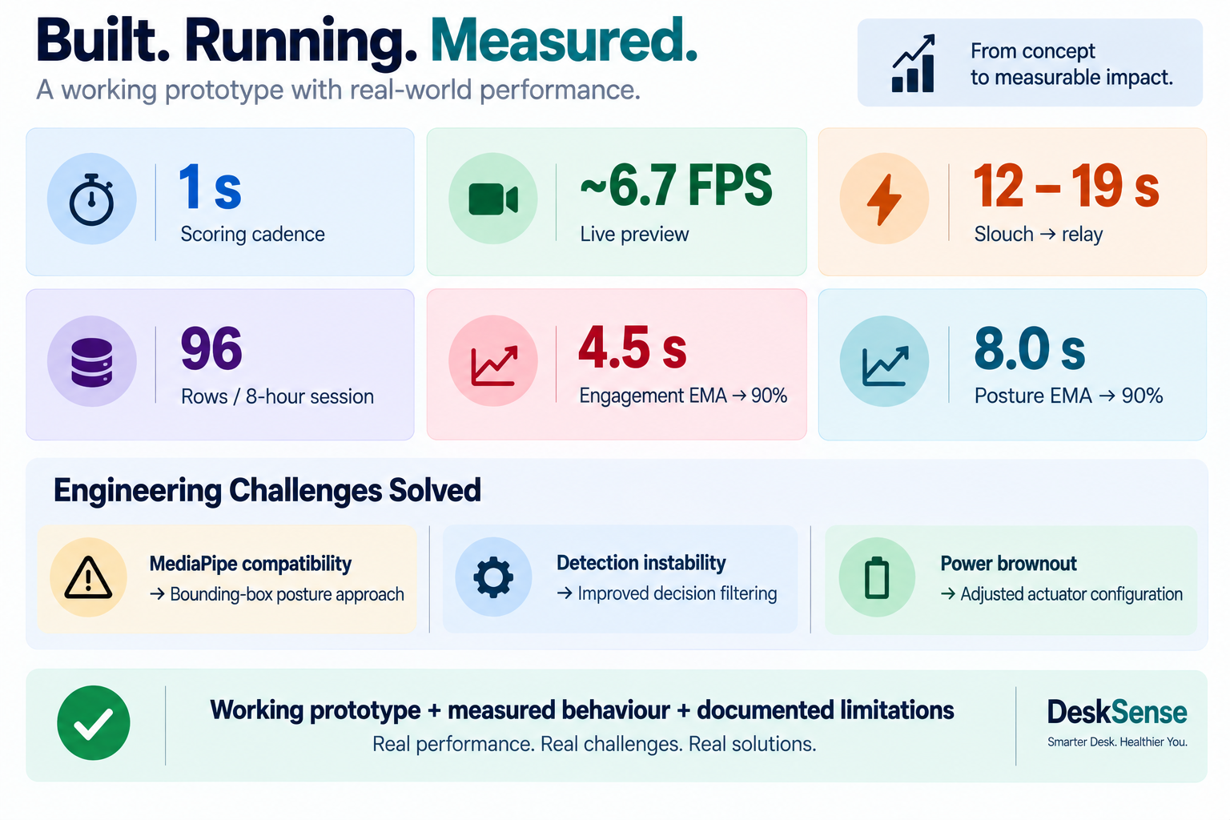
Built, running and measured
A working prototype with instrumented performance — and its limitations documented, not hidden.
Notes:
1 s scoring cadence, ~6.7 FPS preview, 12-19 s slouch-to-relay, 96 rows per 8-hour session.

Slide 6
Why this is hard to copy
Three positions that a cloud-based competitor cannot hold at the same time.
Privacy by architecture
A baseline per person
It acts, not just observes
Inference runs locally — no cloud dependency
Camera frames are never written to disk
Only aggregate session data is stored
No account, no sign-up, no third party
8-second individual calibration on sit-down
Scores drift from your own posture, not a fixed ideal
Median-locked, reset whenever you leave the desk
Works for a 5'2" and a 6'2" user without retraining
Relay-controlled desk devices — lamp, fan, and more
OLED and alerts at the desk, in the moment
Debounced so it nudges on drift, not on a twitch
A local LLM writes the end-of-session summary
Person-owned, not employer-owned. Every competing product asks the user to trade privacy for insight. This one does not make the trade.
Notes:
The privacy claim is architectural, not a policy promise — there is no cloud path to switch back on.

Slide 7
Market and business model
A one-time purchase for a person, not a per-seat subscription sold to their employer.
The opportunity
How it makes money
5.95 M
Device sale, one-time
people employed by the Indian tech industry in FY26
Bought by the person who sits at the desk. No subscription and no data business — that is the promise the product is built on.
Nasscom
4.50 crore
Institutional per-desk bundles
students enrolled in Indian higher education
Ten- to fifty-desk deployments in college labs, libraries and co-working floors, sold on ergonomics outcomes.
AISHE 2023–24
$2.60 B → $4.07 B
Open-source software core
India corporate wellness market, 2025 to 2034 (5.09% CAGR)
The code stays public. Trust is the moat, and it is cheaper to earn in the open than to claim in a privacy policy.
IMARC
Unit economics — estimates, not quotes
Prototype BOM ≈ ₹9,300 at single-unit Indian retail — the UNO Q 2 GB board (₹6,745) is about 72% of it, with camera, relay module and enclosure making up the rest. An indicative retail band of ₹12,000–15,000 leaves roughly 30–40% gross margin before volume pricing on the board. Every figure on this line is an estimate built from list prices.
Notes:
Board price from Robocraze, Sep 2026. Margin band is illustrative and needs a real quote before it is presented as fact.

Slide 8
Where this goes next
From a working prototype to something people can own.
Now
3 months
6 months
12 months
Token auth on the dashboard — the one honest gap, closed
Pilot in a college lab: 20 users, measured adoption and retention
Enclosure, single-board BOM, install in under ten minutes
Weekly summaries and a real pose model once one runs on ARMv8.0
Who it reaches
Students
Desk workers
Shared spaces
Healthier study habits during long sessions
Timely posture and attention feedback
Wellness without centralised surveillance
DeskSense · Team THIRAN-X · Government College of Engineering, Bargur
Notes:
Close on the ask. The pilot is the next real milestone; everything else follows from its data.

