Slide 1
CityEye
Problem Statement: "Smart City Road Safety Monitoring Through Existing
Public Transport Infrastructure"
Theme: Smart Mobility & Transportation
1

Slide 2
PROPOSED SOLUTION
UrbanSense AI
An AI-powered urban intelligence platform that
converts public transport buses into continuously
operating mobile sensing units.
Our system uses cameras and GPS already available
on buses to observe road conditions, traffic situations
and safety incidents while buses travel through the city.
It detects:
🕳️ Potholes and damaged road surfaces
💧 Waterlogging and flooded road sections
🚧 Missing or damaged road dividers
🚸 Missing zebra crossings
🚦 Damaged or missing traffic signs
⚠️ Roadside hazards and obstacles
🚗 Vehicle density and traffic congestion
🚶 Pedestrian-related safety situations
🚨 Possible accidents and hit-and-run incidents
Smart Verification
GPS + Time + Evidence for every detection
Unique Event ID for every problem
Same issue detected by multiple buses →
same Event ID + count
Incident → AI verification + number-plate extraction
CONSEQUENCE-AWARE SMART ROUTING
Considers:
Traffic + Road Condition + Waterlogging + Hazards + Distance
Calculates route consequence score
Compares possible routes
🟢 Low | 🟡 Moderate | 🔴 High
Recommends the safer & more efficient route
DETECT → VERIFY → MAP → ANALYSE → RECOMMEND

Slide 3
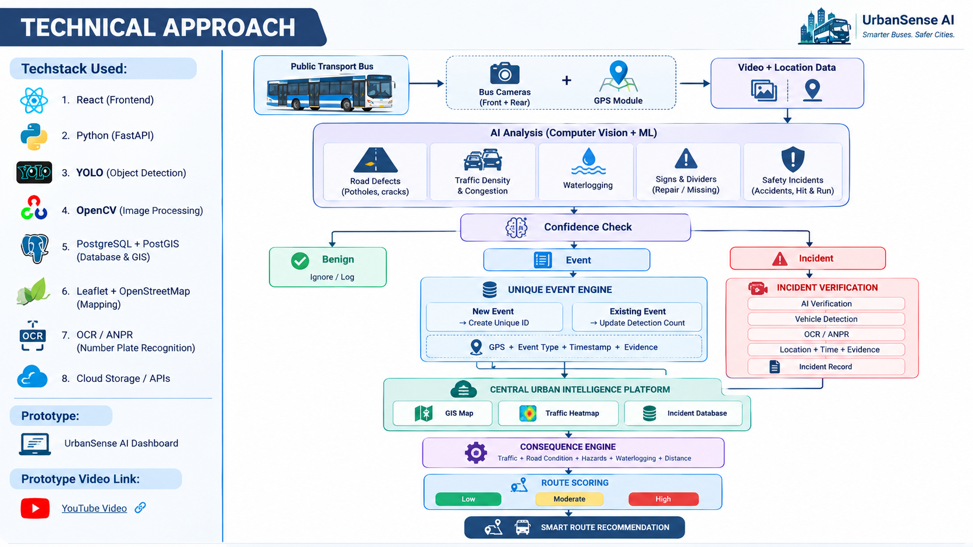
Tech Stack
🐍 Python
👁️ YOLO + OpenCV
🗺️ GIS + GPS
⚡ FastAPI
🗄️ PostgreSQL/PostGIS
⚛️ React
Backend & Data
FastAPI
PostgreSQL + PostGIS
Cloud Storage / APIs
Frontend & GIS
React
Leaflet
OpenStreetMap
Hardware
Front & Rear Bus Cameras
GPS-enabled Public Transport Fleet
Prototype : https://omnix-roads.preview.emergentagent.com/?utm_source=share
Video: https://youtu.be/9C7lmP3Qf9I?si=SPqSJHQYKWbxLiHh

Slide 4
FEASIBILITY
Technical – Achievable
Uses proven AI + Computer Vision + GPS + GIS
Existing buses act as mobile sensing platforms
Edge processing reduces unnecessary video transfer
Cloud platform supports centralized event management
System can scale with additional buses
Economic – Feasible
Uses existing transport infrastructure
Software-based solution
Scalable cloud deployment
Operational – Practical
Works during normal bus operations
Minimal manual intervention
Continuous data collection
CHALLENGES & MITIGATION
Challenge | Solution
Detection accuracy | Confidence + multi-frame verification
Duplicate events | GPS + time + Event ID matching
High bandwidth | Edge-first processing
False incidents | Multi-stage AI verification
Privacy | Secure access & controlled data
“Existing buses + AI = Continuous, scalable urban monitoring.”

Slide 5
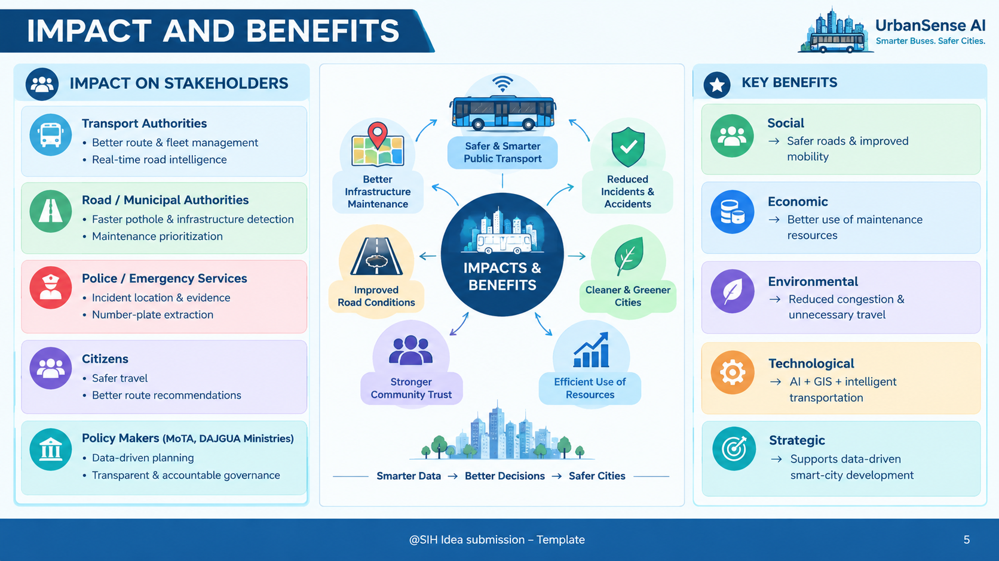
IMPACT ON STAKEHOLDERS
KEY BENEFITS
🏛️ Transport Authorities
Better route & fleet management
Real-time road intelligence
Social
→ Safer roads & improved mobility
🚧 Road / Municipal Authorities
Faster pothole & infrastructure detection Maintenance prioritization
Economic
→ Better use of maintenance resources
🚨 Police / Emergency Services
Incident location & evidence
Number-plate extraction
Environmental
→ Reduced congestion & unnecessary travel
👥 Citizens
Safer travel
Better route recommendations
Technological
→ AI + GIS + intelligent transportation

Slide 6
Road Damage Detection using YOLO https://www.nature.com/articles/s41598-025-14461-7
Traffic Monitoring using Computer Vision https://www.sciencedirect.com/science/article/pii/S0952197619301691
AI-based Smart Route Guidance https://www.sciencedirect.com/science/article/pii/S0378437124004199
Prototype : https://omnix-roads.preview.emergentagent.com/?utm_source=share
Video: https://youtu.be/9C7lmP3Qf9I?si=SPqSJHQYKWbxLiHh

