Slide 1

SENTIMENT ANALYSIS

Slide 2

The purpose of this project is to analyse the customer reviews on the British Airways airline available on a website called Skytrax. We are first going to understand the dataset and the variables present in them. Then we are going to analyse the effect of each variable on the polarity of the review.

Slide 3
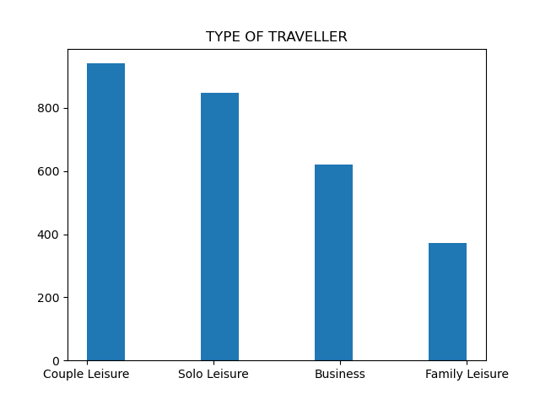
TRAVELER
The Type of Traveler variable takes on four values based on the type of customer(s) using the airline. The plot shows a histogram showing the distribution of the values in the dataset. It is seen that:
Couple Leisure make up the most of the customers in the dataset.
This is followed by Solo Leisure travelers then Business and finally Family Leisure.

Slide 4
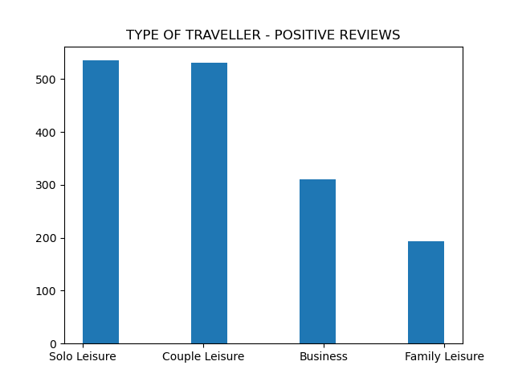
TRAVELER
Analyzing the type of travelers based on the positive reviews, it can be seen that:
Of all the type of travelers in the dataset, Solo Leisure travelers have given the most number of positive reviews.
They are followed by Couple Leisure type of travelers, then Business and Family Leisure.

Slide 5
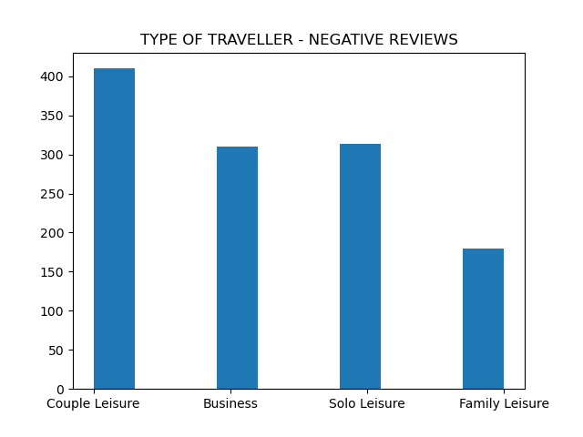
TRAVELER
Analyzing the type of travelers based on the negative reviews, it can be seen that:
Of all the type of travelers in the dataset, Couple Leisure travelers have given the most number of negative reviews.
They are followed by Business type of travelers, then Solo Leisure and Family Leisure.
Family Leisure travelers do not give that many reviews when compared to other types of travelers.

Slide 6
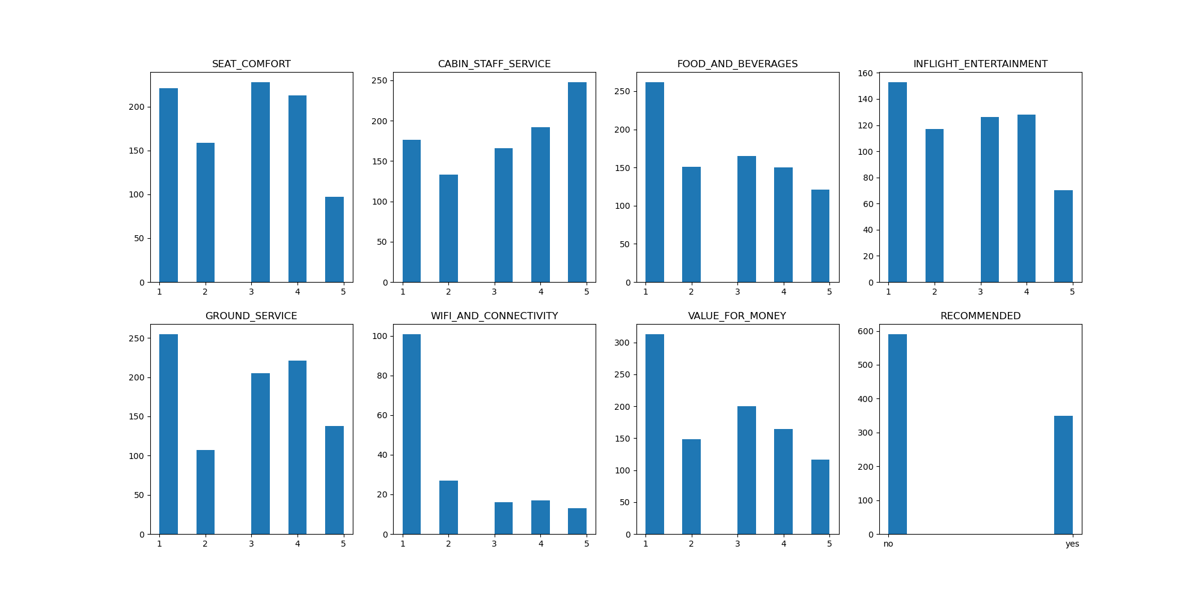
COUPLE LEISURE
Analyzing the Couple Leisure type of travelers it is seen that IMPROVEMENT is REQUIRED in:
Food & Beverages
Wifi & Connectivity
Value for money
These attributes are selected by selecting distributions that vary greatly in terms of rating.
In the rating system 1 is considered the worst whereas 5 is considered to be best rating.

Slide 7
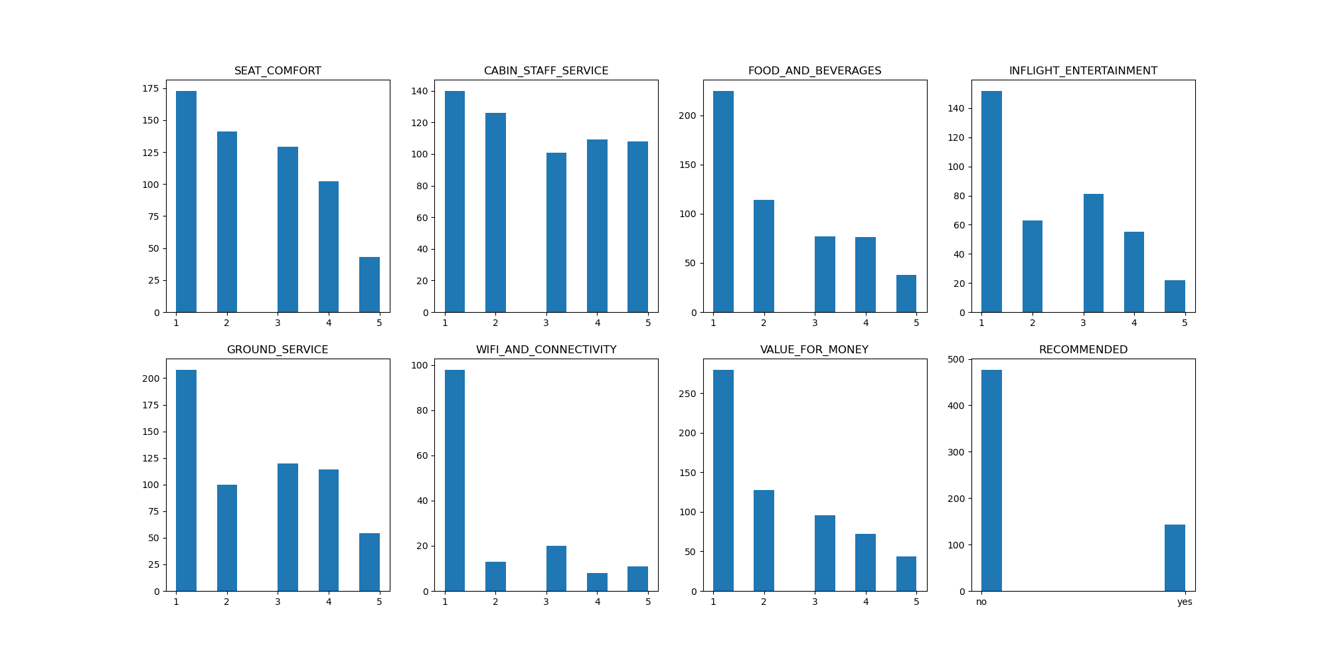
BUSINESS
Analyzing the Business type of travelers it is seen that IMPROVEMENT is REQUIRED in:
Seat comfort
Food & Beverages
Inflight Entertainment
Ground Service
Wifi & Connectivity
Value for money
These attributes are selected by selecting distributions that vary greatly in terms of rating.
In the rating system 1 is considered the worst whereas 5 is considered to be best rating.

Slide 8
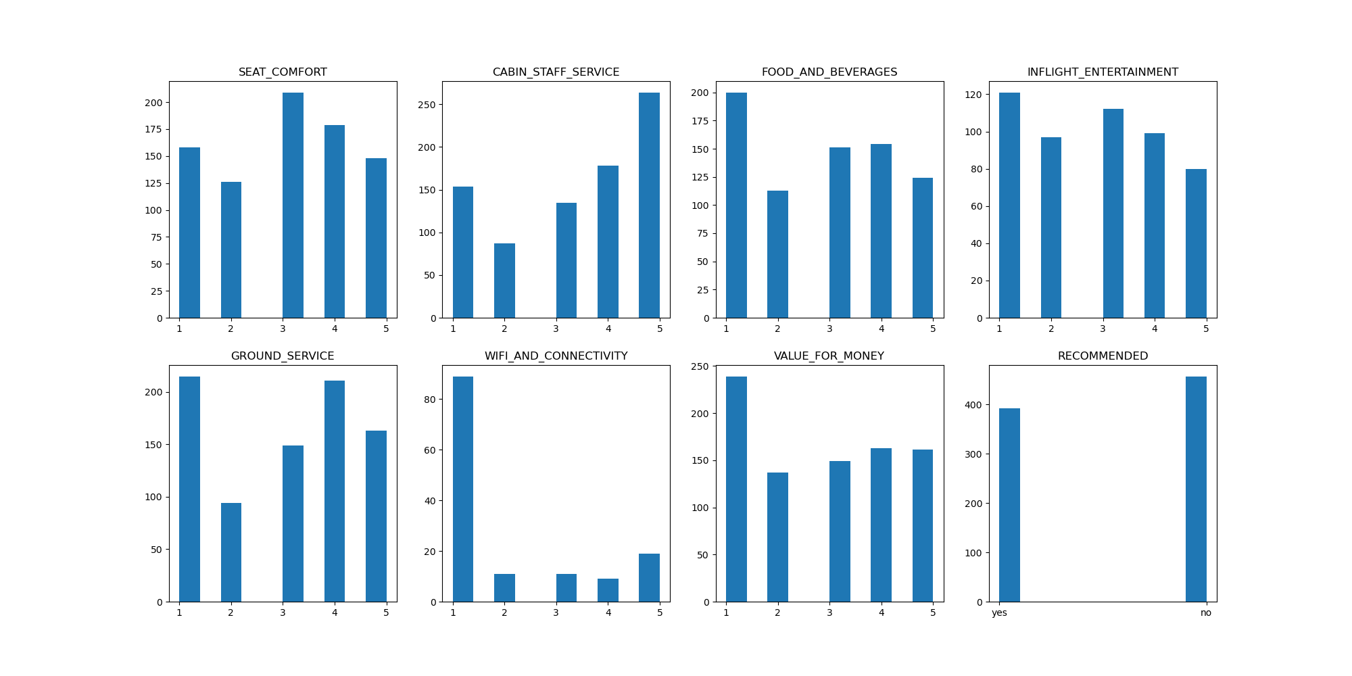
SOLO LEISURE
Analyzing the Solo Leisure type of travelers it is seen that IMPROVEMENT is REQUIRED in:
Food & Beverages
Wifi & Connectivity
Value for money
These attributes are selected by selecting distributions that vary greatly in terms of rating.
In the rating system 1 is considered the worst whereas 5 is considered to be best rating.

Slide 9
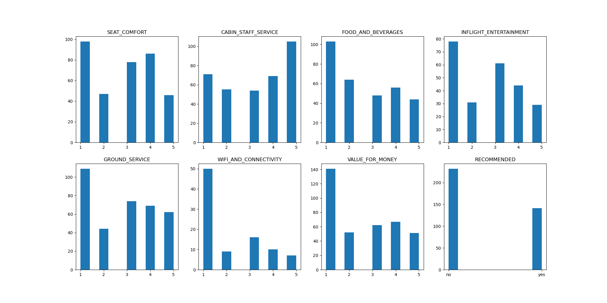
FAMILY LEISURE
Analyzing the Solo Leisure type of travelers it is seen that IMPROVEMENT is REQUIRED in:
Food & Beverages
Inflight Entertainment
Ground Service
Wifi & Connectivity
Value for money
These attributes are selected by selecting distributions that vary greatly in terms of rating.
In the rating system 1 is considered the worst whereas 5 is considered to be best rating.

Slide 10
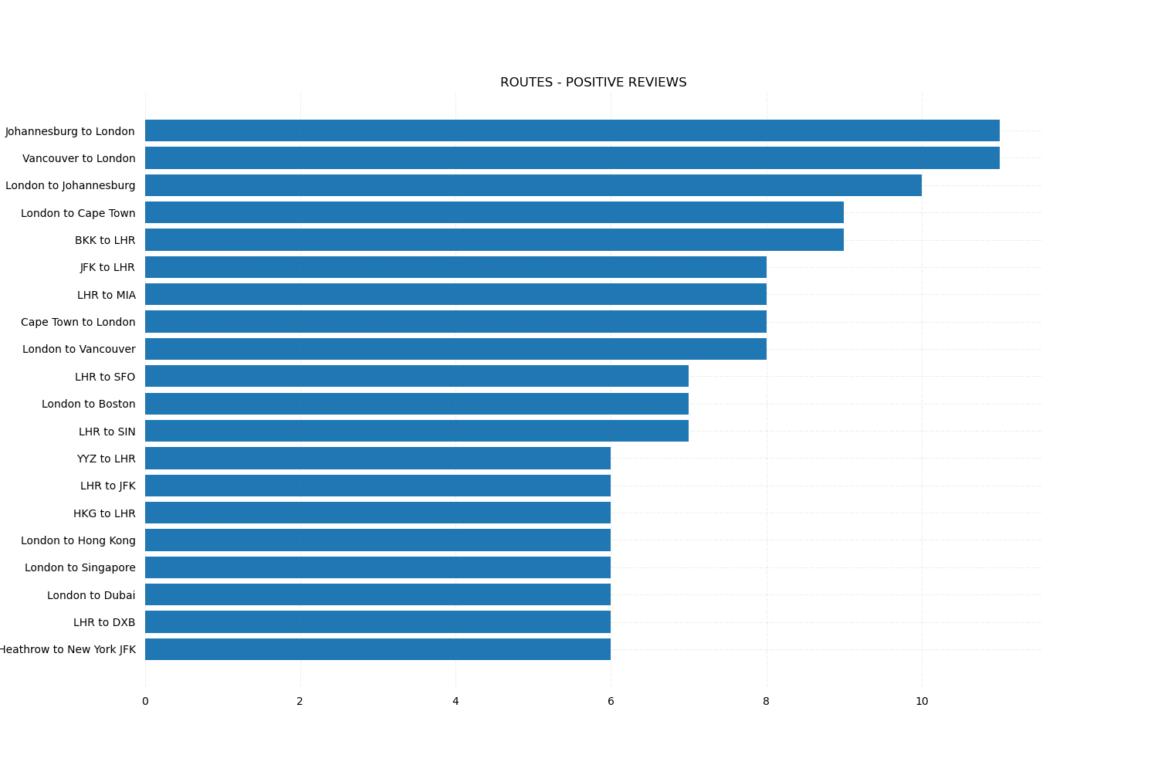
POSITIVE ROUTES
Now lets talk about the routes taken by these customers. Among the positive reviews, the most reviews are on the route of Johannesburg to London followed by Vancouver to London

Slide 11
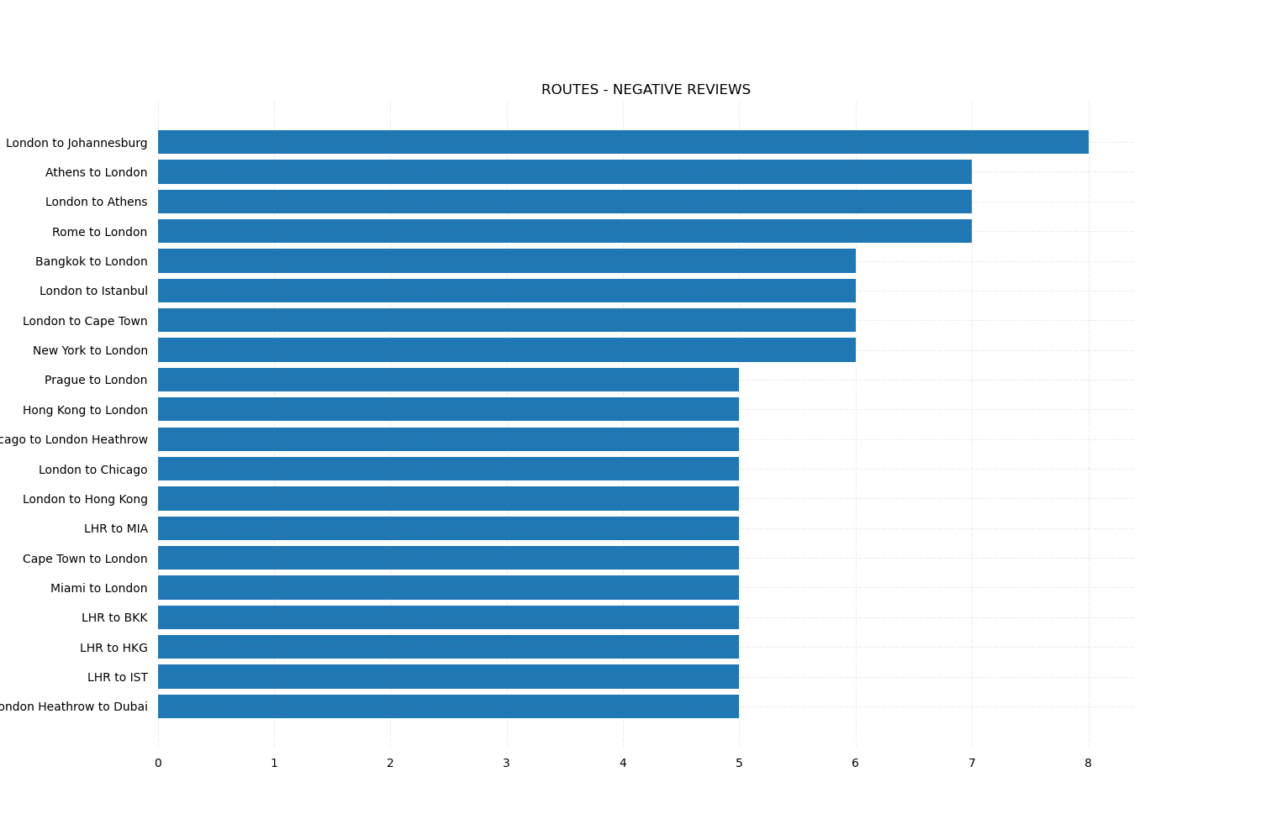
NEGATIVE ROUTES
Now lets talk about the routes taken by the negative reviewers. Among the negative reviews, the most reviews are on the route of London to Johannesburg followed by Athens to London and back. It is seen that London to Athens as well is seen to have equal amounts of negative reviews.

Slide 12
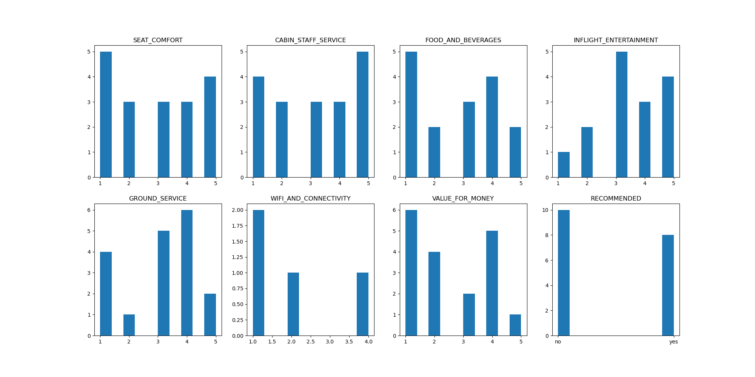
LONDON TO JOHANNESBURG
On analyzing the reviews on this route it is seen that it needs improvement on:
Seat Comfort
Cabin Staff Services
Food and Beverages
Wifi and Connectivity
Value for money
In order to improve the reviews on this route.

Slide 13
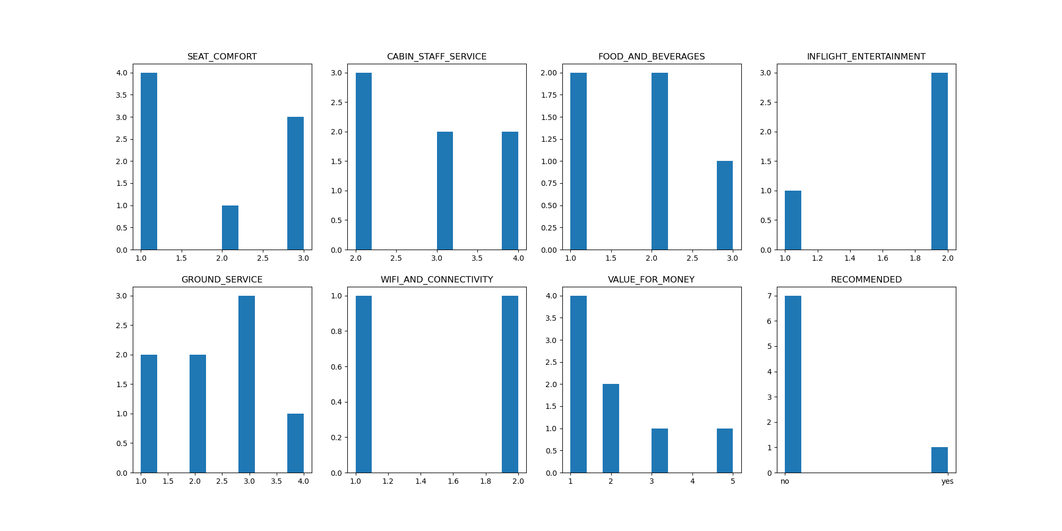
ATHENS TO LONDON
On analyzing the reviews on this route it is seen that it needs improvement on ALL its services in order to improve the reviews on this route.

Slide 14
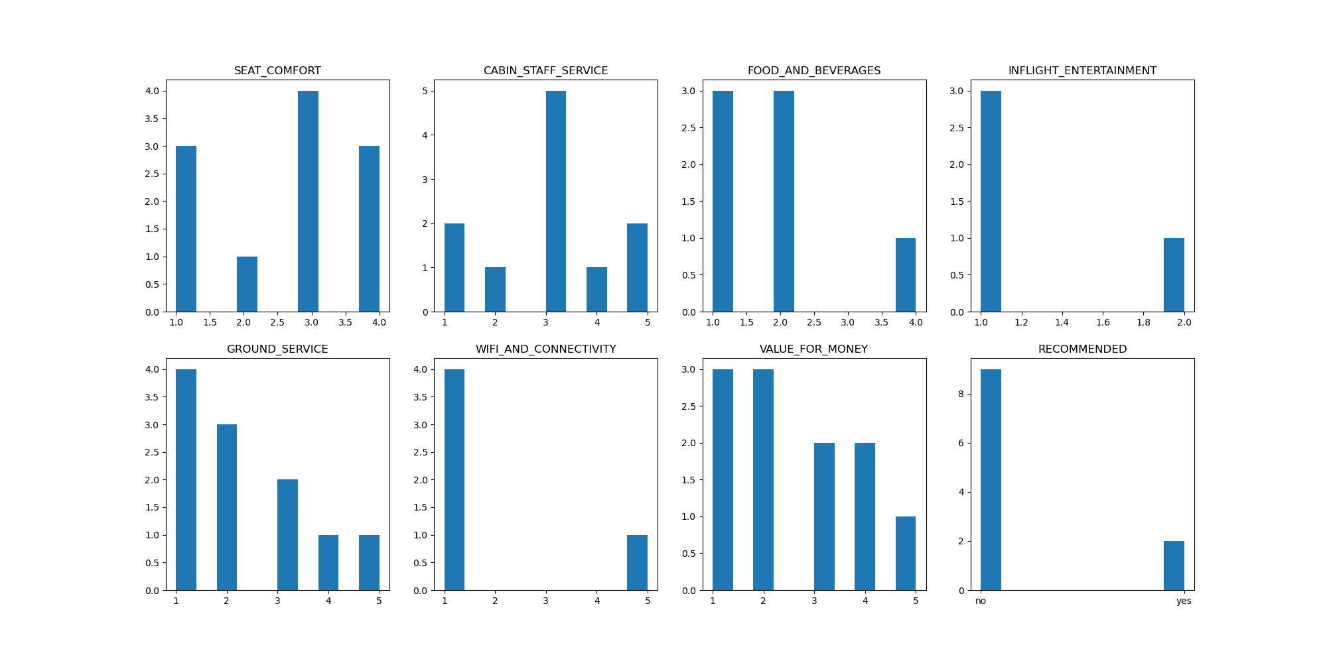
LONDON TO ATHENS
On analyzing the reviews on this route it is seen that it needs improvement on:
Food & Beverages
Inflight Entertainment
Ground Service
Wifi & Connectivity
In order to improve the reviews on this route.

Slide 15
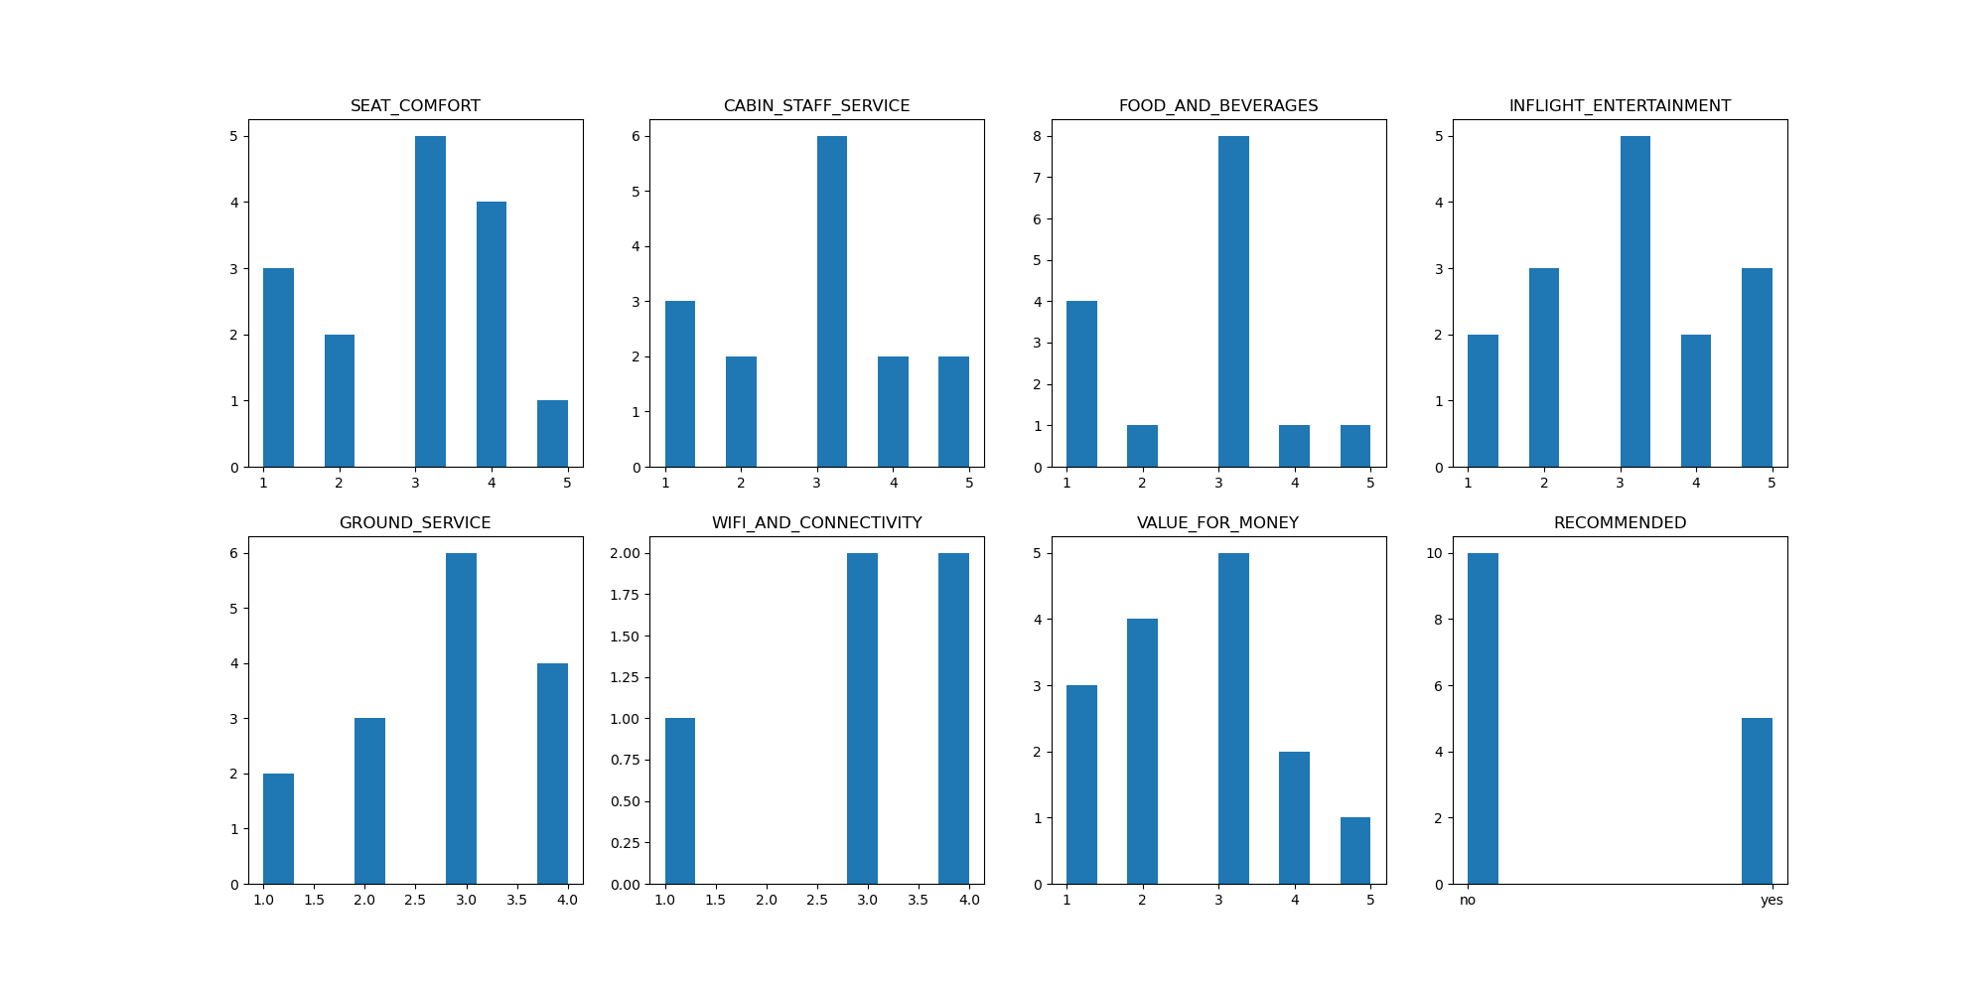
JOHANNESBURG TO LONDON
On analyzing the POSITIVE reviews on this route it is seen that it has good ratings overall in all the important variables, making it the most positively reviewed route in the dataset.

Slide 16
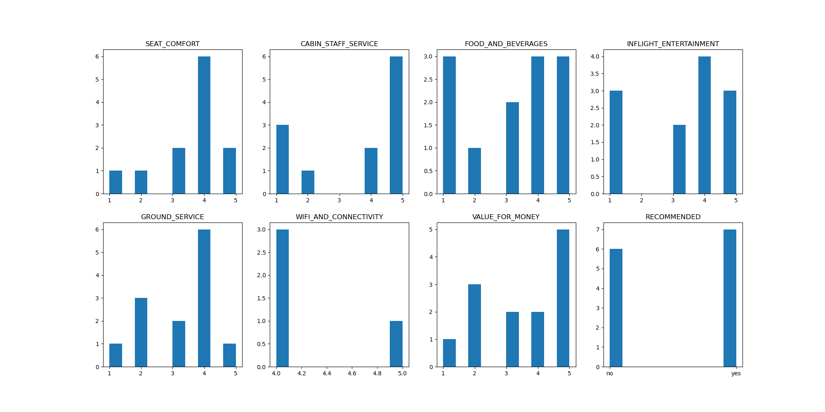
VANCOUVER TO LONDON
On analyzing the POSITIVE reviews on this route it is again seen that it has good ratings overall in all the important variables, making it the most positively reviewed route in the dataset. In order to better improve the ratings, this route can work on its Food & Beverages.

Slide 17
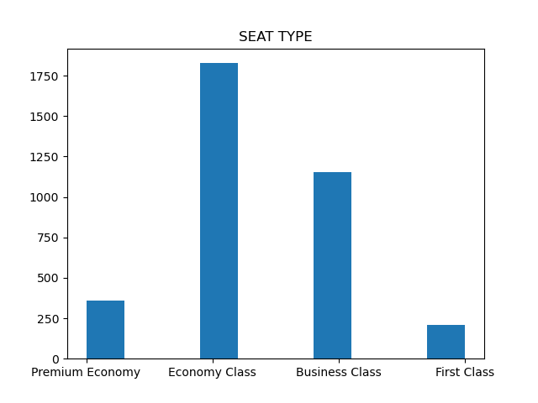
SEAT TYPE
Analyzing the type of seats available, it can be seen that:
Economy lass is the most taken seat type among the customers in the dataset.
This is followed by the Business Class and then Premium Economy and First Class.
Lets see the effect of seat type on the reviews.

Slide 18
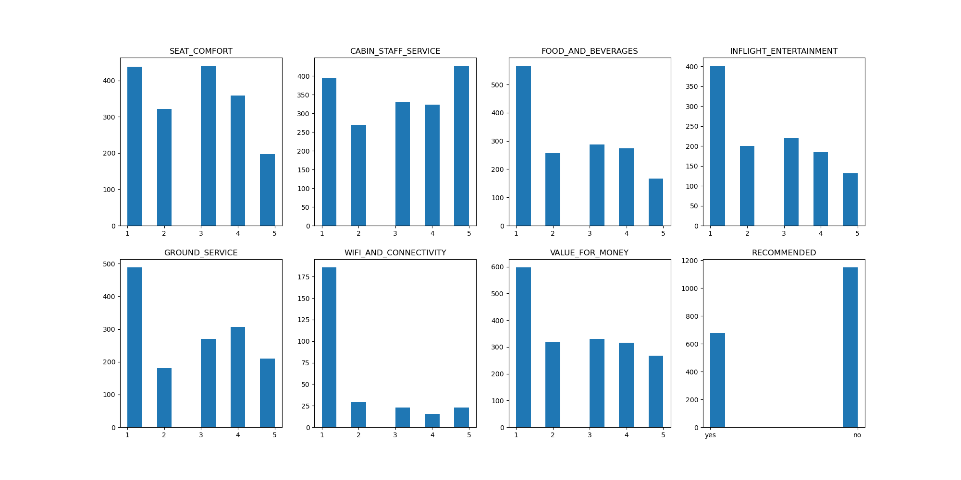
ECONOMY CLASS
On analyzing the reviews on this type it is seen that it needs to improve on:
Food & Beverages
Inflight Entertainment
Wifi & Connectivity
Value for money
In order to get better reviews.

Slide 19
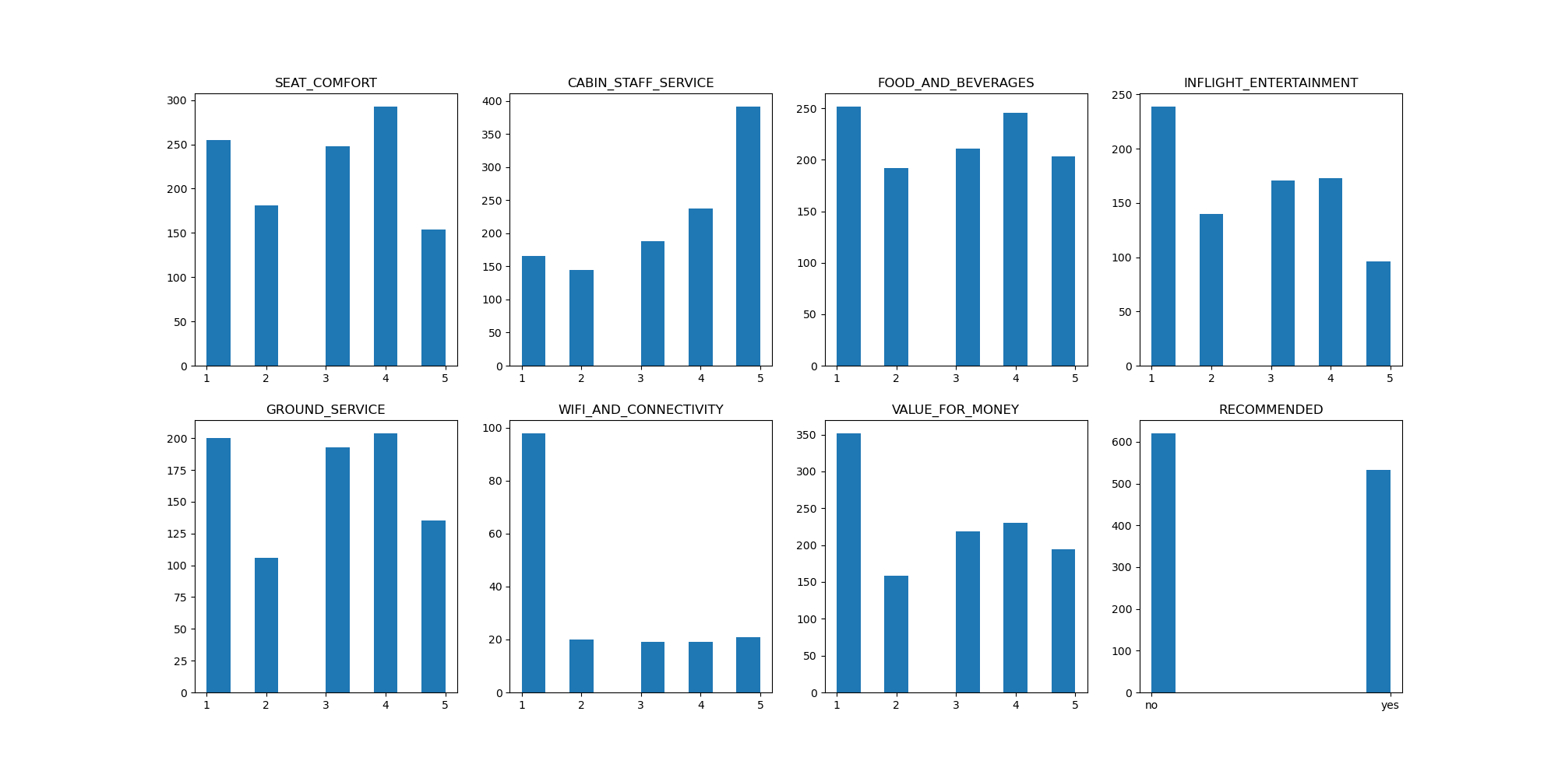
BUSINESS CLASS
On analyzing the reviews on this type it is seen that it needs to improve on:
Wifi & Connectivity
Value for money
In order to get better reviews.

Slide 20
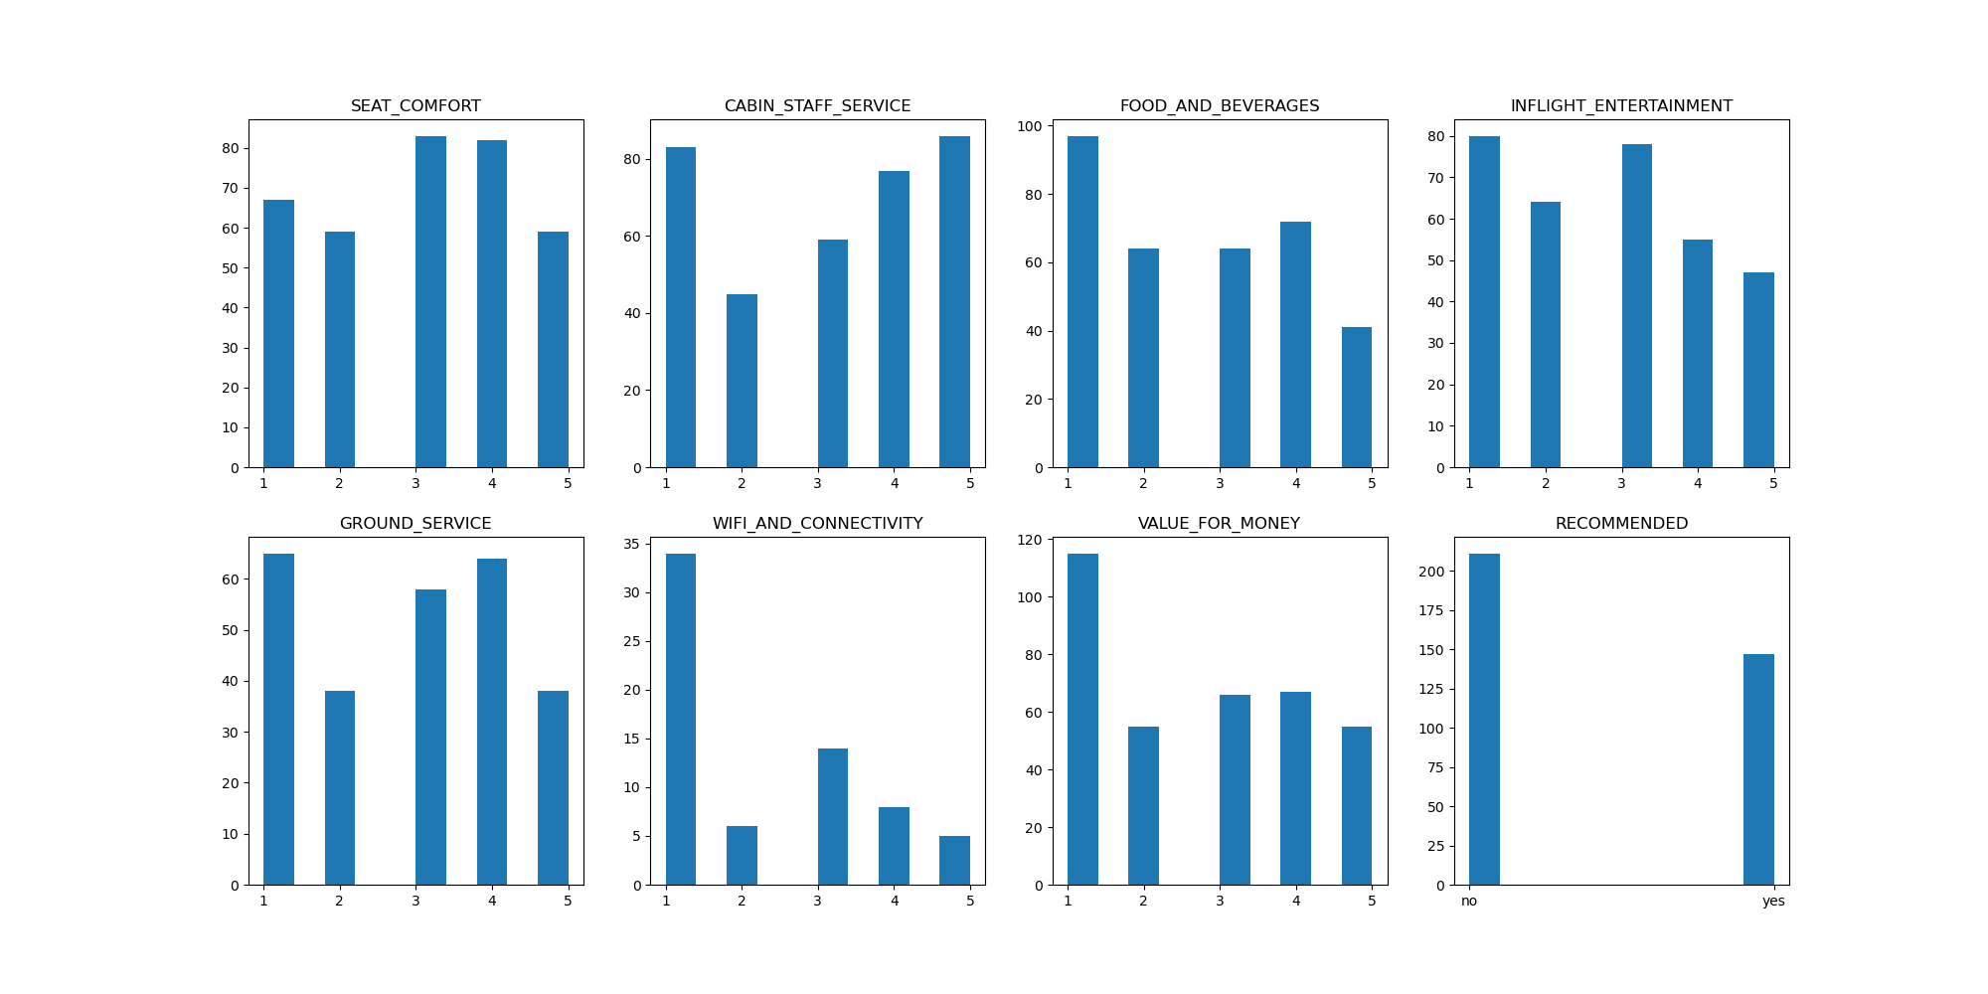
PREMIUM ECONOMY
On analyzing the reviews on this type it is seen that it needs to improve on:
Food & Beverages
Wifi & Connectivity
Value for money
In order to get better reviews.

Slide 21
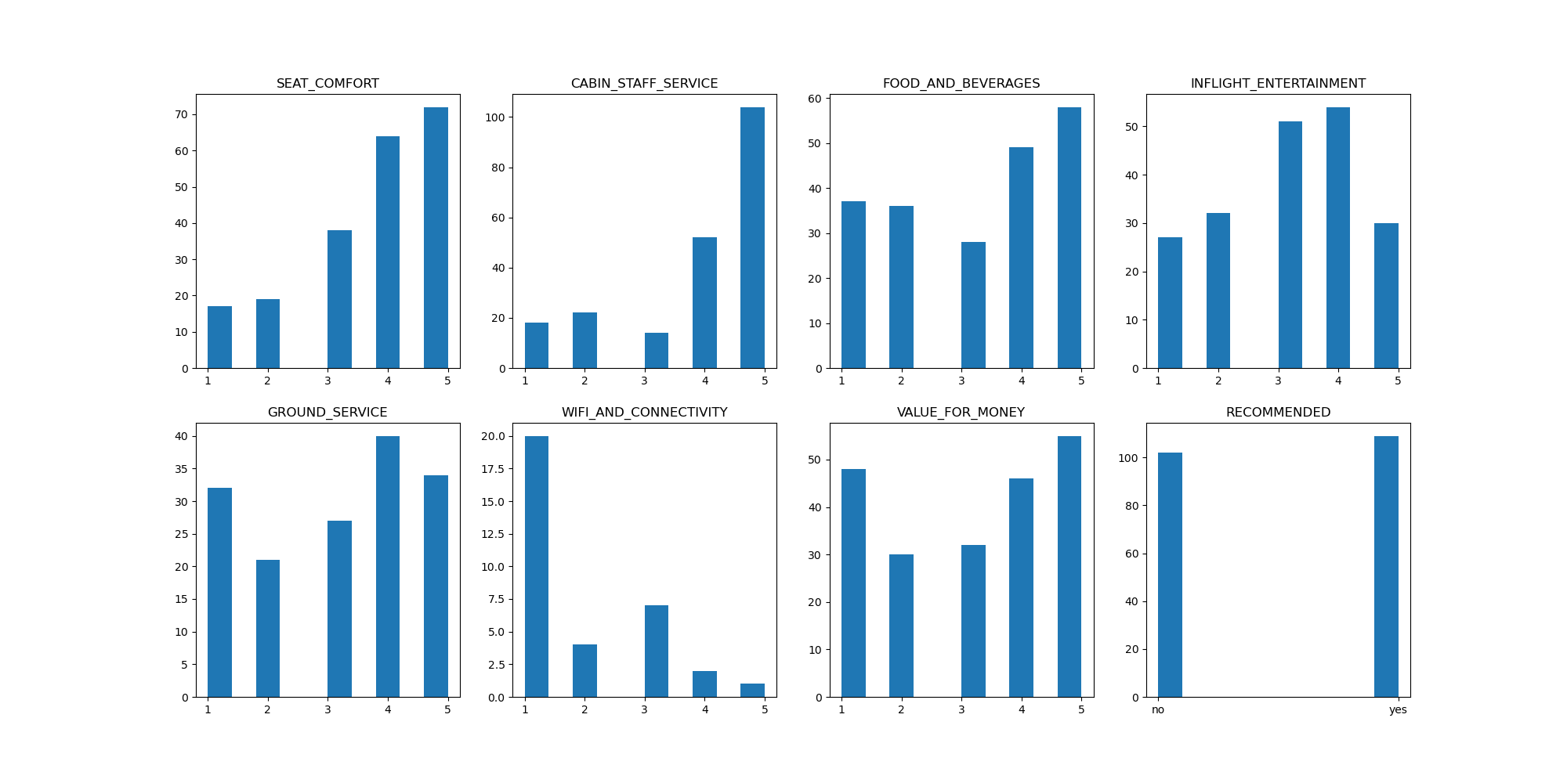
FIRST CLASS
On analyzing the reviews on this type it is seen that it needs to improve on:
Wifi & Connectivity
In order to get better reviews.

Slide 22
Through the analysis of the seat types it is seen that majority of the customers take economy class although through analysis it is seen that, customers have a better experience in higher valued seat types. One problem that persists in all the seat types is the issue with wifi and connectivity which on fixing can improve airline reviews. Value for money is another issue deeply criticized in the reviews. By targeting these issues and others mentioned in the economy class, the reviews can be improved greatly.

Slide 23
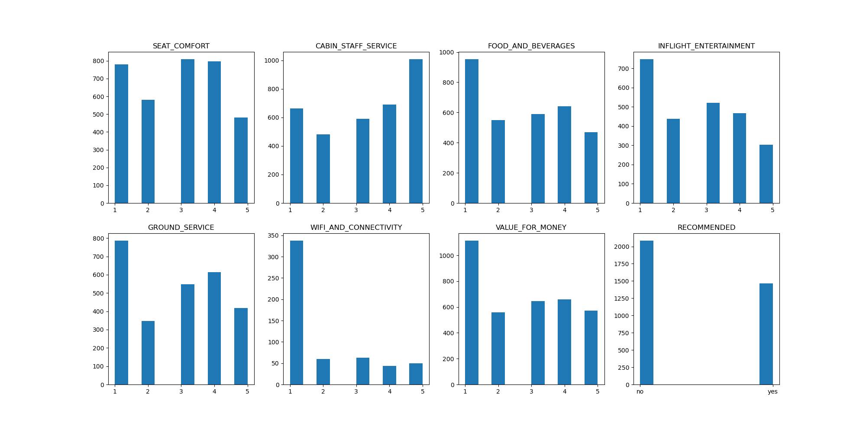
AIRLINE PERFORMANCE
On analysis of these variables as a whole, it is seen that the airlines needs improvement in:
Food & Beverages
Inflight Entertainment
Ground service
Wifi & connectivity
Value for money
And is often not recommended due to these drawbacks based on the dataset at hand.

Slide 24
THANK YOU

