Slide 1

Non Blocking I/O: Efficient and Scalable Data Handling

Slide 2
Agenda
Defining I/O
Blocking & Non blocking I/O
Code examples
Threading, Concurrency, and Parallelism
Event Driven Programming & The Event Loop
Common Libraries

Slide 3
I/O
I/O = Input / Output
process of data exchange between a program and external sources
Common examples are exchange from RAM to/from disk or network Interface Card (NIC).

Slide 4
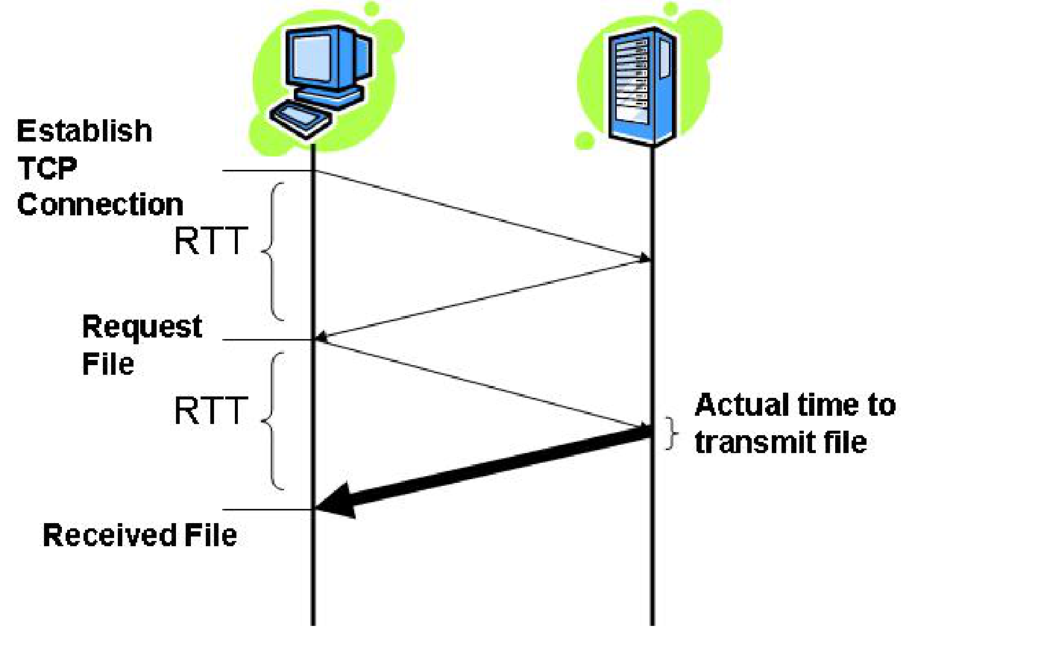
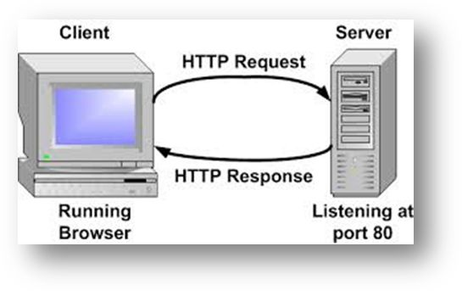
Blocking I/O
Blocking I/O waits until an operation completes before returning control.
Inefficient resource usage, high latency.
Reading from disk, network, or user input in a blocking manner.
Most common type of I/O in programs
Example: Standing in-front of your dryer until it finishes instead of doing something else in the meantime.
Example: Sending an HTTP request and blocking at that line of code until the response comes back. (Round trip time is idle time)

Slide 5
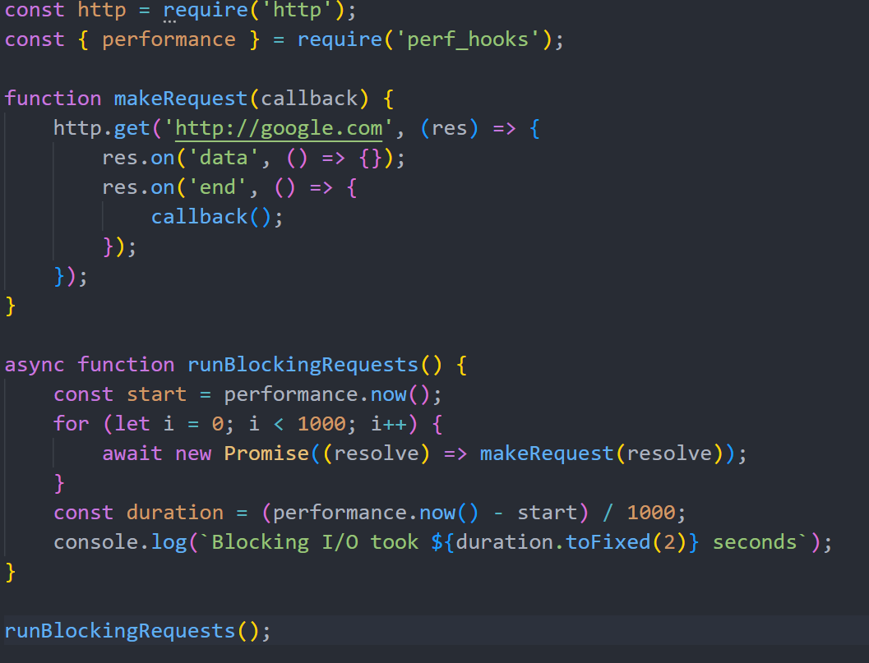

Slide 6
Non-Blocking I/O
immediately returns control and does not wait for the operation to complete.
I/O functions return quickly, allowing the CPU to perform other tasks.
Why is this possible? Because I/O operations are not CPU intensive (they require other resources).
Example: Putting the clothes in your dryer then cooking dinner until the dryer finishes.

Slide 7
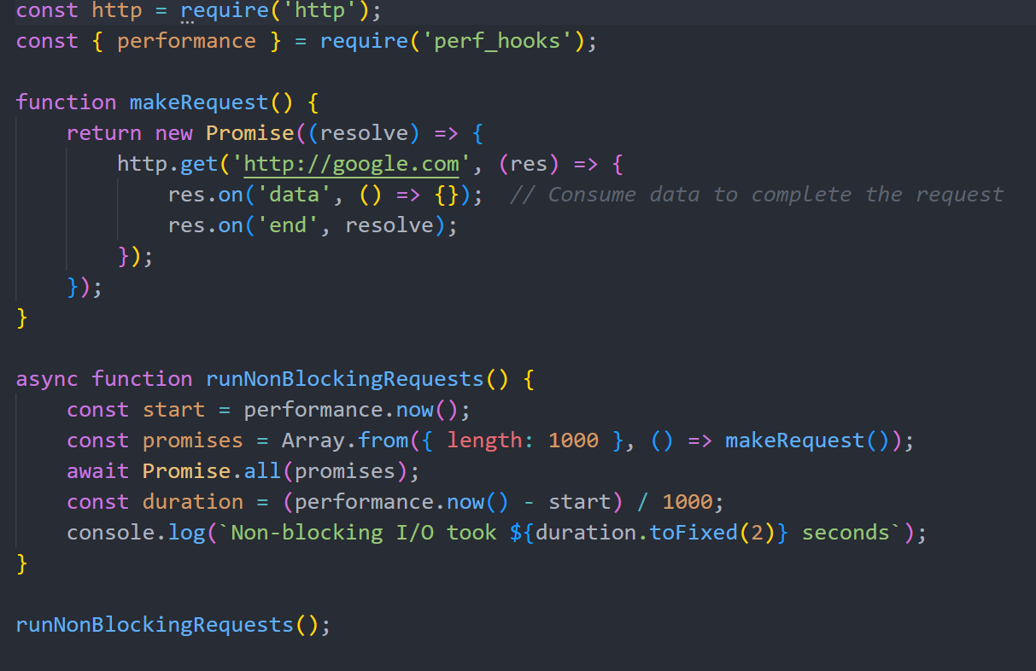

Slide 8
Threads, Concurrency, and Parallelism
Threads are units of execution within a process. (Can be concurrent or parallel)
Traditional approach to handling concurrent I/O by creating multiple threads
Limitations: Context switching, high memory usage, difficulty in synchronization with many threads.
Example: If you have 10 dryers, have 10 people, one waiting at each dryer.

Slide 9
Event Driven Programming
Event-driven programming is a paradigm where the flow of the program is determined by events, such as incoming data, user interactions, or network responses. (Reaction to interaction)
Allows the program to "react" to events as they occur rather than waiting (blocking) for each event to complete before proceeding.
The event loop is the central mechanism that allows a single thread to handle multiple tasks by continuously checking for events (e.g., network response, file read completion) and executing associated callbacks.
Examples
OS Handling events like clicking mouse or keyboard (hardware interrupts)
Frontend frameworks like React handling button clicks
Server handling many connections in one thread
Youtube: Watch a video while incoming video frames are coming in, and you can click like button, put video in mini player mode, and hover over suggested videos all at the same time.

Slide 10
How the Event Loop works
Looping Cycle: The event loop repeatedly checks for events or I/O completions.
Callback Queue: When an event completes (e.g., a file is read or data is received), the event loop places its associated callback function in a queue.
Execution: The event loop processes callbacks one at a time from this queue, allowing tasks to proceed without blocking.

Slide 11
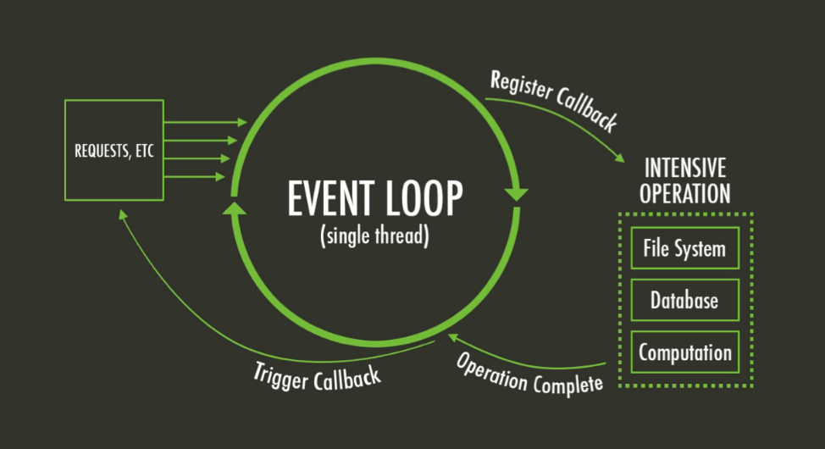
Network

Slide 12
Common Libraries & Frameworks
Node (JS)
Libuv (C++)
Boost ASIO (C++)
C socket library and sys calls (read(), write(), socket(), select(), etc.)

Slide 13
