Slide 1
PROJECT ON ELECTRIC BIKES
DEPARTMENT OF COMPUTER SCIENE AND ENGINEERING
GUIDED BY: PROF. BASAWANTHRAO PATIL
SG20CSE095 OMRAJ TENGLI
SG20CSE113 RUSHIKESH
SG20CSE110 ROHIT R W
SG20CSE096 PAVAN B

Slide 2
.
CONTENTS
INTRODUCTION
ABOUT
ADVANTAGES
RESULTS

Slide 3
INTRODUCTION
Making its foray in the electric vehicle segment, Jindal Worldwide hasHighlights
line
Earth Energy EV hasThe EV start-up has already appointed distributors across 10 states – Maharashtra, Gujarat, Karnataka, Kerala, Tamil Nadu, Telangana, Andhra Pradesh, Chhattisgarh, Madhya Pradesh and Odisha – which will be retained by Jindal Mobilitric. In addition, the company also plans to add new touchpoints in each market.
Rushii Senghani, CEO and founder, Earth Energy, said, “Our vehicles have been put through 7 lakh testing hours and the confidence shown inus is commendable as we work together to build the Indian EV infrastructure that is a reliable and efficient modern scooter made for the modern commuter.” introduced 3 models - Glyde+, Evolve Z & Evolve X
The EVs get a digital display with smartphone app-based connectivity

Slide 4
ABOUT
The Evolve X is the start-up flagship model with a top speed of 110 kmph Earth Energy currently has three vehicles listed on its website, two of which seem to be some time away, while the Glyde SX electric scooter is open for pre-bookings at the moment. The acquisition will see Jindal Mobilitric take over all models – the Glyde SX e-scooter as well as the upcoming Evolve R and the Evolve Z electric motorcycles.

Slide 5
ADVANTAGES

Slide 6
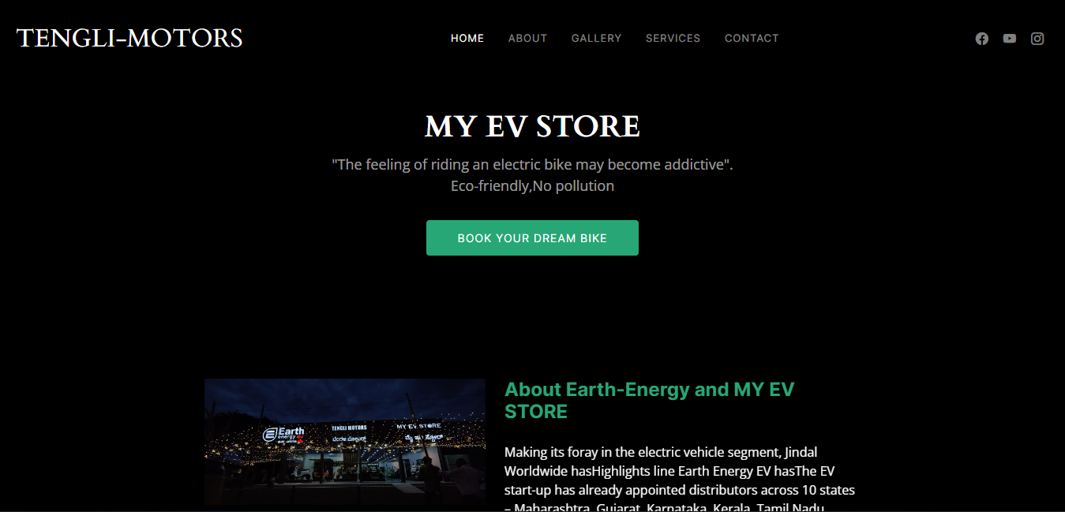

Slide 7


Slide 8
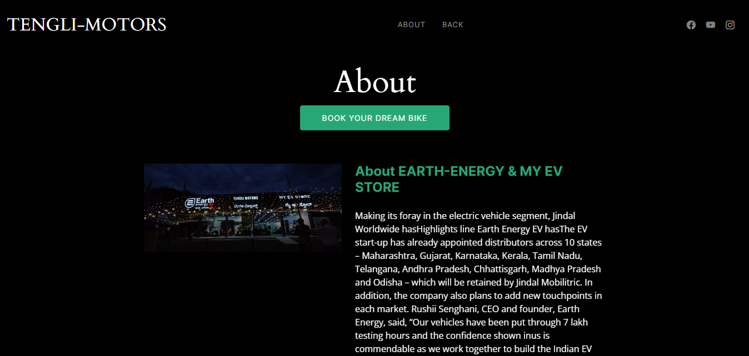

Slide 9
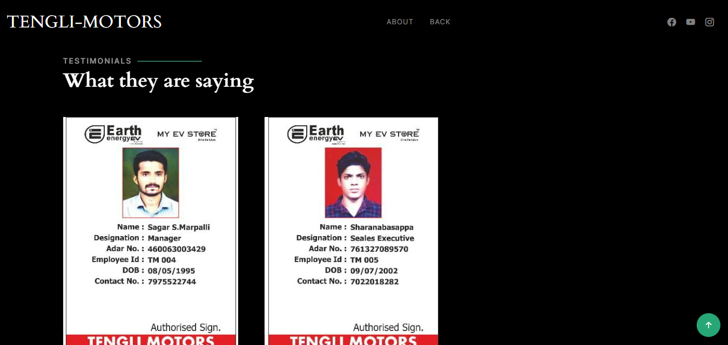

Slide 10
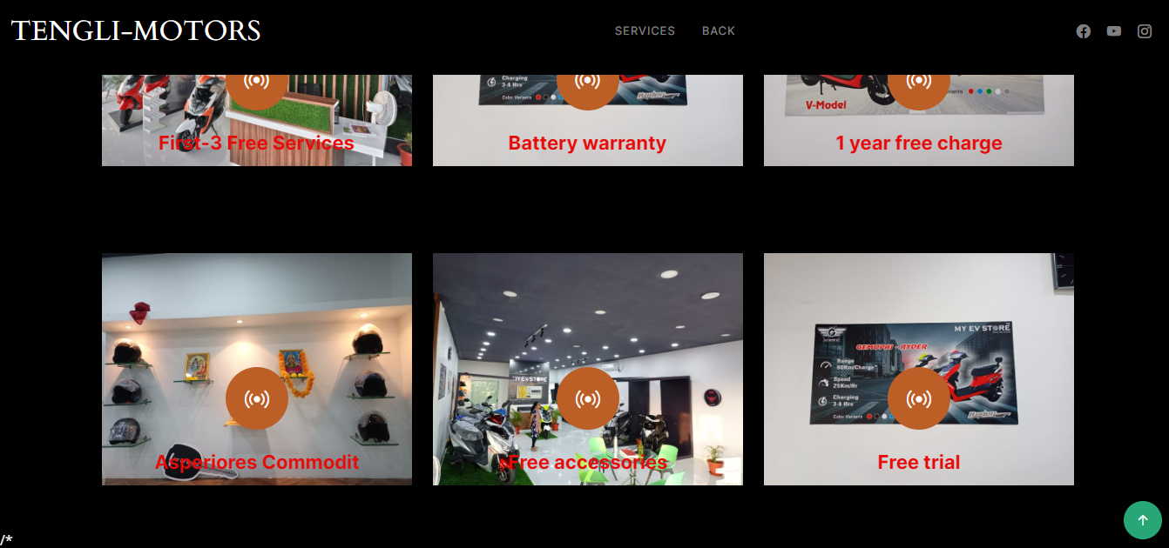

Slide 11


Slide 12
THNKING YOU

