Slide 1


Slide 2
PRINCIPLE
OF
ENGINEERING
DESIGN

Slide 3
DESIGN
Design is the creative expression of knowledge. Design is the integration of arts , science , engineering, humanities & professional knowledge of economics.

Slide 4
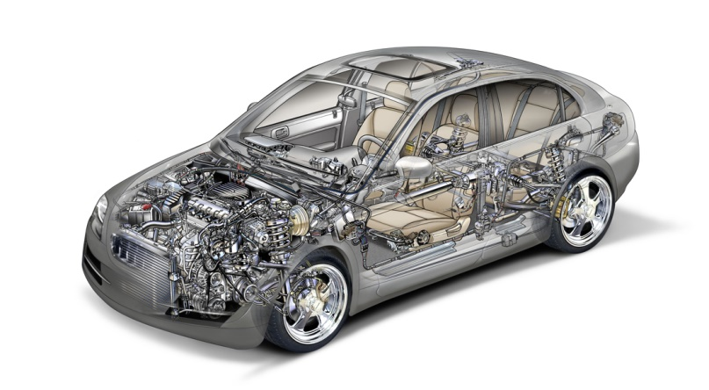
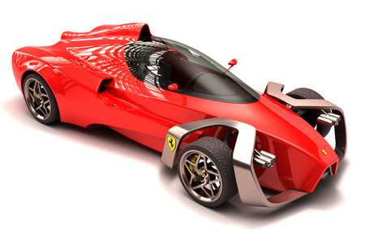
Some picture related to design

Slide 5
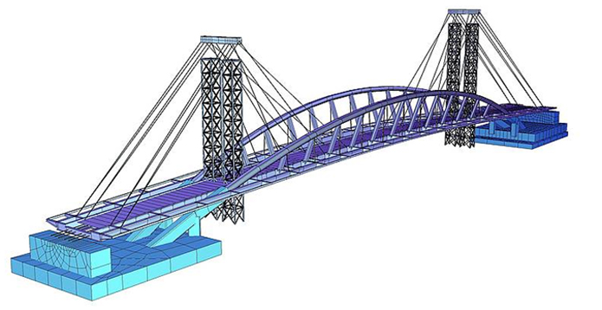

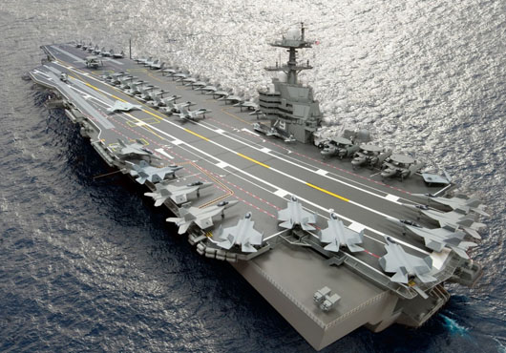

Slide 6
PRINCIPLES OF ENGINEERING DESIGN
PRINCIPLE OF INNOVATION
The possibilities for the innovation are not by any means exhausted, technological development is always offering new opportunities for innovative design but innovative design always develop in tandem with innovative technology that can never be end itself.

Slide 7

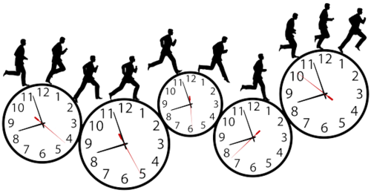
PRINCIPLE OF TIME
It is an important factor that affect design the feature & characteristic of all the product change according to time therefore, a design cannot be evaluated with concentration of time.
INNOVATION

Slide 8
PRINCIPLE OF VALUES
All product have different relative value under different circumstances and time value when the product is used. It is not fixed. Good software design created few years ago is probably out of data now. Designer should be aware of the user type and the purpose of use.
PRINICIPLE OF RESOURCES
The resources that are available for the design , manufacture and operation of the product are important factor that the designer must take into a concentration such resources includes material, machines, tools, skills and technology available.

Slide 9
PRINCIPLE OF ITERATION
This principles states that the importance of iteration in design process feedback, place and important role in iteration. This helps to correct the output upto desired best possibble solution.
PRINCIPLE OF COMPETENCE
An important factor that affects design is competence the design. Design competence is the ability to create a design that satisfies all the requirements including functional and non-function.

Slide 10
PRINCIPLES OF ERGONOMICS
People involved in a designed process are many important factor that affects design. What important is? Firstly individual involment in design & second their working relationships between them.
PRINCIPLE OF SERVICE
It states that the service must also be considered in design . Design must satisfies everybody and not just the user from whom it has created, it must be easy to maintain, easy to reuse, user & environment friendly.

Slide 11

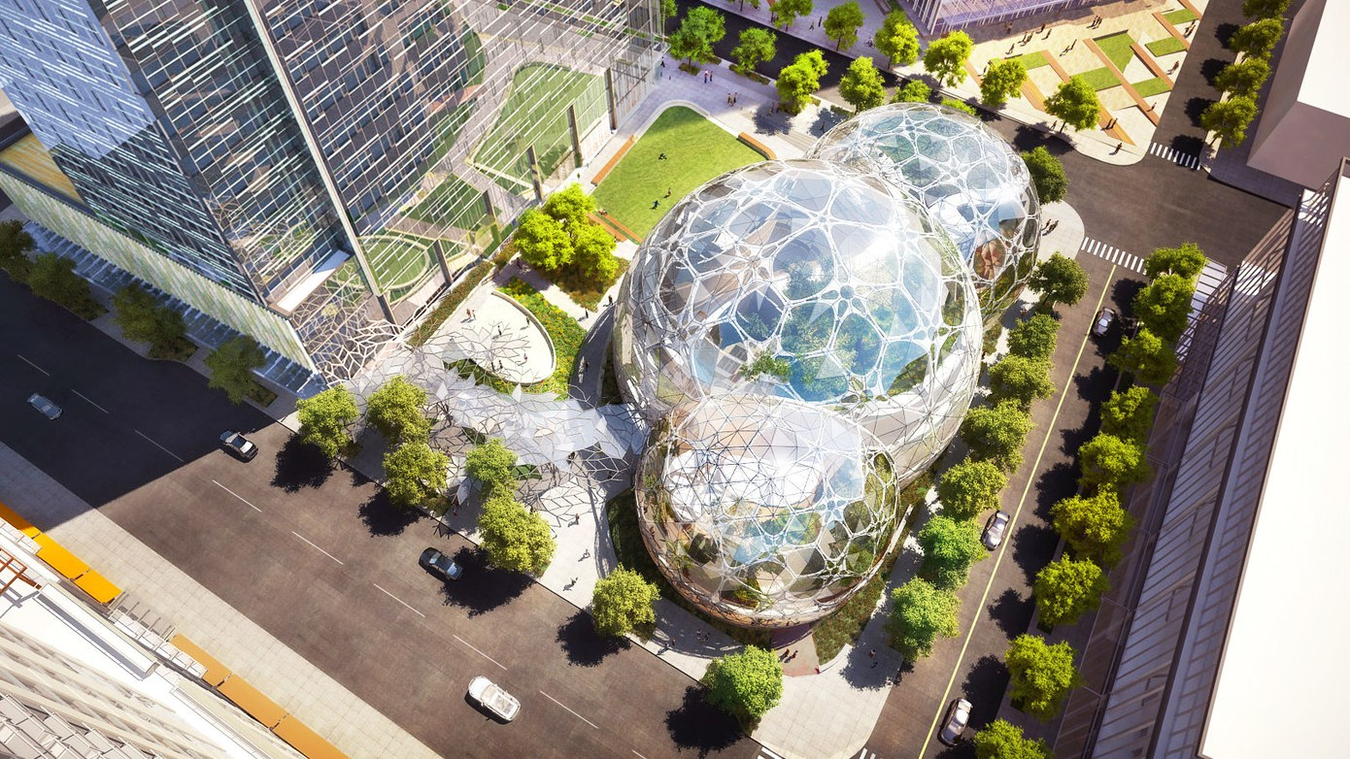
PRINCIPLES OF COMPACTNESS
Less but better because it conncentrate on the essential aspects & the products are not burdened with non-essentials.

Slide 12
PRESENTED BY – Om Raman

Slide 13


