Slide 1
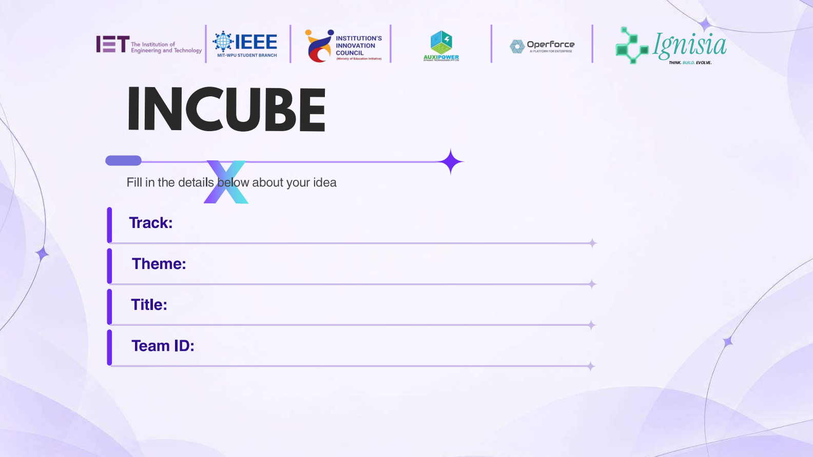
Education Counsellor
AI-powered college recommendations and student guidance
AI-enabled education technology
Personalized college discovery and counselling
Hybrid College Recommendation Platform
Not listed in project files
Notes:
Project source files: README.md, DOCUMENTATION.md

Slide 2
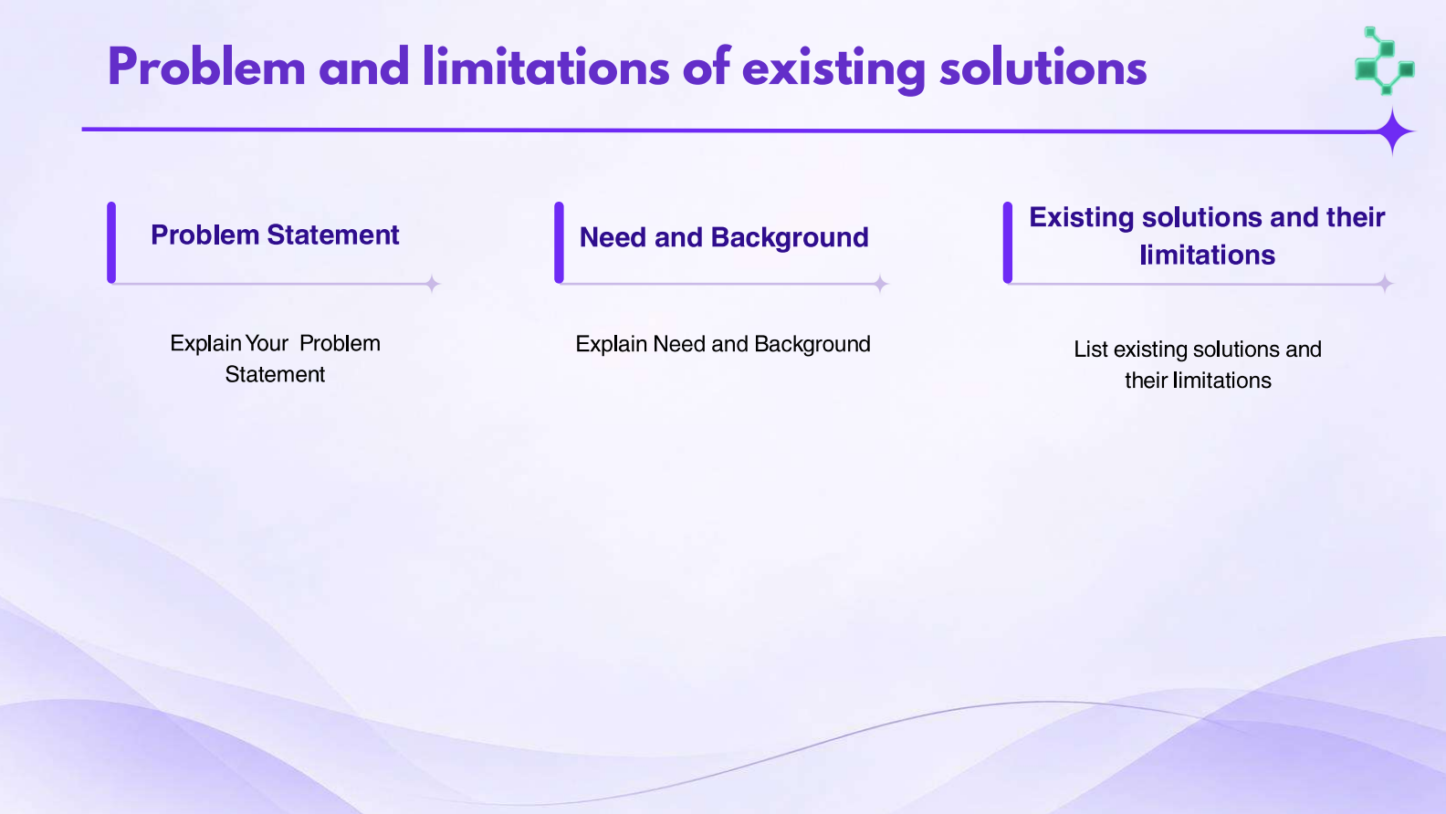
Entrance exams use different score units: marks, rank, percentile or percentage.
Students can misread a score when its exam context or unit is missing.
Cutoff history and admission rules are spread across many records and notices.
Comparing colleges by exam, branch, location and category takes time.
Static lists rarely adapt to a student profile or preferences.
General language models can state unsupported cutoff numbers.
Need: relevant options with exam-aware checks and clear context for follow-up questions.
Notes:
Project source files: README.md, DOCUMENTATION.md, backend/services/recommender.py, backend/services/gemini_service.py

Slide 3
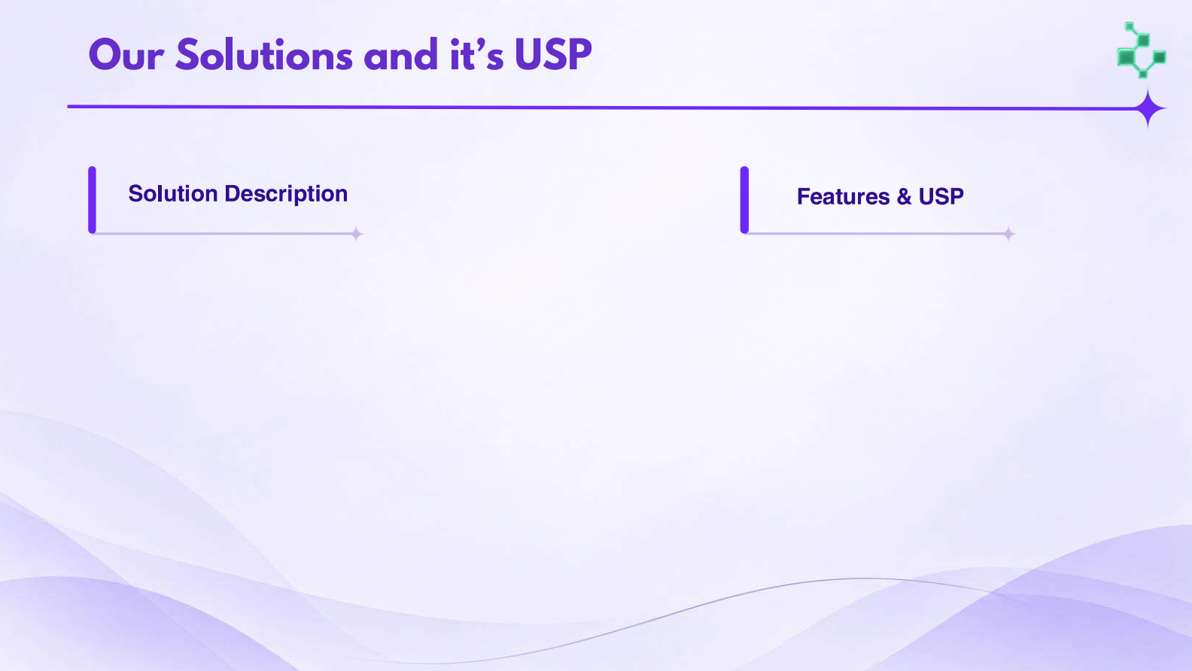
Student profile captures stream, exam, score and score unit, target location and preferences.
Recommendation service searches structured cutoff records and can fall back to an in-memory catalog.
Counsellor chat uses the active profile and retrieved college context to answer follow-up questions.
Exam and stream post-filters constrain the generated recommendation list.
College details, comparison, CAP simulation and scholarship estimates support review.
Translation and text-to-speech routes extend the guidance experience.
Notes:
Project source files: frontend/src/pages/ProfileForm.jsx, frontend/src/pages/Dashboard.jsx, backend/services/recommender.py, backend/services/gemini_service.py, backend/routes/recommend.py

Slide 4
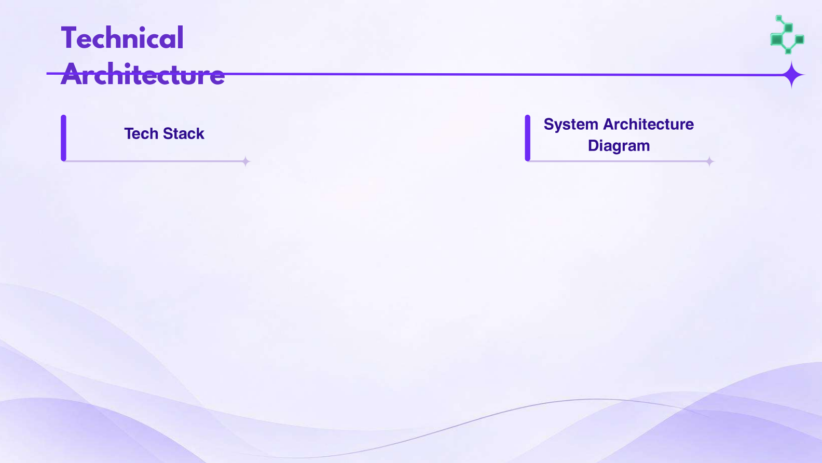
Technical Architecture
Frontend: React 18, Vite, React Router and Bootstrap
API: Python, FastAPI, Pydantic and Uvicorn
Data: MongoDB through Motor; persistent ChromaDB
AI: Google GenAI SDK with Gemini models
→
MongoDB
React + Vite
FastAPI
Profiles • chat history
structured cutoff records
→
→
Gemini API
Profile • dashboard
college details • chat
REST routes
recommend • chat • tools
Recommendation text
and counselor replies
→
ChromaDB
Semantic college content
and source metadata
Vite proxies /api calls to FastAPI during local development.
Notes:
Project source files: frontend/vite.config.js, backend/main.py, backend/routes/recommend.py, backend/routes/chat.py, backend/services/recommender.py, backend/services/vector_store.py, backend/services/gemini_service.py

Slide 5
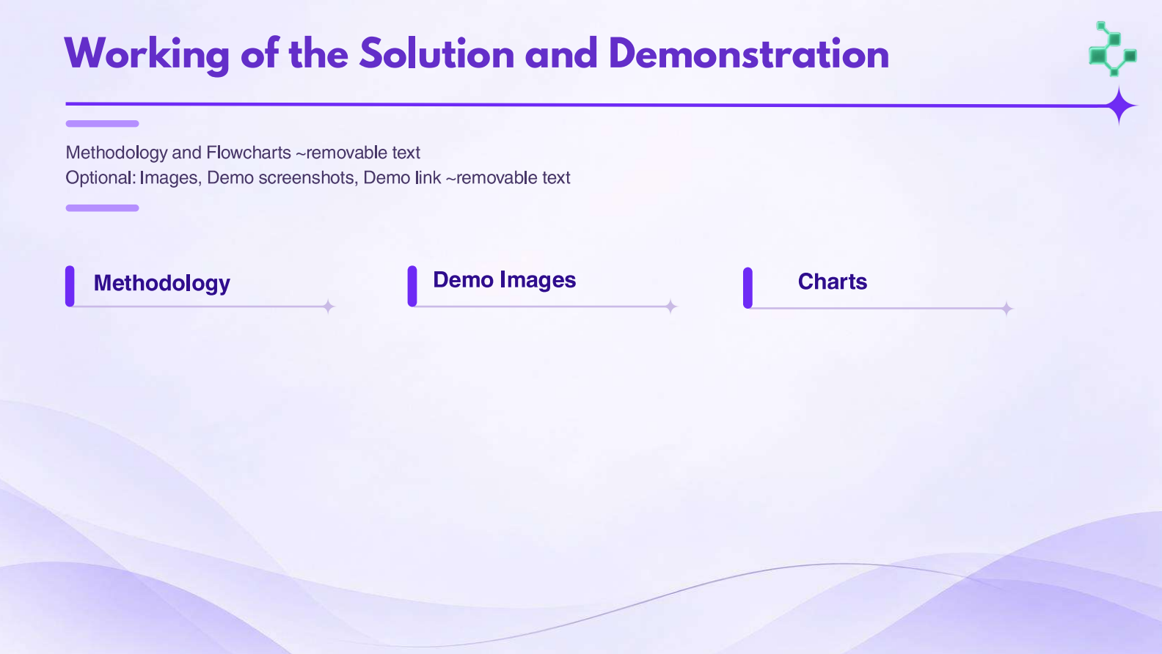
Recommendation flow uses the exam, score unit and preferences supplied in the student profile.
Student profile
Find college pool
Generate options
Check fit
Explore results
→
→
→
→
Stream • exam • score
location • preferences
MongoDB cutoff query
or catalog fallback
Gemini receives the
profile based prompt
Stream and exam
post-filters apply
Recommendations, details
and comparison
Counsellor chat path
Student question + profile → ChromaDB semantic retrieval → Gemini response with retrieved source metadata when available
Related endpoints: compare colleges • simulate CAP options • estimate scholarships • translate • text to speech
Notes:
Project source files: backend/services/recommender.py, backend/routes/recommend.py, backend/routes/chat.py, backend/services/vector_store.py, backend/services/gemini_service.py

Slide 6
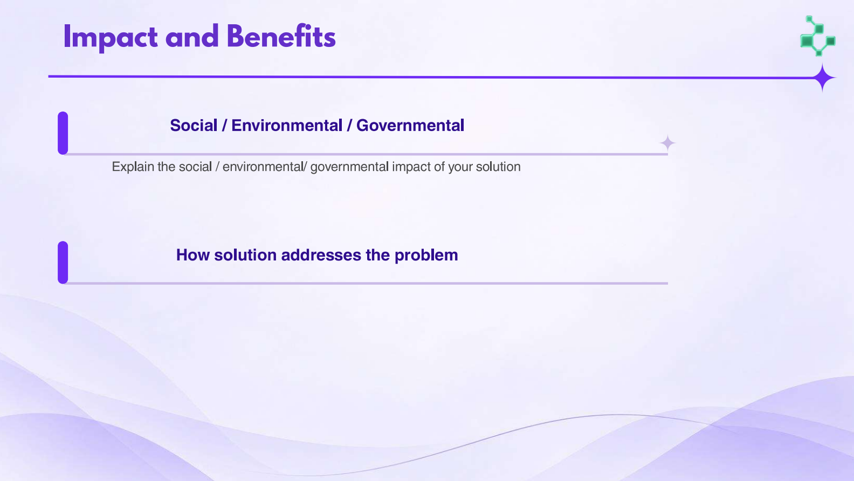
Students can review options using their exam, score unit and location preferences.
Eligibility labels and college details provide comparison context; they do not guarantee admission.
Combines structured cutoff lookup with profile-aware recommendation and semantic counselling.
Comparison, CAP simulation and scholarship tools support the next decision steps.
Translation and speech routes can make guidance easier to access.
Notes:
Project source files: frontend/src/pages/Dashboard.jsx, backend/services/recommender.py, backend/routes/recommend.py, backend/routes/chat.py, backend/services/translation_service.py, backend/services/tts_service.py
The project files do not report measured user, environmental or government impact outcomes.

Slide 7
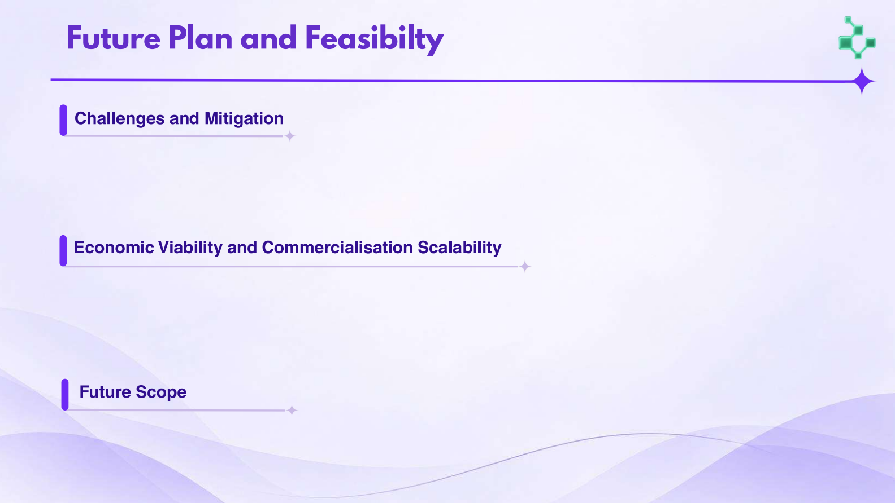
Cutoff data can become stale; maintain a dated import and validation process.
AI output can vary; preserve exam/stream checks, retrieved context and service fallbacks.
Existing React, FastAPI and database components form a working application foundation.
Scale-up needs hosting, data maintenance, privacy controls and an AI usage budget; no cost or revenue study is included.
Validate cutoff provenance and freshness against official counseling sources.
Evaluate recommendations with representative profiles and user feedback before wider deployment.
Notes:
Project source files: README.md, DOCUMENTATION.md, backend/requirements.txt, frontend/package.json
The last two points are proposed next steps, not claims about completed project work.

Slide 8

README.md: project summary, features, technology stack and setup instructions.
DOCUMENTATION.md: system overview, architecture, data stores, APIs and roadmap.
backend/services/recommender.py: recommendation and filtering logic.
backend/services/vector_store.py and backend/services/gemini_service.py: retrieval and AI response path.
backend/routes/recommend.py and backend/routes/chat.py: API entry points.
frontend/src/pages/ProfileForm.jsx and frontend/src/pages/Dashboard.jsx: profile and results experience.
Project documentation was used as the source; its numerical accuracy and impact claims were not independently verified for this presentation.
Notes:
Project source files: README.md, DOCUMENTATION.md, backend/services/recommender.py, backend/services/vector_store.py, backend/services/gemini_service.py, backend/routes/recommend.py, backend/routes/chat.py, frontend/src/pages/ProfileForm.jsx, frontend/src/pages/Dashboard.jsx

