Slide 1
Reading COVID checks

Slide 2
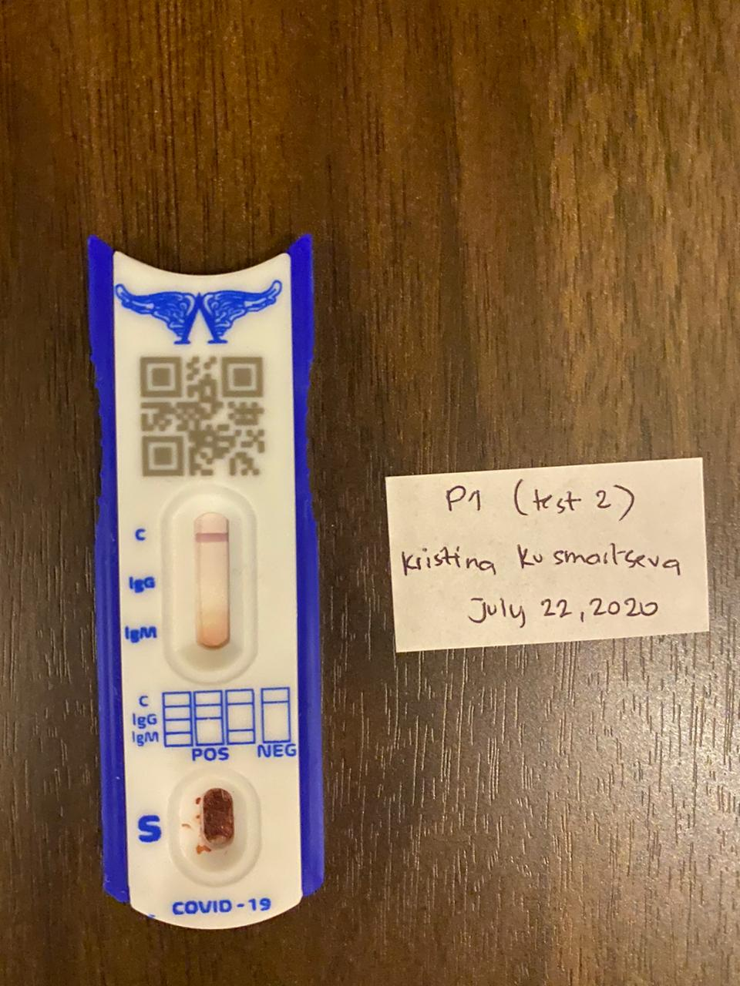
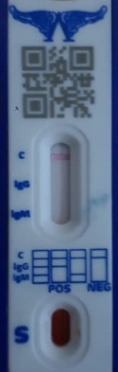

Three Step Way

Slide 3
Step One
The first step is to be able to pick out the COVID meter in the image.
We can use Haar-Cascade classifier to detect the object and get a bounding box around it. It will need about 200-300 images.

Slide 4
Step Two

