Slide 1

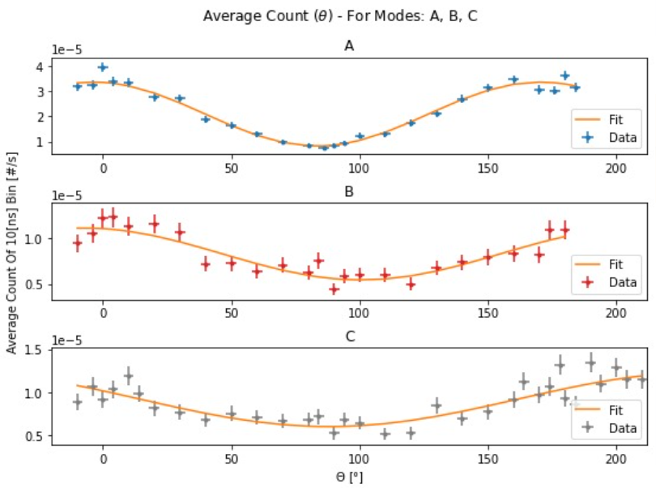
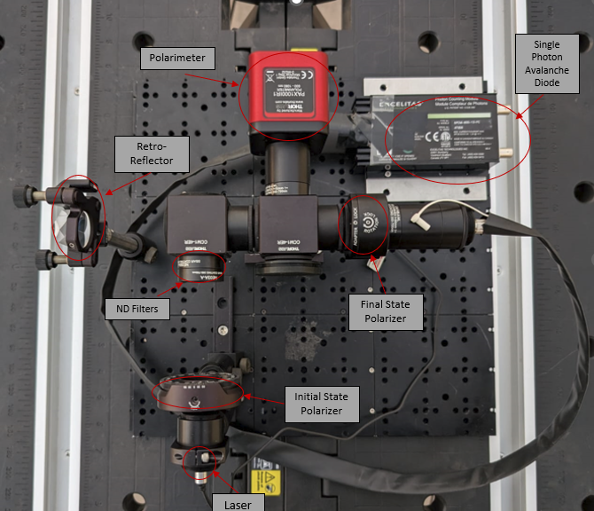
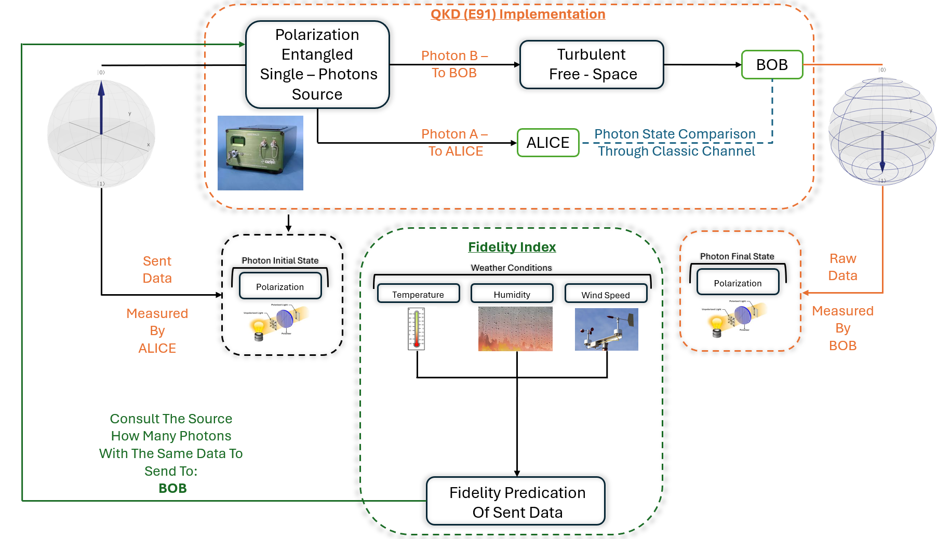
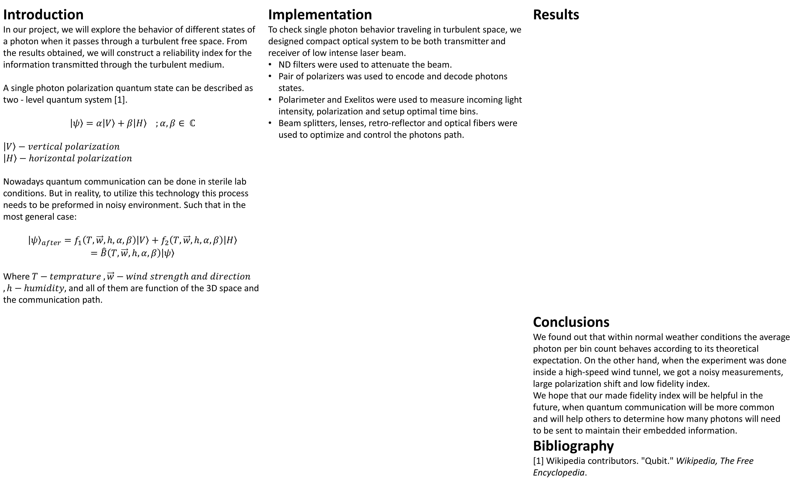
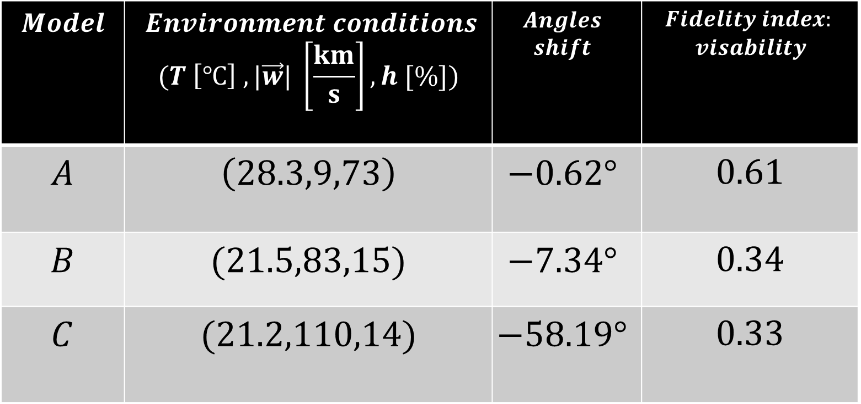
Signal Stabilization in Quantum Communication
Project Number: 21-1-1-2753
Names: Omri Atir & Ido Reshef
Advisor: Khen Cohen
Introduction In our project, we will explore the behavior of different states of a photon when it passes through a turbulent free space. From the results obtained, we will construct a reliability index for the information transmitted through the turbulent medium. A single photon polarization quantum state can be described as two - level quantum system [1]. $$\left|ψ\right\rangle =α\left|V\right\rangle +β\left|H\right\rangle ;α,β∈ ℂ$$ $$\left|V\right\rangle −vertical polarization$$ $$\left|H\right\rangle −horizontal polarization$$ Nowadays quantum communication can be done in sterile lab conditions. But in reality, to utilize this technology this process needs to be preformed in noisy environment. Such that in the most general case: $${\left|ψ\right\rangle }_{after}=f_{1}\left(T,\vec{w},h,α,β\right)\left|V\right\rangle +f_{2}\left(T,\vec{w},h,α,β\right)\left|H\right\rangle$$ $$=\hat{B}\left(T,\vec{w},h,α,β\right)\left|ψ\right\rangle$$ Where $T−temprature ,\vec{w}−wind strength and direction$ $, h−humidity,$ and all of them are function of the 3D space and the communication path. | Implementation To check single photon behavior traveling in turbulent space, we designed compact optical system to be both transmitter and receiver of low intense laser beam. ND filters were used to attenuate the beam. Pair of polarizers was used to encode and decode photons states. Polarimeter and Exelitos were used to measure incoming light intensity, polarization and setup optimal time bins. Beam splitters, lenses, retro-reflector and optical fibers were used to optimize and control the photons path. | Results Conclusions We found out that within normal weather conditions the average photon per bin count behaves according to its theoretical expectation. On the other hand, when the experiment was done inside a high-speed wind tunnel, we got a noisy measurements, large polarization shift and low fidelity index. We hope that our made fidelity index will be helpful in the future, when quantum communication will be more common and will help others to determine how many photons will need to be sent to maintain their embedded information. Bibliography [1] Wikipedia contributors. "Qubit." Wikipedia, The Free Encyclopedia.
Polarimeter
Single Photon Avalanche Diode
Retro- Reflector
$$Fidelity index:$$ $$visability$$ | $$Angles$$ $$shift$$ | $$Environment conditions$$ $$(T \left[℃\right] ,|\vec{w}| \left[\frac{km}{s}\right],h [\%])$$ | $$Model$$
$$0.61$$ | $$−0.62°$$ | $$\left(28.3,9,73\right)$$ | $$A$$
$$0.34$$ | $$−7.34°$$ | $$(21.5,83,15)$$ | $$B$$
$$0.33$$ | $$−58.19°$$ | $$(21.2,110,14)$$ | $$C$$
ND Filters
Final State
Polarizer
Initial State
Polarizer
Laser

