Slide 1
Address Translation
&
IRAM Cache
Omri Dassa & Ori Yeffet
Group 327
Advisor: Nadav Rotter
12/03/19

Slide 2
Agenda
Progress:
  MAS
  Coding MVP
Results + Validation:
  Schematics
  Waves
  Timing
  Area

Slide 3
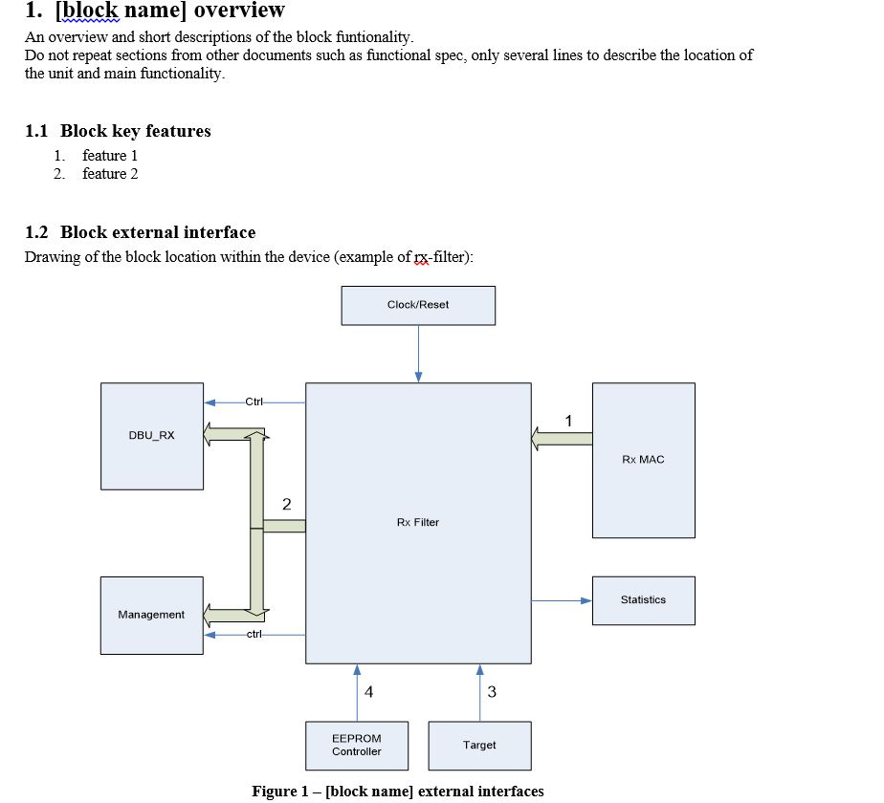
MAS – Micro Architectural Specifications

Slide 4
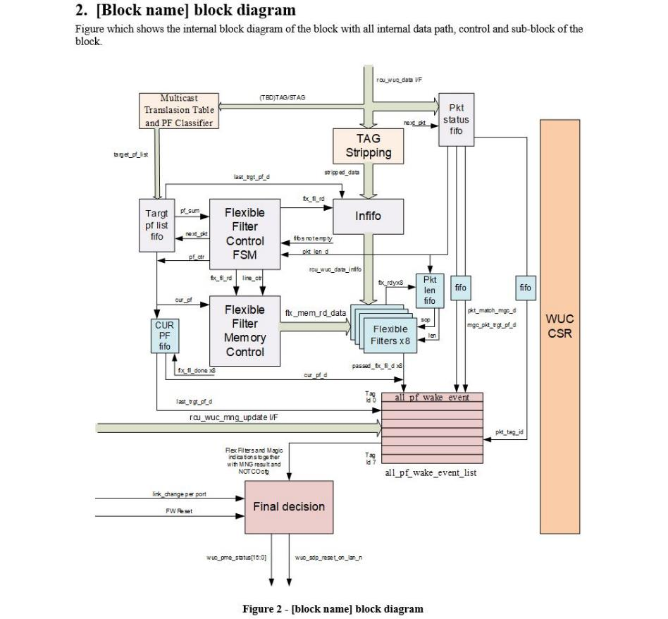
MAS – Micro Architectural Specifications

Slide 5
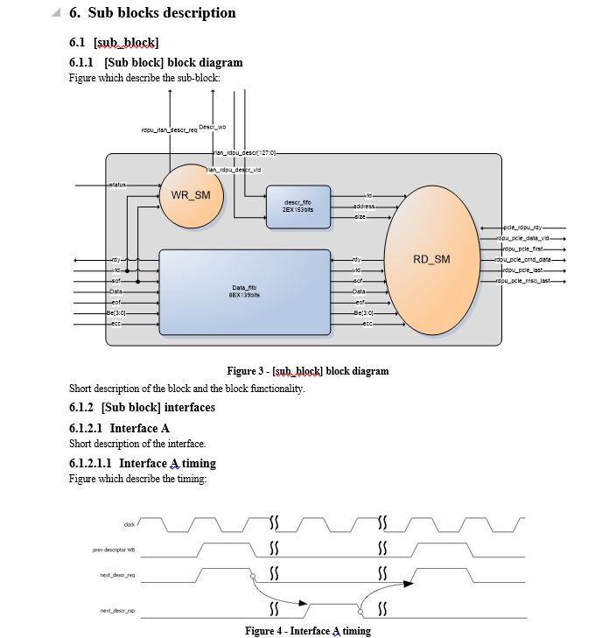
MAS – Micro Architectural Specifications

Slide 6
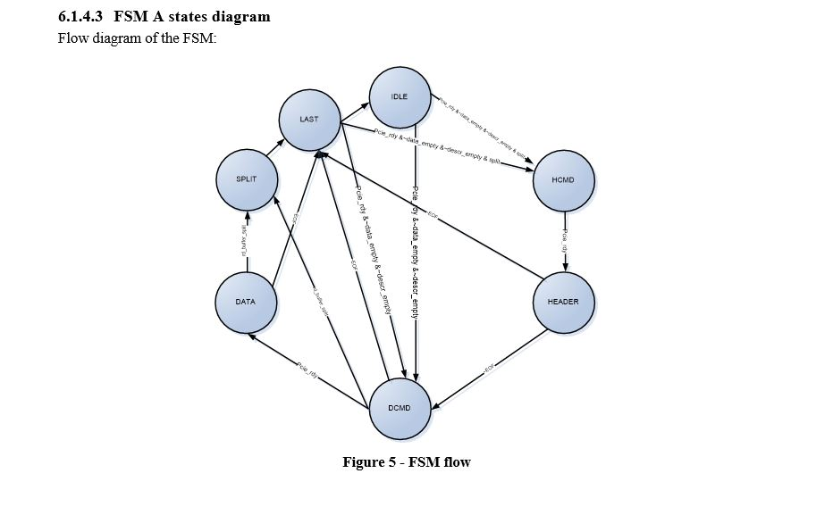
MAS – Micro Architectural Specifications

Slide 7
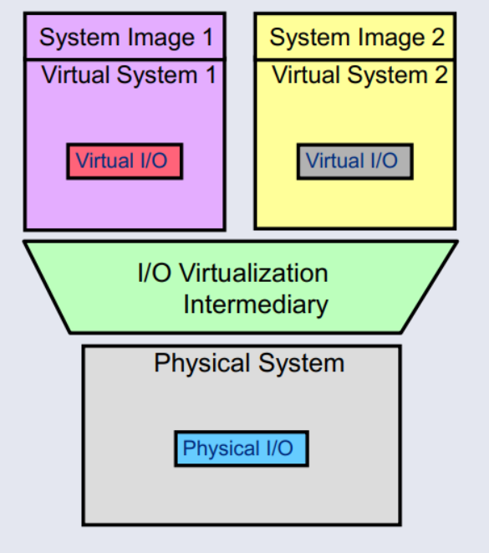
Address Translation – Purpose

Slide 8
Address Translation – Flow Scheme

Slide 9
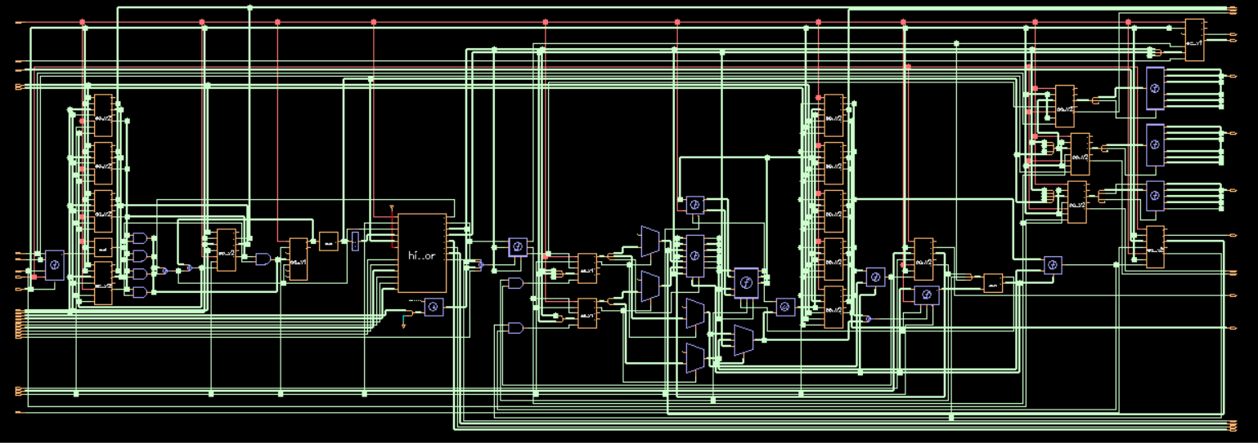
Address Translation – MVP Schematic

Slide 10
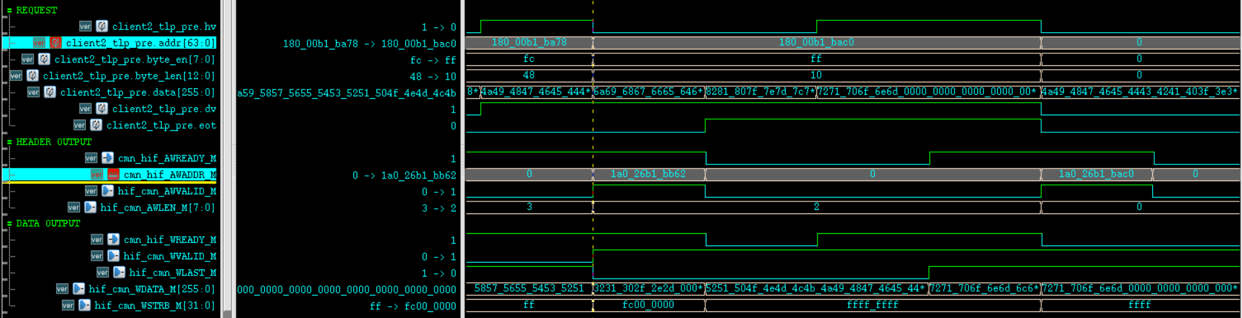
Address Translation – MVP Waves

Slide 11
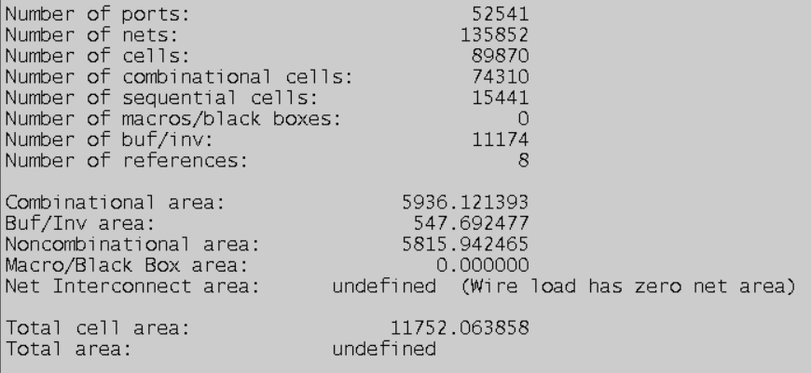
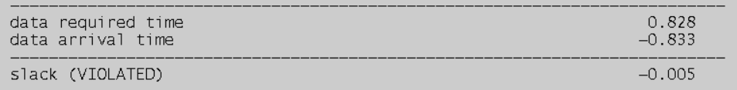
Address Translation – MVP Area & Timing
Area:
Timing:

Slide 12
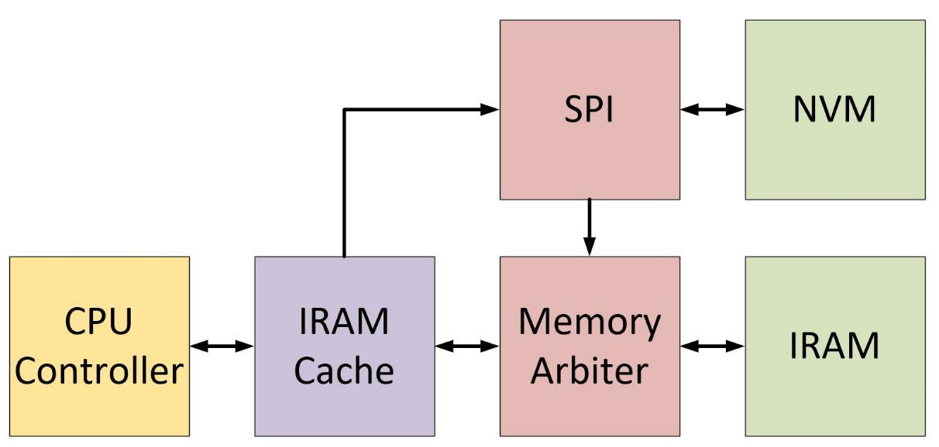
IRAM Cache – Purpose

Slide 13
IRAM Cache – Flow Scheme

Slide 14
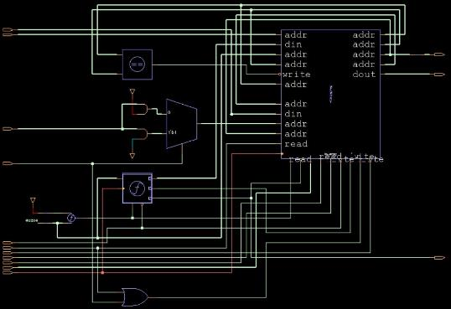
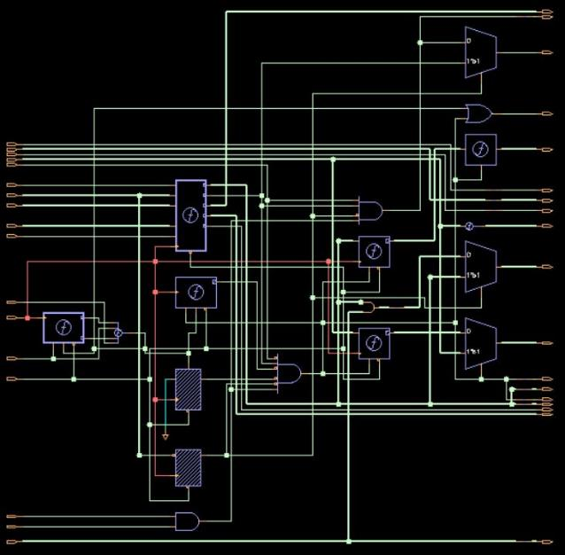
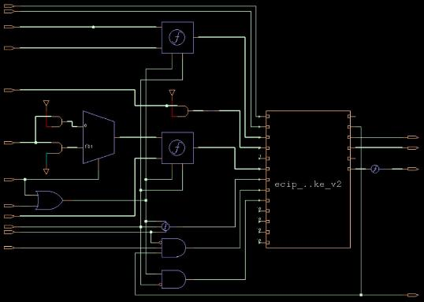
IRAM Cache – MVP Schematic
LRU
MISS HANDLER
CAM

Slide 15
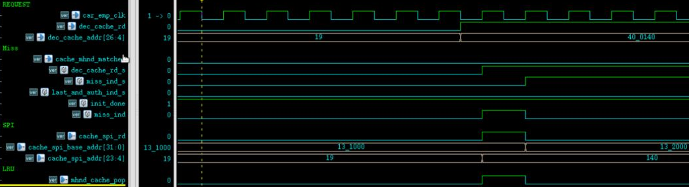
IRAM Cache – MVP Waves

Slide 16
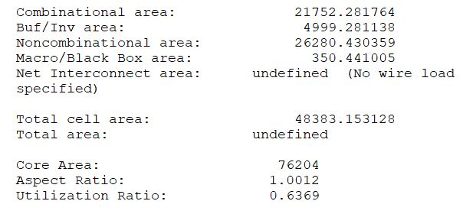
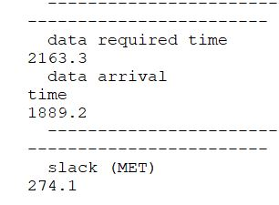
IRAM Cache – MVP Area & Timing
Area:
Timing:

