Slide 1
Address Translation & IRAM Cache
Omri Dassa & Ori Yeffet
Group 327
Advisor: Nadav Rotter
30/04/19

Slide 2
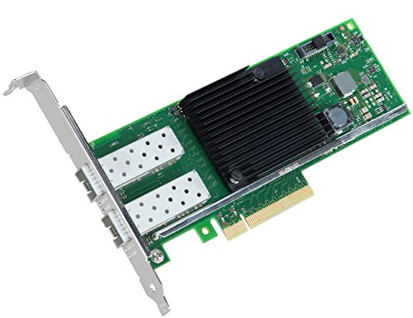
Overview
NICs (Network Interface Controllers) are the gateway to the Internet
Our challenges to face in this projects are:
Address Translation
IRAM Cache
Fortville

Slide 3
Address Translation – Flow Scheme

Slide 4
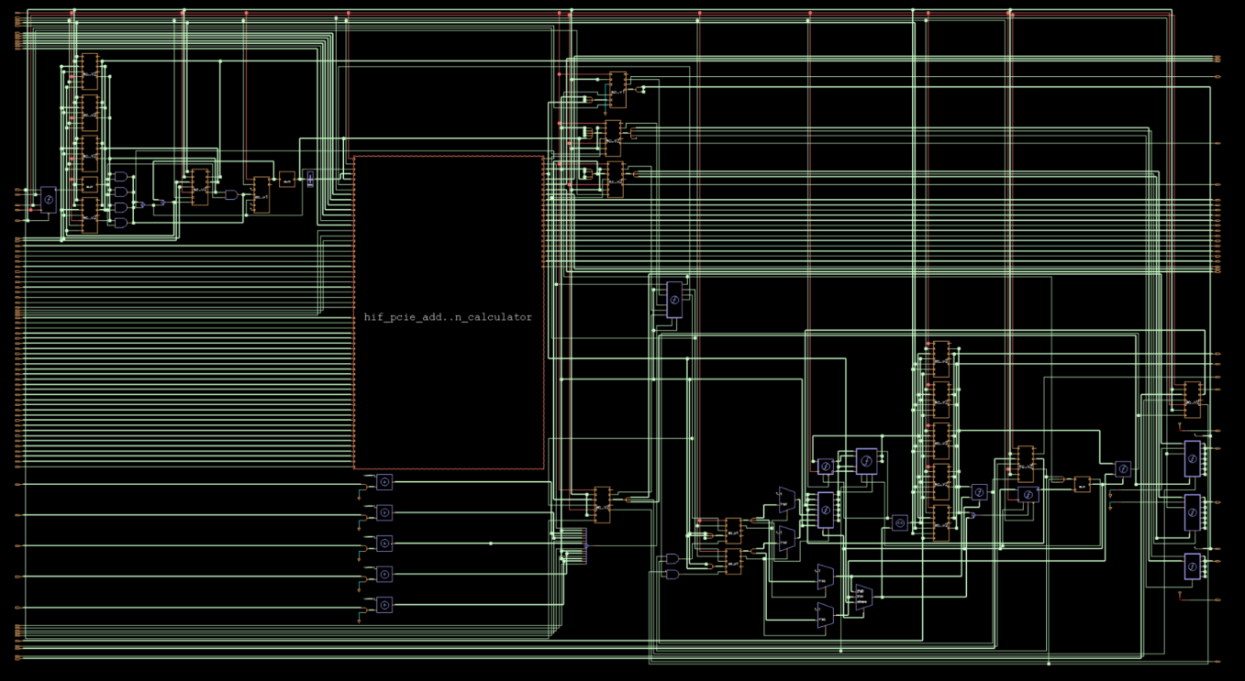
Address Translation – Schematic

Slide 5
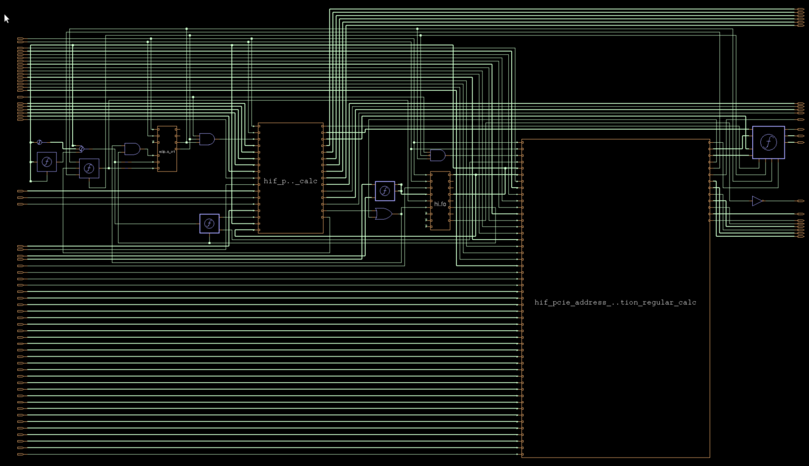
Address Translation – Schematic

Slide 6
IRAM Cache – Flow Scheme

Slide 7
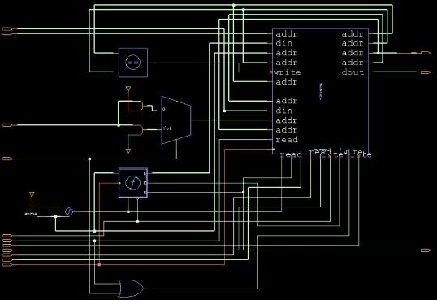
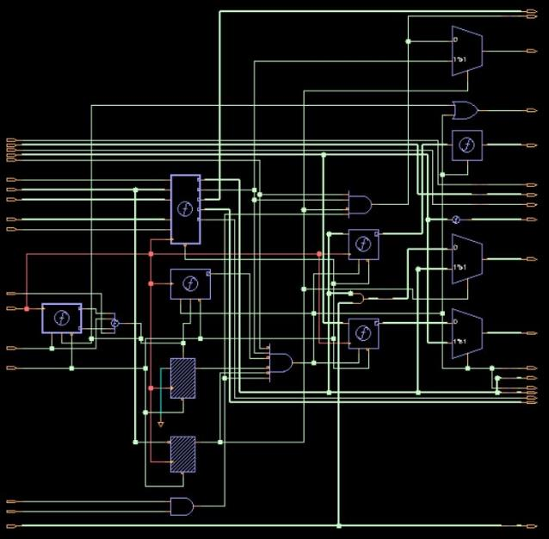
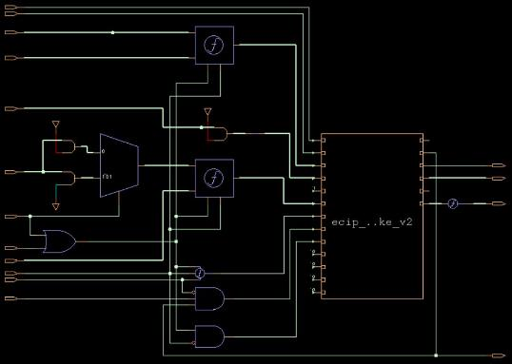
IRAM Cache – MVP Schematic
LRU
MISS HANDLER
CAM

Slide 8
Status
Coding done:
Including address protection
Including bypass mode to IRAM Cache
Timing and area are good
In progress:
Debug
Formal verification – definition + execution
Nice to have – timing and area improvements
Help needed:
Need to get NIC presentation from intel labs for presentation day

