Slide 1
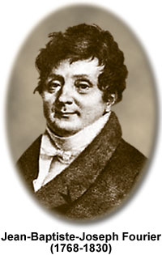
Fast Fourier Transform Project – VLSI LAB
Mid Semester presentation
Students :
Omri Freund
Roy Shvadron

Slide 2
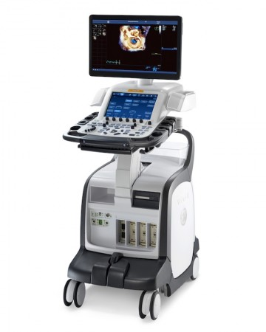
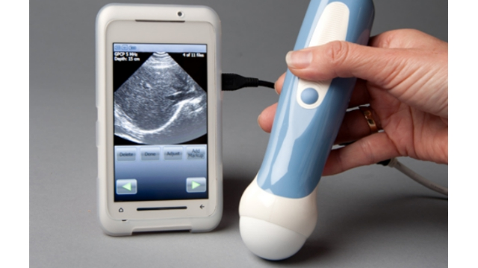
Background
Project description : as part of the effort of SAMPL lab in reduction of the Ultrasound machine size, power consumption and cost, the goal of our project is to design and implement an efficient VLSI architecture for the FFT engine, that will later be a significant part of the Ultrasound machine ASIC.

Slide 3
Signal path comprises of : Buffer -> Mixer -> Digital LPF -> buffer -> FFT engine -> buffer Project requirements is to implement the second half of the signal path ie : buffer -> FFT engine -> buffer

Slide 4
Definitions and goals
The FFT engine will receive 2 sets of inputs, each with 256 samples and each sample is 16 bits wide.
Every set of samples represents the real part of the sample and the other the imaginary part.
The goal is to implement an efficient VLSI architecture which meets timing requirements and require minimal amount of area.

