Slide 1
Avengers
The six original Avengers

Slide 2
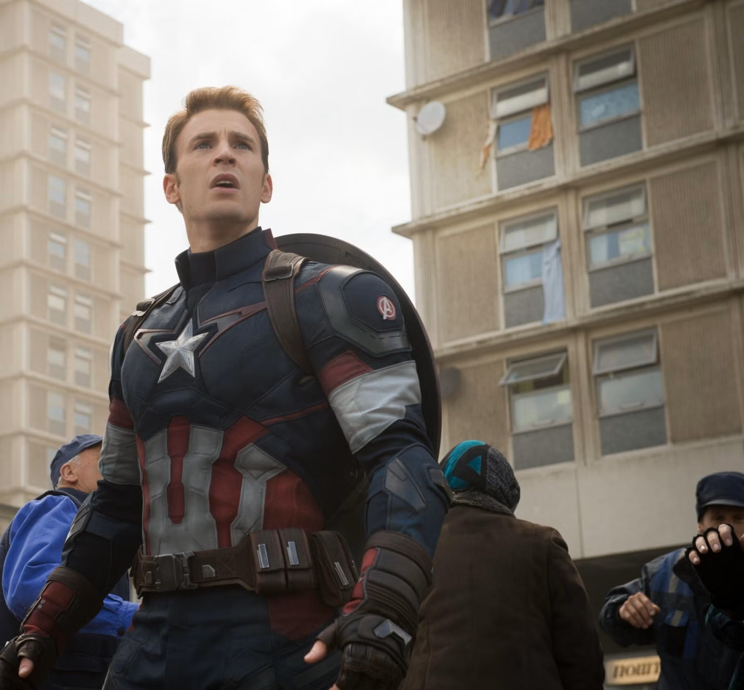
Captain America The first Avenger

Slide 3
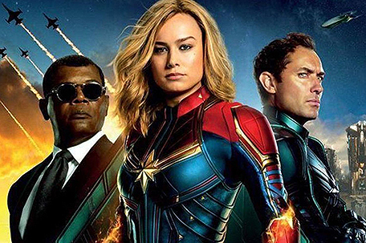
Captain Marvel the second Avenger

Slide 4
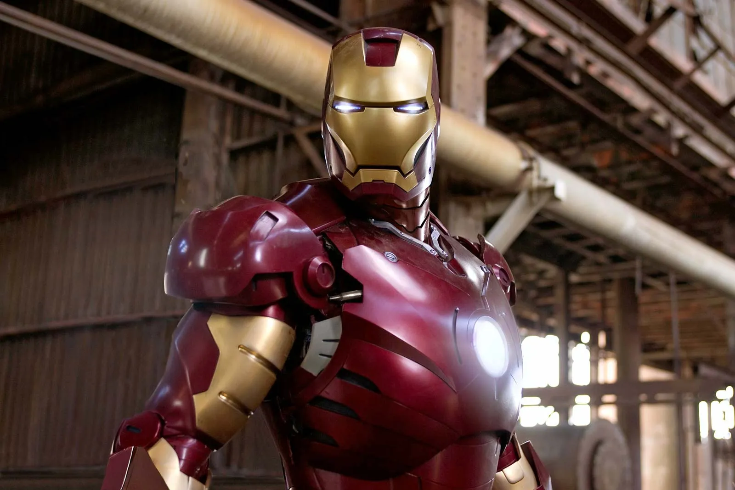
Iron man the third avenger.

