Slide 1
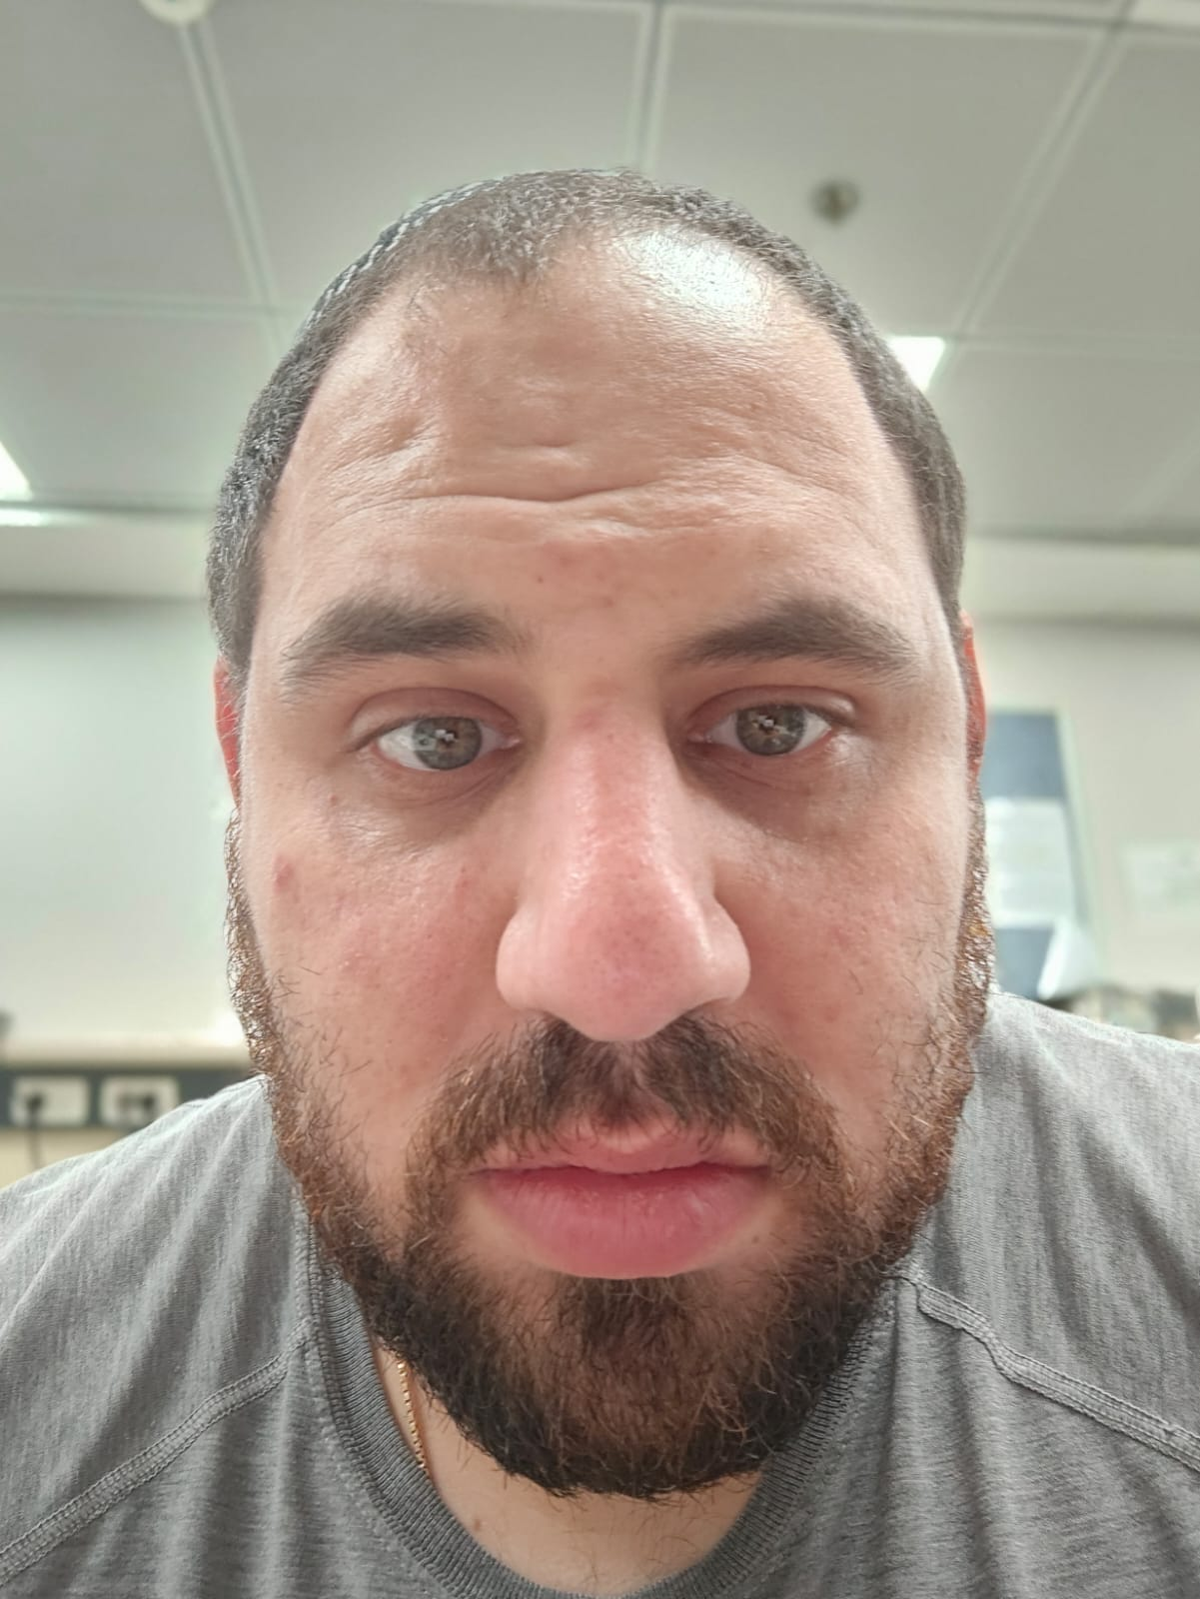
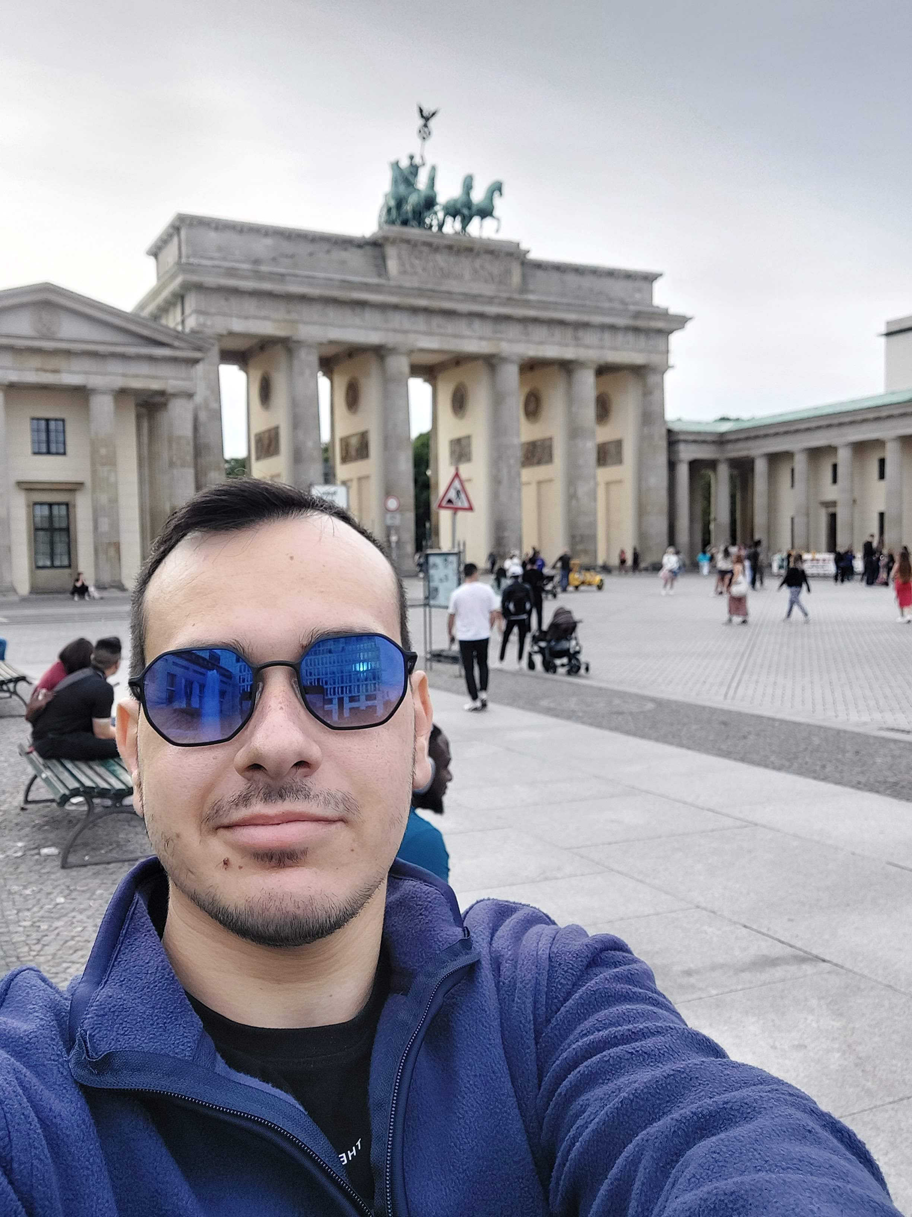
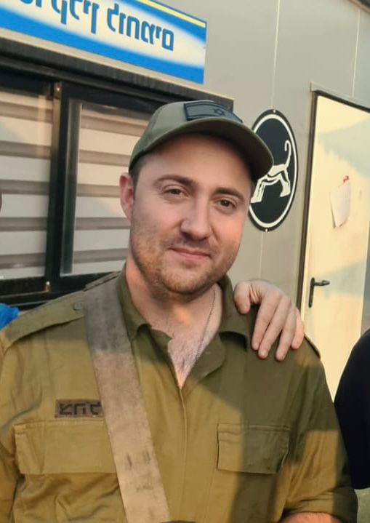
Course: Image Processing 31651
Micro Project 2 (MP2) : Usage of Filtration
Date of submission : 15/09/2024
1
Photo of the student | Shorten Name | ID (4 last digits)
 | shienfeld | 1950 | Student #1
 | pony | 2210 | Student #2
 | akimov | 7939 | Student #3

Slide 2
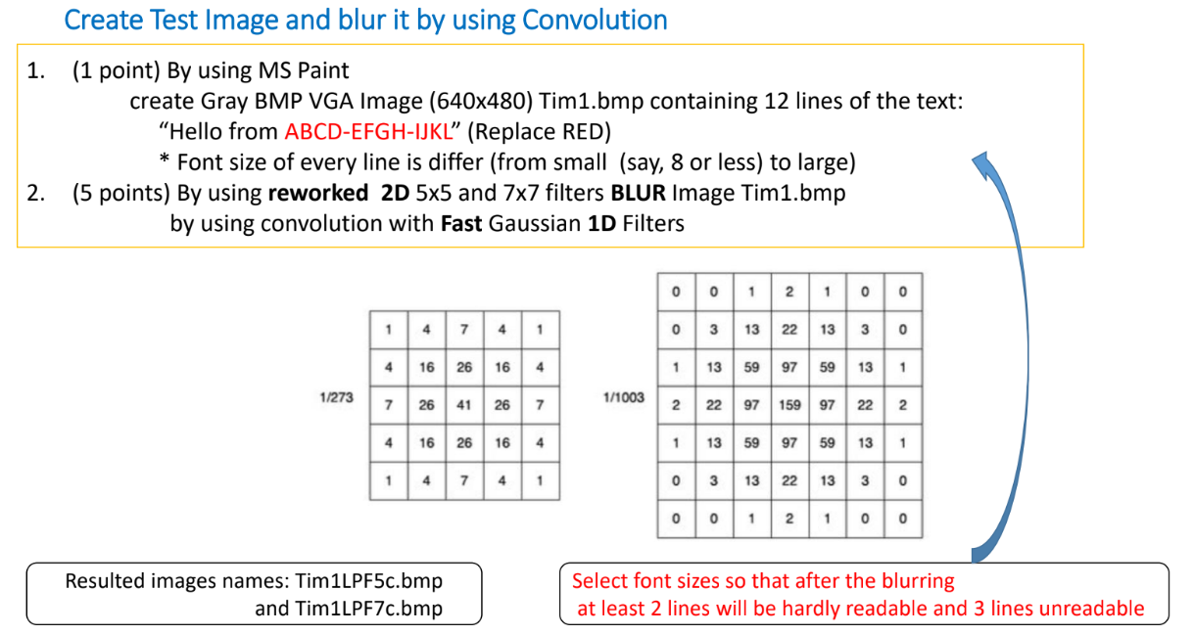
Micro Project 2 (MP2) : Usage of Filtration – the given task: (part 1)
2

Slide 3
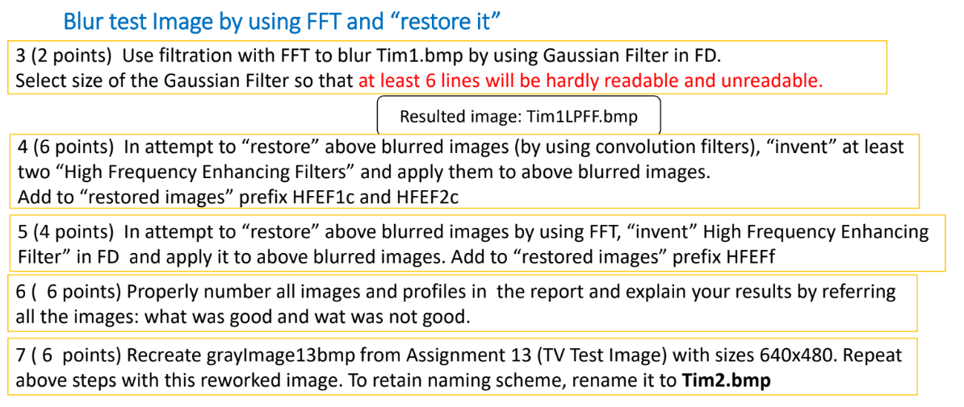
Micro Project 2 (MP2) : Usage of Filtration – the given task: (part 2)
3
Pay attention : that presentation is ordered in the following order : first introductory part where we present and explain the functions we used in the project – stand alone way (every function independently from the main flow) – and then the formal results for 1-7 sub tasks. They will be marked MP2.#

Slide 4
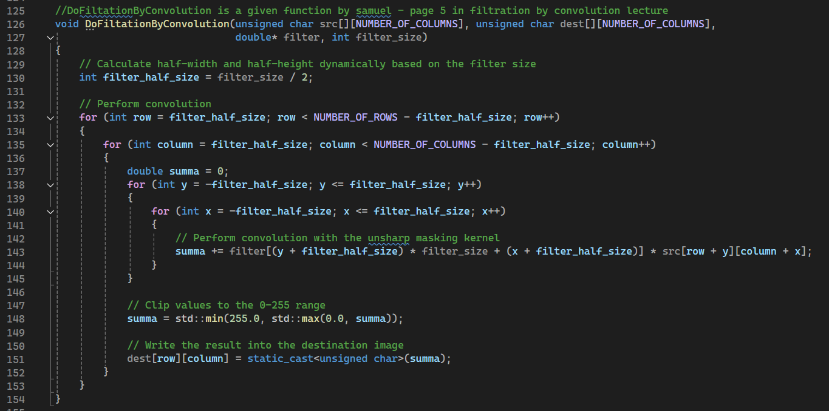
MP2.0 – introduction part 1.1 - the function “DoFiltationByConvolution”
4
That function applies a convolution operation between a given image (src) and a filter kernel (filter) to produce a filtered image (dest)
Due to the nature of the function (nested loops) we prefer to explain it step by step in a big space- hence the explanation will be in the next slide!

Slide 5
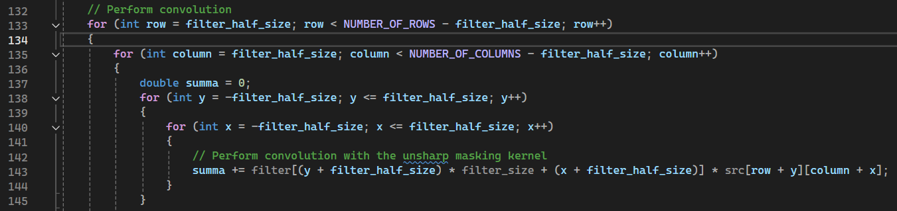
MP2.0 – introduction part 1.2 - the function “DoFiltationByConvolution”
5
First , calculates the filter half size through the filter size – we do it for determining the "radius" of the filter
Then we use 4 nested loops – the two first loops are Iterating Over Each Pixel in the Source Image (Excluding Borders)
Then declare a variable to accumulates the weighted sum of neighboring pixel values based on the filter coefficients.
Then , in the two last for loops , applying the Convolution Filter – the results are being added
For each pixel at position (row, column), the function calculates the convolution sum (summa) by multiplying each element of the filter kernel with the corresponding pixel in the src image. The sum is accumulated for the entire kernel.

Slide 6
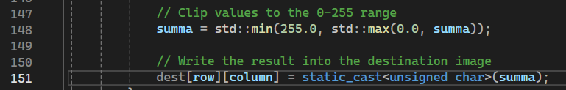
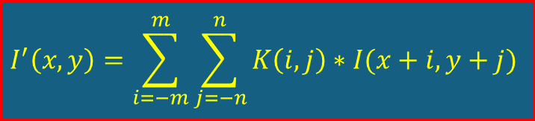
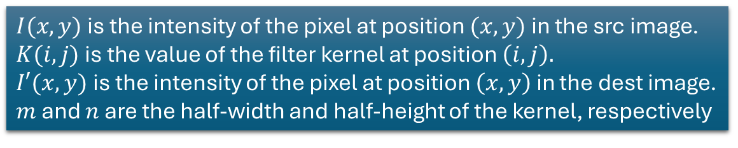
MP2.0 – introduction part 1.3 - the function “DoFiltationByConvolution”
6
next is clipping the Result to the Valid Pixel Range (0-255).
The purpose: Ensures that the resulting pixel value stays within the valid grayscale range.
If summa is less than 0.0, it is set to 0.0.If summa is greater than 255.0, it is set to 255.0.Otherwise, summa remains unchanged.
Finally : assign the Computed Value to the Destination Image
Short remainder of 2D convolution:
$I(x,y)$is the intensity of the pixel at position $(x,y)$in the src image.
$K(i,j)$is the value of the filter kernel at position $\left(i,j\right).$
$I′(x,y)$is the intensity of the pixel at position $\left(x,y\right)$ in the dest image.
$m$ and $n$ are the half-width and half-height of the kernel, respectively
$$I^{′}\left(x,y\right)=\sum_{i=−m}^{m}{\sum_{j=−n}^{n}{K\left(i,j\right)∗I(x+i,y+j)}}$$
The 2D convolution is a dimensional expansion to the well known 1D convolution as we studies in digital signal processing Couse

Slide 7
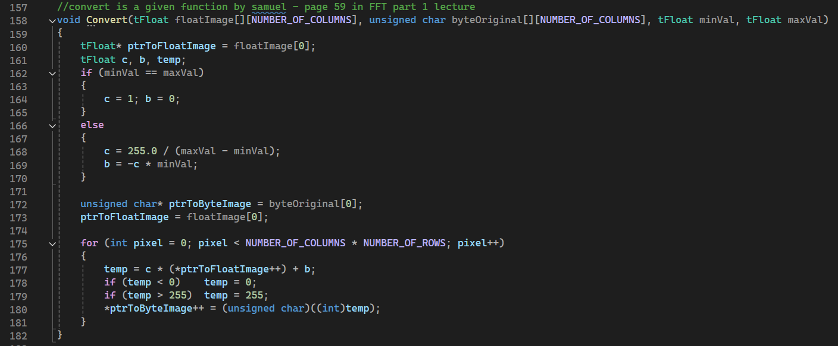
MP2.0 – introduction part 2 - the function “Convert”
7
The Convert function scales and normalizes the floating-point image data (floatImage) into the 0-255 range, which is suitable for 8-bit grayscale images.
The function calculates two factors, c and b, which are used to linearly transform the values in floatImage to the desired 0-255 range.
The function then iterates over every pixel in the floatImage, applying the linear transformation defined by c and b.
For each pixel, the formula used is temp = c * (*ptrToFloatImage++) + b. This calculates the new pixel value in the normalized range.
The value is then clamped to ensure it stays within the 0-255 range. If temp is less than 0, it is set to 0; if greater than 255, it is set to 255.

Slide 8
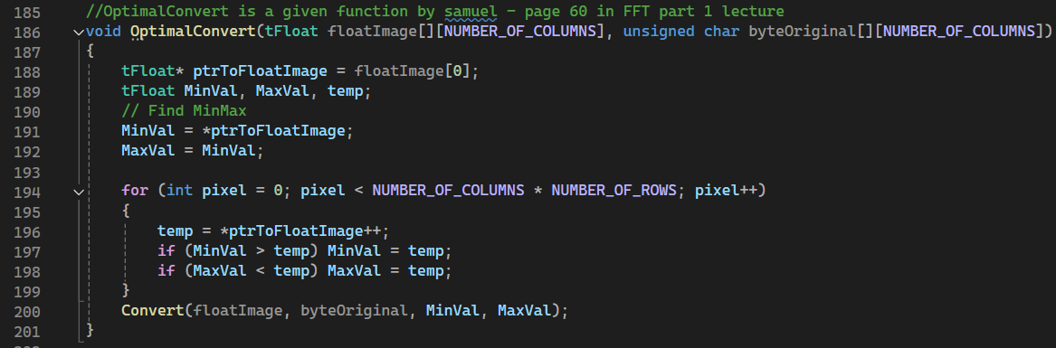
MP2.0 – introduction part 3 - the function “OptimalConvert”
8
That function is designed to take an image represented in the frequency domain (stored in a floating-point array floatImage) and convert it into a grayscale image represented as an 8-bit unsigned char array (byteOriginal).
The function scans through the floatImage to find the minimum (MinVal) and maximum (MaxVal) values. This step is crucial because the pixel values after FFT and subsequent operations might span a wide range and normalizing them is necessary for visualization.
The function then calls Convert, passing the MinVal and MaxVal it found. The Convert function normalizes the values in floatImage so that they fit within the 0-255 range, which is suitable for a grayscale image.
This conversion is crucial because, after various operations in the frequency domain, the pixel values might not be in a range that can be directly displayed or interpreted.

Slide 9
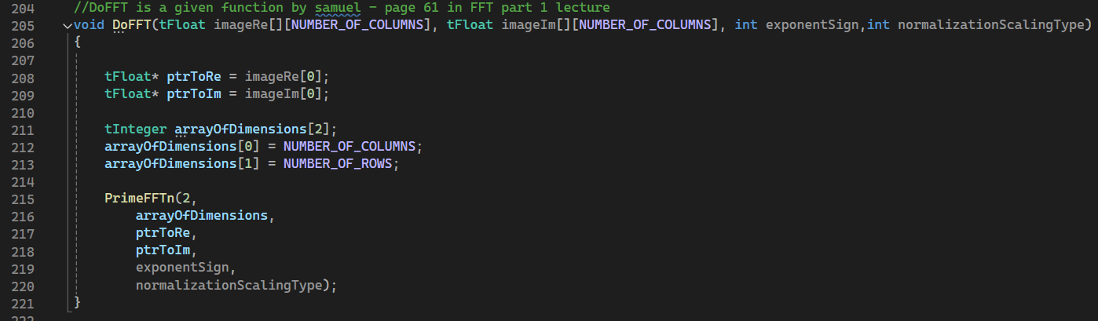
MP2.0 – introduction part 4 - the function “DoFFT”
9
The DoFFT function converts an image between the spatial domain and the frequency domain. In the frequency domain, the image data is represented by two components: the real part (imageRe) and the imaginary part (imageIm).
The core of the DoFFT function is the call to PrimeFFTn, which is a specialized FFT function provided in the PrimeFFTn.h library (was given to use in the website of the course). This function performs the actual FFT calculation based on the provided parameters:
2 indicates that the FFT is being performed on a 2D array.
arrayOfDimensions specifies the dimensions of the array.
ptrToRe and ptrToIm point to the real and imaginary parts of the image data.
exponentSign determines the direction of the FFT.
normalizationScalingType controls how the result is scaled.

Slide 10
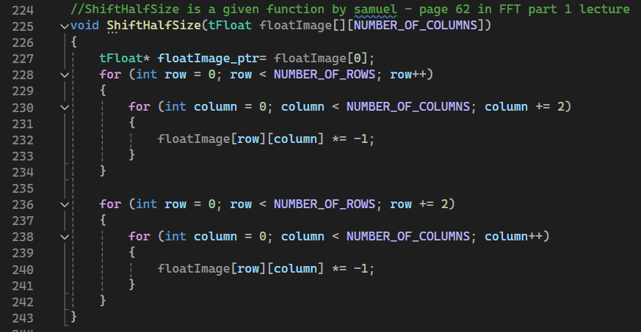
MP2.0 – introduction part 5 - the function “ShiftHalfSize”
10
That function shifts the quadrants of the image so that the zero frequency component (also known as the DC component) is centered.
It rearranges the output of the FFT such that the low frequencies are centered, which is often more intuitive for analysis and visualization.
The ShiftHalfSize function is conceptually similar to the fftshift function in MATLAB.

Slide 11
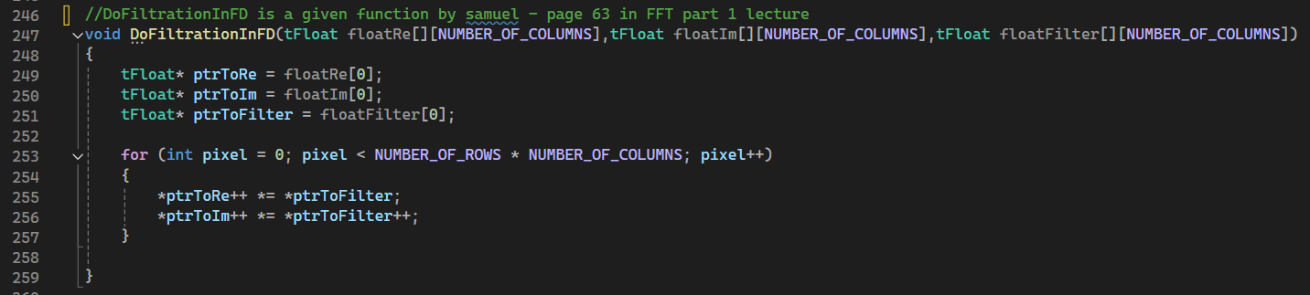
MP2.0 – introduction part 6 - the function “DoFiltrationInFD”
11
The primary purpose of DoFiltrationInFD is to apply a filter (stored in floatFilter) to an image that has already been transformed into the frequency domain.
The filtering is done by element-wise multiplication of the frequency domain representation of the image (stored in floatRe and floatIm arrays) with the filter.
After applying the filter in the frequency domain, the next step is to perform an inverse FFT (using DoFFT with a negative exponent) to transform the filtered image back into the spatial domain.
The result is a filtered version of the original image.

Slide 12
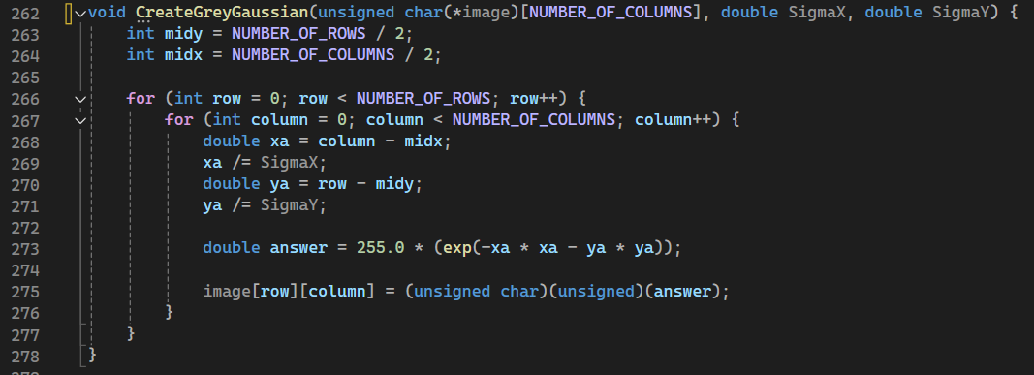

MP2.0 – introduction part 7 - the function “CreateGreyGaussian”
12
The purpose of the CreateGreyGaussian function is to create a synthetic grayscale image that simulates the effect of a Gaussian function applied over a 2D plane.
Example of the outcome – from the work() function – with the parameters we chose for blurring
The purpose of the function is to be the basis of the blurring process using FFT – LPF gaussian blurring
In this case the parameters are:
filter_size / 10.0, filter_size / 10.0

Slide 13
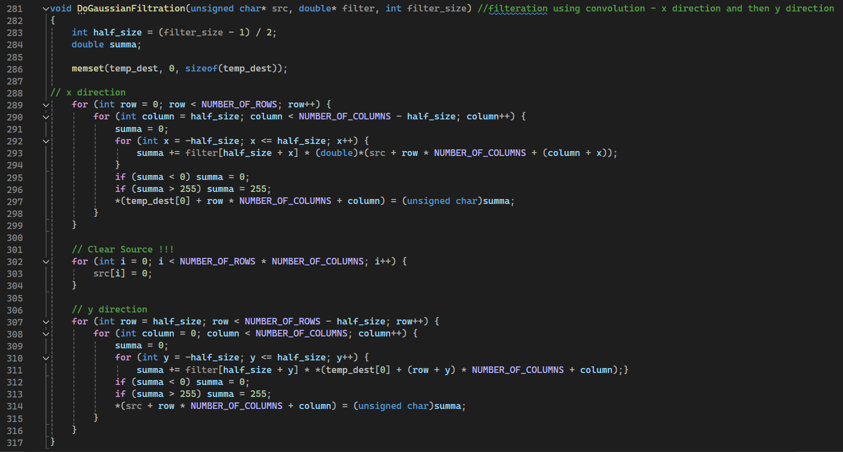
MP2.0 – introduction part 8.1 - the function “DoGaussianFiltration”
13
The purpose of this function is perform a linear convolution in TD between a gaussian filter (a kernel in certain filter size) and a source input image
Next slide we will present the main idea of the function – of how it convolve the filter with the src in an efficient way because of the gaussian filter

Slide 14
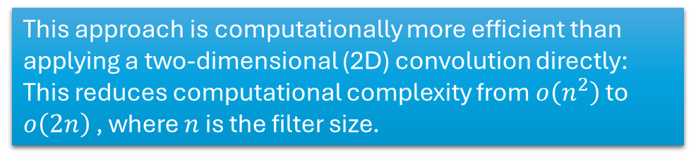
MP2.0 – introduction part 8.2 - the function “DoGaussianFiltration”
14
The function performs Gaussian filtering on a grayscale image using a separable convolution approach.
Calculate the half-size of the filter to handle boundary conditions.
This method involves two consecutive one-dimensional (1D) convolutions—first along the x-axis (horizontal direction) and then along the y-axis (vertical direction).
Clear the temporary buffer (temp_dest) to prepare for storing intermediate results.
Apply the 1D Gaussian filter across each row and Store the filtered results in temp_dest.
This approach is computationally more efficient than applying a two-dimensional (2D) convolution directly:
This reduces computational complexity from $o\left(n^{2}\right)$ to $o\left(2n\right)$ , where $n$ is the filter size.
Apply the 1D Gaussian filter across each column using the intermediate results from temp_dest and then Store the final filtered values back into src.

Slide 15
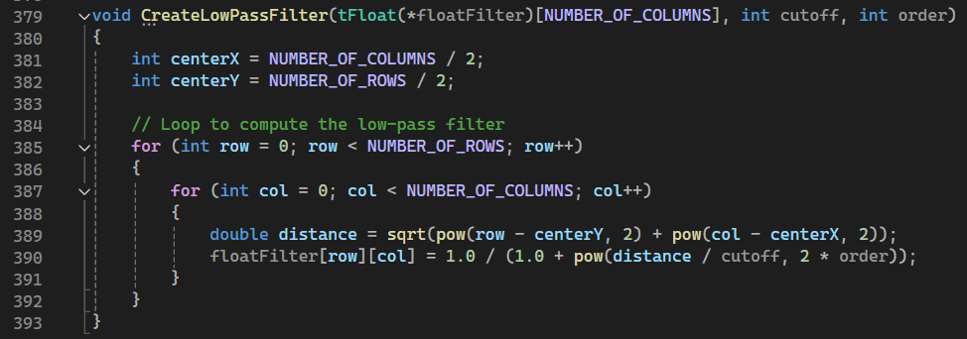
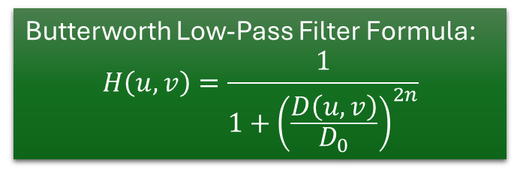
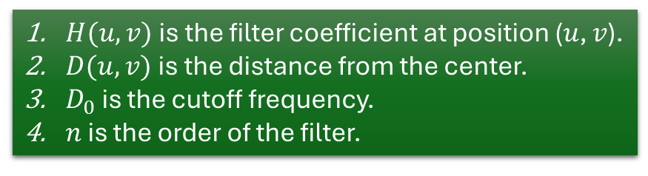
MP2.0 – introduction part 9 - the function “CreateLowPassFilter”
15
The function computes a 2D Butterworth low-pass filter based on the provided cutoff frequency and order.
The Butterworth filter is known for its maximally flat magnitude response in the passband, meaning it doesn't have ripples and provides smooth attenuation.
By modifying the order, you can control how quickly the filter transitions from passband to stopband, allowing flexibility based on application needs.
Butterworth Low-Pass Filter Formula:
$$H\left(u,v\right)=\frac{1}{1+{\left(\frac{D\left(u,v\right)}{D_{0}}\right)}^{2n}}$$
$H(u,v)$is the filter coefficient at position (𝑢, 𝑣).
$D(u,v)$is the distance from the center.
$D_{0}$​ is the cutoff frequency.
$n$ is the order of the filter.

Slide 16
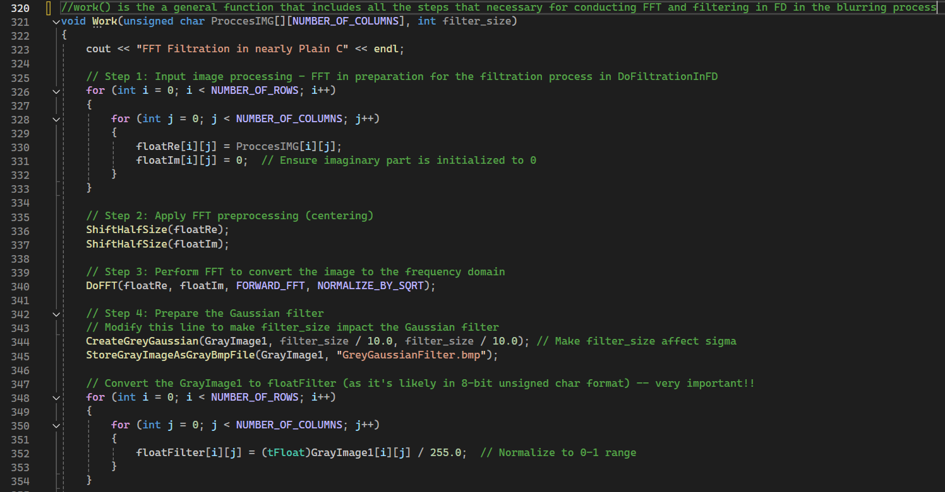
MP2.0 – introduction part 10.1 - the function “Work”
16
The function is a comprehensive image processing routine that applies a High-Frequency Enhancing Filter (HFEF) to a grayscale image using Frequency Domain Filtering.
The work() function uses most of the functions we explained in the previews parts of MP2.0
Next slide – an block diagram of the function and the rest of the code

Slide 17
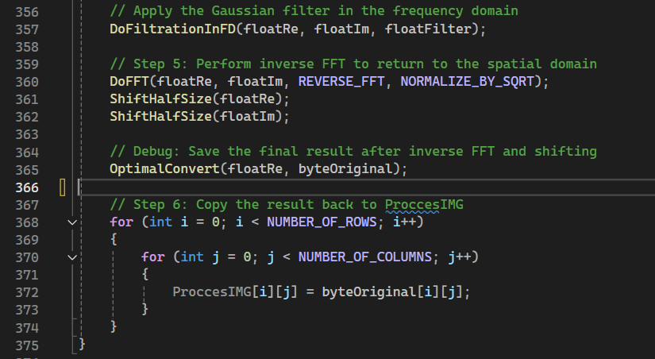
MP2.0 – introduction part 10.2 - the function “Work”
17
Block diagram of the work() function:
start
Input image : ProccesIMG
Step 1: Prepare for FFT :
i) Copies ProccesIMG to floatRe
ii) Initializes floatIm to 0
Step 6 : inverse FFT:
Arguments are: floatRe, floatIm , REVERSE_FFT, NORMALIZE_BY_SQRT
Step 7: Centering :
i) ShiftHalfSize on floatRe
ii) ShiftHalfSize on floatIm
Step 2: Centering:
i) ShiftHalfSize on floatRe
ii) ShiftHalfSize on floatIm
Step 8: Convert to Image Format with normalization
Step 5: apply filter in FD
Step 3: Forward FFT:
Arguments are: floatRe, floatIm , FORWARD_FFT , NORMALIZE_BY_SQRT
Step 9: Update Original Image:
Copies byteOriginal back to ProccesIMG
Step 4: create gaussian LPF:

Slide 18
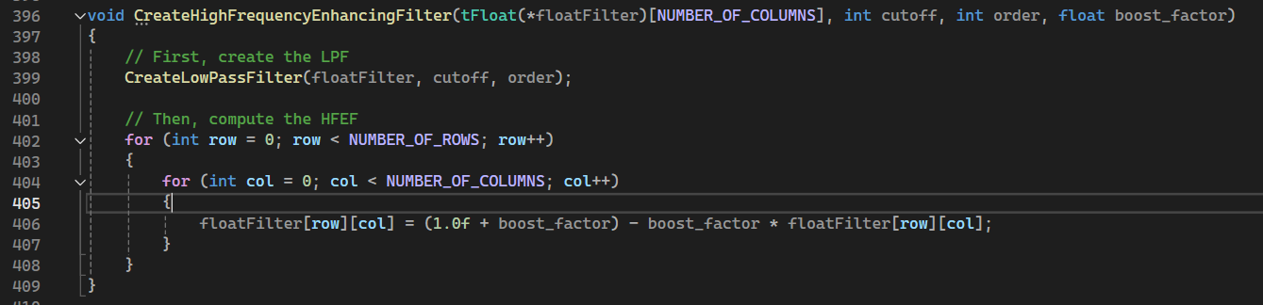
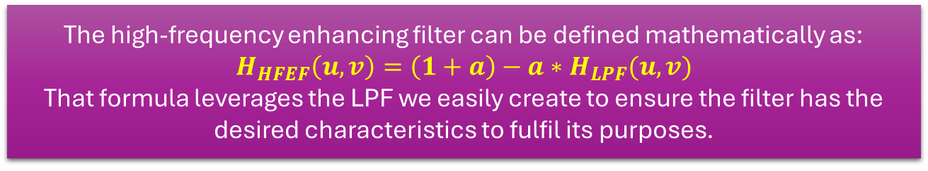
MP2.0 – introduction part 11.1 - the function “CreateHighFrequencyEnhancingFilter”
18
The function is designed to generate a High-Frequency Enhancing Filter (HFEF) in the frequency domain
The function begins by invoking CreateLowPassFilter, which generates a Butterworth Low-Pass Filter (LPF) and stores it in the floatFilter matrix.
Then , the function transforms the created LPF into High-Frequency Enhancing Filter (HFEF)
An HPF attenuates low frequencies and allows high frequencies to pass through.
An HFEF amplifies high frequencies while keeping low frequencies unchanged or less amplified.
The high-frequency enhancing filter can be defined mathematically as:
$$H_{HFEF}\left(u,v\right)=\left(1+a\right)−a∗H_{LPF}(u,v)$$
That formula leverages the LPF we easily create to ensure the filter has the desired characteristics to fulfil its purposes.

Slide 19
MP2.0 – introduction part 11.2 - the function “CreateHighFrequencyEnhancingFilter”
The function we created use several parameters in accordance with the mathematical background of the filter
Cutoff frequency – determines the frequency at which the filter transitions from low to high frequencies
Boost factor – determines the amount by which high frequencies are amplified.
The lower the boost factor , the subtle enhancement to high frequencies
Filter order-controls the sharpness of the filter’s transition between low and high frequencies.
The lower the order – the smoother (gradual) transition

Slide 20
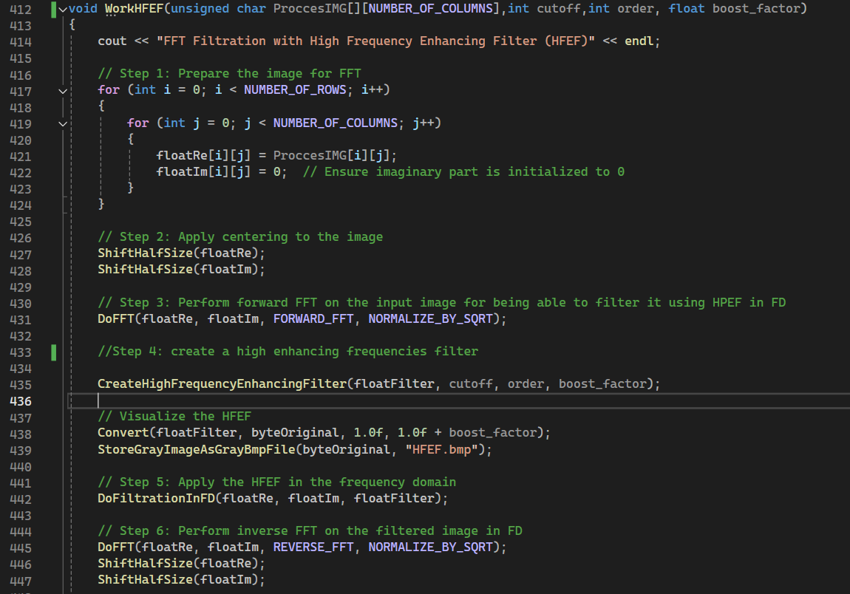
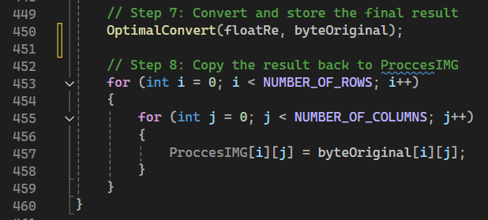
MP2.0 – introduction part 12.1 - the function “WorkHFEF”
20
The function is a comprehensive image processing routine that applies a High-Frequency Enhancing Filter (HFEF) to a grayscale image using Frequency Domain Filtering.
Pay attention : the structure of that function is very similar to the structure of the work() function – the only difference between them is step 4 which is the creation of the filter. We did not manage to combine the functions into one generic function due to lack of time

Slide 21
MP2.0 – introduction part 12.2 - the function “WorkHFEF”
21
Block diagram of the WorkHFEF () function:
Step 7: Centering :
i) ShiftHalfSize on floatRe
ii) ShiftHalfSize on floatIm
start
Step 8: Convert to Image Format with normalization
Input image : ProccesIMG
Step 9: Update Original Image:
Copies byteOriginal back to ProccesIMG
Step 6 : inverse FFT:
Arguments are: floatRe, floatIm , REVERSE_FFT, NORMALIZE_BY_SQRT
Step 1: Prepare for FFT :
i) Copies ProccesIMG to floatRe
ii) Initializes floatIm to 0
Step 5: apply filter in FD
Step 2: Centering:
i) ShiftHalfSize on floatRe
ii) ShiftHalfSize on floatIm
Step 4: create HFEF:
Create a Butterworth low pass filter and apply the mathematical formula of the HFEF using it
Step 3: Forward FFT:
Arguments are: floatRe, floatIm , FORWARD_FFT , NORMALIZE_BY_SQRT

Slide 22


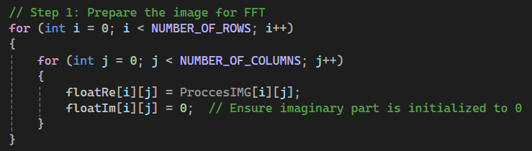
MP2.0 – introduction part 12.2 - the function “WorkHFEF”
22
Some additional notes about the processes that related both to WorkHFEF() and work()
Converts the real part of the spatial domain image (floatRe) to an unsigned char format.
Purpose: Maps floating-point pixel intensities to the 0-255 range suitable for image representation.
Repositions the zero-frequency (DC component) from the top-left corner to the center of the frequency domain.
Purpose: Centers the frequency components, making it easier to apply frequency-based filters.
Purpose: Prepares the image data for the Fourier Transform by separating real and imaginary components.

Slide 23
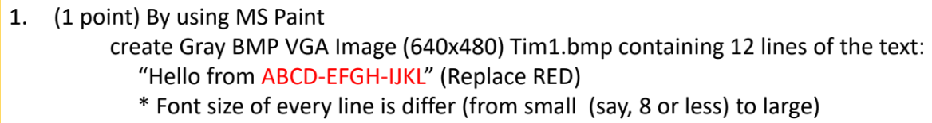
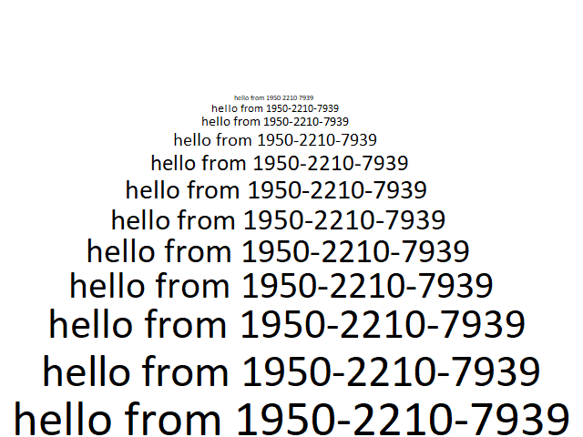
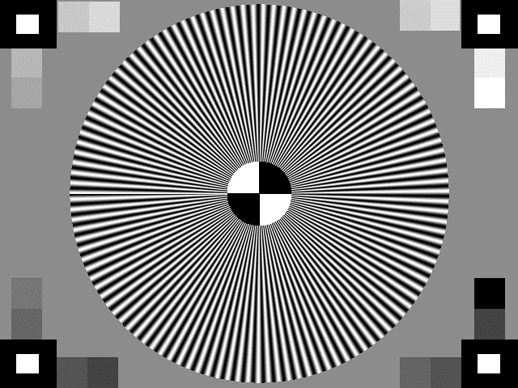
MP2.1 – the input images we are going to test – part 1
23
Tim1.bmp
Tim2.bmp

Slide 24
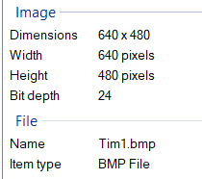
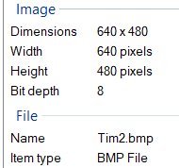
MP2.1 – the input images we are going to test – part 2
24
Tim1.bmp
The Tim1.bmp is comprised of repeated text 12 times.
The font size of the text is declining from 33 to 5 in jumps of 2/3.
Regarding Tim2.bmp – it is a modification of the result of assignment 13 to be in size 640x480

Slide 25
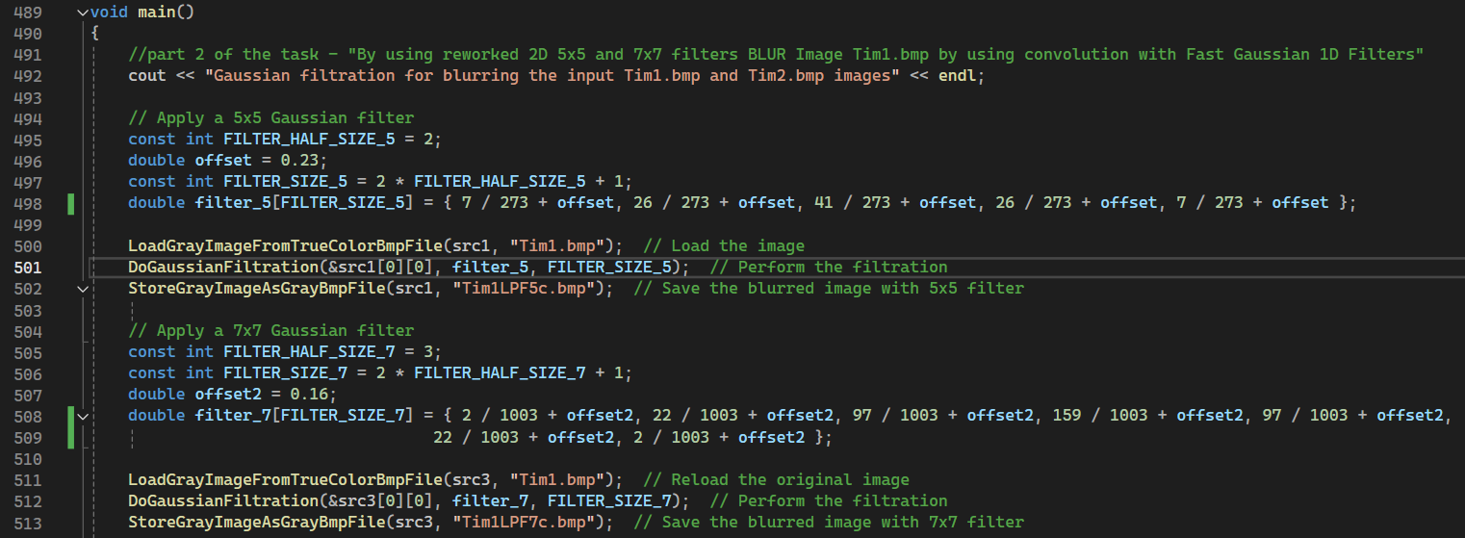
MP2.2 – blurring of the images using two sizes of fast gaussians 1D filters in convolution (TD) - part 1
25
This is the relevant part of the main function. The functions that being used in that part is the DoGaussianFiltration which is a convolution filtering that uses the separability feature of the gaussian
The offsets that we provided to the given kernels to fulfil the requirements – we reached them in trial and error until we got the optimal offsets that stands for the demands
In the first part the filter size is 5 and in the second part the filter size is 7.

Slide 26
MP2.2 – blurring of the images using two sizes of fast gaussians 1D filters in convolution (TD) - part 2
Tim2.bmp
Tim1.bmp
Load into
Load into
Load into
Load into
src4
src2
src3
src1
Blurred with 7x7 gaussian LPF in TD
(result stays in src4)
Blurred with 5x5 gaussian LPF in TD
(result stays in src2)
Blurred with 7x7 gaussian LPF in TD
(result stays in src2)
Blurred with 5x5 gaussian LPF in TD
(result stays in src1)

Slide 27
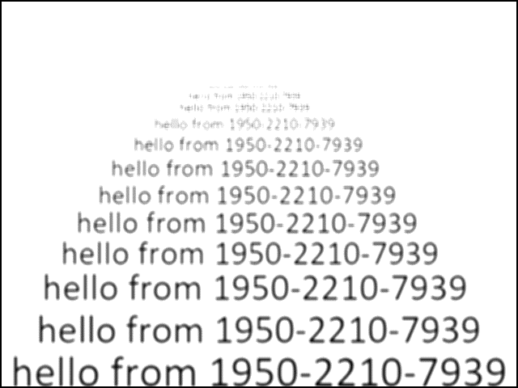
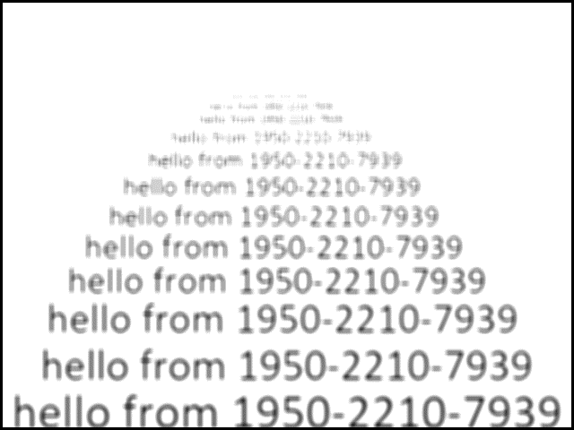
MP2.2 – blurring of the images using two sizes of fast gaussians 1D filters in convolution (TD) - part 1
27
Tim1LPF5c.bmp
filter gives different results in the different kernels sizes (different offset)
Tim1LPF7c.bmp
As one can see-both of the images stands for the demand that : after the blurring
at least 2 lines will be hardly readable and 3 lines unreadable
The presented images are at their original size (640x480)

Slide 28
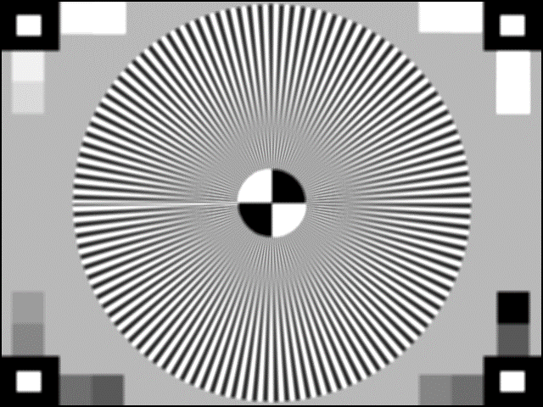
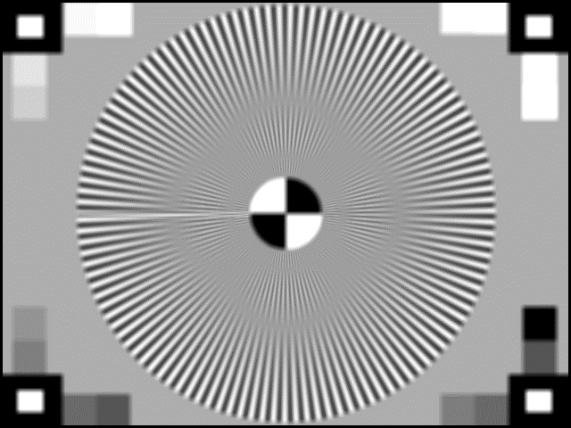
MP2.2 – blurring of the images using two sizes of fast gaussians 1D filters in convolution (TD) - part 2
28
Tim2LPF5c.bmp
The filter gives different results in the different kernels sizes (different offset)
Tim2LPF7c.bmp
We can see that in the result of the 7x7 filter (Tim2LPF7c.bmp) there is much more data loss and in both images there is no aliasing in the image

Slide 29
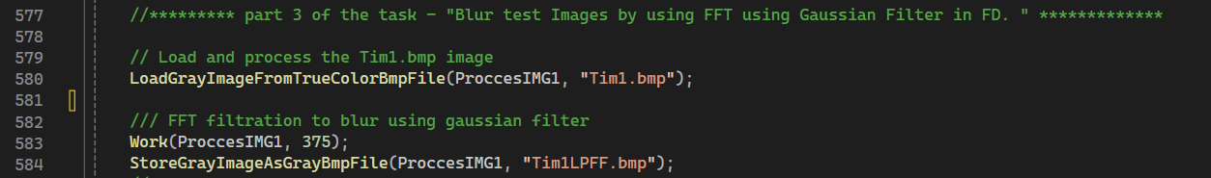
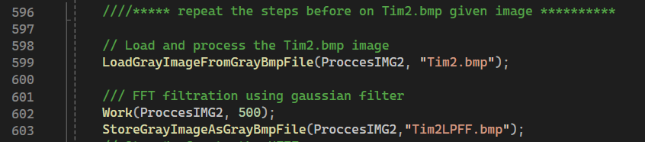
MP2.3 – blurring of the images using one size of gaussians filters using FFT (FD) - part 1
29
In MP2.3 we had to filter in FD – hence using the FFT process using the work() function to blur the input image using gaussian filter.
As a gaussian filter we use the known function of CreateGreyGaussian and needed to adjust its parameters for blurring at least 6 lines that will be hardly readable and unreadable
The size of the filter that we provided to the work() to fulfil the requirements – we reached them in trial and error until we got the optimal sizes that stands for the demands

Slide 30
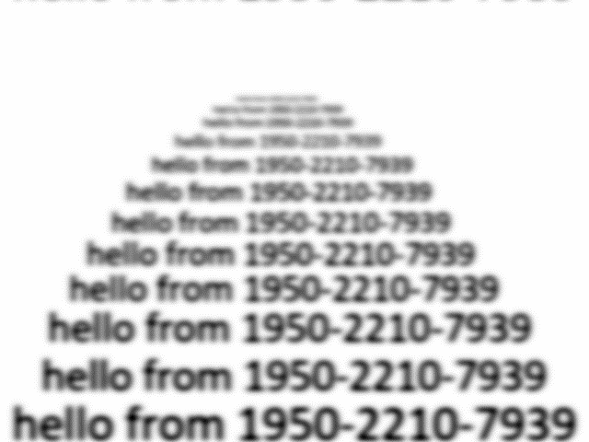

MP2.3 – blurring of the images using one size of gaussians filters using FFT (FD) - part 2
30
Tim1LPFF.bmp
Tim2LPFF.bmp
The presented images are at their original size (640x480)

Slide 31
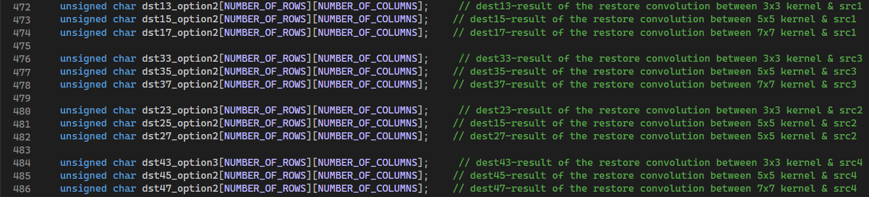
MP2.4 – restoration of the blurred images created using convolution using at least two HFEF - part 0
31
We created 3 restoration types for each blurred image (src#1,2,3,4).
We checked each image with 3 different high frequency enhancement filters – Laplacian , high boost and unsharp masking when for each type we checked for 3 different sizes of kernel – 3 , 5 & 7.
The total number of tested scenarios is 3*3*3*3=27 -> out of them we picked and left in the code (and will present) only the 9 relevant and best from our perspective .
Since the results of the Laplacian were not satisfying enough – we excluded them from that presentation.
The names of the destination’s variables are named after 3 parameters:
1) src number
2) filter size (3/5/7)
3) option number

Slide 32
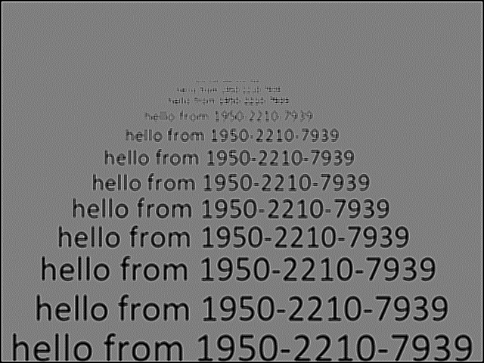
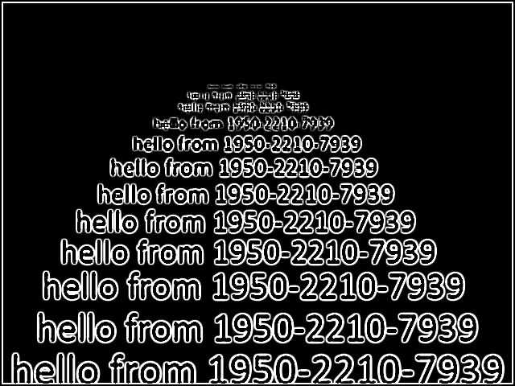
MP2.4 – restoration of the blurred images created using convolution using at least two HPF - part 1
32
Tim1 blurred by gaussian in size 5 restored by kernel_1
Tim1 blurred by gaussian in size 7 restored by kernel_2
Tim1LPF5CHFEF1C.bmp
Tim1LPF5CHFEF2C.bmp

Slide 33
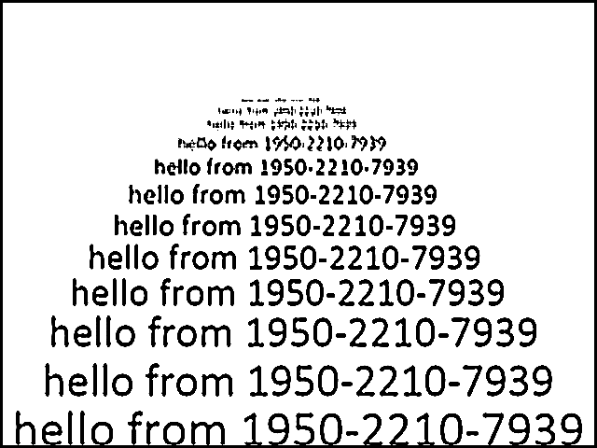
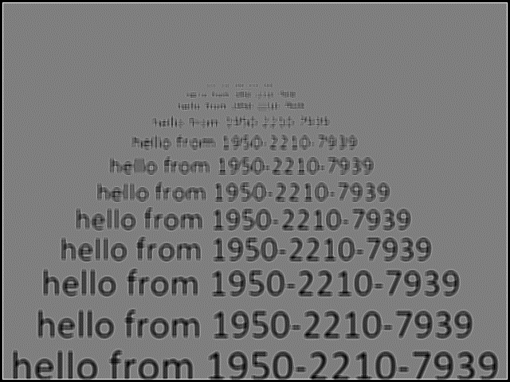
MP2.4 – restoration of the blurred images created using convolution using at least two HPF - part 2
33
Tim1 blurred by gaussian in size 5 restored by kernel_3
Tim1 blurred by gaussian in size 7 restored by kernel_1
Tim1LPF5CHFEF3C.bmp
Tim1LPF7CHFEF1C.bmp

Slide 34
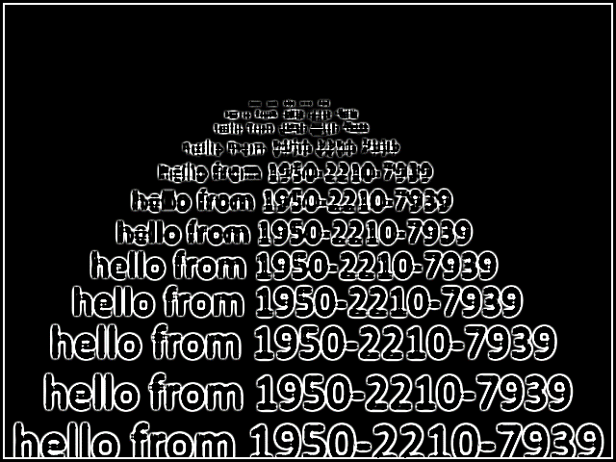
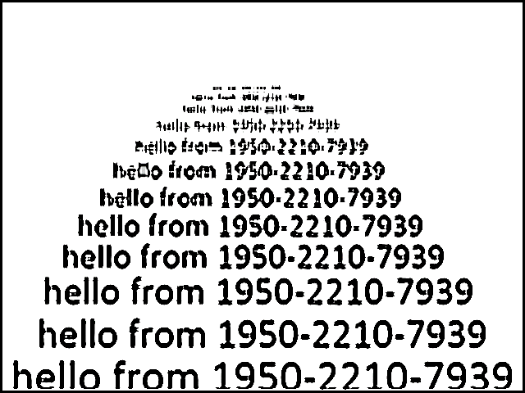
MP2.4 – restoration of the blurred images created using convolution using at least two HPF - part 3
34
Tim1 blurred by gaussian in size 7 restored by kernel_2
Tim1 blurred by gaussian in size 7 restored by kernel_3
Tim1LPF7CHFEF2C.bmp
Tim1LPF7CHFEF3C.bmp

Slide 35
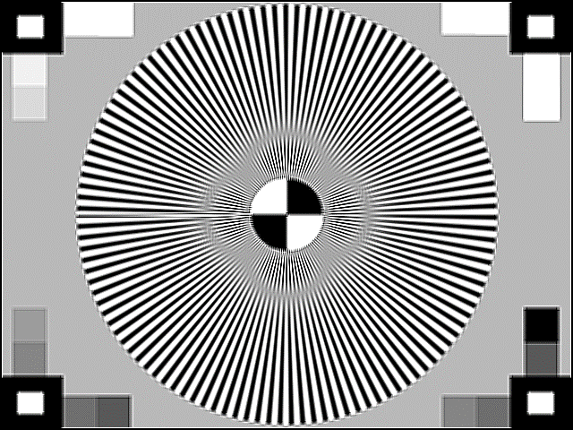
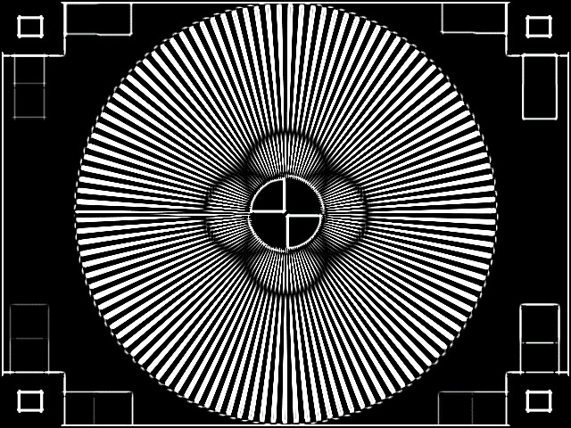
MP2.4 – restoration of the blurred images created using convolution using at least two HPF - part 4
35
Tim2 blurred by gaussian in size 5 restored by kernel_1
Tim2 blurred by gaussian in size 5 restored by kernel_2
Tim2LPF5CHFEF1C.bmp
Tim2LPF5CHFEF2C.bmp

Slide 36


MP2.4 – restoration of the blurred images created using convolution using at least two HPF - part 5
36
Tim2 blurred by gaussian in size 5 restored by kernel_3
Tim2 blurred by gaussian in size 7 restored by kernel_1
Tim2LPF5CHFEF3C.bmp
Tim2LPF7CHFEF1C.bmp

Slide 37


MP2.4 – restoration of the blurred images created using convolution using at least two HPF - part 5
37
Tim2 blurred by gaussian in size 7 restored by kernel_2
Tim2 blurred by gaussian in size 7 restored by kernel_3
Tim2LPF7CHFEF2C.bmp
Tim2LPF7CHFEF3C.bmp

Slide 38

MP2.4 – restoration of the blurred images created using convolution using at least two HPF - part 6
38
The calls to the filtration using convolution from the main

Slide 39

MP2.4 – restoration of the blurred images created using convolution using at least two HPF – part 7
39
The calls to the filtration using convolution from the main - continue

Slide 40


MP2.4 – restoration of the blurred images created using convolution using at least two HPF - part 8
These kernels were generated by ChatGPT preview o1

Slide 41


MP2.4 – restoration of the blurred images created using convolution using at least two HPF - part 8
These kernels were generated by ChatGPT preview o1

Slide 42

MP2.5 – restoration of the blurred images created using FFT using one “enhancing HPF “- part 1
42
Tim1LPFF.bmp – the blurred image through FFT
Tim1LPFFHFEFf.bmp– the restored image through FFT
We can see that from line 5 there is a separation between letters in the “hello from” which indicates on good restoration

Slide 43

MP2.5 – restoration of the blurred images created using FFT using one “enhancing HPF “- part 2
43
Tim2LPFF.bmp – the blurred image through FFT
Tim2LPFFHFEFf.bmp– the restored image through FFT
The enhanced image is much sharper in the edges of the circle and the initial blurring in the center has now sharper edges

Slide 44


MP2.5 – restoration of the blurred images created using FFT using one “enhancing HPF “- part 3
44
In both cases the parameters were created by a trial and error until reaching the optimal results (maximum enhancement)

Slide 45
MP2.6 – bibliography
ChatGPT – thanks to the chat for a lot of wonderful work
Course lecturers – we used the lecturers and the functions in it

