Slide 1
Course: Image Processing 31651 Micro Project 1 (MP1) : Convert Color Image to Grayscale Image (N=1)
Presentation date: 1/8/2024 on laboratory session (V=1)
Photo of the student | Shorten Name | ID
 | pony | 2210 | Student #1
 | shienfeld | XXXXXEFGH | Student #2
 | akimov | XXXXXIJKL | Student #3

Slide 2
Course: Image Processing 31651 Micro Project 1 (MP1) : Convert Color Image to Grayscale Image (N=1)
Presentation contains:
# | Description
1 | Description of the problem to be solved
2 | Description of the algorithm including description of: Input Image(s), algorithm’ parameter(s), output image(s)/value(s)
3 | Detailed Block chart (Flow Chart/Block Diagram) of the algorithm(s)
4 | Extracts of the important parts of the code with proper comments
5 | Examples of the code operation by using images selected by students including a discussion when algorithm’ worked and when not
6 | List of sources used (Bibliography)

Slide 3


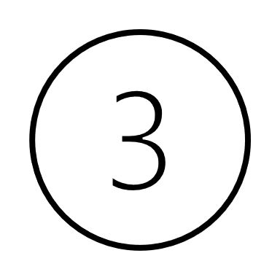
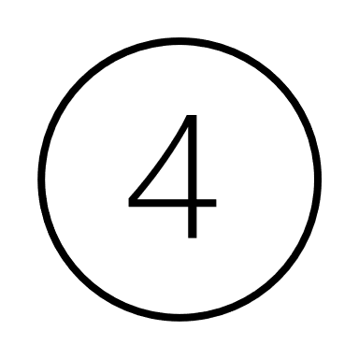
Micro Project 1 (MP1) : Convert Color Image to Grayscale Image (N=1)
P1.1 Description of the problem to be solved
Grayscale images reduce the amount of data that needs to be processed, as they contain only intensity information compared to three channels (red, green, and blue) in color images.
This reduction in data simplifies algorithms and decreases computational load.
Consequently - With fewer data points to process, operations on grayscale images are generally faster, which is crucial for real-time applications such as video processing.
Grayscale images require less storage space and memory compared to color images, making them more efficient for storage and processing.
Many image processing techniques, such as edge detection, histogram equalization, and thresholding, are simpler to implement and perform more efficiently on grayscale images.
Combining photos taken in different weather conditions into one panoramic picture can make them look as if they were taken at the same time and under the same weather conditions.
Notes:
If there is an edge (a step change in pixel value) in hue that is hard to detect in a grayscale image, or if we need to identify objects of known hue (orange fruit in front of green leaves), then color information could be useful.
C. If you get into the business of attempting to distinguish colors from one another, then you'll either want to (a) follow tradition and control the lighting, camera color calibration, and other factors to ensure the best results, or (b) settle down for a career-long journey into a topic that gets deeper the more you look at it, or (c) wish you could be back working with grayscale because at least then the problems seem solvable.
D.With modern computers, and with parallel programming, it's possible to perform simple pixel-by-pixel processing of a megapixel image in milliseconds. Facial recognition, OCR, content-aware resizing, mean shift segmentation, and other tasks can take much longer than that. If we make the hand-wavy assumption that processing a three-channel color image takes three times as long as processing a grayscale image. Cutting processing time by a factor of three to four can mean the difference between running an 8-hour overnight test that ends before you get back to work, and having your computer's processors pegged for 24 hours straight.

Slide 4
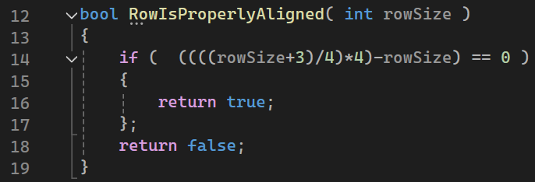
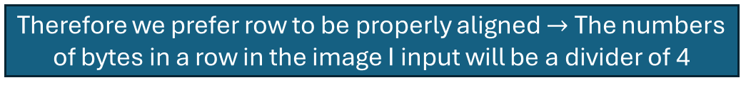
Micro Project 1 (MP1) : Convert Color Image to Grayscale Image (N=1)
Intoduction to P1.2 – conditions to ensure an image is suitable to be an input of the system – part 2
Processor works on integers always – therefore if we will try to use number of bytes that does not characterize integers, we will have a problems
Therefore we prefer row to be properly aligned $→$ The numbers of bytes in a row in the image I input will be a divider of 4
Pay attention that every image in that project will be 320x240 with 3 colors - therefore this condition is inherently satisfied

Slide 5
Micro Project 1 (MP1) : Convert Color Image to Grayscale Image (N=1)
Intoduction to P1.2 – conditions to ensure an image is suitable to be an input of the system – part 2
Color depth, also known as bit depth, refers to the number of bits used to represent the color of a single pixel in an image. The more bits per pixel, the more colors can be represented.
We are dealing with two types of images: True Color (24-bit RGB) images and Grayscale (8-bit) images.
True Color Images (24-bit RGB):
Each pixel is 24 bits (3 bytes).
Represented by three values: Blue, Green, Red.
Checked in the code to ensure the BMP file has 24 bits per pixel.

Slide 6
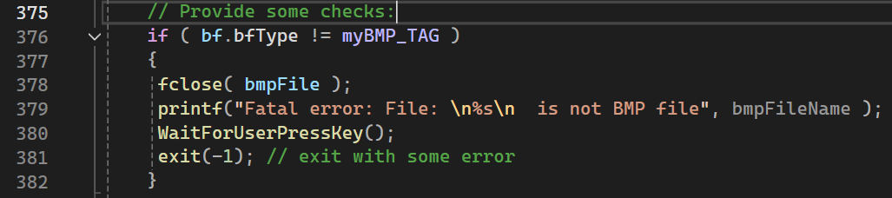
Micro Project 1 (MP1) : Convert Color Image to Grayscale Image (N=1)
Intoduction to P1.2 – conditions to ensure an image is suitable to be an input of the system – part 2
The BMP file must have the correct signature, represented by myBMP_TAG. This ensures the file being processed is indeed a BMP file.
The file signature is checked using bf.bfType == myBMP_TAG.

Slide 7
Micro Project 1 (MP1) : Convert Color Image to Grayscale Image (N=1)
P1.2 Description of the algorithms – part 1
Load a "True color" image with a size of 320x240 pixels
Average Algorithm
Luminosity Algorithm
Algorithm
Lightness Algorithm
Store the resulted image as a BMP file in the directory of the code

Slide 8
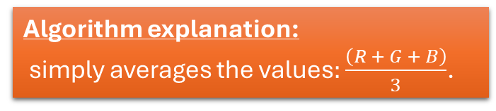
Micro Project 1 (MP1) : Convert Color Image to Grayscale Image (N=1)
P1.2 Description of the algorithms – part 2
Input Image(s) : The algorithm takes one "True color" image with a size of 320x240 pixels. (predefined in the attached header file)
Algorithm Parameters :
one parameter: 0.33 (division by 3)
Average Algorithm
Output Image(s):
This algorithm produces one grayscale image with a size of 320x240 pixels.
Algorithm explanation:
simply averages the values$:\frac{\left(R + G + B\right)}{3}$.

Slide 9
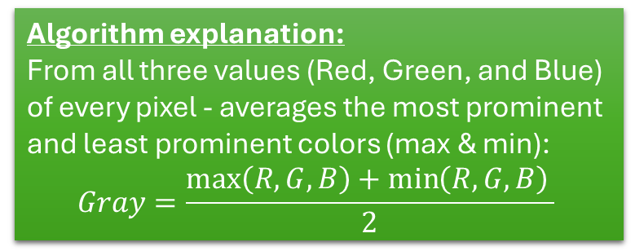
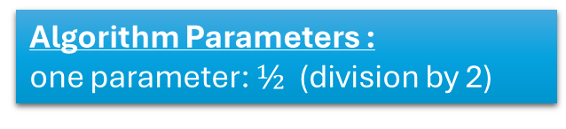
Micro Project 1 (MP1) : Convert Color Image to Grayscale Image (N=1)
P1.2 Description of the algorithms – part 3
Input Image(s) : The algorithm takes one "True color" image with a size of 320x240 pixels. (predefined in the attached header file)
Algorithm Parameters :
one parameter: $½$ (division by 2)
Lightness Algorithm
tends to reduce contrast.
Output Image(s):
This algorithm produces one grayscale image with a size of 320x240 pixels.
Algorithm explanation:
From all three values (Red, Green, and Blue) of every pixel - averages the most prominent and least prominent colors (max & min):
$$Gray=\frac{\max\left(R,G,B\right)+\min\left(R,G,B\right)​}{2}$$

Slide 10
Micro Project 1 (MP1) : Convert Color Image to Grayscale Image (N=1)
P1.2 Description of the algorithms – part 4
Input Image(s) : The algorithm takes one "True color" image with a size of 320x240 pixels. (predefined in the attached header file)
Algorithm Parameters :
First parameter (R) : 0.21, second parameter (G) : 0.72, third parameter (B) : 0.07
works best overall and is the default method used if you are asked to change an image from RGB to grayscale from a given Image
Luminosity Algorithm
Algorithm explanation:
A more sophisticated version of the average method. It also averages the values, but it forms a weighted average to account for human perception. We’re more sensitive to green than other colors, so green is weighted most heavily.
Output Image(s):
This algorithm produces one grayscale image with a size of 320x240 pixels.

Slide 11
Micro Project 1 (MP1) : Convert Color Image to Grayscale Image (N=1)
P1.2 Description of the algorithms – part 5

Slide 12
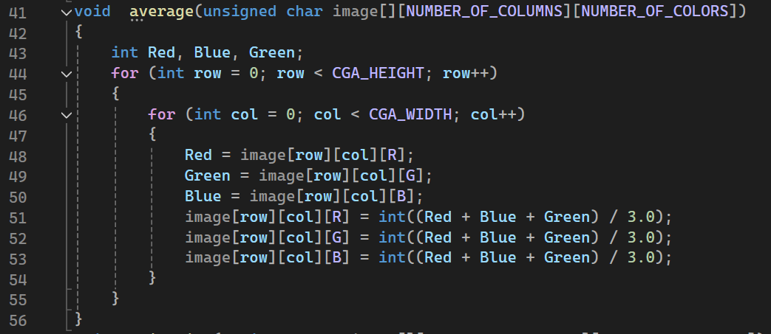
Micro Project 1 (MP1) : Convert Color Image to Grayscale Image (N=1)
P1.4 Extracts of the important parts of the code with proper comments – part 1
The average method converts a color image to grayscale by computing the average of the Red, Green, and Blue components for each pixel. This method is straightforward and considers all three-color channels equally.
For each pixel in the image:
Extract the Red, Green, and Blue components. For example in line 32 : Red=image[row][col][R];
Compute the average of the three components: $\frac{Red + Green + Blue}{3}$
Set the Red, Green, and Blue components of the pixel to this grayscale value.

Slide 13
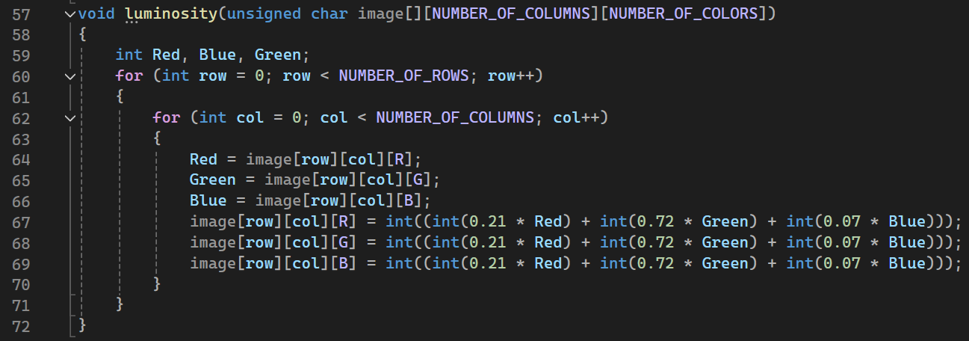
Micro Project 1 (MP1) : Convert Color Image to Grayscale Image (N=1)
P1.4 Extracts of the important parts of the code with proper comments – part 2
The luminosity method converts a color image to grayscale by taking a weighted sum of the Red, Green, and Blue components. This method accounts for human perception, giving more importance to the Green component as the human eye is more sensitive to green light.
For each pixel in the image:
Extract the Red, Green, and Blue components. For example in line 32 : Red=image[row][col][R];
Compute the grayscale value using the formula$: 0.21 ∗ Red + 0.72 ∗ Green + 0.07 ∗ Blue$
Set the Red, Green, and Blue components of the pixel to this grayscale value.

Slide 14
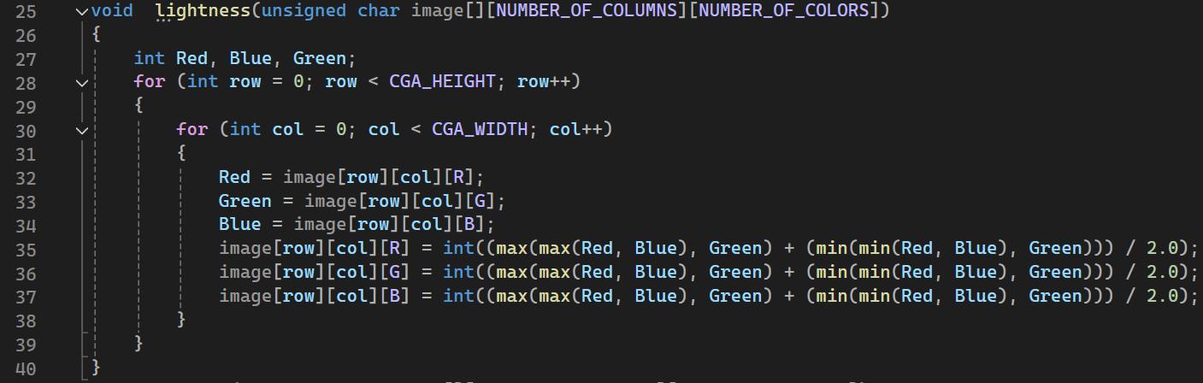
Micro Project 1 (MP1) : Convert Color Image to Grayscale Image (N=1)
P1.4 Extracts of the important parts of the code with proper comments – part 3
The lightness method converts a color image to grayscale by taking the average of the maximum and minimum RGB values of each pixel. This method considers the extremes of the color range, making it sensitive to the lightest and darkest parts of the image.
For each pixel in the image:
Extract the Red, Green, and Blue components. For example in line 32 : Red=image[row][col][R];
Calculate the maximum value among the three components: $max⁡(Red, Green, Blue)$
Calculate the minimum value among the three components: $min⁡(Red, Green, Blue)$
Compute the grayscale value as the average of the maximum and minimum values: $\frac{\max{+}min}{2}$ $→$ and Set the Red, Green, and Blue components of the pixel to this grayscale value.

Slide 15
Course: Image Processing 31651 Micro Project 1 (MP1) : Convert Color Image to Grayscale Image (N=1)
P1.4 Extracts of the important parts of the code with proper comments – part 4

Slide 16
Course: Image Processing 31651 Micro Project 1 (MP1) : Convert Color Image to Grayscale Image (N=1)
P1.4 Extracts of the important parts of the code with proper comments – part 5

Slide 17
Course: Image Processing 31651 Micro Project 1 (MP1) : Convert Color Image to Grayscale Image (N=1)
P1.4 Extracts of the important parts of the code with proper comments – part 6

Slide 18
Course: Image Processing 31651 Micro Project 1 (MP1) : Convert Color Image to Grayscale Image (N=1)
P1.4 Extracts of the important parts of the code with proper comments – part 7

Slide 19
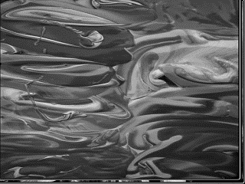
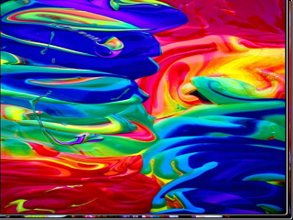
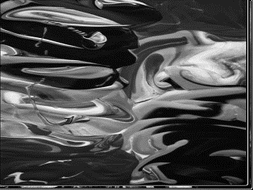
Course: Image Processing 31651 Micro Project 1 (MP1) : Convert Color Image to Grayscale Image (N=1)
P1.5 Examples of the code operation by using images selected by students – part 1
Using “average algorithm”
Using “luminosity algorithm”

Slide 20
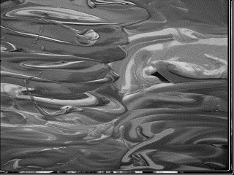
Course: Image Processing 31651 Micro Project 1 (MP1) : Convert Color Image to Grayscale Image (N=1)
P1.5 Examples of the code operation by using images selected by students – part 2
Using “lightness algorithm”
Using “algorithm”

Slide 21
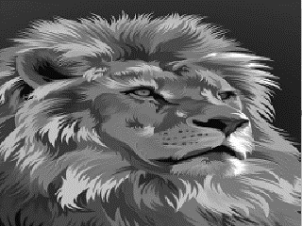
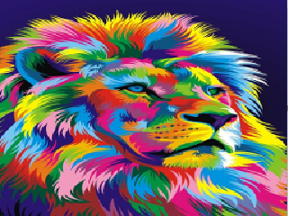
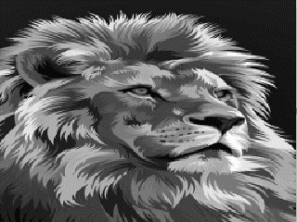
Course: Image Processing 31651 Micro Project 1 (MP1) : Convert Color Image to Grayscale Image (N=1)
P1.5 Examples of the code operation by using images selected by students – part 3
Using “average algorithm”
Using “luminosity algorithm”

Slide 22
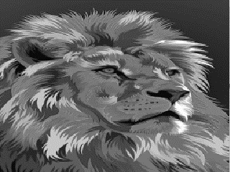
Course: Image Processing 31651 Micro Project 1 (MP1) : Convert Color Image to Grayscale Image (N=1)
P1.5 Examples of the code operation by using images selected by students – part 4
Using “lightness algorithm”
Using “algorithm”

Slide 23
Course: Image Processing 31651 Micro Project 1 (MP1) : Convert Color Image to Grayscale Image (N=1)
P1.5 Examples of the code operation by using images selected by students – part 5

Slide 24
Course: Image Processing 31651 Micro Project 1 (MP1) : Convert Color Image to Grayscale Image (N=1)
P1.5 Examples of the code operation by using images selected by students – part 6

Slide 25
Course: Image Processing 31651 Micro Project 1 (MP1) : Convert Color Image to Grayscale Image (N=1)
P1.5 Examples of the code operation by using images selected by students – part 7

