Slide 1
Course: Image Processing 31651 Assignment #11 Synthetic Image Creation (Part 1)
Photo of the student | Shorten Name | ID
 | pony | 316352210 | Student #1
 | shienfeld | XXXXXEFGH | Student #2
 | akimov | XXXXXIJKL | Student #3

Slide 2
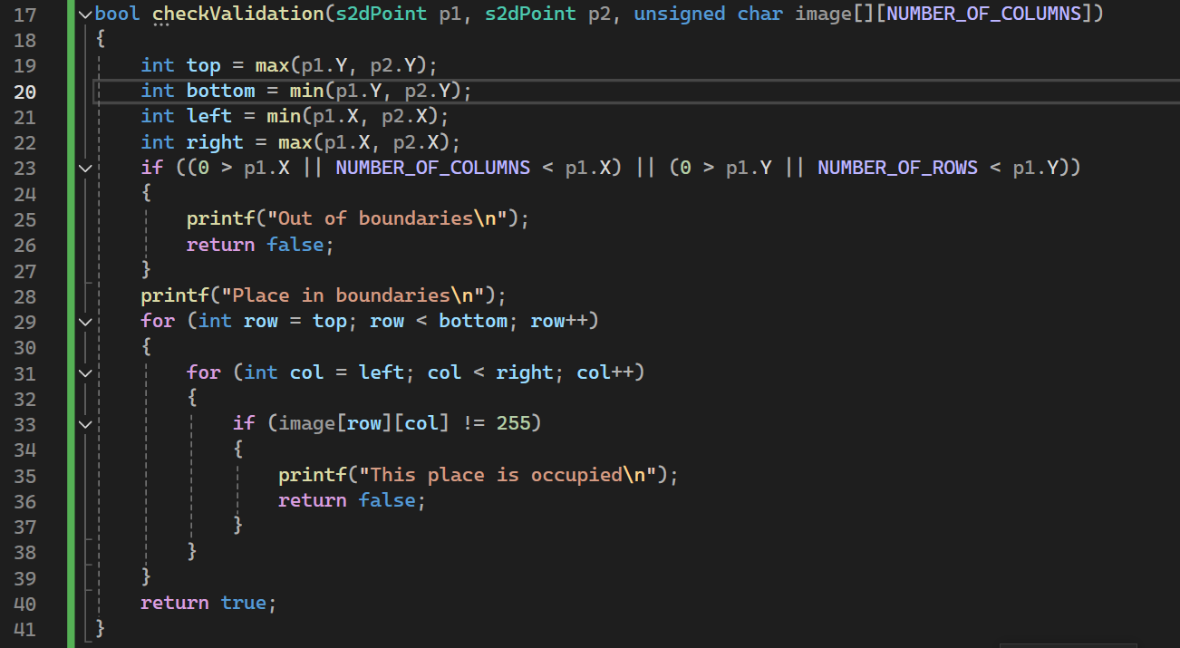
Part 1 of Introduction to 11.1 – apply “checkValidation” function
The checkValidation function is designed to verify whether a given rectangle, defined by two points (p1 and p2), lies within the boundaries of an image and that the region is not already occupied.
In the next slide a more thorough explanation about that function will be presented
2

Slide 3

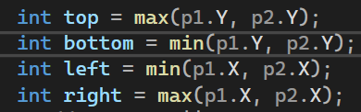
Part 2 of Introduction to 11.1 – apply “checkValidation” function
In the next few slides we will present the “checkValidation” function a bit deeper
First step- Parameters of the function:
s2dPoint p1 → is the first point defining one corner of the rectangle.
s2dPoint p2 → is the second point defining the opposite corner of the rectangle.
unsigned char image[][NUMBER_OF_COLUMNS] → is A 2D array representing the image.
The function returns a Boolean output : true if the rectangle is valid (within boundaries and not occupied), otherwise false.
Second step - define Rectangle Boundaries:
top: The maximum Y-coordinate between p1 and p2.
bottom: The minimum Y-coordinate between p1 and p2.
left: The minimum X-coordinate between p1 and p2.
right: The maximum X-coordinate between p1 and p2.
3

Slide 4
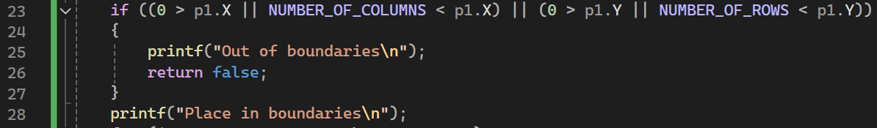
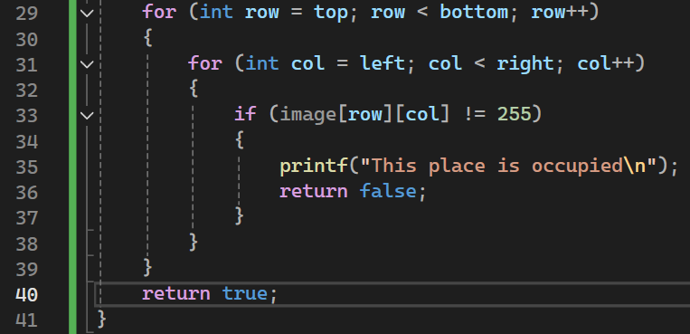
Part 3 of Introduction to 11.1 – apply “checkValidation” function
4
third step – check if a defined point is in or out of bounds:
This part checks if either point p1 is outside the image boundaries. If p1 is out of bounds, it prints "Out of boundaries" and returns false. If within bounds, it prints "Place in boundaries".
fourth step – checking occupancy of pixels within the rectangle:
This loop iterates over the region defined by the rectangle:
Outer loop: Iterates from top to bottom (Y-coordinates).
Inner loop: Iterates from left to right (X-coordinates).
It checks if any pixel within the rectangle is not equal to 255 (assuming 255 represents an unoccupied pixel in a grayscale image).
If it finds an occupied pixel, it prints "This place is occupied" and returns false.

Slide 5
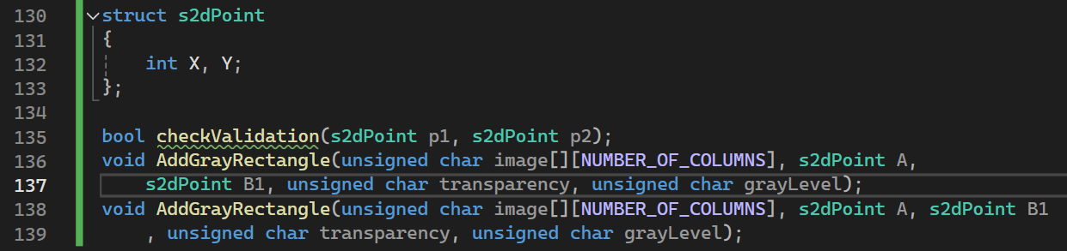
Part 4 of Introduction to 11.1 – apply “s2dpoint” struct and the declarations of the relevant functions in the code
5
The s2dPoint structure is defined at the header file to represent a 2D point with X and Y coordinates.
The s2dPoint structure’s Usage is to store the coordinates of points in the image processing functions.
The AddGrayRectangle input parameters are:
unsigned char image[][NUMBER_OF_COLUMNS] → A 2D array representing the image.
s2dPoint A → The first corner point of the rectangle.
s2dPoint B1 → The opposite corner point of the rectangle.
unsigned char transparency → The transparency level for the rectangle.
unsigned char grayLevel → The gray level for the rectangle.
This function will add a gray rectangle to the image with the specified transparency and gray level, using the points A and B1 to define the rectangle's bounds.

Slide 6
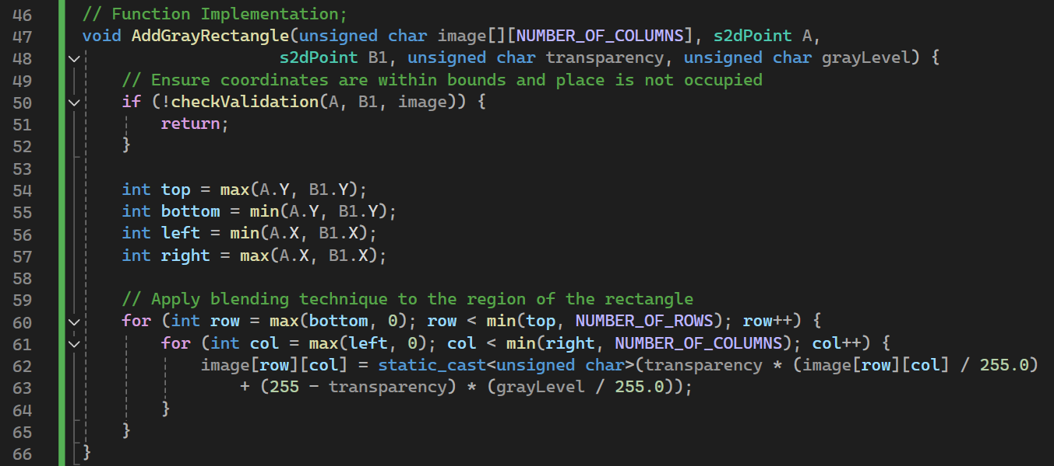
11.1 Code of the function “AddGrayRectangle”
Numerical values of: NUMBER_OF_ROWS and NUMBER_OF COLUMNS
Defined in the file ImProcInPlainC.h
The AddGrayRectangle function ensures that the specified rectangle is within valid boundaries and not occupied before adding it to the image. It calculates the top, bottom, left, and right boundaries of the rectangle and then applies a blending technique to each pixel within these boundaries to incorporate the rectangle with the specified gray level and transparency.
6

Slide 7
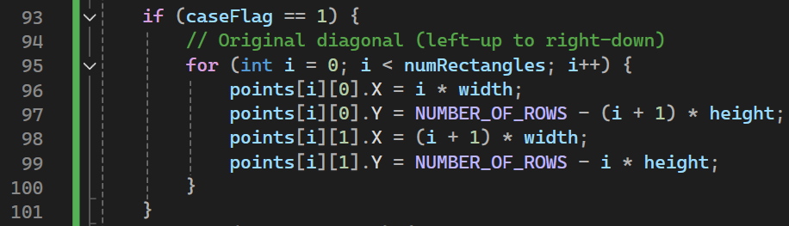

11.2 List of situations tested – part 1
Part 1 of the situations tested is the diagonal (from upper left to lower right) filled with rectangles – the number of rectangles for this demonstration is 10. The idea of the transparencies is that it declines with the rectangles .
One can see that there has been created 10 rectangles with a declining transparency over the diagonal of the screen
7

Slide 8
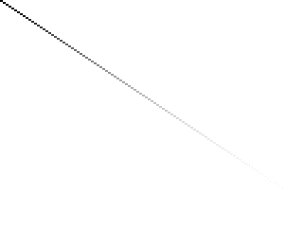
11.2 List of situations tested – part 2
Part 2 of the situations tested is the diagonal (from upper left to lower right) filled with rectangles – the number of rectangles for this demonstration is 100. The idea of the transparencies is that it declines with the rectangles .
One can see that there has been created 100 rectangles with a declining transparency over the diagonal of the screen
8

Slide 9

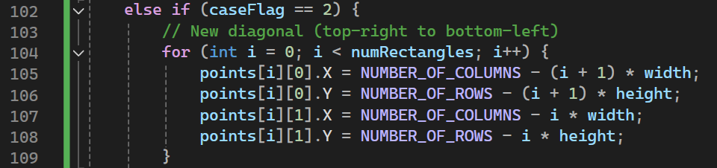

11.2 List of situations tested – part 3
9
Part 3 of the situations tested is the diagonal (from upper right to lower left – case 2) filled with rectangles – the number of rectangles for this demonstration is 10. The idea of the transparencies is that it declines with the rectangles.
One can see that there has been created 10 rectangles with a declining transparency over the diagonal of the screen

Slide 10
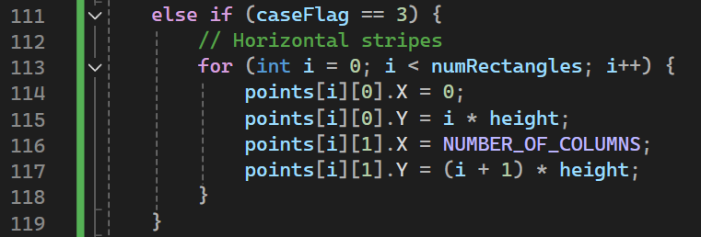



11.2 List of situations tested – part 4
Part 4 of the situations tested is the horizontal axis (case 3) filled with rectangles – the number of rectangles for this demonstration is 10. The idea of the transparencies is that it declines with the rectangles .
One can see that there has been created 10 rectangles with a declining transparency over the horizon axis of the screen
10

Slide 11
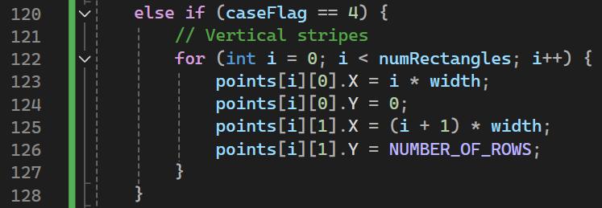

11.2 List of situations tested – part 5
11
Part 5 of the situations tested is the vertical axis (case 4) filled with rectangles – the number of rectangles for this demonstration is 10. The idea of the transparencies is that it declines with the rectangles .
One can see that there has been created 10 rectangles with a declining transparency over the vertical axis of the screen

Slide 12
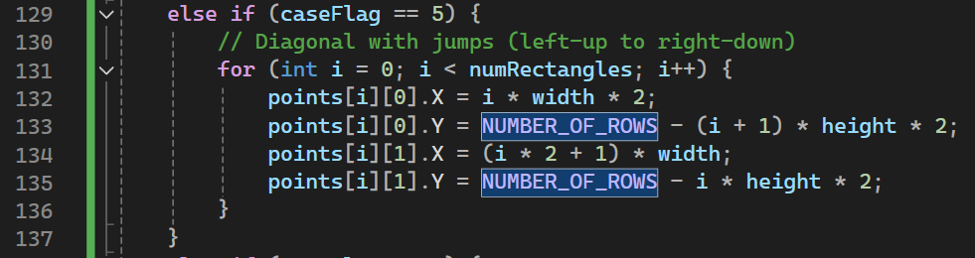

11.2 List of situations tested – part 6
Part 6 of the situations tested is Diagonal with jumps (left-up to right-down-case 5) filled with rectangles – the number of rectangles for this demonstration is 10. The idea of the transparencies is that it declines with the rectangles .
One can see that there has been created 5 rectangles with a declining transparency over the diagonal of the screen (between every couple of a rectangle there is another white rectangle (total of 10)

Slide 13
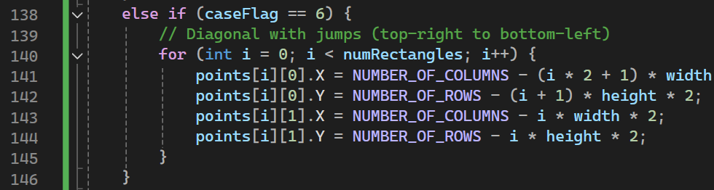

11.2 List of situations tested – part 7
Part 7 of the situations tested is Diagonal with jumps (top-right to bottom-left-case 6) filled with rectangles – the number of rectangles for this demonstration is 10. The idea of the transparencies is that it declines with the rectangles .
One can see that there has been created 5 rectangles with a declining transparency over the diagonal of the screen (between every couple of a rectangle there is another white rectangle (total of 10)

Slide 14
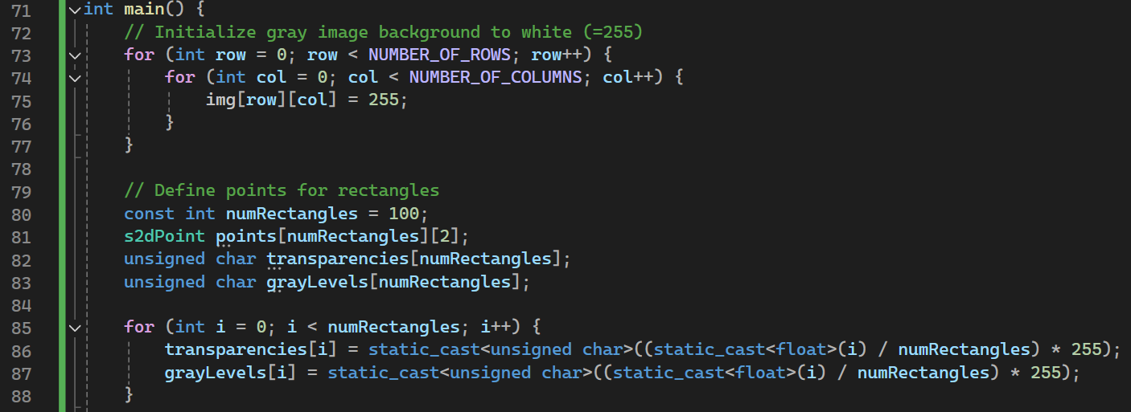
11.4 Code of the “main” function and set of intermediate images-part 1
During the presentation of scenarios the numRectangles parameter will be changed to show its effect!
This nested loop initializes a 2D array img representing the image. Each pixel in the image is set to 255, which represents white in a grayscale image. The loop iterates over all rows and columns of the image, ensuring the entire background is white.
numRectangles is set to 100, indicating the number of rectangles to be added to the image.
This loop calculates the transparency and gray levels for each rectangle.
points is a 2D array of s2dPoint structures, where each rectangle is defined by two points (top-left and bottom-right corners).
transparencies is an array to store the transparency levels for each rectangle.
grayLevels is an array to store the gray levels (color) for each rectangle.
14

Slide 15
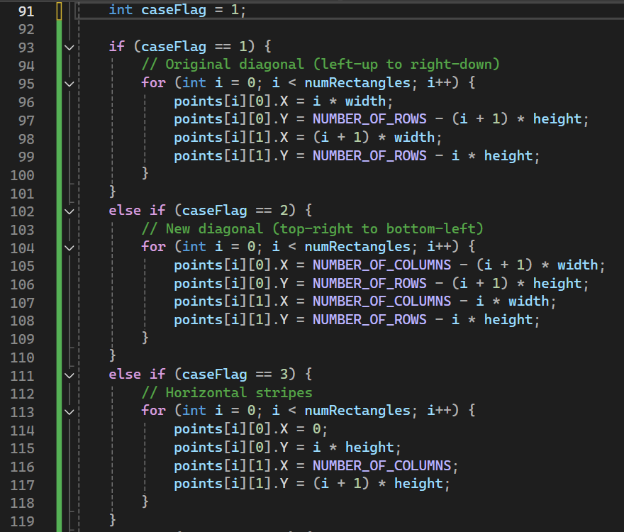
11.4 Code of the “main” function and set of intermediate images-part 2
width and height are calculated to evenly distribute the rectangles across the image.
The different cases – we decided to demonstrate 6 different cases that can be pick using the caseFlag variable.

Slide 16
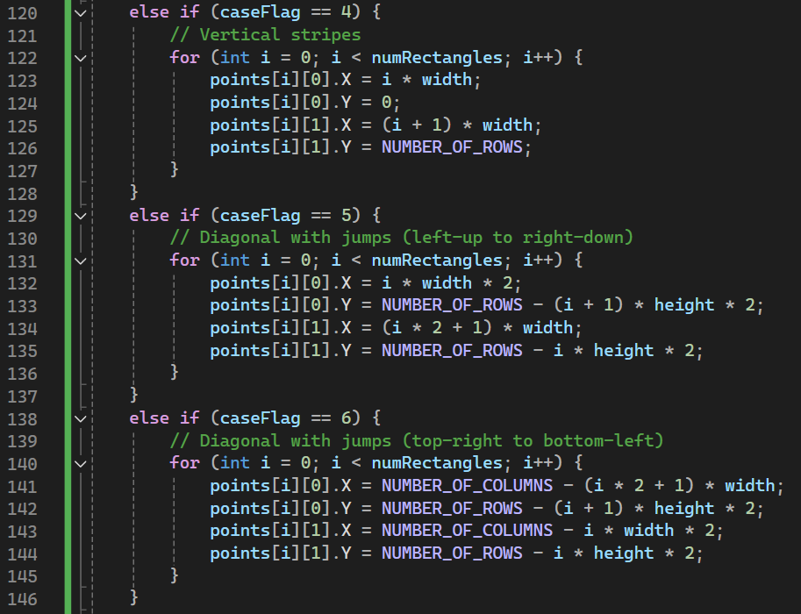
11.4 Code of the “main” function and set of intermediate images-part 3
The different cases – we decided to demonstrate 6 different cases that can be pick using the caseFlag variable.

Slide 17
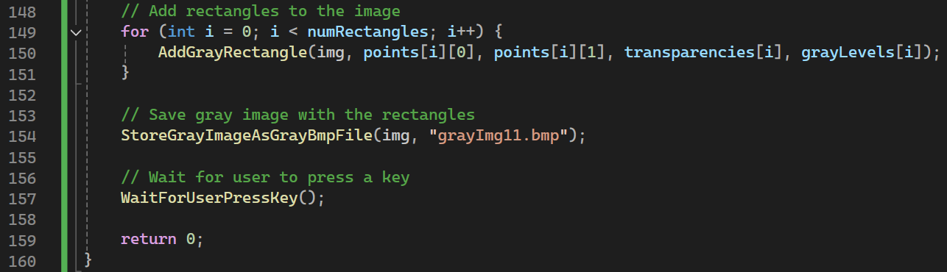
11.4 Code of the “main” function and set of intermediate images-part 4
The loop iterates over the number of rectangles. For each rectangle, the AddGrayRectangle function is called with the input parameters:
Calls the function StoreGrayImageAsGrayBmpFile to save the image img as a BMP file named "grayImg11.bmp".

