Slide 1

Course: Image Processing 31651 Assignment #12 Synthetic Image Creation (Part 2)
1
Photo of the student | Shorten Name | ID
 | pony | 2210 | Student #1
 | shienfeld | XXXXXEFGH | Student #2
 | akimov | XXXXXIJKL | Student #3

Slide 2
2

Slide 3
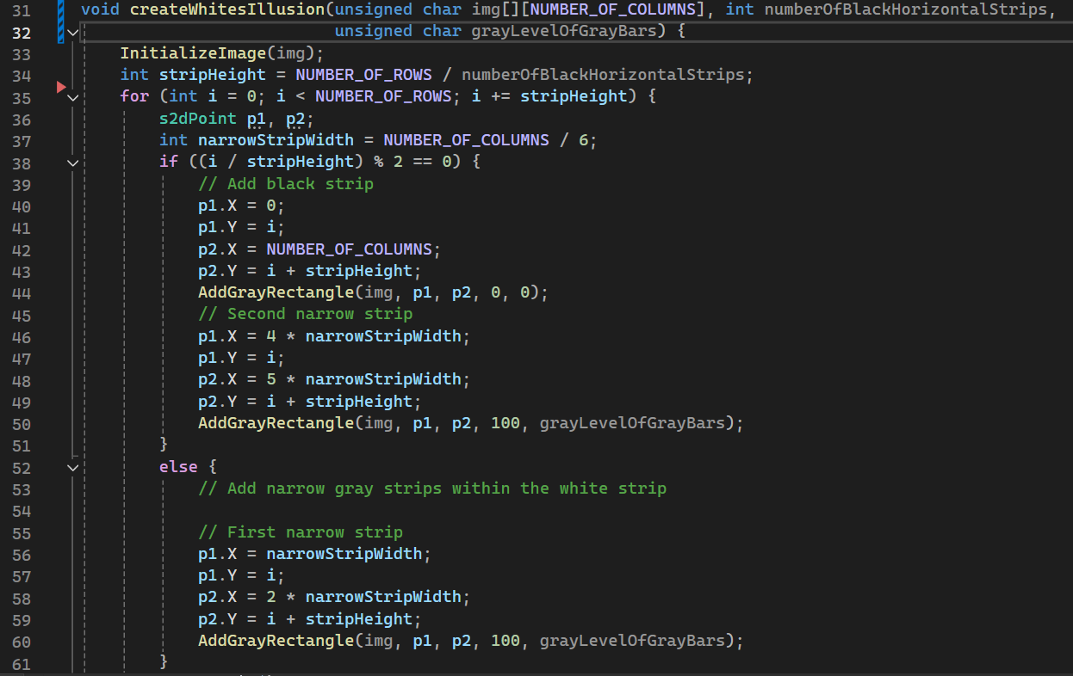

12.3 Code of the function “createWhitesIllusion” – part 1
3
That code generates and stores images of an illusion with varying levels of transparency and gray levels.
The createWhitesIllusion function, which adds gray rectangles on an initialized image.
The function's purpose is to create an image with alternating black and white strips, and within the white strips, it adds narrow gray strips. The gray level of these narrow strips is controlled by the grayLevelOfGrayBars parameter.
In the next slides we will break through that function to explain the algorithm for creating the white illusion. We will not present the AddGrayRectangle function because it was presented in Assignment #11

Slide 4
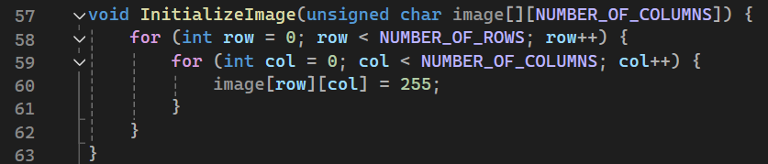
12.3 Code of the function “createWhitesIllusion” – part 2
4
First of all – define a white image – a function that will be called in the beginning of the process
This function initializes the img array, likely setting all pixels to a default value - white.
The height of each horizontal strip is calculated by dividing the total number of rows by the number of black horizontal strips which is a variable that initialized as 20
This loop iterates through the image rows, incrementing by stripHeight in each iteration, effectively dividing the image into horizontal strips.

Slide 5
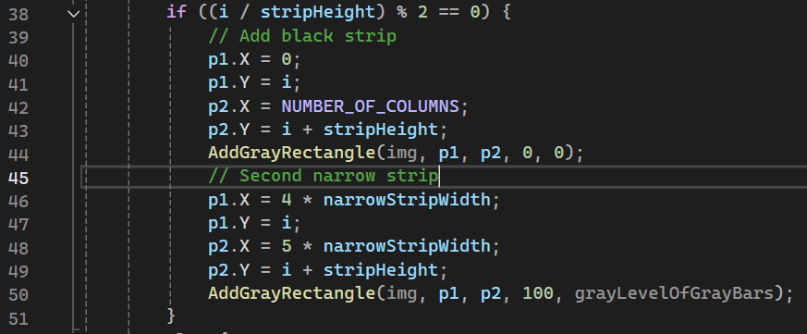
12.3 Code of the function “createWhitesIllusion” – part 3
5
s2dPoint is a structure to define a point with X and Y coordinates.
narrowStripWidth is calculated as one-sixth of the total number of columns.
For even-numbered strips, a black strip is added across the full width of the image.
A narrow gray strip is added within the black strip.

Slide 6
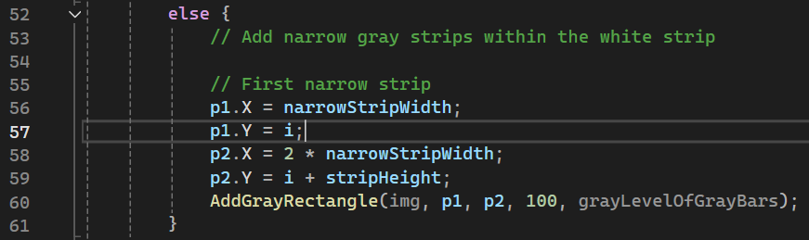
12.3 Code of the function “createWhitesIllusion” – part 4
6
For odd-numbered strips, a narrow gray strip is added within the white strip.
Finally, the modified image is stored as a BMP file.

Slide 7





12.1 our resulted images “grayImage12n.bmp” with add short comment– part 1
7

Slide 8





12.1 our resulted images “grayImage12n.bmp” with add short comment– part 2
8

Slide 9
12.1 our resulted images “grayImage12n.bmp” with add short comment– part 3
9
white_illusion9.bmp
white_illusion0.bmp

Slide 10
12.2 Relevant Profiles – part 1
10

Slide 11
12.2 Relevant Profiles – part 2
11

Slide 12
12.2 Relevant Profiles – part 3
12

Slide 13
13

Slide 14
12.5 What did we learned ?
14

