Slide 1
Course: Image Processing 31651 Assignment #11 Synthetic Image Creation (Part 1)
Photo of the student | Shorten Name | ID
 | pony | 316352210 | Student #1
 | shienfeld | XXXXXEFGH | Student #2
 | akimov | XXXXXIJKL | Student #3

Slide 2
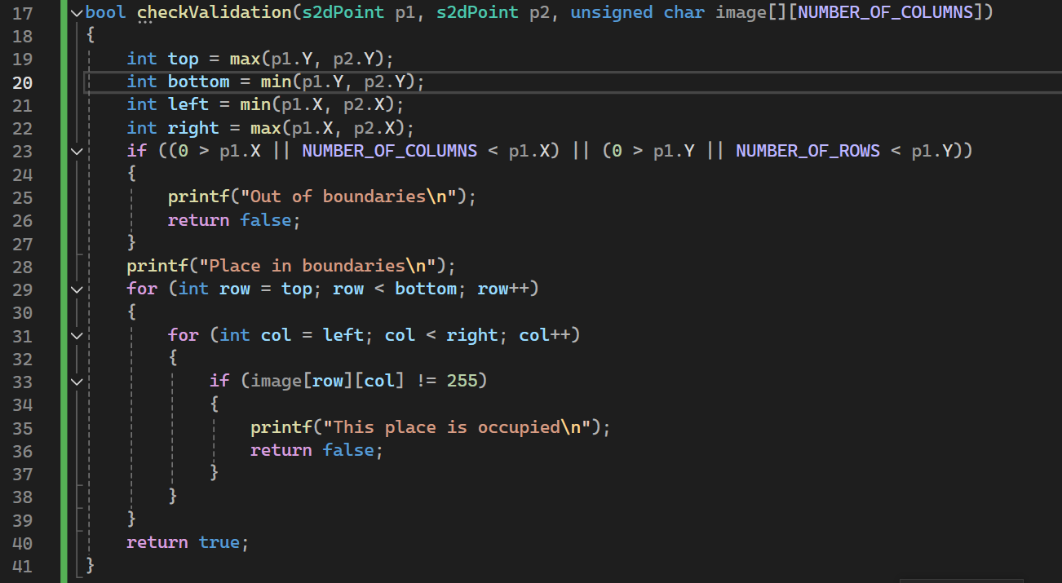
Part 1 of Introduction to 11.1 – apply “checkValidation” function
The checkValidation function is designed to verify whether a given rectangle, defined by two points (p1 and p2), lies within the boundaries of an image and that the region is not already occupied.
In the next slide a more thorough explanation about that function will be presented
2

Slide 3

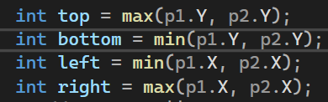
Part 2 of Introduction to 11.1 – apply “checkValidation” function
In the next few slides we will present the “checkValidation” function a bit deeper
First step- Parameters of the function:
s2dPoint p1 → is the first point defining one corner of the rectangle.
s2dPoint p2 → is the second point defining the opposite corner of the rectangle.
unsigned char image[][NUMBER_OF_COLUMNS] → is A 2D array representing the image.
The function returns a Boolean output : true if the rectangle is valid (within boundaries and not occupied), otherwise false.
Second step - define Rectangle Boundaries:
top: The maximum Y-coordinate between p1 and p2.
bottom: The minimum Y-coordinate between p1 and p2.
left: The minimum X-coordinate between p1 and p2.
right: The maximum X-coordinate between p1 and p2.
3

Slide 4
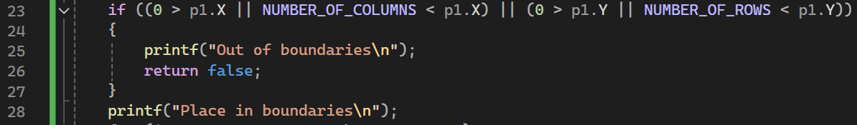
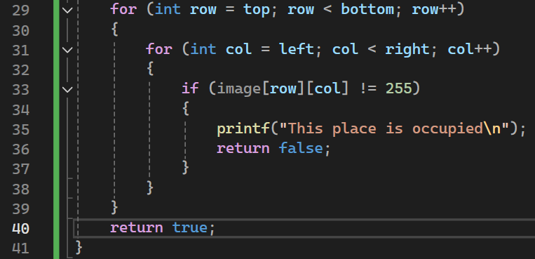
Part 3 of Introduction to 11.1 – apply “checkValidation” function
4
third step – check if a defined point is in or out of bounds:
This part checks if either point p1 is outside the image boundaries. If p1 is out of bounds, it prints "Out of boundaries" and returns false. If within bounds, it prints "Place in boundaries".
fourth step – checking occupancy of pixels within the rectangle:
This loop iterates over the region defined by the rectangle:
Outer loop: Iterates from top to bottom (Y-coordinates).
Inner loop: Iterates from left to right (X-coordinates).
It checks if any pixel within the rectangle is not equal to 255 (assuming 255 represents an unoccupied pixel in a grayscale image).
If it finds an occupied pixel, it prints "This place is occupied" and returns false.

Slide 5
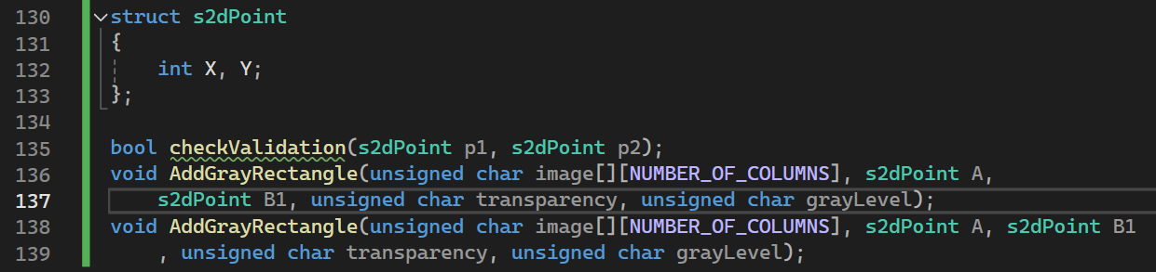
Part 4 of Introduction to 11.1 – apply “s2dpoint” struct and the declarations of the relevant functions in the code
5
The s2dPoint structure is defined at the header file to represent a 2D point with X and Y coordinates.
The s2dPoint structure’s Usage is to store the coordinates of points in the image processing functions.
The AddGrayRectangle input parameters are:
unsigned char image[][NUMBER_OF_COLUMNS] → A 2D array representing the image.
s2dPoint A → The first corner point of the rectangle.
s2dPoint B1 → The opposite corner point of the rectangle.
unsigned char transparency → The transparency level for the rectangle.
unsigned char grayLevel → The gray level for the rectangle.
This function will add a gray rectangle to the image with the specified transparency and gray level, using the points A and B1 to define the rectangle's bounds.

Slide 6
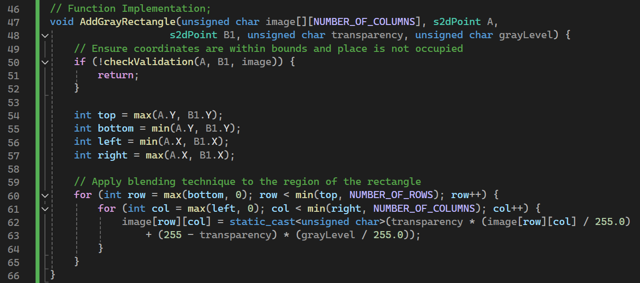
11.1 Code of the function “AddGrayRectangle”
Numerical values of: NUMBER_OF_ROWS and NUMBER_OF COLUMNS
Defined in the file ImProcInPlainC.h
Pay attention that in the code that For each pixel, blend the new gray level using the formula:
image[row][col] = static_cast<unsigned char>(transparency * (image[row][col] / 255.0) + (255 - transparency) * (grayLevel / 255.0));
The AddGrayRectangle function ensures that the specified rectangle is within valid boundaries and not occupied before adding it to the image. It calculates the top, bottom, left, and right boundaries of the rectangle and then applies a blending technique to each pixel within these boundaries to incorporate the rectangle with the specified gray level and transparency.
6

Slide 7
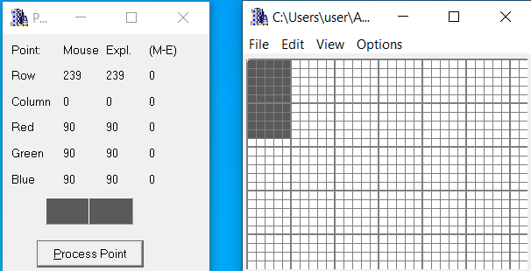

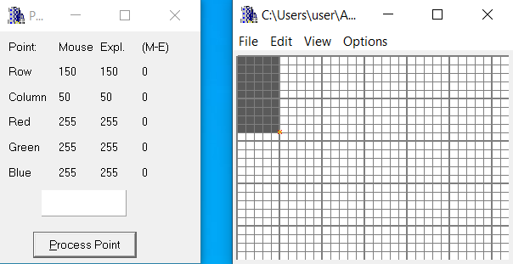

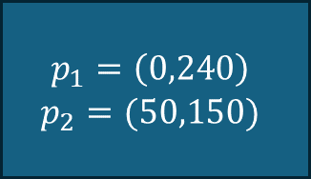



11.2 List of situations tested – part 1
$$p_{1}$$
$$(320,239)$$
$$p_{2}$$
$$(0,0)$$
This test image will be listed as #1
$$p_{1}=\left(0,240\right)$$
$$p_{2}=(50,150)$$

Slide 8
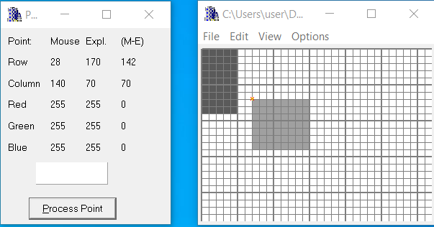

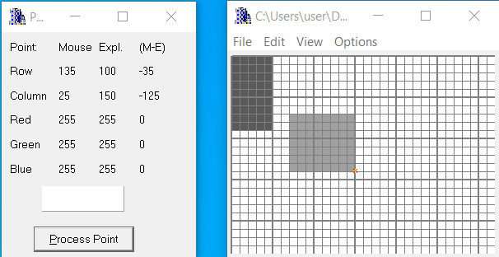

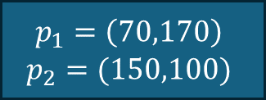



11.2 List of situations tested – part 2
$$(320,240)$$
$$p_{1}$$
$$p_{2}$$
$$(0,0)$$
This test image will be listed as #2
$$p_{1}=\left(70,170\right)$$
$$p_{2}=(150,100)$$

Slide 9
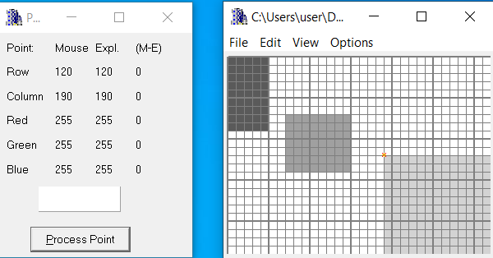

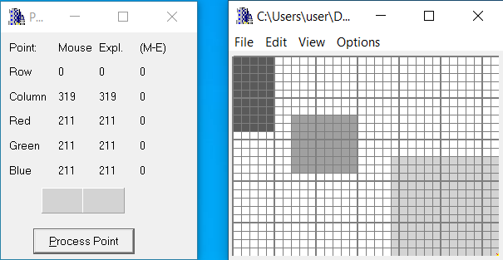

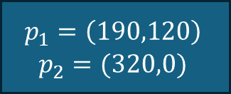



11.2 List of situations tested – part 3
$$(320,240)$$
$$p_{1}$$
$$p_{2}$$
$$(0,0)$$
This test image will be listed as #3
$$p_{1}=\left(190,120\right)$$
$$p_{2}=(320,0)$$

Slide 10
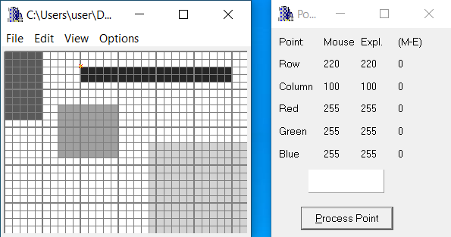

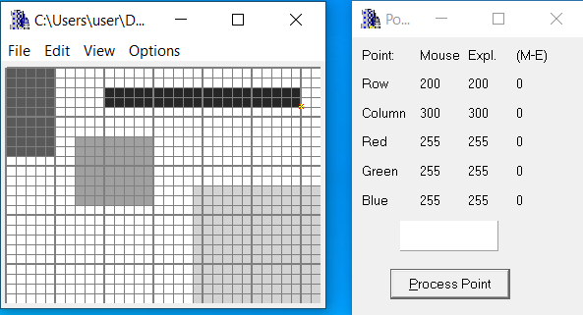

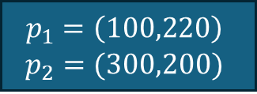



11.2 List of situations tested – part 4
$$(320,240)$$
$$p_{1}$$
$$p_{2}$$
$$(0,0)$$
This test image will be listed as #4
$$p_{1}=\left(100,220\right)$$
$$p_{2}=(300,200)$$

Slide 11
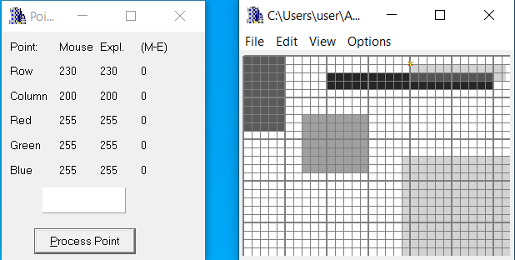

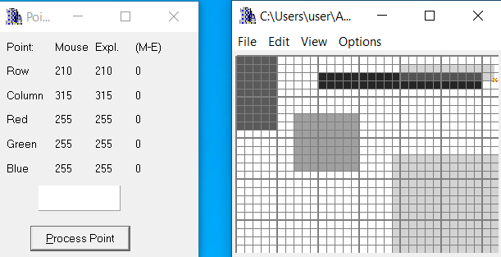

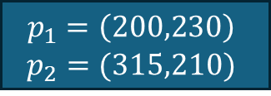



11.2 List of situations tested – part 5
$$p_{1}$$
$$(320,240)$$
$$p_{2}$$
$$(0,0)$$
This test image will be listed as #5
$$p_{1}=\left(200,230\right)$$
$$p_{2}=(315,210)$$

Slide 12
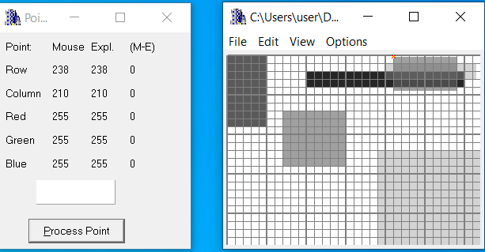

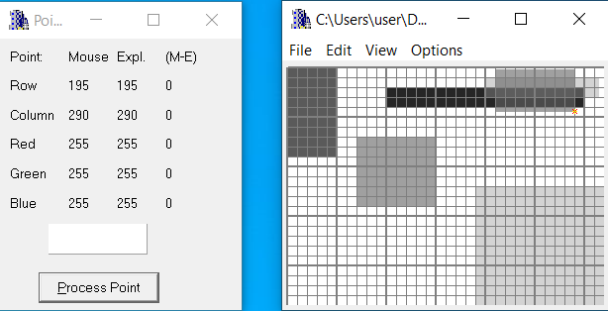




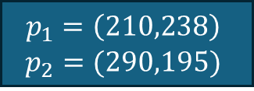
11.2 List of situations tested – part 6
$$p_{1}$$
$$(320,240)$$
$$p_{2}$$
$$(0,0)$$
This test image will be listed as #5
$$p_{1}=\left(210,238\right)$$
$$p_{2}=(290,195)$$

Slide 13
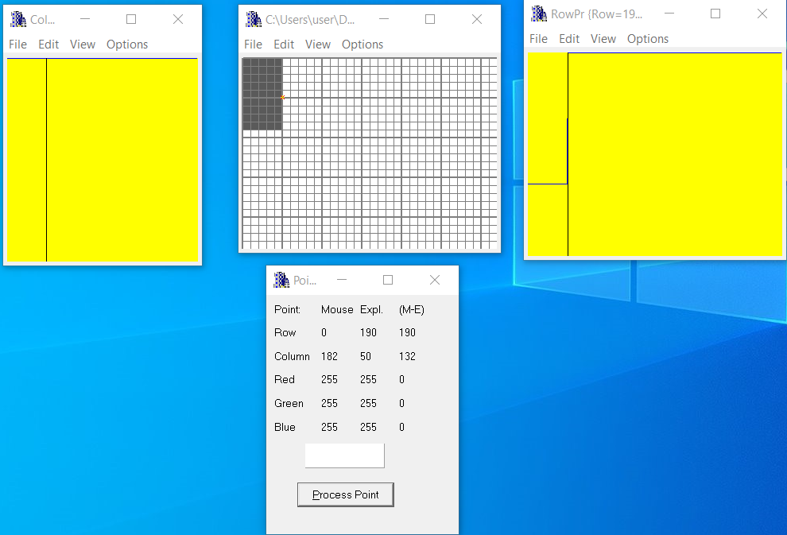

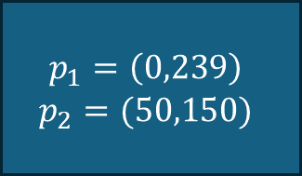



11.3 For the specific test images (see 11.2), put relevant profiles
and refer relevant lines of code to prove that specific test having specific rectangle were created as required – part 1
Regarding test image #1 – we look at the border of the rectangle and can see a clear step (like a step function) in the rows view.
$$p_{1}$$
$$(320,239)$$
$$p_{2}$$
$$(0,0)$$
$$p_{1}=\left(0,239\right)$$
$$p_{2}=(50,150)$$

Slide 14
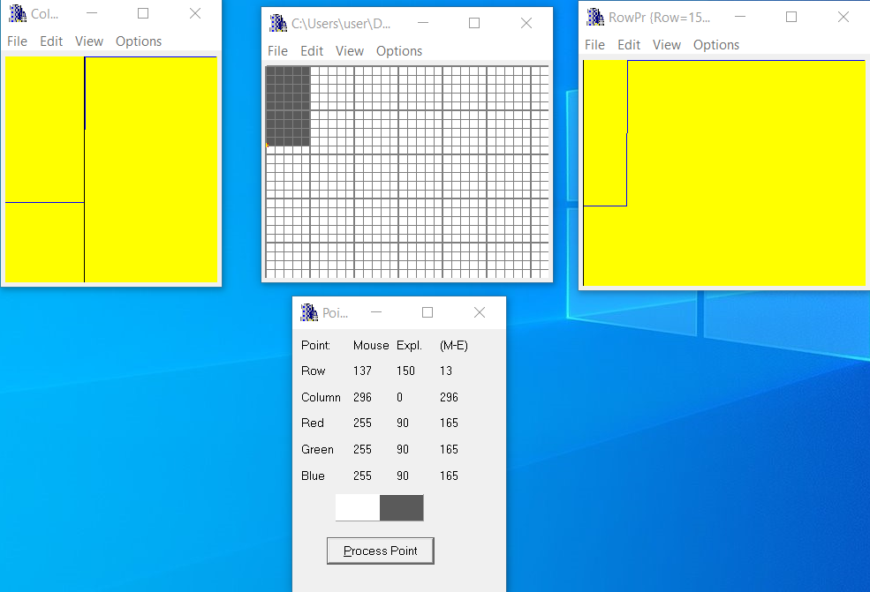

11.3 For the specific test images (see 11.2), put relevant profiles
and refer relevant lines of code to prove that specific test having specific rectangle were created as required – part 2
Regarding test image #1 – we look at the border of the rectangle and can see a clear step (like a step function) in the columns view.
$$p_{1}$$
$$(320,240)$$
$$p_{2}$$
$$(0,0)$$
$$p_{1}=\left(0,239\right)$$
$$p_{2}=(50,150)$$

Slide 15
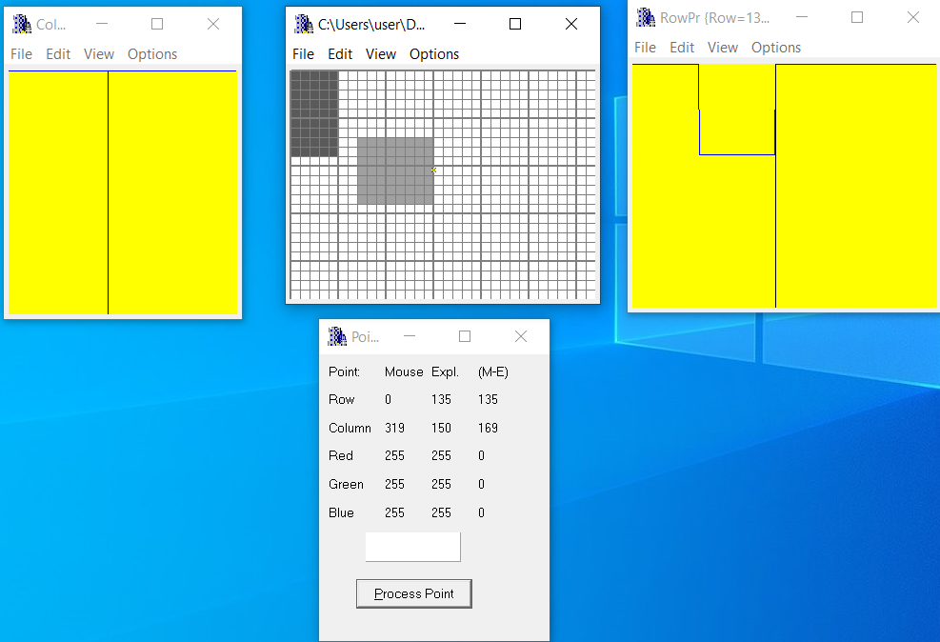

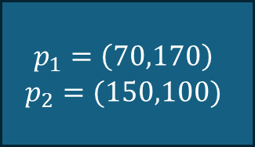



11.3 For the specific test images (see 11.2), put relevant profiles
and refer relevant lines of code to prove that specific test having specific rectangle were created as required – part 3
$$(320,240)$$
Regarding test image #2 – we look at the border of the rectangle and can see a clear hole (like a potential hole) in the rows view. The hole is between the borders of the second rectangle
$$p_{1}$$
$$p_{2}$$
$$(0,0)$$
$$p_{1}=\left(70,170\right)$$
$$p_{2}=(150,100)$$

Slide 16





11.3 For the specific test images (see 11.2), put relevant profiles
and refer relevant lines of code to prove that specific test having specific rectangle were created as required – part 4
Regarding test image #2 – we look at the border of the rectangle and can see a clear hole (like a potential hole) in the columns view. The hole is between the borders of the second rectangle
$$(320,240)$$
$$p_{1}$$
$$p_{2}$$
$$p_{1}=\left(70,170\right)$$
$$p_{2}=(150,100)$$

Slide 17
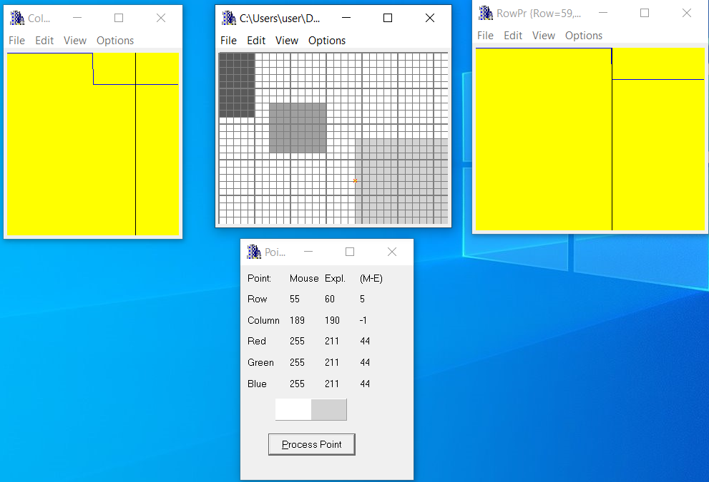
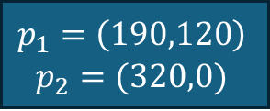

11.3 For the specific test images (see 11.2), put relevant profiles
and refer relevant lines of code to prove that specific test having specific rectangle were created as required – part 5
$$(320,240)$$
$$p_{1}$$
$$p_{2}$$
$$(0,0)$$
$$p_{1}=\left(190,120\right)$$
$$p_{2}=(320,0)$$

Slide 18

11.3 For the specific test images (see 11.2), put relevant profiles
and refer relevant lines of code to prove that specific test having specific rectangle were created as required – part 6
$$(320,240)$$
$$p_{1}$$
$$p_{2}$$
$$(0,0)$$
$$p_{1}=\left(190,120\right)$$
$$p_{2}=(320,0)$$

Slide 19
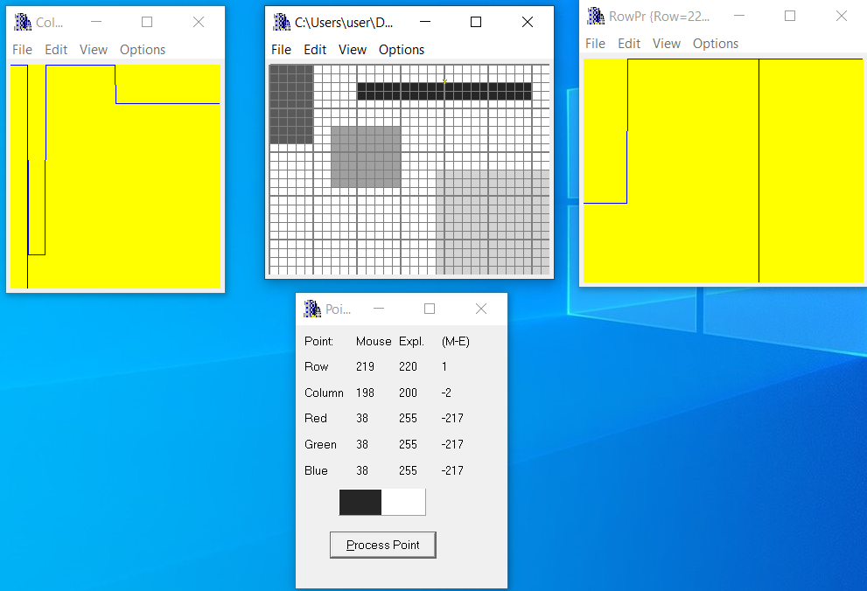





11.3 For the specific test images (see 11.2), put relevant profiles
and refer relevant lines of code to prove that specific test having specific rectangle were created as required – part 7
$$(320,240)$$
$$p_{1}$$
$$p_{2}$$
$$(0,0)$$
$$p_{1}=\left(100,220\right)$$
$$p_{2}=(300,200)$$

Slide 20
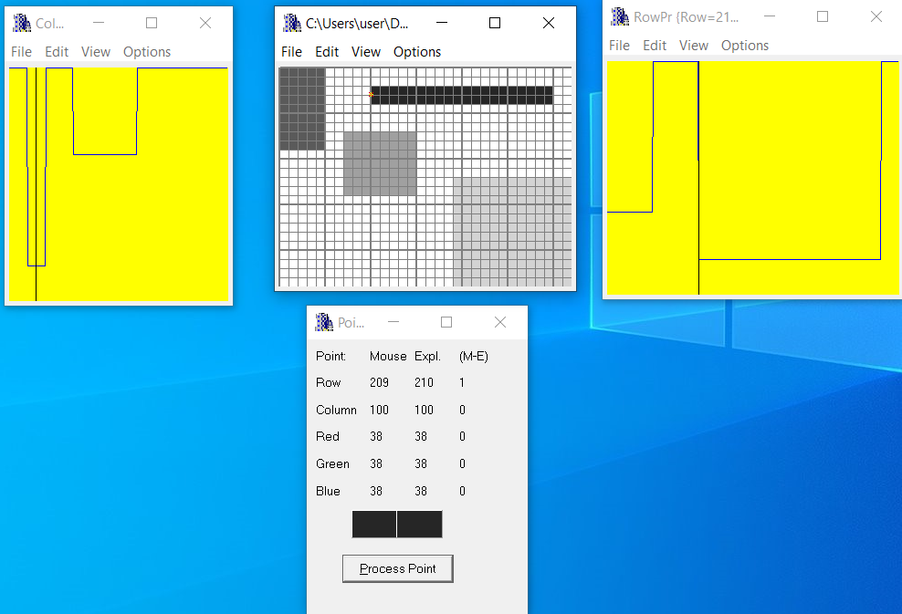
11.3 For the specific test images (see 11.2), put relevant profiles
and refer relevant lines of code to prove that specific test having specific rectangle were created as required – part 8
$$(320,240)$$
$$p_{1}$$
$$p_{2}$$
$$(0,0)$$
$$p_{1}=\left(100,220\right)$$
$$p_{2}=(300,200)$$

Slide 21
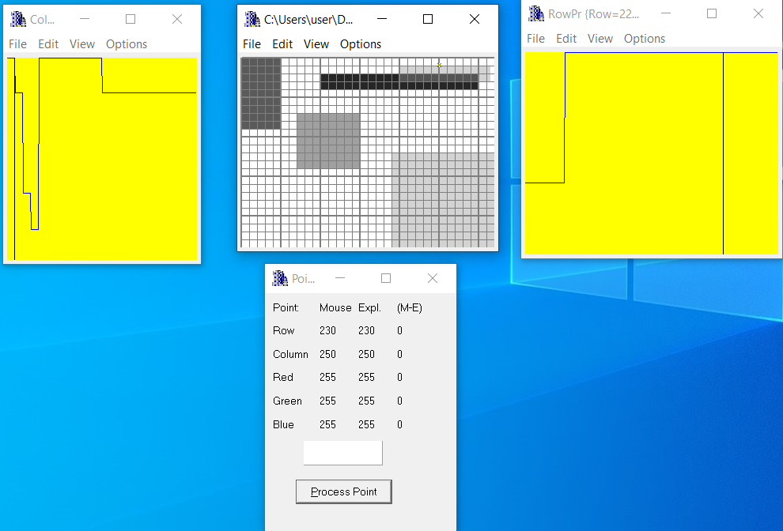

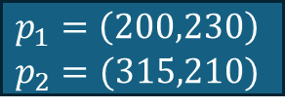



11.3 For the specific test images (see 11.2), put relevant profiles
and refer relevant lines of code to prove that specific test having specific rectangle were created as required – part 9
$$p_{1}$$
$$(320,240)$$
$$p_{2}$$
$$(0,0)$$
$$p_{1}=\left(200,230\right)$$
$$p_{2}=(315,210)$$

Slide 22
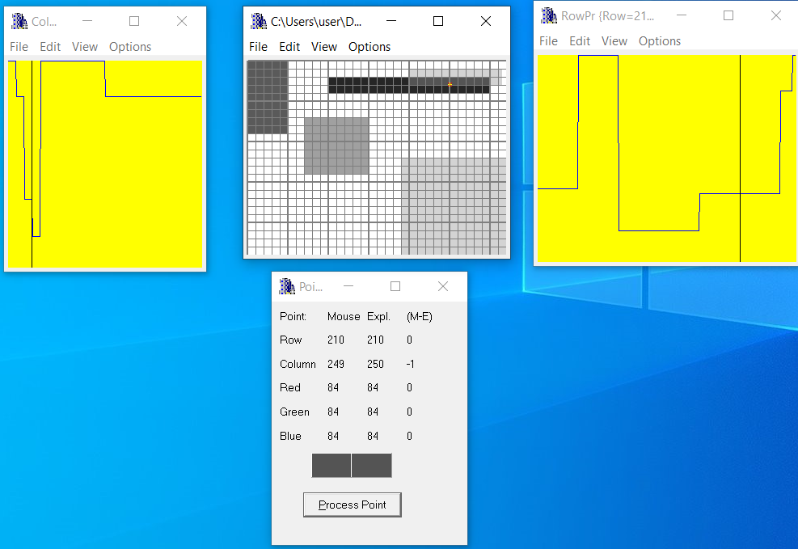

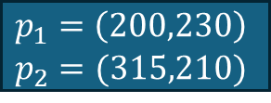



11.3 For the specific test images (see 11.2), put relevant profiles
and refer relevant lines of code to prove that specific test having specific rectangle were created as required – part 10
$$p_{1}$$
$$(320,240)$$
$$p_{2}$$
$$(0,0)$$
$$p_{1}=\left(200,230\right)$$
$$p_{2}=(315,210)$$

Slide 23


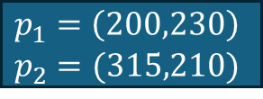



11.3 For the specific test images (see 11.2), put relevant profiles
and refer relevant lines of code to prove that specific test having specific rectangle were created as required – part 11
$$p_{1}$$
$$(320,240)$$
$$p_{2}$$
$$(0,0)$$
$$p_{1}=\left(200,230\right)$$
$$p_{2}=(315,210)$$

Slide 24
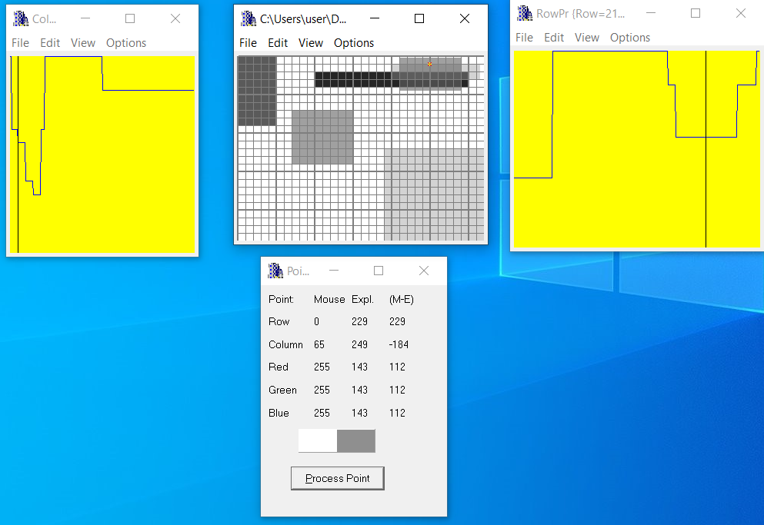



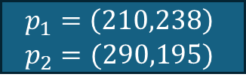

11.3 For the specific test images (see 11.2), put relevant profiles
and refer relevant lines of code to prove that specific test having specific rectangle were created as required – part 12
$$p_{1}$$
$$(320,240)$$
$$p_{2}$$
$$(0,0)$$
$$p_{1}=\left(210,238\right)$$
$$p_{2}=(290,195)$$

Slide 25
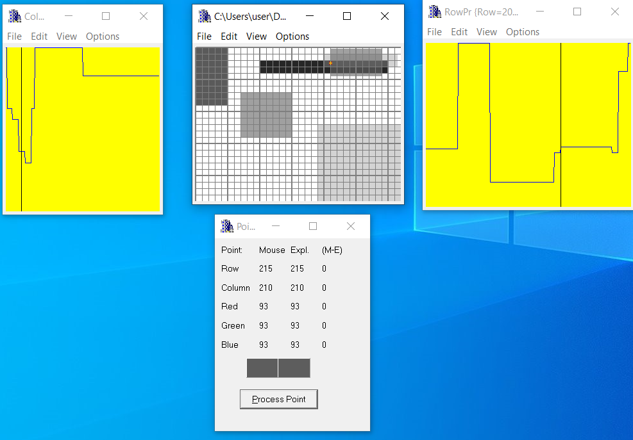


11.3 For the specific test images (see 11.2), put relevant profiles
and refer relevant lines of code to prove that specific test having specific rectangle were created as required – part 13
$$p_{1}$$
$$(320,240)$$
$$p_{2}$$
$$(0,0)$$
$$p_{1}=\left(210,238\right)$$
$$p_{2}=(290,195)$$

Slide 26
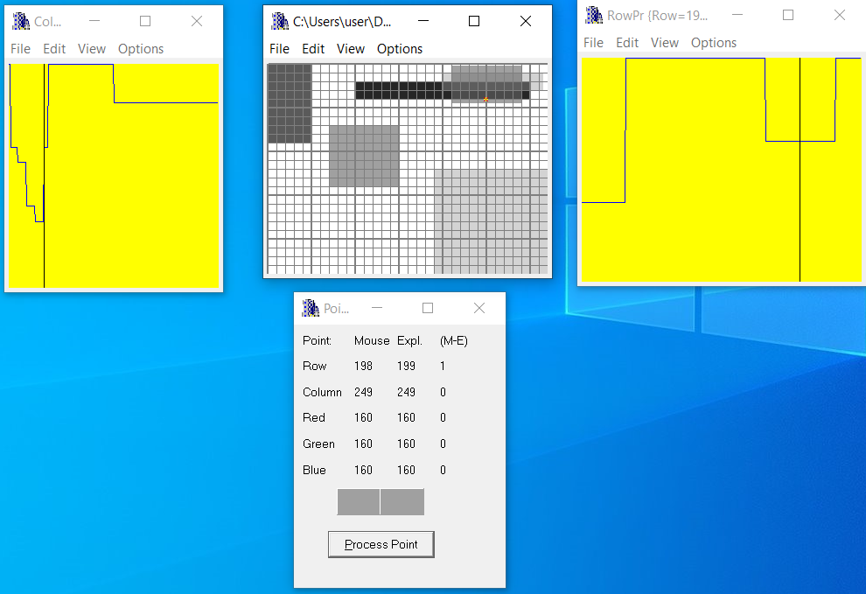



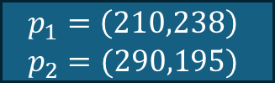

11.3 For the specific test images (see 11.2), put relevant profiles
and refer relevant lines of code to prove that specific test having specific rectangle were created as required – part 14
$$p_{1}$$
$$(320,240)$$
$$p_{2}$$
$$(0,0)$$
$$p_{1}=\left(210,238\right)$$
$$p_{2}=(290,195)$$

Slide 27
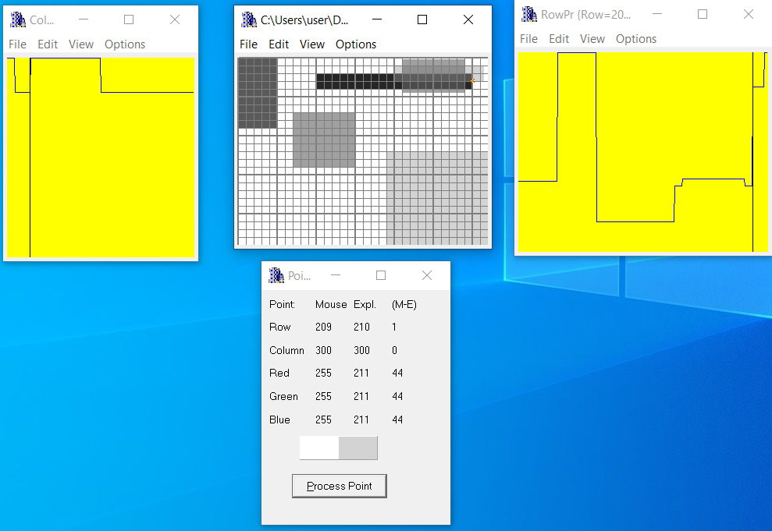
11.3 For the specific test images (see 11.2), put relevant profiles
and refer relevant lines of code to prove that specific test having specific rectangle were created as required – part 15
$$p_{1}$$
$$(320,240)$$
$$p_{2}$$
$$(0,0)$$
$$p_{1}=\left(210,238\right)$$
$$p_{2}=(290,195)$$

Slide 28
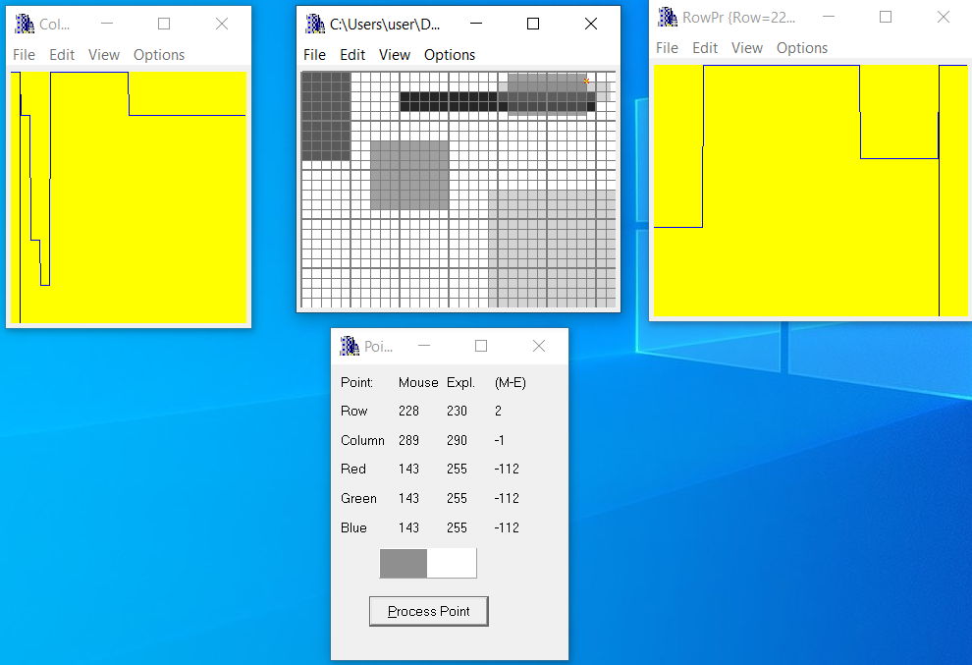
11.3 For the specific test images (see 11.2), put relevant profiles
and refer relevant lines of code to prove that specific test having specific rectangle were created as required – part 16
$$p_{1}$$
$$(320,240)$$
$$p_{2}$$
$$(0,0)$$
$$p_{1}=\left(210,238\right)$$
$$p_{2}=(290,195)$$

Slide 29
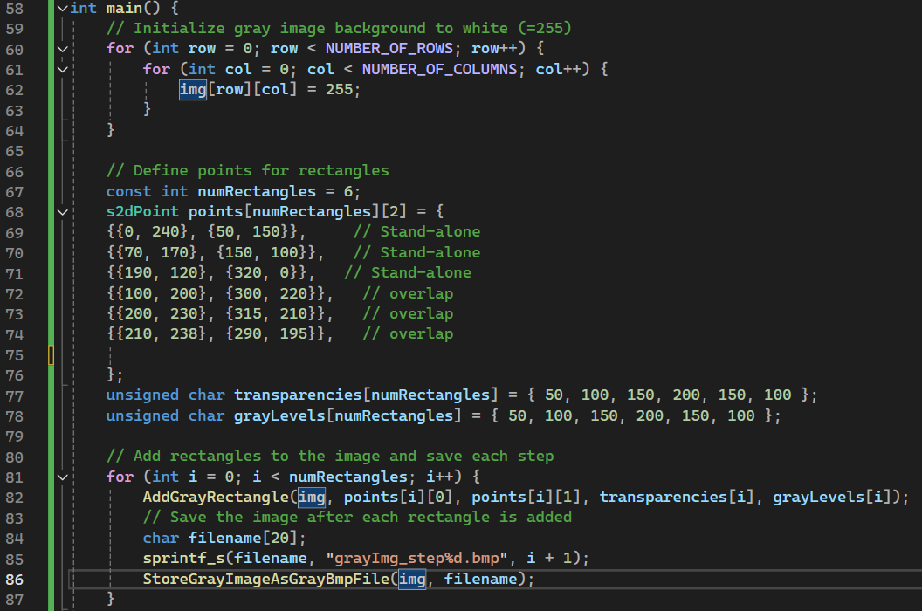
11.4 Code of the “main” function and set of intermediate images-part 1
This nested loop initializes a 2D array img representing the image. Each pixel in the image is set to 255, which represents white in a grayscale image. The loop iterates over all rows and columns of the image, ensuring the entire background is white.
points is a 2D array of s2dPoint structures, where each rectangle is defined by two points (top-left and bottom-right corners).
This arrays stores the transparencies and gray levels for each rectangle.
This for loop save an image in the folder of the project after every iteration – in order to show a step-by-step creation of the rectangles
29

Slide 30
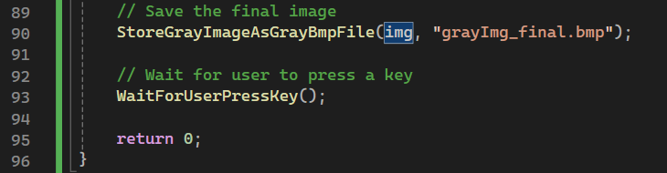
11.4 Code of the “main” function and set of intermediate images-part 2
Calls the function StoreGrayImageAsGrayBmpFile to save the image img as a BMP file named "grayImg11.bmp".

Slide 31
11.4 Code of the “main” function and set of intermediate images-part 3
series of intermediate images created in the main step by step with proper explanations
Step 1 to step 6 of the creation of the rectangles

