Slide 1
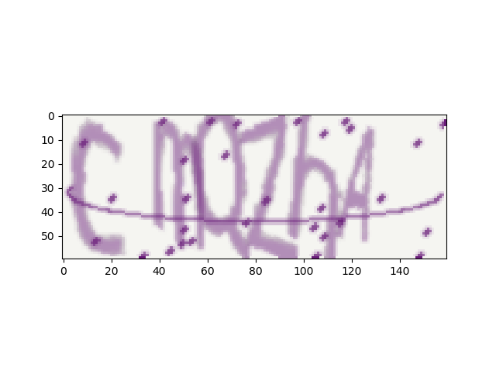
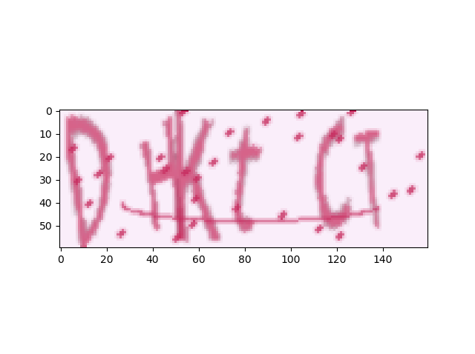
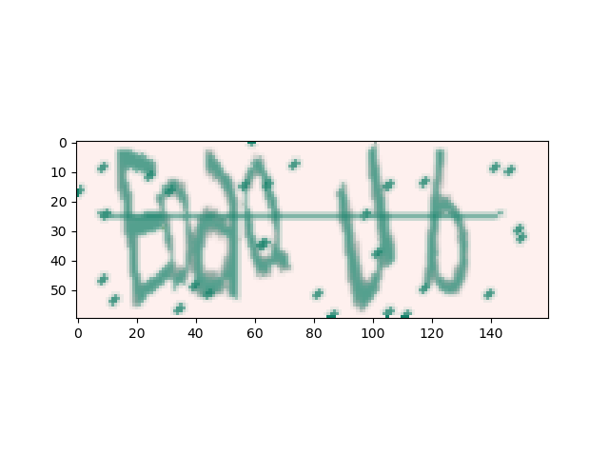
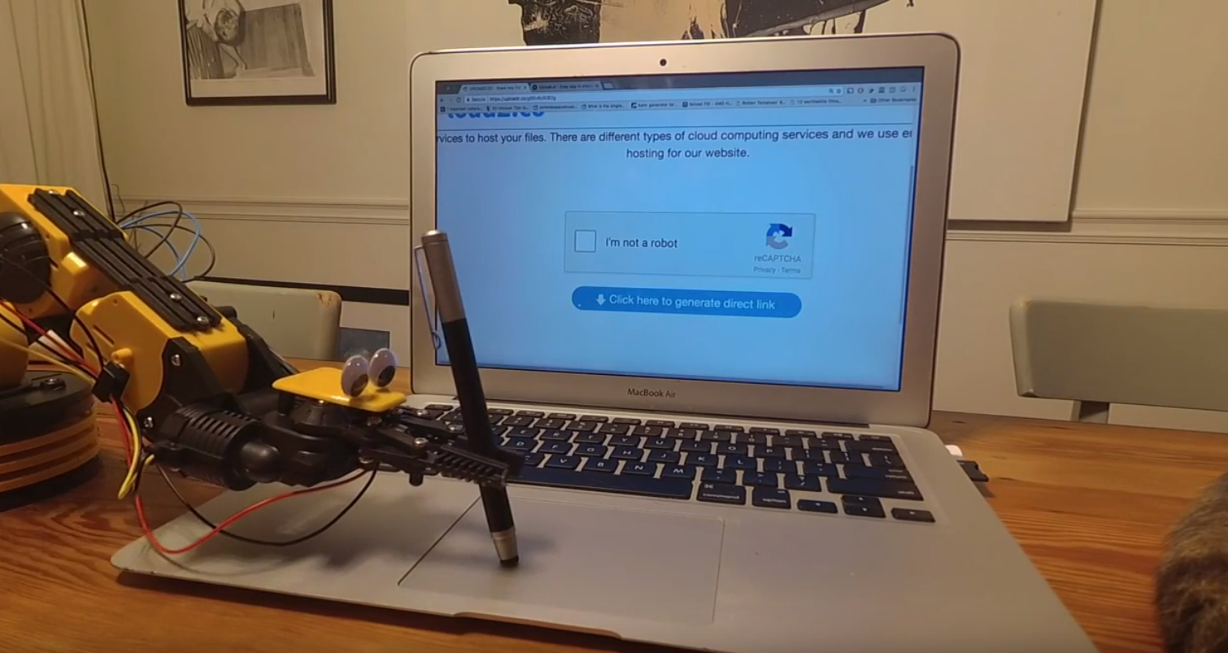
CAPTCHA - Completely Automated Public Turing test to tell Computers and Humans Apart
Generator
The Plan
Classifier Architecture
Fully CNN
Resnet/Inception
Adversary – GAN
Designing Better Captchas
Learning Optimization (selecting which words to generate in training)
Use on other problems with generator

Slide 2
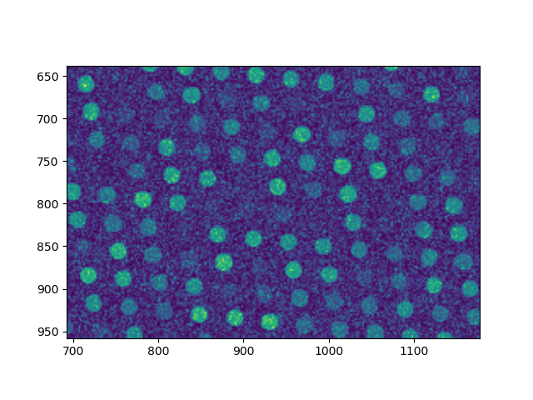

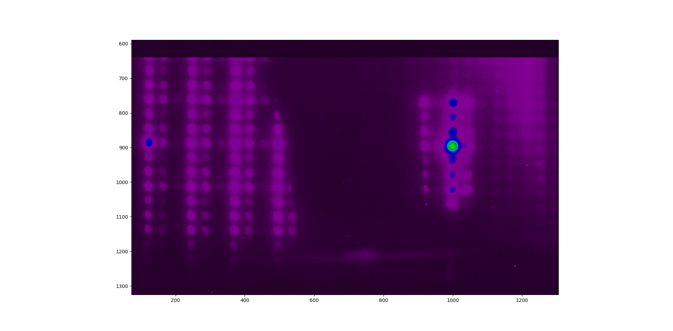
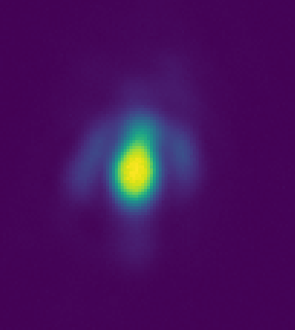
Applicable to many problems
Generated
Generated
Generated
Real Data
Real Data
2000 x 2000 x 1
200 X 200 x 1
160 x 60 x 3
1 x 1 x 5 (position grid)
1 X 1 x 100
(Aberration Parameters)
1 x 1 x 500 (pixel average of spot)
6 x 1 x 52 (Letters)

Slide 3

Modules:
Cnn Module:
ResNet Module:
Legend:
Conv3X3, s=1, p=1
Adaptive Average Pooling
$$⨁$$
BatchNorm
LeakyRelu

Slide 4






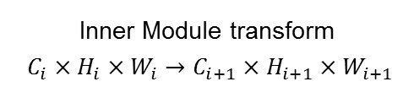


Solver - Model
Loss function : Cross Entropy
Image: $C_{in}× H_{in}× W_{in}$
$C_{in}⋅10× H_{in}/2× W_{in}/2$
$$100× H_{in}/4 × W_{in}/4$$
$$52 ×H_{in}/2^{n}×W_{in}/2^{n}$$
Target: $52×1×6$
$$⋯$$
$$⋯$$
$$⋯$$
Inner Module transform
$C_{i}×H_{i}×W_{i}→C_{i+1}×H_{i+1}×W_{i+1}$

Slide 5
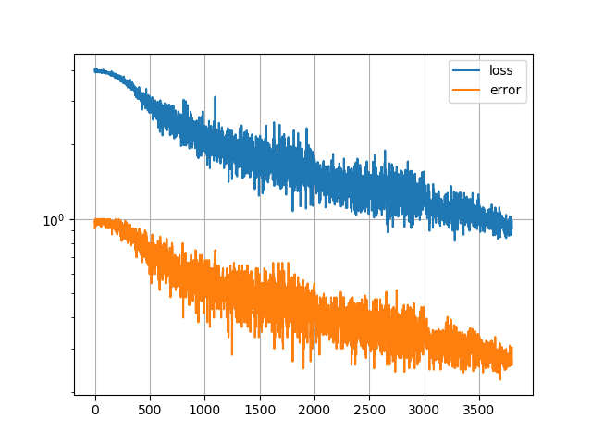
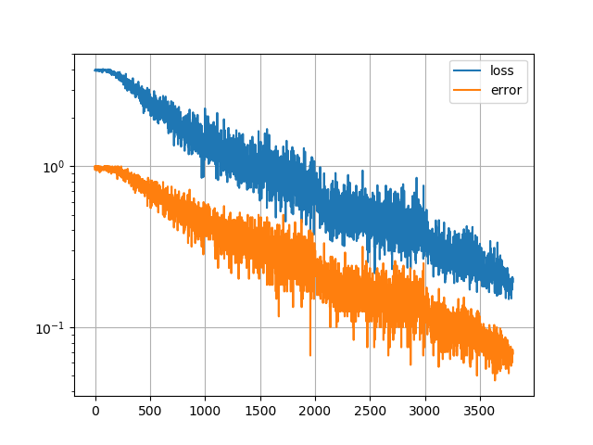

Learning Procedure:
Changing Batch Size, Not Learning Rate [???]:
Total number of examples
for learning $∼100K$
CNN
ResNet

Slide 6
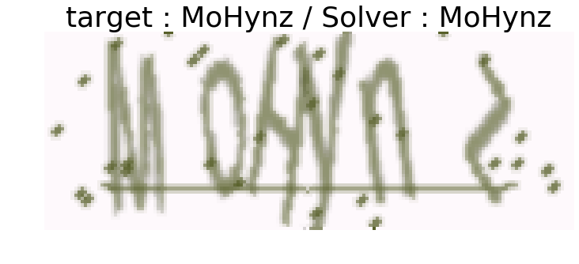
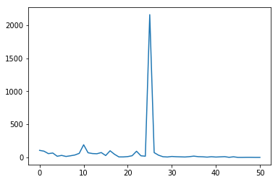
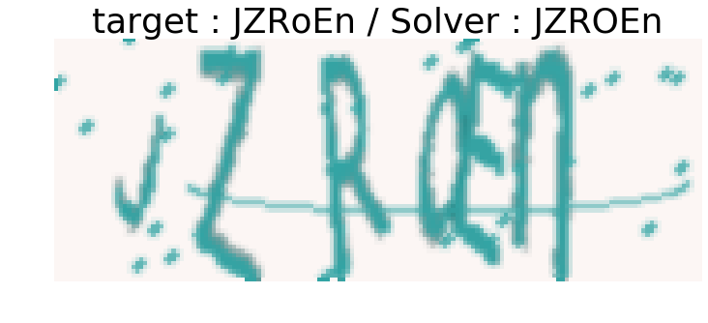
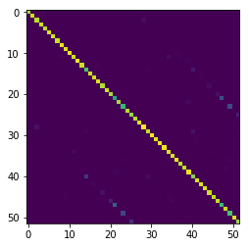
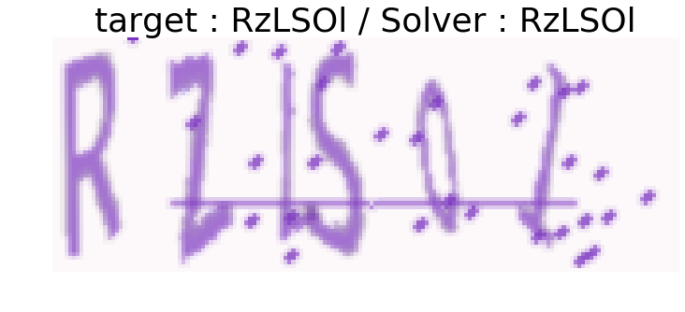
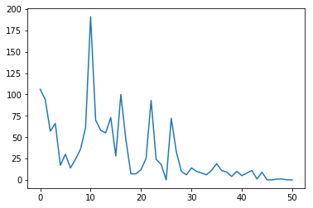
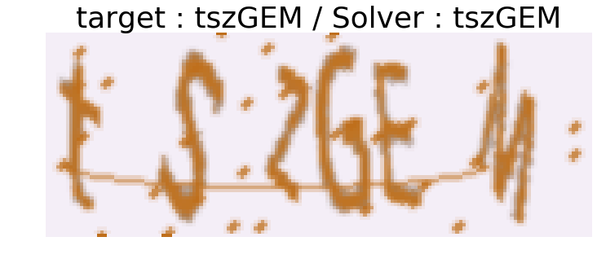
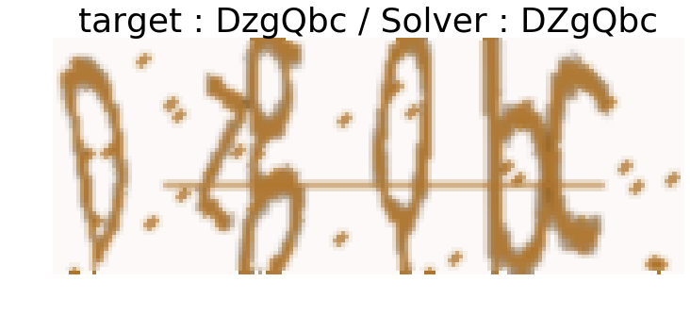
7% Error
Error Count
Distance between letters
3% Error
Error Count
Distance between letters

Slide 7
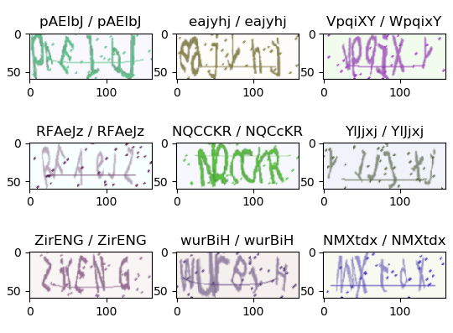
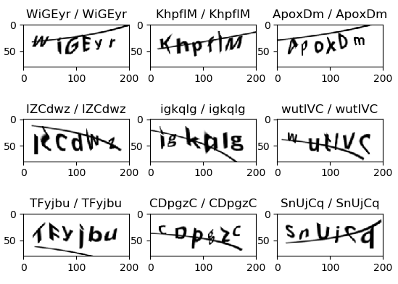
Compare different generators

Slide 8
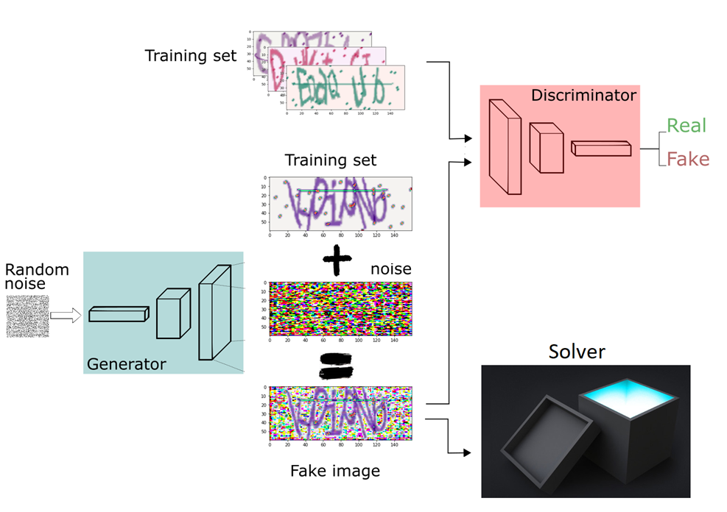
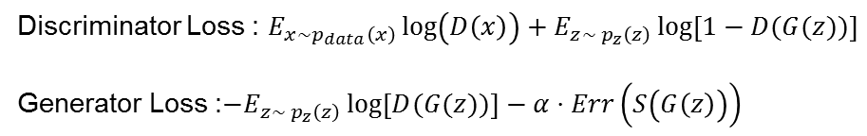
GAN
Human can
Solve
Discriminator Loss : ${E_{x∼p_{data}\left(x\right)}\log\left(D\left(x\right)\right)+E}_{z∼ p_{z}\left(z\right)}\log\left[1−D(G(z))\right]$
Generator Loss :$−E_{z∼ p_{z}\left(z\right)}\log\left[D(G(z))\right]−α⋅Err\left(S\left(G\left(z\right)\right)\right)$
Machine can’t
Solve

Slide 9


Conclusions
Solver works well for different generators
GAN is hard
Long training time
$→$ Not converging into a good solution
$→$ Hard to test new ideas

