Slide 1
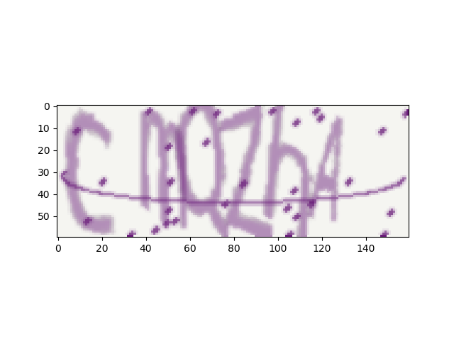
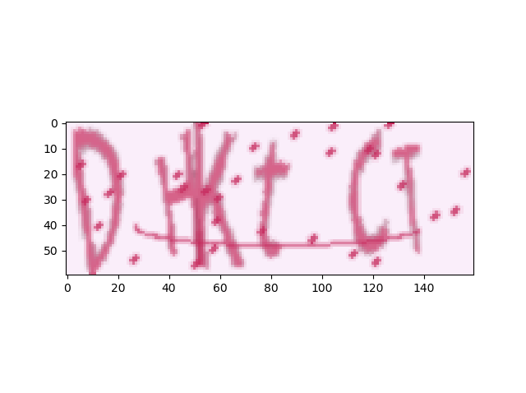
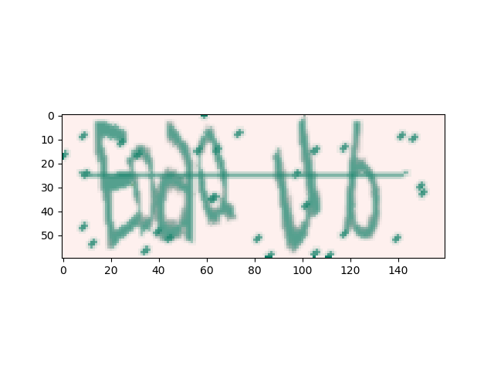
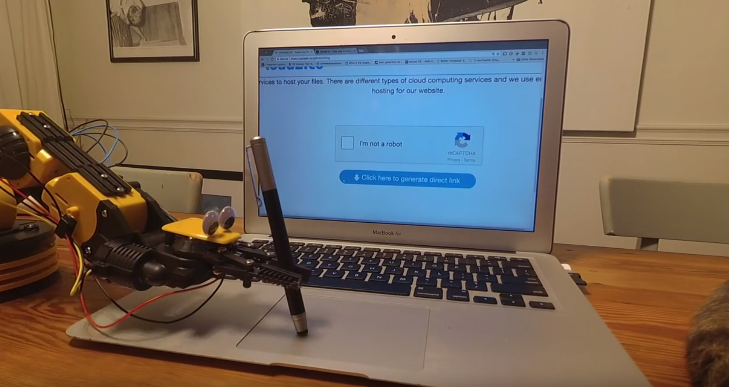
CAPTCHA - Completely Automated Public Turing test to tell Computers and Humans Apart
Generator
The Plan
Classifier Architecture
Fully CNN
Resnet/Inception
Adversary – GAN
Designing Better Captchas
Learning Optimization (selecting which words to generate in training)
Use on other problems with generator

Slide 2
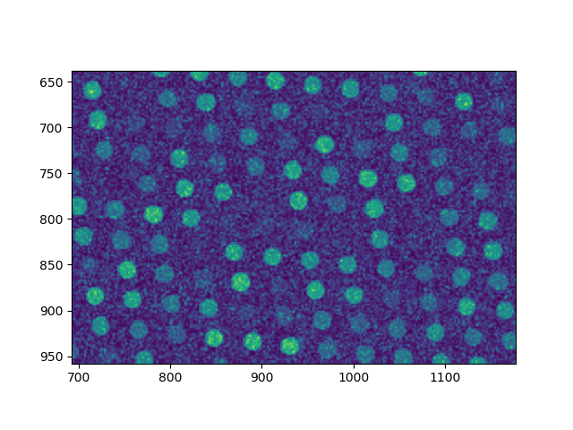
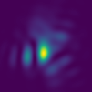
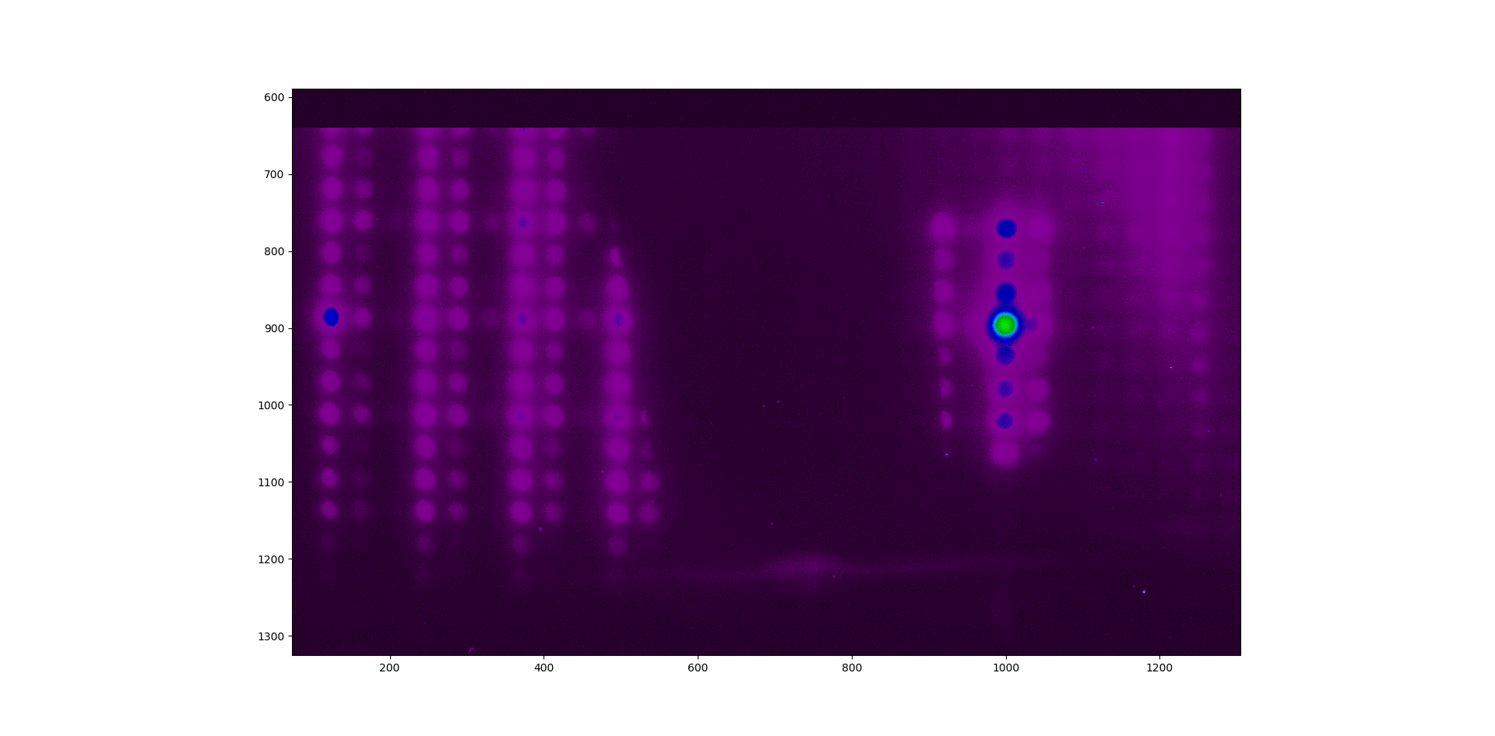
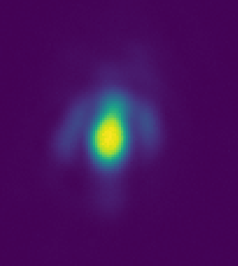
Applicable to many problems
Generated
Generated
Generated
Real Data
Real Data
2000 x 2000 x 1
200 X 200 x 1
160 x 60 x 3
1 x 1 x 5 (position grid)
1 X 1 x 100
(Aberration Parameters)
1 x 1 x 500 (pixel average of spot)
6 x 1 x 52 (Letters)

Slide 3
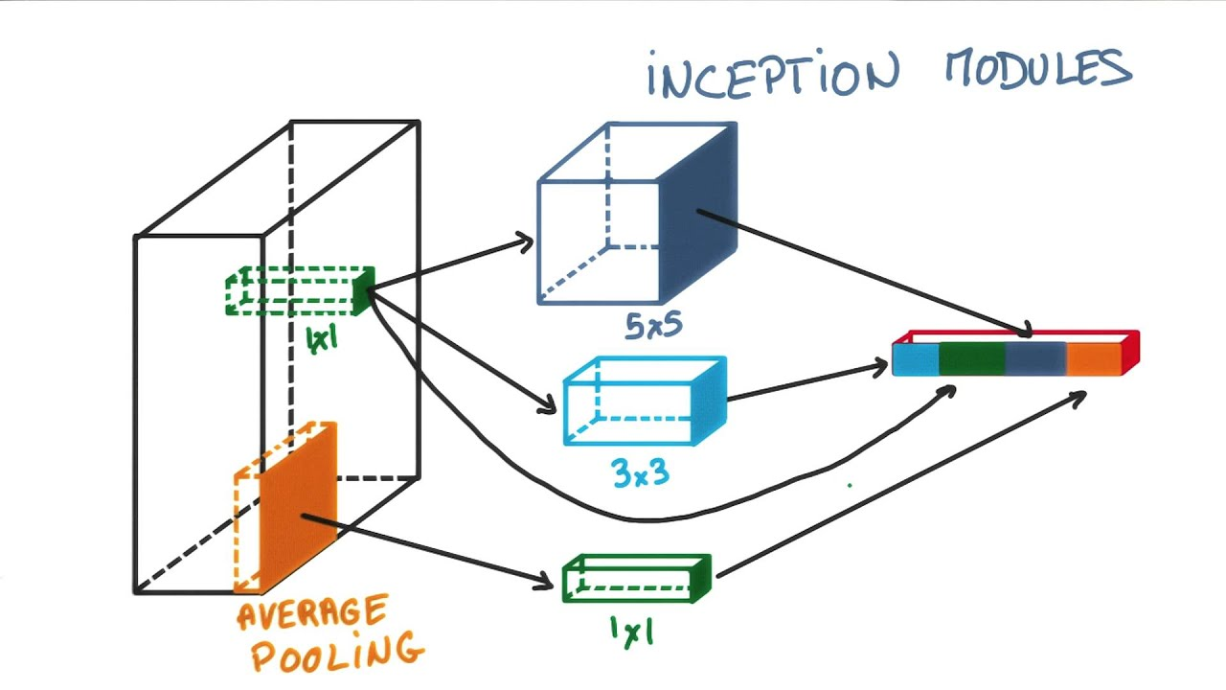
Solver - Inception

Slide 4
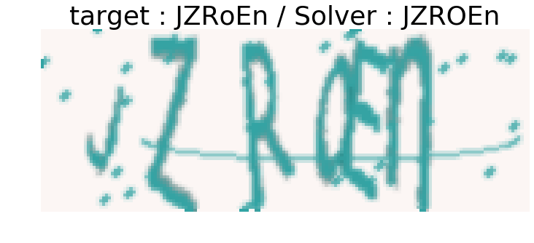
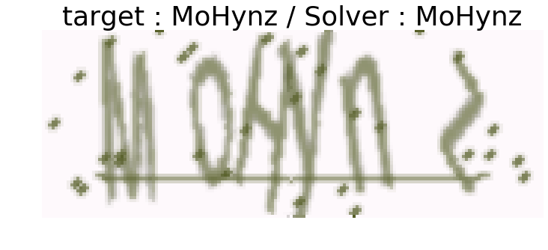
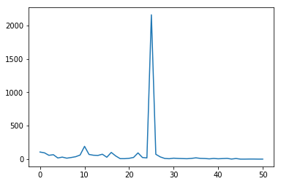
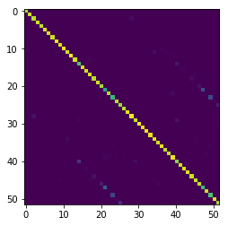
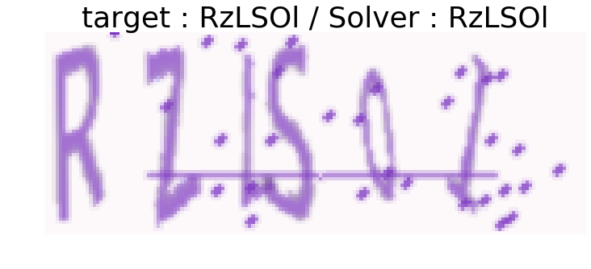
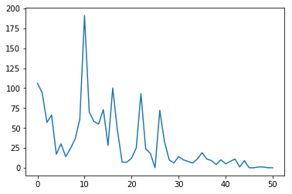
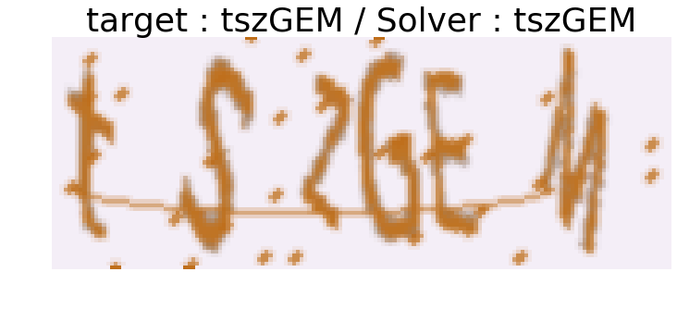
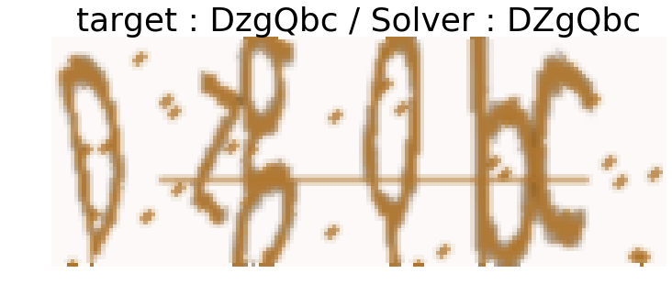
93%
97%

Slide 5
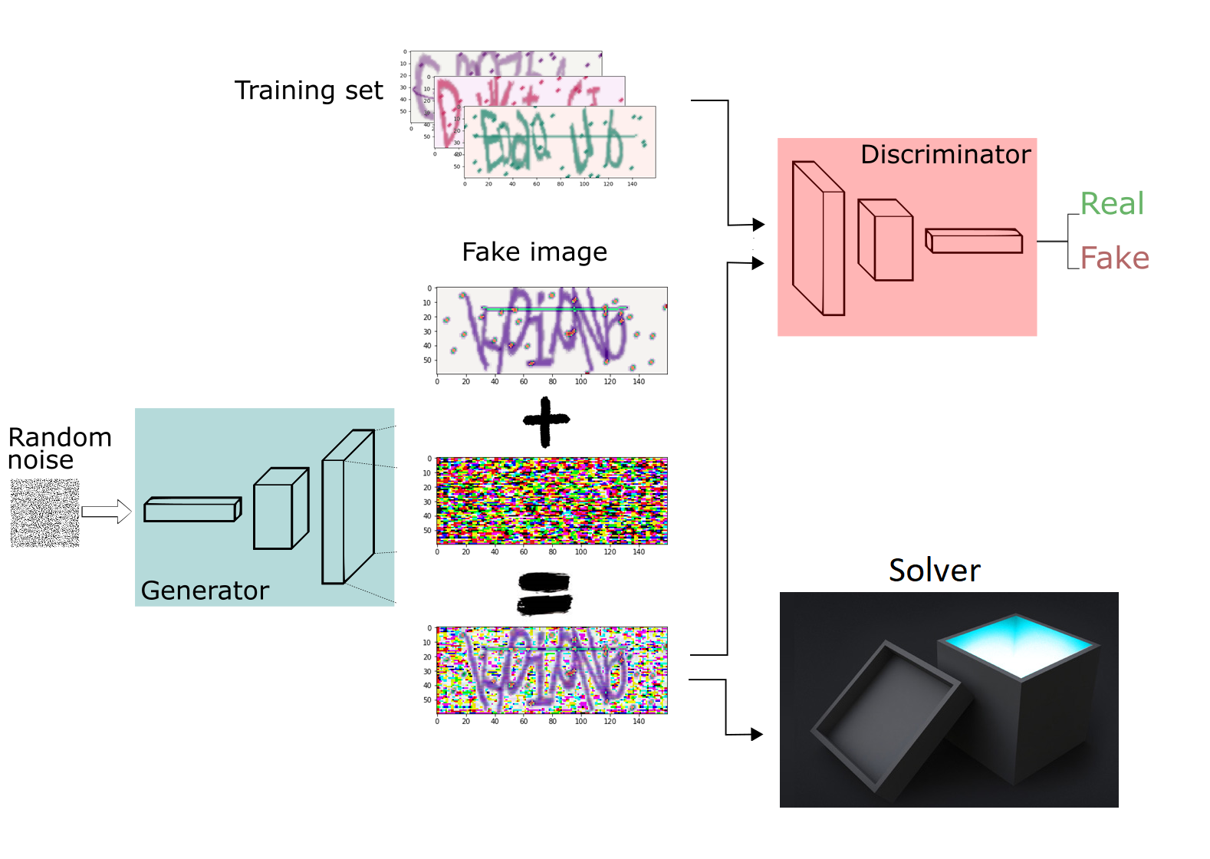
GAN
Human can
Solve
$${minimax}_{GD}V\left(D, G\right) =\underset{Discriminator loss}{\underbrace{E_{x∼p_{data}\left(x\right)} log\left[D\left(x\right)\right]}}−\underset{Solver loss}{\underbrace{E_{z∼ p_{z}\left(z\right)}\log\left[1−Err\left(S\left(G\left(z\right)\right)\right)\right]}}$$
Machine can’t
Solve

Slide 6
TODO
Plot new confusion matrix after GAN noise
Show some examples of solver failing
If not very successful – can we think of a reason ? Suggest improvements ?
Sampler ?

