Slide 1
Spectral Hallucination Detection
Progress Update -- May 2026
Omri Segev | Advisors: Ofir Lindenbaum, Bracha Laufer-Goldshtein, Amir Globerson
Method: H(n) Spectral Features + Nadler Fusion
Results: Math | GPQA | Factual QA | RAG | Agentic
Next: Phase 11a complete + Phase 11b code/navigation pilots

Slide 2
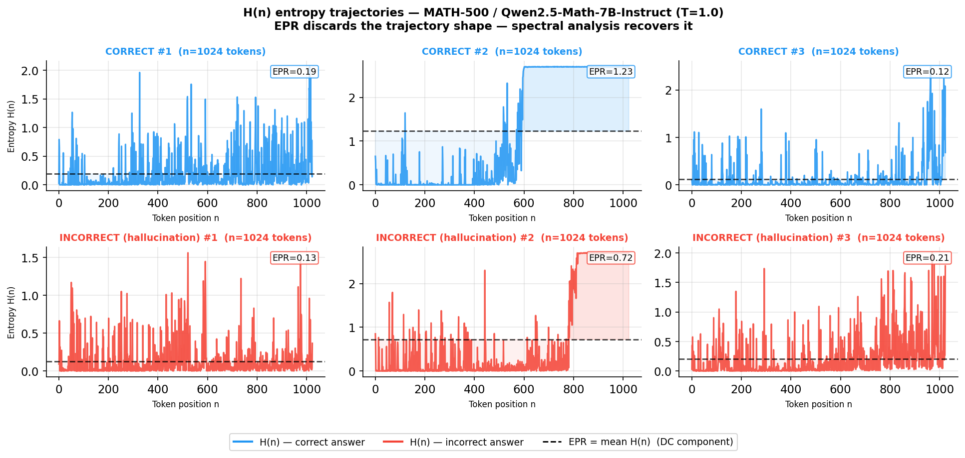
What Are We Detecting?
MATH-500 / Qwen-7B T=1.0 | 3 correct (blue) vs 3 hallucinated (orange) | EPR = DC (mean) only -- discards all shape
Incorrect answers show HIGHER, MORE VARIABLE entropy throughout the reasoning trace. Gray-box method: only token log-probabilities from one forward pass -- no attention maps, no extra sampling.

Slide 3
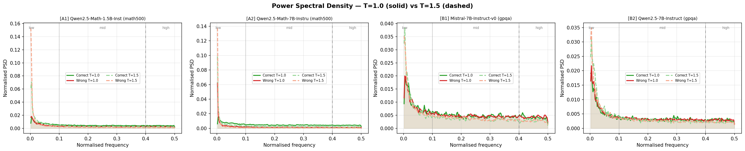
Hallucination Changes the Spectral Signature
Average PSD (DC/EPR removed) | 4 panels: MATH-500 (1.5B, 7B) and GPQA (Mistral-7B, Qwen-7B) | T=1.0 solid, T=1.5 dashed
x-axis: normalised frequency in cycles per token (0 = DC removed by construction; 0.5 = alternates every 2 tokens) Low band (0-0.1): one full oscillation per 10+ tokens -- slow structural patterns, reasoning stages High band (0.4-0.5): rapid 2-3 token bursts -- local uncertainty spikes, hallucination signature
Pattern is CONSISTENT across 4 model/dataset combos: incorrect = more high-freq energy

Slide 4
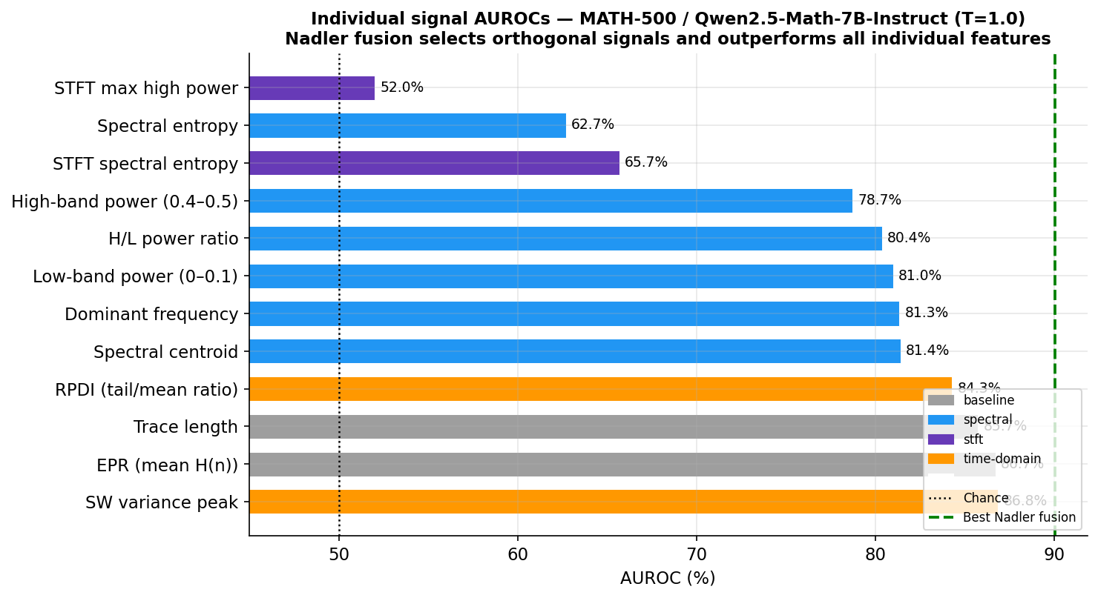
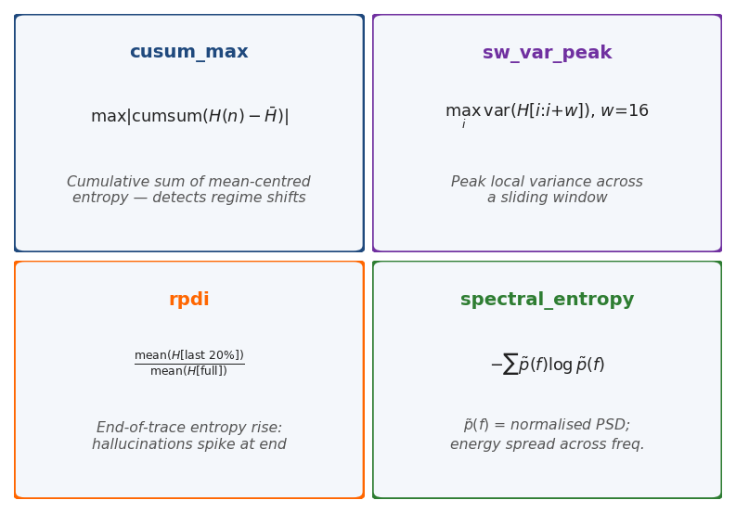
16 Spectral Features -- Individual Performance on MATH-500
Phase 5 bar shows 12 features; 4 more added in Phase 8: cusum_max, pe_mean, hurst, cusum_shift_idx | 16 total
Dataset:
MATH-500 (500 problems) / Qwen2.5-Math-7B-Instruct / T=1.0 Model accuracy 68.7% => ~310 correct, ~190 wrong (balanced) Why 7B? 1.5B at T=1.0 had too few errors for stable detection (advisor feedback from previous meeting on class imbalance)
Best Nadler subset (4 of 16): trace_length + spectral_centroid + rpdi + sw_var_peak Selected by rho-filtered exhaustive search (|rho|<0.75) => 90.0% AUROC
Key feature formulas:

Slide 5
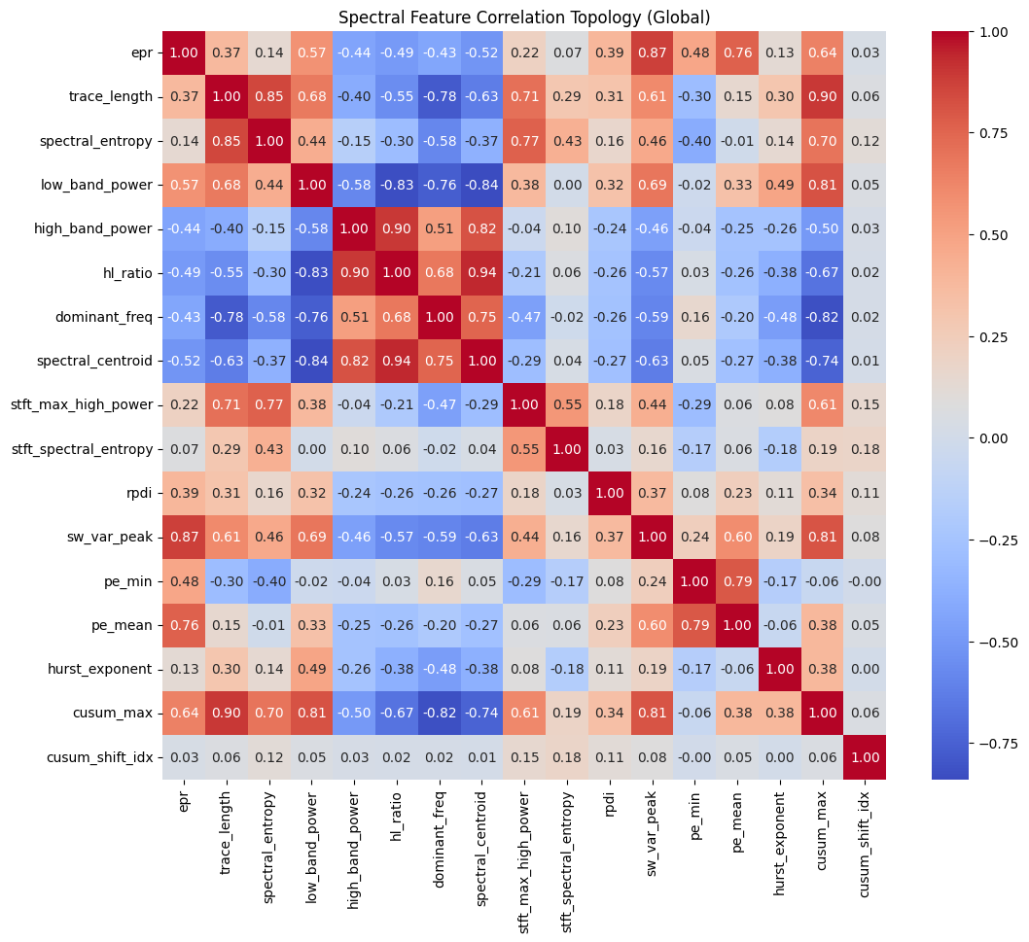
Feature Correlation Topology -- 7,001 Samples Across 5 Domains
All 16 features (incl. Phase 8 additions) | meta-analysis | Spearman rho | why Nadler works: orthogonality to EPR cluster
What this shows:
-> epr / hurst / pe_mean are correlated (all measure global entropy level)
-> spectral_entropy and stft_entropy correlated (same signal, different window)
-> sw_var_peak + cusum_max are ORTHOGONAL to EPR cluster => Nadler gains signal
-> pe_min isolated from all clusters => confirmed noise, removed (rank 17/17)

Slide 6
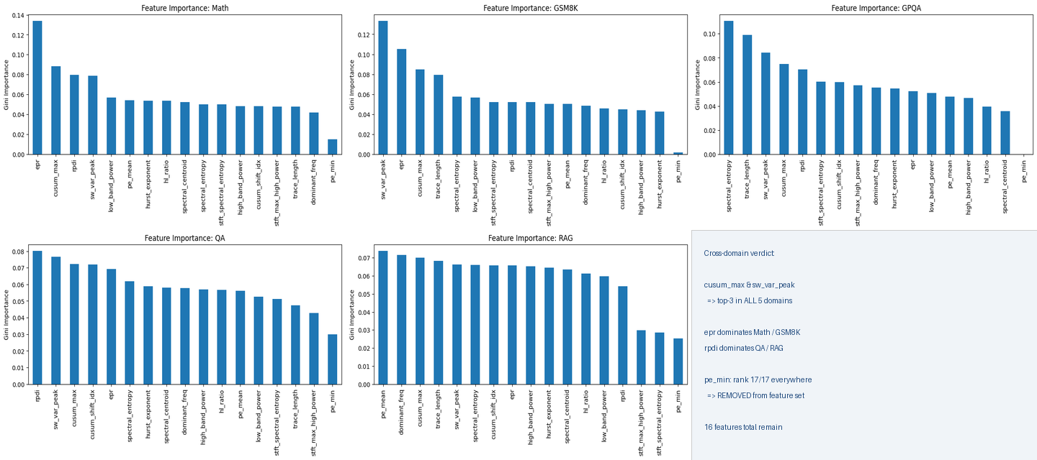
Feature Importance Varies By Domain -- Meta-Analysis (7,001 Samples)
Random Forest Gini importance | 5 domains | bottom-right panel: cross-domain verdict

Slide 7
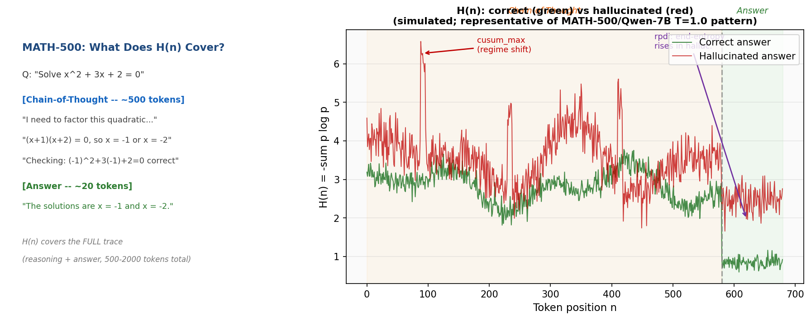
How It Works: Math Reasoning Domain
H(n) covers the FULL generation trace (reasoning chain + answer) | ~500-2000 tokens
Hallucinating model: regime shifts (cusum_max) and local variance spikes (sw_var_peak) appear mid-reasoning. Correct model: smooth low-entropy trajectory.

Slide 8
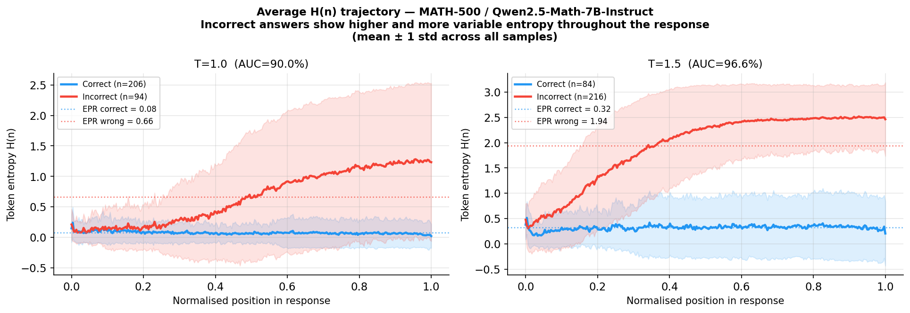
Math Reasoning: Results vs Competitors
Long reasoning traces (500-2000 tokens) give FFT sufficient frequency resolution
Performance comparison:
Method | Dataset / Model | AUROC | Labels | Access | Passes
Spectral Nadler (Ours) | MATH-500 / Qwen-7B T=1.0 | 90.0% | None | Gray-box | 1
Spectral Nadler (Ours) | GSM8K / Llama-3.1-8B | 76.0% | None | Gray-box | 1
LapEigvals (2502.17598) | GSM8K / Llama-3.1-8B | 72.0% | None | White-box (attn.maps) | 1
+4.0 pp over closest unsupervised competitor on same task+model LapEigvals is WHITE-BOX: needs full attention maps (all layers+heads) + supervised logistic probe. Our method: token log-probs only (gray-box) -- strictly less model access. T=1.5 gives 96.6% -- ceiling artifact (more mistakes => easier task); honest comparison is T=1.0.

Slide 9
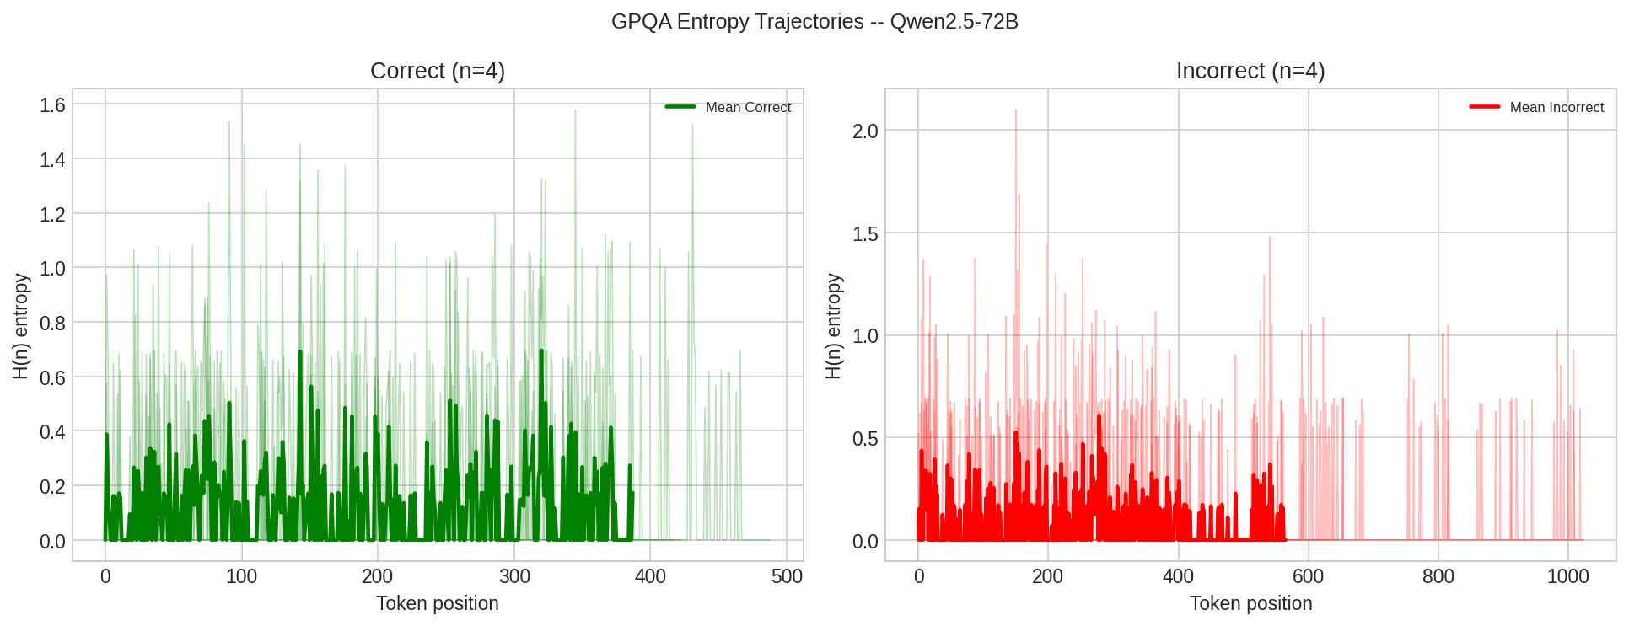
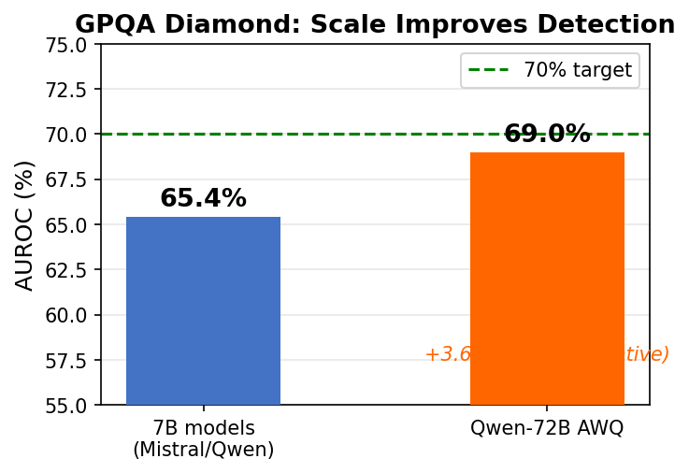
GPQA Diamond: Scale Matters -- PhD-Level Science MCQ
198 questions, 4-option MCQ | traces shorter (~100-400 tokens) | detection ceiling = model's own task accuracy
Performance comparison:
Method | Model | AUROC | Labels | Access | Passes
Spectral Nadler (Ours) | Qwen-72B AWQ | 69.0% | None | Gray-box | 1
Spectral Nadler (Ours) | 7B models | 65.4% | None | Gray-box | 1
No published spectral competitor on GPQA | -- | -- | -- | -- | --
-> 7B models: ~30-40% task accuracy => too few correct examples for detector
-> 72B AWQ raises accuracy to 40.4% => +3.6 pp AUROC
-> Bottleneck: model performance, not the detector
-> Gate not yet passed: need >=70%; direction: even stronger model or ensembling

Slide 10
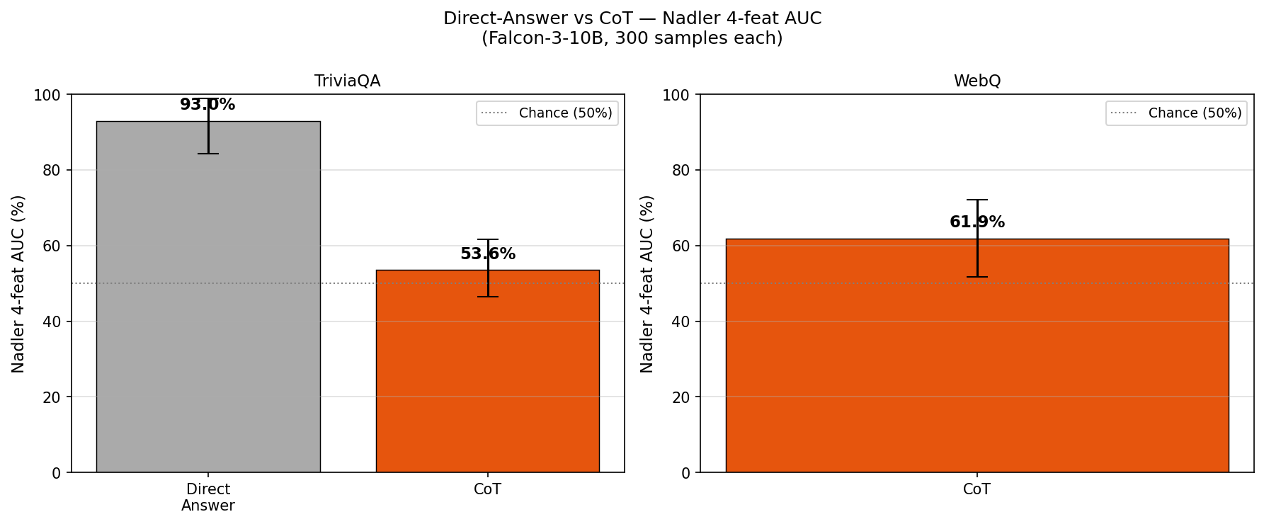
Negative Result: Spectral Features Don't Transfer to Factual QA
Falcon-3-10B | 300 samples each | CoT extends traces to 200-500 tokens -- still fails | TriviaQA plot only
Comparison:
Method | TriviaQA | WebQ CoT | Labels | Access | Passes
Spectral Nadler (Ours, CoT) | 53.6% | 61.9% | None | Gray-box | 1
EPR direct answer (no CoT) | 79.1% | 71.8% | None | Gray-box | 1
WebQ direct answer: 0 correct samples in run => AUC undefined for direct-answer mode. Plot above shows TriviaQA only. WebQ CoT = 61.9% (CoT added enough tokens to compute spectral features).
-> Direct traces: 20-50 tokens => FFT has no frequency resolution
-> CoT traces: 200-500 tokens => no systematic spectral structure
-> CoT SMOOTHS entropy (confidence masking) => worse than direct EPR
-> Factual recall != reasoning: model retrieves, not generates structure
This is a BOUNDARY CONDITION, not a failure. Spectral features detect generative uncertainty during REASONING -- not factual recall.

Slide 11
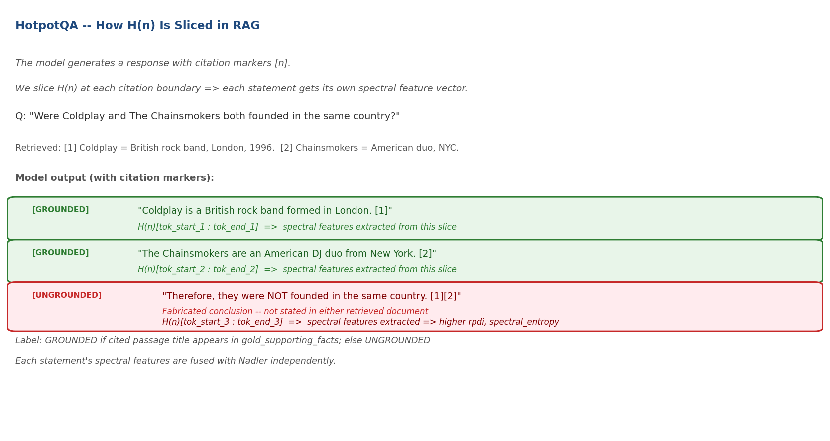
How It Works: RAG Domain -- Detecting Ungrounded Statements
L-CiteEval | model prompted to cite retrieved passages [n] | H(n) sliced by citation boundaries

Slide 12
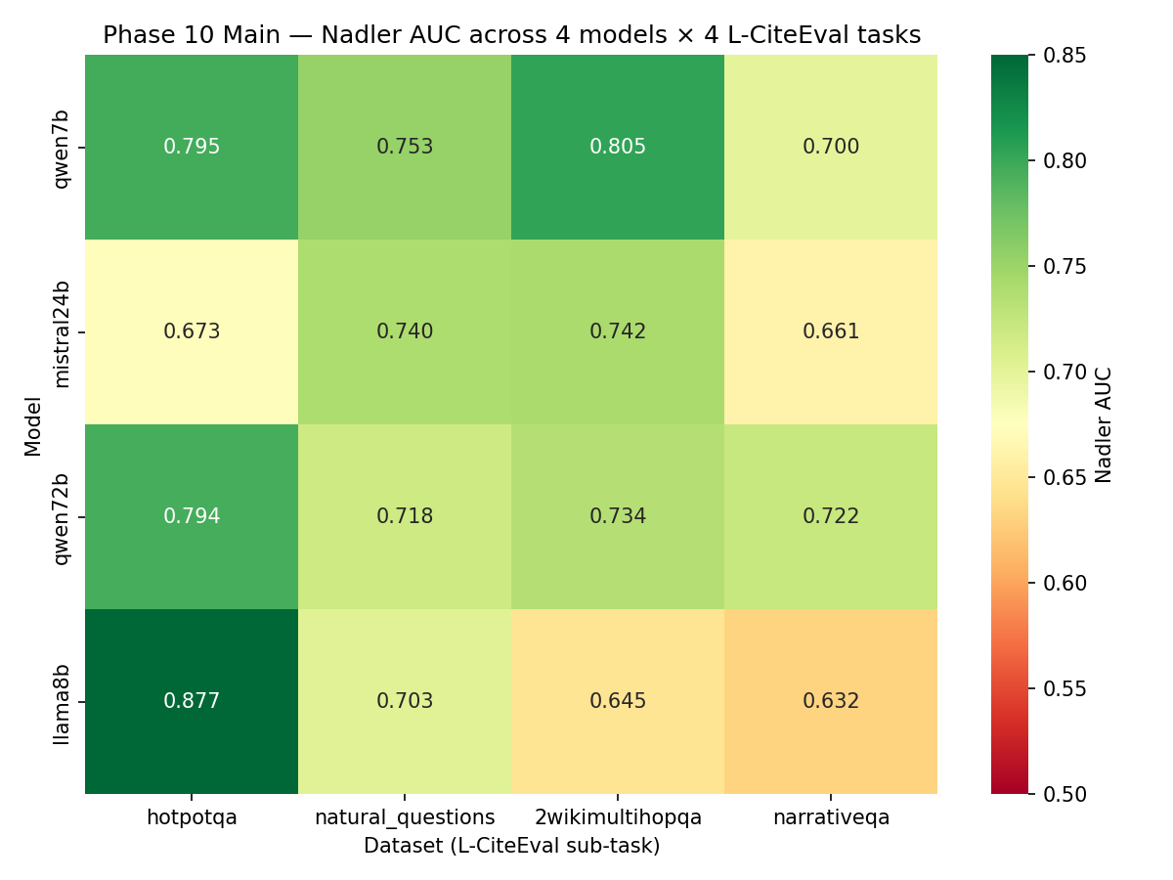
RAG Results: 16 Cells (4 Models x 4 Datasets)
Median AUROC ~72.8% | 12/16 cells >=70% | Best: llama8b/HotpotQA = 87.7%
vs competitors:
Method | Dataset | AUROC | Labels | Access | Passes
Spectral Nadler (Ours, Llama-8B) | HotpotQA | 87.7% | None | Gray-box | 1
Spectral Nadler (Ours, Qwen-7B) | 2Wiki | 80.5% | None | Gray-box | 1
LOS-Net (2503.14043) DIFFERENT TASK | Std HotpotQA (no citations) | 72.92% | Required | Gray-box | 1
* Novel task: unsupervised citation grounding on L-CiteEval -- no direct published competitor
-> LOS-Net uses standard HotpotQA (raw QA, no citation markers) -- different task
-> Closest available benchmark: LOS-Net = 72.92%; we beat it by +14.8 pp (unsupervised!)
-> Median 16 cells: ~72.8% | 12/16 >= 70%

Slide 13
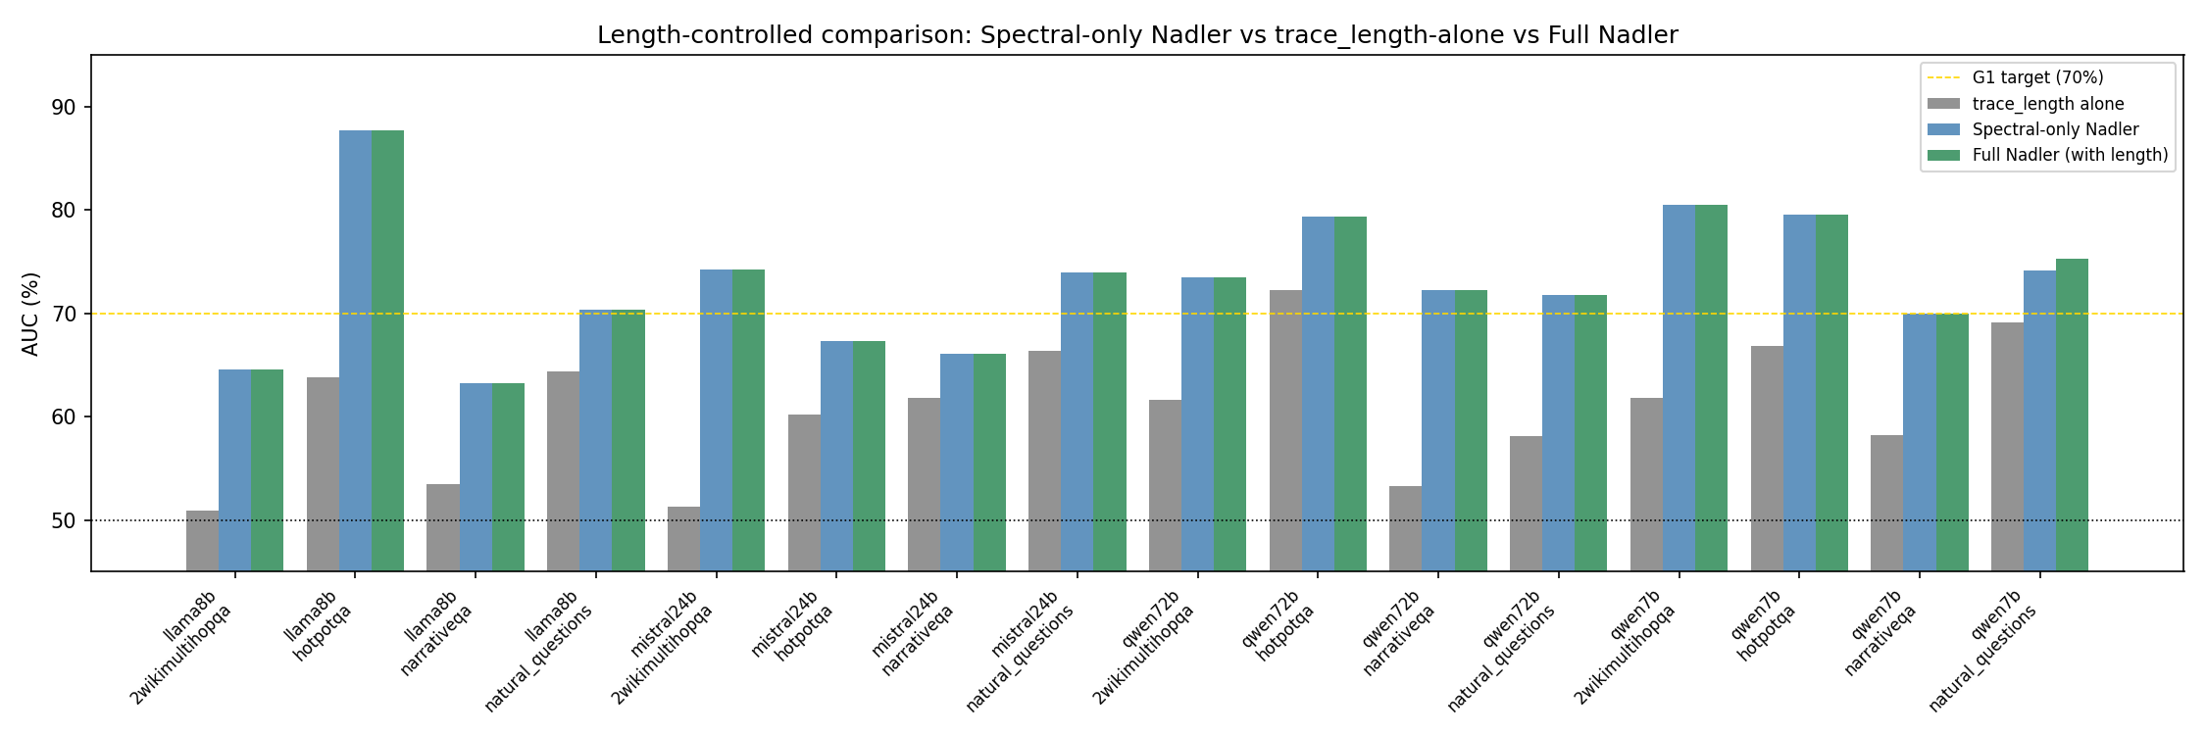
RAG Sanity: Signal Is Spectral Shape, Not Response Length
trace_length alone gives 50.8% (chance) -- the AUC comes from spectral structure, not verbosity

Slide 14
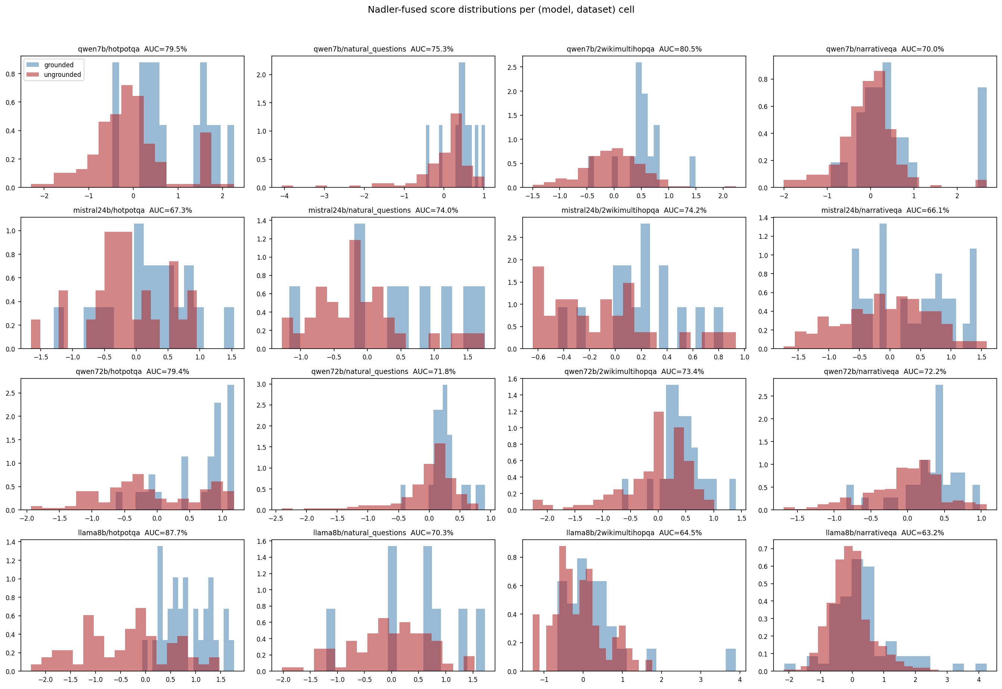
RAG: Score Distributions -- Grounded vs Ungrounded Statements
Nadler-fused scores per (model, dataset) cell | AUC annotated per panel | separation is visible

Slide 15
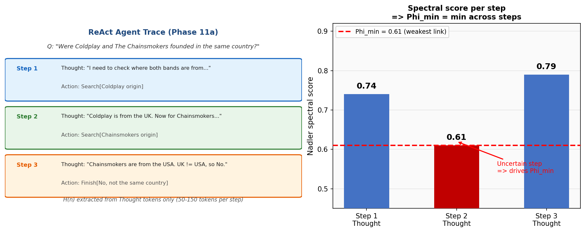
How It Works: Agentic ReAct Loops
Phase 11a | Task: multi-hop QA via ReAct | H(n) from Thought tokens only | Phi_min = weakest-link aggregation
Task (Phase 11a):
Input: question + Wikipedia passage dictionary Model: ReAct loop, up to 3 steps (Thought => Action: search/finish => Observation) Label: trajectory_correct = final answer matches gold answer string
vs RAG (Phase 10): RAG = 1 forward pass, model generates full cited response, H(n) sliced by citation markers. Agentic = 3 separate passes; H(n) extracted from each Thought step (50-150 tokens); then aggregated via Phi.
Phi_min = min(score_step1, score_step2, score_step3) -- weakest link. Phi_avg = mean across steps. Phi_last = final Thought only. Phi_min outperforms: a reasoning chain is only as reliable as its most uncertain step.

Slide 16
Agentic: Early Signal vs AUQ Baseline (Zhang et al. 2026)
4 models x 2 datasets x 3 aggregations | run not yet complete (Mistral-24B + Qwen-72B pending)
Phi_min = min(score_step1, …, score_stepK) [weakest link] Phi_avg = mean(score_step1, …, score_stepK) [average reliability] Phi_last = score_stepK only [final Thought quality]
Comparison:
Method | Setting | AUROC | Labels | Access | Passes
Spectral Nadler Phi_min (Ours, mid-run) | 2Wiki / DeepSeek-7B | 85.0%* | None | Gray-box | 1/step
AUQ verbalized (Zhang et al. 2026) | ALFWorld / Phi_min | 79.1% | None | White-box | 1/step
-> 4 models: Qwen-7B, DeepSeek-R1-7B, Mistral-24B, Qwen-72B
-> Datasets: HotpotQA + 2WikiMultiHopQA (N=200 each)
-> AUQ = asks model 'how confident are you?' in natural language
-> RLHF-aligned models often claim high confidence even when wrong
-> Our method: no verbalization; reads spectral shape only => gray-box
Run not yet complete: Mistral-24B + Qwen-72B cells pending. Mid-run signal is DeepSeek-R1-7B only. Official results after full run.

Slide 17
What's Next
Phase 11a completion + Phase 11b new domains + thesis end-game
Phase 11a: Complete ReAct Multi-hop QA
Phase 11b Pilot A: HumanEval (Code)
Phase 11b Pilot B: ALFWorld (Navigation)
- Run Mistral-24B (normal runtime)
- Run Qwen-72B (fresh runtime + gptqmodel stub)
- Full analysis: 8 cells (4 models x 2 datasets)
- Official Phi_min / Phi_avg / Phi_last AUC table
- Competitor: AUQ (Zhang et al. 2026)
White-box verbalized confidence = 79.1%
Our mid-run gray-box: 85.0% (+5.9 pp)
- Target: beat AUQ by >=5 pp, unsupervised
- Domain: code generation + execution
- N=20 problems, qwen25_7b, 3 attempts each
- Label: unit test pass/fail (objective!)
- H(n) from code generation tokens
- Competitor: DSDE (2026)
Execution-based disagreement
AUROC: 0.82-0.84
- GO/NO-GO: >=5 solved, traces non-degenerate
- Domain: embodied text navigation
- N=5 tasks, pick_and_place type
- Model: qwen25_7b, MAX_STEPS=20
- Label: task_success (binary)
- H(n) from Thought tokens per step
- Competitor: AUQ (Zhang et al. 2026)
Same paper as Phase 11a SOTA
AUROC: 0.791 on ALFWorld
- GO/NO-GO: alfworld imports stable
Thesis end-game (after Phase 11):
LTT Conformal Calibration (Bracha)
Manifold Analysis (Ofir)
Update Research_Directions + thesis write-up
~50 lines | data exists | converts AUROC -> deployment guarantee: recall>=90% at 95% confidence
Do entropy trajectories lie on a manifold? Hallucination = escape. LOCA + IMM.
4 arenas confirmed: math | GPQA | RAG | agentic. 2 new pilots: code + navigation.

