Slide 1
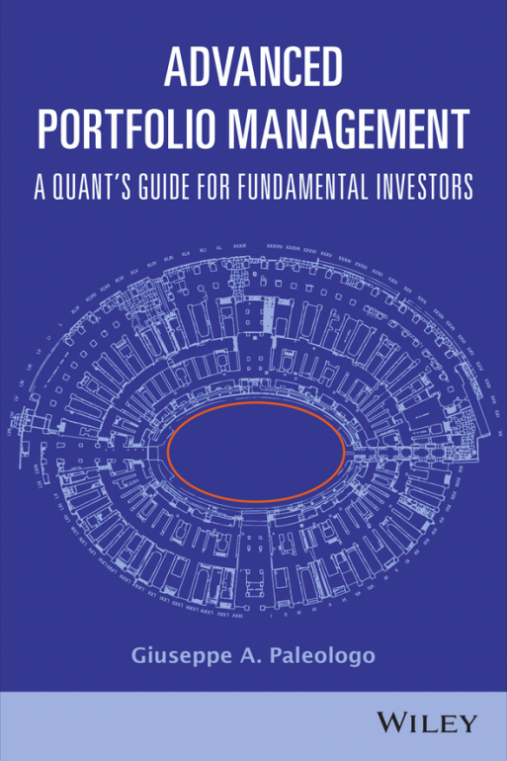
Ch7: Manage Factor Risk

Slide 2
Agenda
Background
Sharpe Ratio
Risk Based Sizing
Proportional Rule
The risk Parity (RP) rule
The Mean-Variance (MV) optimal Rule
The Shrinked Mean-Variance (MV) Optimal Rule
Empirical Analysis of the sizing rules
Factor-Neutrality implementation
Time-series risk-based portfolio targeting
Volatility targeting
References

Slide 3
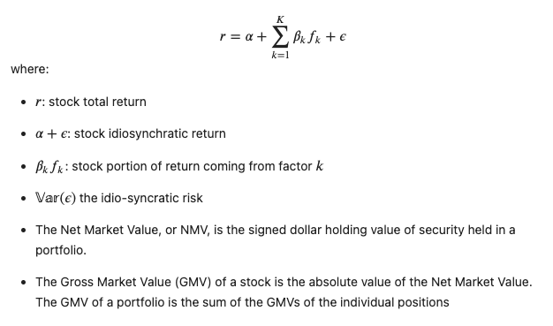
Background

Slide 4
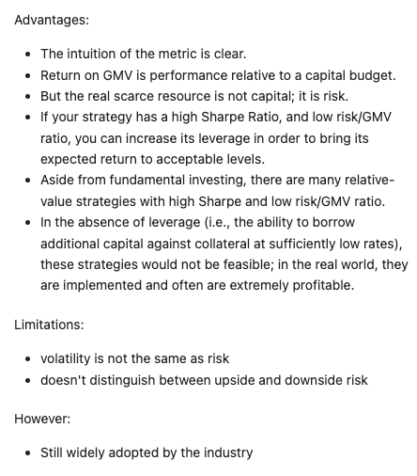
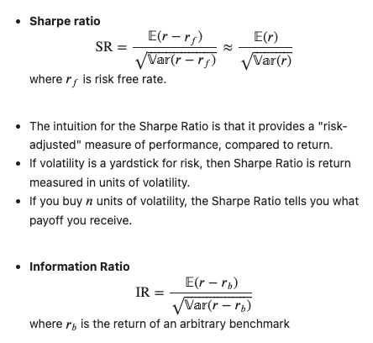
Sharpe Ratio

Slide 5
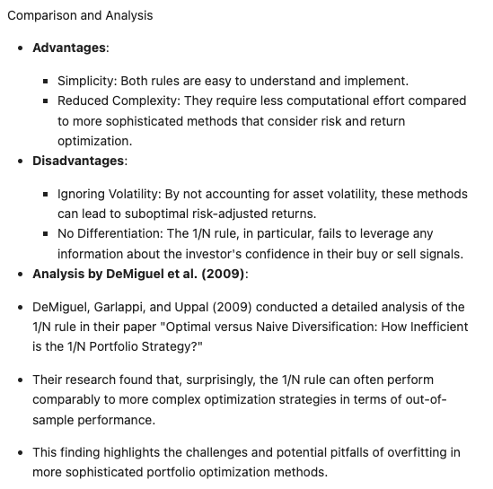
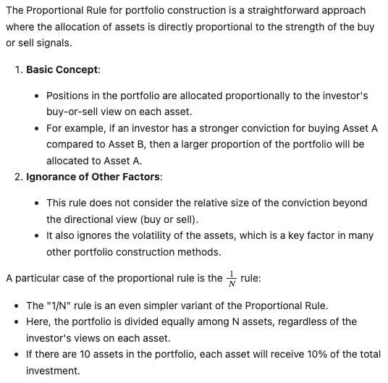
Proportional Rule
Source: DeMiguel et al (2007), Optimal Versus Naïve Diversification: How Inefficient is the 1/N portfolio strategy?

Slide 6
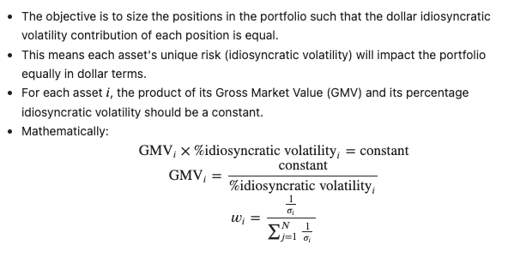
Risk Parity (RP) Rule

Slide 7
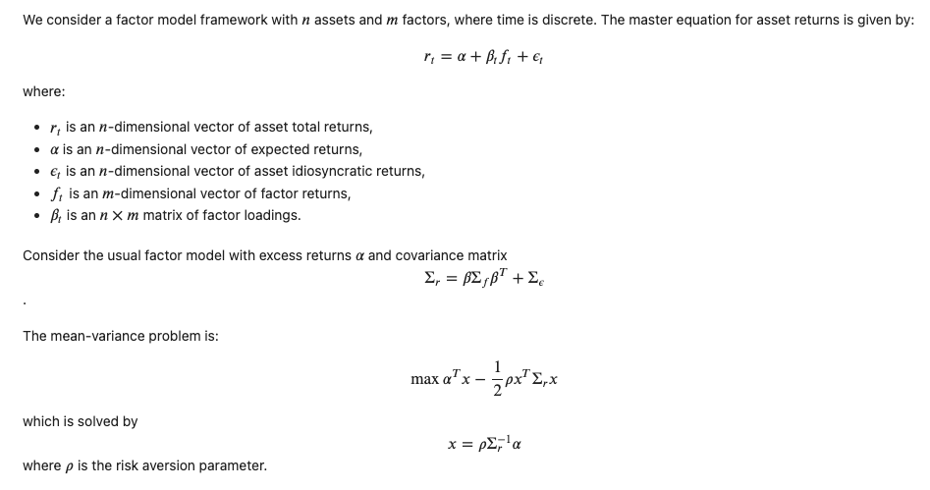
Mean-Variance Optimization (MVO)

Slide 8
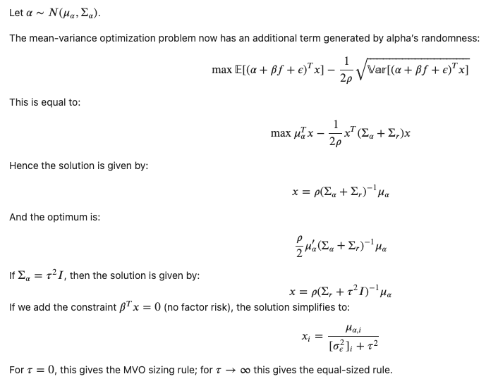
Shrinked MVO

Slide 9
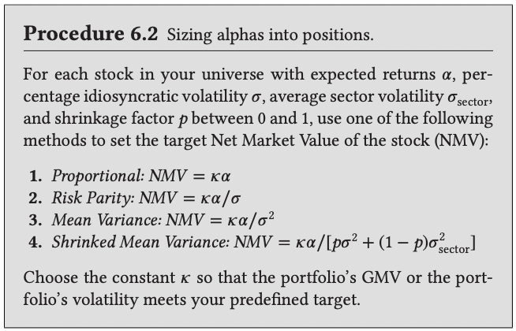
Summary of sizing rules

Slide 10
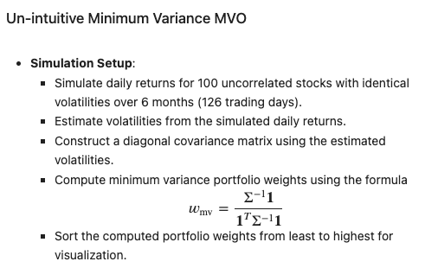
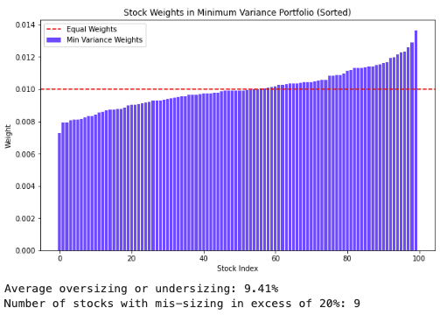
Empirical Analysis of the sizing rules

Slide 11
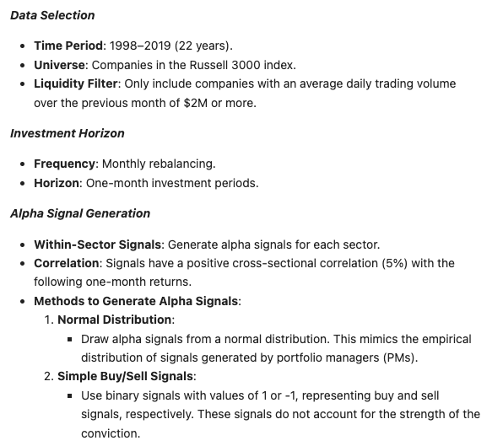
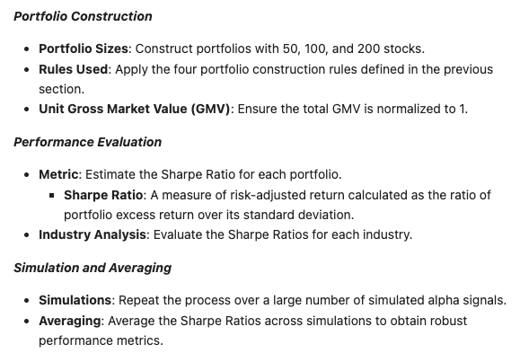
Realistic Experiment

Slide 12
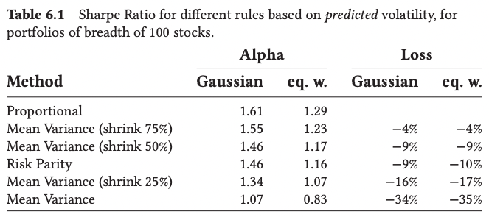
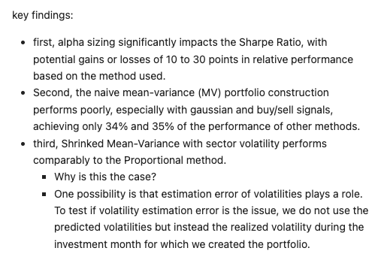
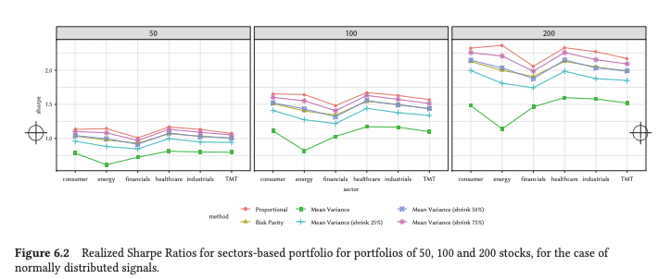
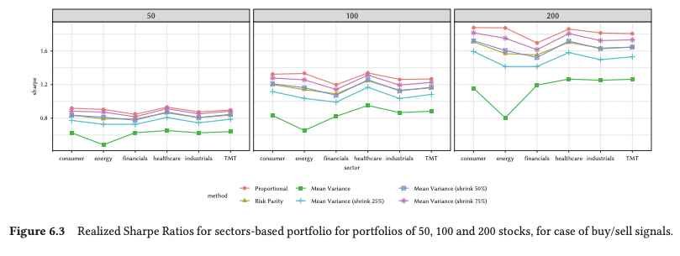
Results with predicted volatility

Slide 13
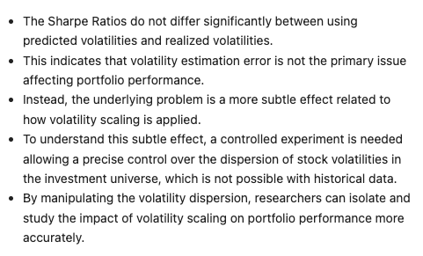
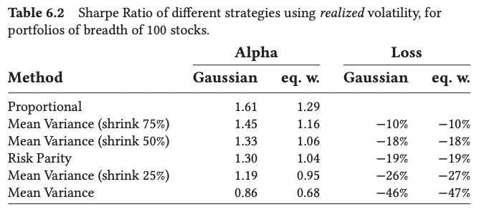
Results with realized volatility

Slide 14
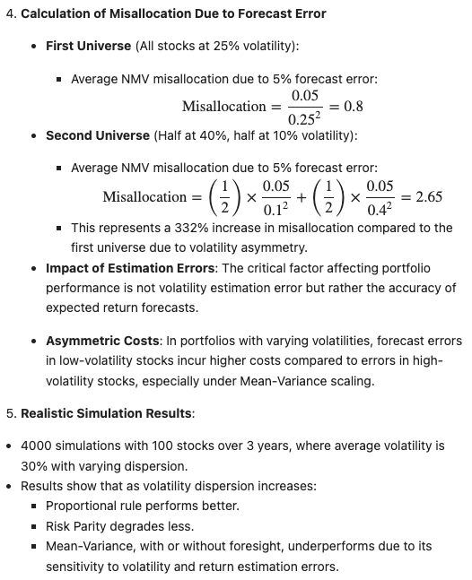
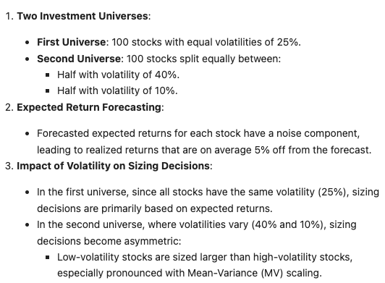
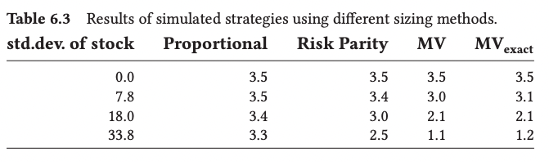
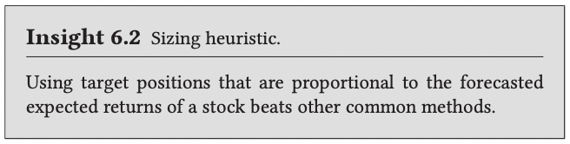
Controlled experiment

Slide 15
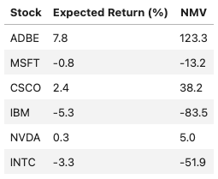
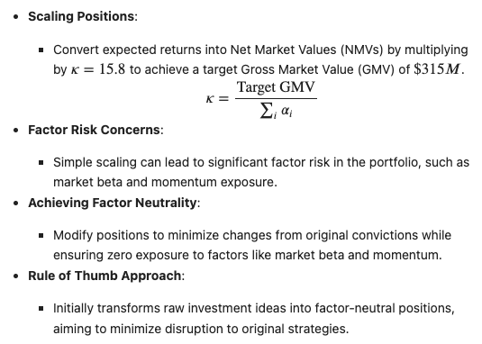
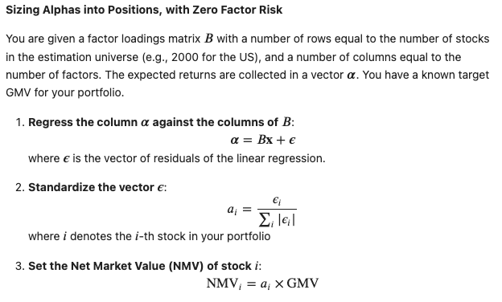
Factor-Neutrality implementation

Slide 16
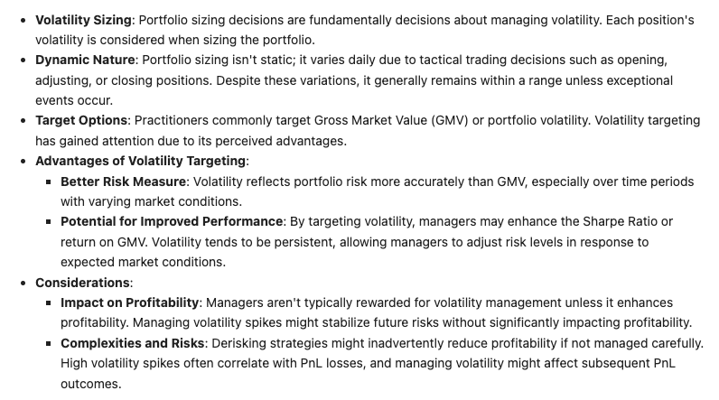
Time-series Risk-Based Portfolio Targeting

Slide 17
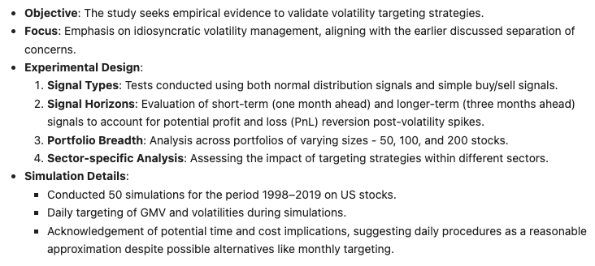
Empirical Confirmation

Slide 18
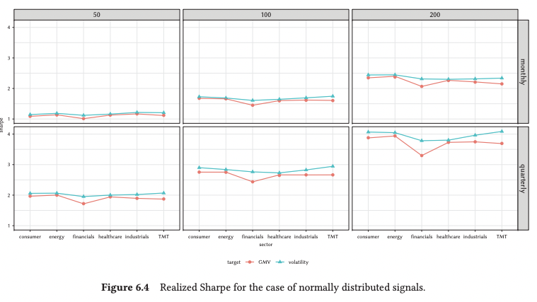
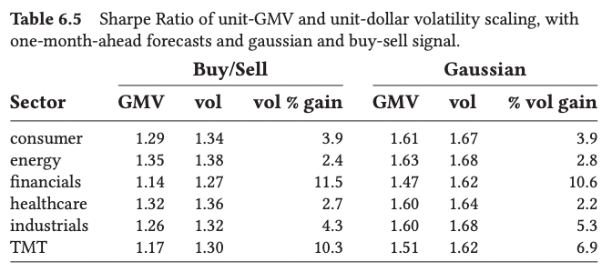
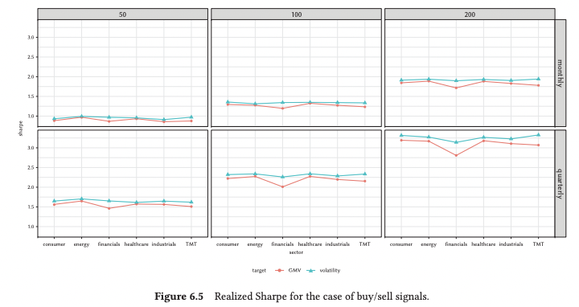
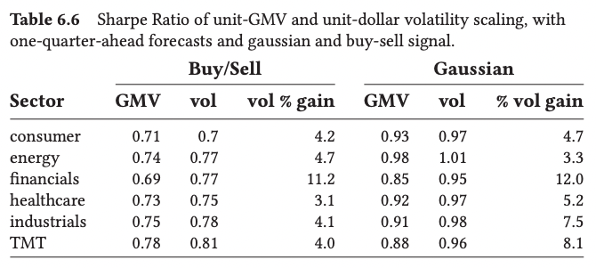
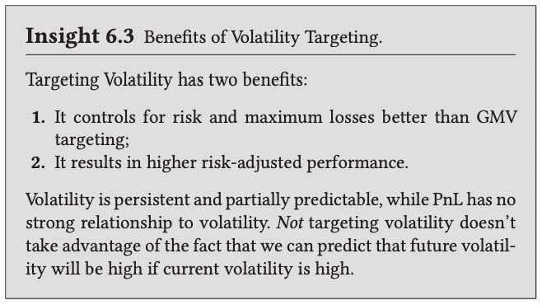
Results

Slide 19
References
Richard Grinold and Ronald Kahn, 2000, Active Portfolio Management, McGraw-Hill
Giuseppe A. Paleologo, 2021, Advanced Portfolio Management, A quant’s guide for fundamental investors. Wiley.

