Slide 1
WTI Volume Dynamic

Slide 2
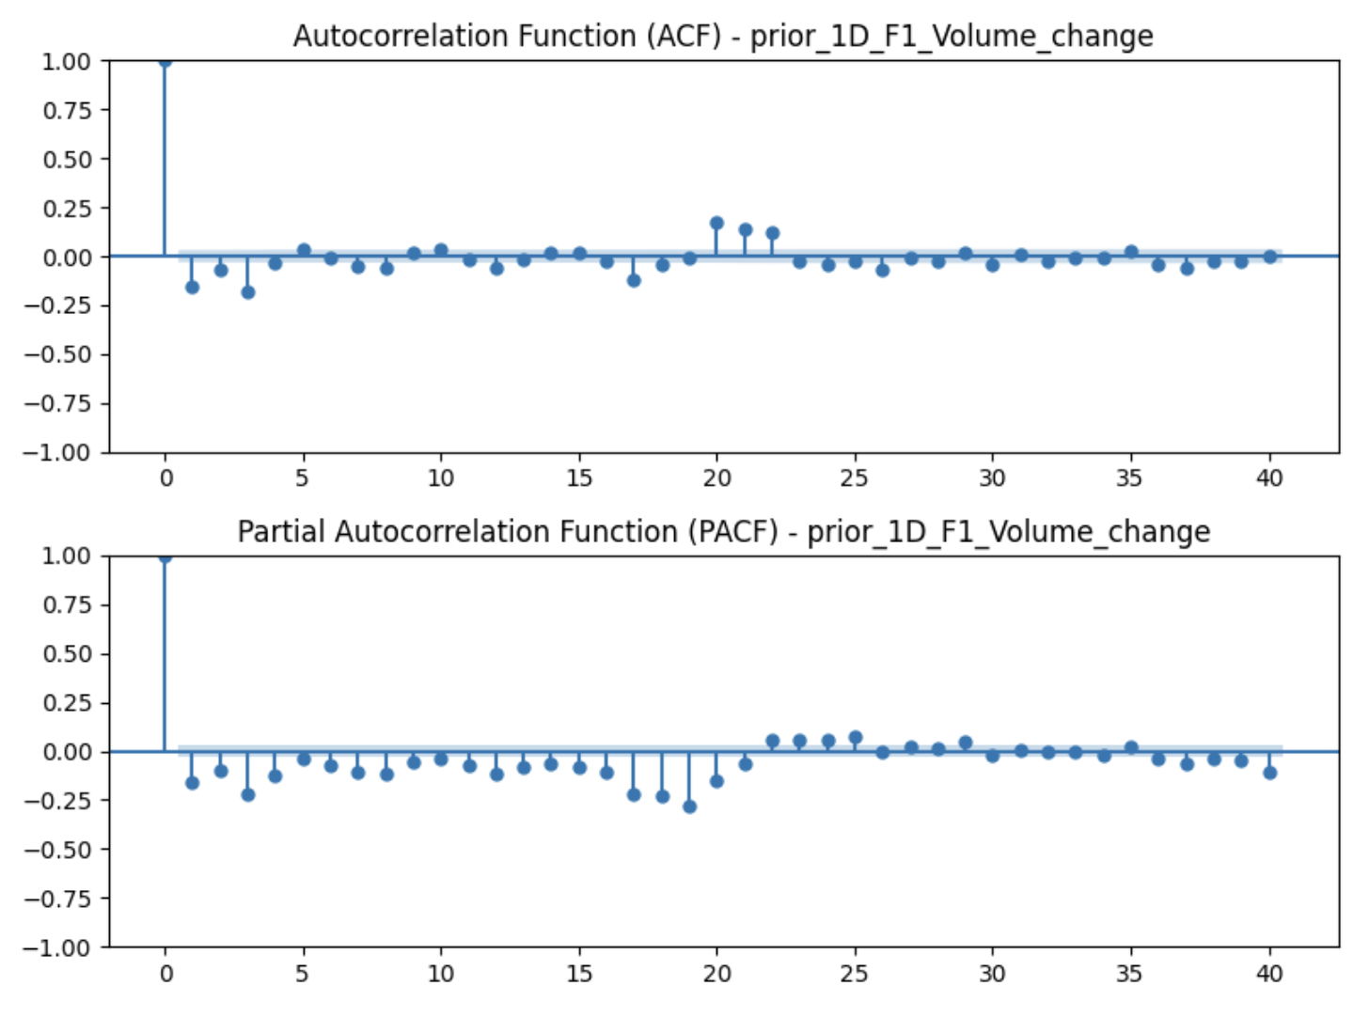
F-1 WTI Volume Profile - Index Roll Cycles?
It seems there is a recurring monthly rhythm in volume behavior, roughly every 20 to 23 trading days, there's a noticeable pickup in trading activity.
A surge in volume tends to be followed, about three weeks later, by a cooldown or drop off. It's like the market gets active leading into a specific period, then steps back, possibly after positions are rolled or adjusted

Slide 3
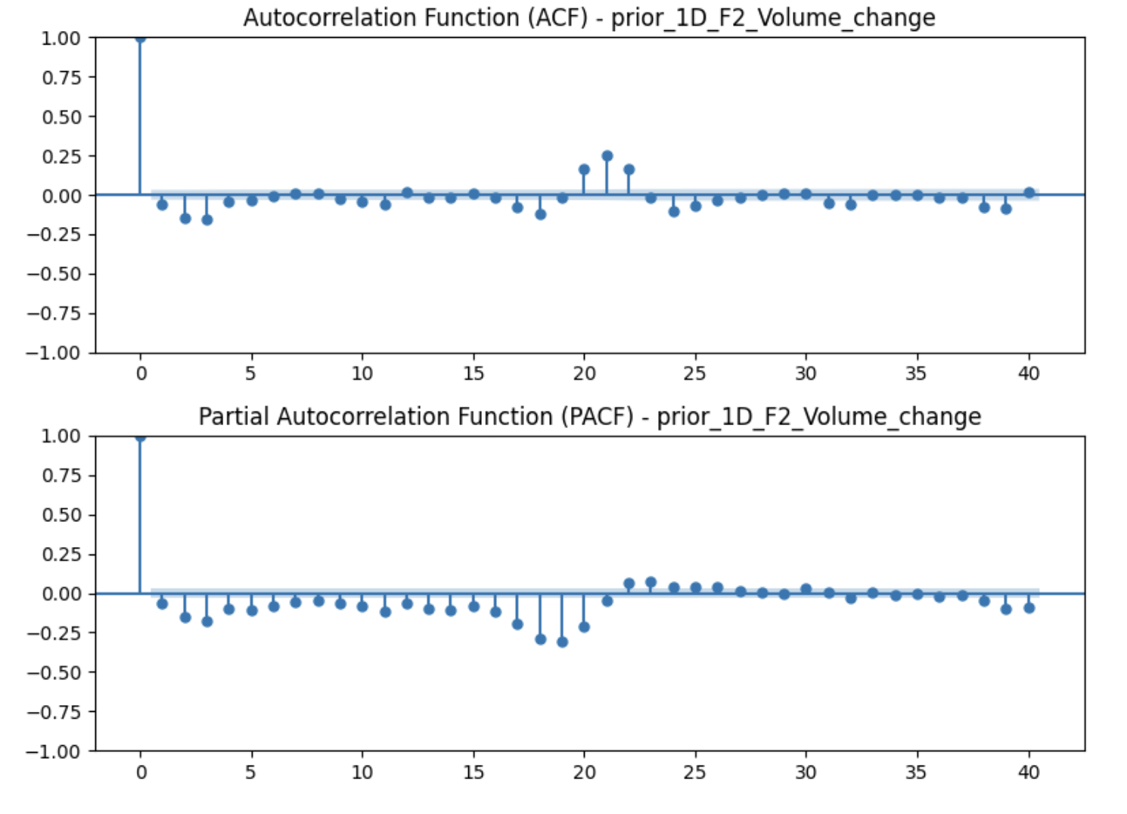
F-2 WTI Volume Profile - Index Roll Cycles?
This points to a recurring pattern every 20 to 23 trading days in volume changes which is highly consistent with monthly index roll behavior.
This again reinforces the idea of a roll effect: market builds up, spikes, then corrects.

Slide 4
Appendix
ACF vs PACF: What They Measure
Function | Measures | Interpretation
ACF (Autocorrelation Function) | Total correlation between a variable and its past values at different lags | Captures direct + indirect effects
PACF (Partial Autocorrelation Function) | Correlation between the variable and a lag, removing the effects of intermediate lags | Captures pure/direct influence only

