Slide 1
DDPM Denoises Covariance due to Inductive Bias: Formal Statements and Step-by-Step Proofs
Oualid Missaoui

Slide 2

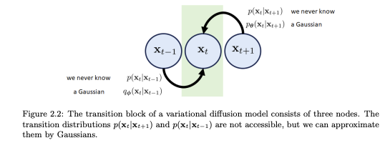
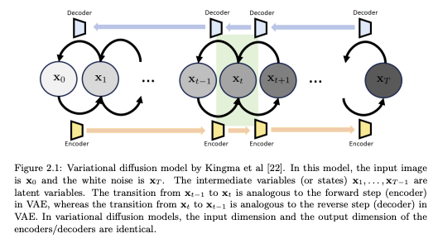




DDPM Formulation
Diffusion Models
Gradually add gaussian noise then reverse
$$x_{0}$$
$$x_{1}$$
$$x_{2}$$
…………..
$$x_{T}$$
source
Notes:
Stanley Chan

Slide 3

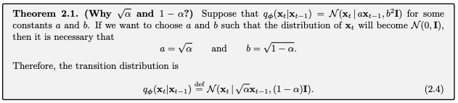

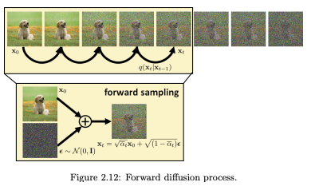
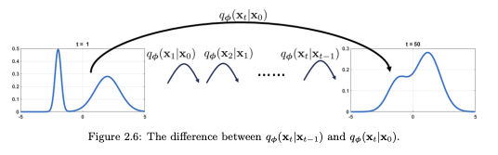
Forward Process

Slide 5
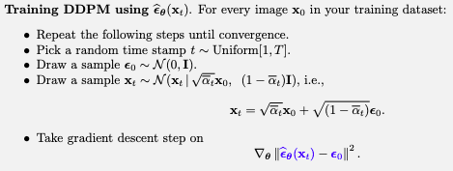
What does DDPM train for ?
source

Slide 6
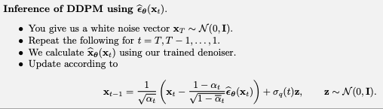
DDPM Inference
source

Slide 7
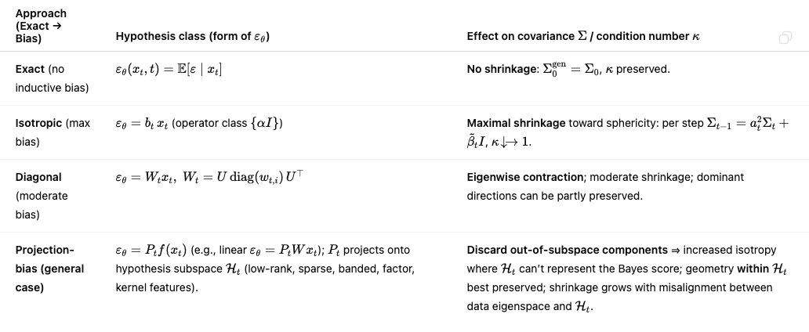
What possible solutions we can have ?

Slide 8
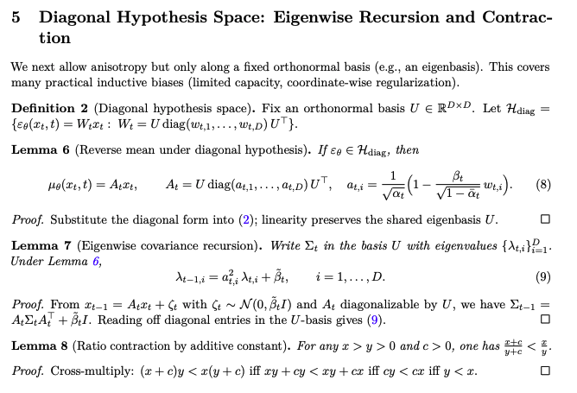
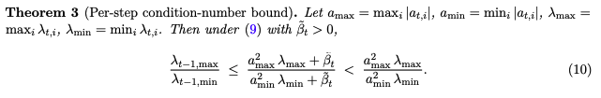

Slide 9
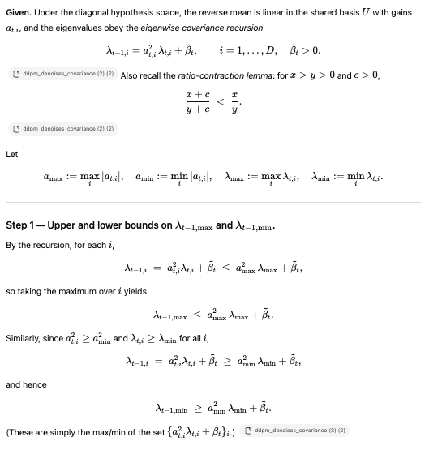
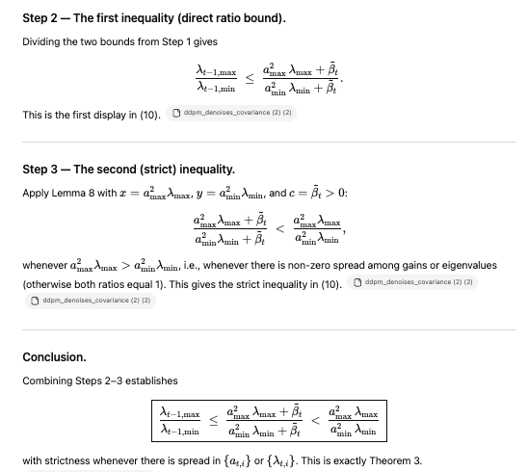
Proof of theorem 3

