Slide 1

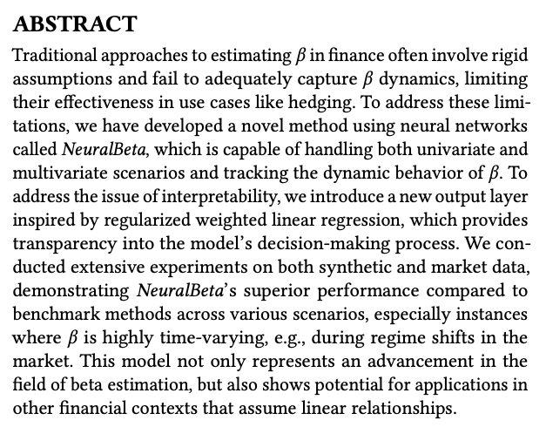
source

Slide 2
Agenda
Problem Setup
Neural Beta Model Architecture
Interpretable Neural Beta Model Architecture
Experiments
Synthetic Data
Market Data
Results reproduction

Slide 3
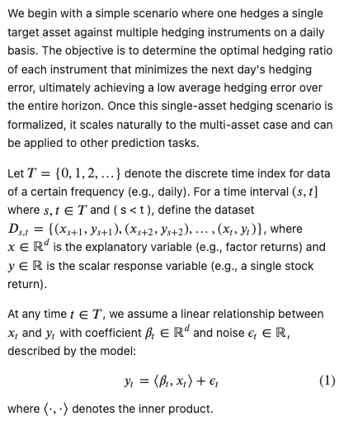
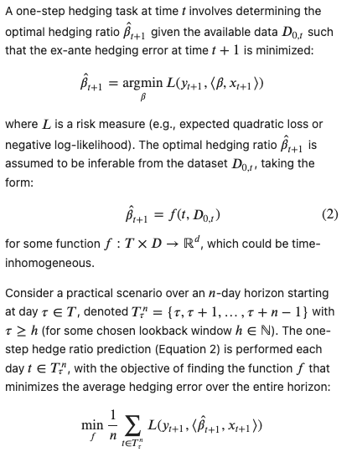
Problem Setup

Slide 4
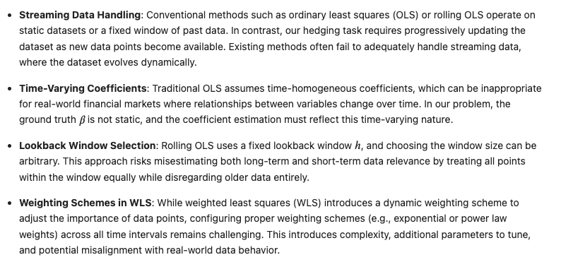
Limitations of existing methods

Slide 5
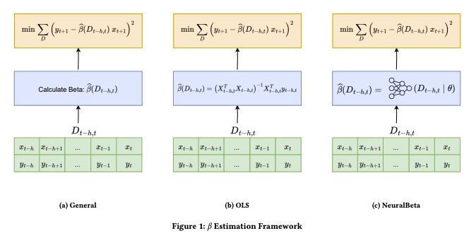
Beta Estimation Framework

Slide 6







Neural Beta Model Architecture
$$β_{t+1}$$
$$FC$$
$$GRU$$
$$y_{t−h}||x_{t−h}$$
$$…$$
$$y_{t}||x_{t}$$

Slide 7
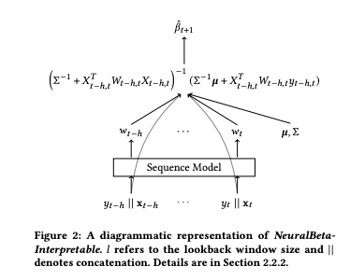






Interpretable Neural Beta Model Architecture
NB
INB
Non-linear
Linear
Solution of linear model
$$β_{t+1}$$
$$FC$$
$$GRU$$
$$y_{t−h}||x_{t−h}$$
$$…$$
$$y_{t}||x_{t}$$

Slide 8
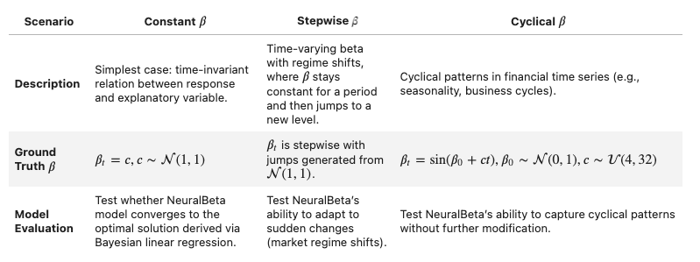

Synthetic data

Slide 9
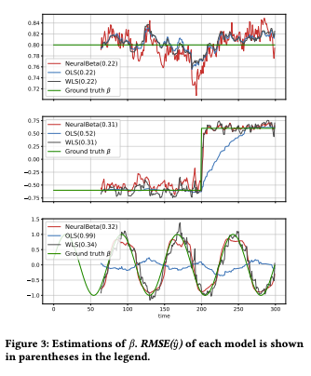
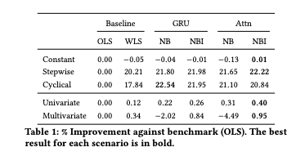
Synthetic Data

Slide 10
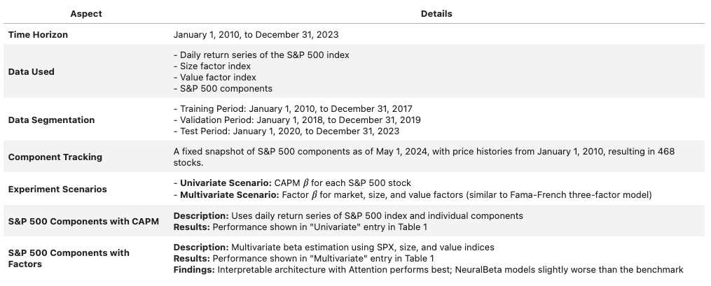
Market Data

Slide 11
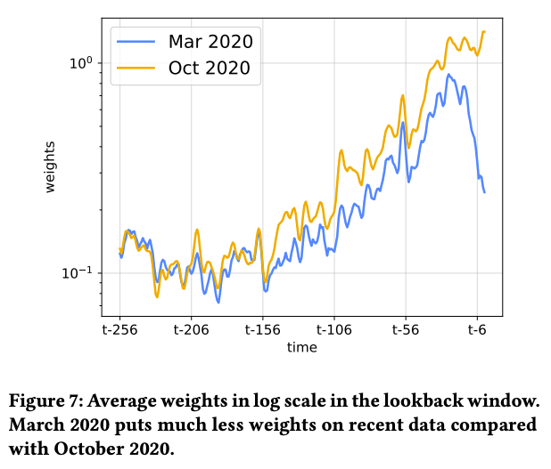
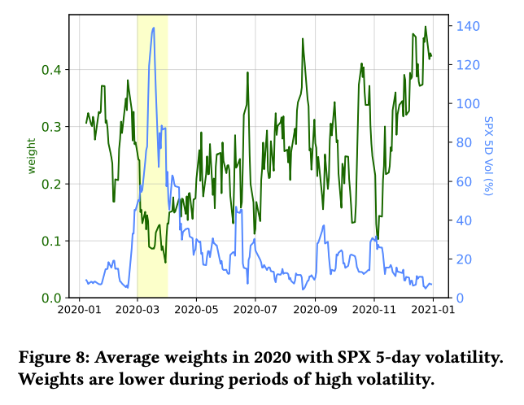
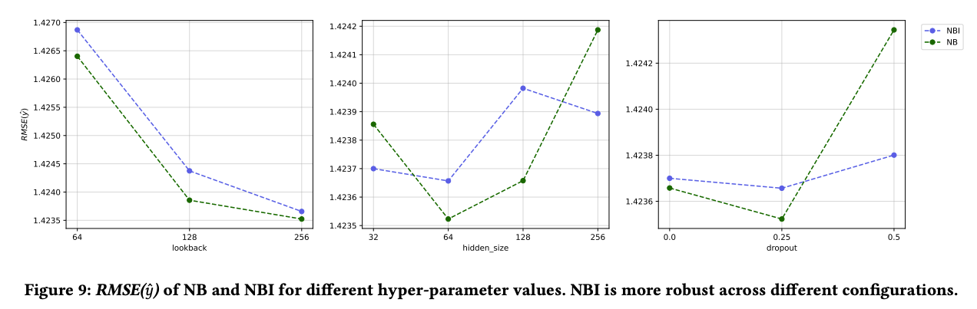
Market Data

Slide 12
Empirical results reproduction
Implemented a version of the neural beta model
Implemented the synthetic data generation
repo

