Slide 1
Ownership

Slide 2
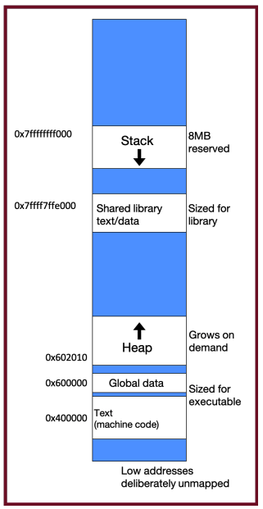
Memory Layout
Stack
The stack is the place where all local variables and parameters live for each function. A function’s stack “frame” goes away when the function returns.
The stack grows downwards when a new function is called and shrinks upwards when the function is finished.
Heap
The heap is a part of memory that you can manage yourself.
The heap is a part of memory below the stack that you can manage yourself.
Unlike the stack, the memory only goes away when you delete it yourself.
Unlike the stack, the heap grows upwards as more memory is allocated.
The heap is dynamic memory – memory that can be allocated, resized, and freed during program runtime.
Source

Slide 3
Memory Management
Explicit Management
C/C++
Malloc/free, new/delete
Garbage Collection
Java/Python
Ownership System
Rust/Go/Swift

Slide 4
Ownership system
The main concepts in Rust's ownership system are:
Ownership: Each value in Rust has a single owner, which is responsible for managing the value's memory.
Borrowing: References to values can be borrowed either mutably or immutably, with strict rules to prevent data races.
Lifetimes: Lifetimes are used to track how long references are valid, ensuring that references do not outlive the data they point to.

