Slide 1
Ch1: Deep Generative Modeling
Prepared by Oualid Missaoui

Slide 2
Agenda
Mathematical Setup
Training
  Forward KL
  Beyond KL
Prominent DGMs
  Energy-Based Models (EBMs)
  Autoregressive Models
  Variational Autoencoders (VAEs)
  Normalizing Flows
  GANs

Slide 3






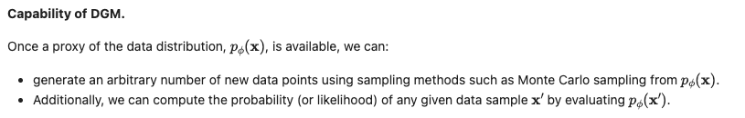
Mathematical Setup
Unknown true distribution
Model distribution
We cannot draw new samples from it
directly
The network’s trainable
parameters
Generative Model
Find
that satisfies

Slide 4
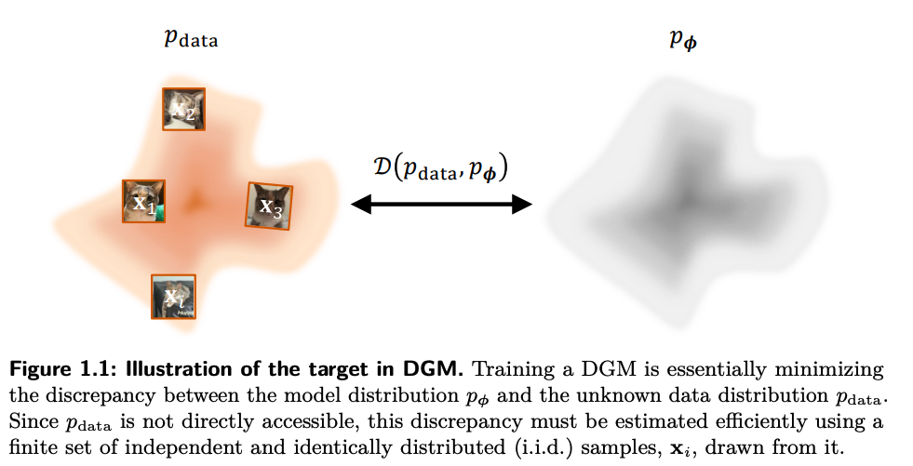
Illustration

Slide 5
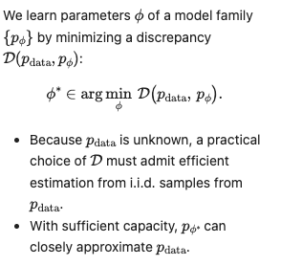
Training of DGM
The discrepancy can be:
  Forward KL and Maximum Likelihood Estimation (MLE)
  Fisher Divergence
  Beyond KL: f-divergences

Slide 6
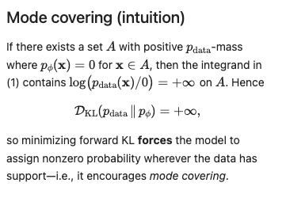
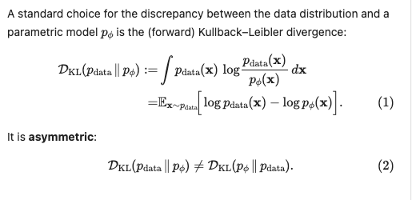
Forward KL and Maximum Likelihood Estimation (MLE)

Slide 7
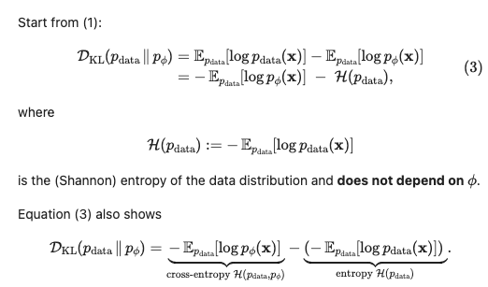
Decomposing the forward KL

Slide 8
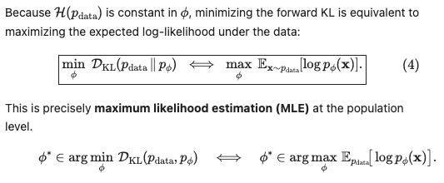
Minimizing KL

Slide 9
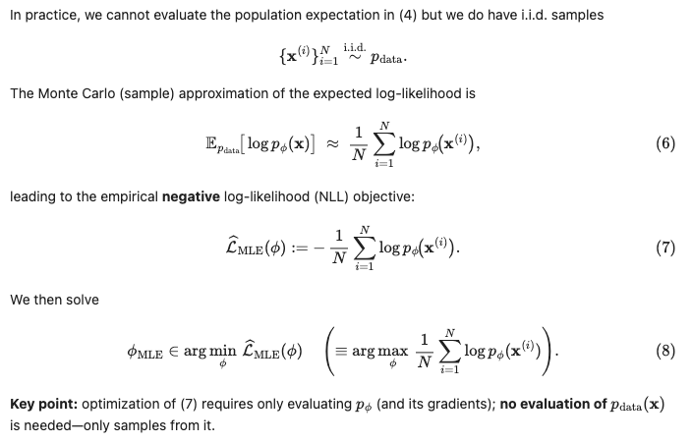
Empirical MLE via Monte Carlo

Slide 10
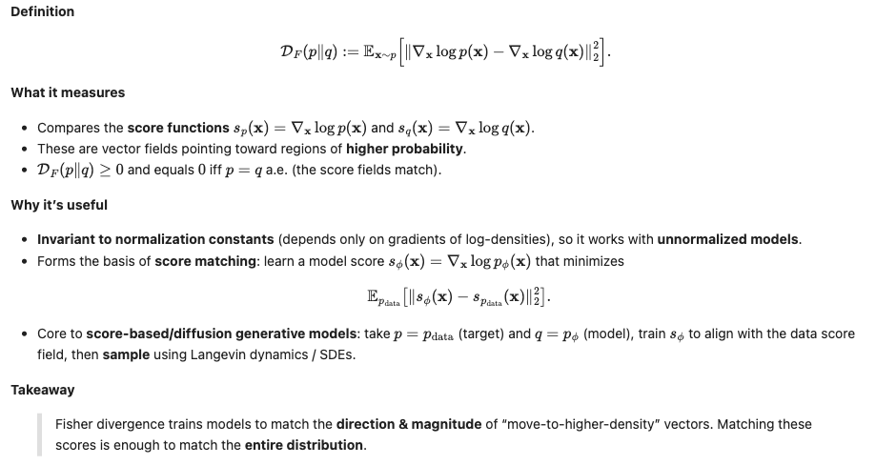
Fisher Divergence (Score-Based Modeling)

Slide 11
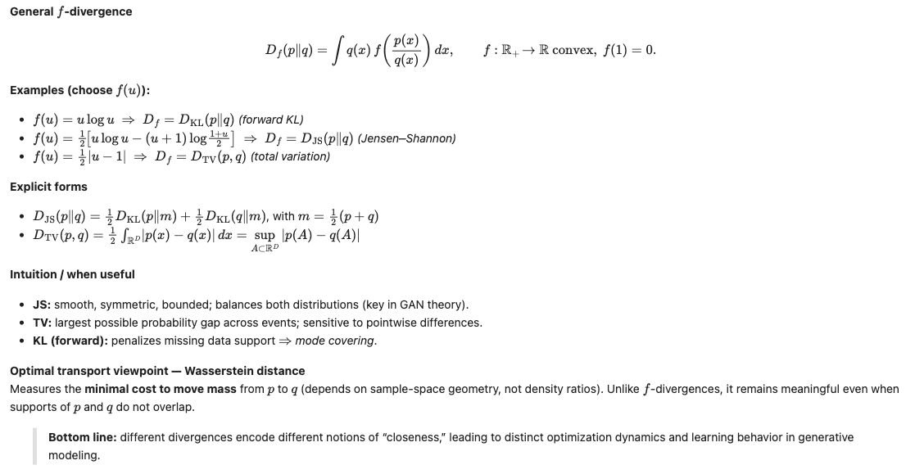
Beyond KL

Slide 12





Challenges in Modeling Distributions
Non-negativity
Normalization

Slide 13
Prominent DGMs
Energy-Based Models (EBMs)
Autoregressive Models
Variational Autoencoders (VAEs)
Normalizing Flows
GANs

Slide 14
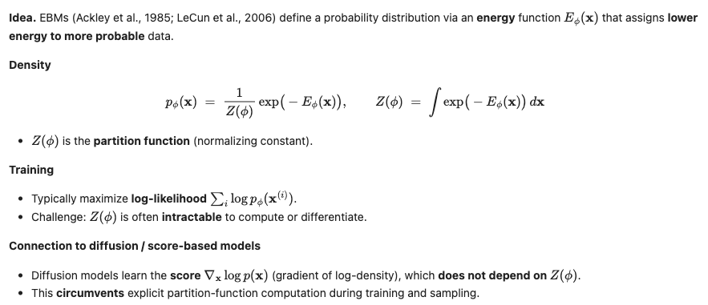
Energy-Based Models (EBMs)

Slide 15
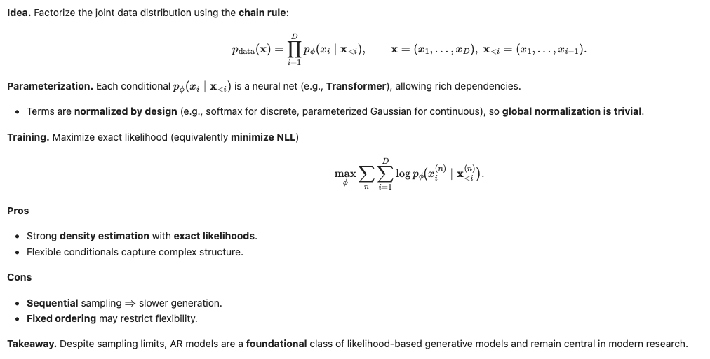
Autoregressive (AR) Models

Slide 16
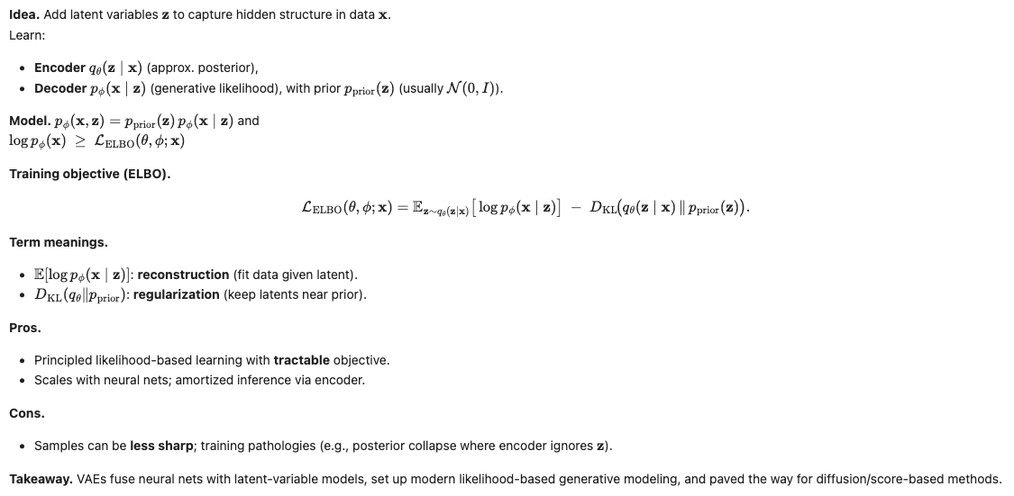
VAE

Slide 17
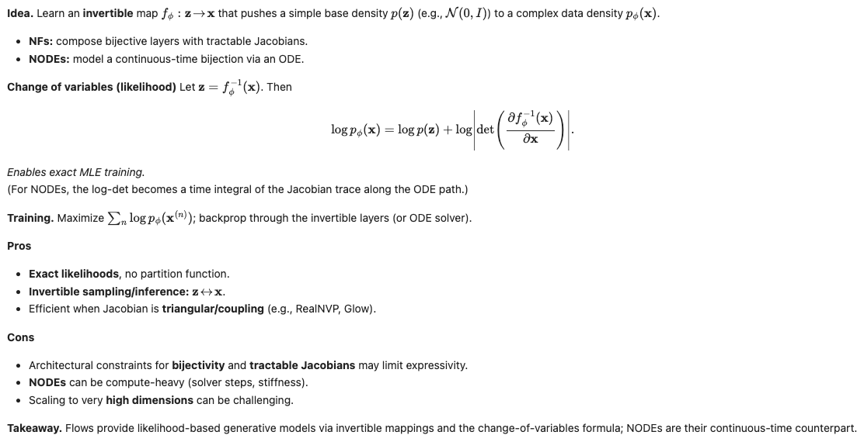
Normalizing flows

Slide 18
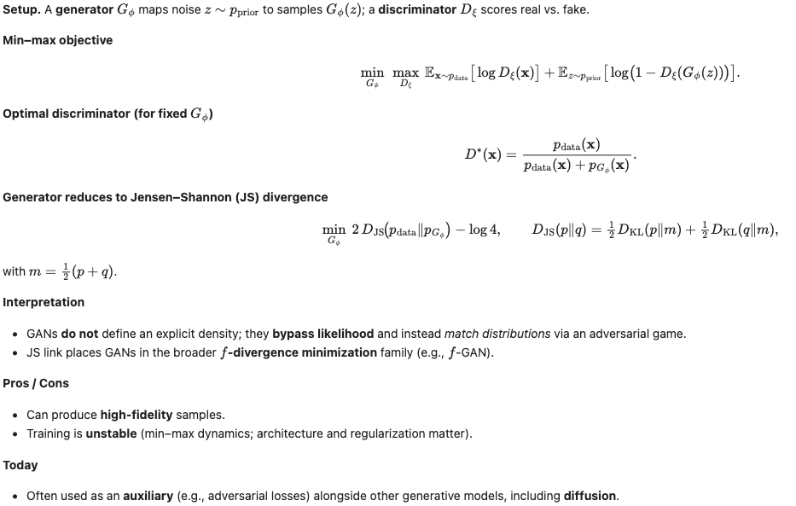
GANs

