Slide 1
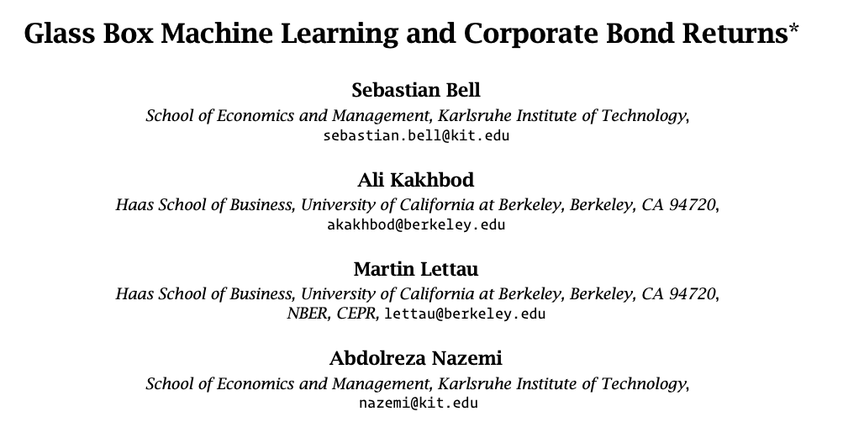
ssrn link
Prepared and Presented by Oualid Missaoui

Slide 2
Agenda
Introduction
Summary of the Research
Key Findings and Contributions
Methodology
Formulation
Explainable Boosting Machines
Evaluation
Importances
Data
Empirical Results

Slide 3
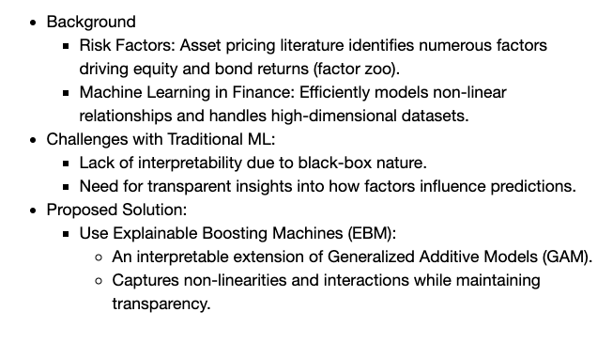
Introduction – Summary of the research

Slide 4
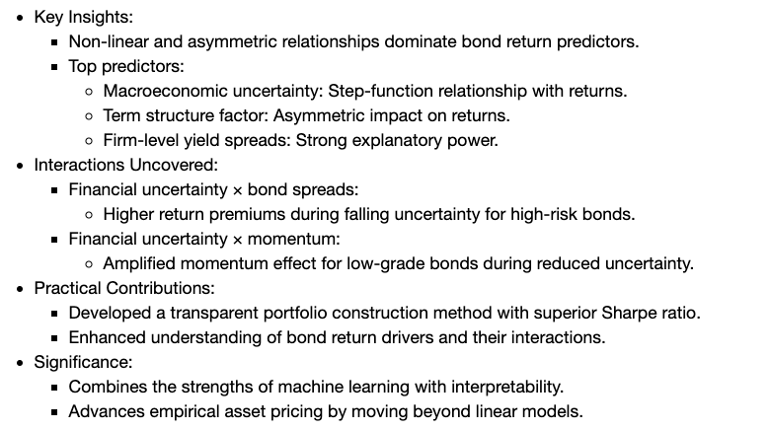
Introduction – Key Findings & Contributions

Slide 5
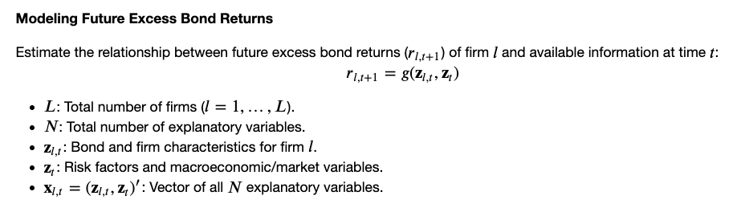
Methodology

Slide 6
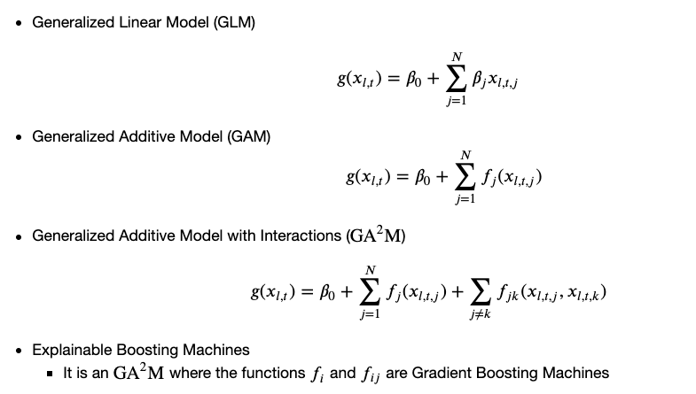
Explainable Boosting Machines

Slide 7
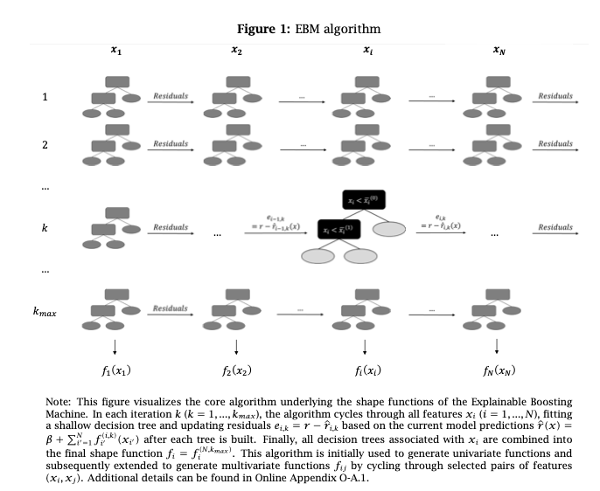

Slide 8
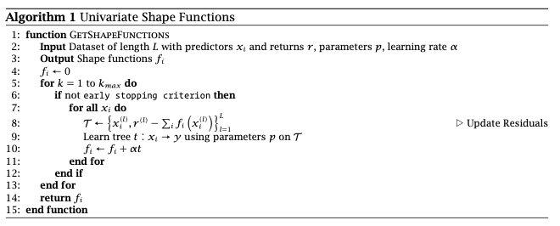
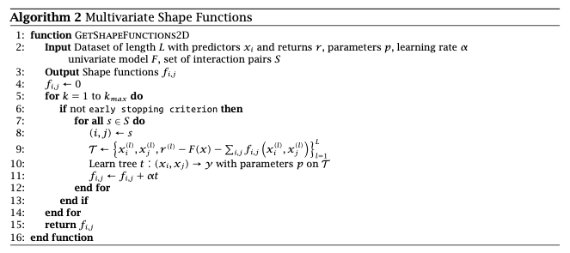

Slide 9
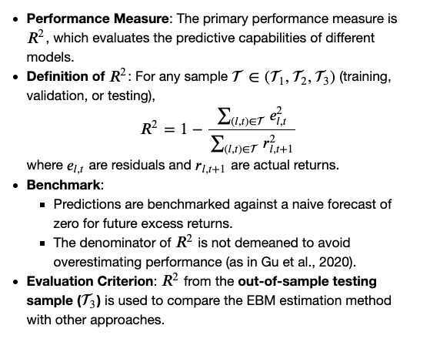
Evaluation

Slide 10
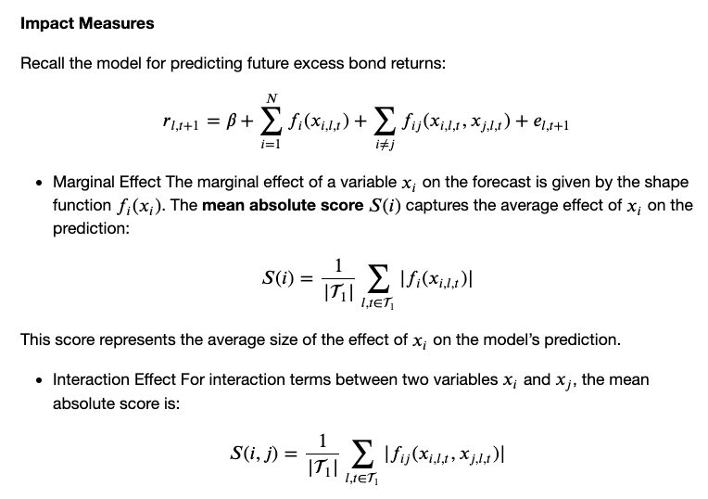
Effects of variables

Slide 11
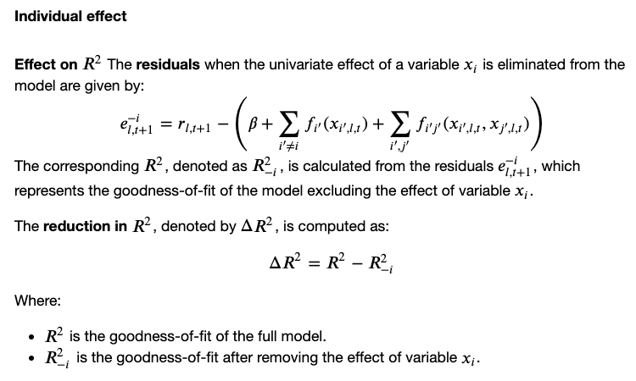
Effects of variables

Slide 12
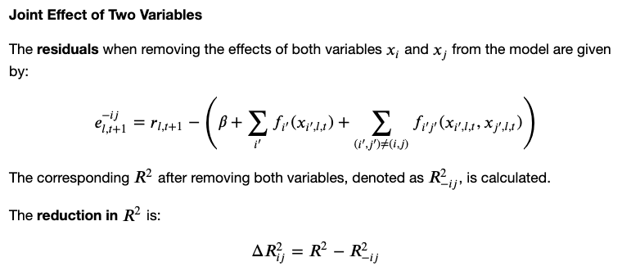
Effects of variables

Slide 13
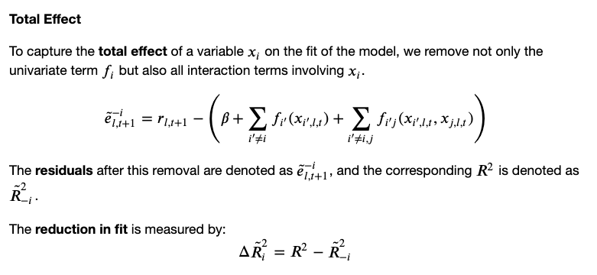
Effects of variables

Slide 14
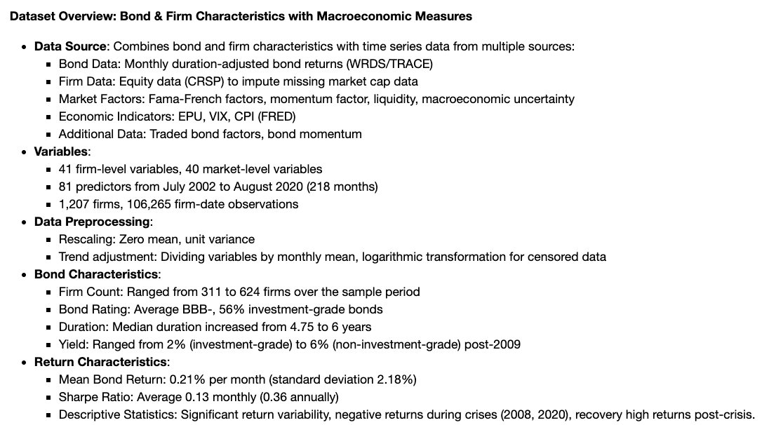
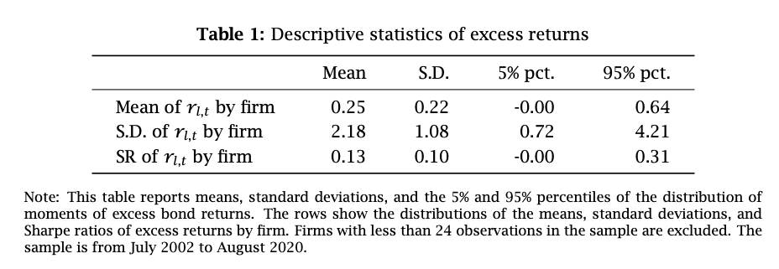
Data

Slide 15
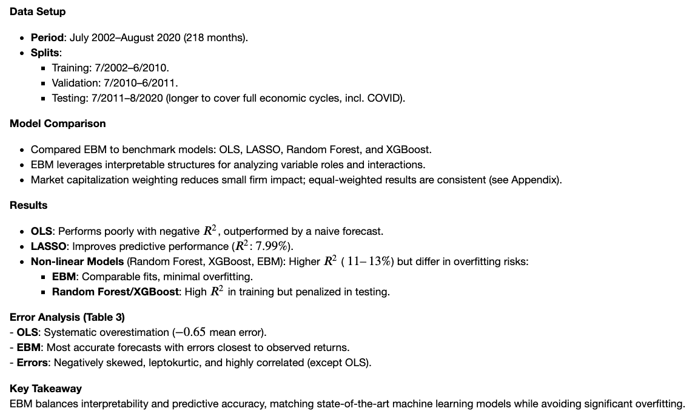
Empirical Results

Slide 16
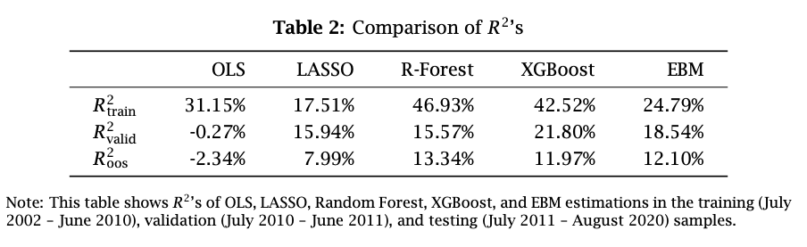
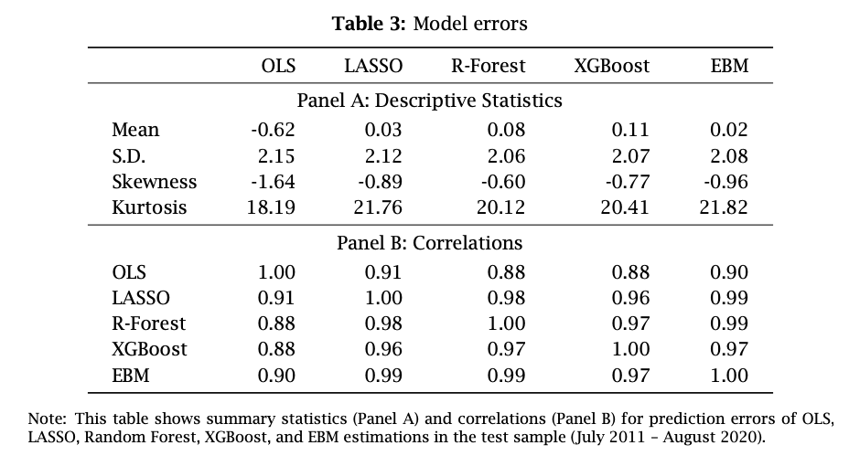

Slide 17
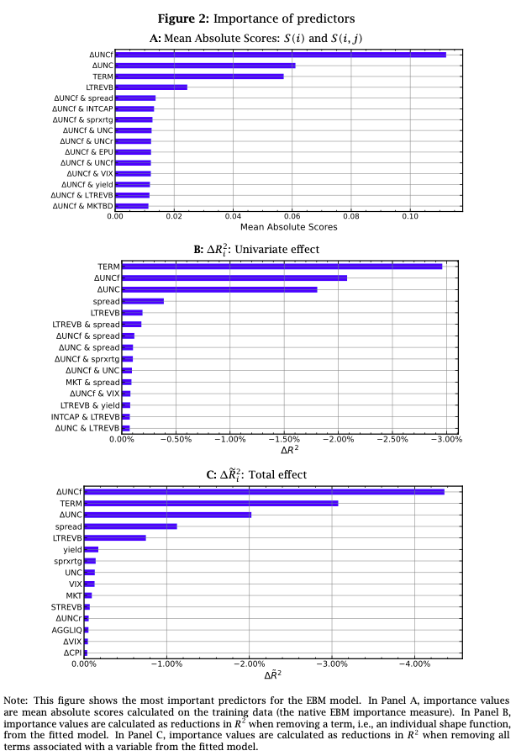
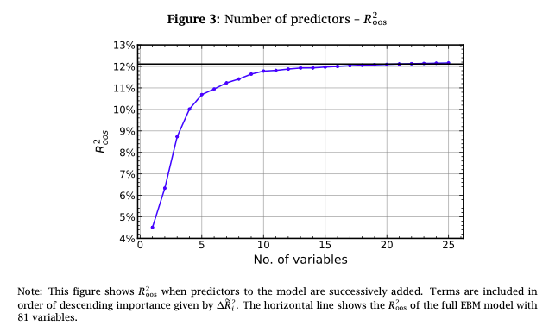
Predictor Importance

Slide 18
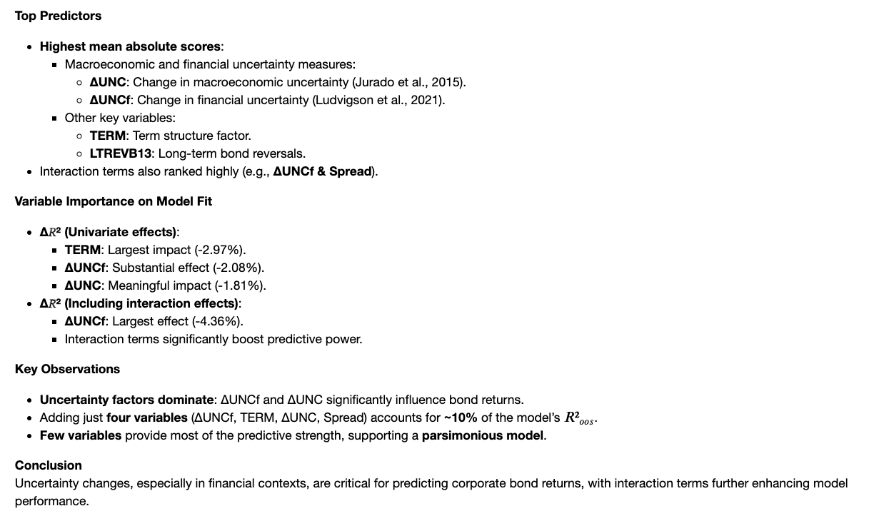
Bali, Turan G., Avanidhar Subrahmanyam, and Quan Wen (2021a) “Long-term reversals in the corporate bond market,” Journal of Financial Economics, 139 (2), 656–677.
Jurado, Kyle, Sydney C. Ludvigson, and Serena Ng (2015) “Measuring uncertainty,” American Economic Review, 105 (3), 1177–1216.

Slide 19
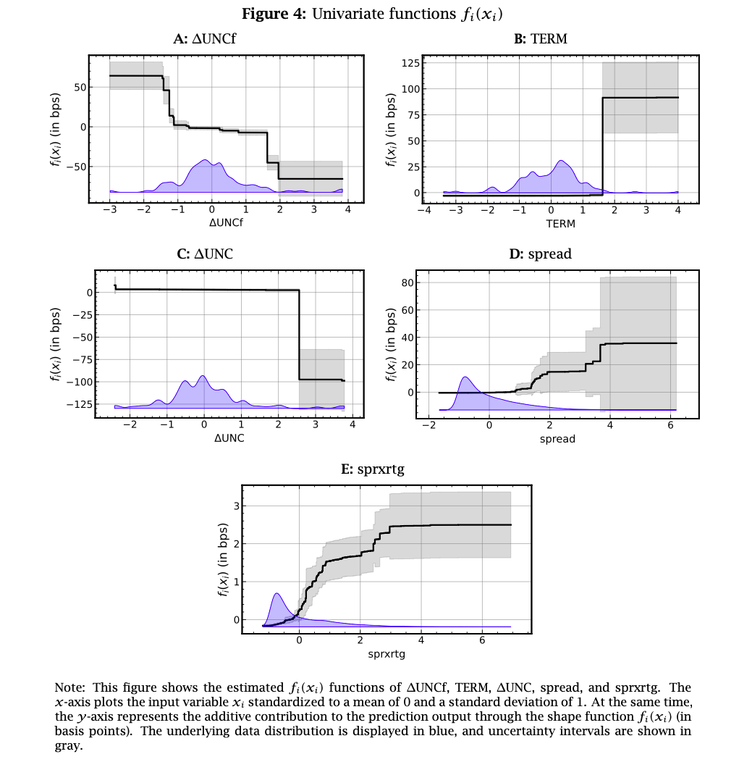
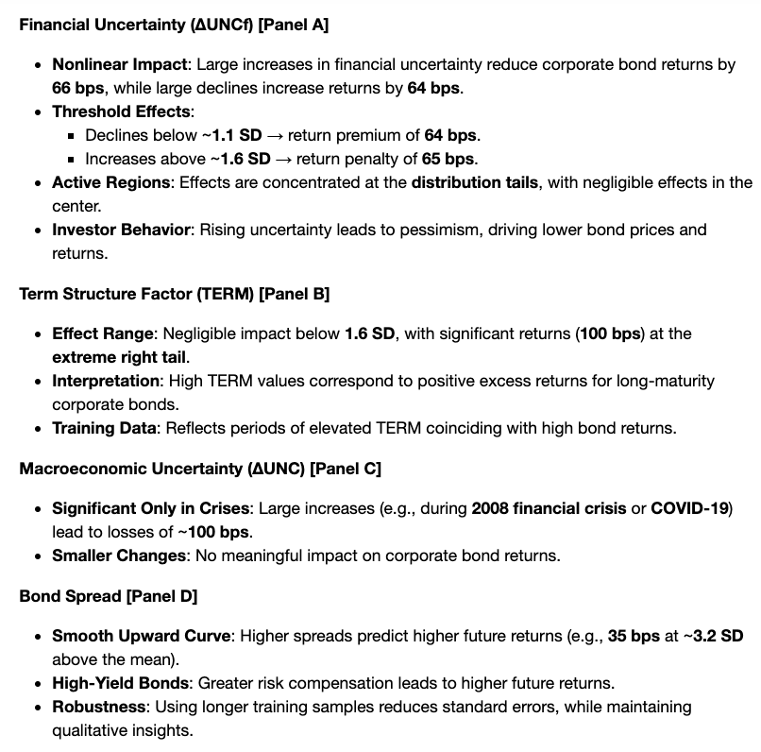
Univariate Effects

Slide 20
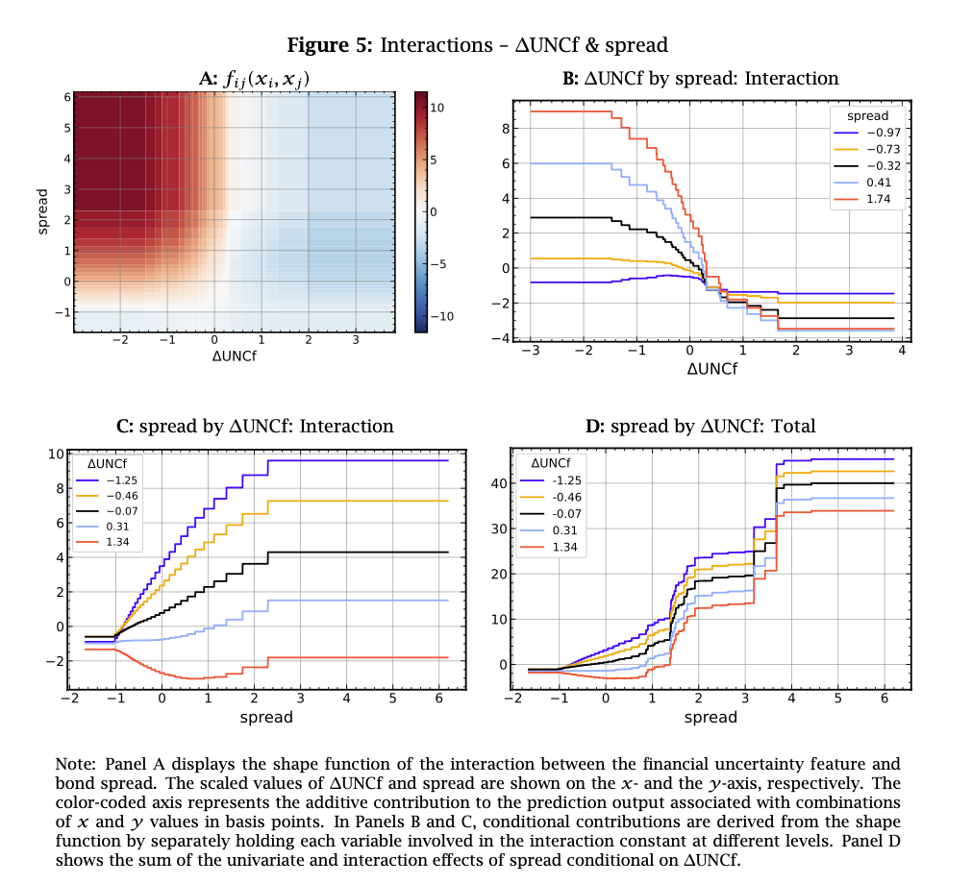
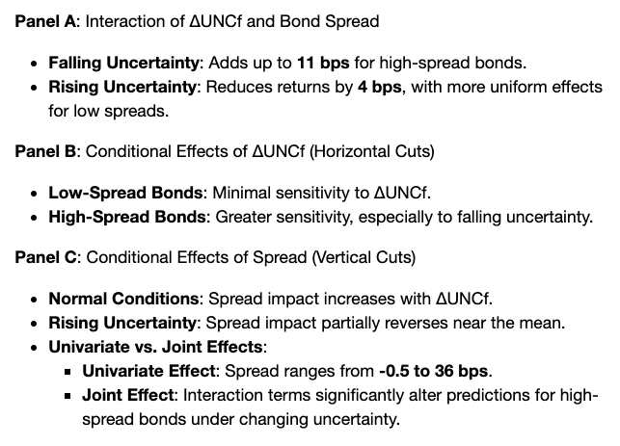
Interaction Effects

Slide 21
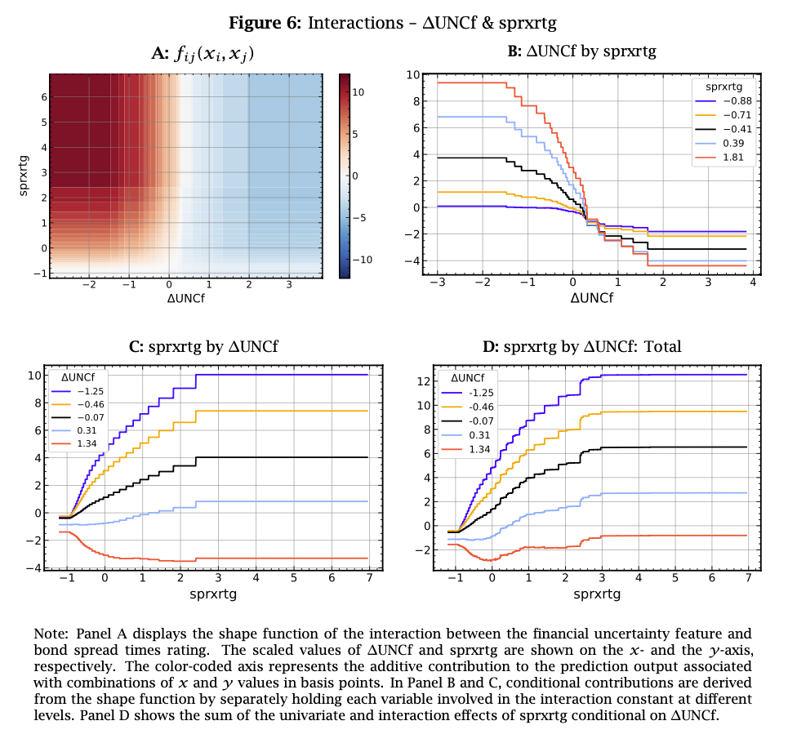
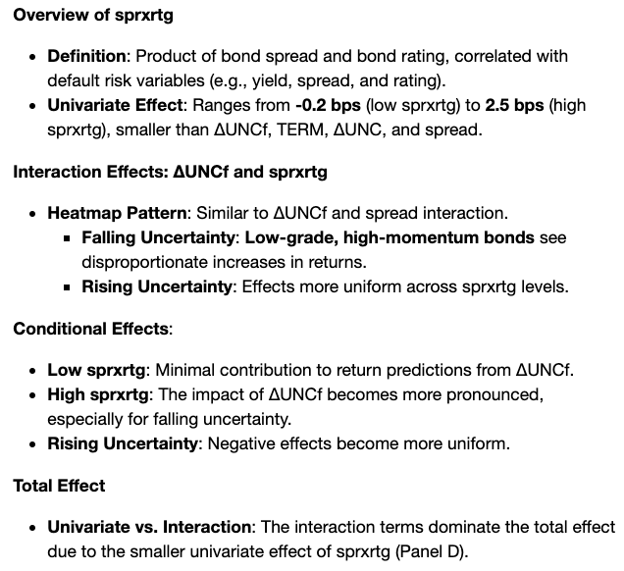
Interaction Effects

Slide 22
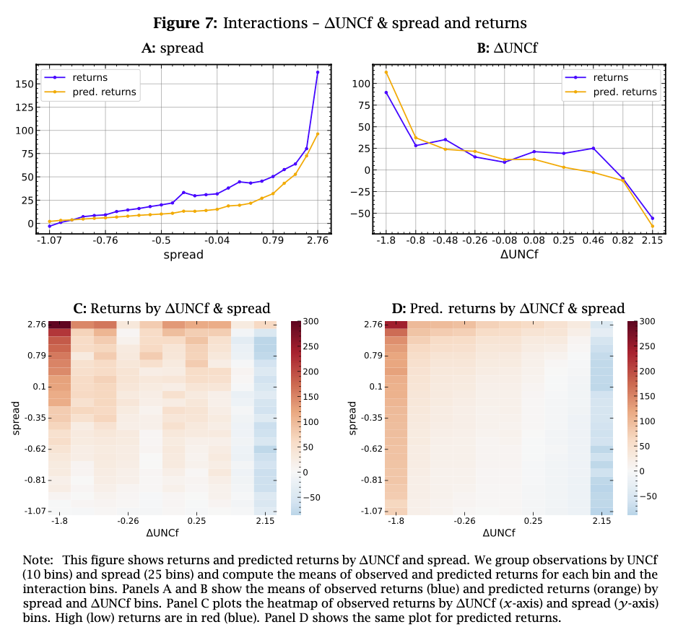
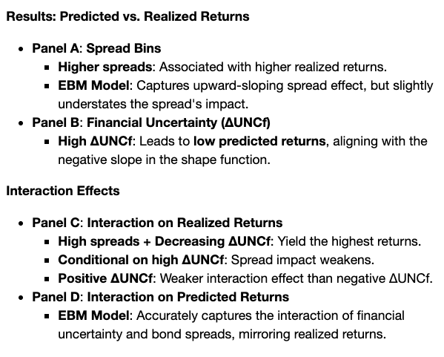
Interaction Effects in Returns

Slide 23
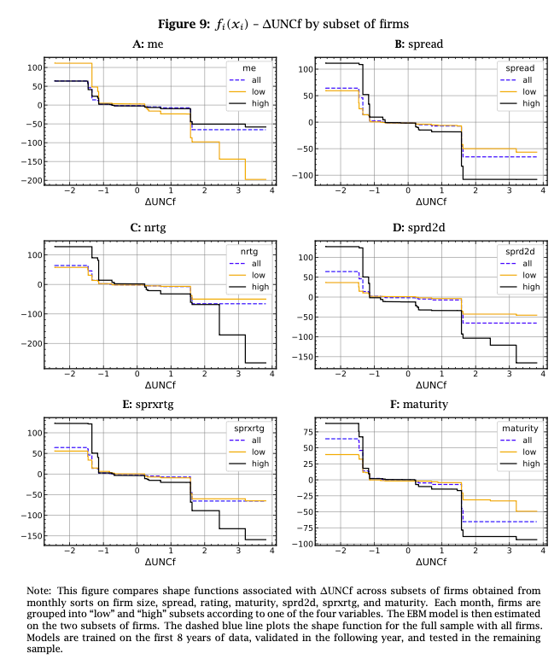
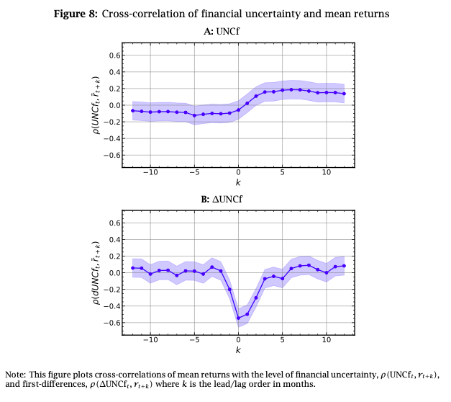
More on financial uncertainty

Slide 24
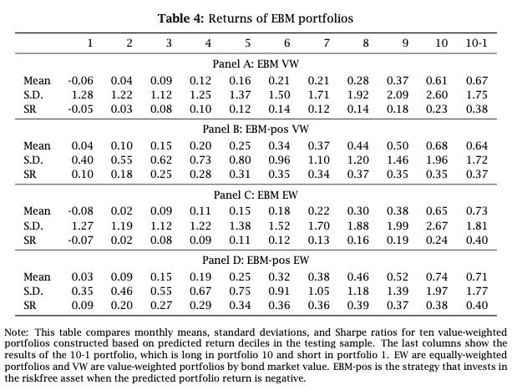
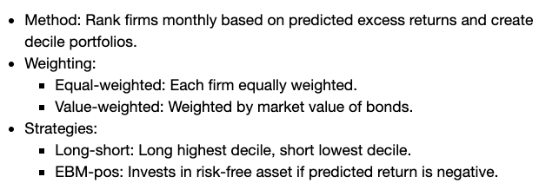
Portfolios based on the EBM model

Slide 25
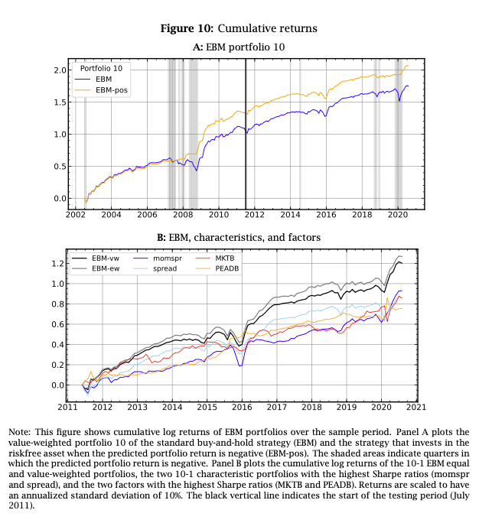

Slide 26
References
EBM Implementation
Interpret.ML: https://interpret.ml/docs/ebm.html

