Slide 1
Jobs Jobs Jobs

Slide 2
The anatomy of labor market status reporting
Report Name | Component | Frequency | Reporting entity
Employment Situation Report | - Total Nonfarm Payrolls - Unemployment Rate - Labor Force Participation Rate - Average Hourly Earnings - Job Creation Numbers | Typically released on the first Friday of each month at 8:30 AM Eastern Time | Released by the U.S. Bureau of Labor Statistics - BLS
Job Openings and Labor Turnover Survey (JOLTS) Report | - Job Openings | Released on the second Tuesday of each month at 10:00 AM Eastern Time. | Released by the U.S. Bureau of Labor Statistics - BLS
Weekly Jobless Claims Report | - Initial Jobless Claims - Continuing Jobless Claims | Released weekly on Thursdays at 8:30 AM Eastern Time. | Released by the U.S. Department of Labor
ISM Manufacturing Report on Business | ISM Employment index | Released monthly, typically on the first few days on the month | The Institute for Supply Management
ADP National Employment report | ADP employment change | Monthly Basis | Automatic Data Processing (ADP), a global provider of human resources management software and services.

Slide 3
Impact
 |  | Market
 |  | Stock | Bond | Dollar
Labor market | Strengthening | Up | Down | Up
 | Weakening | Down | Up | Down

Slide 4
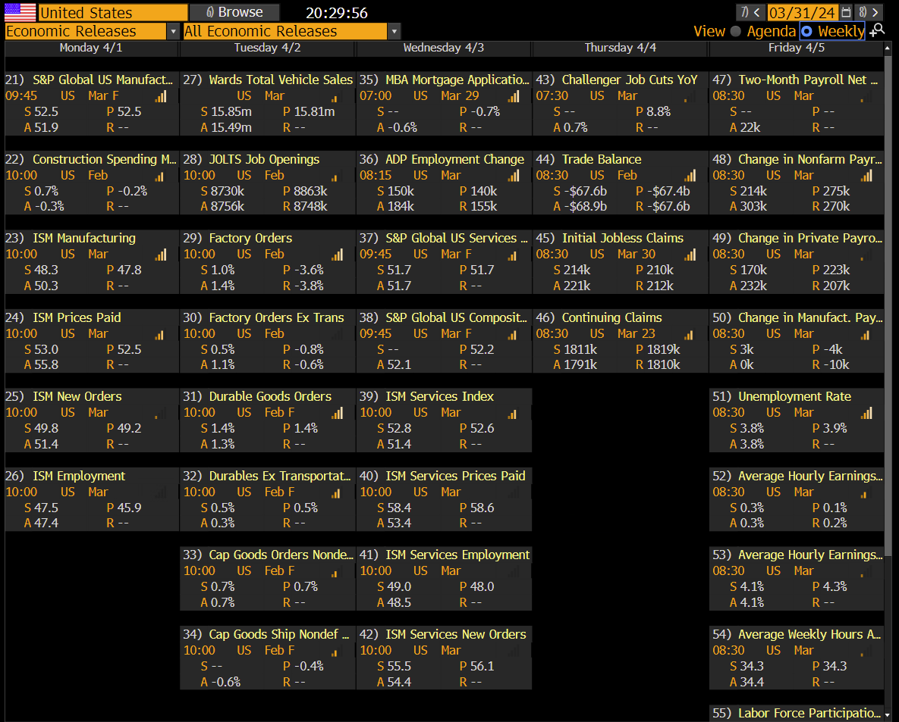

Slide 5
2024-04-01 week’s information flow
Date | Metric | Survey/Consensus | Actual | Prior | Revised Prior | Surprise (*)
Monday 04-01-2024 | ISM Employment | 47.5 | 47.4 | 45.9 | - | Missed
Tuesday 04-02-2024 | JOLTS Job Openings | 8730k | 8756k | 8863k | 8748k | Beat
Wednesday 04-03-2024 | ADP Employment Change | 150k | 184k | 140k | 155k | Beat
Wednesday 04-03-2024 | ISM Services Employment | 49.0 | 48.5 | 48.0 | - | Missed
Thursday 04-04-2024 | Initial Jobless claims | 214k | 221k | 210k | 212k | Missed
Thursday 04-04-2024 | Continuing Claims | 1811k | 1791k | 1819k | 1810k | Beat
Friday 04-05-2024 | Change in Nonfarm Payrolls (NFP) | 214k | 303k | 275k | 270k | Beat
Friday 04-05-2024 | Unemployment rate | 3.8% | 3.8% | 3.9% | - | Met
Friday 04-05-2024 | Average Hourly Earnings (AHE) MoM | 0.3% | 0.3% | 0.1% | 0.2% | Met
Friday 04-05-2024 | Labor Force Participation rate | 62.6% | 62.7% | 62.5% | - | Beat
(*) The direction of missed/beat is on a strong labor market

Slide 6
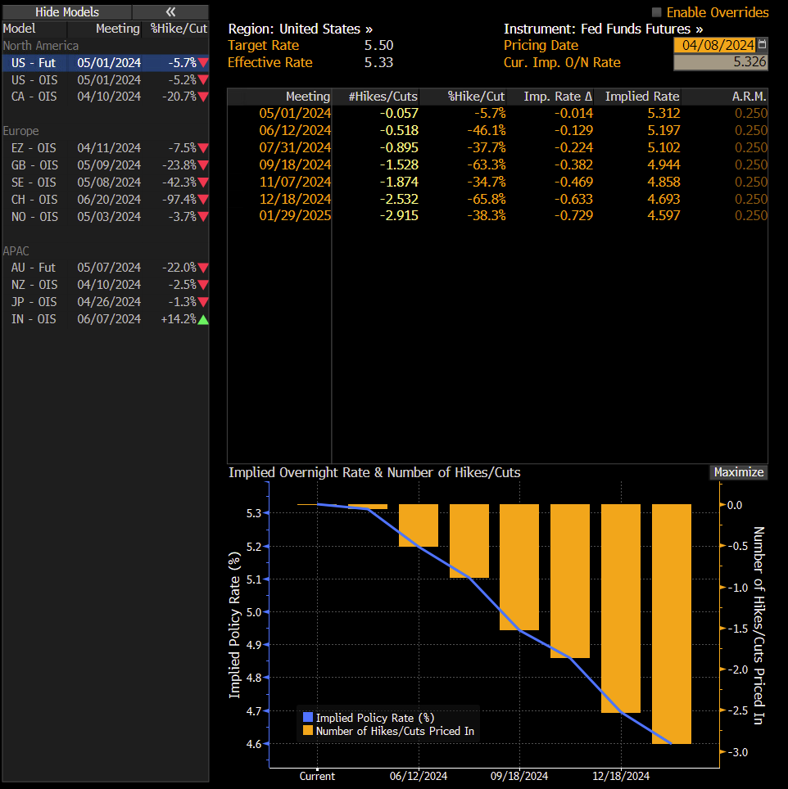

Slide 7
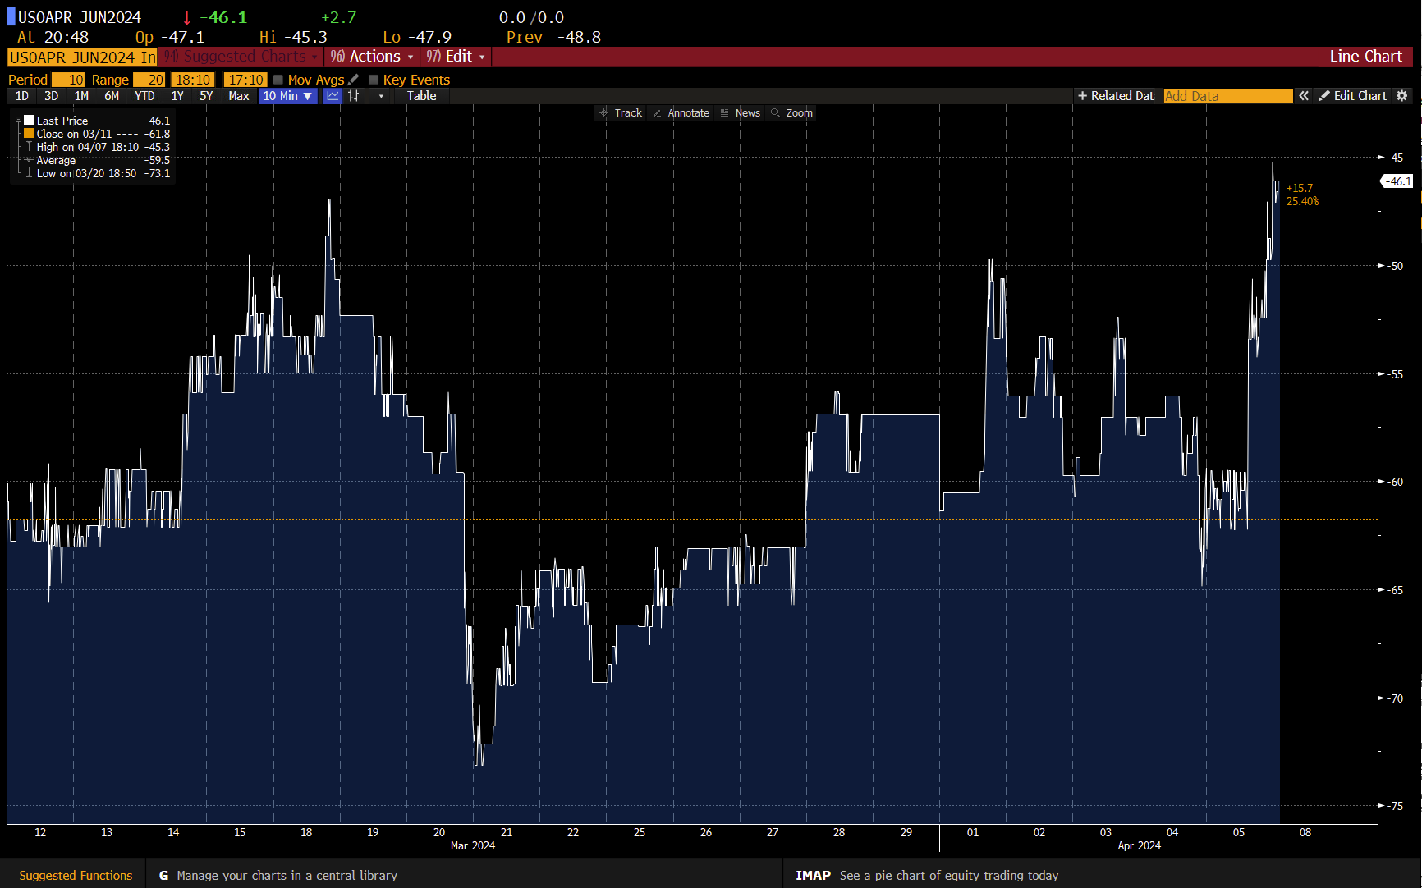
June 2024 Cut Implied Probability

Slide 8
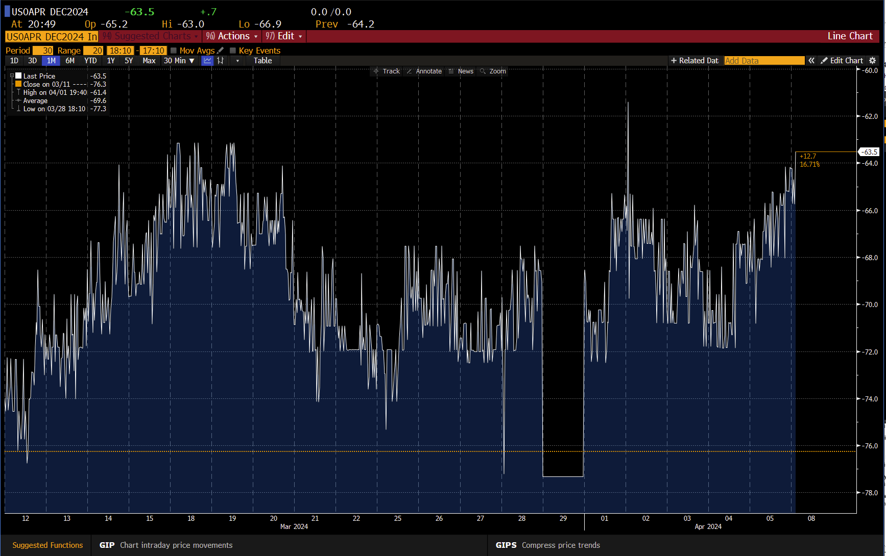
December 2024 Cut Implied Probability

Slide 9
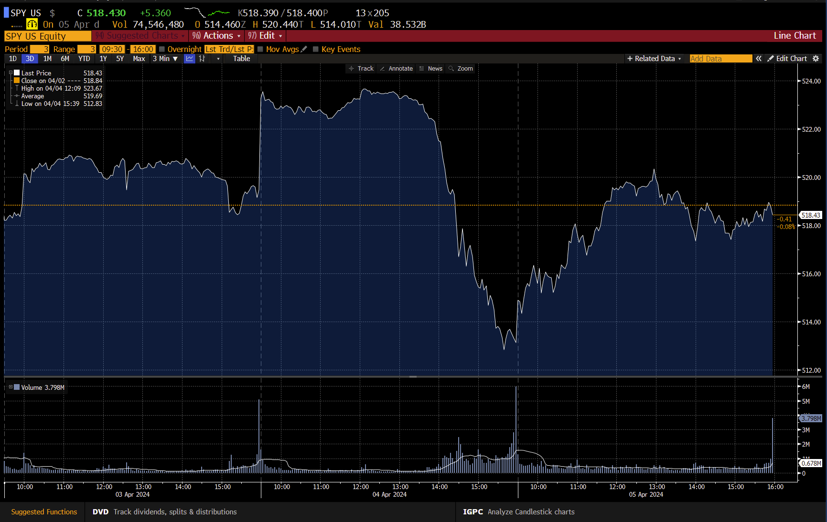
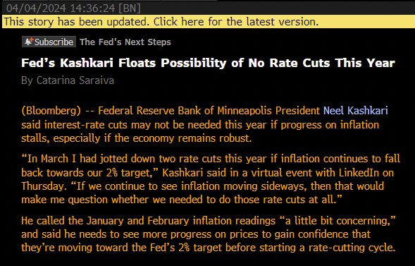
2024-04-07

