Slide 1
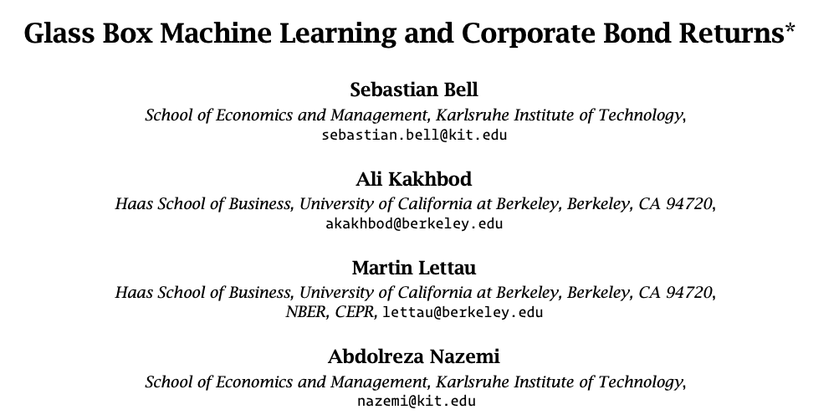
ssrn link
Prepared and Presented by Oualid Missaoui

Slide 2
Agenda
Introduction
Summary of the Research
Key Findings and Contributions
Methodology
Formulation
Explainable Boosting Machines
Evaluation
Importances
Data
Empirical Results

Slide 3
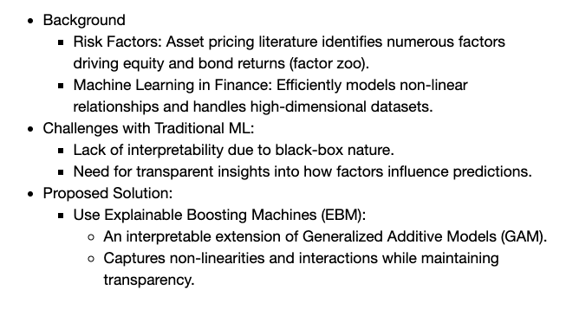
Introduction – Summary of the research

Slide 4
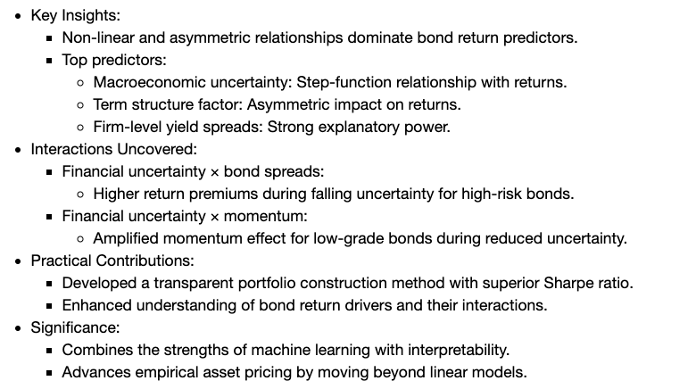
Introduction – Key Findings & Contributions

Slide 5
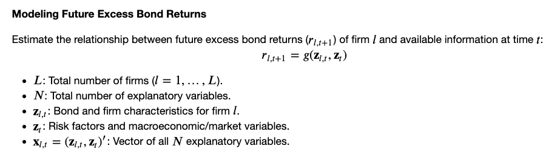
Methodology

Slide 6
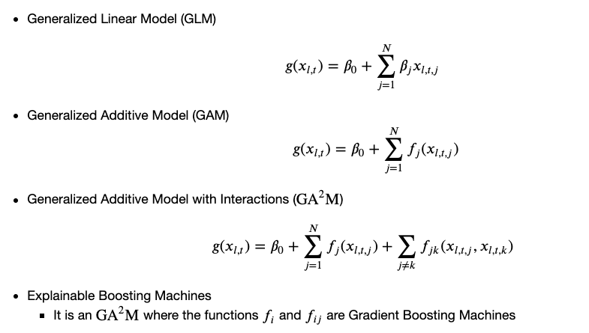
Explainable Boosting Machines

Slide 7
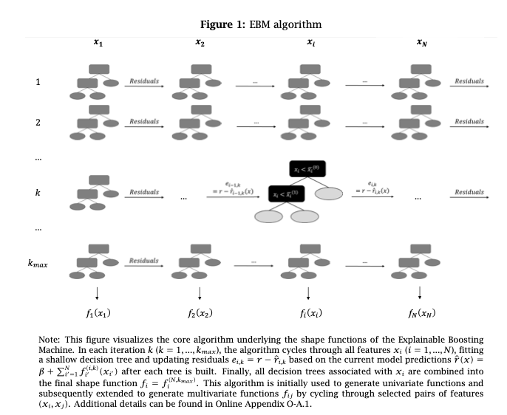

Slide 8
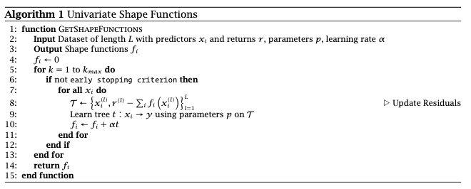
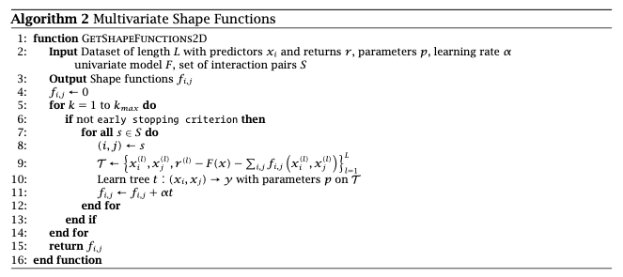

Slide 9
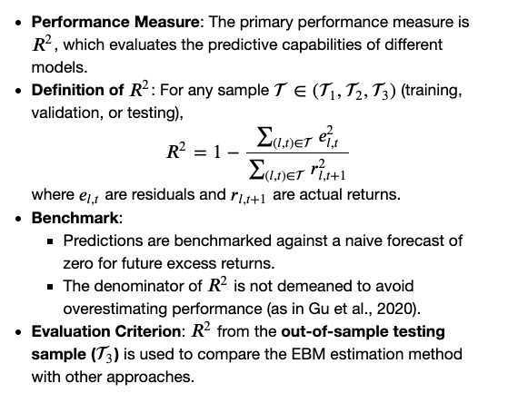
Evaluation

Slide 10
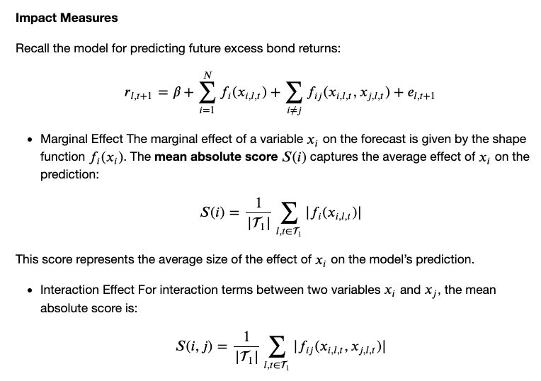
Effects of variables

Slide 11
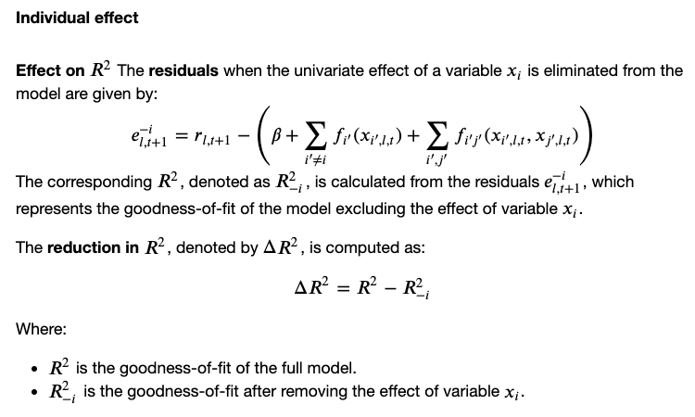
Effects of variables

Slide 12
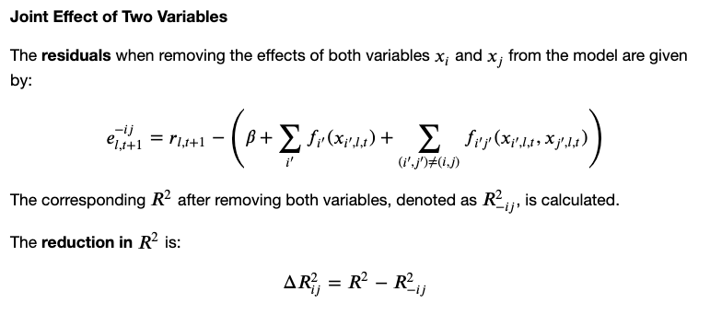
Effects of variables

Slide 13
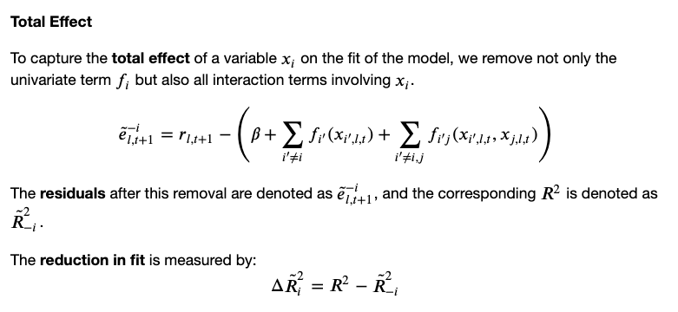
Effects of variables

Slide 14
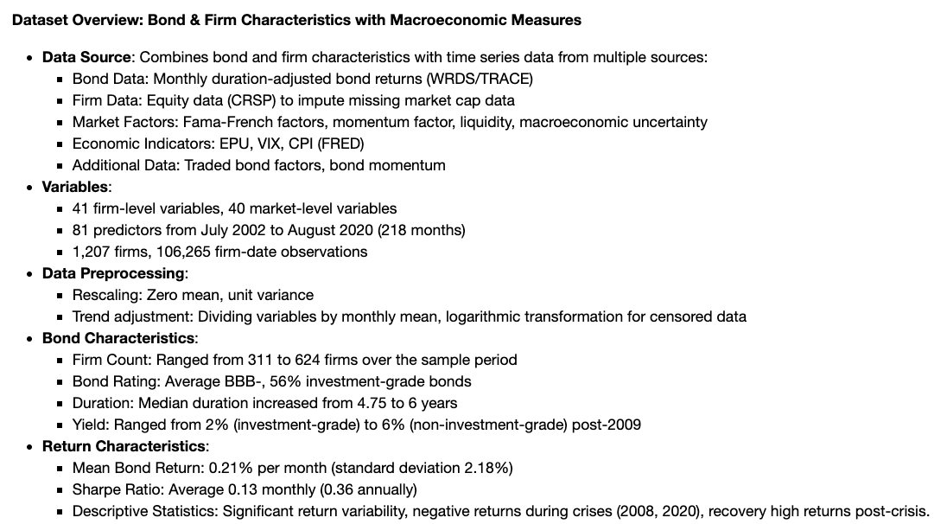
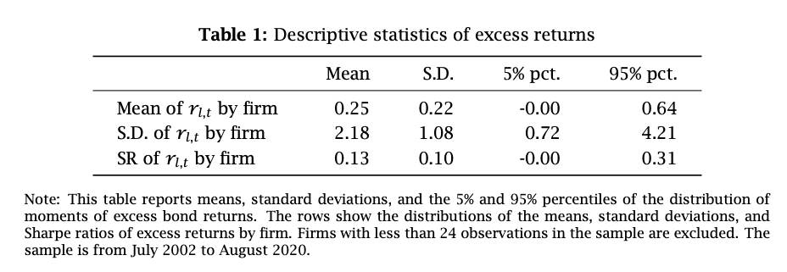
Data

Slide 15
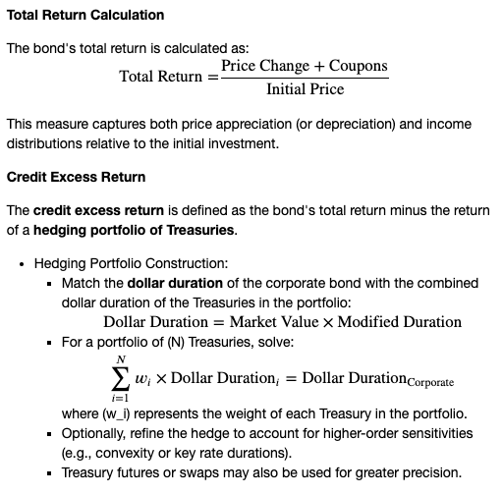
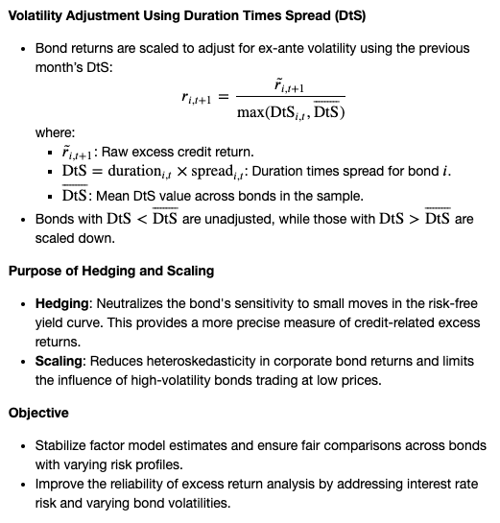
Methodology of excess return calculation
Kelly, Bryan, Diogo Palhares, and Seth Pruitt (2023) “Modeling corporate bond returns,” The Journal of Finance.

Slide 16
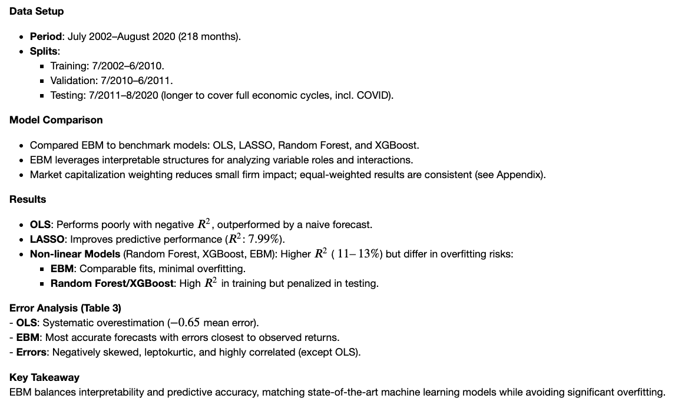
Empirical Results

Slide 17
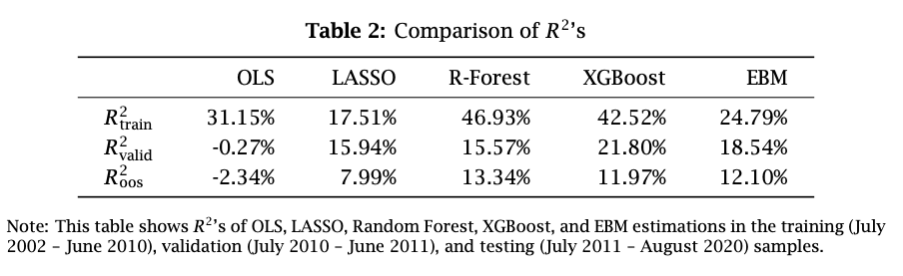
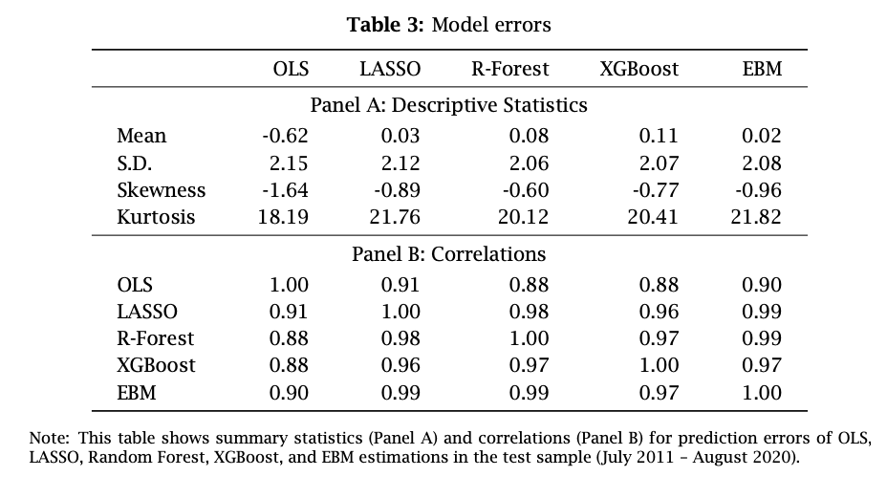

Slide 18
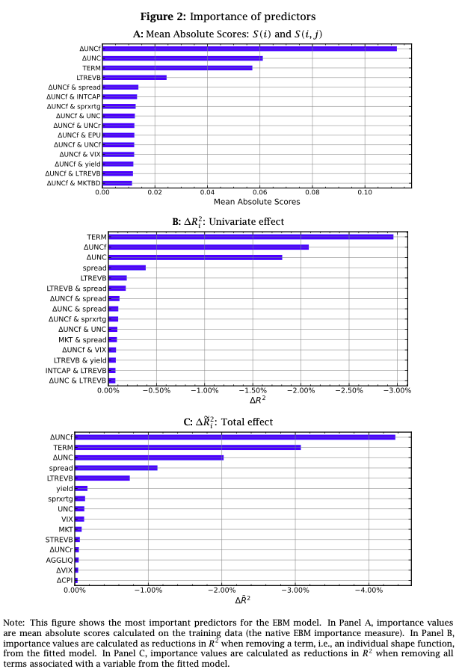
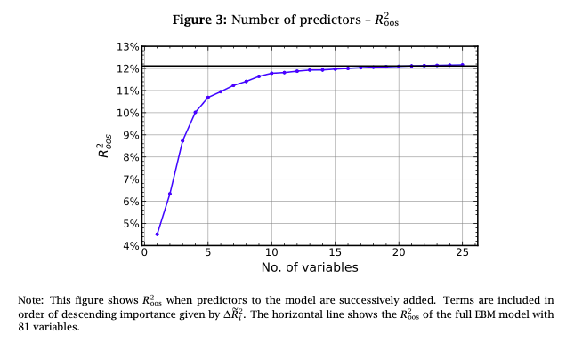
Predictor Importance

Slide 19
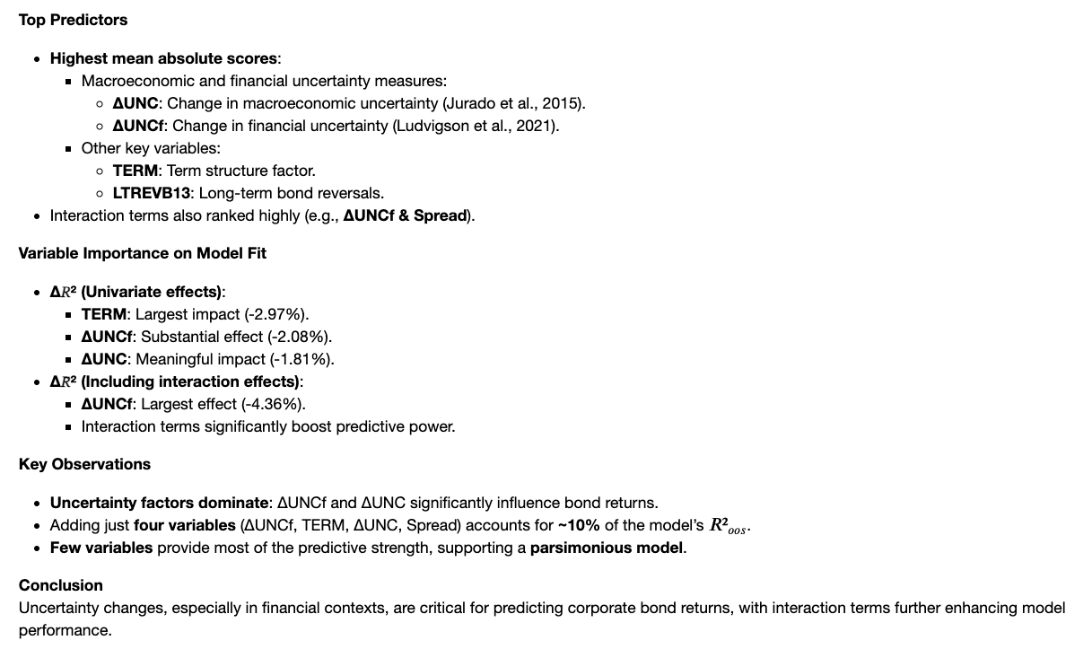
Bali, Turan G., Avanidhar Subrahmanyam, and Quan Wen (2021a) “Long-term reversals in the corporate bond market,” Journal of Financial Economics, 139 (2), 656–677.
Jurado, Kyle, Sydney C. Ludvigson, and Serena Ng (2015) “Measuring uncertainty,” American Economic Review, 105 (3), 1177–1216.

Slide 20
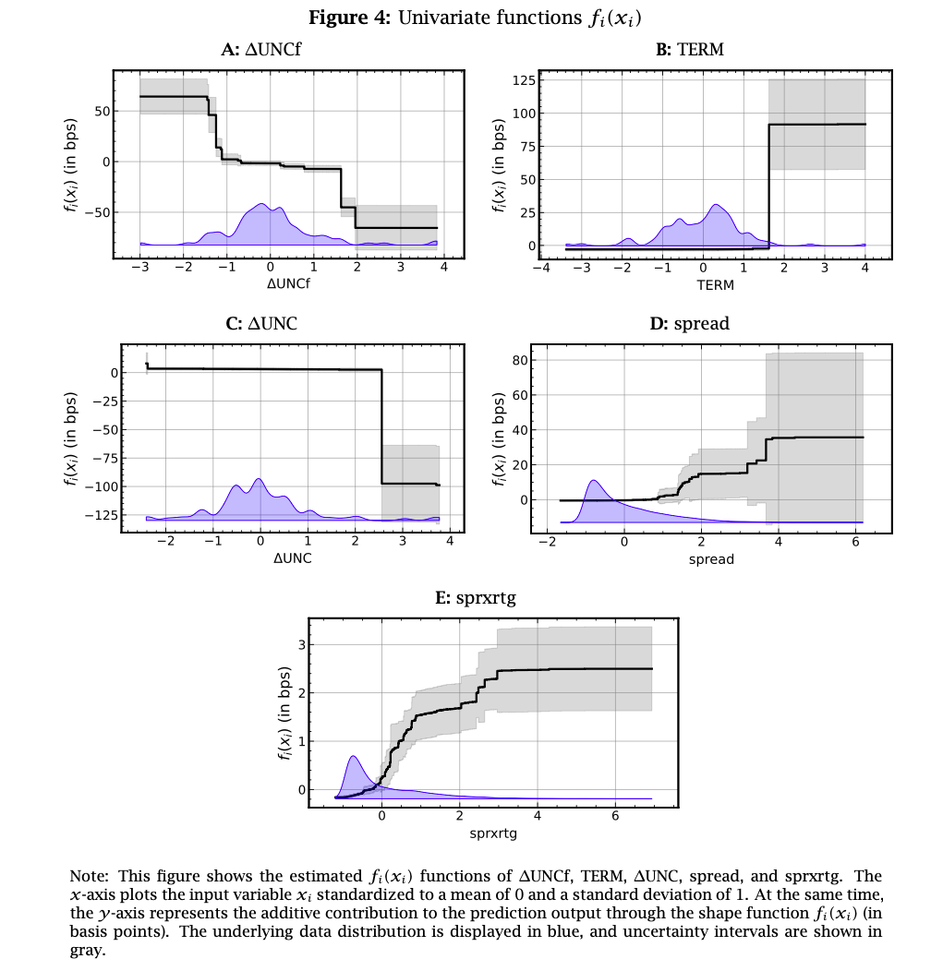
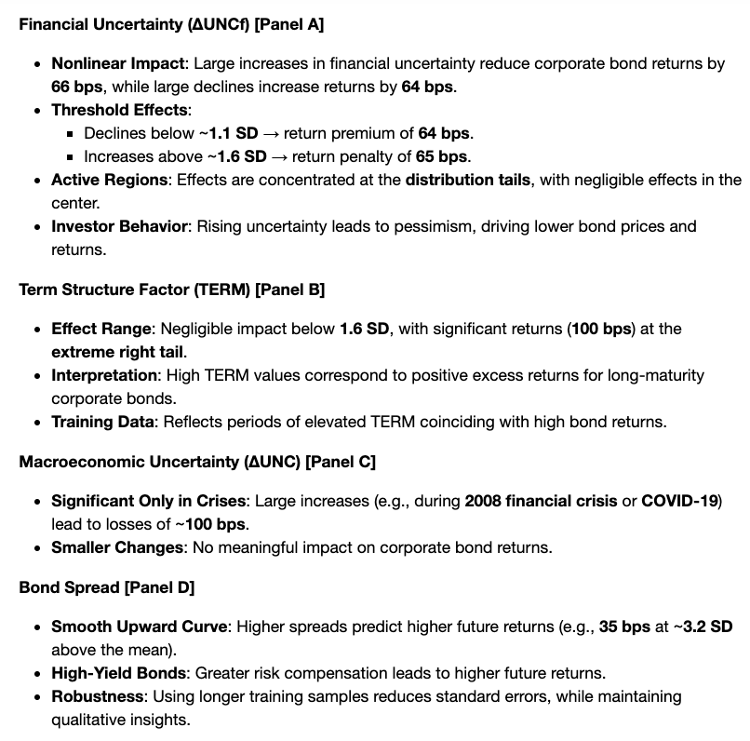
Univariate Effects

Slide 21
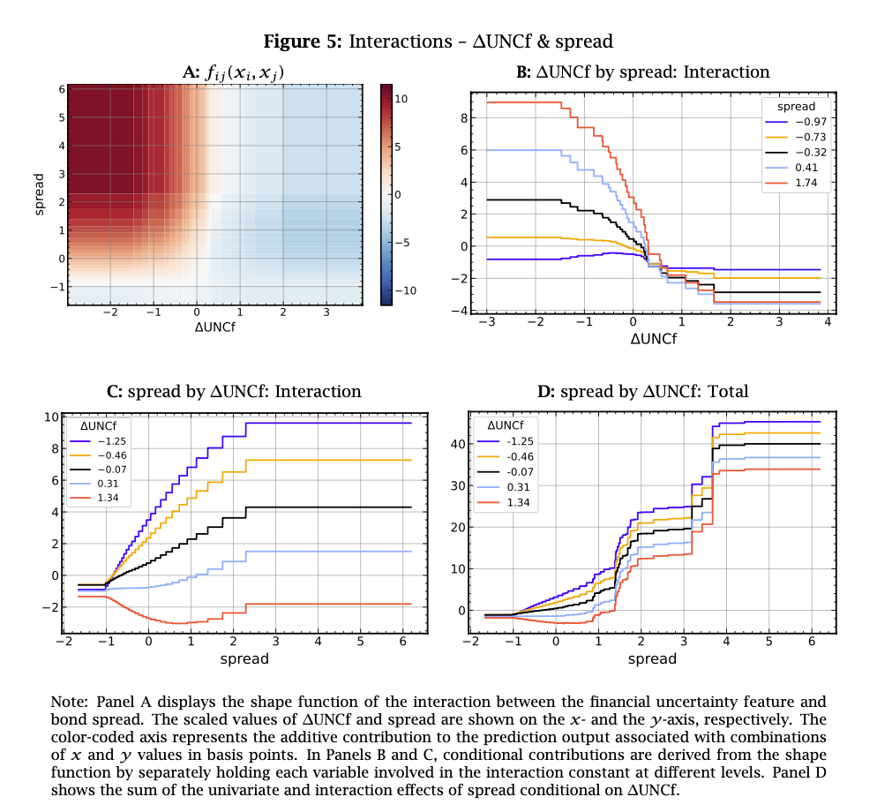
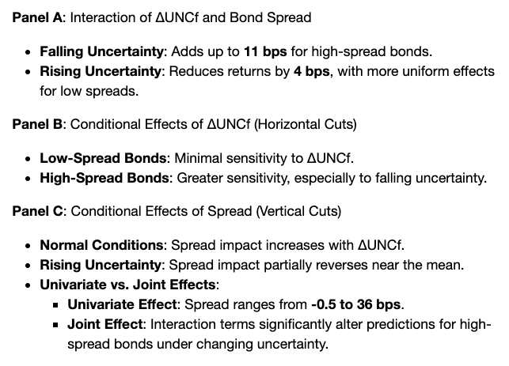
Interaction Effects

Slide 22
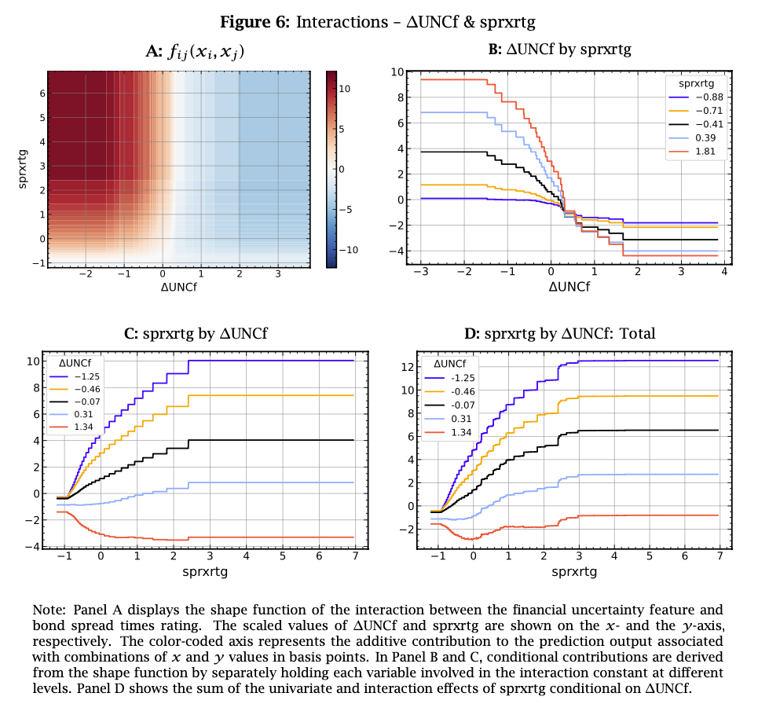
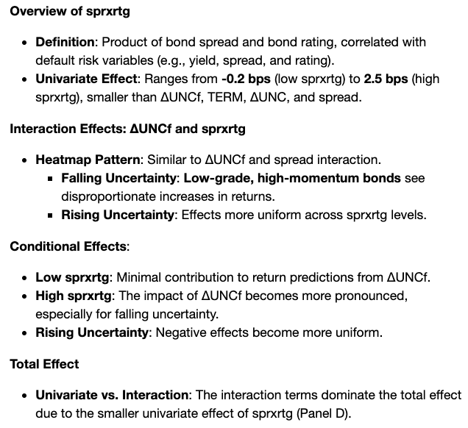
Interaction Effects

Slide 23
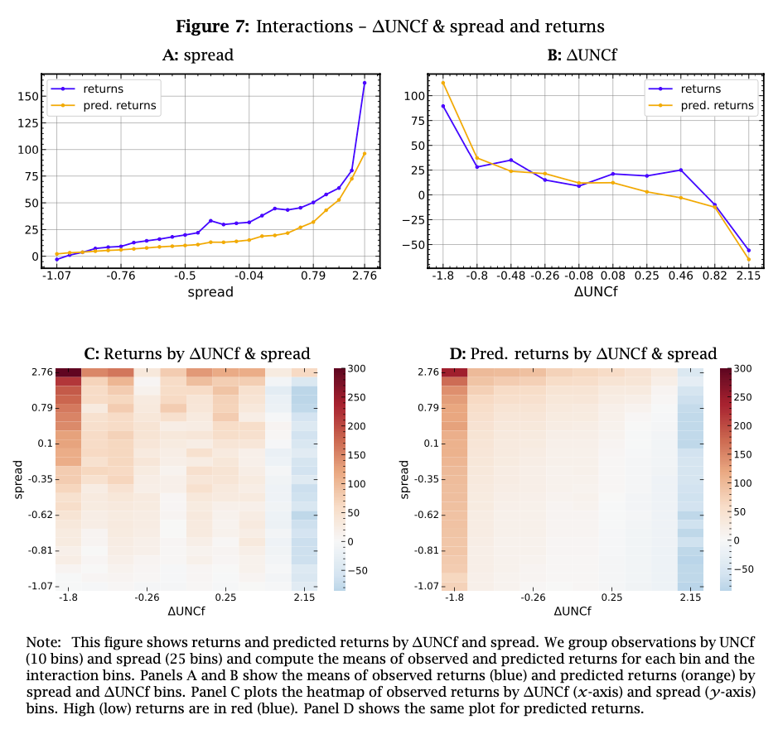
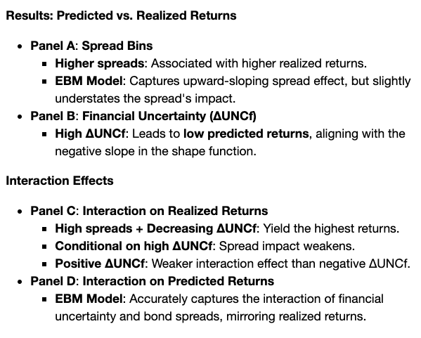
Interaction Effects in Returns

Slide 24
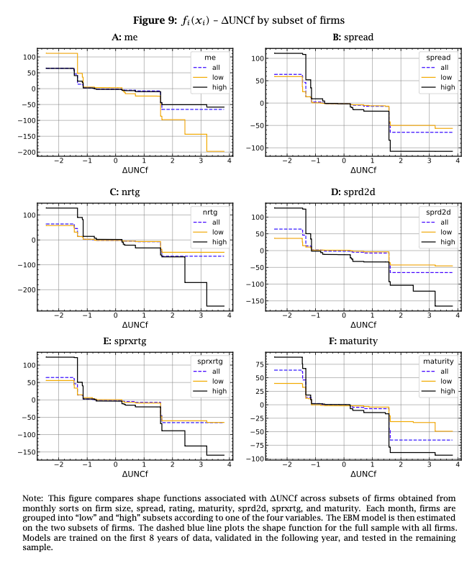
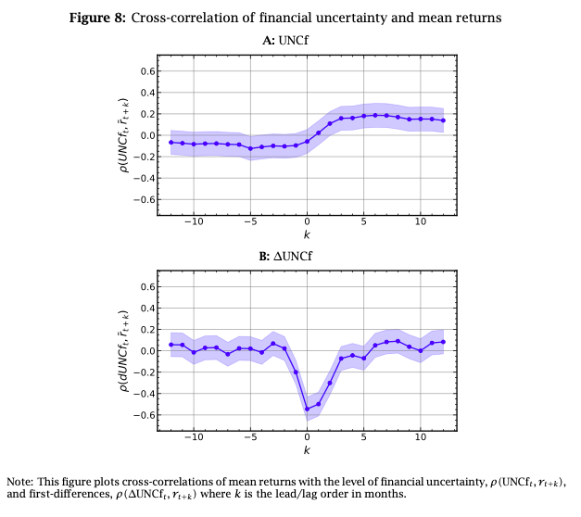
More on financial uncertainty

Slide 25
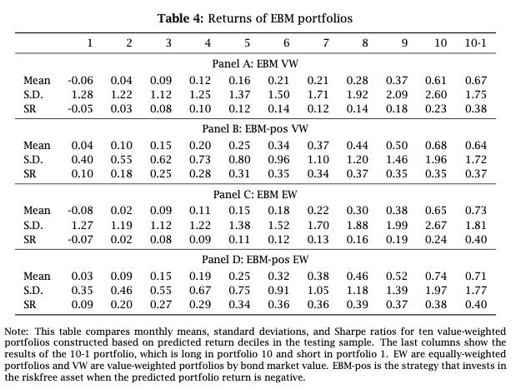
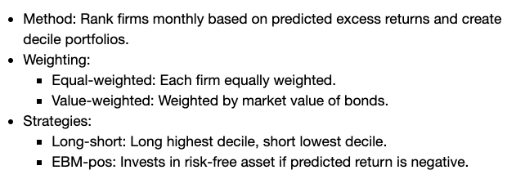
Portfolios based on the EBM model

Slide 26
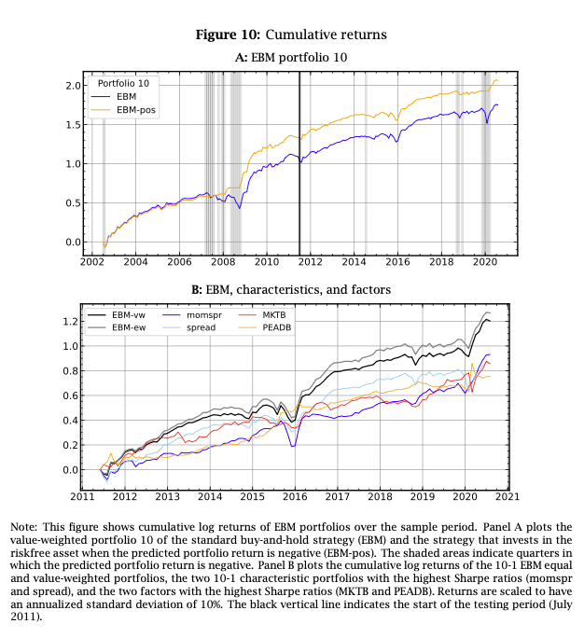

Slide 27
References
EBM Implementation
Interpret.ML: https://interpret.ml/docs/ebm.html

